Slide 1
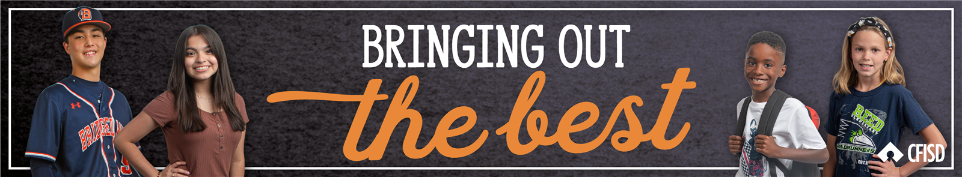
Freedom from Prejudice
January 2024
PK-2nd Grade

Slide 2
Insert CFISD video

Slide 3
Freedom from Prejudice
Define:
Identify:
Apply:
Students will define Freedom from Prejudice.
Students will be able to identify their similarities and differences.
Students will share with the class how they are unique.

Slide 4
Freedom from Prejudice:
Despite differences, seek to understand those around you

Slide 5
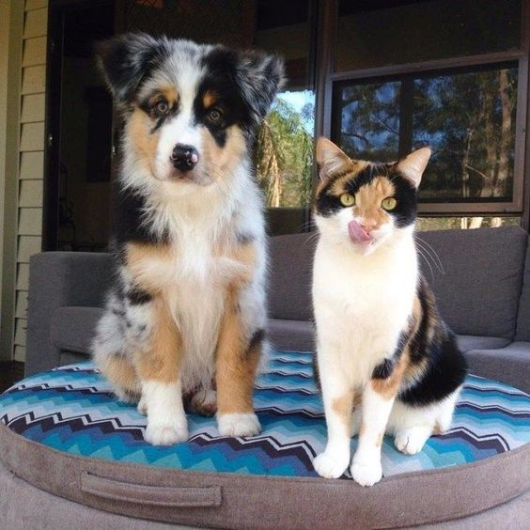
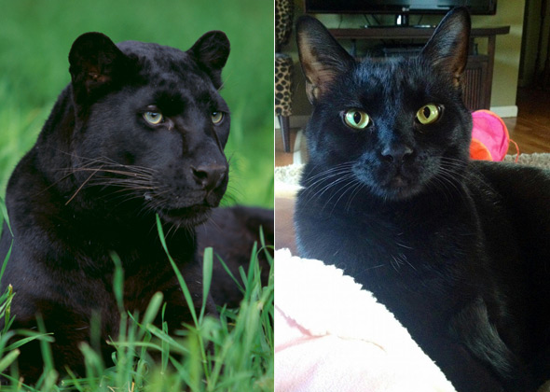
We are all alike in some way!
If we talk to one another, we can find out what we have in common with someone else!

Slide 6
Let’s explore what we have in common with each other!
Activity: Form a circle in the room. Step into the circle if the statement is true to you.
Step into the circle if you have a sister or brother.
Step into the circle if you are an only child.
Step into the circle if you have a pet.
Step into the circle if you play a sport.
Step into the circle if you like candy.

Slide 7

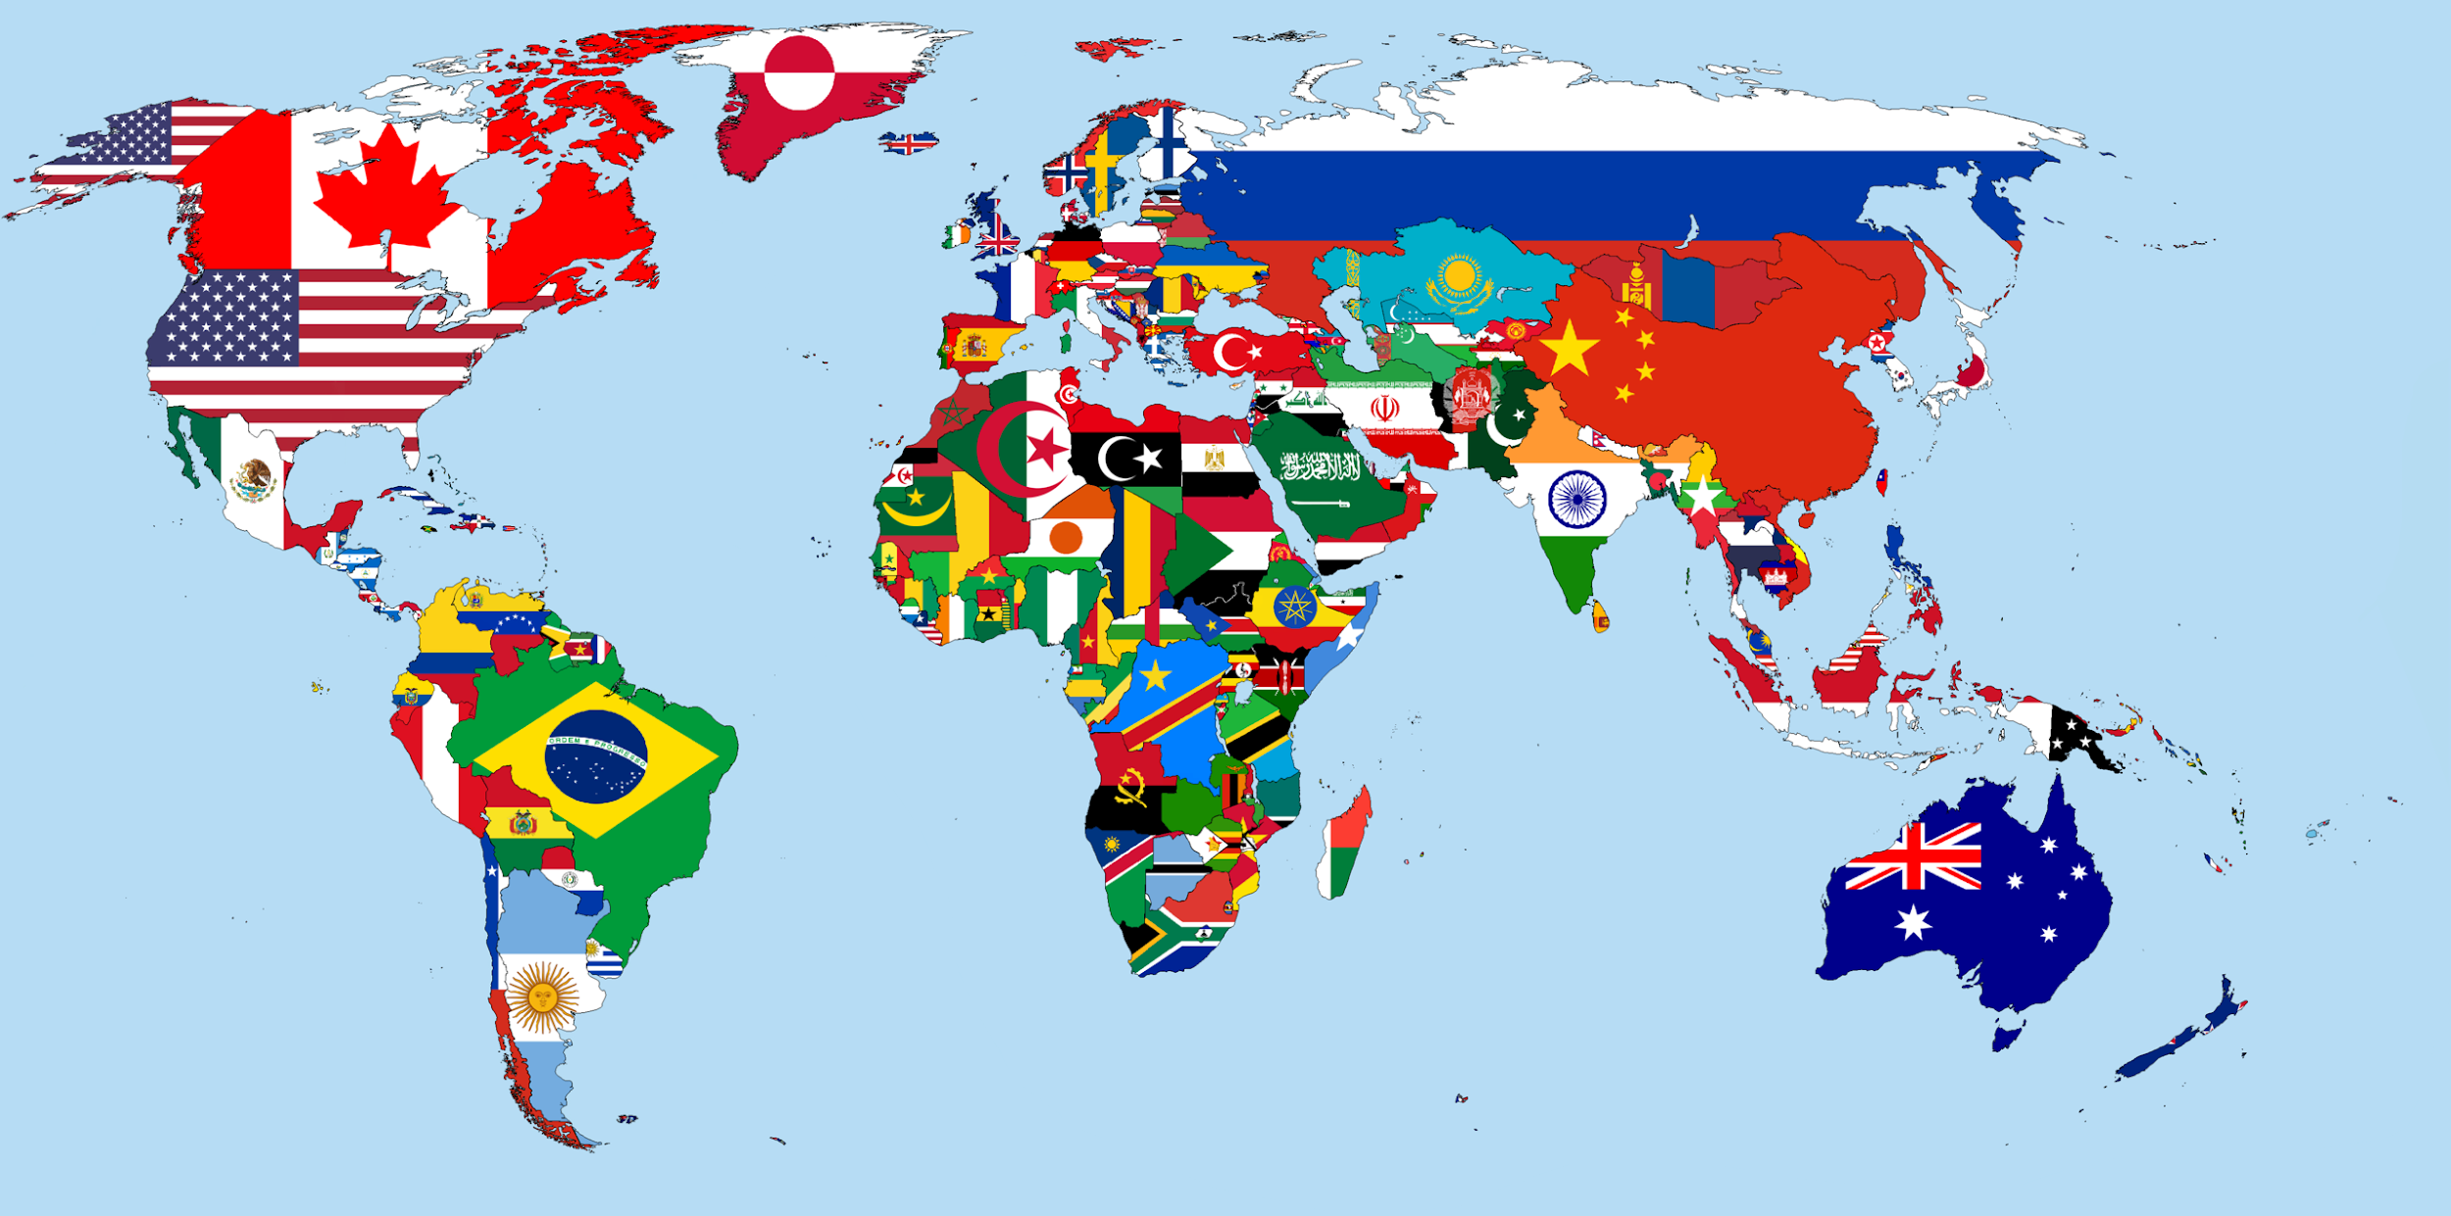
We are all different in some way!
Our differences make us unique and interesting.

Slide 8
Share with the class what makes you unique!
“I know a lot about…..”
“I am really good at…..”
“One time I went to……”
“My favorite activity is….”

Slide 9

We are all unique!

Slide 10
Home Activity: Explore what makes your family unique.
Possible discussion points:
Family Traditions
Holidays celebrated
Food, music, etc.

