Slide 1



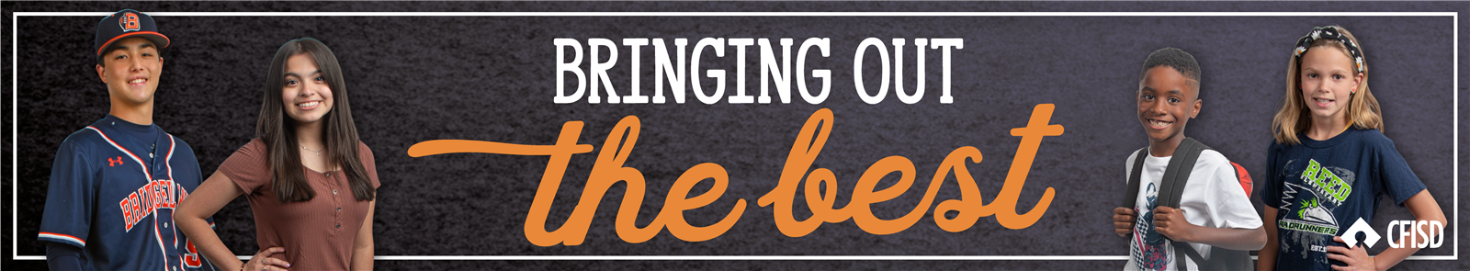



Generosity
November/December
6th-8th

Slide 2


Hello Teachers
In the presentation, students will learn what it means to show Generosity in different situations.
Each slide will contain interactive activities and guided questions for “Bring Out The Best” Generosity Character Trait for grades 6-8.
Generosity

Slide 3

Learning Objective
1
Define what it means to be generous
2
Explore what it means to give in abundance
3
Identify ways one can demonstrate generosity
Generosity

Slide 4

Generosity Is…
The willingness to give
Insert District Video Here
Generosity

Slide 5


Seven Miles For Me
Read and discuss Seven Miles For Me
by:
Clarence W. Stephens, Nicholasville, Kentucky
Generosity

Slide 6
Twice As Nice
Read and discuss Twice As Nice
by:
JoAnn Sanderson, Brandon, Florida
Generosity

Slide 7


In your groups...
You will find a different story at each station. Your task is to come up with a generous ending for each story. Once you have finished, rotate to another station and continue this process until you have read and discussed all of the stories.
Generosity

Slide 8
Home Connection
Students can participate in many activities during the holiday season in order to show their generosity. Some examples are donating to your school-wide food drive, donating clothes / jackets, volunteering your time at your church / community program, etc.
Generosity

