Slide 1

November/December 2023

Slide 2

GENEROSITY
Definition:
A willingness to give
November/December 2023
Notes:
Discuss different definitions and synonyms of GENEROSITY

Slide 3
Today, we will…
discuss the meaning of generosity.
brainstorm examples of generosity.
conclude reasons why generosity is an important character trait.

Slide 4

Picture It!
What do you see in this picture?
Who is in this picture?
What are they doing?
Notes:
Discuss who and what you see in the picture. Lead students to visualize an adult reading to a small child.

Slide 5


Slide 6

Notes:
Teacher will discuss aspects of generosity.

Slide 7
Let’s Talk
What does generosity mean to you?
TURN & TALK
THINK-PAIR-SHARE
Why is generosity an important character trait?
Notes:
Have students “Turn & Talk” about what generosity means to them. Then have students think-pair-share why generosity is an important character trait. Teacher should lead discussion and make sure that students are drawing the following conclusions:
Generosity: giving to others freely and abundantly (a large amount)
Giving: to present someone with something without expecting them to give you anything in return

Slide 8
Generous or Not Generous?
Generous:
NOT Generous:
STINGY
HELPFUL
GIVING
GREEDY
DONATE
SELFISH
MINDFUL
KIND
Notes:
**Keep this slide in EDIT mode, not SLIDESHOW mode.** Generosity is the desire to give what you have to others. Generous people are not selfish. They want to help those in need and are always willing to share. Generosity doesn’t always have to be of monetary value; it can be as simple as spending time with another person.
Activity: Drag and drop the words that are associated with being GENEROUS and NOT GENEROUS

Slide 9
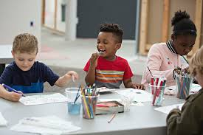

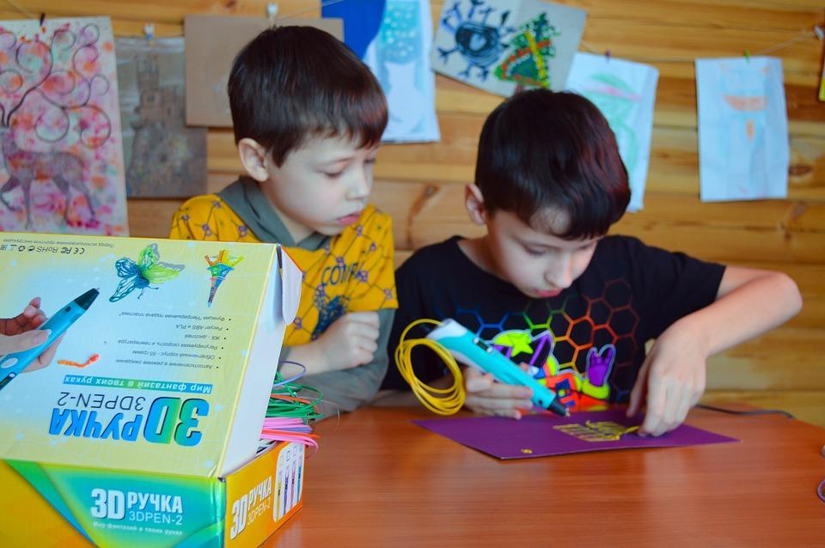
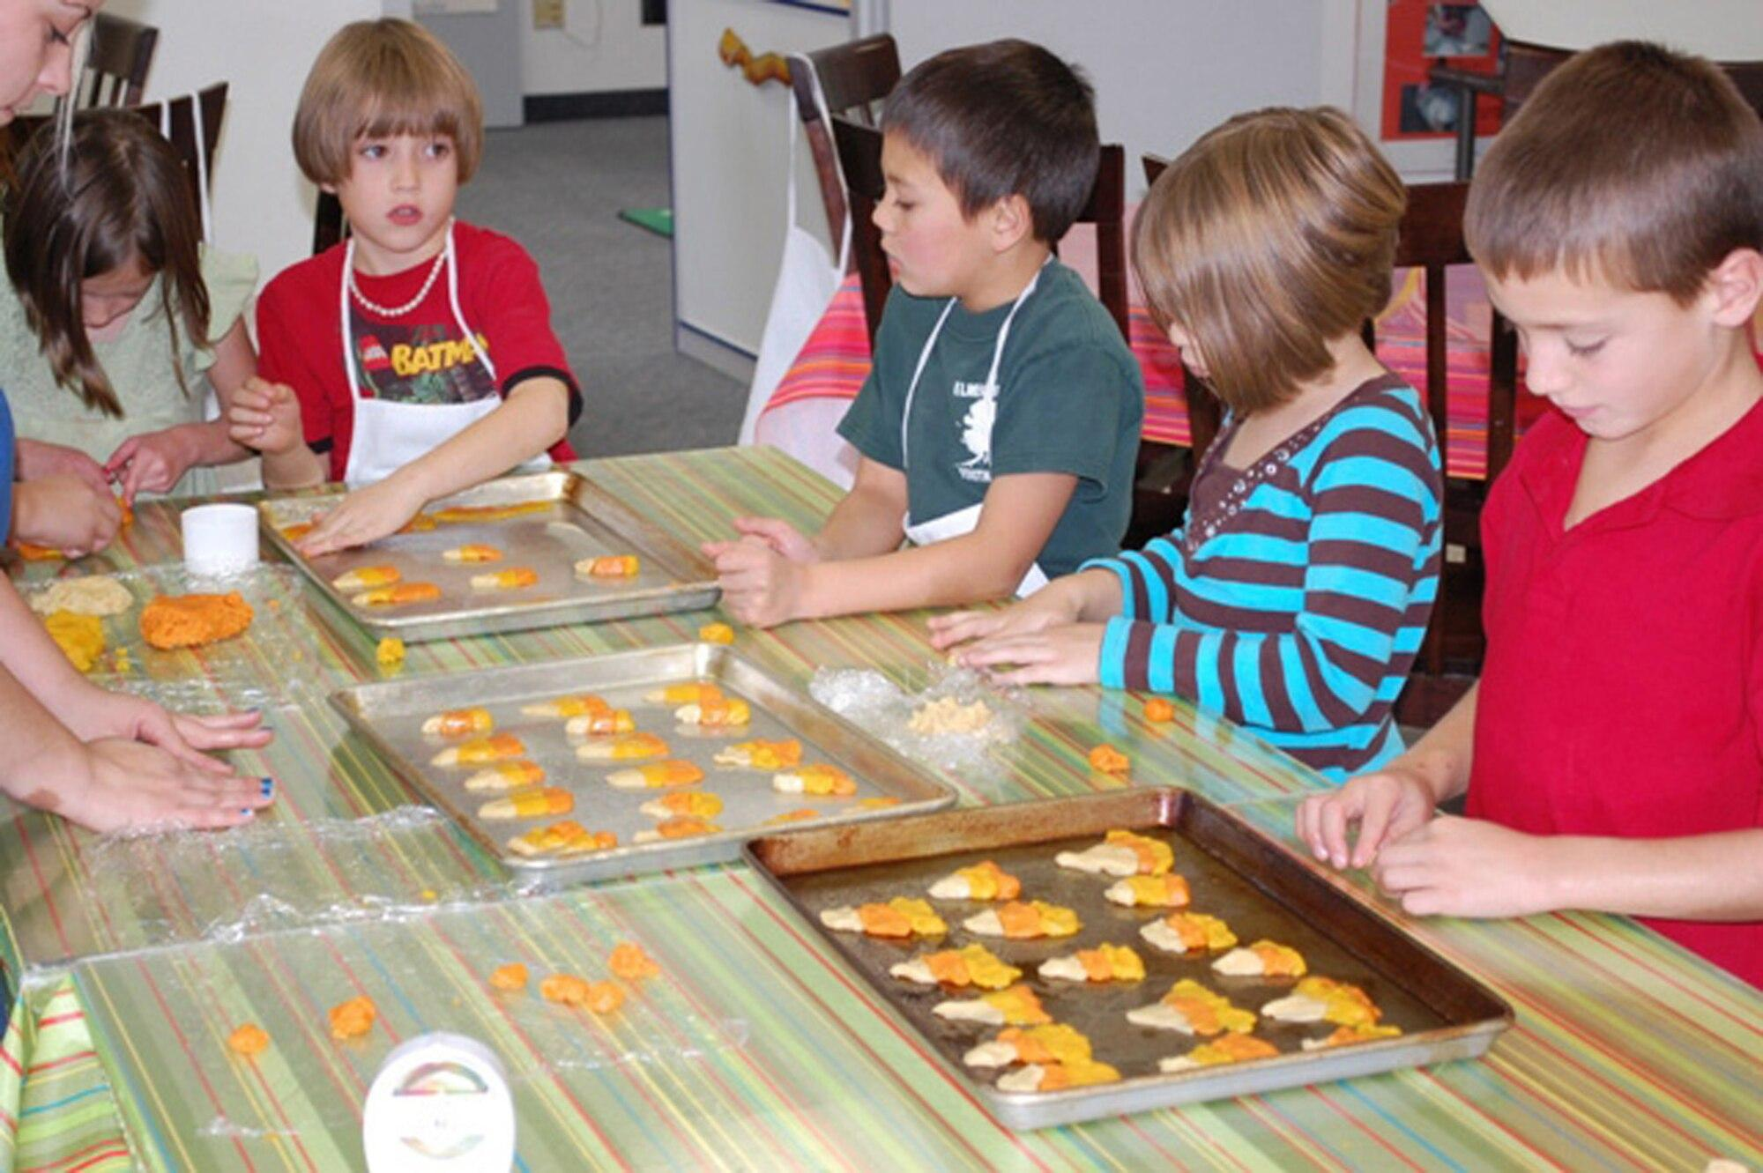
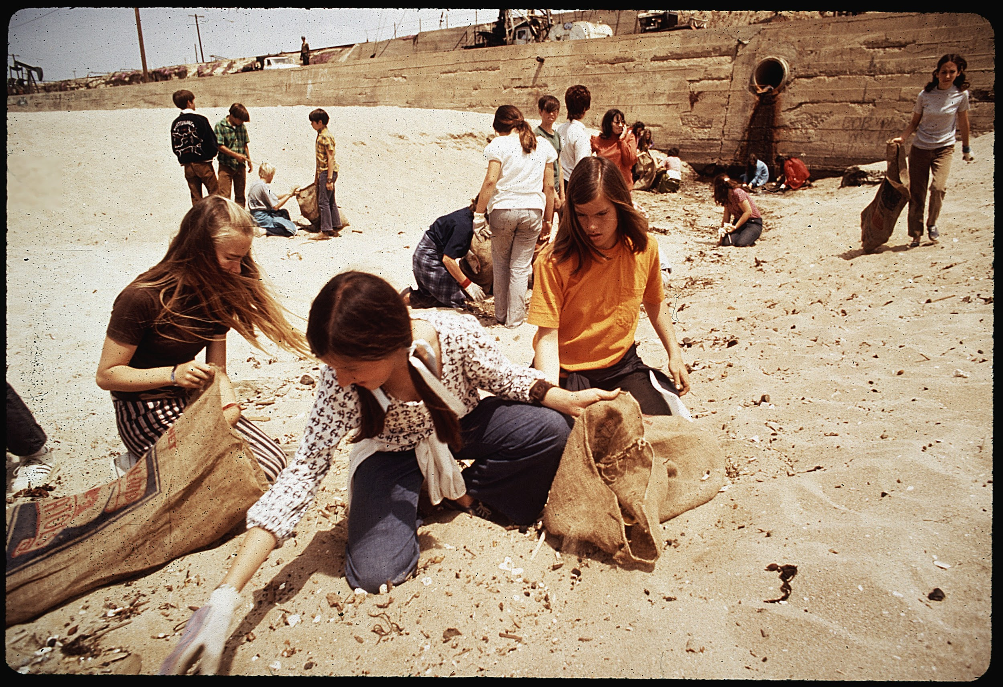
GENEROSITY MATCH
Match the image to the act of generosity
Helping a friend
Cleaning the beach
Sharing
Spending time with a friend
Baking cookies for a retirement home
Notes:
**Keep this slide in EDIT mode, not SLIDESHOW mode.**
Activity: Drag the description to match the picture. Answers: Column 1 - Cleaning the beach; Column 2 - Helping a friend; Column 3 - Spending time with a friend; Column 4 - Helping a friend; Column 5 - Baking cookies for a retirement home

Slide 10

Take Action
What are some ways you can show generosity in school this week?
What are some ways you can show generosity at home this week?
What are some ways you can show generosity within your community this week?

Slide 11

HOME CONNECTION
Talk with your family about different ways you can show generosity in your home or within your community. Write down what each person plans to do and then check it off once the act of generosity is complete.
Sample

