Slide 1

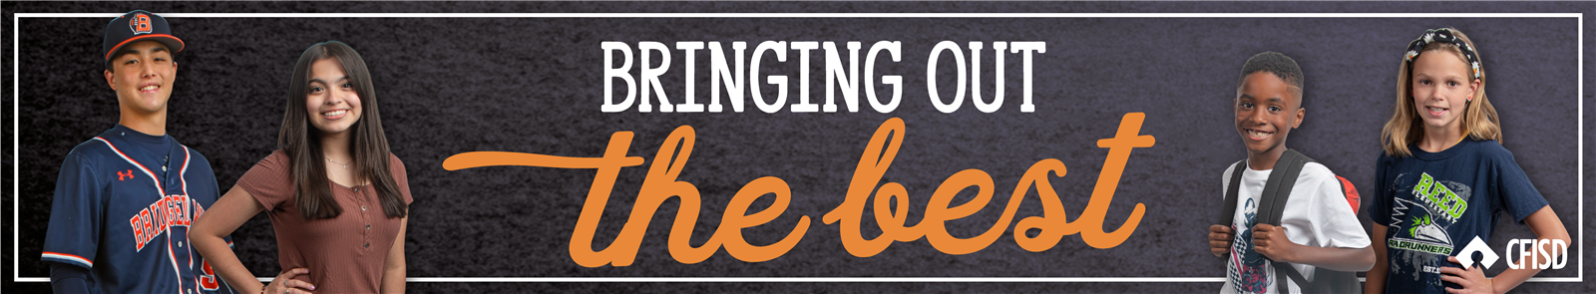


Generosity PreK-2nd

Slide 2


Generosity
Definition:
A Willingness to Give

Slide 3



Generosity

Slide 4


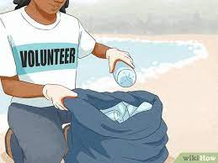
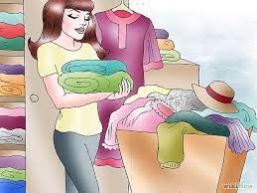
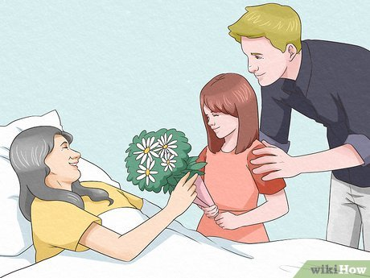
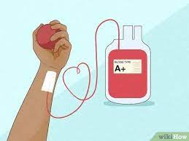
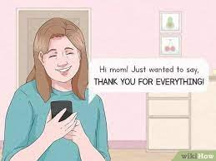

Ways to Show Generosity

Slide 5

Instructions: Generous or Not Generous?
On the next 5 slides,
Students can vote by a show of hands
OR
Students can vote by sitting or standing
OR
Students can vote by moving to the left or right side of the room

Slide 6


Does the scenario below display Generosity?
A family member wants to play your video game and you say, “no, it’s mine!”
Generous
Not Generous
Generous
Not Generous
Generous | Not Generous

Slide 7

Does the scenario below display Generosity?
Buying a movie ticket for a friend.
Generous | Not Generous

Slide 8
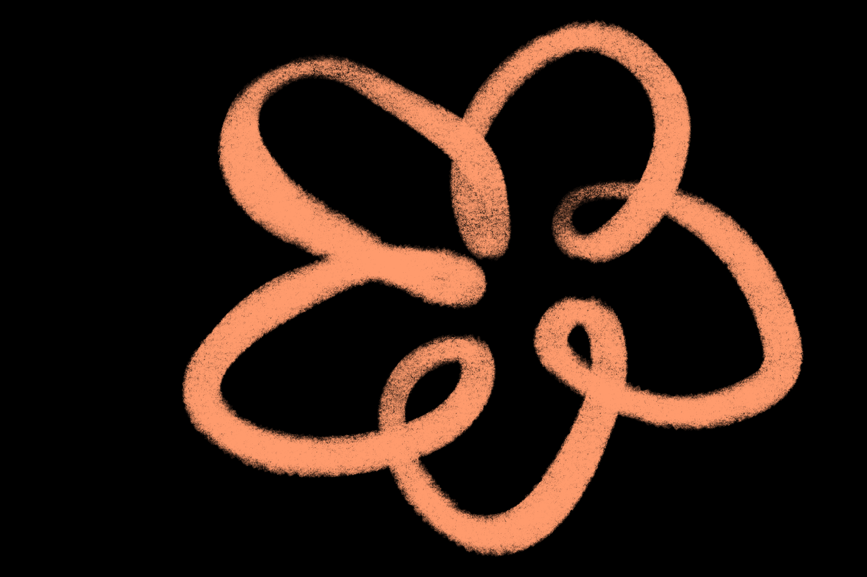
Does the scenario below display Generosity?
Throwing your old toys away.
Generous
Not Generous
Generous
Not Generous
Generous | Not Generous

Slide 9

Does the scenario below display Generosity?
Not sharing your crayons with a friend.
Generous | Not Generous

Slide 10

Does the scenario below display Generosity?
Giving your sneakers away that are too small.
Generous | Not Generous

Slide 11

Optional: Do the scenarios below display Generosity?
Telling a friend they did a good job.
Helping carry in the groceries.
You play with a ball out at recess and leave it when you go inside.
Your teacher accidentally drops a book and you pick it up to give it back.
You drop your tray at lunch and go back to the line without cleaning it up.

Slide 12
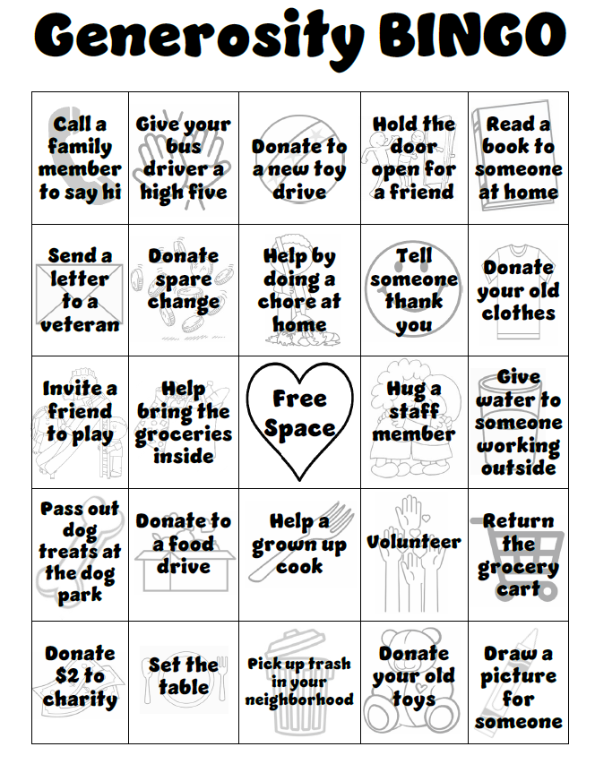
Generosity BINGO
Home Activity
See how many BINGO squares you can complete during the months of November & December!

