Slide 1



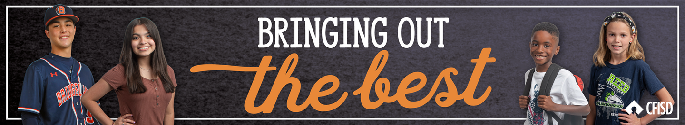






October Character Trait
RELIABILITY

Slide 2





TEACHERS
In the presentation, students will learn what it means to be reliable in different situations.
Each slide will contain interactive activities and guided questions for “Bring Out The Best” Reliability Character Trait for grades 6-8.
RELIABILITY

Slide 3
CAMPUS MATRIX
RELIABILITY

Slide 4



The Learner will...
01
Define what it means to be reliable
02
Explore what being reliable looks like
LESSON OBJECTIVES
03
Identify ways to be reliable at school and at home
04
Self reflect on how reliable they are
RELIABILITY

Slide 5


The ability to be trusted to do or provide what is needed
DEFINITION
Traits of Reliable person:
Trustworthy, honest, caring, integrity, loyal
RELIABILITY

Slide 6
DISTRICT VIDEO
RELIABILITY

Slide 7
01
Share any reflections you have from the video.
VIDEO REFLECTION
02
Can you think of someone you know who is reliable?
RELIABILITY

Slide 8

READ & DISCUSS...
CLICK HERE
FOR PASSAGE
Click on the link to the left and read the passage to class.
Reliable Rita Discussion Questions:
  How did Rita show her teachers she was reliable in the story?
  Are you reliable like Rita?
  Can your teachers and other students rely on you?
      Why or why not?
WHOLE GROUP ACTIVITY
RELIABILITY

Slide 9

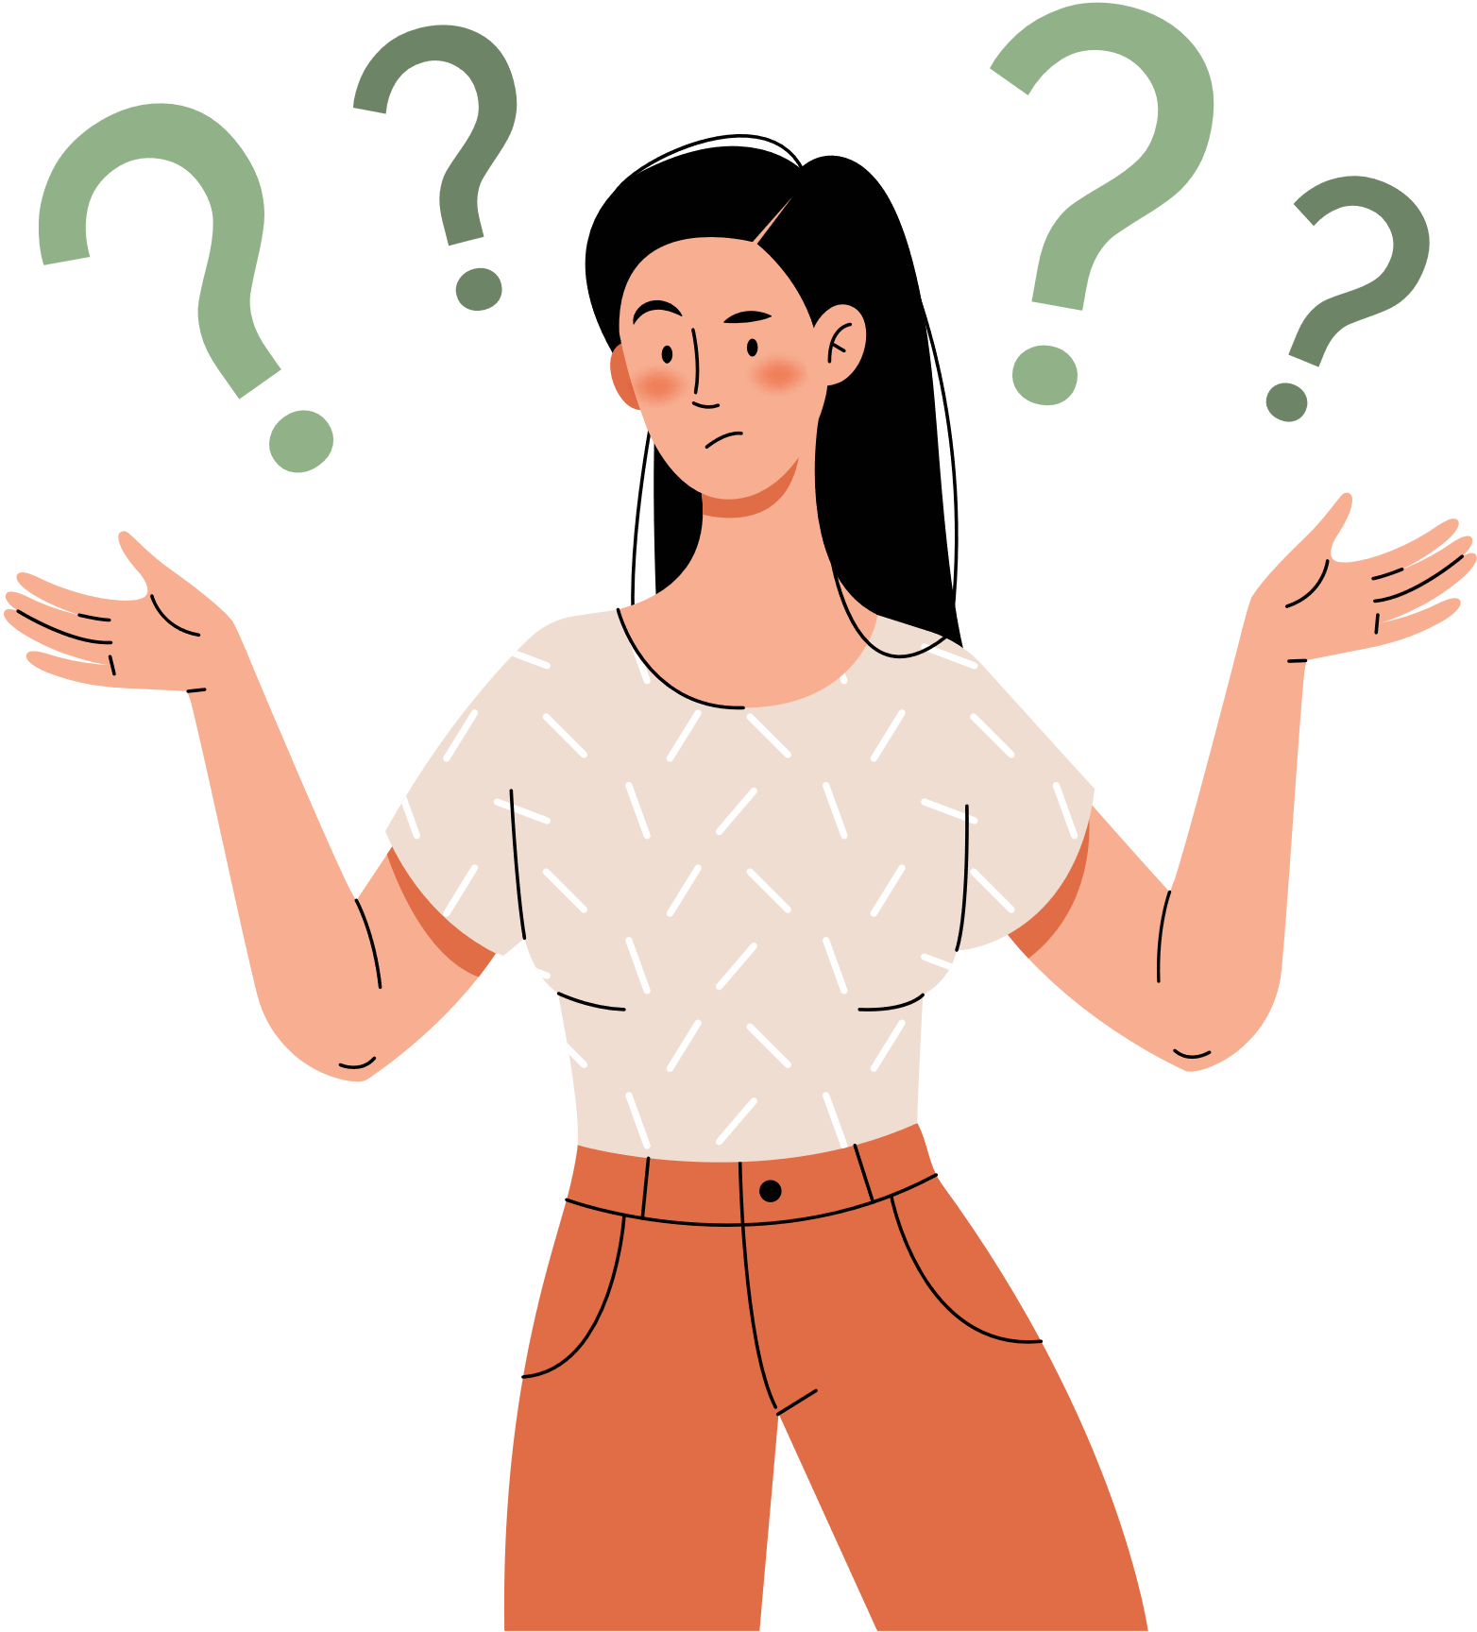

CLOSURE:
SELF-REFLECTION
Are you a Reliable Rita?
How can you be more reliable to your friends, family, and community?
Now that you know what reliability means, is there a time or situation where you could have been more reliable? Explain
RELIABILITY

Slide 10





HOME ACTIVITY
STUDENTS, CHOOSE A FAMILY MEMBER OR SOMEONE IN YOUR HOME TO READ AND DISCUSS EACH QUESTION ON RELIABILITY.
WHAT DOES IT MEAN TO BE RELIABLE?
WHAT IS A POSITIVE TRAIT OF A RELIABLE PERSON?
WHAT IS ONE WAY YOU CAN BE A RELIABLE PERSON AT HOME?
RELIABILITY

Slide 11



EXTENSION LESSONS
WANT ANOTHER ACTIVITY TO CONTINUE OUR TRAIT OF THE MONTH?
  CREATE A COMPETITION BETWEEN EACH CLASS PERIOD THAT IS SHOWING RELIABILITY
  CLICK HERE ON WORD CLOUD CHOOSING WORDS WITH THE CLASS THAT DEFINES RELIABILITY IN THEIR OWN WORDS.
  CREATE A CLASS SPOTIFY LIST HERE BASED ON THE CHARACTER TRAIT: RELIABILITY
FOR
'S
ONLY
RELIABILITY

