Slide 1


OCTOBER
Reliability

Slide 2

Reliability
The ability to be trusted to do or provide what is needed
“You can count on me!”

Slide 3
Today we will
home
guest
Define reliability
Explore ways to express reliability
Formulate a plan for showing reliability

Slide 4


FOOTBALL
home
guest
Insert CFISD video here

Slide 5
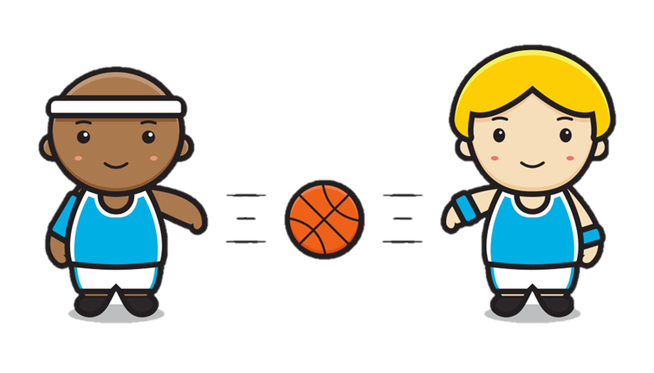
Turn and talk
home
Talk to your elbow partner about the following:
What ways did you see reliability being exhibited in the video?
guest

Slide 6
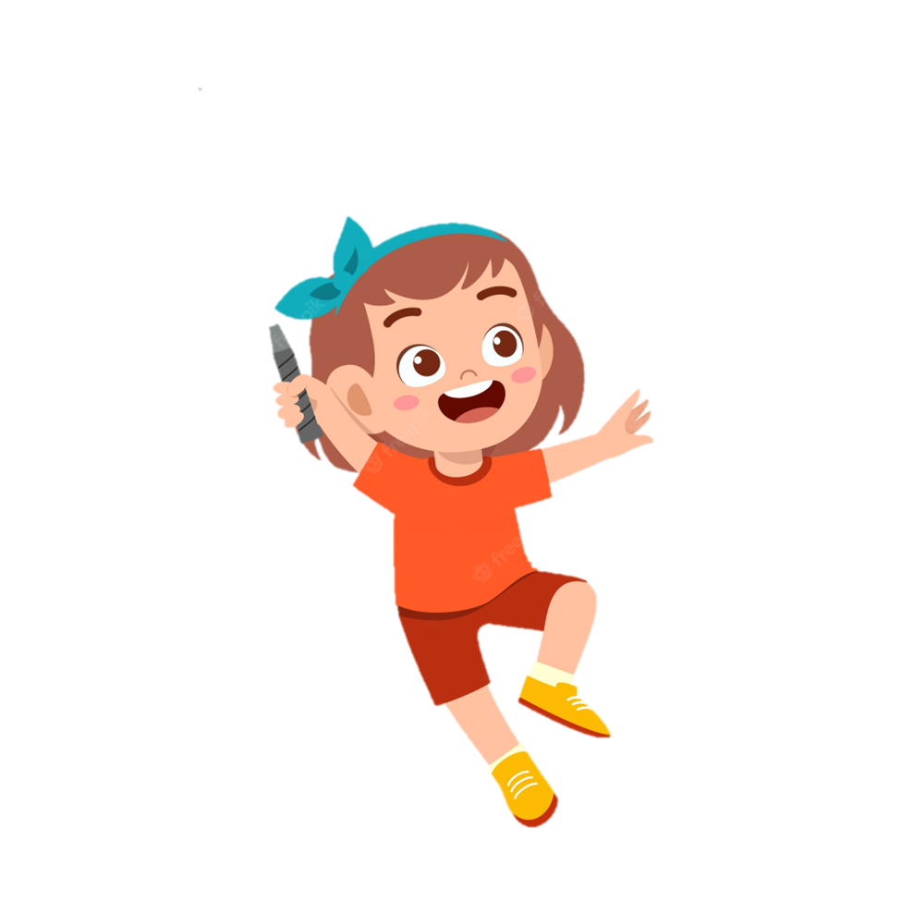
BADMINTON
Let’s play badminton!
Read the statement on the screen. If the statement shows reliability, move to the left side of the room. If it does not, move to the right side.
home
guest
As you are leaving the cafeteria, you notice some napkins and plastic wrap left on the floor. You pick them up and throw them away, even though it’s not yours.

Slide 7
BADMINTON
Let’s play badminton!
Read the statement on the screen. If the statement shows reliability, move to the left side of the room. If it does not, move to the right side.
home
guest
You have a group project you are working on in class today, but you don’t feel like doing it. You decide to stay home and play “sick” instead.

Slide 8
BADMINTON
Let’s play badminton!
Read the statement on the screen. If the statement shows reliability, move to the left side of the room. If it does not, move to the right side.
home
guest
While getting ready for school in the morning, you place your dirty clothes in the clothes hamper instead of on the floor.

Slide 9
BADMINTON
Let’s play badminton!
Read the statement on the screen. If the statement shows reliability, move to the left side of the room. If it does not, move to the right side.
home
guest
As you are leaving the restroom, you notice some paper towels left on the floor. You didn’t drop them, so you leave them there.

Slide 10
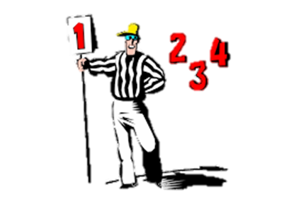
Effort - Be willing to grow and challenge yourself
2. Discipline - Develop a routine and stick to it
GAME PLAN
Effort
Discipline
Practice
Determination
4. Determination - Remember your promise has importance. People are counting on you!
3. Practice - Consistency is key! It may take several tries.

Slide 11

Wrap-Up
Let’s discuss:
How can YOU demonstrate reliability in the following places?
at home
in the classroom
around the school
home
guest

Slide 12
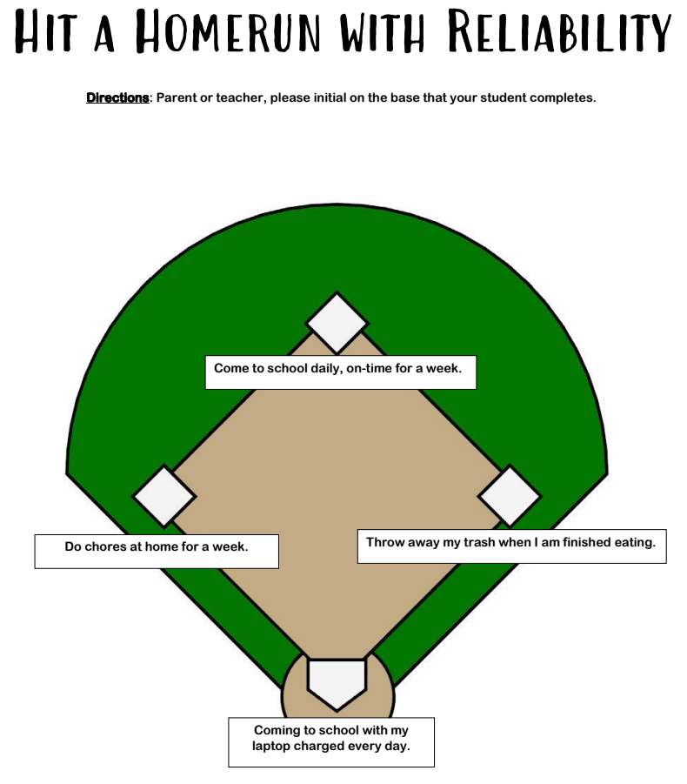
BASEBALL
home
guest
Hit a HOMERUN with Reliability
Students, you can hit a homerun with reliability by having either your parent or teacher initial the base you complete.

