Slide 1
Science Safety
Onslow County School
K-5

Slide 2
Chemicals in the classroom
Must be in a labeled container out of the reach of children. Leave the original label attached to the container.

Slide 3
Chemicals in the classroom cont.
When bringing in chemicals for onetime use, please use and take home instead of storing in the classroom.
Regularly used items such as baby wipes, Clorox wipes, Lysol, etc. that are continuously stored must have a MSDS sheet attached.
DO NOT store Bleach and Ammonia in the same location as it has a chemical reaction that causes toxic fumes. Vinegar and baking soda can have the same effect.
Classroom inventory sheet.

Slide 4



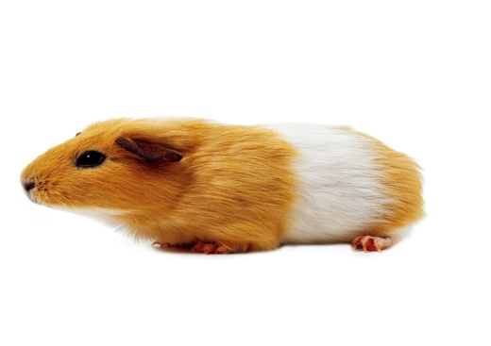
Animals in the Classroom
OCS Policy - Animals are permitted in the classroom as classroom pets with prior approval. Please fill out an animal identification sheet to be place in the Science Safety binder in case of a fire. All animals should be removed from school during breaks.
Teachers should check on fur and feather allergy prior to obtaining an animal
Special permission may be granted in advance for temporary instructional needs.
  Example- incubators to hatch eggs (all instructional needs should be aligned to the NCESS)
  All offspring should only be handled by an adult.

Slide 5


Do not allow students to bring dead or wild animals into the classroom!
“State law prohibits holding any wild animal or bird in captivity without a license from the Wildlife Resources Commission. Before the Commission can issue a license authorizing a person to keep a wild animal or bird in captivity, it must determine that the animal or bird was acquired lawfully and will not be kept merely as a pet. An approved facility must be provided”.
-North Carolina Wildlife Resources Commission

Slide 6

Plants in the classroom
Be aware of the specific type of plant you have.
Know if the plant you have is toxic and what may need to be done if an emergency occurs.
Keep original identification with the plant and keep it in a safe location.

Slide 7
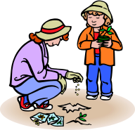


Plants and Soils
If using soil, it is safer to use sterilized potting soil.
If using soil, have students use proper tools for digging up and examining the samples, not their bare hands.
Wash all surfaces thoroughly after plant, seed, or soil activities.
Try to obtain plant specimens from reputable scientific suppliers.
Do not use seeds intended for commercial field planting.
FDA- Wash hands before and after, do not substitute hand sanitizer.

Slide 8



All procedures and protocols for Safety should be addressed in the lesson plan.
Don’t forget to add your Science safety
steps to your lesson plans.
If you have any questions please contact Michelle Chadwick (michelle.Chadwick@onslow.k12.nc.us)

Slide 9
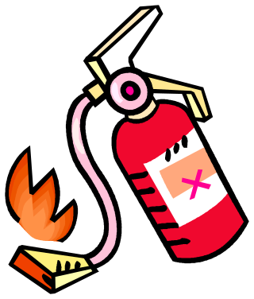

Science Safety
. Please visit the following site for additional fire safety information:
www.nfpa.org.

