Slide 1

12 Test
Taking Tips

Slide 2
Become familiar with the test directions BEFORE test day so you don’t waste time on test day reading the directions <increase speed and accuracy>
Learn and use test taking strategies BEFORE the test <increase confidence and reduce anxiety>
Use TestNav to practice ACT-style test questions
Tip 1
Prep and Practice

Slide 3
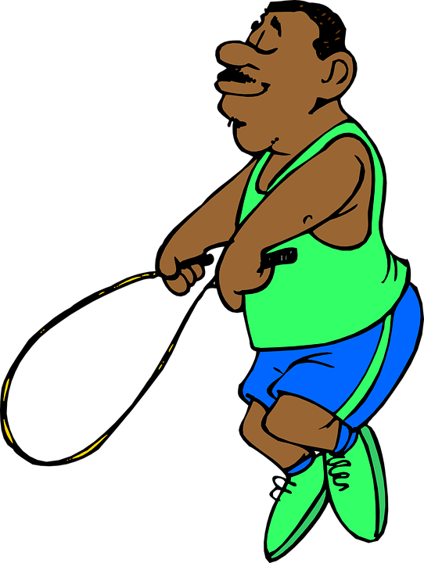
On a timed test like this, saving a minute is huge. If it’s easy to you, answer it NOW. If it’s going to take a few minutes, note it, skip it, and return to it LATER. If you have no clue, choose your “answer of the day” and NEVER go back; just forget about it.
*At the start of the test, pick an “answer of the day” and mark that answer choice whenever you’re unsure – you’ll save time in the moment when you don’t have to agonize over which random answer to choose.
Tip 2
Skip and Return: Now, Later, and Never

Slide 4

The ACT does NOT penalize you for guessing incorrectly. Always guess. If you can’t figure out a problem at once, use the skip-and-return strategy. If you return to the problem and are still stumped, make a new guess or leave your “answer of the day” choice.
Tip 3
Always Guess-Always

Slide 5

For the English portion of the ACT, read only one paragraph at a time and then answer the corresponding questions to that paragraph. Don’t read the whole passage at once; you will have to go back and re-read specific lines. Also, don’t skip reading; you will have to read to understand the main idea of the passage to answer some questions.
Tip 4
Read and Answer as You Go

Slide 6

Read only what you have to, BUT when you read, read actively:
Question as you read to actively engage your brain
Comment on the passages as you go (annotation: underline, circle, take notes, ask questions and answer them, sketch, highlight, etc.)
Anticipate what will happen next
Tip 5
Read Actively

Slide 7

Write down your own personal answer BEFORE you look at the answer choices.
This will help you avoid being distracted by the test-makers’ efforts to confuse you.
Tip 6
write your answer down first

Slide 8

If a choice sounds downright absurd, contains a clear grammatical error, or is completely unrelated to the passage, cross it out. You will be 25% closer to guessing the correct answer with each choice you eliminate!
Tip 7
Eliminate Choices

Slide 9

Most questions offer a “no change” and “delete” as an answer choice. Many first-time test takers feel that a “real” answer is required. This is not necessarily true.
Tip 8
Don’t ignore “no change” and “delete”

Slide 10
Tip 8 Practice
After the battle, the winning army took control of the city and the general wedded the city’s young and beautiful princess-- she was truly pretty.
A. NO CHANGE
B. , and she was pretty.
C. --pretty as she was.
D. DELETE the underlined portion

Slide 11
Tip 8 Practice
After the battle, the winning army took control of the city and the general wedded the city’s young and beautiful princess-- she was truly pretty.
A. NO CHANGE
B. , and she was pretty.
C. --pretty as she was.
D. DELETE the underlined portion

Slide 12

The ACT favors short, concise answers. Think about which answer choice says the most in the fewest words and chances are, that’s the correct answer! About ⅓ of the questions on the English portion require you to scout for redundancy and relevance.
Tip 9
Shorter is Sweeter

Slide 13
tip 9 practice
After the loss, my coach patted us all on the back, reminding us that there are no true wins without losing games too.
A. NO CHANGE
B. losing a few games.
C. losing games, as well.
D. losses.

Slide 14
tip 9 practice
After the loss, my coach patted us all on the back, reminding us that there are no true wins without losing games too.
A. NO CHANGE
B. losing a few games.
C. losing games, as well.
D. losses.

Slide 15

Instead of thinking about how to “defend” each answer choice, “attack” what is wrong with each one and begin to eliminate choices. This will prevent you from being tricked into thinking: “it sounds good, now that I think about it.”
Tip 10
Don’t Defend the Choices-Attack them

Slide 16


Beware of extremes. It’s harder to support extreme answers than moderate ones.
For example: all, every, only, always, never, absolute, impossible, inevitable, etc.
Tip 11
Avoid Extremes

Slide 17

General answer choices are much more likely to be correct than specific choices. The more specific and detailed the choice, the less likely it is to be supported by the passage.
Tip 12
Choose general over specific

