Slide 1

Suicide Prevention
How to help
2023-2024
This presentation is adapted from the Washington State Youth Suicide Prevention Project
Youth Suicide Prevention Program
444 NE Ravenna Blvd., Suite 401
Seattle, WA 98115
206-297-5922
www.yspp.org
Notes:
Discuss class norms for this delicate, but serious presentation. Talk about how this information can be sensitive to others, may bring up strong feelings for some, may be difficult to hear. Some people may have experienced suicide in their life (friend, family member, loved one), and we don’t know everybody’s story so need to be sensitive and caring for everybody.
Raise hand to ask a question
Don’t tell personal stories or stories about a friend or somebody you know
This is a serious topic but we know 7th graders are mature and can handle the information.
We do this presentation every year in 7th grade health classes because it can help to save lives.

Slide 2
Suicide Is hard to talk about
Be respectful and guarded of your own personal experiences
Be respectful of other people experiences
About our language around suicide………….
Died by suicide
Took their life
Passed away

Slide 3

Learning Targets
Understand confidentiality in the counseling setting
Recognize the warning signs associated with suicidal thinking
Have a better understanding of Depression
Gain tools for how to be a supportive ally to a friend or family member
Know how to seek help for someone who may have thoughts of suicide
Identify adults and other resources for help
Notes:
Renee
Be sure to let students know this is a serious topic
Others might have history with the topic so be sensitive during discussions

Slide 4

Talk to your counselor
If feeling difficult emotions or you have a concern for yourself or a friend, talk to your counselor or a trusted adult in your life
Email your counselor, or any counselor, today to set up a meeting OR sign up in the counseling office
  Mrs. Coons A-K jcoons@lwsd.org
  Mr. Doyle L-Z tdoyle@lwsd.org
  Ms. Rowan Youth Eastside Services (YES)
Notes:
Renee
If something in this presentation brings up difficult feelings for you, please talk about it with a trusted adult. Email your counselor today and they can arrange to talk with you. Share what you are feeling and going through. There will also be drop in sessions in the afternoon today where you can join a meeting to talk with a counselor as needed. Ms. Downs will post the links to the drop in sessions in the General channel Post.

Slide 5

Confidentiality
What is discussed between you and your counselor in most situations can remain private
When do we have to include others:
- If the student may be in danger to themself or a danger to another.

Slide 6

The WHY?
Young people talk about their problems to other young people most often
Young people share their feelings with their friends more than adults
You know what’s going on in each other’s lives more than the adults at school
You can save a life if you connect somebody who needs help to an adult
Talking about suicide doesn’t cause someone to do it
You see social media that adults don’t, where students might express suicidal thinking

Slide 7

TRUE or FALSE
True or False? Two Washington State youth die by suicide each week
TRUE
True or False? One out of ten youth attempts suicide
TRUE
True or False? One out of six middle school age youth seriously considers suicide
TRUE
True or False? Talking about suicide will “cause” someone to do it
FALSE
True or False? A person who talks about suicide is not really serious about dying
COULD BE EITHER BUT NOT FOR YOU TO DECIDE.
REPORT IT AND BE THE PATHWAY FOR THEM TO GET HELP
Notes:
Renee
Jackie will check the poll on Teams and verbally share results.
Before we get into the presentation, let’s see what you already know about youth suicide.
[Review each true or false question as a group and invite responses from the group. Award a lifesaver to each student who answers correctly]
ANSWER KEY: 1) True 2) True 3) True 4) False 5) Sometimes…we always check with the person if they ever talk about suicide to find out more.
Some of these are myths and some of these are actually true. It’s important to know the difference in order to make a difference in someone’s life.

Slide 8
Fact or Myth?
Asking someone if they are thinking about suicide will make them suicidal
Suicide is not an issue that impacts kids from Timberline
One out of 10 youth (15-24) attempts suicide
One out of 6 middle school aged youth seriously consider suicide
A person who talks about suicide is not serious about dying
Talking about suicide will “cause” someone to do it

Slide 9
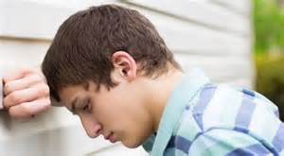
The concern is real
  Suicide is the second leading cause of death in the state of Washington for youth 10-24
  Nearly twice as many suicides as homicides of youth ages 10-24
  Nearly 1 in 6 students between the ages of 12-17 have seriously considered it
Source: http://www.yspp.org/about_suicide/statistics.htm
Notes:
Renee
So, how big is this problem in Washington state? Let’s look at some of the facts.
[Review stats on the slide]
There are lots of taboos associated with suicide so the facts aren’t well known and myths are thought to be true.
We want to help teach you about what to look for and where to go to for help so that we have less youth making attempts and dying by suicide in our state.
It’s important to know this information so that suicide can be prevented!
You can find out more on the Washington Department of Health website or by visiting the Healthy Youth Survey website.

Slide 10
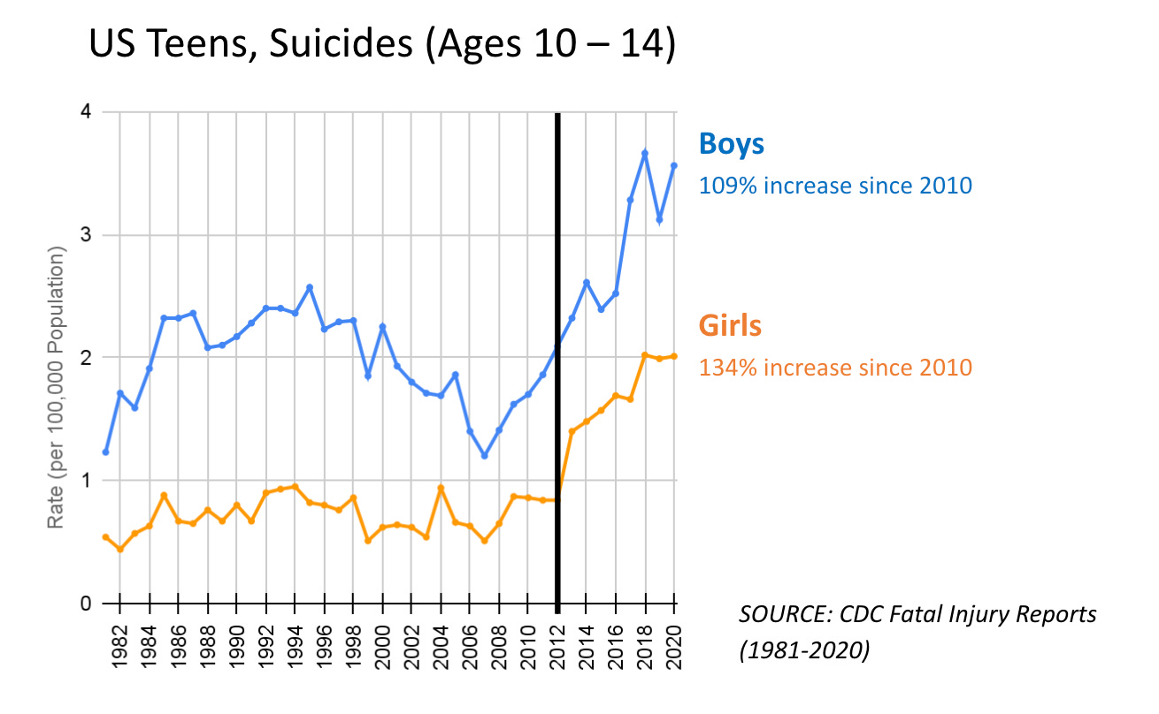

Slide 11
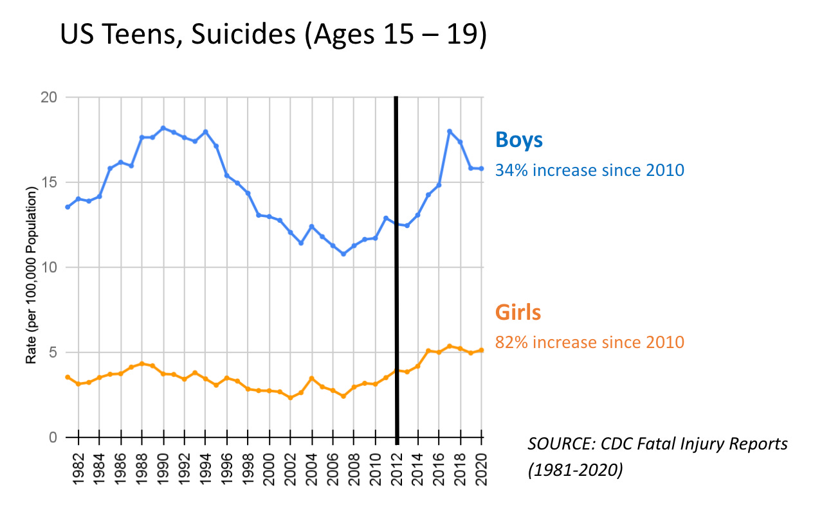

Slide 12
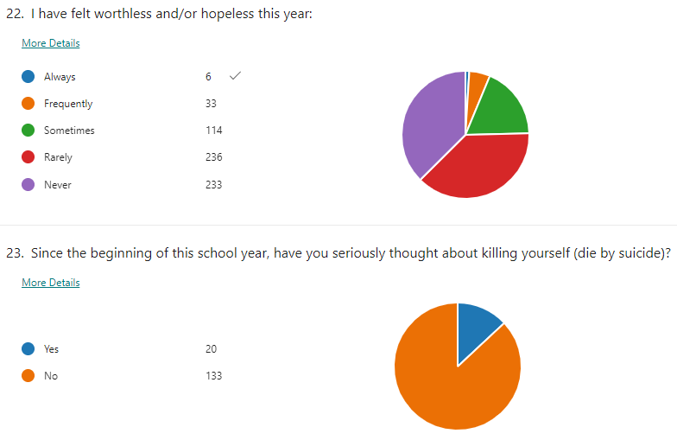
TMS 2023-24 School Year Student Survey
Notes:
646 students took survey – 31% selected Always, Frequently, or sometimes
4% of our students have thought of killing themselves this year - about 1 student in a class of 30

Slide 13

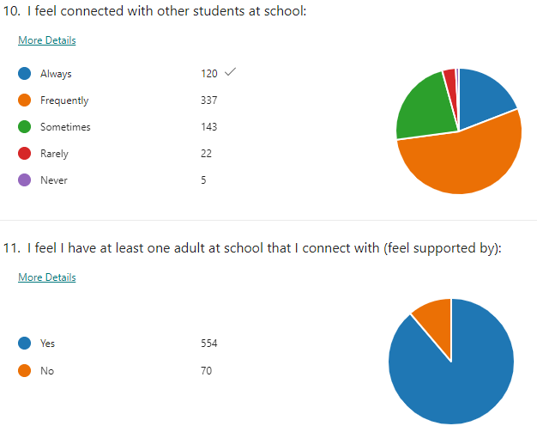
Feeling Connected at TIMBERLINE

Slide 14
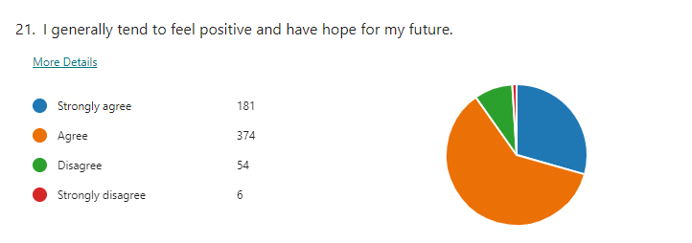

Hope and Positive Mindset

Slide 15
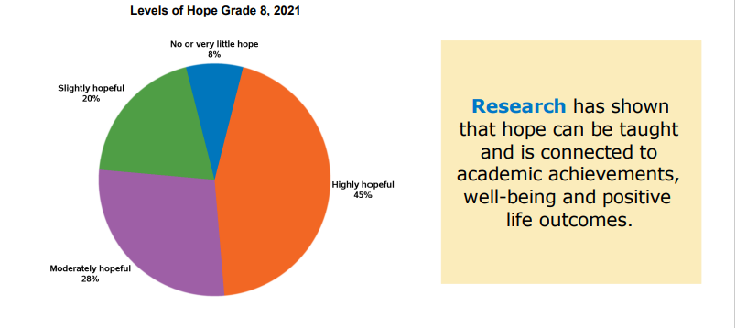
Hope Helps
“We must accept finite disappointment, but never lose infinite hope.” .

Slide 16

Prevention
About 80% of the time people who die of suicide have given definite signals or talked about suicide to somebody
The key to prevention is knowing what the warning signs are and what to do to help
Notes:
Toby
Ask: Why is the statistic helpful?
Answer- because most of the time people who are suicidal talk about it so that we can know they need help and can intervene…get them help.

Slide 17
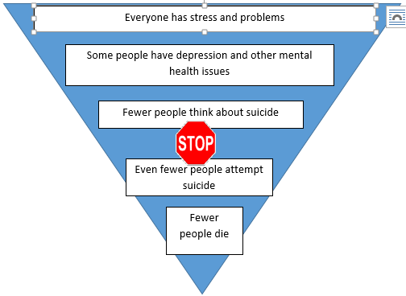
Notes:
Toby
Let me ask you something: Who here has never had a problem or experienced stress? [Ask for show of hands] Exactly! Everyone experiences stress and when we’re scared to talk about suicide we may think that suicide is inevitable when something bad happens to a person. But, that isn’t true. There are ways to prevent suicide and this diagram shows that people are doing just that.
The experience of depression or other mental health issues isn’t experienced by everyone, but are still fairly common – it’s estimated that about one in eight adolescents is experiencing depression at any given time, and there are other mental health issues linked to suicide as well.
Less common than that is suicidal thinking. Not everyone who thinks about suicide is depressed and not everyone with depression thinks about suicide.
We also know most people who think about suicide don’t act on those thoughts.
And most people who attempt suicide survive. So we can see that the number of people who die by suicide is way smaller than the number of people who have problems or struggles with mental health.
What we’ll focus on today is how to help a peer experiencing stress, depression, or suicidal thinking and help them stop before that leads to a suicide attempt.

Slide 18

What is DEPRESSION?
Feelings of intense sadness that last several weeks
A treatable illness that is not the person’s fault
Causes:
Brain chemistry
Situations and experiences
Notes:
Toby
This is a simple explanation of depression. [Go over definition of depression and causes on slide]

Slide 19

What are some Signs &
Symptoms of Depression?
Notes:
Toby – students can raise hand and say what a sign is or direct kids to type in their answers on the questions for the teacher channel in Teams
Ask class, “What are some signs and symptoms of depression?”
How many of you have known someone who was depressed? [Ask for a show of hands].
How did you know that they were depressed? [Invite responses from the class – be sure that answers include sad or depressed mood, anger-irritability, trouble concentrating, crying, changes in eating and sleeping behaviors, physical complaints, drug and alcohol use, self-harm, and thoughts of suicide].
Depression is when feelings of sadness, hopelessness, and despair persist over time and interfere with day-to-day functioning.
Everyone gets sad or feels down at times.
Depression becomes a concern when that bad or sad mood lasts for several weeks and it is not possible to cheer up. Here are the signs of depression in adolescents.

Slide 20

Signs & Symptoms of Depression
Anxiety or irritability
Changes in eating/sleeping
Physical complaints
Poor school performance
Drug or alcohol abuse
Moodiness, hopelessness, withdrawal
Notes:
Toby
Review signs of depression on slide
Depression doesn’t look the same in adults as it does in teens. We are used to seeing pictures of people looking sad or not being able to get out of bed – this is more common in adults.

Slide 21
Taking care of yourself is important
“Self-compassion is simply giving the same kindness to ourselves that we would give to others.”
Take breaks- from watching, reading, or listening to news stories, including those on social media
Take care of yourself- Eat healthy, exercise, get plenty of sleep, and give yourself a break if you feel stressed out
Make time to unwind
Talk to others
Connect with your community
Recognize when you need more help
Notes:
We can not be an ally to others and help others without first taking care of ourself

Slide 22
Benefits of Getting Help for Depression
What keeps people from getting help?
Why is it worth it to get help?
Safe place to talk
Someone to listen
Learn coping skills
Get support that you need
Provides hope
Notes:
Toby
Most teens who are suicidal are depressed, which is why we started talking about depression.
Most depressed teens can get better by getting help. This doesn’t always mean that you have to take medicine. [Go through points on the slide] It means having a safe place to talk; someone to listen; it means learning new ways of coping with problems and getting support.
Let’s talk about coping. What is a coping skill? [Invite responses from group] Good, it’s how we deal with things that happen in our life.
What are some ways you cope with stress or depression? [Invite responses from group]
We all are different and have different strategies like relaxing, journaling, exercise, listening to music, sports, art and sometimes we need to learn new ways of dealing with stress and depression.
What keeps people from getting help? [Invite responses from group]

Slide 23
Signs of suicidal thinking:
The FACTS
Feelings
Sad, lonely, hopeless, in pain, moody, irritable
Actions
Pushing away friends and family, giving away important possessions, using alcohol or drugs, making unsafe decisions, making or researching suicide plans, making art or writing about death
Changes
Changes in school performance, changes in appearance or hygiene, changes in personality or attitude, just not seeming like themselves
Threats
Saying they’re going to kill themselves, saying goodbye
Situations
Has the person had a crisis or trigger situation, especially in the last couple of weeks?
www.yspp.org
Notes:
Jackie
Now that you know a little bit about depression and what it looks like, we want to give you some tools for knowing what to do when you recognize the symptoms in a friend.
When we are concerned about a friend, the FACTS framework can be a helpful tool.
The FACTS is an acronym that stands for Feelings, Actions, Changes, Threats and Situations. These are some helpful signs to look for when you are concerned someone you know might be thinking of suicide.
Review the slide with the class.

Slide 24

Looking for signs
What behaviors would be concerning to you if this was your friend?
Youth Suicide Prevention Video
Notes:
Renee
Add link to post so kids can access
Ask students to look for warning signs

Slide 25
What were some signs that would have made you concerned if this was your friend
Irrational reaction to his friend/ Overly emotional
Giving away a prized possession
Isolating himself/ Feeling alone and wanting to be alone
Telling his friend, he doesn’t know if he is alright- says things like it doesn’t matter anymore
How does his friend help support him?

Slide 26
What’s YOUR Role?
Friend’s
Role
Adult’s
Role
  Show you care
Don’t keep a secret
Know the warning signs
Offer Support
Listen!!
Be a good
friend
Suicide prevention education
Ensure safety
Teach skills
Support Provide resources
Notes:
Jackie
Let’s take a look at your role in helping a friend who might be at risk for suicide.
If you have a friend thinking about suicide or who has talked about it – it is serious! You have a role to play in helping your friend, but it is not to be the adult or to be a counselor. [Go over friend and adult roles on the slide]
There is a very important role for a friend that includes being a good friend and educating yourself about suicide so you know what to look for and when to be concerned: What does it mean to “be a good friend?”
The adult’s role is also to be able to assess the seriousness of the suicide talk. When the crisis has resolved they can also teach new skills for coping and dealing with the depression.
There are also some things that both roles are responsible for which include some intervention steps that we’ll talk about next. We want you to understand that you need to get them to someone who can help and not try to be the counselor yourself – they need you to be their friend.

Slide 27

Take Action with S.A.G.!
Show you care
  “I am worried about you; I want to help.”
Ask the question
  “Are you thinking about suicide?”
Get help
  Do not leave them alone
www.yspp.org
Notes:
Jackie
There are three helpful phrases and all you have to do is remember these three strategies in order to be helpful to a suicidal friend.
Show You Care: You show someone you care when you listen carefully to what they are saying and tell them that you are concerned about their feelings. What are some other ways you can show you care? [Solicit some responses and reinforce helpful ones]
Ask the Questions: The only way to really know if someone is suicidal is to ask, “are you thinking of suicide?” The question may be difficult to ask but it is important that you ask it in a direct, caring and non-judgmental way. It is important to use the word suicide and be direct and wait for a response.
Get Help: If they says that they are suicidal, when you ask, then it is important to stay with them and offer to get help.
How would you encourage a friend to get help? What could you say to them?
Not everyone is willing to get help right away. Sometimes, it is hard to encourage them to talk to someone. Remember how important and serious this step is! Their life is at risk. It is better to have a friend that might be mad at you than to lose a friend to suicide. You must get help for them if you are concerned they may end their life.

Slide 28

1. SHOW YOU CARE
Listen Carefully
Try to stay calm- be a mirror for emotions
Keep the focus on them
Be present and in the moment with them
Notes:
JackieDo not try to argue someone out of suicide.
Instead, let them know that you care, that they are not alone and that they can get help.
What could you say to Carlos?

Slide 29

2. ASK THE QUESTION
Be direct but in a caring and non-judgmental way:
- “Are you thinking about suicide?”
- “Do you feel safe right now?”
Using the word suicide is OK. Research indicates that asking the question will not give them the idea of suicide
Notes:
Jackie
Ask Questions
Begin by telling the suicidal person you are concerned about them.
Tell them specifically what they have said or done that makes you feel concerned about suicide.
Don't be afraid to ask whether the person is considering suicide, and whether they have a particular plan or method in mind. These questions will not push them toward suicide if they were not considering it.
Do not try to argue someone out of suicide. Instead, let them know that you care, that they are not alone and that they can get help.
What would this look like with Carlos?

Slide 30
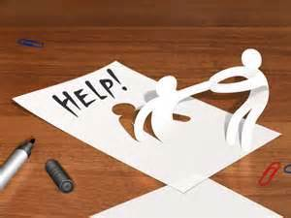
3. GET HELP
Do not leave them alone
Seek an adult for help
Things to say:
- “You’re not alone. Let me help you.”
-“I know where we can get some help.”
Notes:
Jackie
Encourage Professional Help
Actively encourage the person to see an ADULT - parent; teacher; school counselor; coach - physician or mental health professional immediately.
People considering suicide often believe they cannot be helped. If you can, assist them to identify an ADULT (school staff or others) and If they will let you, go with them to talk to that ADULT

Slide 31
What is NOT Helpful
Ignoring or dismissing the issue
  “Oh, let’s talk about something else.”
Acting shocked or embarrassed
  “You aren’t REALLY thinking of suicide, are you?”
  “That makes no sense!”
Challenging or debating
  “You don’t really want to kill yourself; you are looking for attention”
Giving harmful advice
  “Maybe you should just run away”
  "Try to forget about it...I am sure you will feel better tomorrow“
Sharing personal information with friends or on social media
  “Did you hear _____ is suicidal”
  Posting to social media: “Let’s all help _____ my suicidal friend”
Notes:
Jackie
Now that you know what to look for, here are some things to keep in mind that most people are tempted to do, but aren’t very helpful to someone who’s thinking about suicide.
Why do you think these statements aren’t helpful? How might they make the person feel? [Invite responses from group]
These kinds of reactions can be silencing and hurtful and makes it less likely that the person will want to open up and talk about what’s going on with them.

Slide 32

What are some resources or
people you can go to for help if
you are concerned about a
friend?
Notes:
Jackie Ask the class this question.

Slide 33
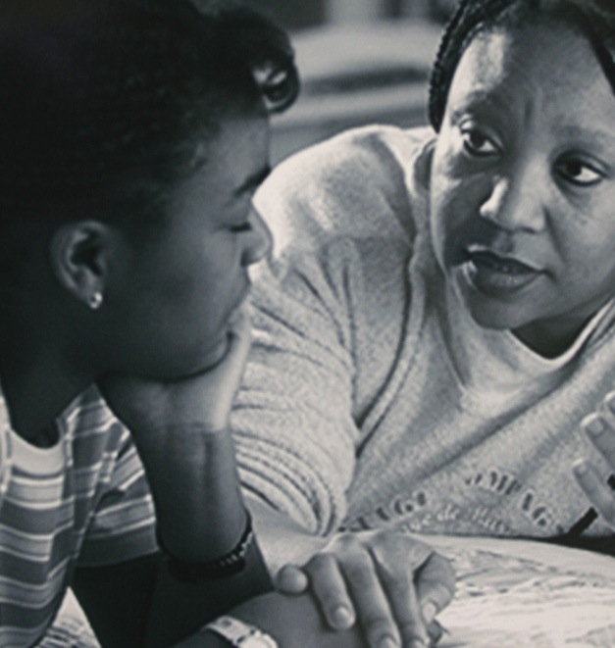
Resources for Help
Trusted adult friend
School counselor
Teachers or coaches
Faith community
Older sibling
Parents or other close family
For Immediate Help:
Dial 988 for immediate help
Text "go" to 741741
LGBTQ - 1-866-4U-TREVOR
Online Chat: http://suicidepreventionlifeline.org/#
Notes:
Jackie
Tell class we will email them and parents a resources handout, check our email.
Let’s talk about the resources that are available for a suicidal teen. There are resources in the school as well as in the community.
Where would you go to if you were worried about a friend?
The crisis hot-line is available 24-hours a day. Talking on the phone may feel more comfortable to some people than sharing concerns face-to-face. We are going to pass out help cards that we want you to keep with you. The web site for the youth suicide prevention program is on the front of the card. It has lots of information about suicide prevention. On the back of the card are the three things that you can do to help a suicidal friend.
The Trevor Project is really helpful for LGBTQ (Lesbian, Gay, Bisexual, Transgendered and Questioning) youth who are dealing with issues related to their sexuality and gender identity if you know someone who is struggling with this and needs someone to talk to who understands.
Teen Link has a chat feature available certain times in the day (SHOW LINK AND HOW TO ACCESS CHAT)

Slide 34
Getting Help At School
Suicide or Depression is problem that needs adult support
–Talk to your counselor/Trusted adult in building
What does getting help look like in the counseling office?
  Supporting a friend anonymously or not?
  Losing a friendship vs. losing a friend…forever
Others will need to be informed; it is not information that anyone should keep to themselves
Notes:
Jackie
Overview process with School Counselor around typical scenarios – how info handled- Confidentiality Limits
Especially important during the pandemic when we are feeling so isolated and alone, it is important to connect yourself or a friend to the school counselor to get help. You are not alone!

Slide 35

Important Points To Recap!
Youth suicide is a problem in Washington
Most young people who experience stress and depression do not attempt suicide.
Many teens in crisis go to a friend first. You are a key part of the support network for a peer in crisis!
Using SAG (Show you care, ask the question, get help)to connect your peer with a helpful adult can save their life
Please ask for help from an adult or counselor, you are not alone.
Notes:
Jackie
[Wrap up with this slide, emphasizing the last point about not being responsible for another person’s choices and that it’s important to do what we can]

Slide 36
  RESOURCES
  988 Suicide and Crisis Lifeline - Dial 988 or Lifeline (988lifeline.org)
  24-hour Crisis Line: 206-461-3222
  Teen Link: 206-461-4922 www.866teenlink.org
  National Prevention Line: 1-800-273-TALK (8255) Tip: save to your contacts in cell phone
  Trevor Project 866-488-7386 (LGBQT+ support)
  Text “Go” to 741741
  Suicidepreventionlifeline.org
Notes:
Staffed 24/7, national network that provides free and confidential emotional support for people in distress, plus prevention and crisis resources for you or your loved ones

Slide 37
Talk to your counselor
If feeling difficult emotions or you have a concern for yourself or a friend, talk to your counselor!
Sign up to see your counselor or Email your counselor to set up a meeting
  Mrs. Coons A-J jcoons@lwsd.org
  Mr. Doyle N-Z tdoyle@lwsd.org
  Ms. Rowan Youth Eastside Services (YES)
Notes:
Jackie

Slide 38

Questions

Slide 39
Thank you for your participation
Remember to talk to a trusted adult such or your counselor if you hear of ANY talk of suicide
Little acts can make big differences
Notes:
Jackie
ENCOURAGE THEM TO ADD to Handout PERSONAL SUPPORT SYSTEM:
Friends; Family; Professionals/ phone #s

Slide 40
Check Your Understanding and Feedback
Please go to outlook under subject Health Class Survey from Ms. Coons
Click on link for the 7th Grade Suicide Lesson Survey link in the e-mail from Ms. Coons
Complete and Submit
Notes:
Jackie
Post link to forms survey on Teams

Slide 41
Scenario
Your friend Carlos has always been the class clown. But ever since his dad got sick a couple of months ago, he’s been quiet and serious. He sometimes acts sad and has even quit the soccer team. You have noticed that his mood has been down for the last several weeks and he shows up to school looking tired and sad most of the time.
Carlos has been dating Jamie since school started. He told you he loves Jamie so much he would want to die if their relationship ended. You just found out they broke up last night and you’re going to see Carlos next period in lunch. When you go to sit with Carlos, he says that hew wants to be alone. You usually always eat with Carlos, so this is unusual.
What are some of the FACTS that might make you concerned for the safety of Carlos?
FEELINGS, ACTIONS, CHANGES, THREATS, SITUATIONS
Notes:
Jackie- have a student read the scenario
F- is there a volunteer that can identify a Feeling
A- is there a volunteer that can identify an action
So on
Use this scenario to identify “the facts”
Divide into groups and complete worksheet outlining the facts that might lead us to be concerned
Have groups report back (use next slide for discussion)

Slide 42


Slide 43
More Practice
Latosha is a new student who just moved to your school. Her parents recently divorced and she did not want to move. You are the only friend she has made at school. Latosha says she never sleeps and that her parents are upset with her because she is failing so many classes. Her eyes are often red and puffy as though she has been crying. Her closest friend is her sister who will be leaving for college in the Fall. Yesterday she gave you her birthstone ring, and said she wouldn’t need it anymore so she wanted you to have it.
Notes:
Role play practice with partners or empty chair with whole class. If time allows, extra practice.

Slide 44
What can you do to prevent suicide?
http://www.youtube.com/watch?v=9yrwt5gG9zg
Notes:
IF TIME ALLOWS…
video (9 min 50 sec length)
LOOK, LISTEN, LINK
Youth Suicide Prevention Program (2008)
OR…..read story from Chicken soup for the teenage soul

Slide 45
Depression
In 2016, 21.2% of 8th graders felt so sad or hopeless almost every day for two weeks or more in a row that they stopped doing some usual activities. (77 out of 363)
10.8% of 6th graders surveyed had serious thoughts of suicide (41 out of 381).
13.3% of 8th graders survey had serious thoughts of suicide (48 out of 362)
We don’t have Healthy Youth Survey Results since Timberline is new.
Notes:
These numbers are from the Healthy Youth Survey fall 2016 from a different nearby middle school in our district. We don’t have data from TMS because we weren’t a school yet when the survey was given. These numbers are lower than the state averages, but still important to address.

Slide 46
Important Points To Recap!
Youth suicide is an increasing problem in Washington.
Most young people who experience stress and depression do not attempt suicide.
Many teens in crisis go to a friend first. You are a key part of the support network for a peer in crisis!
Using SAG and connecting your peer with a helpful adult can save their life
Please ask for help from an adult or counselor, you are not alone.
Notes:
Jackie
[Wrap up with this slide, emphasizing the last point about not being responsible for another person’s choices and that it’s important to do what we can]
Show you care
Ask the Question
Get help

Slide 47
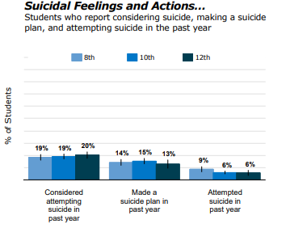
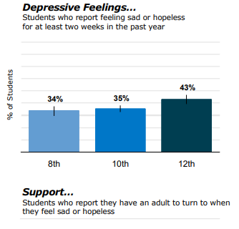
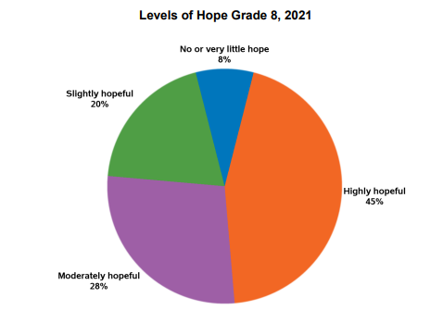

Slide 48
What are the FACTS
F- Feelings
A- Actions
C- Changes
T- Threats
S- Situations
Notes:
Jackie
As a class share group observations about these steps

