Slide 1
District Performance Committee
April 20th, 2022

Slide 2
Welcome
Grab Dinner
Mingle
We will get started shortly

Slide 3
Good Things!

Slide 4
Tonight’s Agenda
Changes to
2022-2023 Calendar
2021- 2022
Calendar Feedback
2023 - 2024 Calendar Next Steps

Slide 5
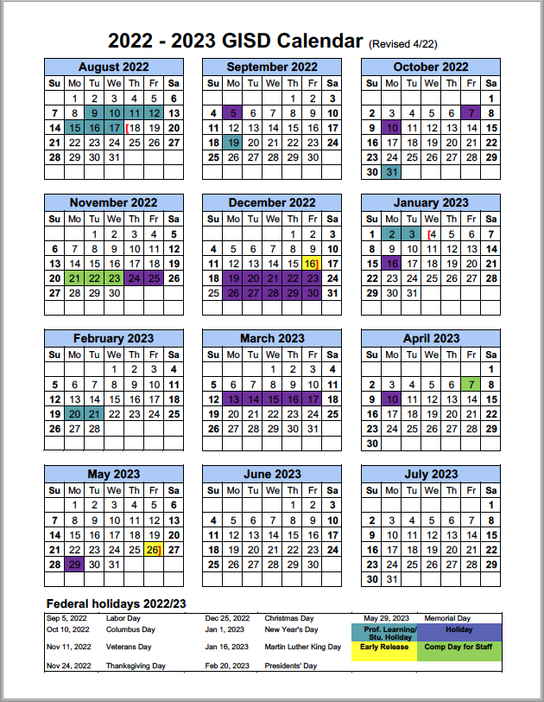
Changes to 22-23 Calendar

Slide 6
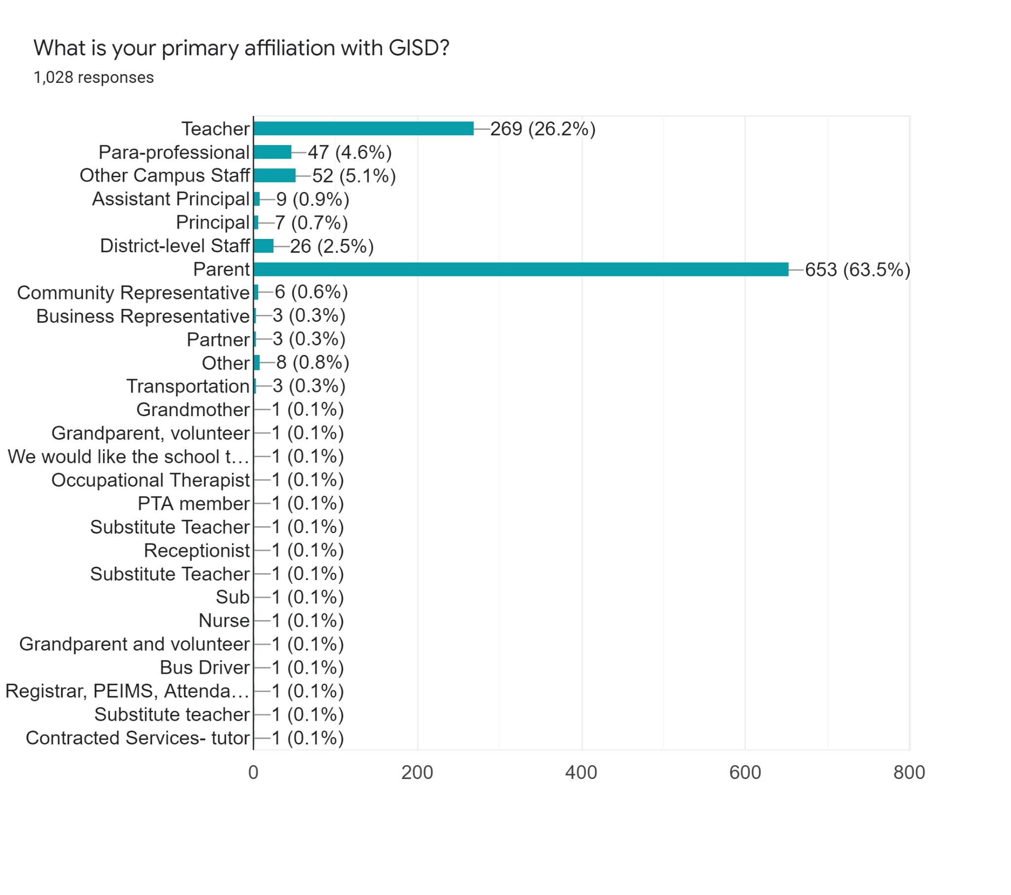
2021-2022 Feedback

Slide 7
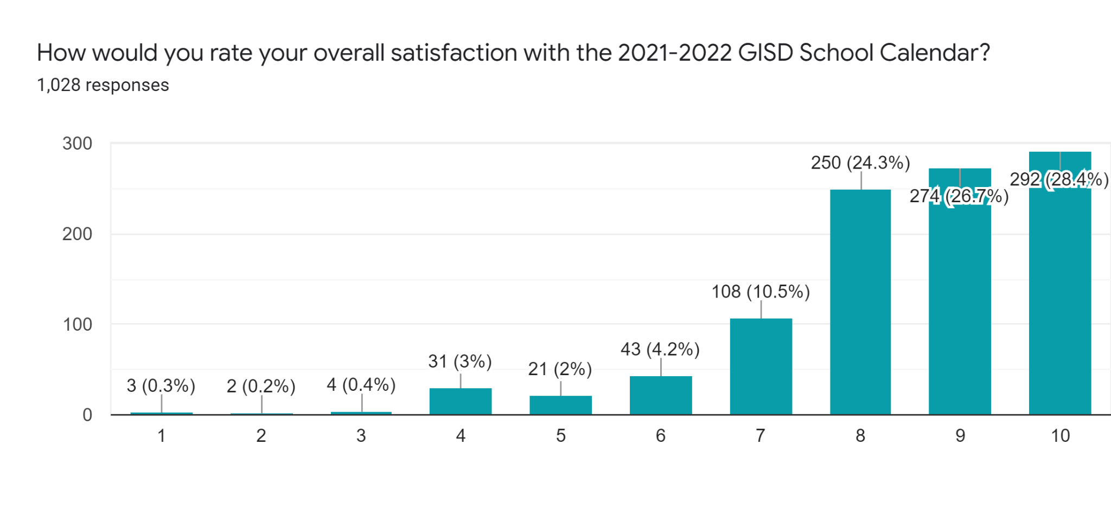

Slide 8
What did you like best about the 20-21 Calendar?
Frequent breaks built in (729)
Thanksgiving break (433)
Winter holiday break (423)
Spring break (394)
End of school date (389)
3 Academic support days built in throughout the year (330)
Balance of semesters (286)
Start date for students (238)
Two February professional learning days (217)
Start date for staff (97)

Slide 9
What did you like least about the 20-21 Calendar?
Start date for students (202)
Start date for staff (182)
Frequent breaks built in (113)
Balance of Semesters (47)
Spring break (29)
Nothing (47)

Slide 10
Quick look at the numbers
 | Responses | Average rating
Teacher | 269 | 8.4
Other campus staff | 112 | 8.5
District Staff | 38 | 8.6
Parent | 599 | 8.4
Other | 13 | 8.4
Total | 1031 | 8.4

Slide 11
Let’s dive in!
Take 20 minutes and review the data provided on your own. Feel free to spread out across the first floor.
Review the parent data and then the staff data separately
Take note of trends and “aha’s”
Notes:
5:20-5:30

Slide 12
Bring it back together
In your table groups, take 15 minutes to discuss trends you see with the staff and parent data.
Notes:
5:20-5:30

Slide 13
Table trends
In your table groups, take 15 minutes to discuss the top priorities you have discovered.
Notes:
5:20-5:30

Slide 14
Table groups will share out the priorities they have discovered.
Notes:
5:20-5:30

Slide 15
Build a calendar that…
AVOIDS…
Keeps or continues…

Slide 16
23-24 Calendar Next Steps

Slide 17
Next Steps
March -April
Gather Feedback
May 4 - Review Options
May 25
Vote on calendar
GISD administers survey to collect feedback on current calendar
DPC reviews options GISD creates from feedback and consults stakeholders
DPC votes on calendar options and sends recommendation to Board

Slide 18
Future Meeting Dates
May 4
May 25
All future meeting will be held at the Hammerlun Center
for Leadership & Learning
From 5:30 - 7:30
(dinner provided)

Slide 19
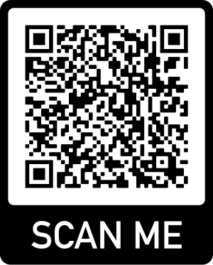
See you next time!
Please take a moment to leave feedback!

