Slide 1
District Performance Council
December 1, 2021, 5:30 pm

Slide 2
Agenda
Welcome & Dinner
Good Things
Review of the District of Innovation Plan
Vote on DOI
Next Meeting Dates & Future Topics
Exit Ticket and Closing

Slide 3
Good Things

Slide 4
District of Innovation Plan
Review the plan
Additions?
Vote on plan

Slide 5
DOI Next Steps
December 13- Final version presented to the Board of Trustees for information (no action) at public meeting of the Board of Trustees.
December 17- Proposed DOI plan posted to the website for 30 days.
January 18-Proposed to the Board of Trustees for vote at public meeting of the Board of Trustees

Slide 6
Future Meeting Dates
All future meetings will be held at the Hammerlun Center for Leadership & Learning from 5:30-7:00 pm (dinner provided)
February 16th
April 13th

Slide 7
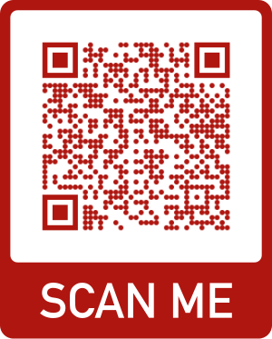
Future Meeting Topics (included but not limited to)
District Improvement Plan
Community Based Accountability
2023- 2024 School Calendar Development

Slide 8
—Someone Famous
‘‘This is a quote, words full of wisdom that someone important said and can make the reader get inspired’’

Slide 9
Table of Contents
01.
02.
03.
04.
Mercury
Venus
Here you can describe the topic of the section
Here you can describe the topic of the section
Saturn
Jupiter
Here you can describe the topic of the section
Here you can describe the topic of the section

Slide 10

01
Wishes
You can enter a subtitle here if you need it

Slide 11
—Someone Popular
“”
‘‘This is a quote, words full of wisdom that someone important said and can make the reader get inspired’’

Slide 12
Whoa!
This can be the part of the presentation where you can introduce yourself, write your email...

Slide 13
You Could Use Three Columns, Why Not?
Mars
Jupiter
Venus
Despite being red, Mars is a cold place. It’s full of iron oxide dust
Jupiter is a gas giant and the biggest planet in the Solar System
It has a beautiful name and is the second planet from the Sun

Slide 14
Special Things in This Season
Mercury
Earth
Mercury is the closest planet to the Sun
Earth is the third planet from the Sun
Neptune
Neptune is the farthest planet from the Sun

Slide 15
What about Four Columns?
Mars
Mercury
Despite being red, Mars is actually a cold place
Mercury is the closest planet to the Sun
Venus
Neptune
Venus has a beautiful name, but it’s terribly hot
Neptune is the farthest planet from the Sun

Slide 16
Some Wishes for This Season
Mercury
Venus
Mars
Saturn
It’s the closest planet to the Sun
Venus is the second planet from the Sun
Despite being red, Mars is a cold place
Saturn is a gas giant and has rings

Slide 17
The Best Reason of the Season
.01
.02
.03
.04
Mercury
Jupiter
It’s the closest planet to the Sun
Jupiter is a gas giant and the biggest
Mars
Saturn
Despite being red, Mars is a cold place
Saturn is a gas giant and has rings

Slide 18
Awesome Words!

Slide 19
Some Awesome Words!

Slide 20
Special Events
Neptune
Venus
It’s the farthest planet from the Sun
Venus is the second planet from the Sun
Saturn
Mars
It’s the ringed one and a gas giant
Despite being red, Mars is a cold place

Slide 21
How to Follow the Winter Season
Step 1
Step 3
Step 5
Mars is a very cold planet
Mercury is the smallest planet
Neptune is the farthest planet
Step 2
Step 4
Venus has a beautiful name
Jupiter is the biggest planet

Slide 22
The Best of the Season Is...
Mercury
Venus
Mercury is the closest planet to the Sun and the smallest one in the Solar System—it’s only a bit larger than the Moon
Venus has a beautiful name and is the second planet from the Sun. It’s terribly hot—even hotter than Mercury

Slide 23
Great Things to Do
.01
.02
Neptune
Earth
Neptune is the farthest planet from the Sun and the fourth-largest one
Earth is the third planet from the Sun and the only one that harbors life

Slide 24
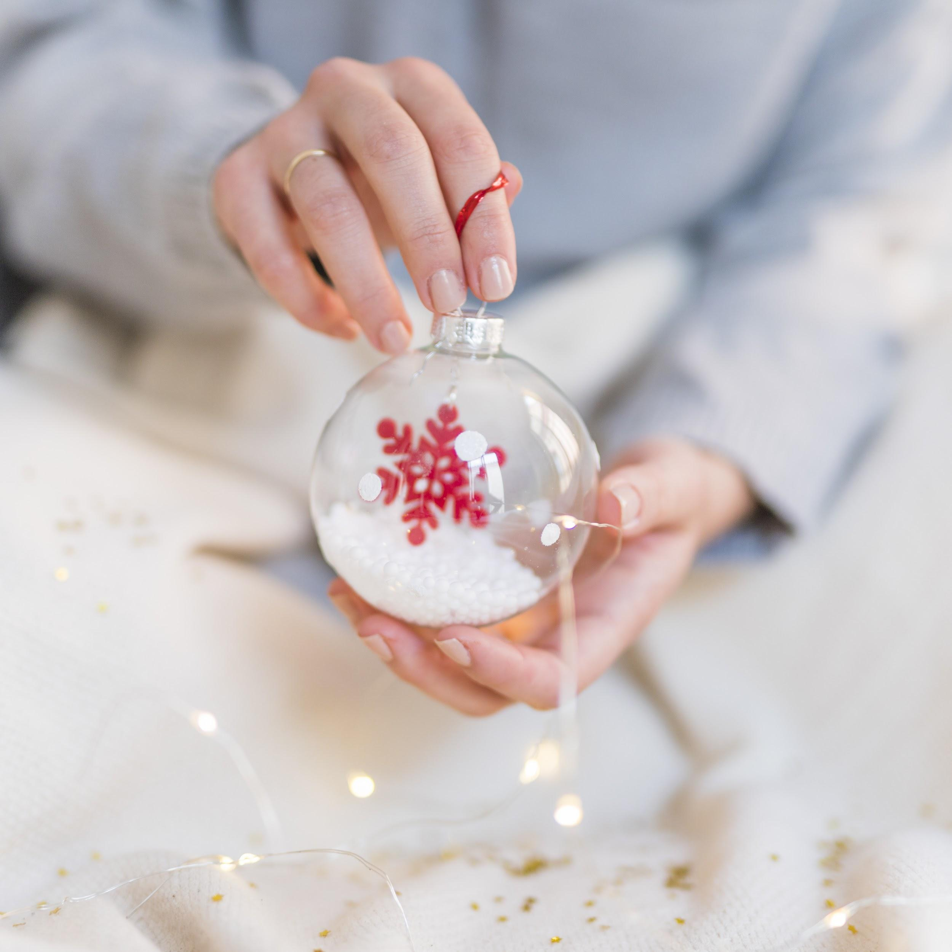
A Picture Always Reinforces the Concept

Slide 25
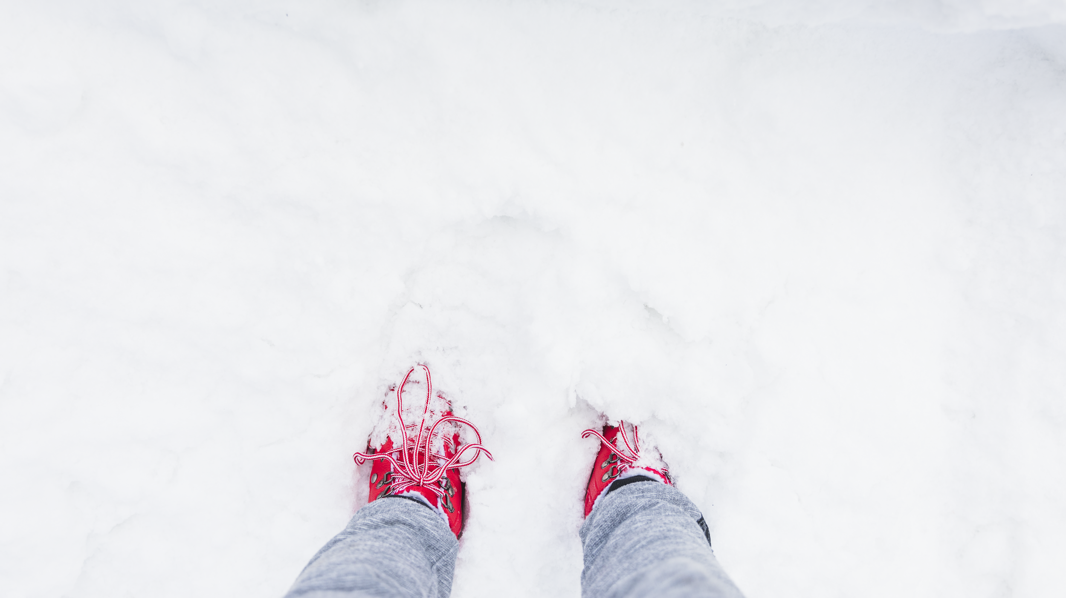
A Picture Is Worth a Thousand Words

Slide 26
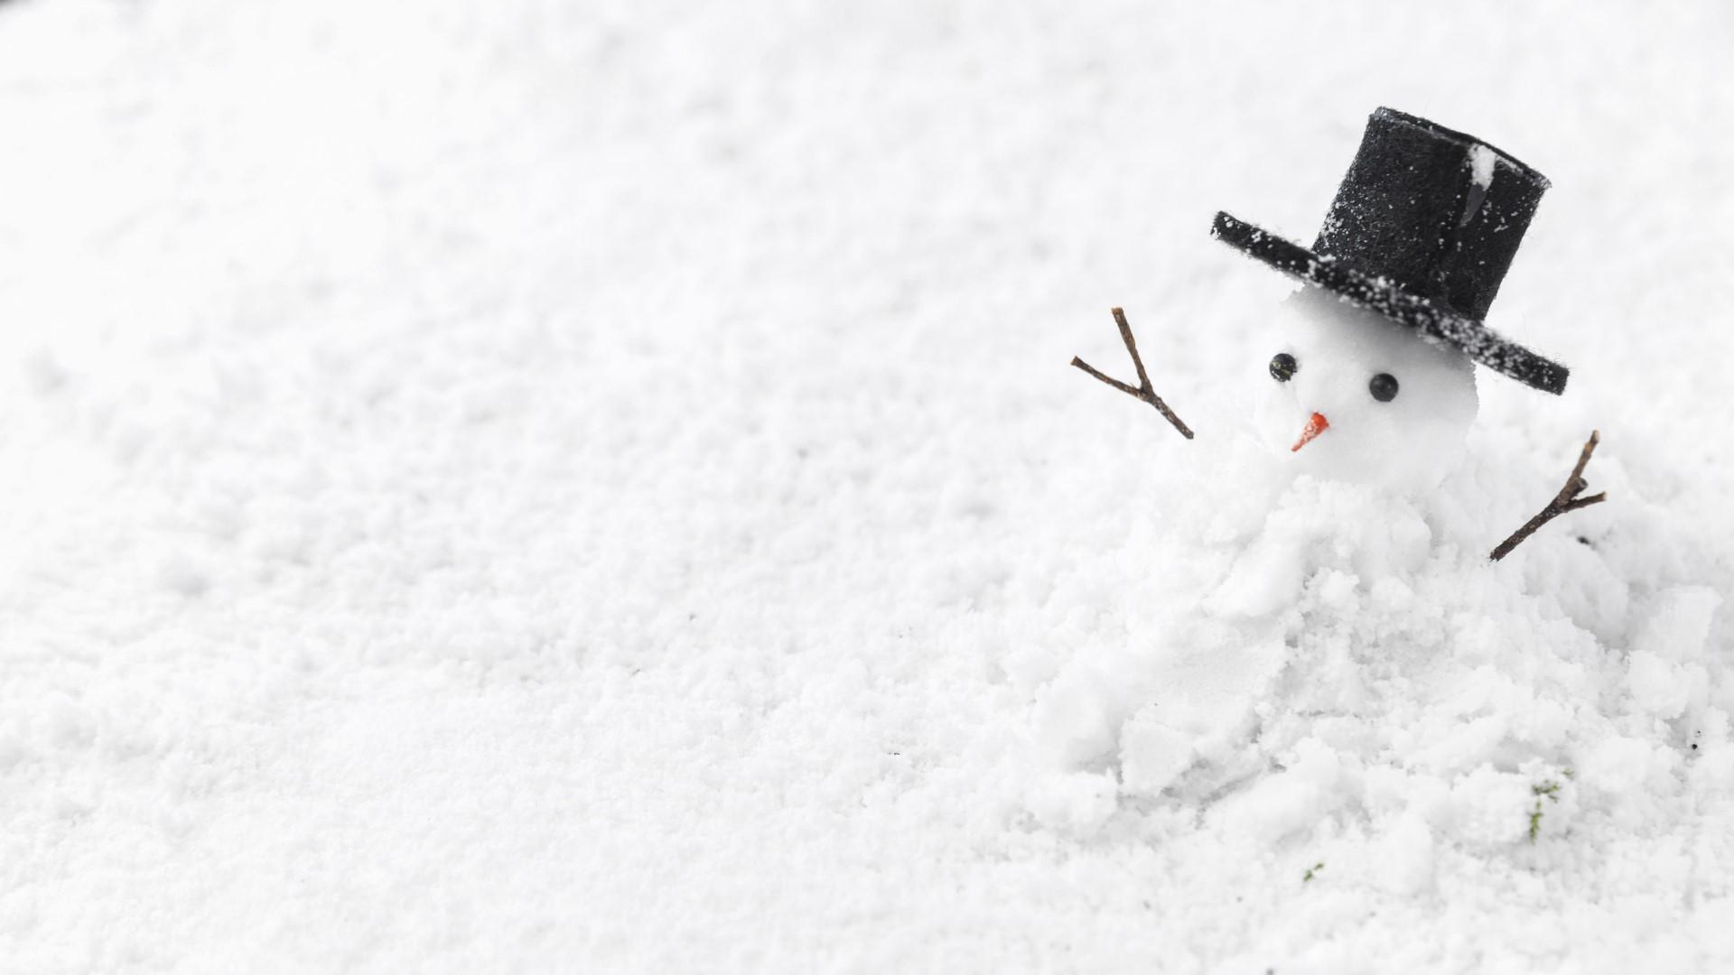
A Picture Is Worth a Thousand Words

Slide 27
This Is a Table
Venus | 2,025 | 6,203 | 6,900 | 7,510
Mars | 1,250 | 4,250 |  | 9,620
Saturn | 3,600 | 1,200 | 3,220 | 5,203
4,410

Slide 28
The Coldest Days in the Month
MON | TUE | WED | THU | FRI | SAT | SUN
01 | 02 | 03 | 04 | 05 | 06 | 07
08 | 09 | 10 | 11 | 12 | 13 | 14
15 | 16 | 17 | 18 | 19 | 20 | 21
22 | 23 | 24 | 25 | 26 | 27 | 28
29 | 30 | 31

Slide 29
A Timeline Always Works Well
2005
2013
2016
2019
Despite being red, Mars is actually a cold place
Venus has a beautiful name, but it’s terribly hot
Mercury is the closest planet to the Sun
Saturn is a gas giant and has several rings

Slide 30
Some Reasons to Celebrate
Neptune
Mars
Venus
Mercury
Neptune is the farthest planet from the Sun
Despite being red, Mars is a really cold place
Venus has a beautiful name, but it’s hot
Mercury is the closest planet to the Sun

Slide 31
Special Gifts
You can enter a subtitle here if you need it

Slide 32
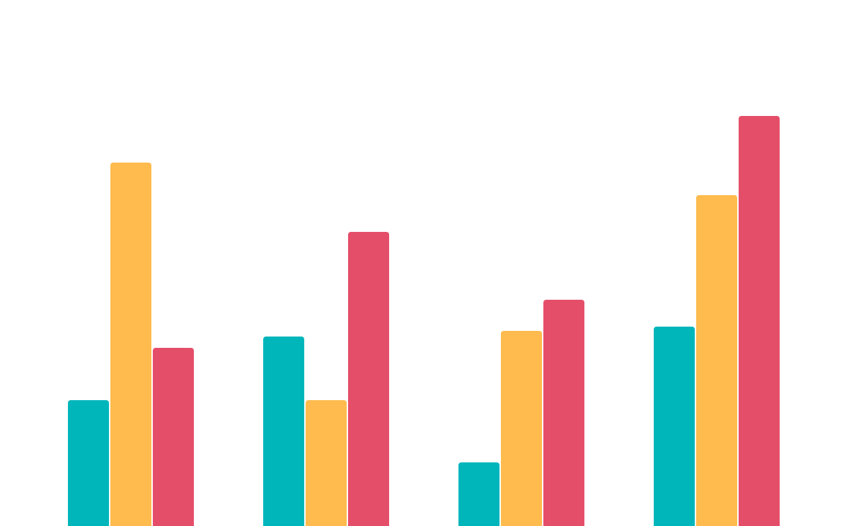
How about a Graph?
Venus
Saturn
Mars
Mercury
Jupiter
Neptune
Earth
To modify this graph, click on it, follow the link, change the data and paste the new graph here

Slide 33
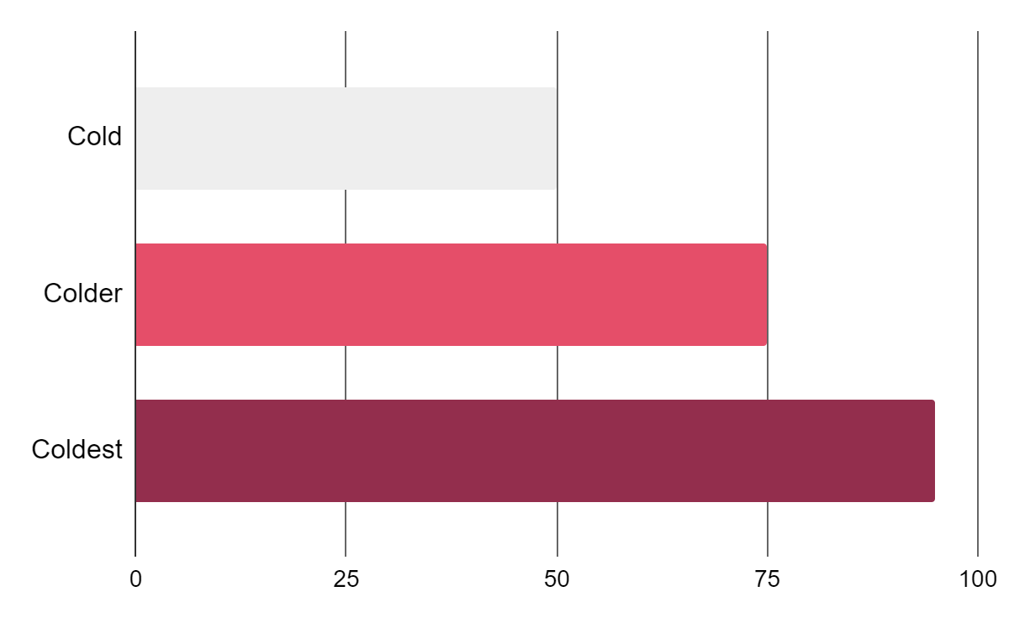
How Is the Weather?
Cold
Earth is the third planet from the Sun
Colder
Venus is the second planet from the Sun
Coldest
Despite being red, Mars is actually a cold place
To modify this graph, click on it, follow the link, change the data and paste the new graph here

Slide 34
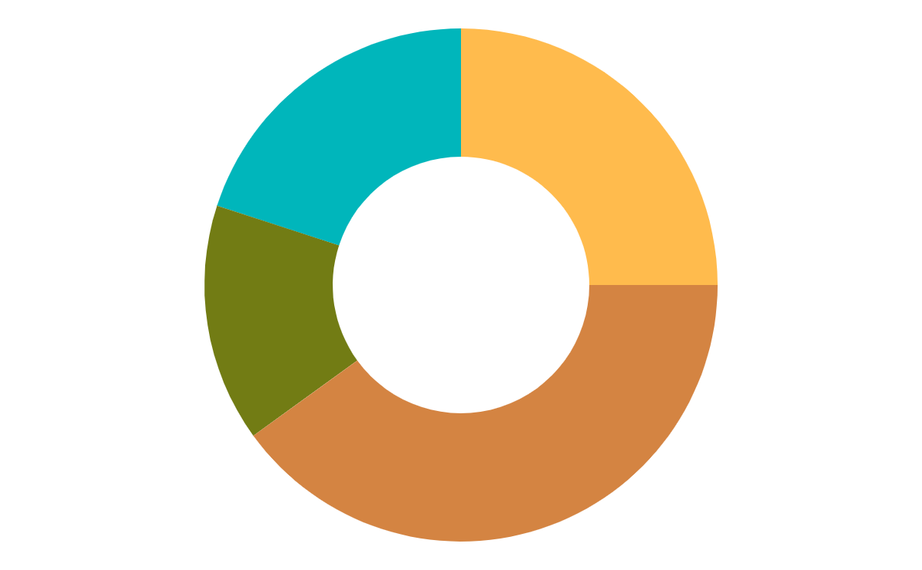
Happiness Levels in Winter
Mercury
Venus
20%
25%
Mercury is the closest planet to the Sun
Venus has a beautiful name, but is hot
Jupiter
Mars
15%
40%
Jupiter is a gas giant and the biggest planet
Despite being red, Mars is a cold place
To modify this graph, click on it, follow the link, change the data and paste the new graph here

Slide 35
Some Special Numbers
You can enter a subtitle here if you need it

Slide 36
Sometimes, Reviewing Concepts Is a Good Idea
Mars
Jupiter
Despite being red, Mars is actually a cold place
It’s the biggest planet in the Solar System
Venus
Saturn
Venus has a beautiful name but it’s terribly hot
Saturn is composed mostly of hydrogen and helium
Mercury
Neptune
Mercury is the smallest planet in the Solar System
It’s the fourth-largest planet in the Solar System

Slide 37
Reviewing Concepts Is a Good Idea
Mercury
Venus
Mars
Mercury is the closest planet to the Sun
Venus has a
beautiful name
Despite being red, Mars is a cold place
Jupiter
Saturn
Neptune
It’s the biggest planet in the Solar System
Saturn is the ringed one and a gas giant
It’s the farthest planet from the Sun

Slide 38
How about These Percentages?
97%
78%
82%
67%
47%
Click and drag to change of the height
Despite being red, Mars is a cold place
Venus has a beautiful name, but it’s really hot
Mercury is the closest planet to the Sun
Neptune is the farthest planet from the Sun

Slide 39
Why to Celebrate Winter
Mars
Despite being red, Mars is a very cold place
Neptune
Neptune is the farthest planet from the Sun
Mercury
Mercury is the closest planet to the Sun
Saturn
Saturn is a gas giant made of hydrogen and helium

Slide 40
Who Celebrates the Season?
30%
20%
Venus
Mercury
Venus has a beautiful name
Mercury is the smallest planet
25%
25%
Earth
Saturn
Earth is where we all live on
Saturn is the ringed planet

Slide 41
Why People Celebrate Winter?
Mars
Despite being red, Mars is a cold place full of iron oxide dust
Venus
Venus has a beautiful name, but also really high temperatures
Jupiter
Jupiter is a gas giant and the biggest planet in the Solar System

Slide 42
Perhaps You Prefer This Table
Venus | 2,025 | 6,203 | 6,900
Mars | 1,250 | 4,250 | 4,410
Saturn | 3,600 | 1,200 | 3,220

Slide 43
List of Upcoming Events
Event | Date | Description
Venus | 00-11-2222 | Venus has a really beautiful name
Mars | 00-11-2222 | Despite being red, is a cold place
Saturn | 00-11-2222 | It’s the ringed one and a gas giant
Mercury | 00-11-2222 | It's the closest planet to the Sun

Slide 44
This Is a Map
Mars
Despite being red, Mars is actually a cold place
Venus
Venus has a beautiful name but it’s terribly hot
Neptune
Neptune is the farthest planet from the Sun

Slide 45
The Coldest Winter Is Here
Neptune
Mars
Neptune is the farthest planet from the Sun
Despite being red, Mars is actually a cold place
Venus
Saturn
Venus is the second planet from the Sun
Saturn is a gas giant and has several rings

Slide 46
Next Holidays
You can enter a subtitle here if you need it

Slide 47
05
Special Thanks
You can enter a subtitle here if you need it

Slide 48
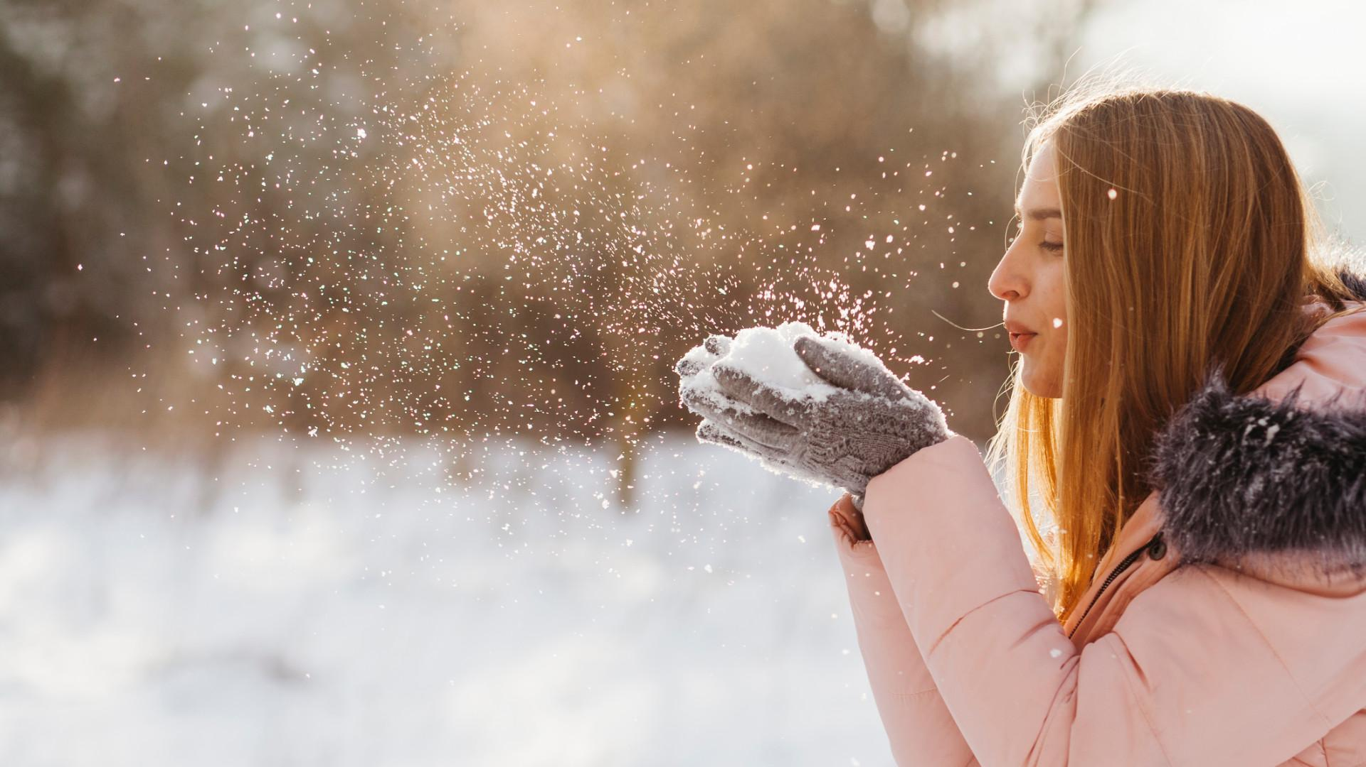
Conclusion
06
You can enter a subtitle here if you need it

Slide 49
4,497,374
Big numbers catch your audience’s attention

Slide 50
333,000.00
9h 37m 23s
386,000 km
earths is the Sun’s mass
is Jupiter’s rotation period
is the distance between Earth and the Moon

Slide 51
2,956,944
Earth is the third planet from the Sun and the only one that harbors life

Slide 52
Some Magical Numbers
75%
50%
25%
10%
Venus
Mars
Saturn
Mercury
Venus has a beautiful name
Despite being red, Mars is cold
It’s the ringed one and a gas giant
Mercury is the smallest planet

Slide 53
Our Services
Basic
Pro
Premium
You can explain your product or your service
Characteristic
Characteristic
You can explain your product or your service
Characteristic
Characteristic
You can explain your product or your service
Characteristic
Characteristic
$35
$60
$85

Slide 54
Some Special Things from This Season
Saturn
Neptune
Mars
Saturn is the ringed one. It’s a gas giant
Neptune is the farthest planet from the Sun
Despite being red, Mars is actually a cold place

Slide 55
Our Team
Jenna Doe
You can replace the image on the screen with your own
John Doe
You can replace the image on the screen with your own

Slide 56
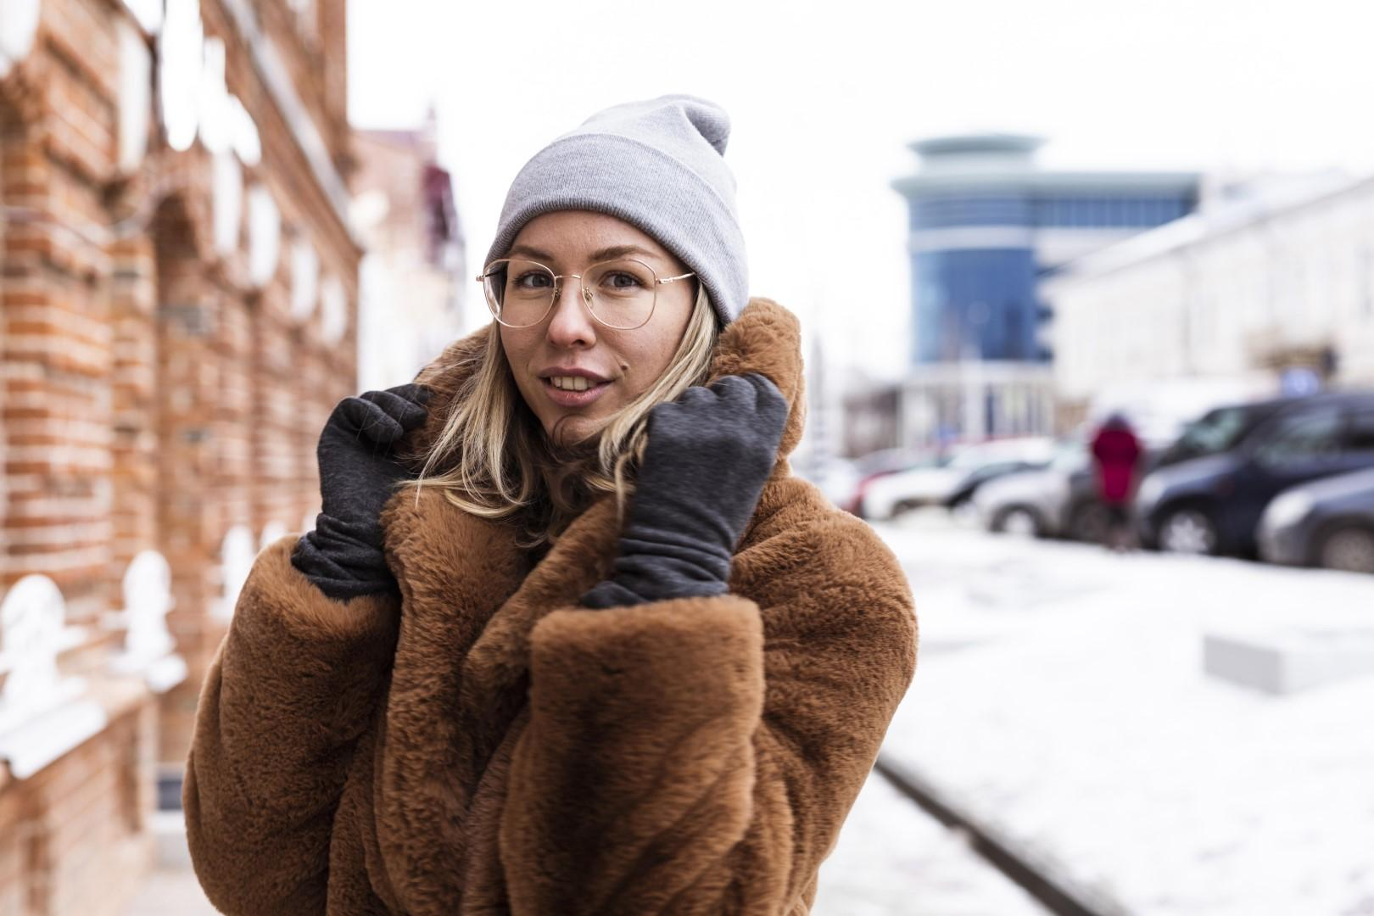


The Best Wishes to...
Jen Han
John Kenec
Marian Paul
You can replace the image on the screen with your own
You can replace the image on the screen with your own
You can replace the image on the screen with your own

Slide 57
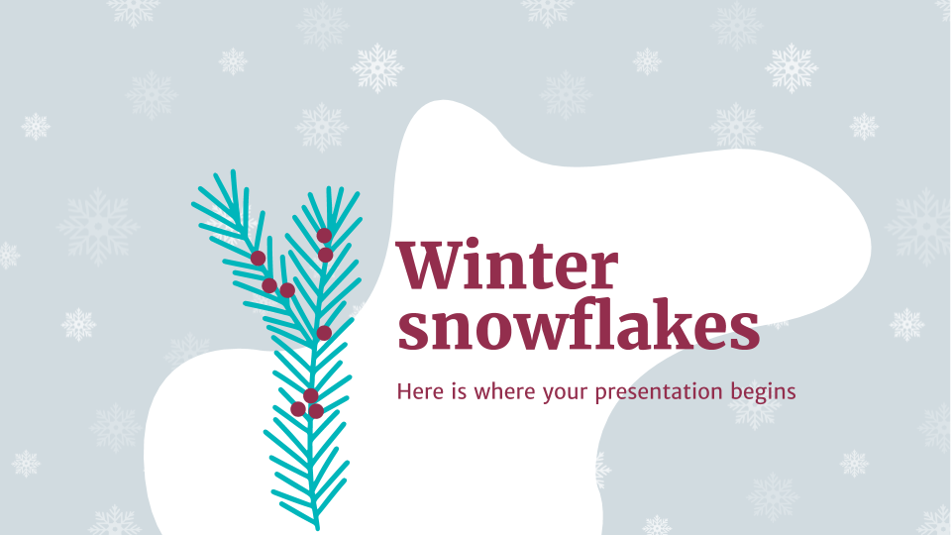
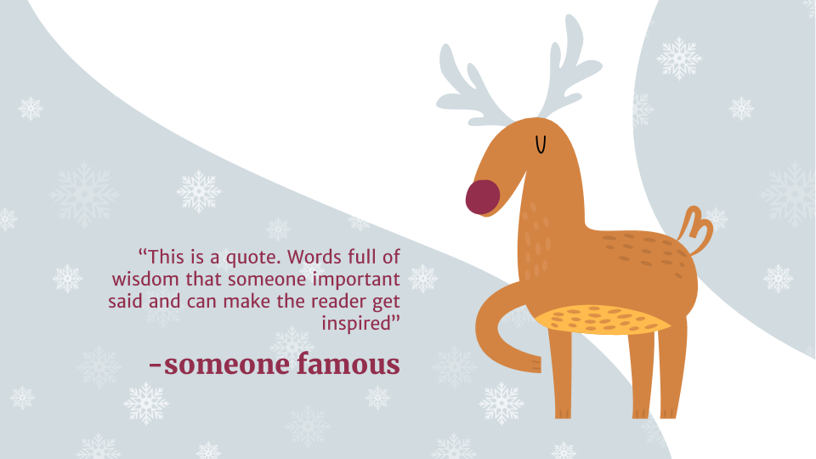
Desktop
Software
You can replace the images in the screens with your own work. Just delete these ones, add yours and center them

Slide 58
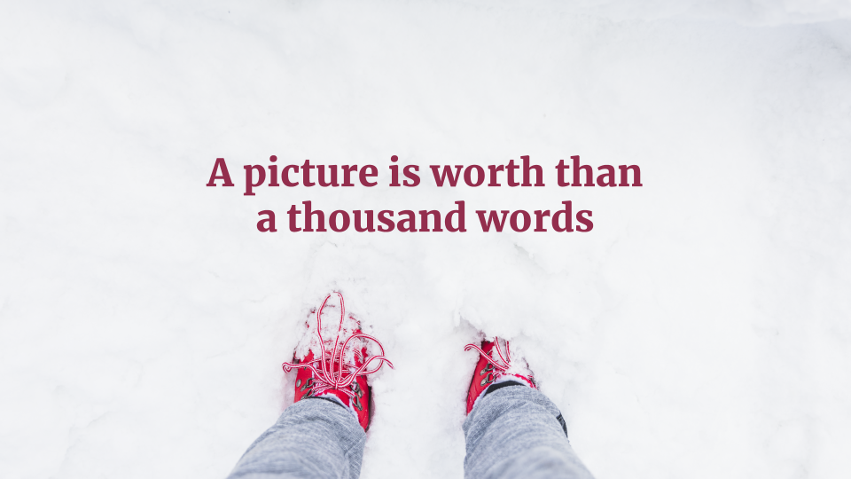
Tablet App
You can replace the images in the screens with your own work. Just delete these ones, add yours and center them properly

Slide 59
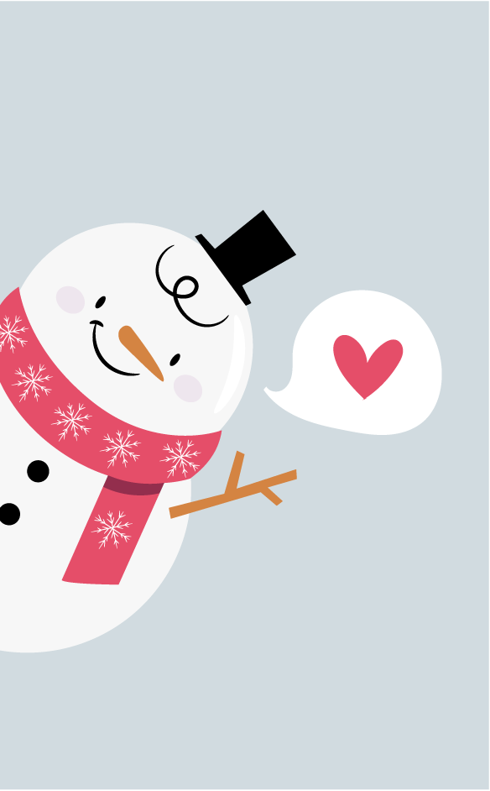

Mobile Web
You can replace the images in the screens with your own work. Just delete these ones, add yours and center them

Slide 60
Video Footage
Mercury is the closest planet to the Sun and the smallest one in the Solar System—it’s only a bit larger than the Moon, just by a bit
Insert your multimedia content here

Slide 61
Thanks!
Do you have any questions?
youremail@freepik.com
+91 620 421 838
yourcompany.com
Please keep this slide for attribution

Slide 62
Alternative Resources

Slide 63
Premium Icon Pack

Slide 64
Premium Resources

Slide 65
Premium Resources

Slide 66
Premium Resources

Slide 67
Resources
Vectors
Snow cap pack flat style
Hand drawn christmas element collection
Hand drawn christmas element collection
Hand drawn christmas element collection
Hand drawn christmas element collection
Peeping out christmas characters background
Watercolor winter landscape with trees
Cloud computing infographic
Christmas element collection flat design
Photos
Woman holding big bauble hand
Person legs snow

Slide 68
Premium Resources
Vector
Hand drawn christmas background
Hand drawn christmas elements collection
Autumn card with organic shapes
Collection of christmas infographics
Collection of christmas infographics
Collection of christmas infographics
Collection of christmas infographics
Photo
Close-up view of snowman concept
Woman blowing snow from hands
Smiley man using his smartphone at home
Medium shot woman with backpack
Medium shot woman posing outdoors
Icon
Christmas Icon Pack

Slide 69
Fonts & colors used
This presentation has been made using the following fonts:
Merriweather
(https://fonts.google.com/specimen/Merriweather)
Merriweather Sans
(https://fonts.google.com/specimen/Merriweather+Sans)
#d1dbe0
#932e4d
#e54e69
#00b6bb
#ffbb4d
#727c14
#d48442

Slide 70

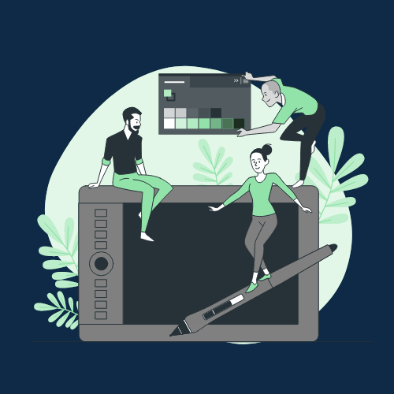



Storyset
Create your Story with our illustrated concepts. Choose the style you like the most, edit its colors, pick the background and layers you want to show and bring them to life with the animator panel! It will boost your presentation. Check out How it Works.
Pana
Amico
Bro
Rafiki
Cuate

Slide 71
Use our editable graphic resources...
You can easily resize these resources without losing quality. To change the color, just ungroup the resource and click on the object you want to change. Then, click on the paint bucket and select the color you want. Group the resource again when you’re done. You can also look for more infographics on Slidesgo.

Slide 74
JANUARY
FEBRUARY
MARCH
APRIL
MAY
JUNE
PHASE 1
Task 1
Task 2
PHASE 2
Task 1
Task 2
JANUARY
FEBRUARY
MARCH
APRIL
PHASE 1
Task 1
Task 2

Slide 77
...and our sets of editable icons
You can resize these icons without losing quality.
You can change the stroke and fill color; just select the icon and click on the paint bucket/pen.
In Google Slides, you can also use Flaticon’s extension, allowing you to customize and add even more icons.

Slide 78
Educational Icons
Medical Icons

Slide 79
Business Icons
Teamwork Icons

Slide 80
Help & Support Icons
Avatar Icons

Slide 81
Creative Process Icons
Performing Arts Icons

Slide 82
Nature Icons

Slide 83
SEO & Marketing Icons

Slide 84


