Slide 1

District Performance Committee
Feb 16, 2022

Slide 2
Welcome
-Grab dinner
-Mingle
-We will get started shortly

Slide 3
Good Things

Slide 4
01
02
District of Innovation
Calendar 23-24
03
04
Calendar 22-23
Conclusion
Take a walk back through the DOI process and current status
Begin process of building calendar for School Year 23-24
Examine new circumstances affecting School Calendar 22-23
Wrap up, next meeting, & exit ticket

Slide 5
DISTRICT of INNOVATION
01
Recap, next steps & questions

Slide 6
2023-2024
CALENDAR DEVELOPMENT
02
Process and timelines

Slide 7
Feb-March
March
Gather Feedback
Consider Feedback
April
May
Review options
Vote on Calendar
GISD administer survey to collect feedback on current calendar
DPC to review feedback and highlight priorities
DPC reviews options GISD creates from feedback and consults stakeholders
DPC Votes on calendar options to send recommendation to Board of Trustees

Slide 8
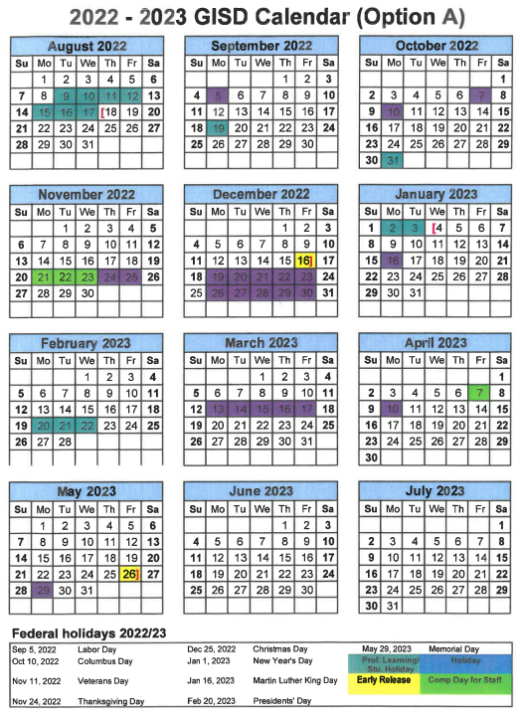
03
2022-2023
CALENDAR
Examine new circumstances affecting School Calendar 22-23

Slide 9
FUTURE MEETING DATES
March 23
April 13th
Early May ??
All future meetings will be held at the Hammerlun Center for Leadership & Learning from 5:30 - 7:00 pm
(dinner provided)

Slide 10
FUTURE MEETING TOPICS
MAY
-calendar vote
MARCH
-calendar feedback
-DIP review
APRIL
-calendar options
-CBAS
(included but not limited to)

Slide 11

See you next time!
Please take a moment to leave feedback!

