Slide 1
District Performance Committee
April 26th, 2023

Slide 2
Agenda
Welcome & Appetizers
Good Things
Calendar Development Update
GISD Strategic Direction
Accountability Update
Future Meetings
Feedback Form

Slide 3
Good Things +
GISD Updates
Notes:
Board search firm
Spring Break 2024 - no change

Slide 4
24-25 calendar development
Feasibility study on 4 day school week
  Costs, benefits, logistics, community impacts, etc…
Legislative impacts + timeline
3-4 meetings beginning in May, ending Sept/Oct.

Slide 5
24-25 calendar development
In the meetings we will
  Get on the same page about our work (why and what)
  Understand rules of the game (laws and such)
  Explore what others in TX are doing (and beyond TX)
  Consider how and what other input we gather
  Build calendar ideas for a 4 day school week

Slide 6
GISD Strategic Direction

Slide 7

The Process
Gathering Input
  Discovery Committee [October 2022] - 80 participants
    Included students, staff, parents and community members
  Extended Discovery Focus Groups [November 2022] - 225 participants
    Included students, staff, parents and community members
  Survey [December 2022] - 871 respondents
    Included staff, parents and community members
Analyzing Input [January 2023]
Reflecting on Prior Strategic Plans + Current Needs [January 2023]
Creating Draft Strategic Priorities + Draft Pictures of Success [January 2023]

Slide 8

Continued process…
Met with the District Leadership Team [Principals, Directors, Executive Directors]
  Processed the Extended Discovery Committee + Survey Data Summaries
  Discussed Relationship between Strategic Direction and District/Campus Improvement Planning + Monitoring Progress
  Reviewed + Reacted to the Draft Strategic Priority Areas + Pictures of Success
  Shared a Timeline for Spring and Summer Work
Revised the Pictures of Success to Reflect Feedback
Shared at State of the District
  The “Why”
  The Process
  The Drafts
  The Relationships to District/Campus Improvement Plans + Monitoring Progress

Slide 9
Strategic Direction:
Strategic Priority Areas
Pictures of Success
Objectives

Slide 10
Four Strategic Priority Areas
Student Learning, Growth and Progress
Student and Staff Well-Being
Staff Recruitment and Retention
Community and Connectivity

Slide 11
Student Learning, Growth, and Progress
Georgetown ISD students engage in challenging, inquiry-based, personalized learning experiences that result in their becoming competent, confident, independent learners. Students find meaning and value in the work provided – work that results in all students learning what’s expected. Instruction, assessment, and intervention are aligned in support of student learning and growth. Learning progress is reflected in a way that makes it possible for all to understand the degree to which students are mastering content, meeting standards, and developing attributes in the GISD Learner Profile.
Resources are provided to support students’ varying abilities and interests, and to help them develop habits of lifelong learners. Students think about and plan for their future and are prepared for postsecondary education and the workforce.
Notes:
Terri

Slide 12
Student and Staff Well-Being
Georgetown ISD’s students want to come to school. They are treated with respect and are respectful to each other and to adults. Students feel Georgetown schools and classrooms are physically and psychologically safe places where fear of harm, harassment or demeaning comments is negligible. Caring adults advocate for students and help them make healthy, safe choices. GISD students have access to guidance, mental health support, and resources. Students participate in extracurricular activities and academic support opportunities. Student growth in their adaptability, perseverance, and personal responsibility is evident.
GISD’s employees find meaning and value in their work. Staff feel physically and psychologically safe and have the resources they need to succeed in their role. Georgetown ISD employees feel connected to their colleagues, their district, and their community, and resources exist to support staff wellness.
Notes:
Lannon

Slide 13
Staff Recruitment and Retention
Georgetown ISD actively recruits, attracts, and retains employees who embrace the organization's vision, mission, beliefs, and norms. A culture of engagement and continuous professional growth exists that includes peer connection, support, and collaboration. The district offers an attractive, inviting, and safe work environment as well as competitive compensation and benefits.
Recruitment and induction systems are utilized to attract, support, and retain new and existing employees. Induction takes place over time; however, initial orientation and induction experiences are focused on developing an understanding of, and appreciation for, the core business of the district. Professional learning experiences engage adult learners and include opportunities for staff to collaborate with and learn from colleagues. Professional learning communities thrive throughout the organization.
Notes:
wes

Slide 14
Community and Connectivity
Georgetown ISD staff and school board trustees serve as community leaders who establish effective relationships with parents and other key leaders in the community in support of students and schools. Parents and community members feel welcome and invited in our schools and are advocates for the district’s needs. As our community experiences growth and change, the district fosters cohesiveness through strategically aligned partnerships. The district is responsive to its community, adaptable to changing needs, and transparent with reporting progress and providing access to information.
Notes:
Lindsay

Slide 15
Student Learning, Growth, and Progress
GISD students engage in challenging, inquiry-based, personalized learning experiences.
GISD students become competent, confident, independent learners.
GISD students find meaning and value in the work provided to them.
GISD students demonstrate excellence in the state’s academic standards and the GISD learner profile attributes.
In GISD, instruction, assessment, and intervention are aligned.
GISD learners’ progress is reflected in a way that makes it easily understood to all audiences.
In GISD, we monitor progress toward students’ mastery of the content, meeting standards, and developing attributes in the Learner Profile.
GISD provides resources to support students of varying abilities and interests.
GISD students develop habits of lifelong learners.
GISD students think about and plan for their future.
GISD students are prepared for postsecondary education and the workforce.
Objectives

Slide 16
Student and Staff Well-Being
Georgetown ISD’s students want to come to school.
GISD students are treated with respect and are respectful to each other and to adults.
Students feel GISD schools and classrooms are physically and psychologically safe.
GISD students have negligible fear of harm, harassment, or demeaning comments occurring in Georgetown schools and classrooms.
In GISD, caring adults advocate for students and help them make safe, healthy choices.
GISD students have access to guidance and mental health support and resources.
In GISD, students participate in extracurricular activities and academic support opportunities.
GISD students’ growth in adaptability, perseverance, and personal responsibility is evident.
GISD employees find meaning and value in their work.
GISD staff feel physically and psychologically safe at work.
GISD staff have the resources they need in order to be successful in their role.
GISD employees feel connected to their colleagues, their district, and the community.
In GISD, resources exist to support staff wellness.
Objectives

Slide 17
Staff Recruitment and Retention
Georgetown ISD actively recruits, attracts, and retains employees who embrace the vision, mission, beliefs, and norms of the organization.
A culture of engagement and continuous professional growth exists in GISD.
Peer connection, support, and collaboration are part of the culture in GISD.
GISD offers an attractive, inviting, and safe work environment.
Georgetown ISD provides competitive compensation and benefits to employees.
In GISD, recruitment and induction systems are utilized to attract, support, and retain new and existing employees.
In GISD, induction experiences are focused on developing an understanding of and appreciation for the core business of the district.
GISD’s professional learning experiences are engaging to adult learners.
GISD’s professional learning experiences include collaboration with and an opportunity to learn from colleagues.
In GISD, professional learning communities thrive across the organization.
Objectives

Slide 18
Community and Connectivity
GISD staff and school board trustees serve as community leaders.
GISD staff and school board trustees establish effective relationships with parents and other key community leaders in support of students and schools.
Parents and community members feel welcome and invited in GISD schools.
Parents and community members are advocates for the needs of Georgetown ISD.
GISD fosters a sense of cohesiveness through strategically aligned partnerships.
GISD is responsive to its community.
GISD is adaptable to changing needs.
GISD is transparent with reporting progress and providing access to information.
Objectives

Slide 19
Student Learning, Growth, and Progress
An Example:
GISD students engage in challenging, inquiry-based, personalized learning experiences.
GISD students become competent, confident, independent learners.
GISD students find meaning and value in the work provided to them.
GISD students demonstrate excellence in the state’s academic standards and the GISD learner profile attributes.
In GISD, instruction, assessment, and intervention are aligned.
GISD learners’ progress is reflected in a way that makes it easily understood to all audiences.
In GISD, we monitor progress toward students’ mastery of the content, meeting standards, and developing attributes in the Learner Profile.
GISD provides resources to support students of varying abilities and interests.
GISD students develop habits of lifelong learners.
GISD students think about and plan for their future.
GISD students are prepared for postsecondary education and the workforce.

Slide 20
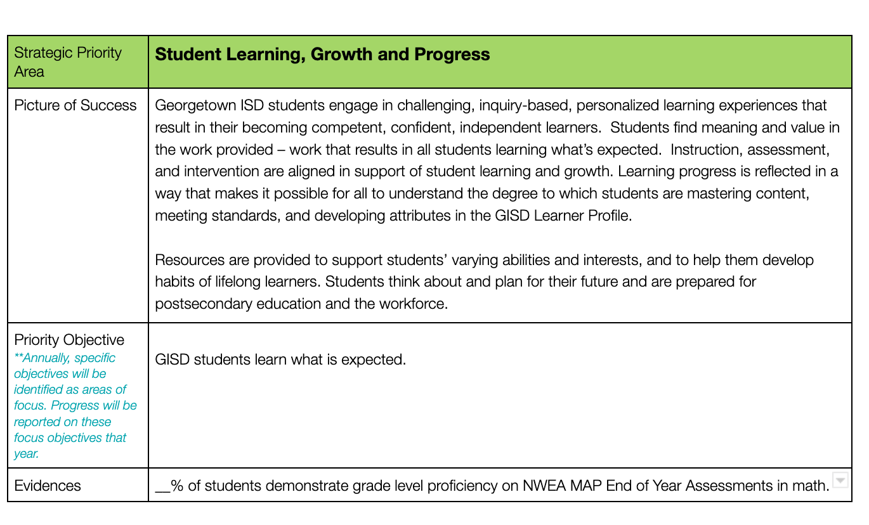

An Example - With Hypothetical Evidences + Actions
Strategic Direction
GISD students demonstrate excellence in the state’s academic standards and the GISD learner profile attributes.
District + Campus Improvement Plans

Slide 21
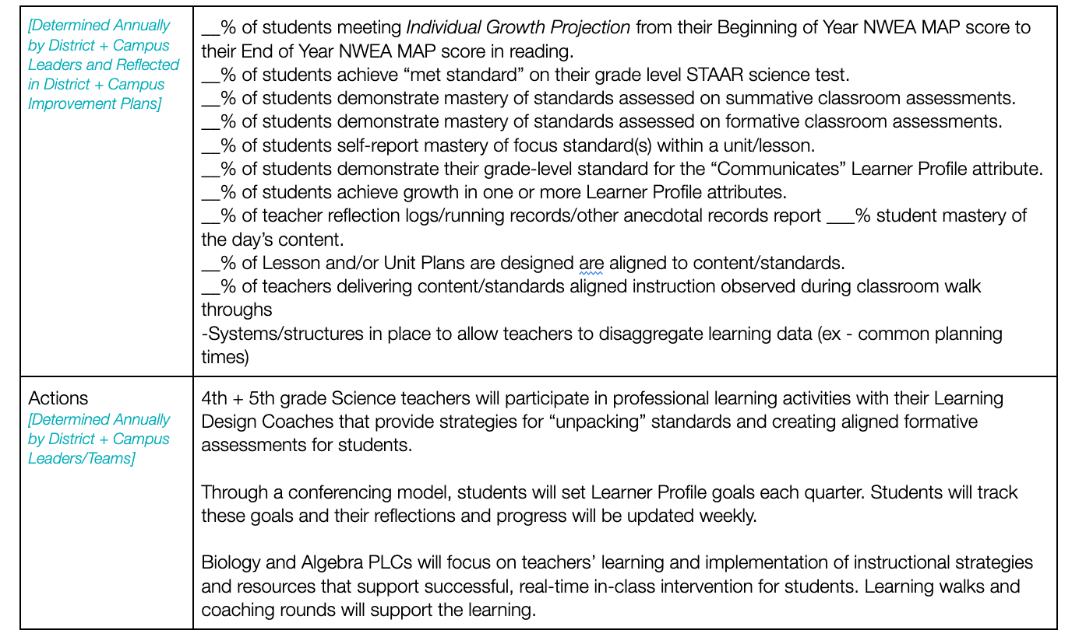
An Example - With Hypothetical Evidences + Actions
District + Campus Improvement Plans

Slide 22
Community and Connectivity
GISD staff and school board trustees serve as community leaders.
GISD staff and school board trustees establish effective relationships with parents and other key community leaders in support of students and schools.
Parents and community members feel welcome and invited in GISD schools.
Parents and community members are advocates for the needs of Georgetown ISD.
GISD fosters a sense of cohesiveness through strategically aligned partnerships.
GISD is responsive to its community.
GISD is adaptable to changing needs.
GISD is transparent with reporting progress and providing access to information.
An Example:

Slide 23
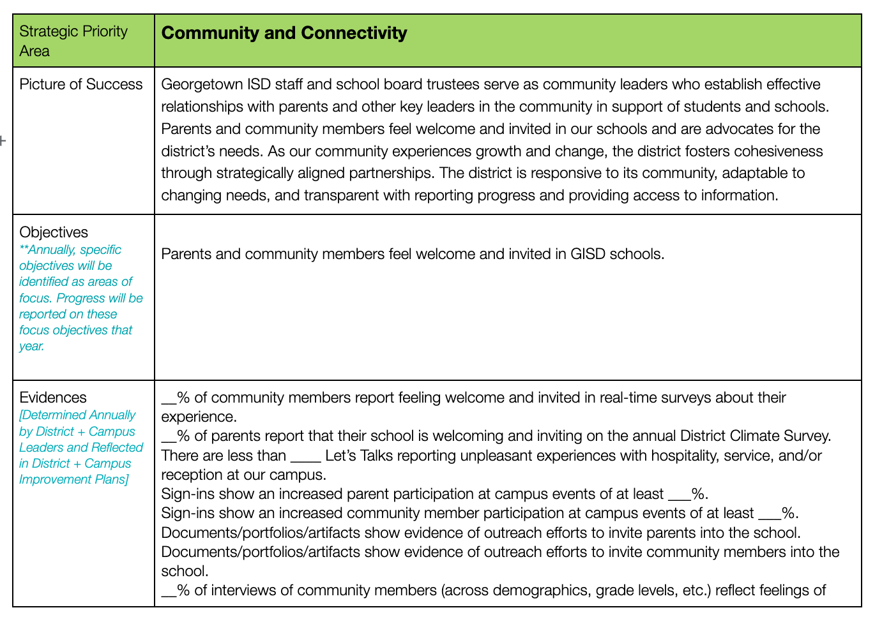

An Example - With Hypothetical Evidences + Actions
Strategic Direction
District + Campus Improvement Plans

Slide 24
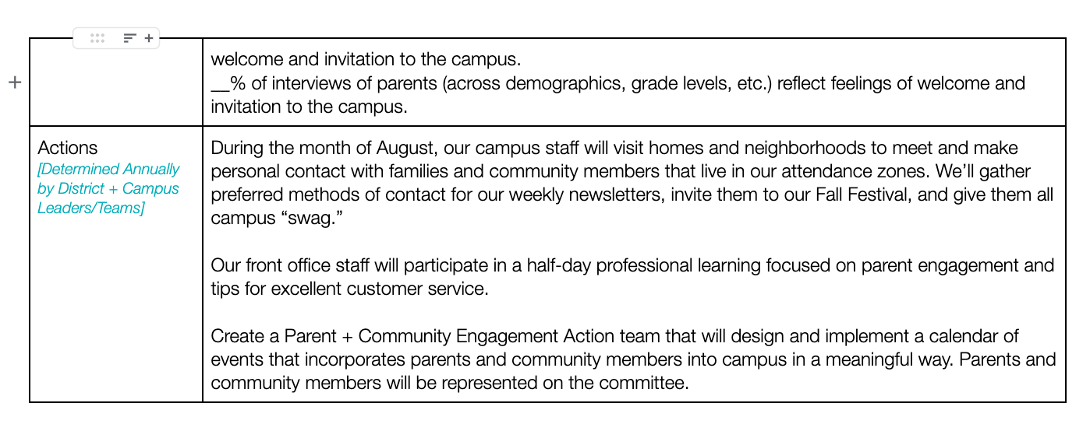
An Example - With Hypothetical Evidences + Actions
District + Campus Improvement Plans

Slide 25
Accountability System Update 2023

Slide 26
What we are going to cover
Why the change + current discussions around the state
3 coming changes (current vs adjusted + impact)
  Timeline of data release and accountability ratings
  The STAAR 2.0
  Actual accountability measurements and scaling
Questions and wonders
Next steps

Slide 27
Why the changes?
2017 Statute intends for Texas to be a national leader in education…
Legislative commitment to not change accountability system for 5 years…
Stated in recent webinar from TEA with regards to CCMR: Approximately 75% of schools were an A in CCMR, “the target was no longer rigorous.”
  There have been adjustments during this time as well
School districts are organizing to request for reconsiderations adjustments to CCMR.

Slide 28
Historical Look at the Texas A-F Accountability Rating System
2017-18 A-F Accountability ratings for districts only
2018-19 A-F Accountability ratings for campuses and districts
2019-20 All districts and campuses rated Not Rated - Declared State of Disaster (COVID- no STAAR administered)
2020-21 All districts and campuses rated Not Rated - Declared State of Disaster (COVID)
2021-22 Ratings of A, B, C, or Not Rated. Any domain or overall score
less than 70 will receive the label: Not Rated
Coming soon! Almost here!
2022-23 A-F Accountability 2.0
Framework to be released Fall ‘22 + Jan ‘23 + Summer ‘23

Slide 29
Timeline of accountability work
May: Campus and District What-if Reports
May 22: 3-8 and EOC Early Raw Scores reported
May 31: EOC results released
Late Summer: Final 2023 Accountability Manual published
August 11: Grades 3-8 STAAR results released
September: A-F Accountability released
Notes:
Important to note that final EOC results will be after the school year has ended (possible impact on graduation)
TEA has provided charts to be used with the raw score results we receive on May 22 ( see next slide)
Changes to accountability will not be official until publication of the final Accountability Manual
Not having STAAR scores this summer gives us the opportunity to focus on things other than STAAR as we prepare for 23-24

Slide 30
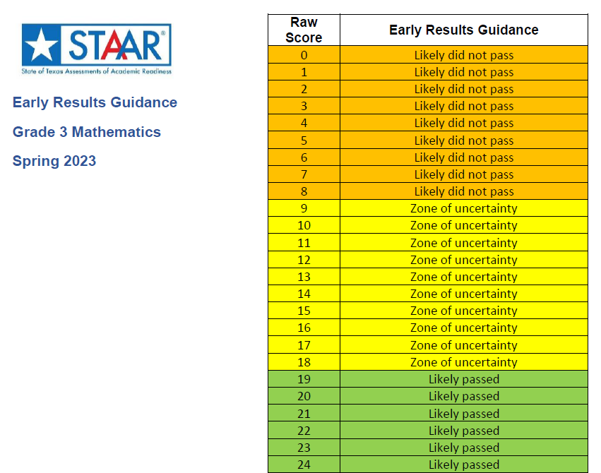
Notes:
These tables have been released for all 2023 STAAR tests and can be used with the release of raw scores on May 22.

Slide 31
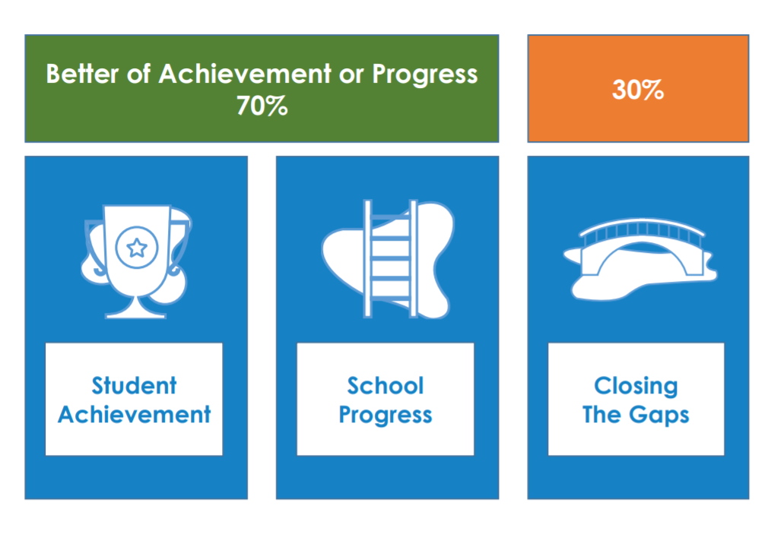
Current System
Domain 1
Domain 2 A & B
Domain 3
Notes:
There are no changes to the overall calculation of A-F. This chart doesn’t show that School Progress is the best of 2A (Growth) or 2B (Relative Performance). That is shown on the next slide though.

Slide 32
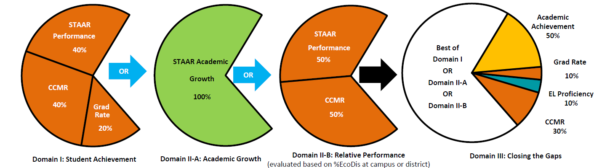
Overall District Calculation 2018-2022
https://lead4ward.com/
Notes:
The previous methodology for computing district ratings was identical to how high school campuses were computed.
Rationale: Calculating district ratings proportionately using the outcomes of the campuses they serve increases the alignment of district and campus ratings.

Slide 33
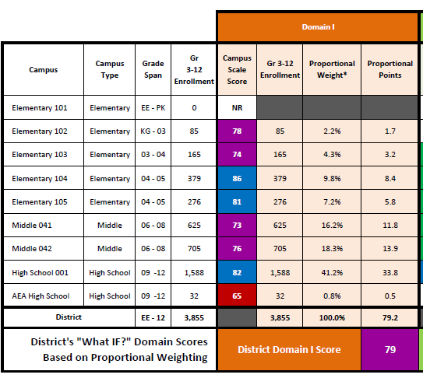
Overall District Calculation 2023
The domain scores for each campus contribute proportionally to the district score, based on campus enrollment
https://lead4ward.com/
Notes:
This is a sample data chart showing the proportional weight of each campus based on Gr 3-12 enrollment and how each campus contributes to the overall district rating. A score is computed for each domain and the same methodology is used to determine overall rating as before (70% is best of D1, D2A or D2B and 30% is D3)

Slide 34
Domain 1: Student Achievement
Elementary and Middle Schools
STAAR Performance
  All STAAR subjects and grade levels evaluated
  Credit awarded for Approaches, Meets and Masters Grade Level
No changes for 2023
High Schools
STAAR Performance
  All STAAR subjects evaluated
  Credit awarded for Approaches, Meets and Masters Grade Level
  No changes for 2023
College, Career and Military Readiness (CCMR)
  Major scaling changes for 2023
Graduation Rate
  Scaling changes for 2023
Notes:
This is a comparison of what is calculated for Domain 1. This is no different from previous accountability system, but some of the calculations have changed

Slide 35
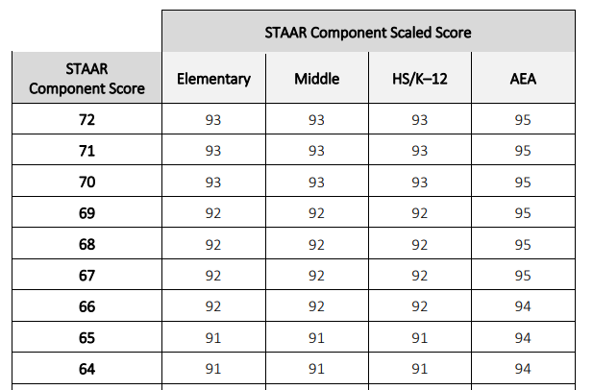
What is scaling?
In order to align letter grades and scores used in accountability to the common conception of letter grades, raw domain and component scores are adjusted or “scaled.”
Notes:
This slide explains what scaling is and why it’s done. The sample chart shows scaled scores for the STAAR performance component (% approaches + % meets +% masters divided by 3) just to provide context around the scaling process. The highlighted row is just to show an example

Slide 36
Domain 1: CCMR
Changes for 2023: Scaling
Domain 1: Student Achievement CCMR Component Score Cut Points
Rating | 2018 | 2019 | 2021 | 2022 | 2023
A | 60 | 60 | 60 | 60 | 88
B | 53 | 53 | 53 | 53 | 78
C | 39 | 39 | 39 | 39 | 64
D | 29 | 29 | 29 | 29 | 51
“Initial estimates show over 630 high school campuses out of the nearly 1,600 campuses rated will drop one to two letter grades based on this technical change. Commissioner Morath indicated it is possible schools will see improved student performance but still receive a lower A-F rating under these proposed changes.”
Notes:
This chart shows the cut points for scale scores in the CCMR component of Domain 1. Note that this has not changed since 2018. Also, this is 40% of the Domain 1 score.
Rationale: There has been rapid improvement in CCM readiness for Texas graduates over the past five years. Given class of 2021 CCMR rates averaged 65 percent, the agency will use 65 percent as a baseline for a mid-C moving forward. The agency plans to set a cut score of 88 percent for an A in CCMR, which is based on evidence would ensure at least 60 percent of Texas students would be prepared for postsecondary success consistent with college or career persistence at least one year after graduation. Statute requires the A–F system be designed to ensure this state is a national leader in preparing students for postsecondary success, and this cut score change better accomplishes that objective.

Slide 37
Domain 1: Graduation Rates
Changes for 2023: Scaling
 | Graduation Rate | 2018 Scale Score | 2019 Scale Score | 2021 Scale Score | 2022 Scale Score | 2023 Scale Score
EVHS | 96.9 | 90 | 90 | 90 | 90 | 80
GHS | 98.1 | 95 | 95 | 95 | 95 | 90
RHS | 100 | 100 | 100 | 100 | 100 | 100
Notes:
This chart shows the graduation rate from 2022 accountability and how the scale score will be different for 2023. RHS doesn’t really show any changes to scaling, but it is awesome to see that they had a 100% grad rate

Slide 38
Domain 2: School Progress
Domain 2A: Academic Growth
Credit awarded for students who improve performance from previous year on STAAR reading and mathematics.
Major changes in methodology for 2023
Domain 2B: Relative Performance
Credit awarded based on performance in the following areas relative to campuses with a similar percentage of economically disadvantaged students:
STAAR performance
  No changes for 2023
CCMR scores (HS only)
  Major scaling change for 2023
Notes:
These measure the same components as before. The methodology is changing significantly for Domain 2A. The only change to 2B is a result of the change to CCMR scaling described in Domain 1

Slide 39
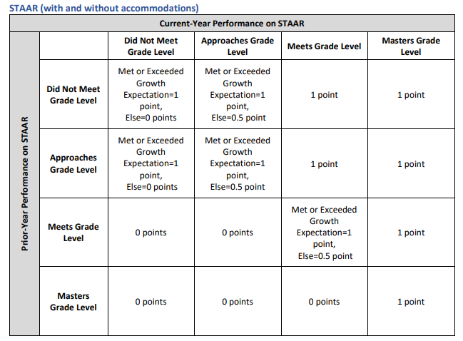
Domain 2A: Academic Growth 2018-2022
Notes:
This table has been used previously to determine growth points. It shows prior year performance compared to current year. It has only been used to show growth for current year 4-8 reading and math, Algebra I and English II.

Slide 40
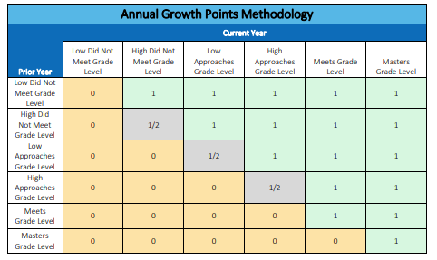
Domain 2A: Academic Growth 2023
Changes: New Transition Table
Notes:
This new table increases the opportunity for gaining growth points by dividing up Did Not Meet and Approaches performance levels into low and high.
Rationale: The transition table model is transparent, easy to understand, and easy to duplicate at the local level. By using the transition table model, additional assessments will be eligible for evaluation such as STAAR RLA in grade 8 to English I EOC and Spanish to English RLA.

Slide 41
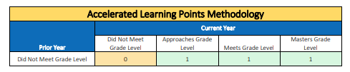
Domain 2A: Academic Growth 2023
Changes for 2023: Addition of HB 4545 results
Domain 2A Score = Annual Growth + Accelerated Learning Points
Notes:
The points calculated from students going from Did Not Meet to Approaches/above are added to the growth score for this domain, but there are no changes to scaling. Because of this, these are considered “bonus” points and can only help the score in this domain. Poor 4545 performance will not lower the Domain 2A score.

Slide 42
Domain 2A: Academic Growth
Changes for 2023: Scaling
Domain 2A: Academic Growth
 | Raw Score | 2018 Scale Score | 2019 Scale Score | 2021 Scale Score | 2022 Scale Score | 2023 Scale Score
Example 1 | 66 | 70 | 70 | 70 | 70 | 65
Example 2 | 79 | 86 | 86 | 86 | 86 | 83
Notes:
This table shows the changes in scaling from previous accountability to 2023. The raw score is the number of growth points earned divided by the number of growth points possible.

Slide 43
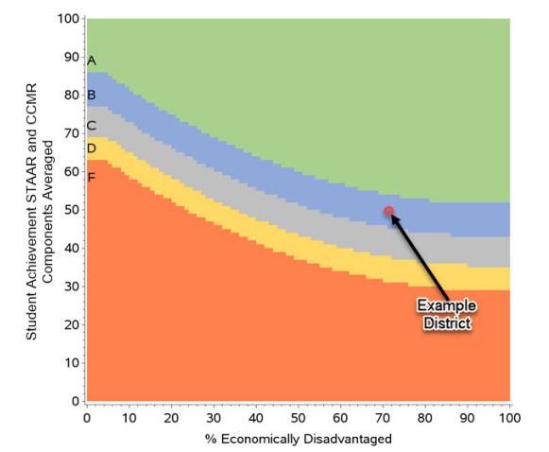
Domain 2B: Relative Performance
Changes: CCMR Scaling
The CCMR scale score calculated in Domain 1 is also used in Domain 2B
  Major changes in scaling as discussed earlier
Notes:
This is an example of the chart that shows the relative performance score. For high schools, the methodology is to use the average of the Domain 1 STAAR performance and the Domain 1 CCMR scale scores for the y-axis and the % eco dis for the x-axis. Because of the major scaling changes to CCMR discussed in Domain 1, the placement on this table will be significantly different.

Slide 44
Domain 2B: Relative Performance
Changes for 2023: CCMR Scaling Calculation
 | Raw Score | Scale Score 2018-2022 | Scale Score 2023
HS Campus 1 | 63 | 76 | 69
HS Campus 2 | 57 | 78 | 67
Notes:
The raw score is the average of Domain 1 STAAR performance and CCMR scale scores. The impact of changes to CCMR scaling will be evident in this calculation.
The reason the raw score for campus 1 is higher but the scale score is lower than campus 2 is that this uses the relative comparison chart based on eco dis percentages

Slide 45
Domain 3: Closing the Gaps
Elementary and Middle School
Academic Achievement
  Meets level or above on math and reading STAAR
Growth Status
  Percentage of students who improved STAAR performance over previous year
  Math and reading
English Language Proficiency
  TELPAS
Student Success (STAAR Performance)
  Same calculation as in Domain 1
High School
Academic Achievement
  Meets level or above on math and reading STAAR
Graduation Rate
English Language Proficiency
  TELPAS
CCMR
Notes:
There are no changes to what is measured in Closing the Gaps for 2023. There are major changes to how these are measured

Slide 46
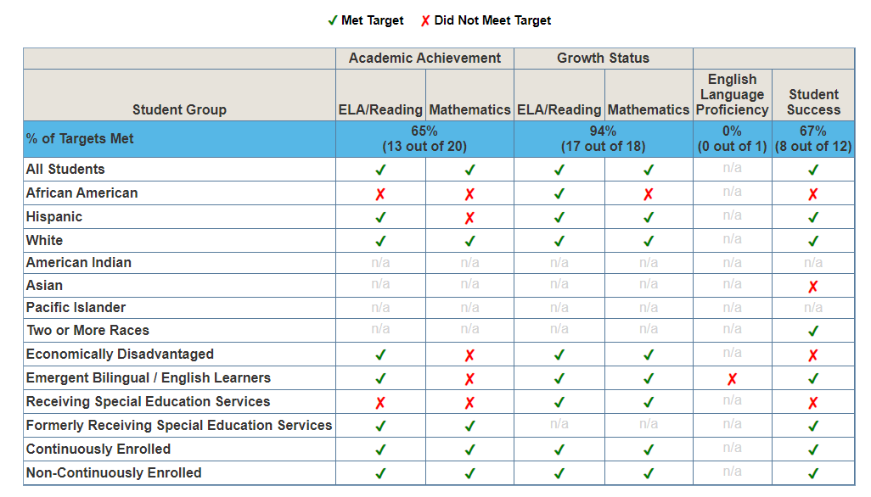
Domain 3: Closing the Gaps 2018-2022
Every student group with at least 25 students is evaluated against a state target
Notes:
This is a sample chart from one of our middle schools in 2022 showing the student groups that met/didn’t meet the state targets for each component of D3. The n/a are for student groups with less than 25 students

Slide 47
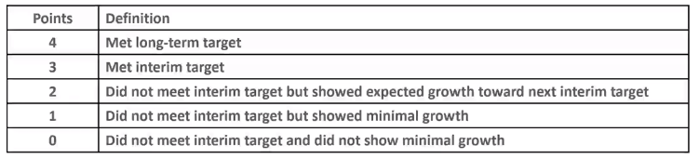
Domain 3: Closing the Gaps 2023
Changes for 2023:
Met/Did Not Meet is being replaced by graduated outcomes
Notes:
This replaces the yes/no methodology previously used. It allows points for growth even if the target is not met. Targets being used are still the ones set from 2017 results. They were supposed to increase in 2023, but did not due to pandemic.

Slide 48
Domain 3: Closing the Gaps 2023
Changes for 2023
Minimum size of groups reduced from 25 to 10 students
The number of groups evaluated has been reduced to:
All Students group
2 lowest performing race/ethnicity groups from prior year
Super Group (High Focus Group)
Combined group with Economically Disadvantaged, Special Education, Emergent Bilingual, Homeless, Migrant, Foster
Notes:
Reducing the minimum group size means that we will have student groups on campuses evaluated that have never been evaluated before. This will potentially be reflected in #2 group above. Also, all student groups with 10 or more students will be evaluated for ATS/TSI school improvement (the 0s and 1s from the table on the previous slide)

Slide 49
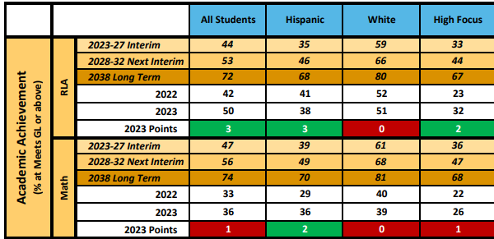
Domain 3: Closing the Gaps 2023
Notes:
This is a sample of a data table showing the 4 student groups (assuming white and hispanic groups were lowest performing race/ethnicity groups from 2022), state targets (brown) and the points earned using the graduated outcomes table from the previous slide

Slide 50
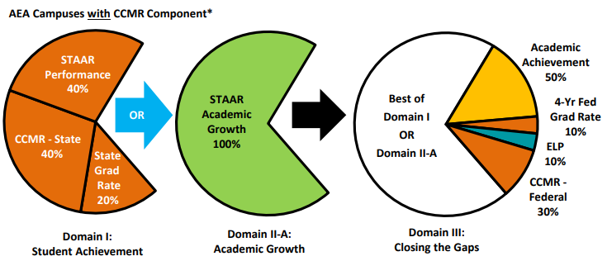
Alternative Education Accountability (AEA) 2018-2022: Richarte
Notes:
Differences between AEA and traditional high schools: there is no Domain 2B, the graduation rate includes non-traditional graduates and scale score conversions are based in 2017 results of AEA campuses statewide

Slide 51
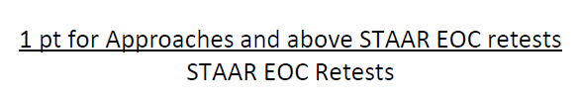
AEA Campuses 2023
Changes for 2023:
Students who previously drop out but return are calculated only into the numerators of Domain 1 CCMR and Graduation Rates
  Those students can only increase the Domain 1 score
A new indicator has been added: Domain 2B Retest Growth
Notes:
Rationale for bullet 1: awarding points for these achievements incentivizes the recovery of at-risk students.
Rationale for bullet 2: ADA campuses serve higher rates of STAAR retesters for which Part A growth opportunities are limited, adding this new Part B focuses on the ADA population by emphasizing retester outcomes.

Slide 52
Questions and Wonders
HB 4545
  Required 30 hours of tutoring per subject in which student “Did Not Meet”
  Tutoring required outside of Tier 1 class time
  Tutoring required to be at 3 students to 1 teachers ratio (waivable)
  Largely funded through ESSER in the form of grants
  Added indicator in Domain 2
  Question is whether funding mechanism will remain
Impacts to closing the gaps groups
Longitudinal comparisons and communications

Slide 53
Next Steps
Conversations with district and campus leaders over the next few weeks/months
More closely examining the subtle changes
Communication efforts with community members to understand that while performance may improve, ratings will likely decrease

Slide 54
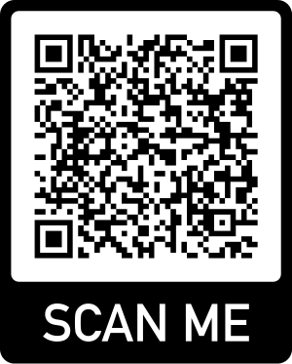
Exit Ticket & Closing
Please leave feedback and indicate your interest in being on the calendar action team.
Final Meeting May 17

Slide 55


