Slide 1
District Performance Committee
February 16th, 2023

Slide 2
AGENDA
Welcome & Dinner
Good Things
DIP - December Formative Review
Budget Conversation
24-25 Calendar Development Process
Future Meetings Re: Calendar
Feedback Form

Slide 3
Introductions &
Good Things

Slide 4
District Improvement Plan (DIP)
DIP Goals are aligned to GISD Strategic Plan Goals
Strategies are determined by analyzing data and connecting needs with campus & district personnel
01
03
Performance Objectives are aligned to GISD Board Goals, GISD Mission & GISD Priorities
Quarterly formative reviews
02
04

Slide 5
December 2022 Formative Review
56 = Total Strategies
24 = Strategies Specific to Math & ELAR
Number of Math & ELAR Strategies That Are:
0 - No Progress (0%)
31 - Some Progress (5-45%)
25 - Considerable Progress (50-95%)
0 - Complete (100%)

Slide 6
District Improvement Plan (DIP)
01
03
Goal 1: Develop a future ready learning experience that reflects voice, choice and ownership.
Leadership: Cultivate an adaptive system of empowered leadership where collaboration and problem solving are our natural behaviors.
02
04
Communication: Engage the community to become champions and advocates for student success and the future of the District.
Establish an innovative culture that encourages risk-taking, diverse thinking and meaningful exploration.
Page: 37
Page: 27
Page: 41

Slide 7
Highlights
Most progress seems to be made in areas that are direct support to campuses, leaving work that is more system level with less progress
Current work indicates working on the processes and systems that result in desired outcomes (i.e. learning labs, professional learning, obtaining resources,

Slide 8
Questions / Discussion

Slide 9
District Performance Committee
School Funding Overview
February 16, 2023

Slide 10
School Funding
General Fund
(M & O)
Day-to-day operations and expenses
M & O tax rate is set by TEA each year, it is comprised of the maximum compressed tax rate (MCR) recalculated each year plus additional pennies.
M & O 2022/23 Tax Rate = .8046 MCR and .0800 pennies allowed for a total of .8846 cents
Debt Service Fund
(I & S)
Principal and interest payments on debt
I & S tax rate pays for capital projects financed by the proceeds from bond issues approved by the voters.
I & S 2022/23 Tax Rate = .3290 cents
Total 2022/23 Tax Rate = $1.2136

Slide 11
General Fund
The General Fund is the main operating fund of the school district
Most significant sources of revenues are:
  Local property tax receipts
  State funding
Additional revenue sources are facility rentals, athletic gate receipts and interest earnings and federal reimbursements.
Most of the operating expenditures of the district are in the General Fund. These expenditures include:
  Payroll and benefit costs for employees
  Operational expenditures including instruction, campus and general administration, guidance and counseling, pupil transportation, maintenance and custodial

Slide 12

Local and State Funding Structure
State Share Decreases
As Local Share Increases..

Slide 13
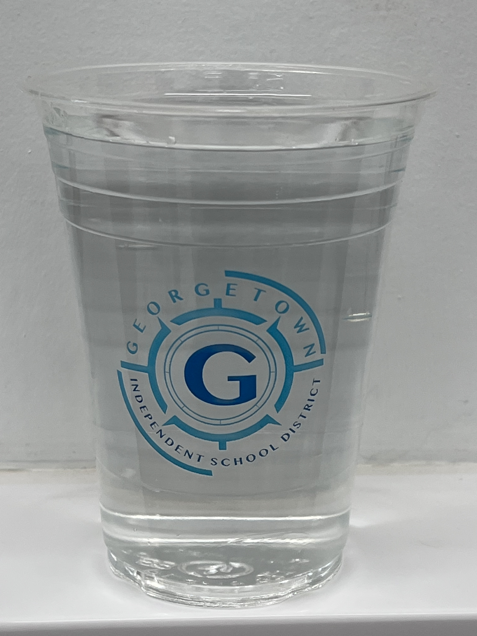
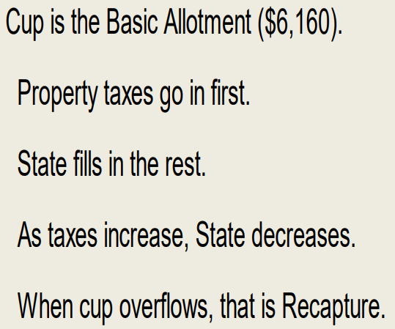

Slide 14
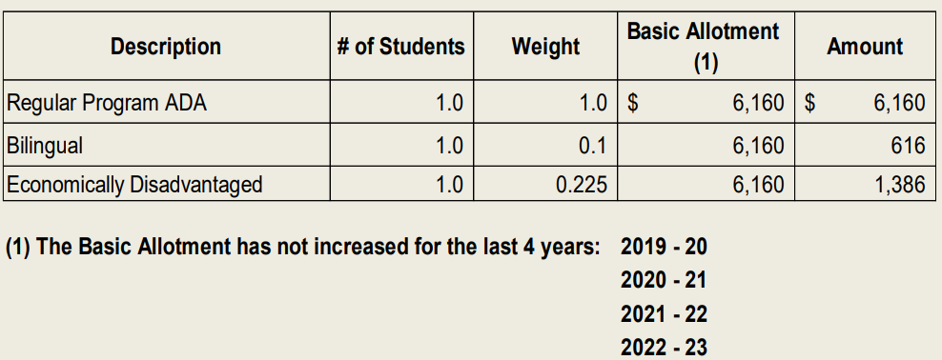
State Funding Calculation – Weighted Average Daily Attendance

Slide 15
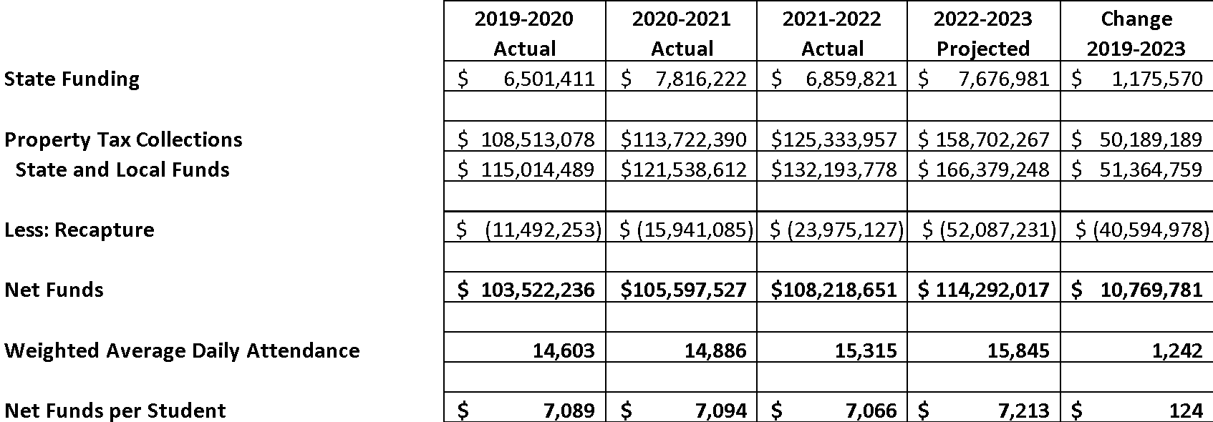
State Funding Levels from 2019-20 to 2022-23

Slide 16
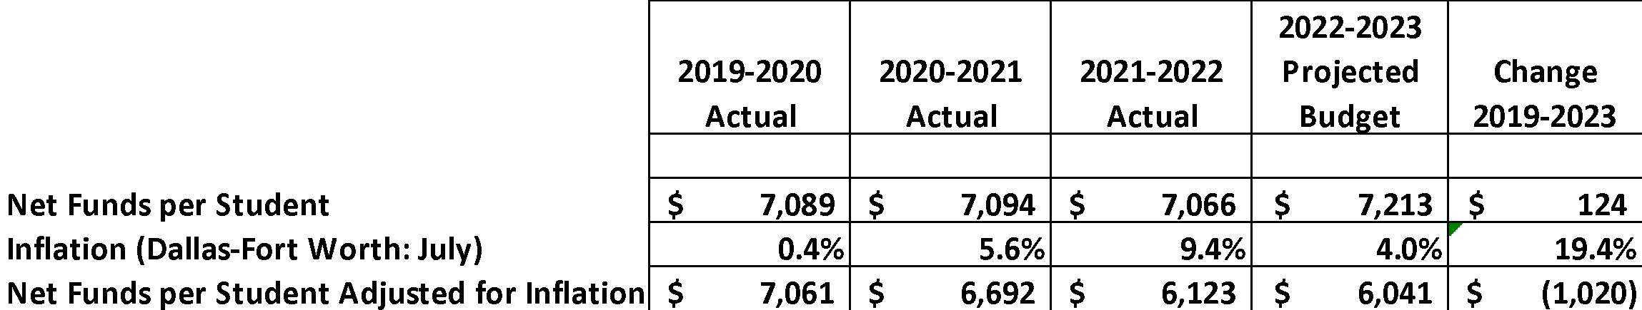
Funding Per Student Adjusted for Inflation

Slide 17
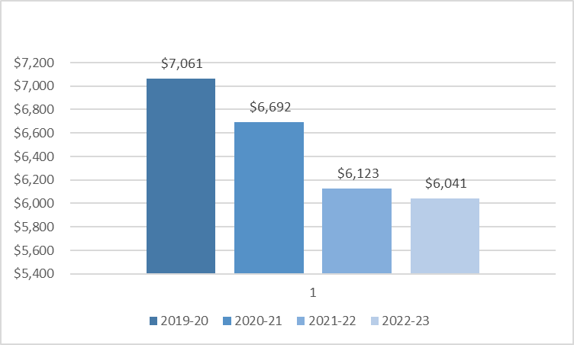
Funding Per Student Adjusted for Inflation

Slide 18

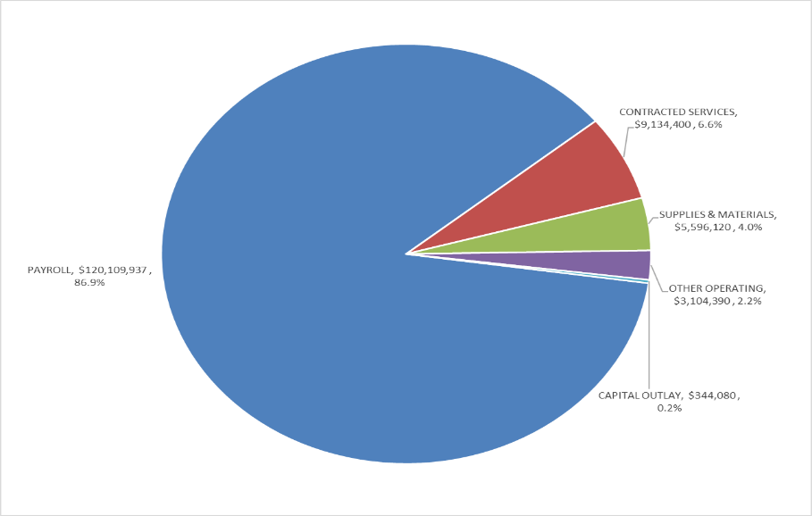
2022-2023 General Fund Budget Expenses by Object
Payroll 87%
Contracted Services 7%
Supplies & Materials 4%
Other Operating 2%

Slide 19
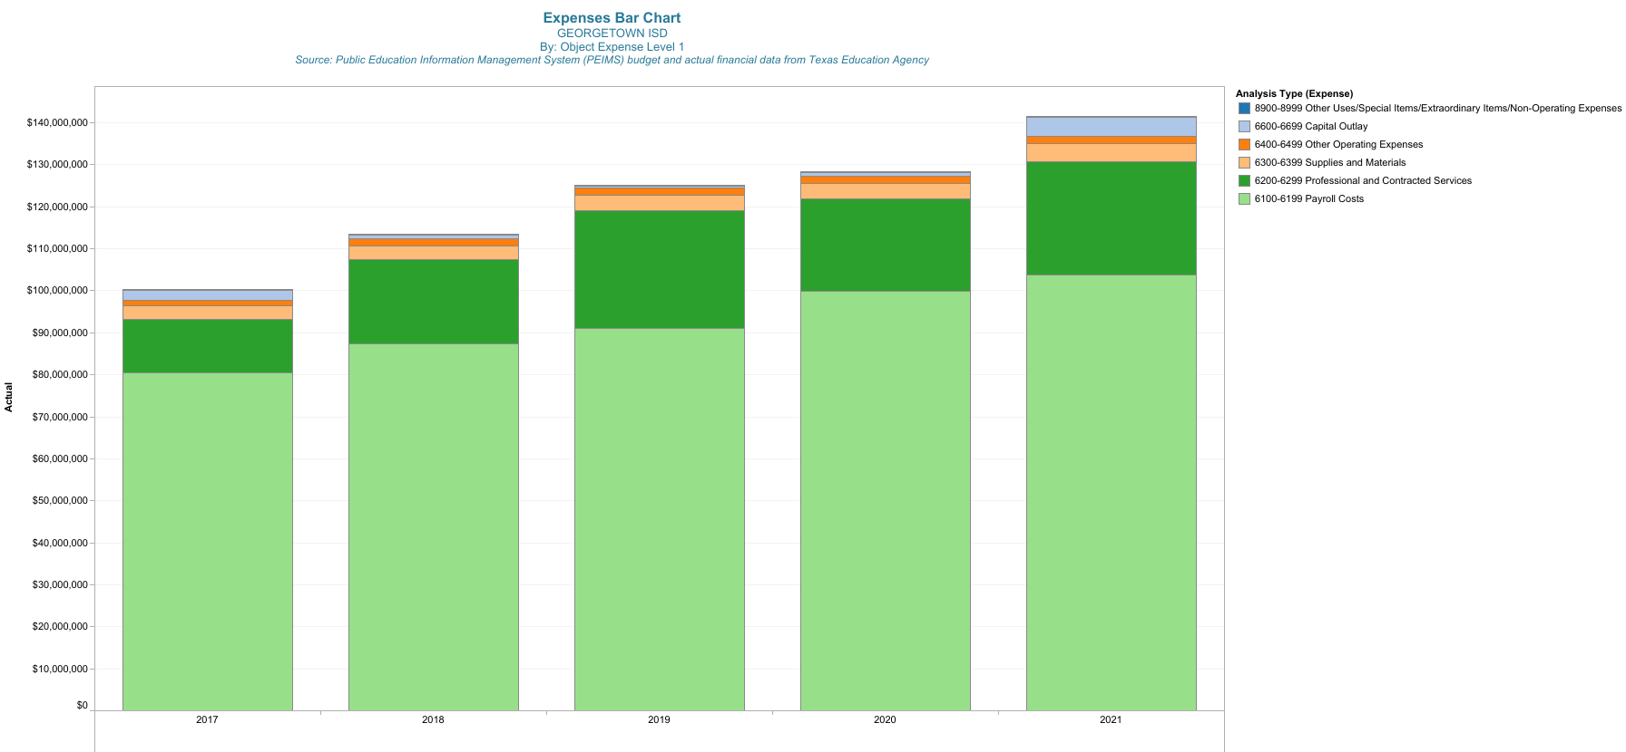
Payroll Costs are Largest Increase
Notes:
Raises every year

Slide 20
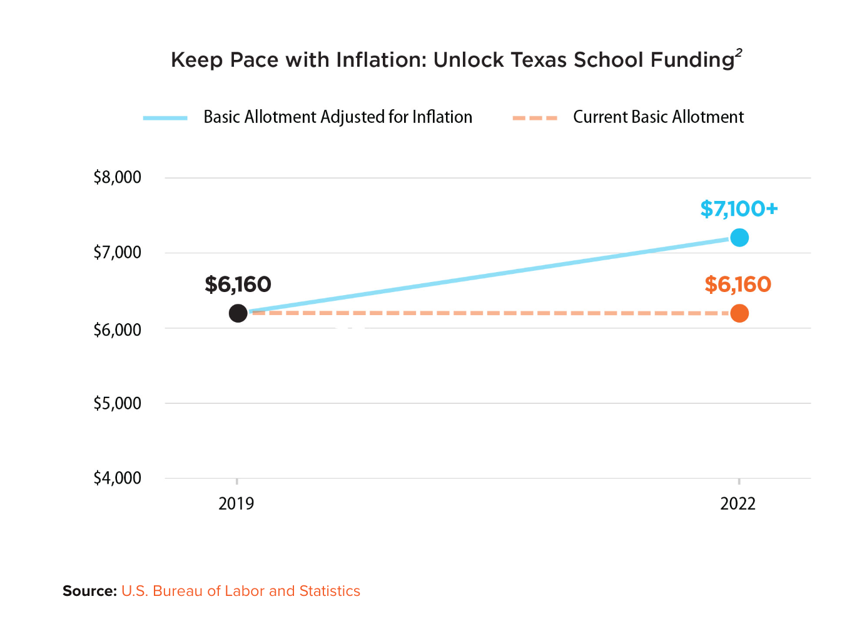
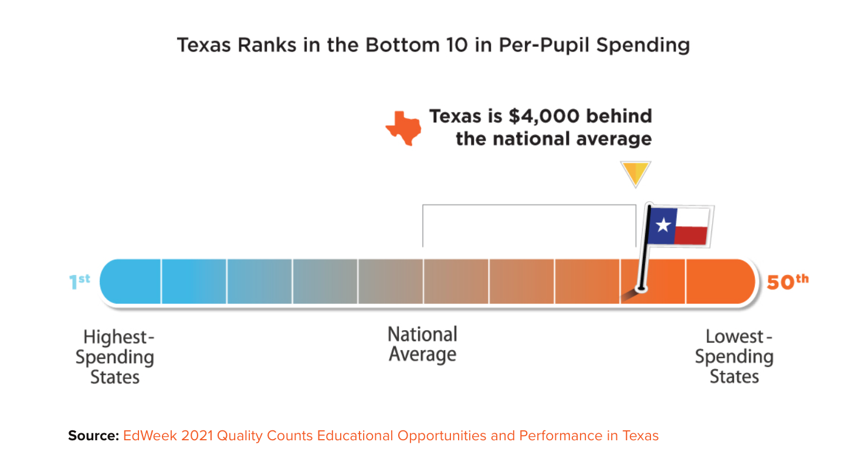
Raise Your Hand Texas Data on Funding

Slide 21
School Funding Takeaways and Discussion
Funding has remained flat, inflation has increased costs over the past four years
Student and campus needs have increased, raising costs for each student
Legislative Session outcomes are unknown

Slide 22
2024-2025 Calendar Development
Meeting 1 (tonight): Review the process
  GISD develops and administers calendar survey
Meeting 2 (April 5): Review stakeholder feedback
  GISD develops calendar options based on feedback
Meeting 3 (April 26): Review calendar options
  DPC members consult constituents to cast vote
Meeting 4 (May 17): Vote on calendar proposal
  Calendar option is presented to Board for consideration

Slide 23
Future Meeting Dates
April 5th, 2023
April 26th, 2023
May 17th, 2023

Slide 24
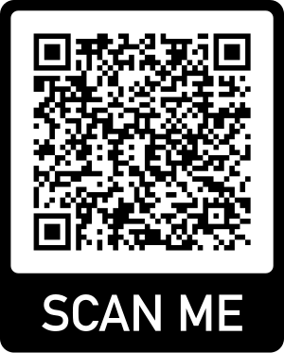
Exit Ticket & Closing
Scan This Code

