Slide 1
District Performance Committee
October 5th, 2022

Slide 2
Agenda
Table & Room Introductions (favorite road trip food?)
Good things
Overview of DPC
21-22 DIP (Review w/notes)
22-23 DIP (Goals & Performance Objectives)
Future Mtg. Dates & Topics
Exit Ticket & Closing

Slide 3
Introductions &
Good Things

Slide 4
Overview of DPC
Why do we meet?
Who we are?
The District Performance Committee serves a very important role at GISD. One of the primary functions of this committee is to work with the district to provide guidance on the District Improvement Plan and provide input on the district calendar prior to submission to the Board or Trustees.
What is our goal?

Slide 5
District Improvement Plan (DIP)
DIP Goals are aligned to GISD Strategic Plan Goals
Performance Objectives are aligned to GISD Board of Trustee Goals, GISD Mission, & GISD Priorities
Strategies are determined by analyzing data and connecting to needs with campus and district personnel
Goals >> Performance Objectives >> Strategies

Slide 6
21-22 District Improvement Plan
Review
4 goals
15 performance objectives
63 strategies
Of 15 performance objectives, 3 were marked “complete”
  5 were marked as “significant progress”
Of 63 strategies, 33 were marked “accomplished”
  13 were marked as 75% progress
  5 were marked as 50-74% progress
  12 were marked less than 45% progress

Slide 7
21-22 District Improvement Plan
Zoom in CCMR
Goal 1: Performance Objective 3: All students will meet College, Career, & Military Readiness (as defined by TEA indicators) by 2025.
67% of graduates in GISD will graduate meeting the state's CCMR criteria by August of 2022.
2022 Actual = 74%.
27% of graduates in GISD enrolled in an AP course will successfully complete the AP exam with a score of 3 or higher.
2022 Actual = 25%.
20% of graduates in GISD will earn college credit by successfully completing dual credit courses and/or OnRamps courses.
2022 Actual = 22%.
11% of graduates in GISD will meet the threshold for CCMR through earning an Industry Based Certification by August of 2022.
2022 Actual = 19%.
54% of GISD graduates will meet the threshold for CCMR through TSI Reading and Math standards by August of 2022.
2022 Actual = 56%.

Slide 8
21-22 District Improvement Plan
Zoom in Numeracy
Goal 1: Performance Objective 4: 100% of GISD students will demonstrate grade level numeracy (number sense, patterns & relationships, problem-solving) by the end of 3rd grade.
Early Numeracy: Grade level numeracy determined by multiple measures including, but not limited to NWEA MAP, STAAR, and Standards Based Teacher Assessments.
70% of grade 3 students will demonstrate grade level numeracy as determined by STAAR, NWEA MAP, or Standards Based Assessments by August 2022.
2022 Actual = 73%.
60% of grade 3 students will demonstrate passing standard on the STAAR assessment by August 2022.
2022 Actual = 64%.
64% of grade 3 students will demonstrate passing equivalent on the MAP Growth Assessment by August 2022.
2022 Actual = 78%.
28% of grade 3 students will demonstrate Met Standard on all identified numeracy standards by August 2022.
2022 Actual = 45%.

Slide 9
21-22 District Improvement Plan
Zoom in Literacy
Goal 1: Performance Objective 5: 100% of GISD students will demonstrate grade level literacy (phonics, phonological awareness, vocabulary, fluency, oral & reading comprehension, writing) by the end of 3rd grade by August 2025.
Early Literacy: Grade level literacy determined by multiple measures including but not limited to NWEA MAP, STAAR, DRA & Standard Based Teacher Assessments.
75% of grade 3 students will demonstrate grade level numeracy as determined by STAAR, NWEA MAP, DRA or Standards Based Assessments by August 2022.
2022 Actual = 80%.
71% of grade 3 students will demonstrate passing standard on the STAAR assessment by August 2022.
2022 Actual = 75%.
62% of grade 3 students will demonstrate passing equivalent on the MAP Growth Assessment by August 2022.
2022 Actual = 68%
17% of grade 3 students will demonstrate Met Standard on all identified literacy standards by August 2022.
2022 Actual = 45%

Slide 10
21-22 District Improvement Plan
Review
Questions on DIP 21-22?

Slide 11
Reviewing and providing feedback on Performance Objectives.
  What questions do you have about a particular PO?
  What concerns do you have about a particular PO?
Capture your feedback on hard copies provided
22-23 DIP - Performance Objectives Review

Slide 12
Future Meeting Dates & Topics
January 18th, 2023
DIP formative review & …
April 5th, 2023
Calendar development & ...
April 26th, 2023
Calendar development & …
May 17th, 2023
Calendar development & …

Slide 13
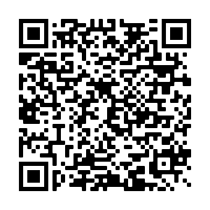
Exit Ticket & Closing
Follow this link: https://tinyurl.com/536v3jse
Scan this Code:

Slide 14


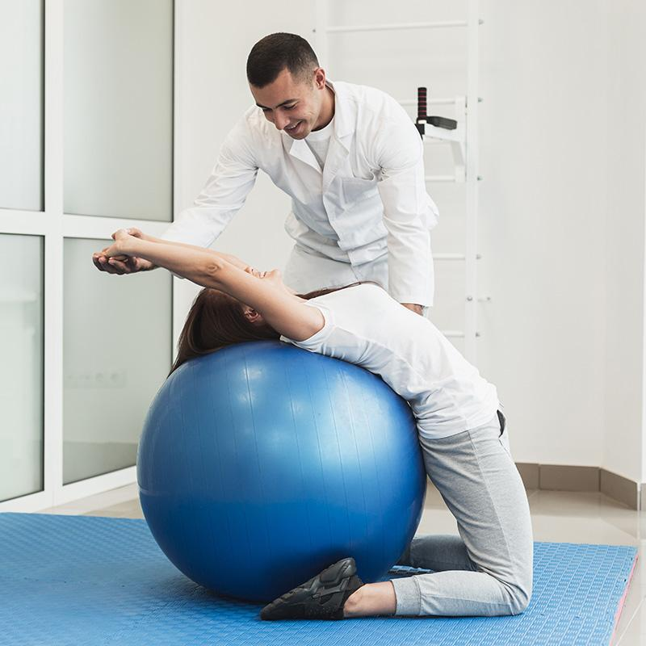
Choose One
Choose the image that best represents the concept given
Venus
01
02
01
Back
Next

Slide 15
Make a List
Make a list of words related to each concept
Jupiter
Mercury
Write the word here
Write the word here
Write the word here
Write the word here
Write the word here
Write the word here
Back
Next

Slide 16
Choose Right
Choose the icons that define the given action
Neptune
Back
Next

Slide 17
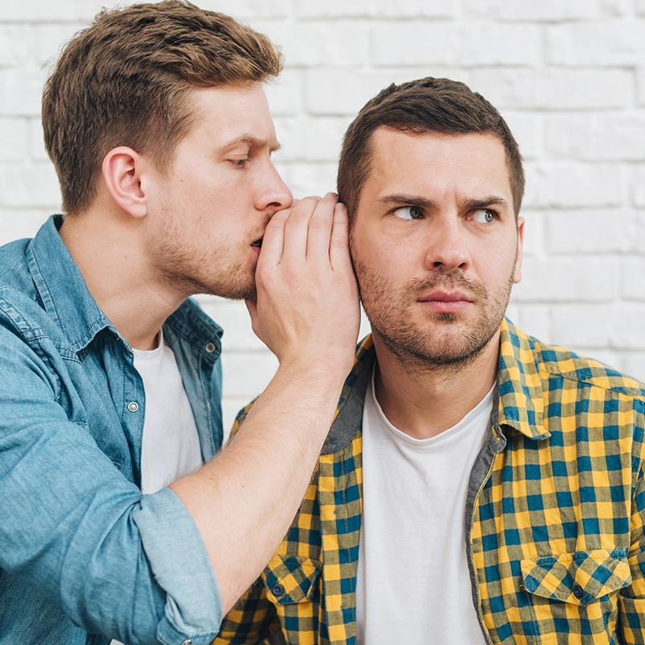
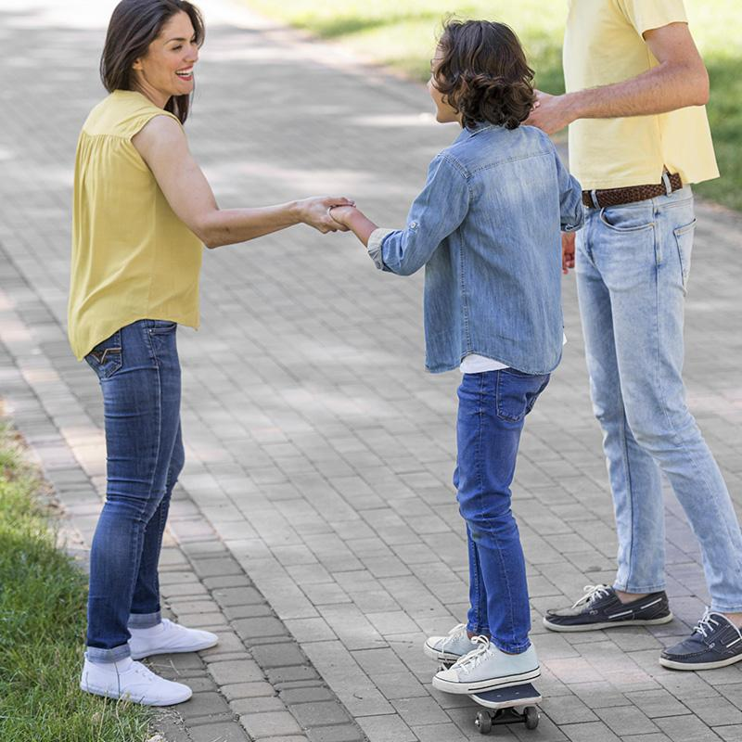
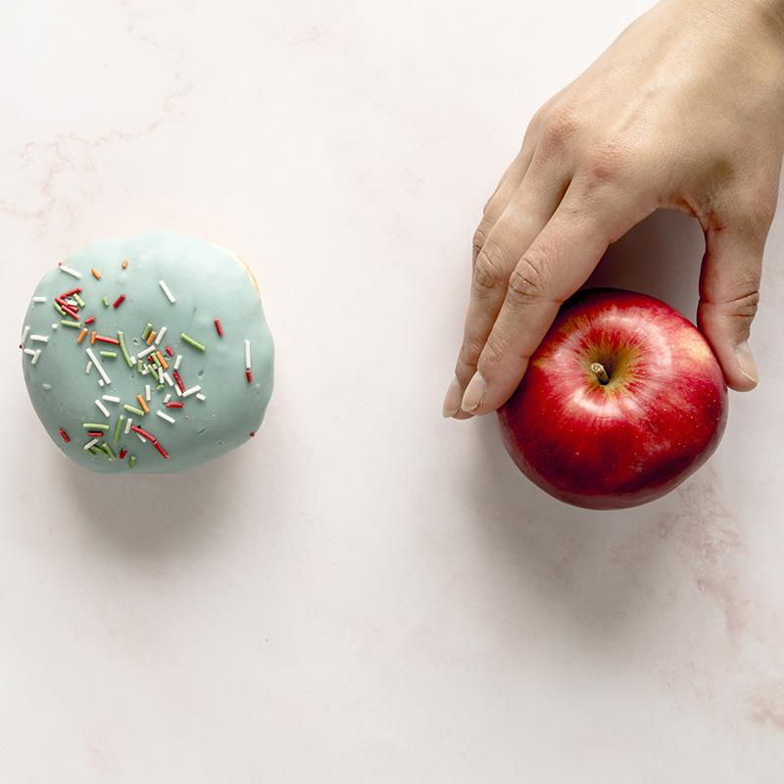
Link It
Link each of the actions to its corresponding image
Mars
Venus
Mercury
01
02
01
Back
Next

Slide 18
Draw It
Draw the action listed below
Saturn
Mercury
Back
Next

Slide 19
03
Relations
Define the theme in the box below
Uses are...
Back
Next

Slide 20
Write It
Write 4 words related to the given word
Mars
Back
Next

Slide 21
Group It
Group the related words
Mars
Venus
Saturn
Ring
Gas
Hot
Iron
Red
Cold
Back
Next

Slide 22
Link It
Link the words that are related to each other
Mars
Giant
Jupiter
Second
Venus
Red
Back
Next

Slide 23
04
Definitions
Define the theme in the box below
Definitions are...
Back
Next

Slide 24
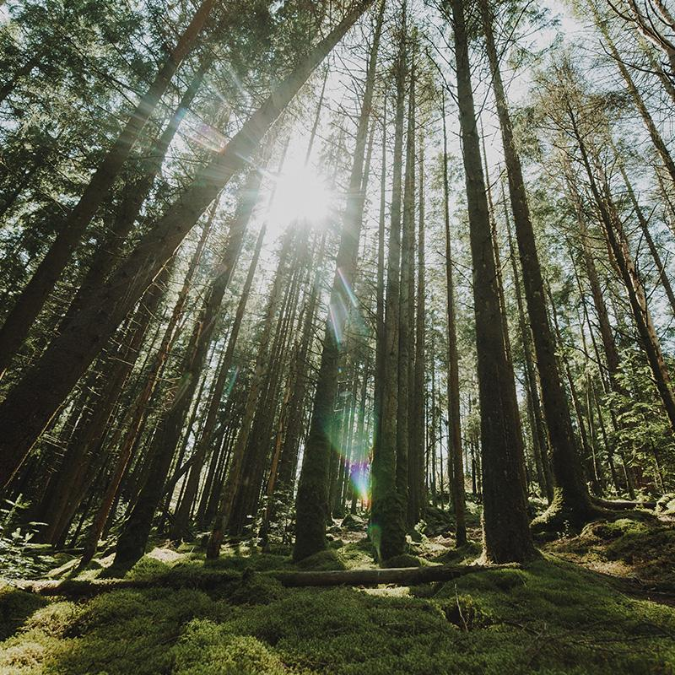
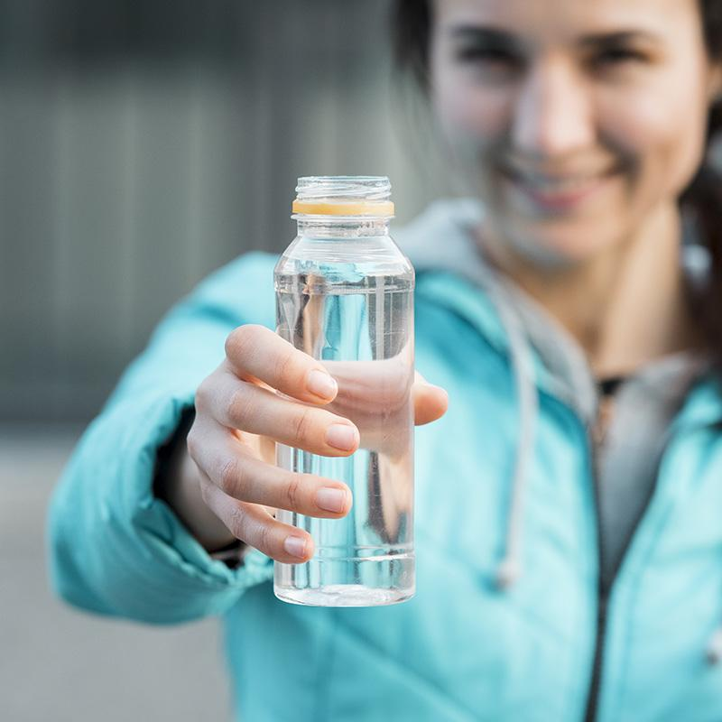
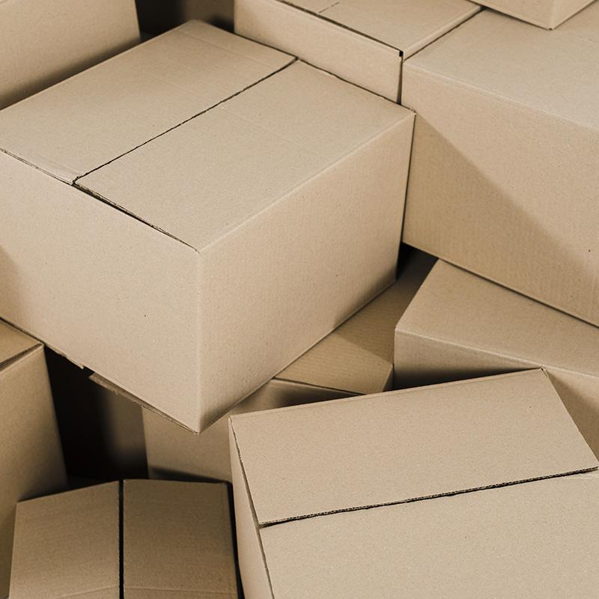
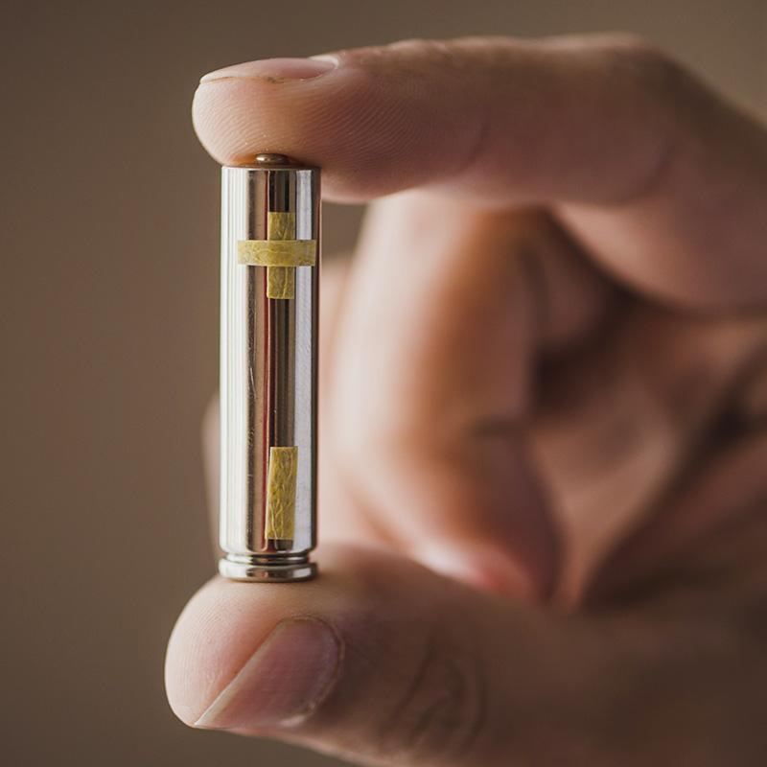
Choose One
Choose the image that best defines the given word
Mars
Venus
01
02
01
02
Back
Next

Slide 25
Choose Right
Choose the words that best define the given word
Mars
Green
Watermelon
Animal
Dog
Plant
Lucky
Back
Next

Slide 26
05
Comparisons
Define the theme in the box below
Comparison are...
Back
Next

Slide 27
Write It
Write words that both icons have in common
Back
Next

Slide 28
Link It
Write an adjective that can be used as a link to compare the given words
Mars
Mars
Jupiter
Jupiter
Venus
Venus
Back
Next

Slide 29
Write It
Make a list of synonyms of the given word
Jupiter
Back
Next

Slide 30
06
Consequences
Define the theme in the box below
Consequences are...
Back
Next

Slide 31
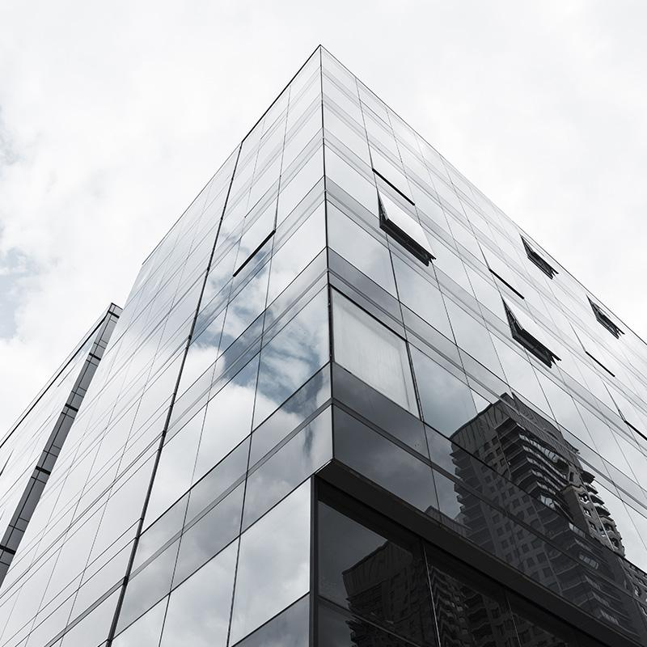

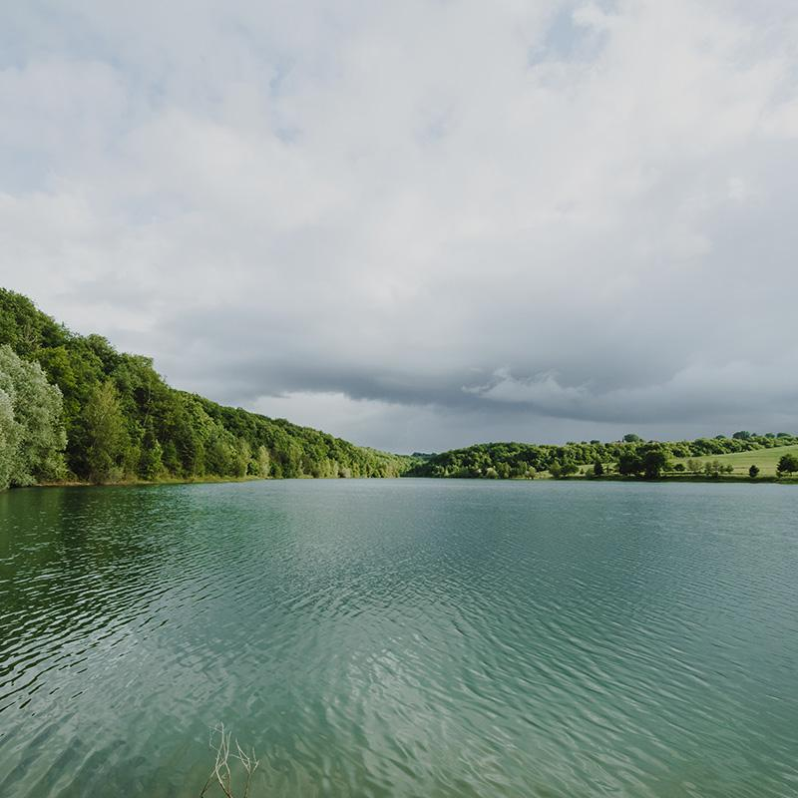
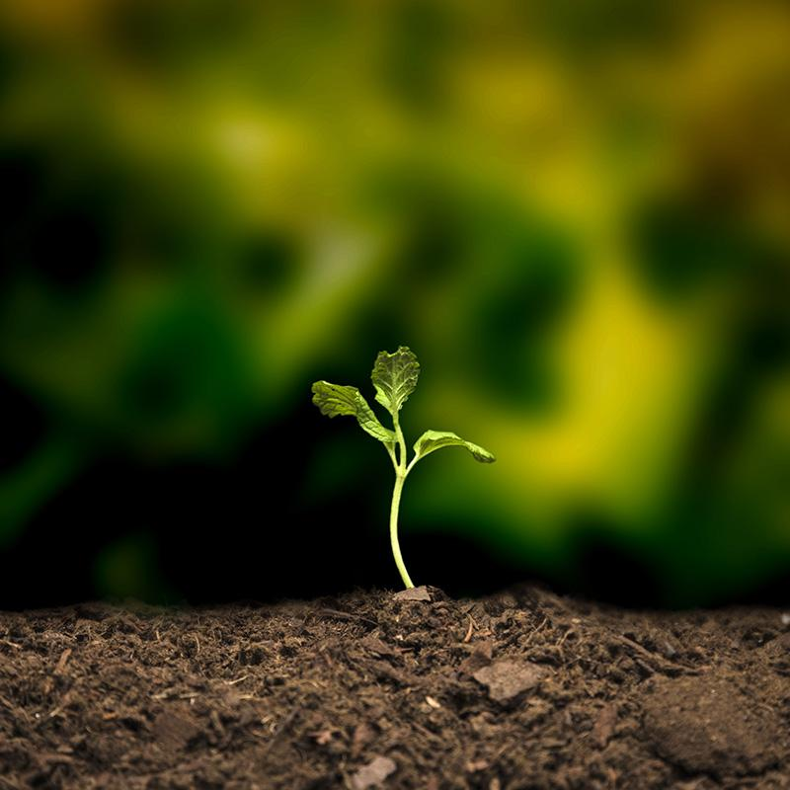
Choose Right
Choose the images that show the consequences of the given word
Mars
01
02
03
04
Back
Next

Slide 32
Write It
Write 3 more words that could be a consequence of the given word
Jupiter
Mars
Venus
Back
Next

Slide 33
Draw It
Draw a scene that could be a consequence of the given word
Mercury
Back
Next

Slide 34
Important Notes
Mars
Venus
Jupiter
Saturn
Despite being red, Mars is actually a cold place
Venus has a nice name and is the second from the Sun
It’s a gas giant and the biggest planet of them all
Saturn is composed mostly of hydrogen and helium

Slide 35
Timetable
 | Monday | Tuesday | Wednesday | Thursday | Friday
10:00 | Project I |  | Practice I | Lab I
11:00 | Lab I | Project I | Lab I | Lab I | Practice I
14:00 | Practice I | Project I | Lab I |  | Project I
15:00 | Practice I |  |  | Project I

Slide 36
Calendar
Mo
Tu
We
Th
Fr
Sa
Su
01
02
03
04
05
06
07
08
09
10
11
12
13
14
15
16
17
18
19
20
21
22
23
24
25

Slide 37
—Someone Famous
“This is a quote, words full of wisdom that someone important said and can make the reader get inspired.”

Slide 38


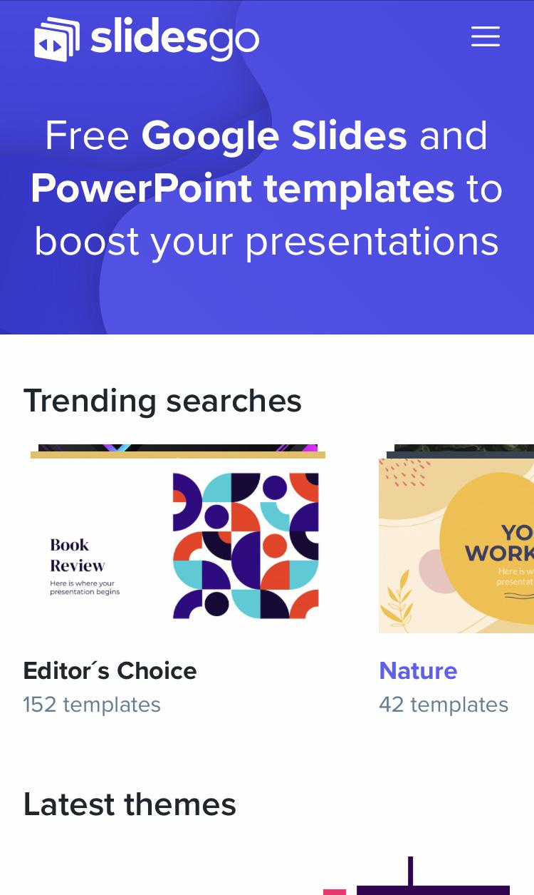
Online Support
You can replace the images on the screens with your own work. Just delete these ones and add yours

Slide 39
Thanks
Do you have any questions?
addyouremail@freepik.com
+91 620 421 838
yourcompany.com
Please keep this slide for attribution.

Slide 40
Online Learning Icon Pack

Slide 41





Stories by Freepik
Create your Story with our illustrated concepts. Choose the style you like the most, edit its colors, pick the background and layers you want to show and bring them to life with the animator panel! It will boost your presentation. Check out How it Works.
Pana
Amico
Bro
Rafiki
Cuate

Slide 45
...and our sets of editable icons
You can resize these icons, keeping the quality.
You can change the stroke and fill color; just select the icon and click on the paint bucket/pen.
In Google Slides, you can also use Flaticon’s extension, allowing you to customize and add even more icons.

Slide 46
Educational Icons
Medical Icons

Slide 47
Business Icons
Teamwork Icons

Slide 48
Help & Support Icons
Avatar Icons

Slide 49
Creative Process Icons
Performing Arts Icons

Slide 50
Nature Icons

Slide 51
SEO & Marketing Icons

Slide 52


