Slide 1


Endorsements
&
Programs of Study

Slide 2
Endorsements are a related series of courses that are grouped together by interest or skill set. They provide students in-depth knowledge of a subject area.
Students can choose from 5 Endorsement areas:
STEM
Business & Industry
Public Services
Arts & Humanities
Multidisciplinary Studies
(Student Booklet – pages 12-13)

Slide 3
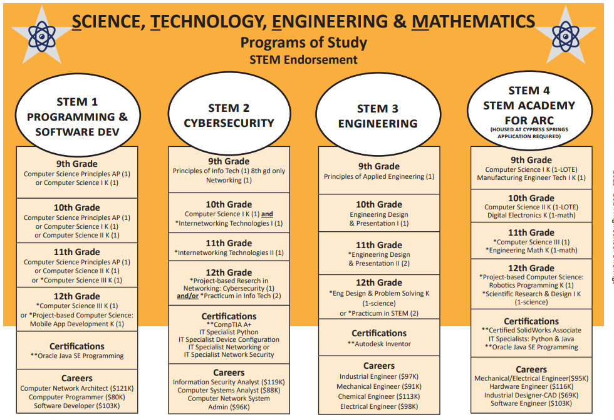
Programs of Study are a coherent sequence of CTE courses, industry-based certifications, & work-based learning designed to ensure students are prepared for in-demand, high-skill, high-wage careers. They also support the completion of an endorsement.

Slide 4
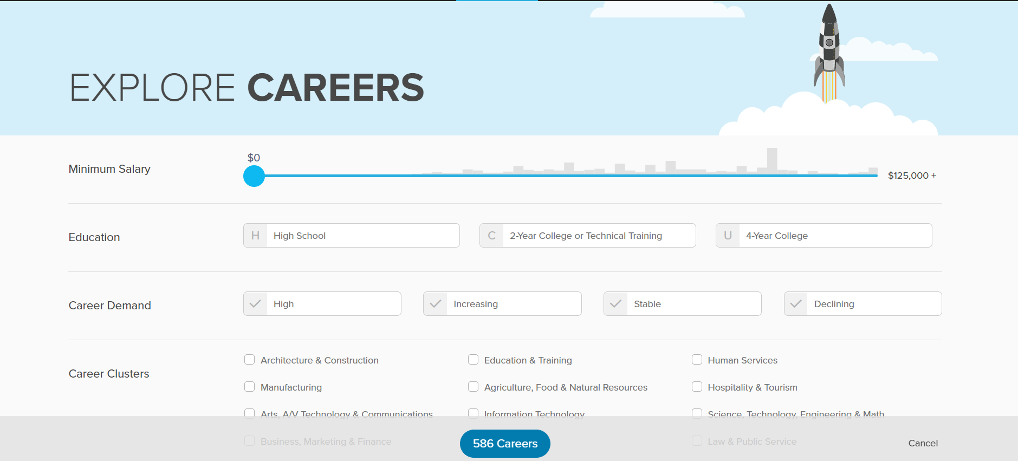
Choosing an Endorsement & Option/Program of Study may seem overwhelming…
Remember that this is a plan - there will be an opportunity to make changes in high school!
Simply start by asking yourself a few questions:
*What are my interest, talents, and/or career aspirations?
*What are my post-secondary goals?
Explore career options in Xello
Mycfisd.net/Additional Resources/Xello SSO Student Access
Xello Dashboard
Explore Options
Careers
Click on More Filters/Career Clusters or School Subjects

Slide 5

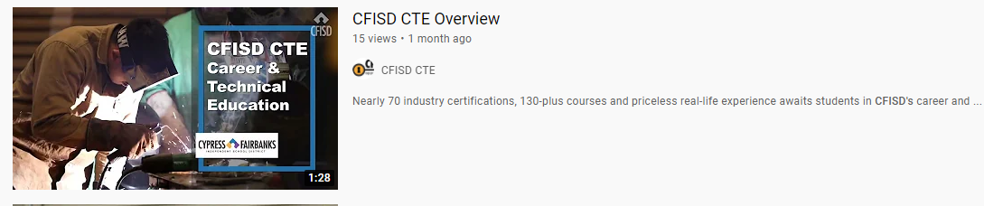
Check out the CFISD CTE videos to learn more about some of the programs available here in our district
https://www.youtube.com/results?search_query=cfisd+cte
(Note: There are several different videos available)

Slide 6

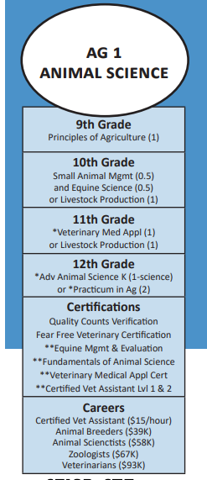
Now…
1 – Select your Endorsement(s) (example: Business & Industry/ Ag, Food & Natural Resources)
2 - Choose an Option or Program of Study (example: Ag1 – Animal Science)
3 – Use the list of courses provided to make your selections for each year
4 – Add these courses to your 4-Year Plan

Slide 7
If you have space available…
Course Title | Course # | Grade Level (s) | Description
Professional Communications (.5 credit) | 06020 | 9-12 | Develop effective interpersonal communication skills
Touch System Data Entry (Keyboarding) (.5 credit) | 51220 | 9-10 | Develop keyboarding & formatting skills needed for success in the workplace
LeadWorthy (.5 credit) | 60220 | 9-12 | Activity-oriented course designed to develop personal responsibility, leadership, and professional skills through explicit social-emotional participatory learning experiences
Photojournalism (.5 credit) | 08620 | 9-12 | Introduces the world of photography and journalism; must have your own digital camera
Principles of Education & Training | 86423 | 9-11 | Basic knowledge and skills needed for a career in education
Lifetime Nutrition & Wellness (.5 credit) | 85720 | 9-11 | 9th graders may enroll after taking Principles of Human Services or Principles of Hospitality & Tourism in middle school Nutrition, digestion, calories/metabolism, diet-related diseases, food allergies, safety & sanitation in food preparation
Automotive Basics | 93943 | 9-11 | Basic repair, maintenance and servicing of vehicle systems
Business Information Management I | 54623 | 9-12 | Word processing, spreadsheets, multimedia presentations, databases, internet research, & emerging technologies
Journalism I | 08123 | 9-12 | Required prerequisite for Adv. Journalism I – Yearbook or Adv. Journalism I - Newspaper Writing, technology, visual, and electronic media are used as tools for learning as students produce effective communications
Debate I | 06513 | 9-12 | Required prerequisite for Debate II-IV Study current events and logic while preparing and presenting arguments on a variety of controversial issues; participation in competitive speech and debate events is required
Intro to Cosmetology | 94023 | 9-11 | Hair style, manicures, skin care, make up, and other aspects of the personal care service industry
Digital Media | 54543 | 9-12 | Design and create multimedia projects using Adobe Photoshop; potential for certification
Child Development | 85233 | 10-12 | Child growth from prenatal through school-age children
Money Matters | 53913 | 9-12 | Bank record management, credit cards, investing, insurance and budgets
Creative & Imaginative Writing (.5 or 1 credit) | 09520 09523 | 10-12 | Develop increased skill, creativity, and versatility as writers
ACT/SAT Prep (.5 credit) | 00370 | 11-12 | Prerequisite: Completion of or concurrent enrollment in Algebra II Provides students with strategies for college entrance exams
African-American Studies | 14213 | 10-12 | Focus on the historical and cultural contributions of African-Americans
Mexican-American Studies | 14113 | 10-12 | Focus on the historical and cultural contributions of Mexican-Americans
Psychology (.5 credit) or Psychology AP (.5 credit) | 13620 13650 | 11-12 | Understanding the concept of human behavior, theories of personality, human growth & development
Sociology (.5 credit) | 13420 | 11-12 | Understanding of self and the society in which one lives
Street Law (.5 credit) or (1 credit) | 13720 13723 | 11-12 | Court structure, criminal procedure, civil rights & other legal issues; criminal law one semester & civil law the other semester
World Area Studies K or H (.5) or (1 credit) | 14010 14113 | 11-12 | Study of geography, culture, history, politics, and economic development of selected regions
PALs I PALs II | 60023 60123 | 11-12 | Peer Assistance & Leadership program; work as a peer mentor with elementary, middle & high school age youth; effective training in resiliency strategies. Application required
College Readiness & Study Skills (.5 credit) | 00340 | 12 | Open to students who plan to attend post-secondary education; designed to help students transition into the post-secondary environment
You may want to consider including:
Additional courses in any of the 4 core academic areas (English, Math, Science, Social Studies)
Additional courses from your Endorsement area(s)
Any of the courses listed in the Student Booklet – page 52

Slide 8
Complete & Check Your 4-Year Plan
List High School credits earned in Middle School (Student Booklet – page 54)
Fill in course names & levels for required courses listed
Add Health, LOTE, Fine Arts, & PE requirements
Add Endorsement/Program of Study courses & Course #’s
List Alternate Electives for 9th Grade (1st & 2nd choice)
Directions: Courses required at a specific grade level are noted in the chart below. Students have flexibility in determining the year of study for the following graduation requirements: World History or World Geography, Foreign Language, Fine Arts, PE and Health.
Pds | High School credits earned in Middle School | 9th Grade | 10th Grade | 11th Grade | 12th Grade
1 |  | English I _____ (Level) | English II _____ (Level) | English III _____ (Level) | English IV: _____ (Level)
2 |  | Math: _________________ (Level) _____ | Math: _________________ (Level) _____ | Math: _________________ (Level) _____ | Math: _________________ (Level) _____
3 |  | Biology _____ (Level) | Science: _______________ (Level) _____ | Science: _______________ (Level) _____ | Science: _______________ (Level) _____
4 |  | (Course #) | (Course #) | U.S. History _____ (Level) | Government (½) _____ (Level) Economics (½) _____ (Level)
5 |  | PACE (½) 00120 __________ (½) ______ | (Course #) | (Course #) | (Course #)
6 |  | (Course #) | (Course #) | (Course #) | (Course #)
7 |  | (Course #) | (Course #) | (Course #) | (Course #)
Alternate Electives for 9th Grade: 1. ____________________________________________ 2._________________________________________________

