Slide 1











Approaching
FAFSA
Presented by Jordan Roberts

Slide 2

What is FAFSA?
30%
  “Free Application for Federal Student Aid”: provides federal grants, loans, work-study
    Covers tuition and fees, room and board, books and supplies, transportation, and more.
  EVERY student applying to college should fill out a FAFSA to find out if they qualify for financial aid - especially as merit scholarships may require FAFSA. Be sure to fill out a FAFSA even if you think you won’t qualify for federal aid.
  Uses parent’s tax info from 2022 (ONLY include parents: biological, adoptive, stepparents)
  Complete the FAFSA ASAP - it should be submitted by the earliest financial aid deadline to each school you apply to. Institutional aid can run out!
Notes:
Explain that grants don’t generally have to be paid back, loans have to be paid back, and work-study doesn’t have to be paid back
Explain at end that the earlier you complete it the better - state aid doesn’t run out, but institutional aid does, so the earlier you complete it, the more aid you can qualify for

Slide 3

Types of Aid
  (Pell) Grants: based on student need, money given on a yearly basis to help pay school costs; DOES NOT need to be paid back
  Scholarships: DO NOT have to be paid back; sometimes based on student need, but also various factors
  Work-study: eligibility determined by need; allows students to pay off part of debt/expenses through working on campus
  Loans
    Subsidized loans: based on student need, DOES NOT accrue interest while student is enrolled
    Unsubsidized loans: NOT based on student need, DOES accrue interest while student is enrolled
    Forgivable loans: offered by diff. organizations to allow students to pay off debt through service (e.g., NC Teaching Fellows)

Slide 4

Eligibility & FSA IDs
  Citizens and eligible noncitizens can complete the FAFSA, regardless of their parents’ citizenship status
  Citizens will enter their SSN into the FAFSA.
  Eligible noncitizens will enter their Alien Registration Number (ARN) on the FAFSA.
  Students AND parents MUST each create a unique FSA ID using a valid non-school email address (have SSN & D.O.B. info)
  No SSN? Use ITIN and complete steps with TransUnion for verification purposes (steps available when FAFSA releases).
    Identification done via knowledge-based personal questions (e.g., “What address have you lived in the past?”
Notes:
Eligible noncitizens include
US Permanent Residents (“green card” holders)
Conditional Permanent Residents
People with an Arrival-Departure Record (I-94) from the Department of Homeland Security showing any one of the following designations: "Refugee," "Asylum Granted," "Indefinite Parole," "Humanitarian Parole," or "Cuban-Haitian Entrant"
“FSA ID” bit An FSA ID is the username and password will be used to confirm their identity and electronically sign and submit the FAFSA.
(if no SSN) ignore the error message that pops up, scroll down to the bottom of the page and click the box that says "Confirm Error." You may have to click twice for two parents, but then you can continue to the next section.

Slide 5

Direct Data Exchange
  Automatic transfer of your 2022 filed tax data to the FAFSA
  Safe and secure
  SAFE: IRS/FAFSA do not communicate with any other government branches
  Parents must have a verified FSA ID (takes 1-3 days) to use DDE
  UPDATE: using DDE, applicants will not have to manually fill in financial info; it will be pulled directly from their provided tax return

Slide 6

Parent Info
  To provide parent info, students MUST invite their parents as a contributor.
    ALL contributors must give consent for their federal tax info (FTI) to be included on the FAFSA, even if they didn‘t file
  If parents are married/divorced + live together: include info for both parents
  If parents are divorced and not living together: report info for parent who contributed most on FAFSA form
  If parent remarried: report info on stepparent on FAFSA form
  STUDENTS WITH LEGAL GUARDIANSHIPS DO NOT HAVE TO PROVIDE PARENT INFO

Slide 7
Independence Criteria
  To be declared as independent (not required to use parent info you must be experiencing one of the following:
    Married
    Serving in military
    Orphan/ward of court/foster care after age of 13
    Emancipated minor
    Court-ordered legal guardian
    Homelessness
    24 by January 1 of award year
    Working on Masters or Ph.D.

Slide 8


Student Aid Report & Verification
  The SAR will include your Student Aid Index (SAI), the number used by colleges to determine how much federal student aid you can receive.
  Verification: 30%+ of students who complete the FAFSA are selected for verification
    Being selected for verification does not mean that you filled out the FAFSA incorrectly
Notes:
“Verification” is the process by which the federal government confirms data that was submitted on the FAFSA to make sure all submitted data is accurate. Specify that verification is done by universities individually, so you might be selected for verification by ECU, but not App State, for example. Each university may do verification differently depending on who they are and what they want.

Slide 9
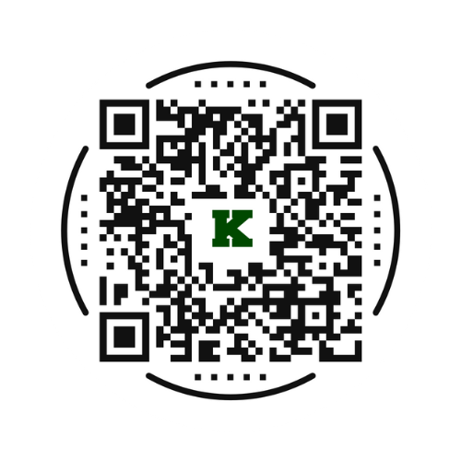
Stay Connected!
@alb_wonders2college
jordan.roberts@kcs.k12.nc.us
(704) 932-6125 ext. 21973

