Slide 1
Georgia Milestones parent information session
Sawyer Road Elementary
Grades 3-5

Slide 2
Georgia MilestoneS
Grades 3-5, online administration with scratch paper
ELA & Math: Grade 3 and Grade 4
ELA, Math, Social Studies, & Science: Grade 5
Selected (multiple choice), technology-enhanced (drag or click), and constructed (typed) responses
Criterion-referenced items (scored) to show mastery of standards
Norm referenced items (some scored) to provide feedback for national norming
Field test items (unscored) to develop new items
Notes:
STEPH, VIDEO

Slide 3
General Test Parameters
ELA will consist of 3 sections, 1 of which will focus mainly on writing
Mathematics will consist of 2 sections
Science will consist of 2 sections (5th Only)
Social Studies will consist of 2 sections (5th Only)
Notes:
NIK

Slide 4
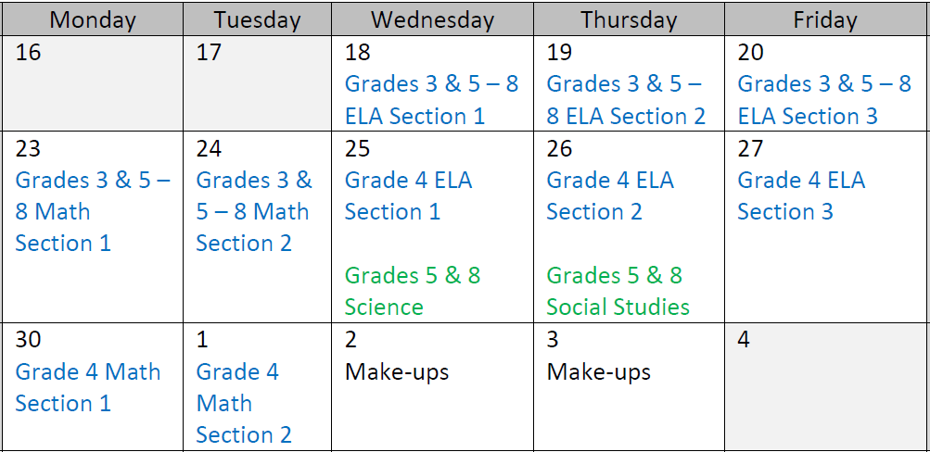

Test schedule
APRIL
RETEST SCHEDULE
MAY
Notes:
NIK

Slide 5
English Language Arts
Criterion-Referenced Scored Items
Total Number of Items: 43
Total Number of Points: 55
Breakdown by Item Type:
38 Selected Response (1 point each, 10 of which provide Norm Reference Test feedback)
1 Technology Enhanced Response (2 points)
2 Constructed Response (2 points each)
1 Extended Constructed Response (4 points)
1 Extended Writing Response (7 points)
Items Not Scored
10 NRT only
10 CR Field Test
Notes:
NIK

Slide 6
Writing at Every Grade
Constructed Response: Short response (2-4 sentences) to a question that can be answered by reading the source text
Extended Constructed Response: Longer response (1-2 paragraphs) writing a Narrative story connected to one or two source texts
Extended Writing Response: Longest response (multiple paragraphs) writing an Informational or Opinion piece connected to two source texts
DAY 1 90 minutes | DAYS 2 & 3 75 minutes
3 Selected Responses 1 Constructed Response 1 Extended Writing Response | 55 Selected Responses 1 Constructed Response 1 Extended Constructed Response
Notes:
NIK

Slide 7
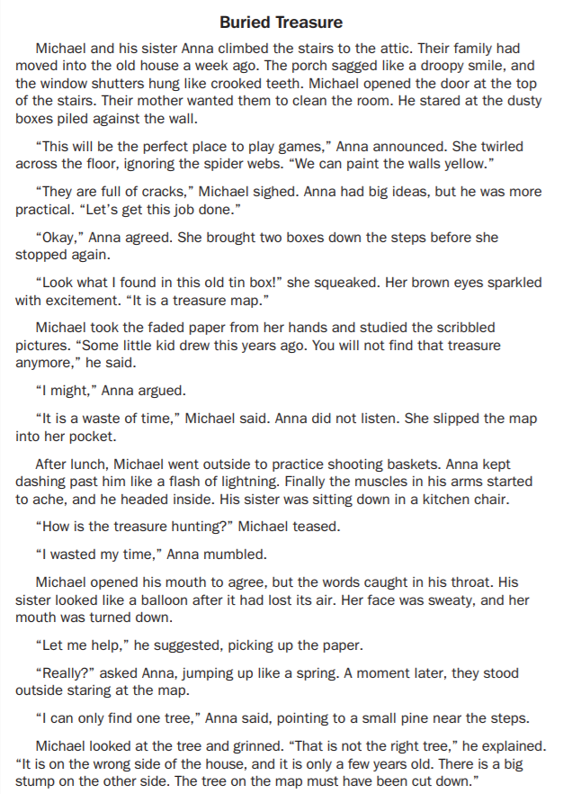
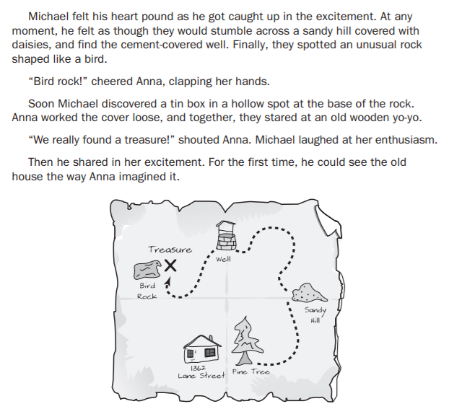
Notes:
NIK

Slide 8
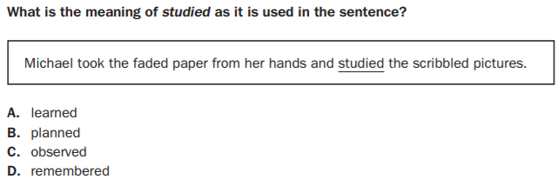
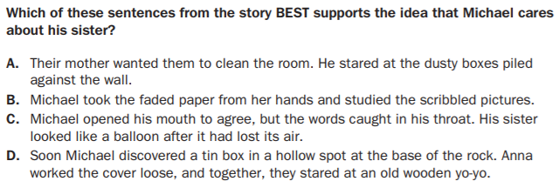
3rd Grade selected response
1-point, Depth of knowledge 2 & DOK 3
Notes:
NIK

Slide 9
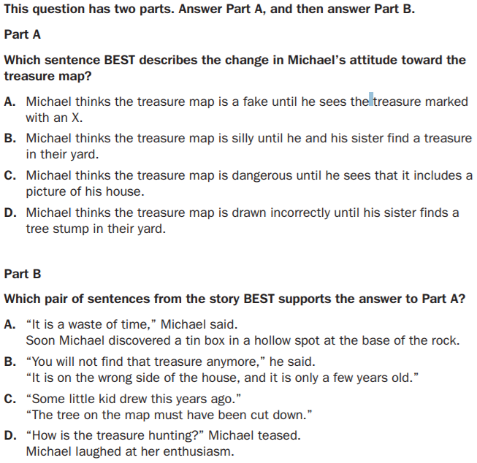
3rd Grade technology enhanced
2-point
Notes:
NIK

Slide 10
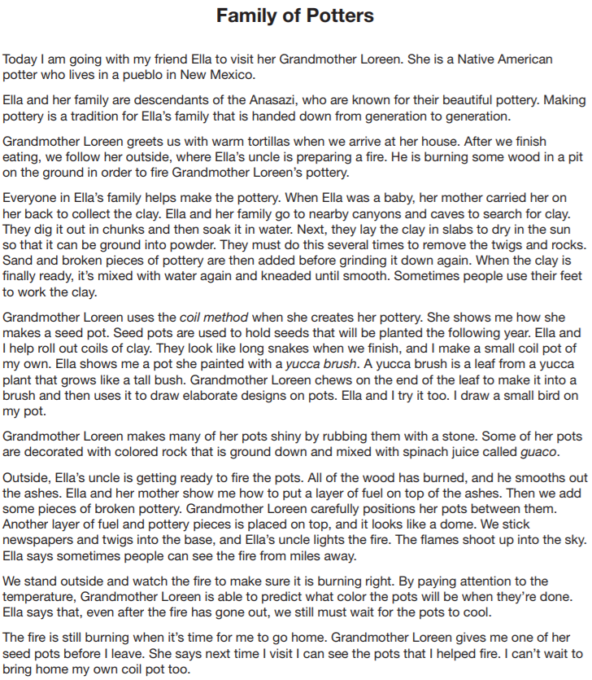
Notes:
3rd Grade Sample Passage, NIK

Slide 11
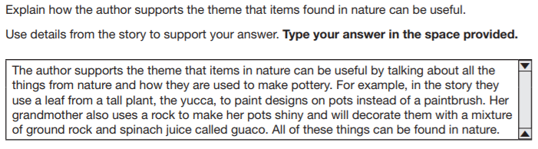
5th Grade constructed response
2-point
Notes:
NIK

Slide 12
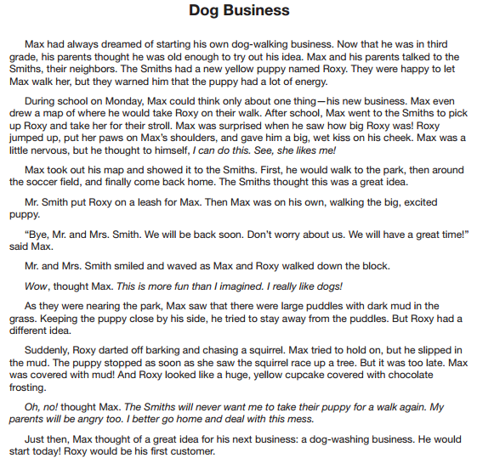
Notes:
3rd Grade Sample Passage, NIK

Slide 13
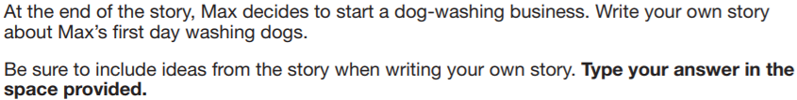
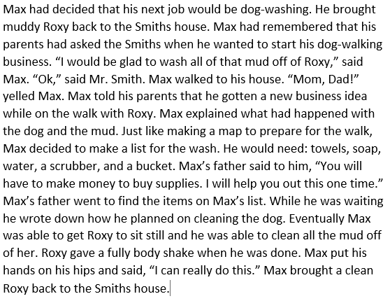
3rd grade extended constructed response
4-point
Notes:
NIK

Slide 14
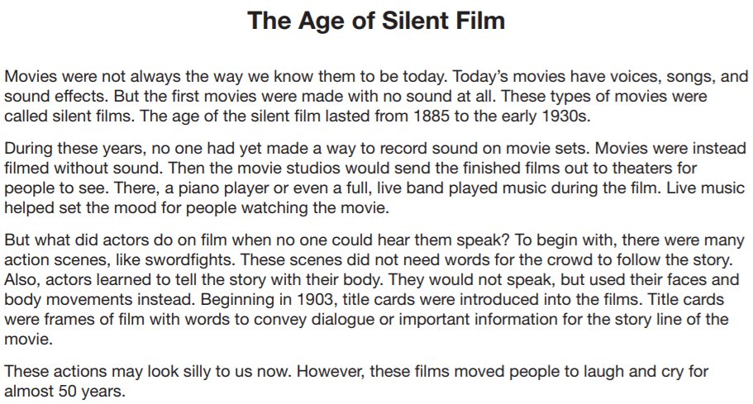
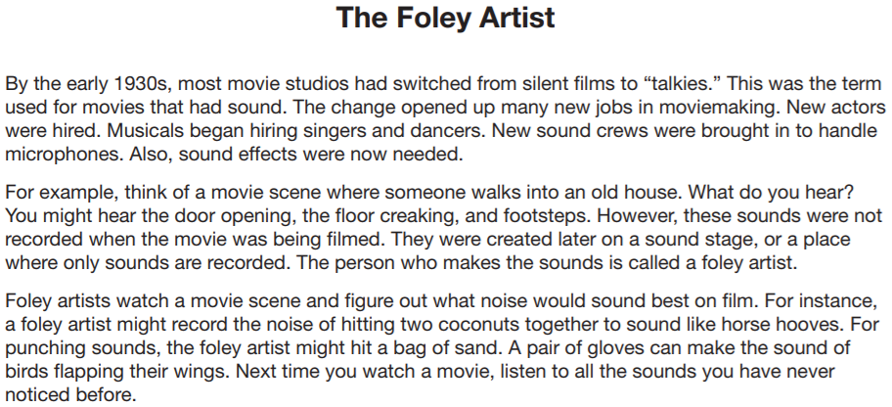
Notes:
4th Grade Sample Passages, LINDS

Slide 15
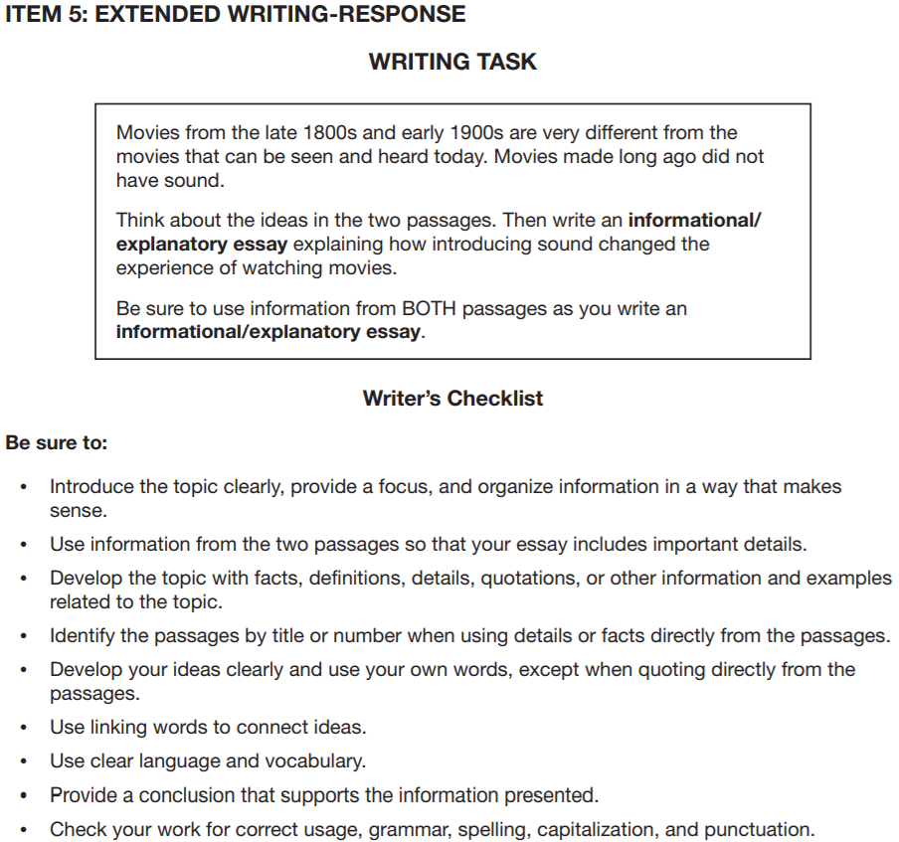
Notes:
LINDS

Slide 16
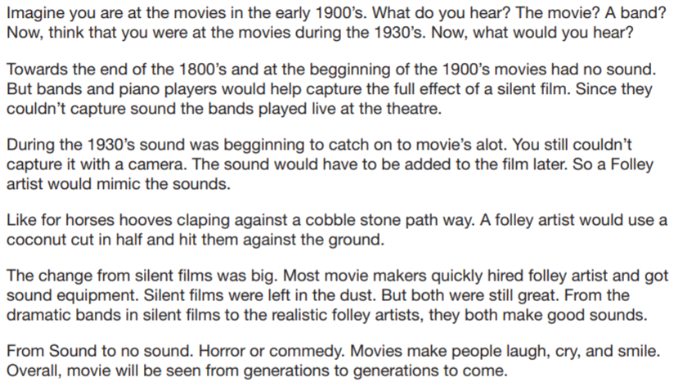
4th grade extended writing response informational essay 7-point
Notes:
LINDS

Slide 17

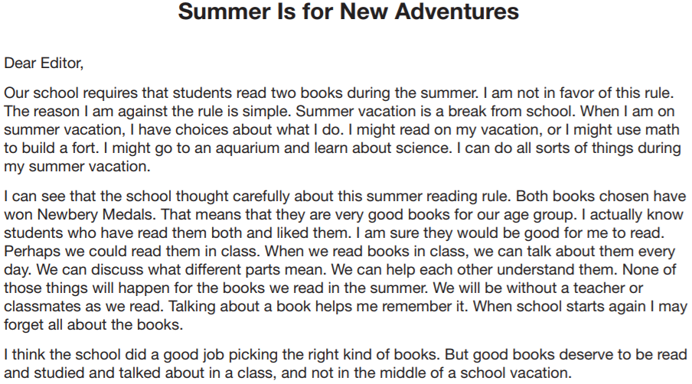
Notes:
LINDS

Slide 18
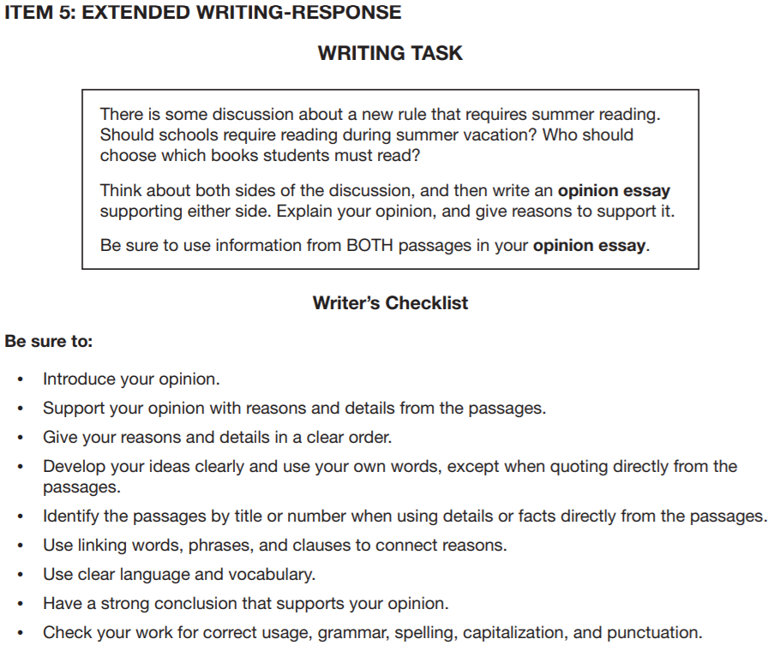
Notes:
LINDS

Slide 19

5th grade extended writing response opinion essay 7-point
Notes:
LINDS

Slide 20
mathematics
Criterion-Referenced Scored Items
Total Number of Items: 52
Total Number of Points: 58
Breakdown by Item Type:
48 Selected Response (1 point each, 8 of which provide Norm Reference Test feedback)
1 Technology Enhanced Response (2 points)
2 Constructed Response (2 points each)
1 Extended Constructed Response (4 points)
Items Not Scored
12 NRT only
9 CR Field Test
Notes:
NIK

Slide 21
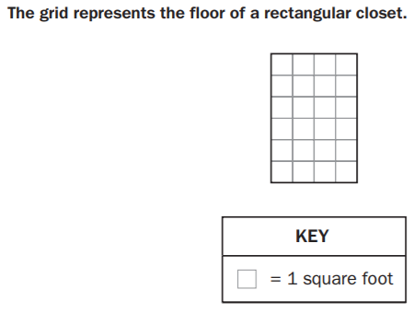
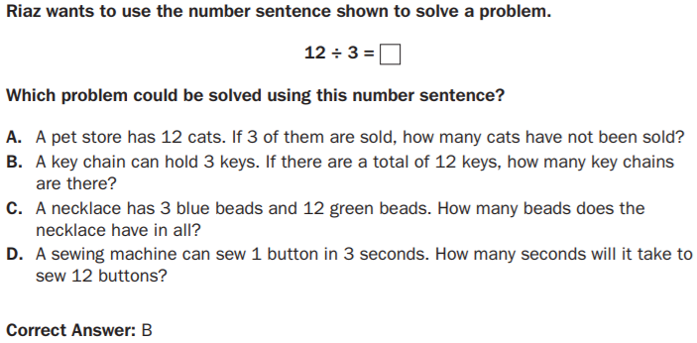
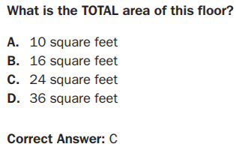
3rd grade selected responses
1-point, DOK 1 & dok 3

Slide 22
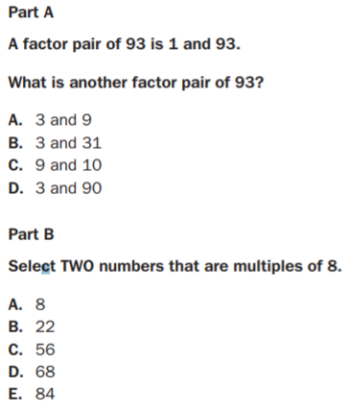
4th grade technology enhanced
2-point

Slide 23
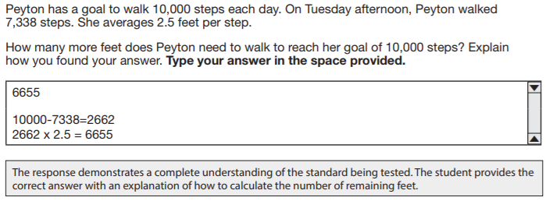
5th grade constructed response
2-points
I got 6655 feet. I took 10,000 times 2.5 to get 25,000 and 7338 times 2.5 to get 18,345 and then I subtracted.

Slide 24
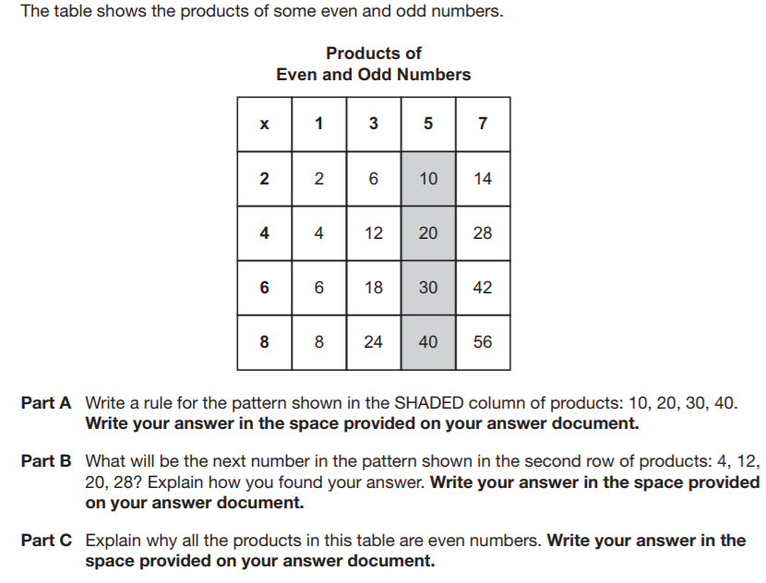
3rd Grade extended constructed response
4-point

Slide 25
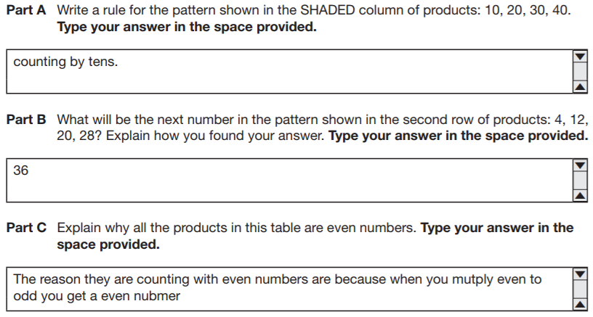
The rule in this pattern is counting up by tens.
The next number will be 36 in this pattern. I multiplied 4 x 9
All of these products on this table are even numbers because they are all multiplied with at least one even number.

Slide 26
Science & social studies
5th grade only
Criterion-Referenced Scored Items
Total Number of Items: 56
Total Number of Points: 60
Breakdown by Item Type:
52 Selected Response (1 point each, 9 of which provide Norm Reference Test feedback)
4 Technology Enhanced Response (2 points each)
Items Not Scored
11 NRT only
9 CR Field Test
Notes:
NIK

Slide 27

Online Testing Experience www.gaexperienceonline.com
Notes:
LINDS LEAD TOOLS, PARENTS EXPLORE

