Slide 1

Could my child be gifted?
A basic guide to giftedness, assessment,
and the Gainesville ISD program of services

Slide 2
What does “gifted” mean?
The Texas Education Agency defines giftedness as:
“...a child or youth that performs at or shows the potential for performing at a remarkably high level of accomplishment when compared to others of the same age, experience, or environment, and who
exhibits high performance capability in an intellectual, creative, or artistic area
possesses an unusual capacity for leadership
excels in a specific academic field
(Texas Education Code 29.121)
A reminder from TAGT: “...it is crucial to emphasize that being identified as gifted and talented is not a badge of honor, not a reason for bragging, nor a reward for good behavior. It is an educational need.”

Slide 3

What does “gifted” mean?
In Gainesville, our Gifted and Talented program currently services those students that excel in a specific academic field and/or show high performance capability in an intellectual area.
At this time, we are unable to test for and service artistic abilities or leadership skills.
However, we do offer art classes at every grade level and various leadership opportunities on our campuses for students to participate in. If you need help fulfilling this need, please contact your campus’s G/T teacher.

Slide 4
How do I know if my child should be tested?
Your child may:
Understand subjects far beyond their peers
Show extreme emotional depth and sensitivity
Have many questions and curiosities
Be very enthusiastic about unique topics and interests
Be behind their peers socially and may prefer talking to adults
Absorb information quickly and feel annoyed by repetition
Feel strongly about worldly issues
Solve problems creatively and have a huge imagination

Slide 5
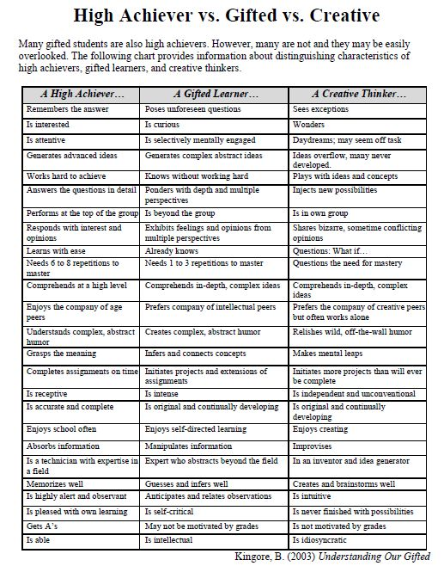
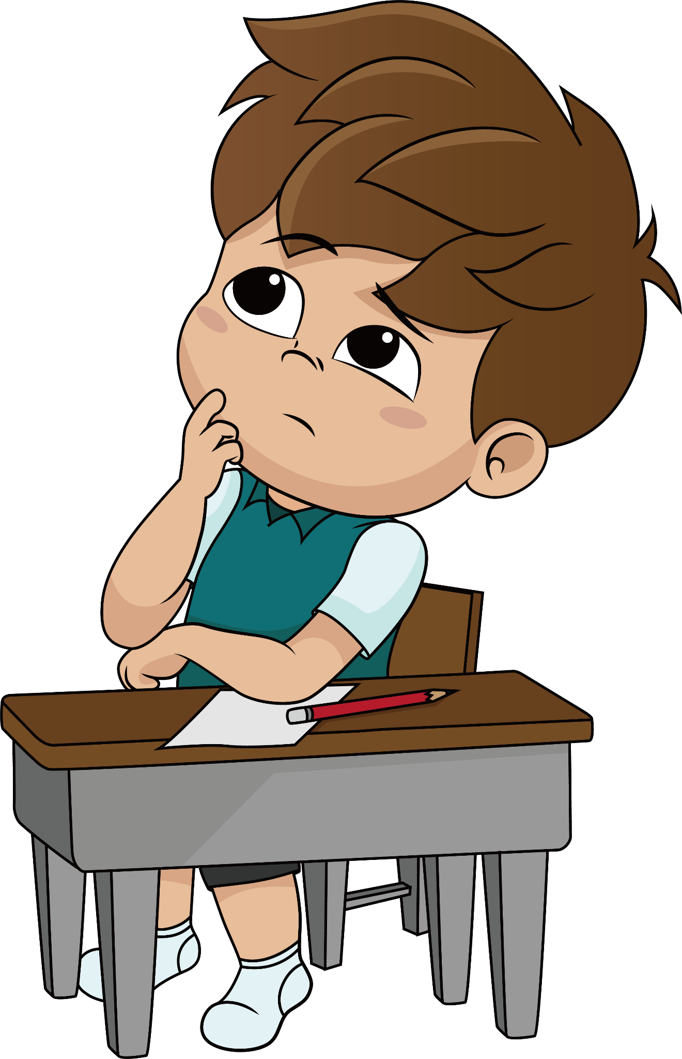

Slide 6
I need to refer my child for testing. How do I do that?
Please click on the link below. You’ll be taken to the district G/T page where you will find referral information.
Curriculum & Instruction / Gifted & Talented
After referring, the parent will be asked to complete and sign a Permission to Test form. Please make sure you return the Permission form to the appropriate person BY THE DUE DATE listed on the form.
REFERRALS MUST BE COMPLETED BY THE CUTOFF DATE FOR SPRING TESTING.
Late applications will carry over to be tested the following school year.

Slide 7
I referred my child and filled out the required forms. What’s next?
1) Testing:
Students will take a series of tests that measure their reasoning abilities. Two or three testing sessions are usually required and are scheduled during the months of January and February.
2) Committee:
Once all testing results are received, the campus G/T committee meets in order to review the findings and determine placement.
3) Notification:
You will receive a letter from the G/T department notifying you of the committee’s decision and guiding you to next steps.
Our goal is for all notification letters to be distributed prior to spring break as referral numbers vary.

Slide 8
What happens in the G/T class?
Driven by student inquiry and initiative, the gifted and talented class focuses on authentic,
real-world problem solving through the use of long-term student designed projects. Students will
further develop written and verbal communication skills, practice critical thinking, and
demonstrate imaginative skills and time management, while learning to collaborate with peer
teams and outside experts. The goal of this class is to provide students with the necessary skills
to think creatively, readily accept challenges, and take control of their own learning, ultimately
preparing them to engage in a post-secondary environment.

Slide 9
What happens in G/T class?
Elementary pull-out classes are taught by G/T trained teachers and meet for 45 minutes per week.
Intermediate and Junior High students are served through a dedicated G/T Advisory period.
High school students are also served through a dedicated G/T Advisory, and may choose from advanced coursework such as AP and dual credit courses as well as CTE and a variety of elective classes.

Slide 10
What if my child doesn’t qualify for G/T services?
All of our core classroom teachers have been trained to accommodate a student’s individual needs. If s/he needs a challenge in a particular area, please contact your child’s teacher and let them know.
Should your child want to retest for G/T, simply refer them again next year.

Slide 11
Who can I contact for help or more information?
Tamra Warner
Advanced Academics Coordinator
twarner@gainesvilleisd.org
Edison – Whitney Vogl
Chalmers – Lori Nixon
Intermediate – Kelly Stogner (6), Donicio Trujillo (5)
Junior High – Jessica Pederson (7), Diana DeSantiago (8)
High School – Jonathon Phelps

