Slide 1




Long Range Financial Analysis
Data Driven Strategic Financial Planning
Dunkirk City School District
Learning For All...Whatever It Takes!
Dr. Rick Timbs
President/CEO
R. G. Timbs, Inc.
Expert@rgtimbsinc.net
January 2022
School District:
Finance
Strategic Plans
Leadership
Educational Development
R. G. Timbs, Inc. is Registered with:
© R. G. Timbs, Inc. 2022

Slide 2

Data Sources:
District Submissions to SED of the Form ST-3 (5 years prior)
State Education Department (NYSED) website financial calculations
School District’s External Auditor Reports/Recommendations
Documents of Capital Expenses, Debt etc.
Buses and Capital Projects Data:
    Bonds, Bond Anticipation Notes
    Use of Capital Reserves
    Debt Service Schedules
All Other Expense Driven State Aid
Interviews with the Superintendent and Interim Business Official
Examination of Tax Cap Calculations
Use of Debt Service Fund or Reserves
Reports of the Comptroller of the State of New York (OSC)
Use of Funds (Appropriated Fund Balances, Unappropriated Fund Balances)
Projected Teachers Retirement System Rates and Employees Retirement System Rates
© R. G. Timbs, Inc. 2022

Slide 3
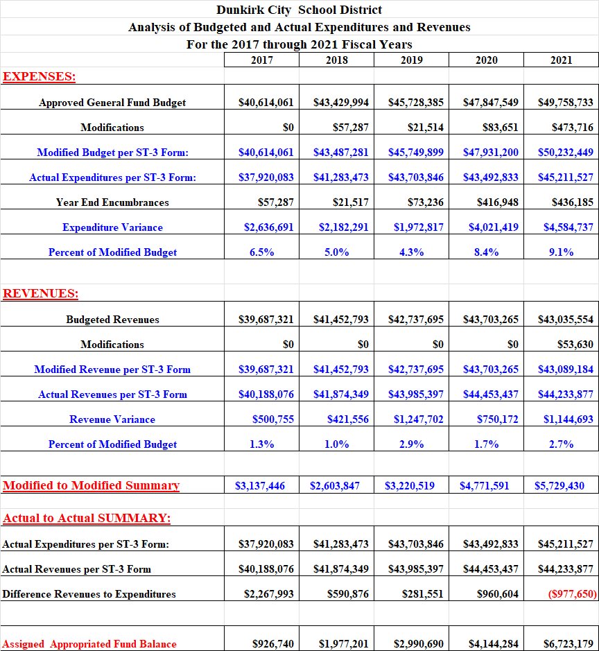
© R. G. Timbs, Inc. 2022

Slide 4
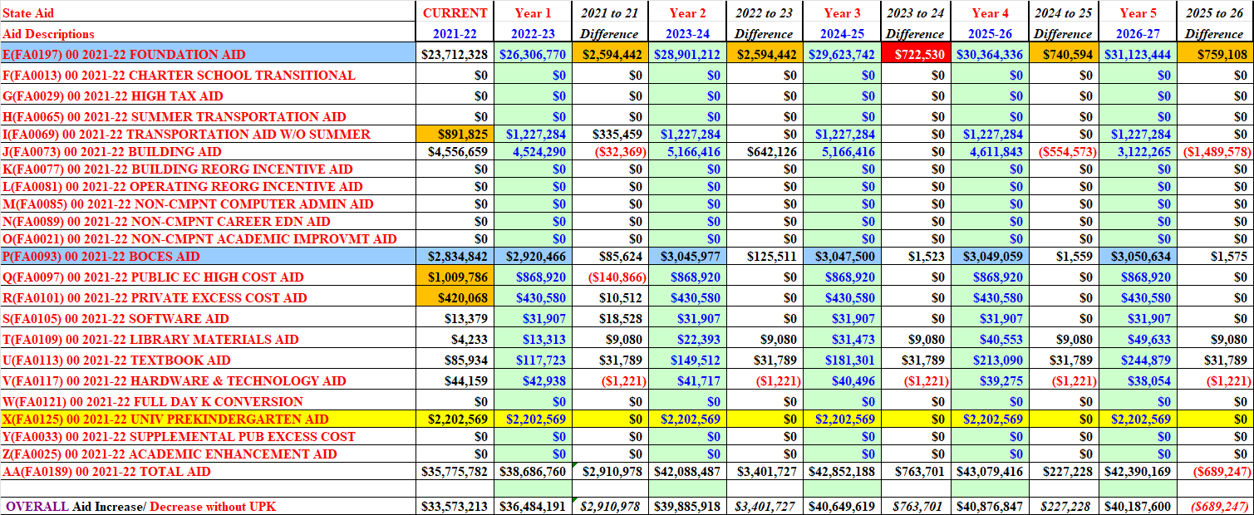
State Aid
© R. G. Timbs, Inc. 2022

Slide 5
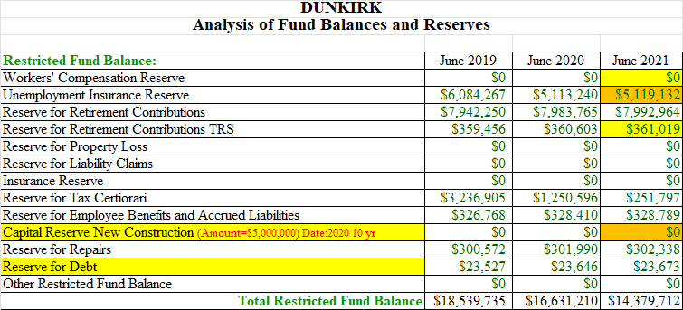
© R. G. Timbs, Inc. 2022

Slide 6
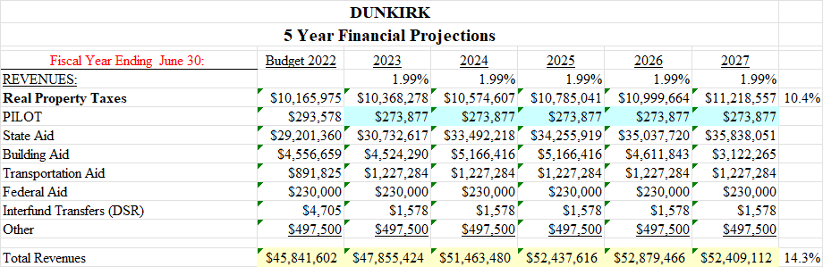
Assumptions Revenues: Tax increase 1.9% and 1.9% Thereafter State Aid Slight but Stable Increase Variable Transportation Aid Building Aid follows Debt Service Schedule* Federal Aid remains Stable Expenditures: Follow contractual Obligations No notable changes in staff patterns Stable ERS and TRS increased costs*
© R. G. Timbs, Inc. 2022

Slide 7
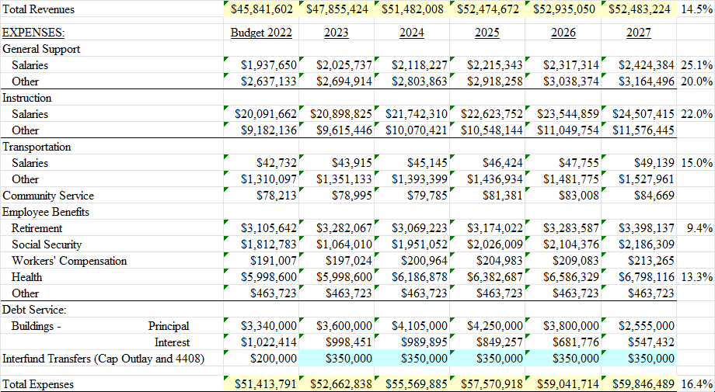
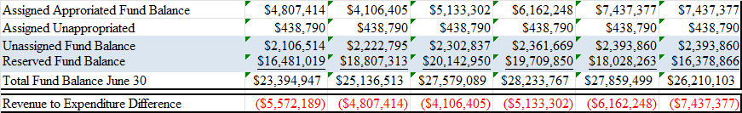
© R. G. Timbs, Inc. 2022

Slide 8
RECOMMENDATIONS
Carefully and Strategically …
Maintain a stable the budget by tracking expenses:
  Examine 2021-22 budget for sustainability and other issues (Carry Over/Reallocations).
  Budget process is always difficult due to the number of assumptions (Extrapolate cost estimates).
  Maintain adequate cash flow to ensure maintenance of quality educational program.
  Attempts for cost reductions should be examined (those away from student programs first) to mitigate escalation of expenses.
  Re-evaluate the use of Textbook, Library and Software Aid
  Reevaluate purchases and staff needs. Examine the possibility of attrition and breakage. Aim for greater efficiency.
  Inflation and other cost pressures will be substantial.
  Beware of possible State Aid Fiscal Cliff 2024-25
Annually reevaluate Reserve and Fund Balance amounts for sustainability and liabilities. When and if possible:
  Build UP TRS Reserve to cover potential escalations in cost
  Reallocate a significant amount of Unemployment Reserve to Capital Reserves(s)
  Further build and Use new Capital Reserves to ensure Building Integrity and Eliminate Tax impact of Capital Construction
  Consider build and Use new Capital Reserves to ensure Eliminate Tax impact of these periodic expenditures (Vehicles, Equipment, Technology for instance)
The Longevity of the New Federal Grants could be problematic.
  Exhibit caution with use of new Federal Funding streams (Fiscal Cliff 2024-25 and 2025-26)
  Use a combination of Supplement and Supplant as practicable.
State Aid: Increases in Foundation Aid will be significant UNTIL Save Harmless Status is reached; expense driven aid continues in current law.
Monitor the Tax Cap… note growing use of Appropriated Fund Balance
© R. G. Timbs, Inc. 2022

Slide 9
Long Range Financial Analysis- Questions?
Data Driven Strategic Financial Planning
Dunkirk City School District
Learning For All...Whatever It Takes!
Dr. Rick Timbs
President/CEO
R. G. Timbs, Inc.
Expert@rgtimbsinc.net
January 2022
© R. G. Timbs, Inc. 2022

