Slide 1

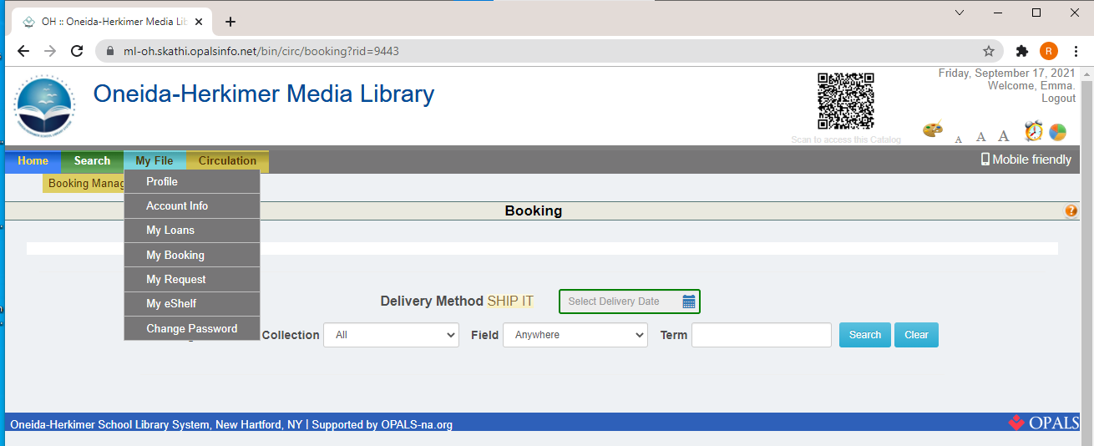
Check the Status and/or Cancel a Booking
step 1
Click the My File tab
And select My Booking

Slide 2
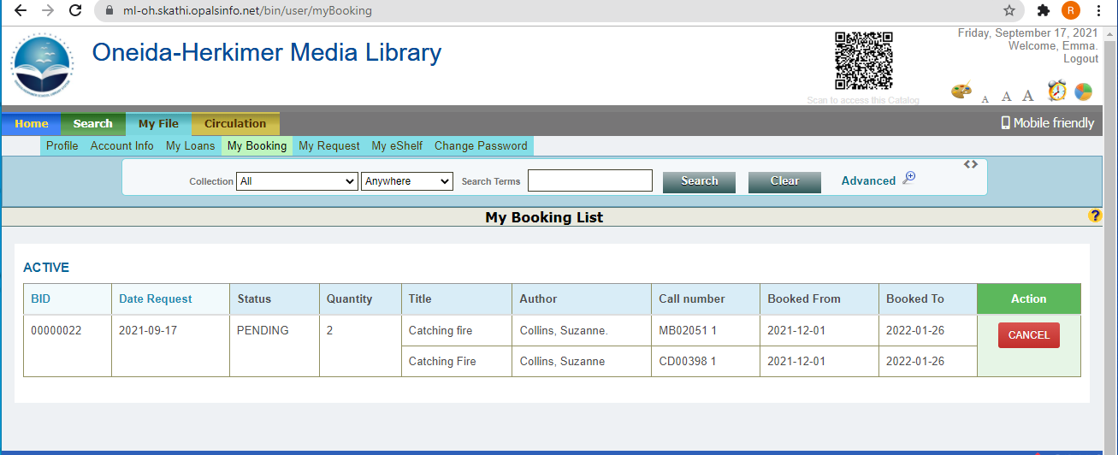
Check the Status and/or Cancel a Booking
step 2
The system will display a list of your bookings.
If you need to cancel a booking, click the CANCEL button.
The status (pending, shipped, etc.) will be displayed here.

Slide 3
Check the Status and/or Cancel a Booking
step 3
Click the My File tab
Select My Booking

Slide 4
Check the Status and/or Cancel a Booking
step 4
The status will be listed here:
To cancel a booking:
Find the one you wish to cancel
And click CANCEL.

Slide 5
THANKS!
Do you have any questions?
Email us at
mediacenter@oneida-boces.org

