Slide 1

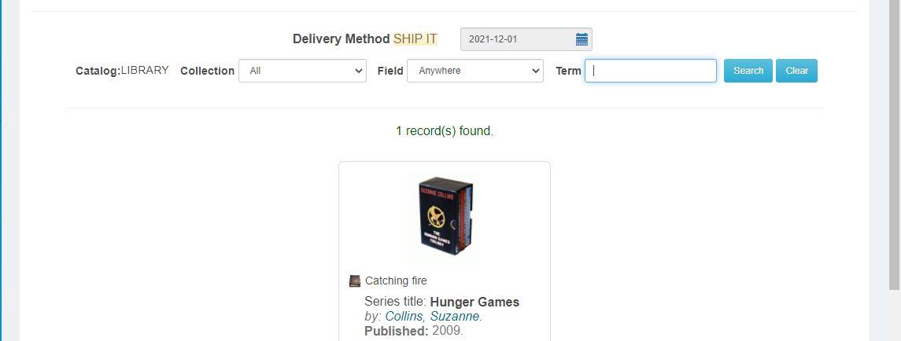
Book Multiple Titles
step 1
**ONLY FOR ITEMS NEEDED FOR THE SAME DATE **
If you have added items to the cart and want to add another title to your book request FOR THE SAME DATE,
Enter in a new term and click Search.
You can also narrow your search by format using this drop down menu.
NOTE: If you need items for multiple dates, you must start a new booking.

Slide 2
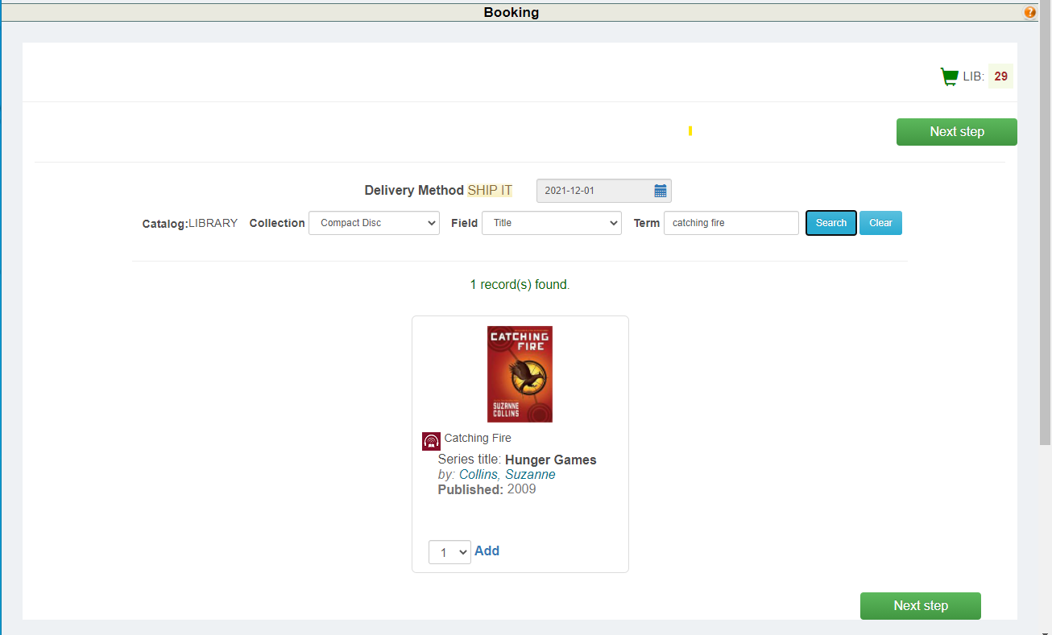
Book Multiple Titles
step 2
**ONLY FOR ITEMS NEEDED FOR THE SAME DATE **
Once you find the title want,
Select the number of copies from the drop down menu
And click Add.
The item(s) will automatically be added to your cart.
Click the Next Step button
and finalize your booking.

Slide 3
THANKS!
Do you have any questions?
Email us at
mediacenter@oneida-boces.org

