Slide 1

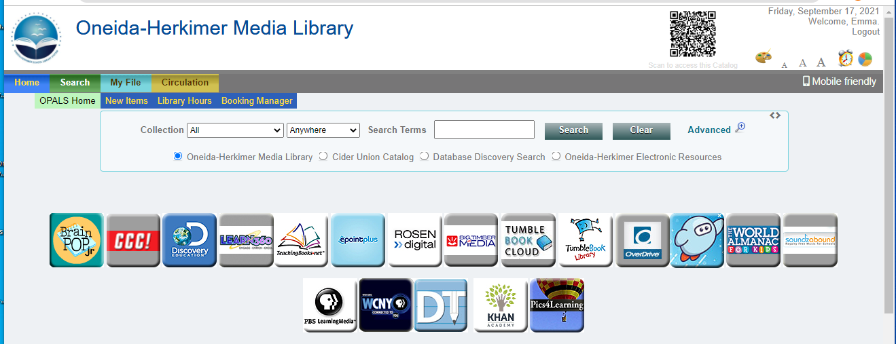
Book a Title
step 1
First, you need to find the title you want to book:
Type in a search term (title, author, keyword, etc.)
And click Search

Slide 2
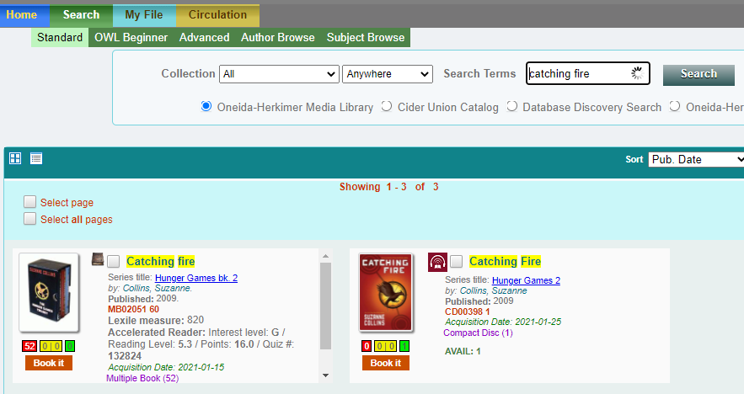
Book a Title
step 2
Once you find a title you want to book
Click Book It
Other important information:
format icon
format &
# of copies

Slide 3
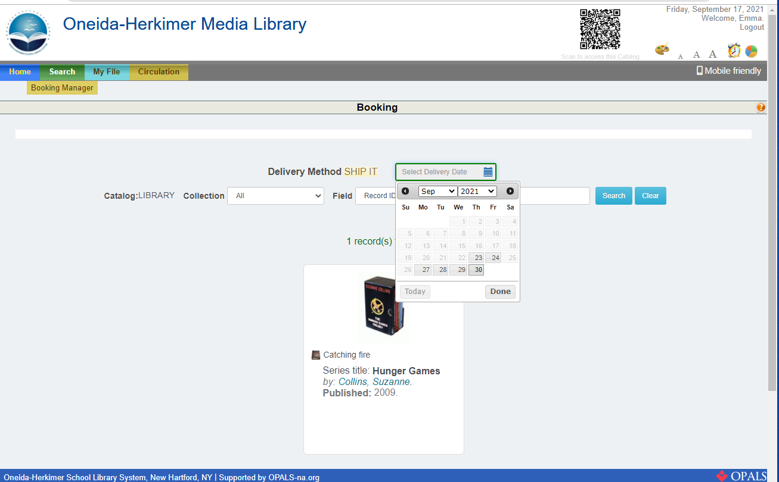
Book a Title
step 3
Click the Calendar button
And use the date picker to select the date you need the title.

Slide 4
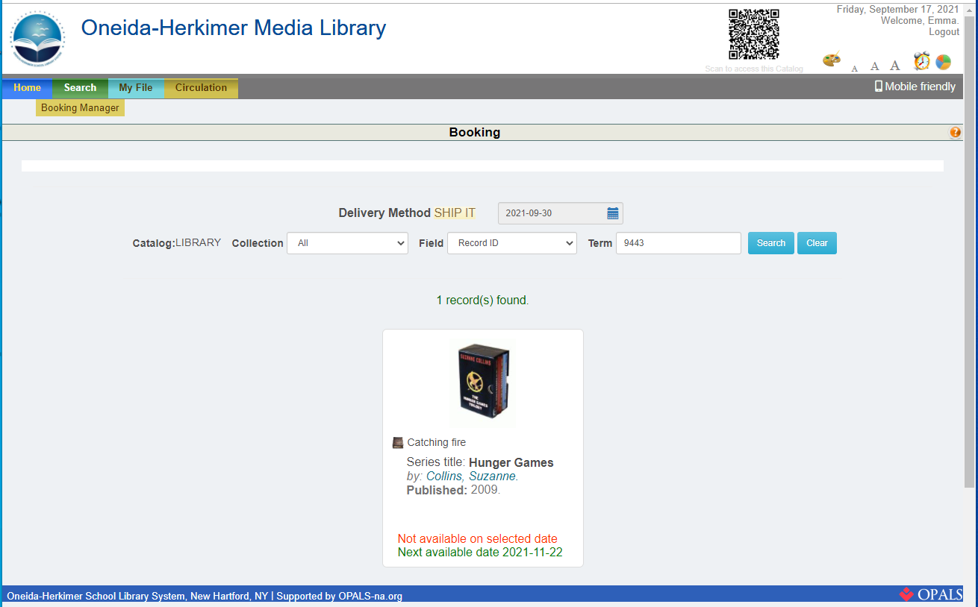
Book a Title
step 4
If you select a date that the title is not available, you will see an alert message:
Note that the system tells you when the title will be available.
To book this title, use the Calendar icon and date picker to select a different date.

Slide 5
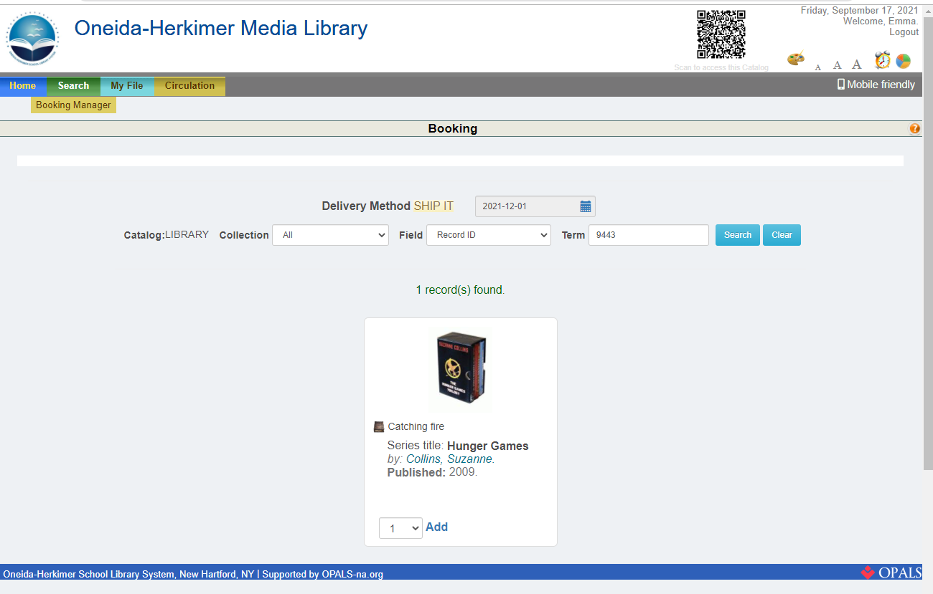
Book a Title
step 5
Use the drop down box to select the number of copies you need.
Then, click Add.

Slide 6
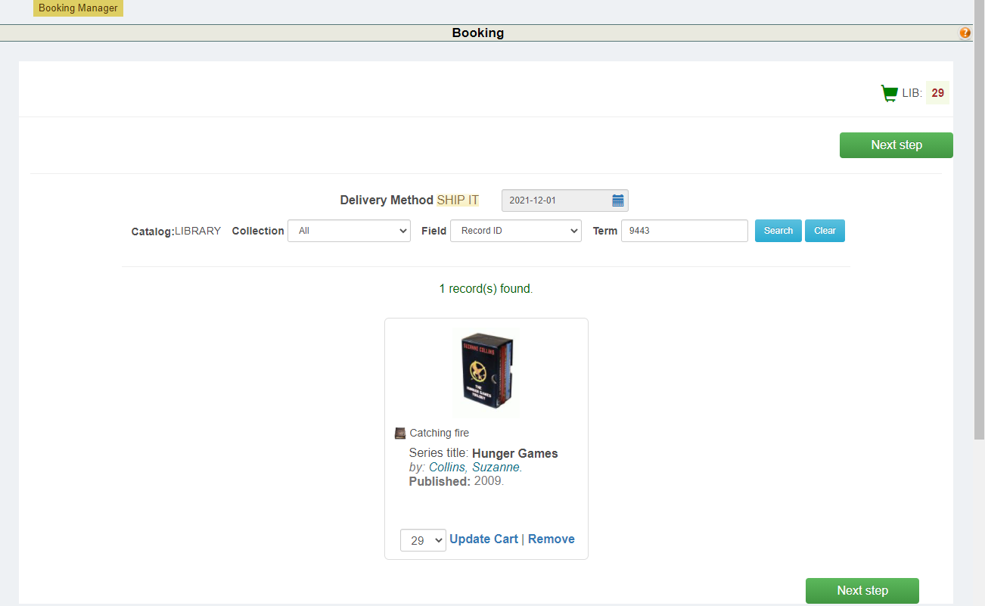
Book a Title
step 6
Click Next Step

Slide 7
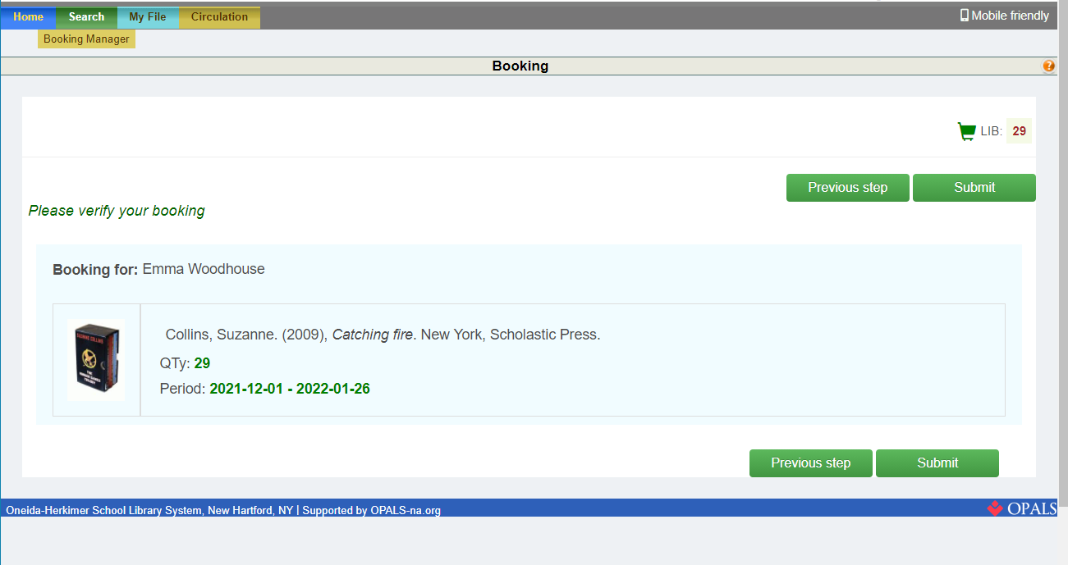
Book a Title
step 7
Review your booking.
Then, click Submit

Slide 8
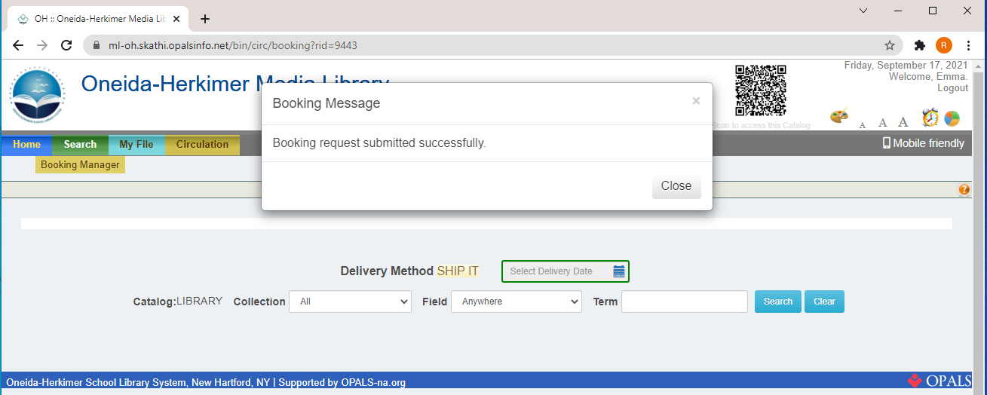
Book a Title
step 7
Once you have submitted your booking request, the system will display a message indicating your request was successful.

Slide 9
THANKS!
Do you have any questions?
Email us at
mediacenter@oneida-boces.org

