Slide 1

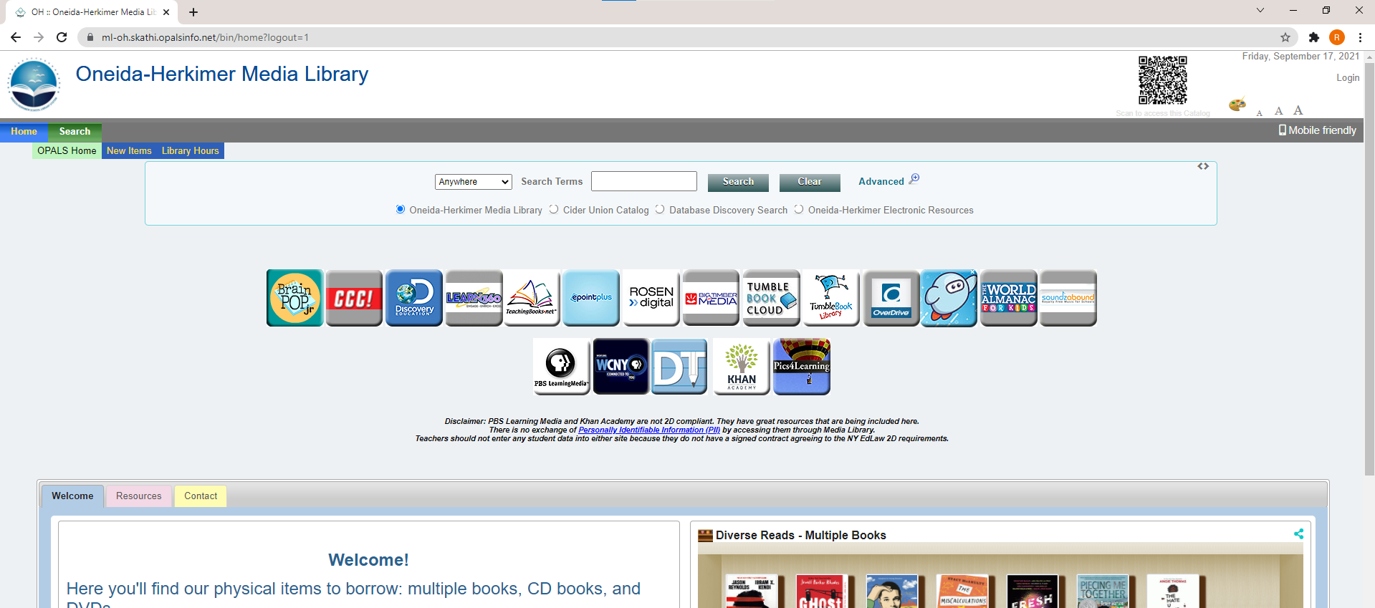
Login to OPALS
step 1
On the main OPALS screen, click Login

Slide 2
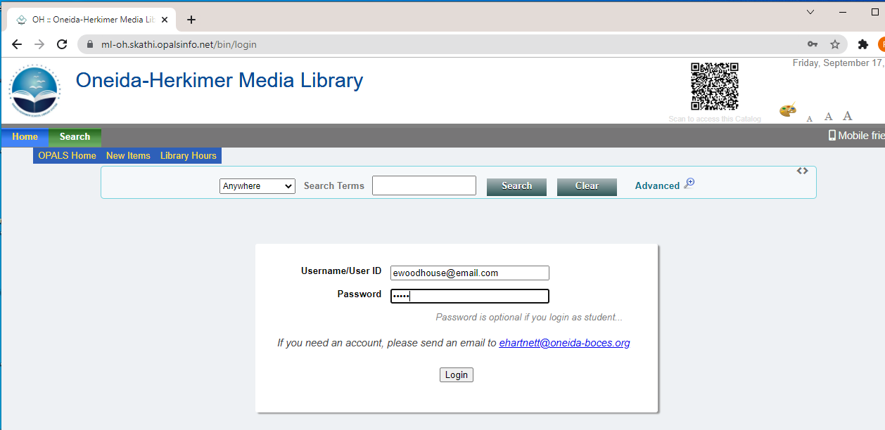
Login to OPALS
step 2
Enter:
Username: your email address
Password: media
And click login

Slide 3
THANKS!
Do you have any questions?
Email us at
mediacenter@oneida-boces.org

