Slide 1

How to use the
BOOKING MODULE
With OHM BOCES SLS OPALS

Slide 2
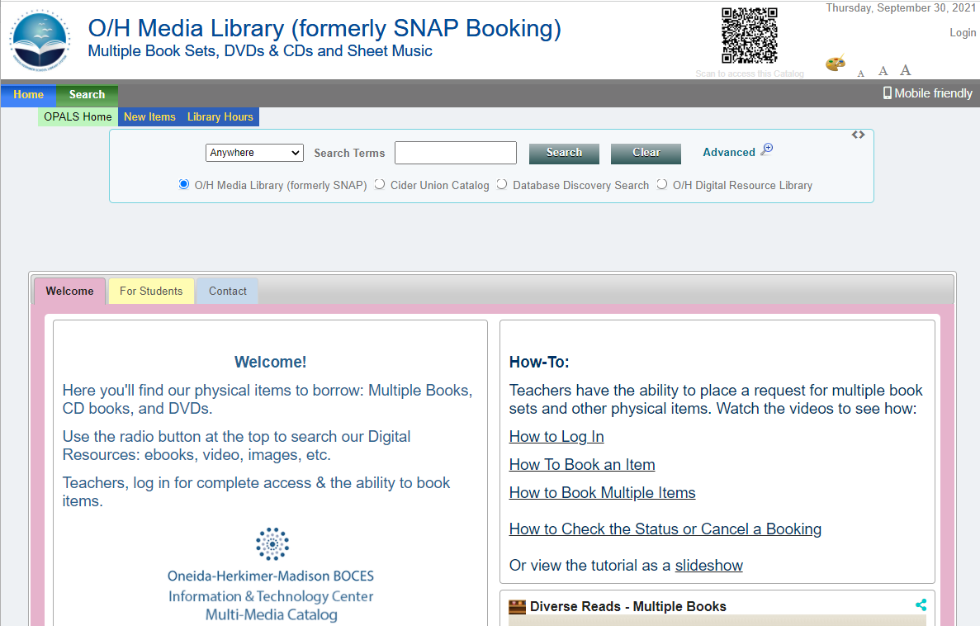

MAIN MENU
Click on a link below for information on how to
Click the play button to watch the video on how to use the entire booking system:
Login to OPALS
Book a title
Book multiple items (same date only)
Check status and/or cancel a booking
You can watch the video clip by clicking the play button.
You can return to this menu at any time by clicking on this icon

Slide 3
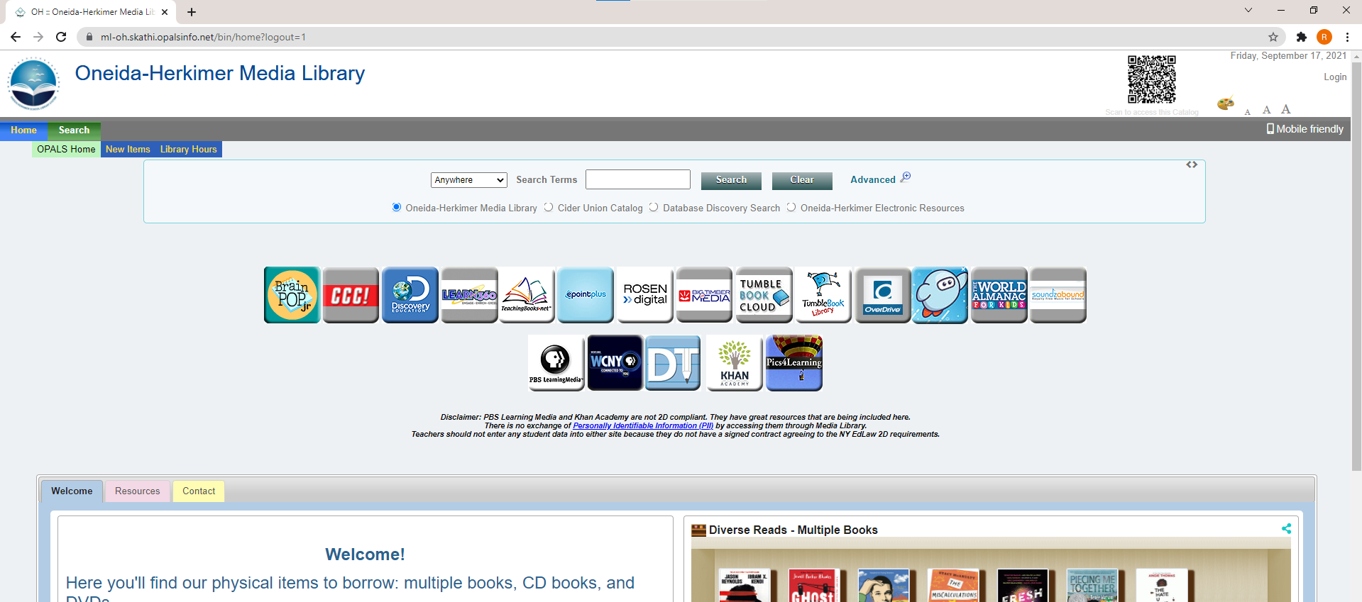
Login to OPALS
step 1
On the main OPALS screen, click Login

Slide 4
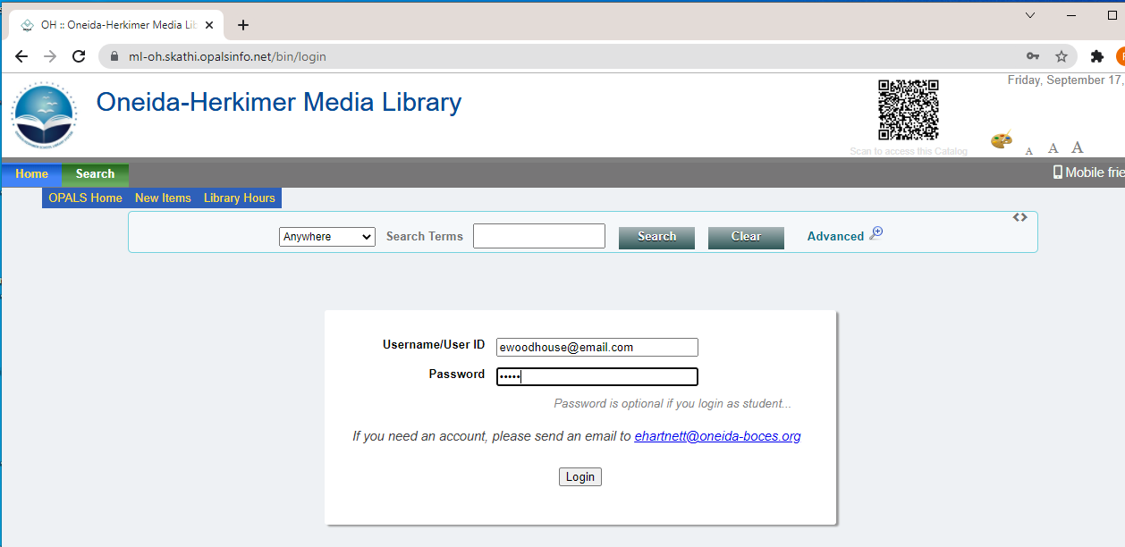
Login to OPALS
step 2
Enter:
Username: your email address
Password: media
And click login

Slide 5
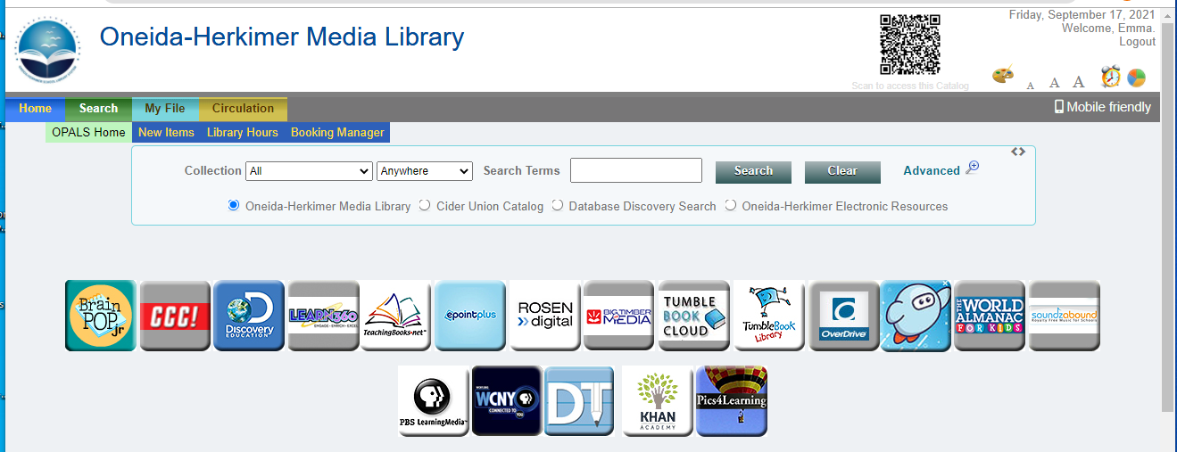
Book a Title
step 1
First, you need to find the title you want to book:
Type in a search term (title, author, keyword, etc.)
And click Search

Slide 6
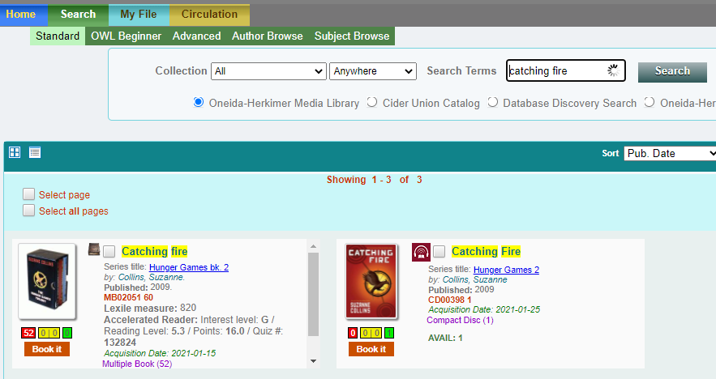
Book a Title
step 2
Once you find a title you want to book
Click Book It
Other important information:
format icon
format &
# of copies

Slide 7
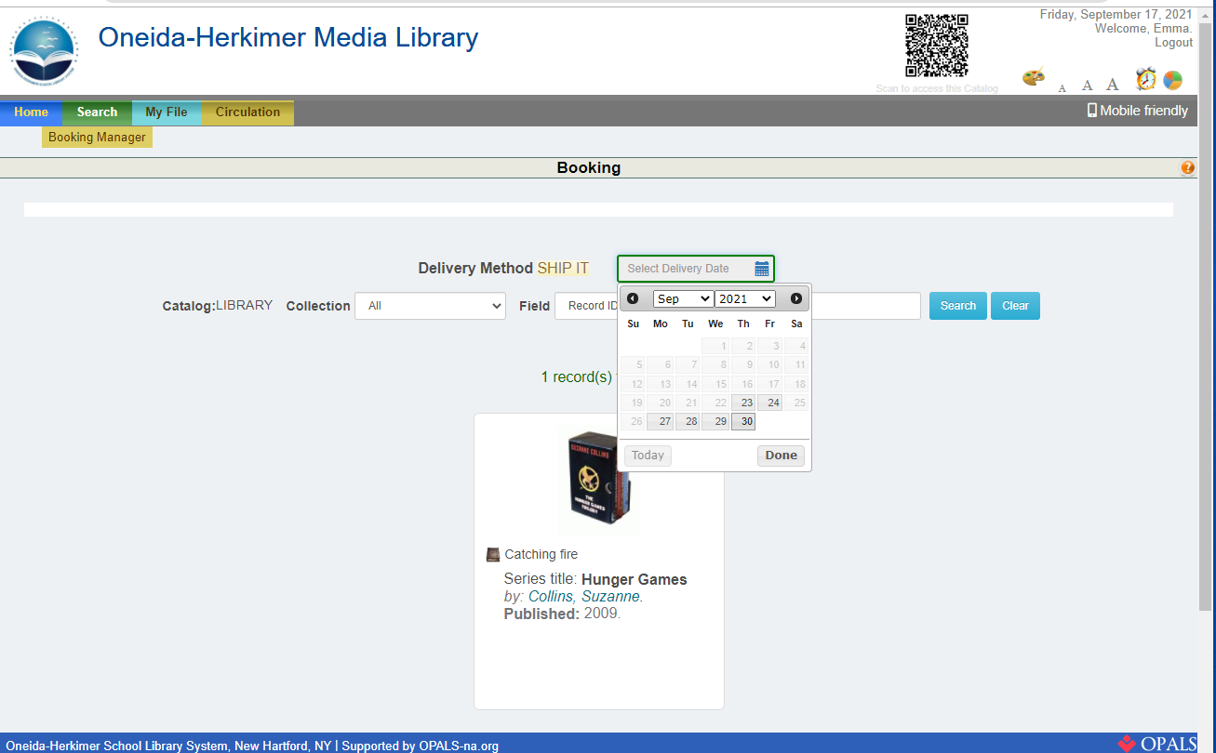
Book a Title
step 3
Click the Calendar button
And use the date picker to select the date you need the title.

Slide 8
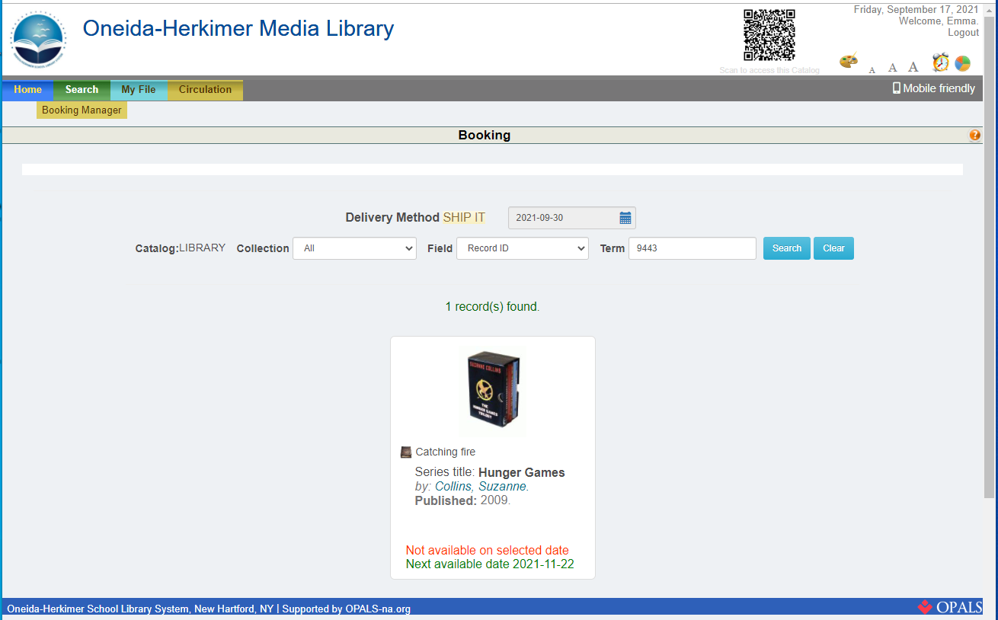
Book a Title
step 4
If you select a date that the title is not available, you will see an alert message:
Note that the system tells you when the title will be available.
To book this title, use the Calendar icon and date picker to select a different date.

Slide 9
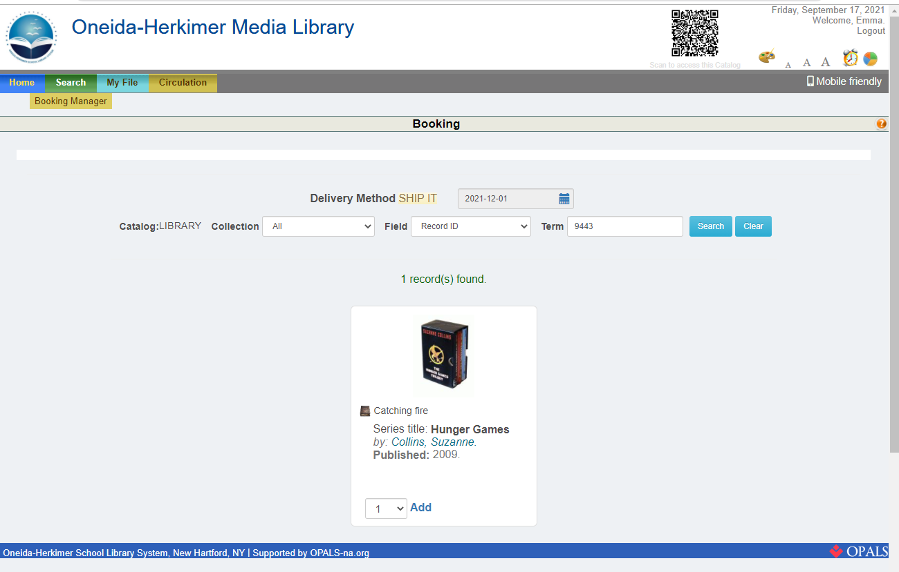
Book a Title
step 5
Use the drop down box to select the number of copies you need.
Then, click Add.

Slide 10
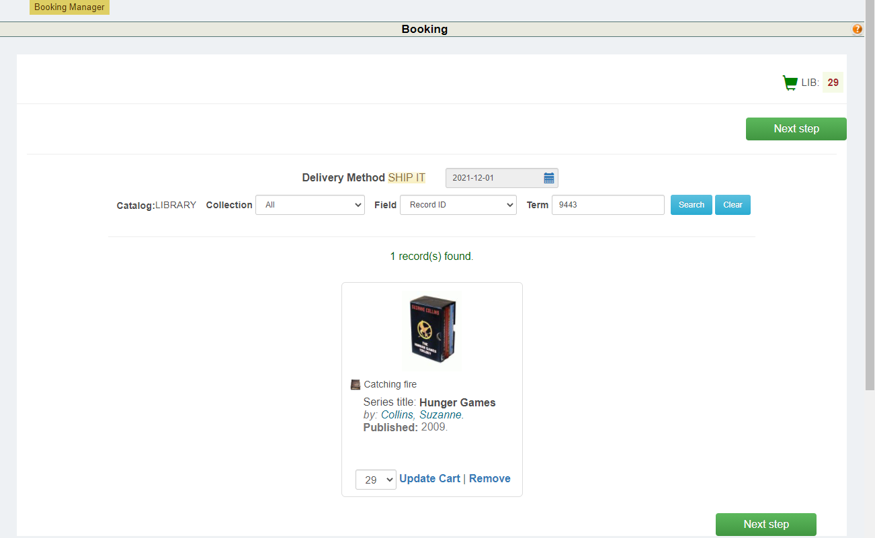
Book a Title
step 6
Click Next Step

Slide 11
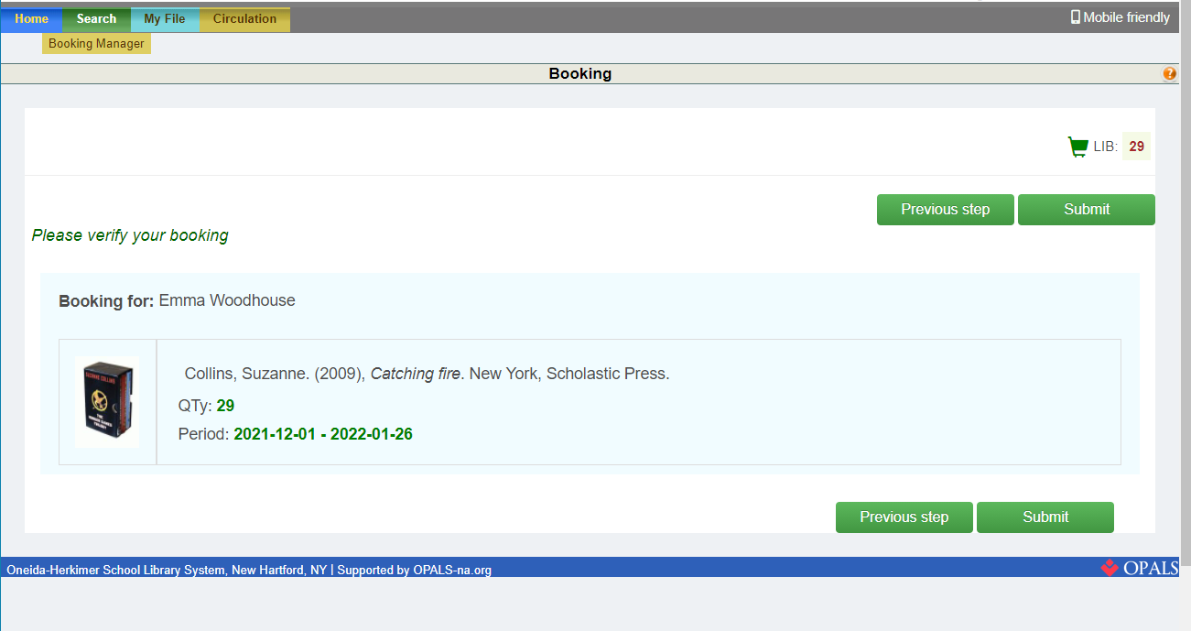
Book a Title
step 7
Review your booking.
Then, click Submit

Slide 12
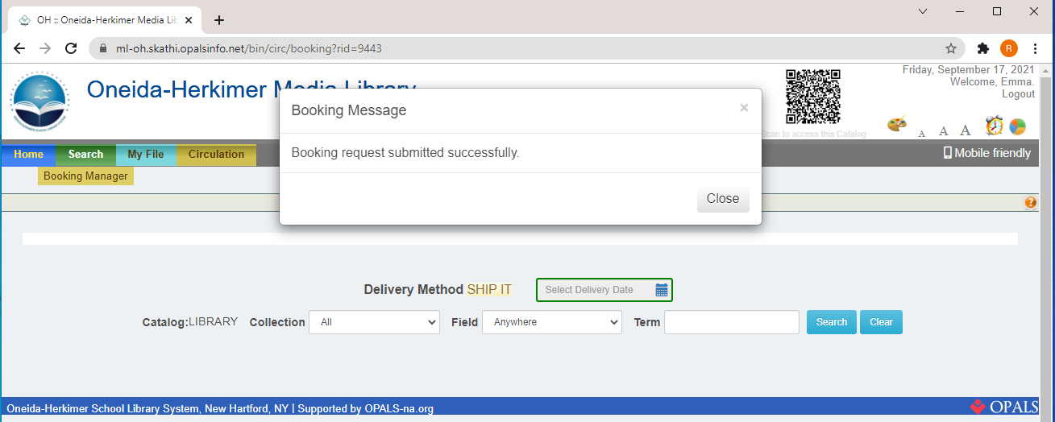
Book a Title
step 7
Once you have submitted your booking request, the system will display a message indicating your request was successful.

Slide 13
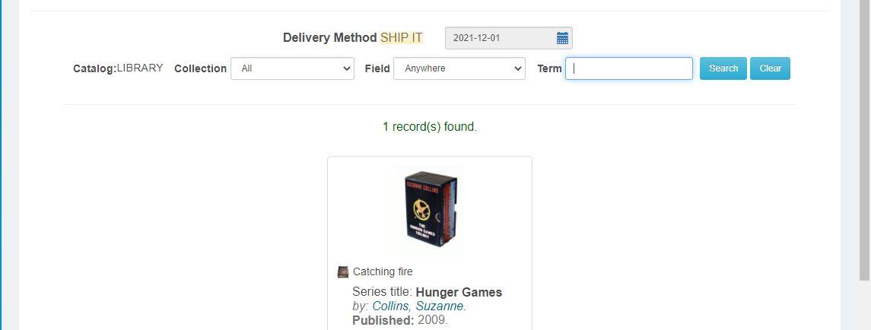
Book Multiple Titles
step 1
**ONLY FOR ITEMS NEEDED FOR THE SAME DATE **
If you have added items to the cart and want to add another title to your book request FOR THE SAME DATE,
Enter in a new term and click Search.
You can also narrow your search by format using this drop down menu.
NOTE: If you need items for multiple dates, you must start a new booking.

Slide 14
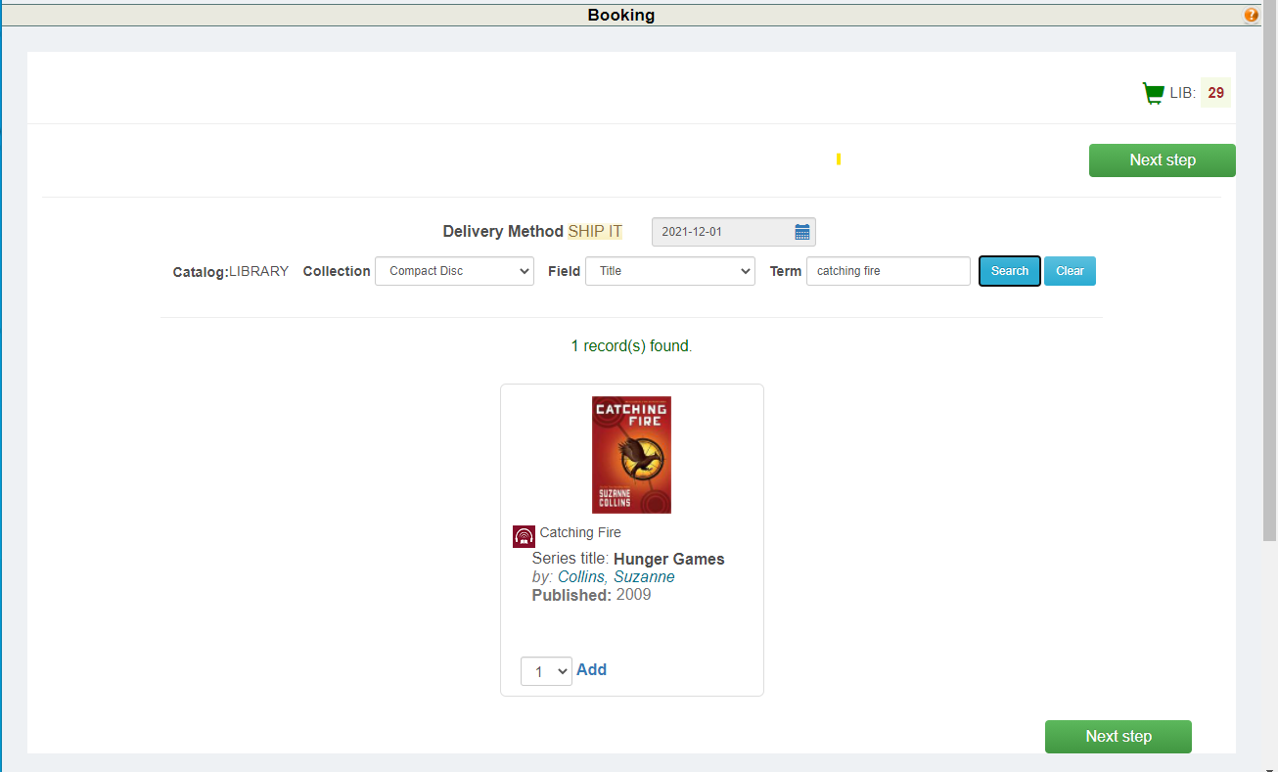
Book Multiple Titles
step 2
**ONLY FOR ITEMS NEEDED FOR THE SAME DATE **
Once you find the title want,
Select the number of copies from the drop down menu
And click Add.
The item(s) will automatically be added to your cart.
Click the Next Step button.
And follow the instructions to finalize your booking.

Slide 15
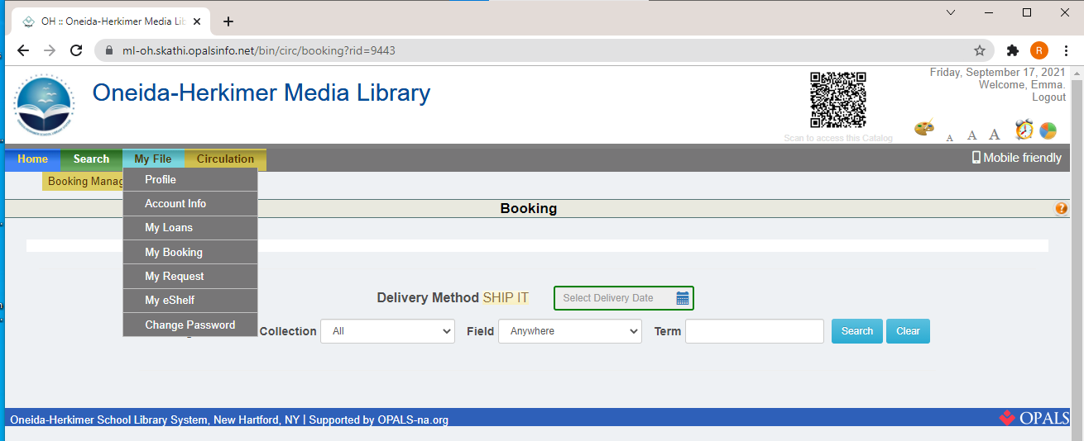
Check the Status and/or Cancel a Booking
step 1
Click the My File tab
And select My Booking

Slide 16
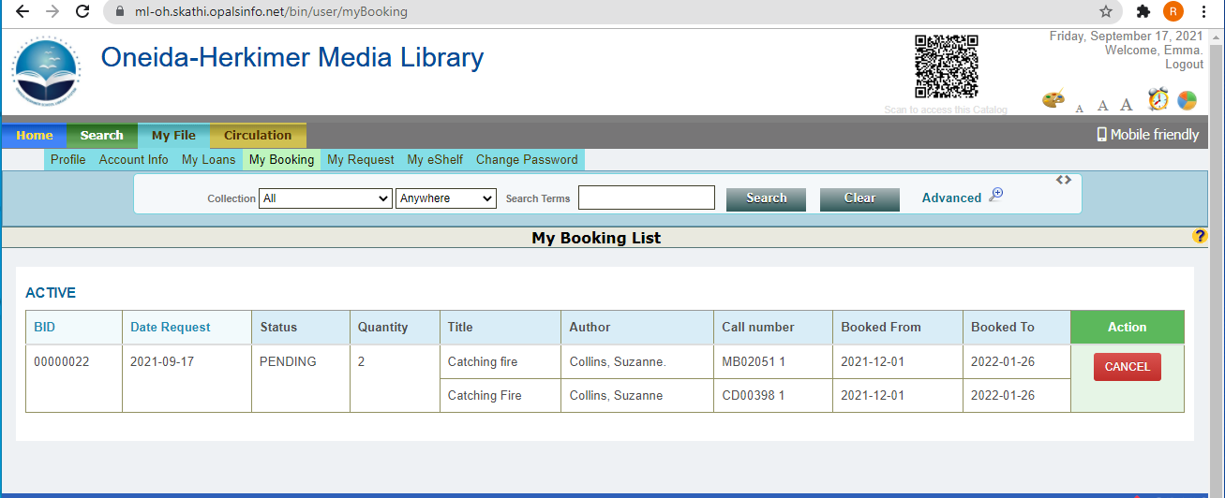
Check the Status and/or Cancel a Booking
step 2
The system will display a list of your bookings.
If you need to cancel a booking, click the CANCEL button.
The status (pending, shipped, etc.) will be displayed here.

Slide 17
Check the Status and/or Cancel a Booking
step 3
Click the My File tab
Select My Booking

Slide 18
Check the Status and/or Cancel a Booking
step 4
The status will be listed here:
To cancel a booking:
Find the one you wish to cancel
And click CANCEL.

Slide 19
THANKS!
Do you have any questions?
Email us at
mediacenter@oneida-boces.org

