Slide 1

Parenting in a Pandemic: Building resilience in Children and adolescents
Presented by Jim bluhm, m.d. and Shannon ODELL, Psy.d.

Slide 2
Jim bluhm, m.d.
Practicing pediatrician with Pediatric Associates of the Northwest for the last 29 years
He completed medical school at Oregon Health and Sciences University, then a pediatric residency at St. Louis University and OHSU
Chair of Pediatrics at Legacy Emanuel Hospital
President of the Children’s Health Alliance and Children’s Health Foundation.
He has two grown children ages 28 and 26

Slide 3
Shannon odell, psy.d.
Graduated with a doctorate in psychology from Xavier University in 2010
Has worked at many top-rated children’s hospitals around the country, including Cincinnati Children’s Hospital, The Cleveland Clinic Children’s Hospital, and Boston Children’s Hospital
Faculty appointment at Harvard Medical School from 2011-2014
Adjunct Faculty at University of Portland, 2014-2017
Staff Psychologist at Pediatric Associates of the Northwest in Portland/Tigard, 2014-2019
Currently owns and operates a private practice for children, teens, and young adults in Lake Oswego
2 step-children, a one-year old daughter, and a husband who very often requires some additional parenting

Slide 4
A Disclaimer
The advice given today does not constitute or serve as a substitute for professional psychological treatment, therapy, or other types of professional advice or intervention. If you have concerns about your or your child’s well-being, consult a physician or mental health professional.

Slide 5
A reminder
NO ONE knows how to parent in a pandemic

Slide 6
Some encouragement
We DO know how to build resilience

Slide 7
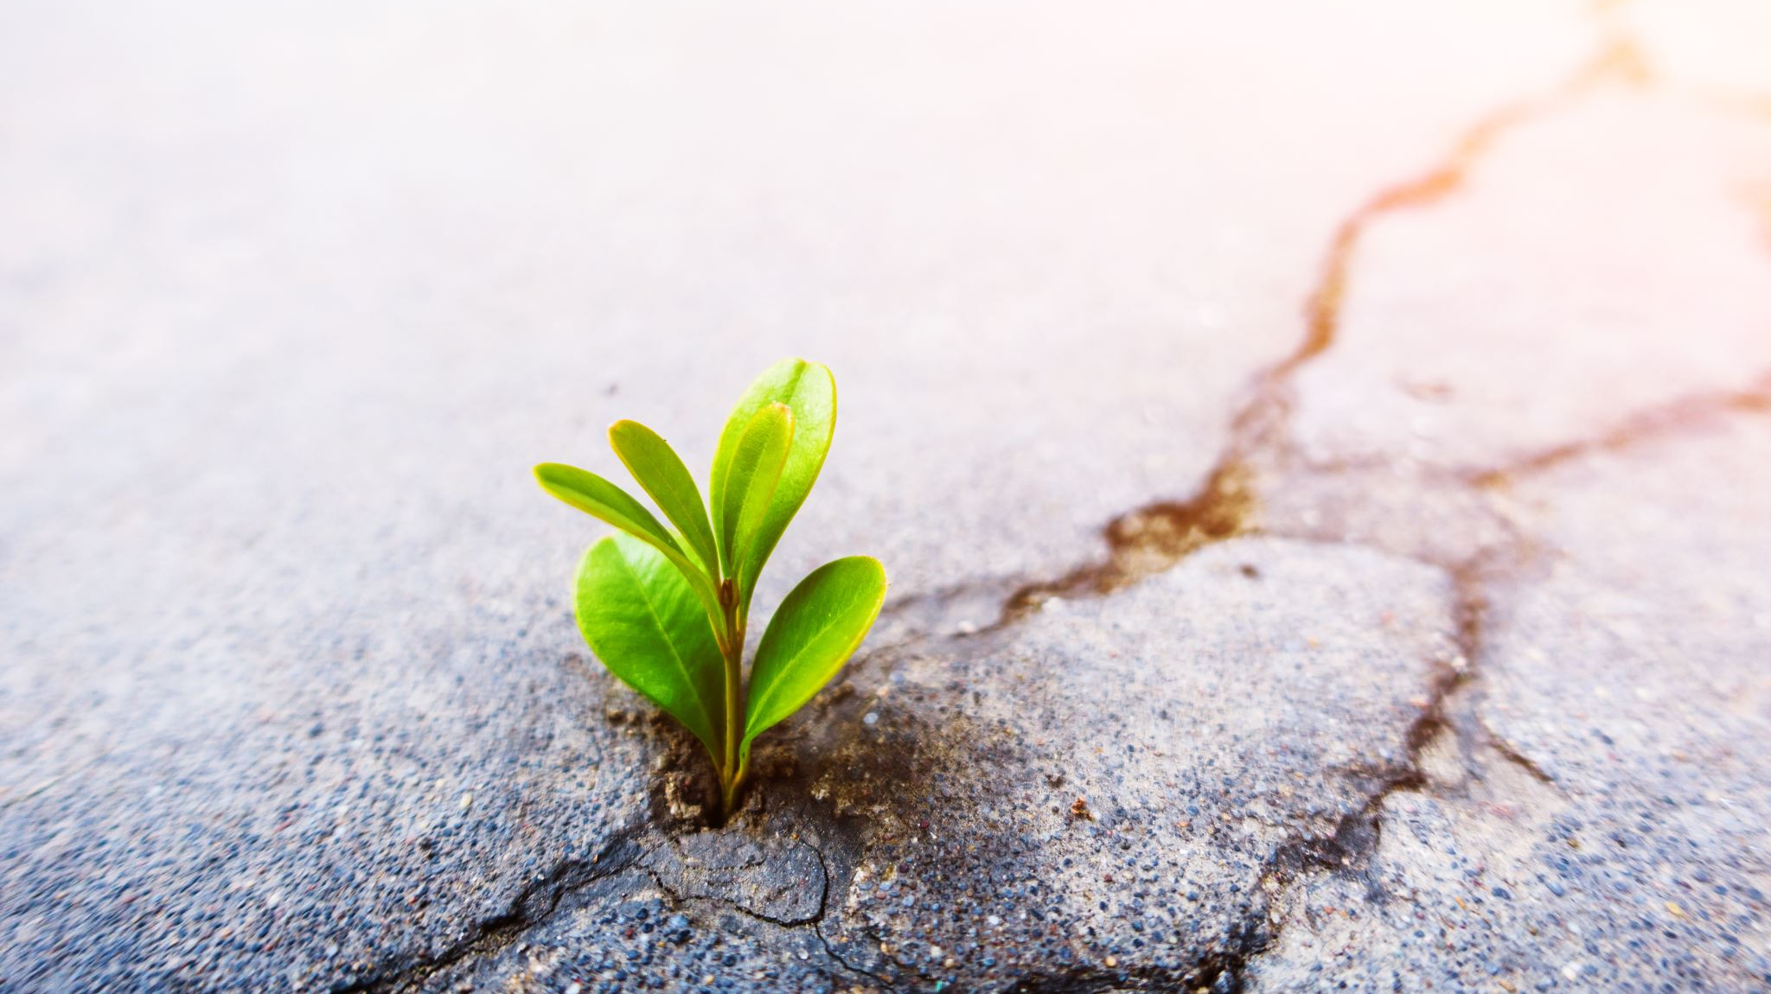
What is resilience?

Slide 8
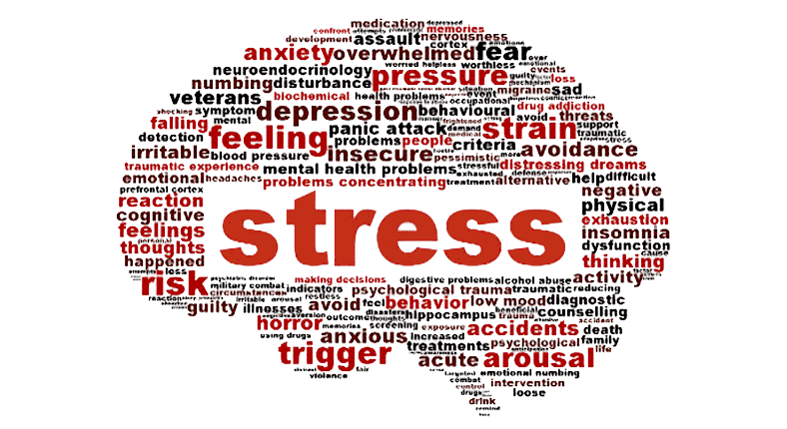
stress
There will always be stress in our lives
Positive stress, or manageable stress, can be growth promoting
UNHELPFUL when chronic or severe, and has been linked to health and psychological problems in adulthood
Pandemic stress will be temporary for some, lasting for others
  Worry
  Social isolation
  Loss of loved ones
  Financial instability
  Parental Stress

Slide 9
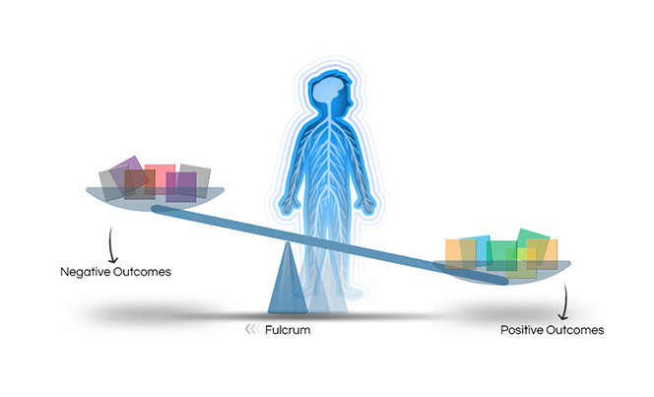
Resilience: The ability to overcome hardship
Protective experiences and coping skills on one side counterbalance significant adversity on the other. Resilience is evident when a child’s health and development tips toward positive outcomes — even when a heavy load of factors is stacked on the negative outcome side. –Harvard University Center on the Developing Child

Slide 10
The 7 C’s of resilience
Confidence
Competence
Connection
Coping
Contribution
Character
Control

Slide 11

But…because we’re in the middle of a worldwide pandemic and we’re already overwhelmed as it is…we’re only going to focus on 3

Slide 12
The “ordinary magic” that creates resilience
Connection
Contribution
Competence

Slide 13

Connection
Develop a close tie in family and/or the community to help solidify a sense of security. This can lead to strong values
How do I facilitate connection?
Build a sense of physical safety and emotional security within your own home
Allow expression of ALL emotions
  This allows children to feel comfortable expressing how they are feeling during difficult times
Address conflict openly in the family to resolve problems
Create a common area where the family can share time
  This is not solely “TV time”
Foster healthy relationships that will reinforce positive messages

Slide 14
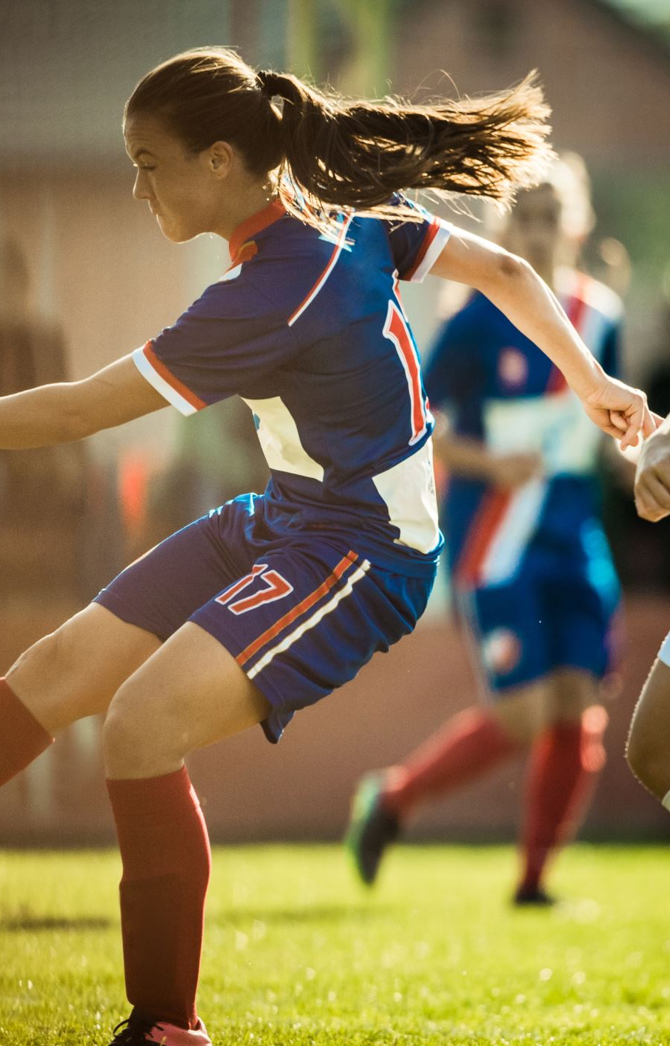
competence
Competence describes the feeling of knowing that you can handle a situation effectively
Can apply to multiple domains: school, sports, dance, friendships
How do I facilitate competence?
Help children focus on individual strengths
Praise effort not outcome
Empower children to make decisions
Recognize competencies of siblings individually
Be careful that your desire to protect your child does not come off as child interpreting you viewing they are not competent to handle things

Slide 15

contribution
Understanding the importance of personal contribution can serve as a source of purpose and motivation. As well as helping children realize the world is a better place because they are in it
In times of stress, the people who gave back or helped others had the best outcomes.
How do I facilitate contribution?
Model generosity
Create opportunities for contributing, either in the community or around the house

Slide 16
Q & A with Mary Kay larson

