Slide 1


2023-24 Budget Advisory Committee Meeting
November 16, 2023

Slide 2
Objectives for Today
1
Year End Update
2
Enrollment Update
3
Budget Status Report
4
Building Budgets

Slide 3
Objectives for Today
1
Year End Update
2
3
4

Slide 4
Year End
Closed Books on October 25th:
  Board Update
    November 27th
    Year in Review
  Committee Update
    December 21st

Slide 5
Annual Budget Cycle
Comparisons & Adjustments
Fall – Comparisons
Winter/Spring – Development
Spring - Preparation
Winter - Projections
Spring/Summer – Adoption & Implementation
Budget Adoption & Implementation
Actual Student Enrollment
Actual Staffing Alignment
State & Federal Revenue
Local Commitments
Budget Hearing & Board Adoption (August)
Summer Implementation
Budget Preparation
Projections
Incorporate recommended budget reductions/additions
F203 (following Legislative session)
F195 (following Legislative Session)
Balance – additional adjustments
Student Enrollment – based on January Enrollment
Projected Expenditure increases/decreases
State & Federal Revenue Projections & Variances
Legislative Focus
Budget Development
Budget Advisory Committee
Budget Parameters
Balanced Educational Program

Slide 6
Objectives for Today
1
Year End Update
2
Enrollment Update
3
4

Slide 7
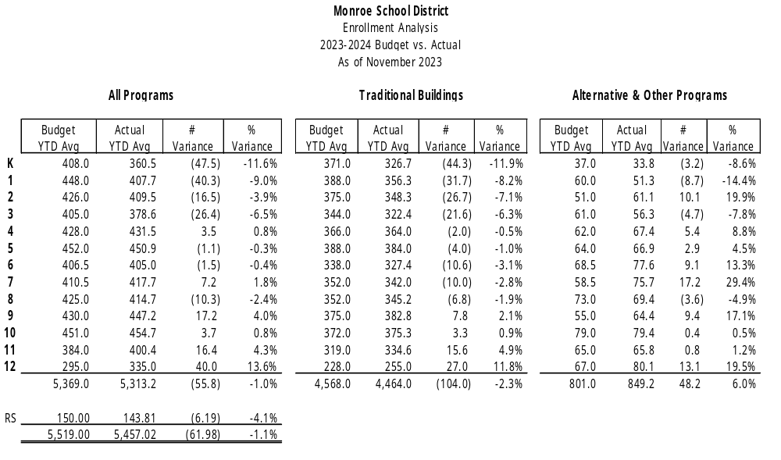
Preliminary Sept Enrollment

Slide 8
Objectives for Today
1
Year End Update
2
Enrollment Update
3
Budget Status Report
4

Slide 9
Table Talks
While looking at Enrollment & Budget Status Report, please ask yourselves:
  What is the Enrollment Report telling us?
  What is the Budget Status Report telling us?
  What impact, if any, will enrollment have on our finances?
  Table Talks
    What are your observations?
    What questions may I answer?
    What impact does this have on MSD?
    What recommendations do you have?

Slide 10
Objectives for Today
1
Year End Update
2
Enrollment Update
3
Budget Status Report
4
Building Budget Discussion

Slide 11

What’s next?
  Next Meeting – Thursday, December 21st
  November Fiscal/Enrollment Reports
  Update on 23-24 Staffing Compliance
  Update on Fiscal Year 2022-2023 Year End
  Questions/Recommendations?
    Brenda Hunt
    huntb@monroe.wednet.edu
    360-804-2519

