Slide 1


2023-24 Budget Advisory Committee Update
September 21, 2023

Slide 2
Objectives for Today
1
Goals for the year
2
Budget Cycle
3
Initial 2023-24 Enrollment
4
Fiscal Report

Slide 3
Goals for this year
More in depth learning on:
  Budget Monitoring
    Budget Reports & Impact
    Enrollment Reports & Impact
  Budget Development
    Enrollment Projections
    Staffing (including Support Services)
    Building budgets
    Categorical Budgets
  End of Cycle Review
    State Auditor’s Audit & Outcomes
    Fiscal End of Year report to Board (November)

Slide 4
Objectives for Today
1
Budget Cycle – Where are we?
2
3

Slide 5
Annual Budget Cycle
Comparisons & Adjustments
Fall – Comparisons
Winter/Spring – Development
Spring - Preparation
Winter - Projections
Spring/Summer – Adoption & Implementation
Budget Adoption & Implementation
Actual Student Enrollment
Actual Staffing Alignment
State & Federal Revenue
Local Commitments
Budget Hearing & Board Adoption (August)
Summer Implementation
Budget Preparation
Projections
Incorporate recommended budget reductions/additions
F203 (following Legislative session)
F195 (following Legislative Session)
Balance – additional adjustments
Student Enrollment – based on January Enrollment
Projected Expenditure increases/decreases
State & Federal Revenue Projections & Variances
Legislative Focus
Budget Development
Budget Advisory Committee
Budget Parameters
Balanced Educational Program

Slide 6
Objectives for Today
1
Budget Cycle – Where are We?
2
Preliminary Sept Enrollment
3

Slide 7
Objectives for Today
1
Budget Cycle – Where are We?
2
Preliminary Sept Enrollment
3

Slide 8
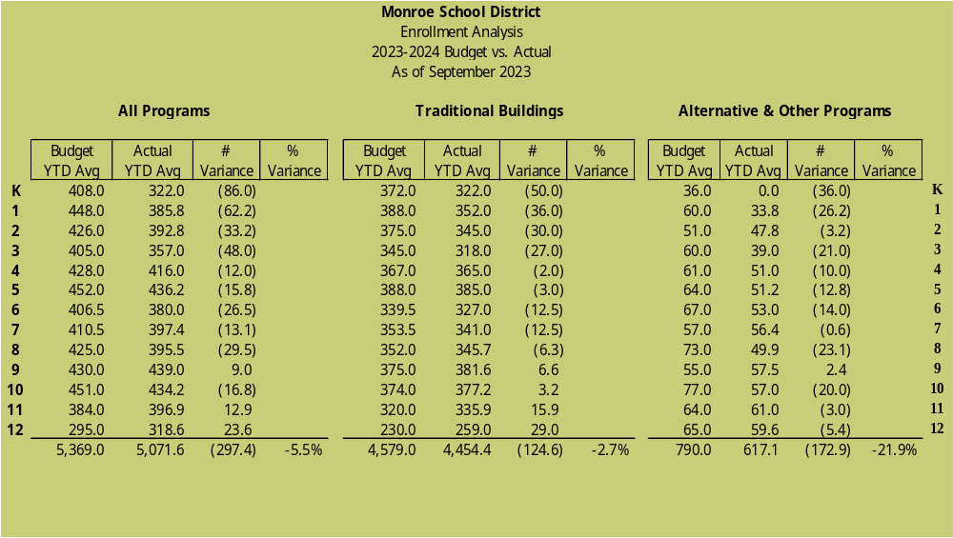
Preliminary September Enrollment

Slide 9
Preliminary Sept Enrollment
When looking at reports, please note:
  Reports are PRELIMINARY
    Reports are as of Sept 11th
    SVEC & LIL had not yet started school
    Traditionally there is an increase of approx.
    50 FTE between September & October
  Table Talks
    What are your observations?
    What are your questions?
    What impact does this have on MSD?
    What suggestions do you have?

Slide 10
Objectives for Today
1
Budget Cycle – Where are We?
2
Preliminary Sept Enrollment
3
Fiscal Reports

Slide 11
Preliminary August Fiscal Reports
When looking at reports, please note:
  Reports are PRELIMINARY
    Books Close on/before October 25th
    Final Numbers will be presented in November
    Payments for 22-23 invoices/payroll
    paid in September must be accrued
    Reconciliation and corrections still pending
  Fiscal Report Handouts
    What are your observations?
    What are your questions?
    What impact does this have on MSD?
    What suggestions do you have?

Slide 12

What’s next?
  Next Meeting – Thursday, October 19th
  September Fiscal/Enrollment Reports
  Update on 23-24 Staffing Compliance
  Update on Fiscal Year 2022-2023 Year End
  Questions/Recommendations?
    Brenda Hunt
    huntb@monroe.wednet.edu
    360-804-2519

