Slide 1


2023-24 Budget Advisory Committee Update
August 17, 2023

Slide 2
Objectives for Today
1
Budget Hearing Presentation
2
Executive Summary
3
Table Talks

Slide 3
Tonight’s Focus
Budget Hearing Presentation
August 14, 2023

Slide 4
Objectives for Today
1
Enrollment Projections
2
3

Slide 5
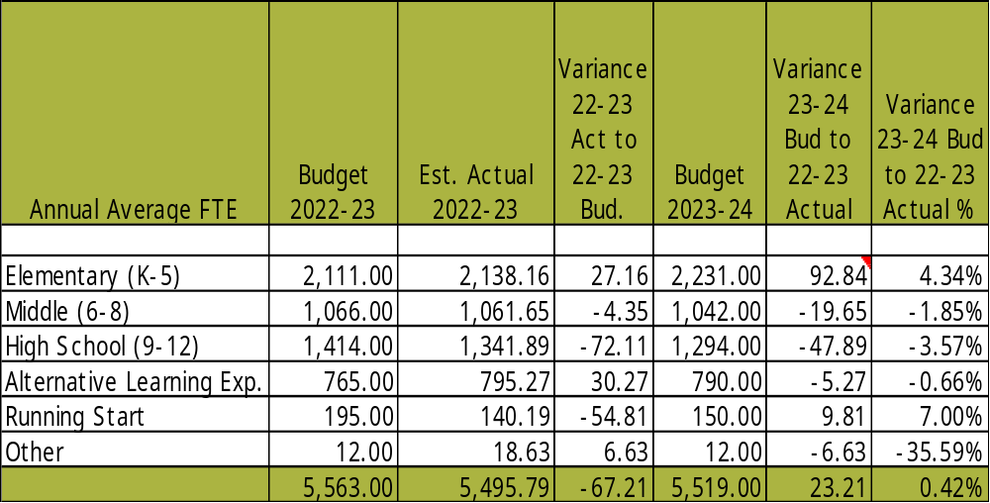
Enrollment Projections

Slide 6
Objectives for Today
1
Enrollment Projections
2
2023-2024 Staffing
3

Slide 7
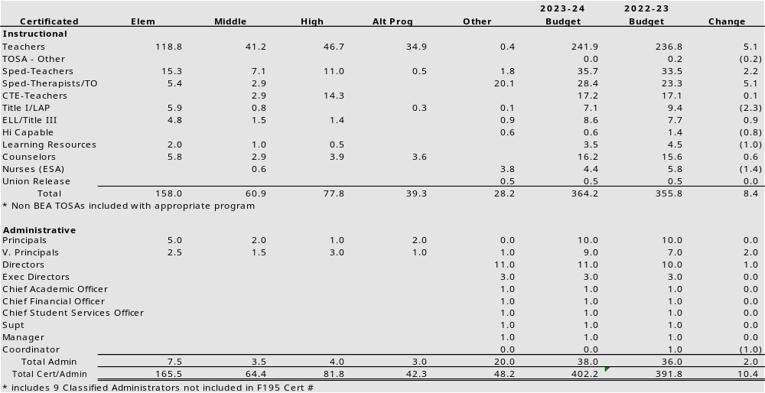
2023-24 Certificated Staff

Slide 8
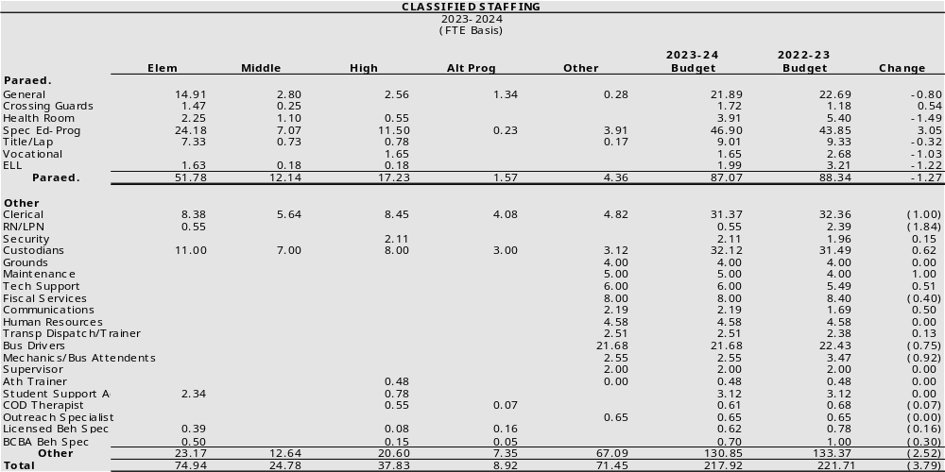
2023-24 Classified Staff

Slide 9
Objectives for Today
1
Enrollment Projections
2
2023-2024 Staffing
3
Revenue Comparisons

Slide 10
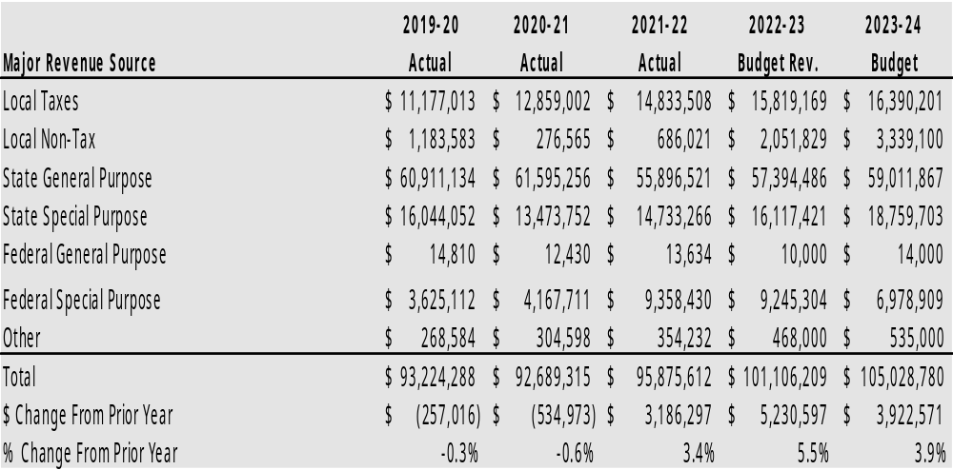
General Fund Revenue Comparison

Slide 11
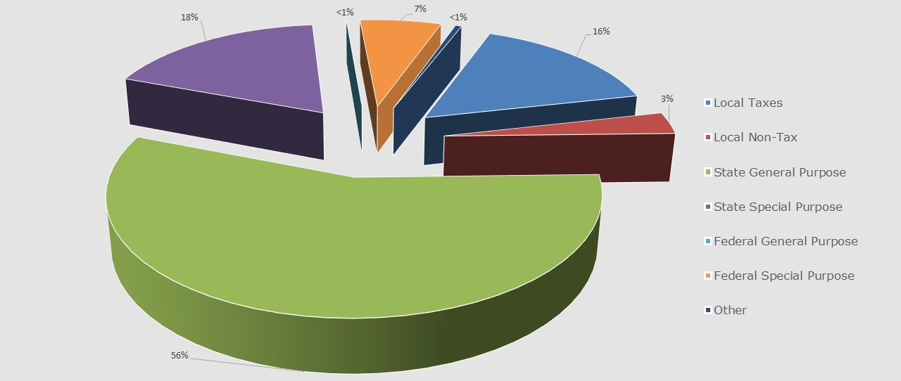
General Fund Revenue Comparison
State Dollars fund 74% of District programs
Federal Dollars fund 7% of District programs
Levy Dollars fund 16% of District programs

Slide 12
Objectives for Today
1
Enrollment Projections
2
2023-2024 Staffing
3
Revenue Comparisons
4
4
Expenditure Comparisons

Slide 13
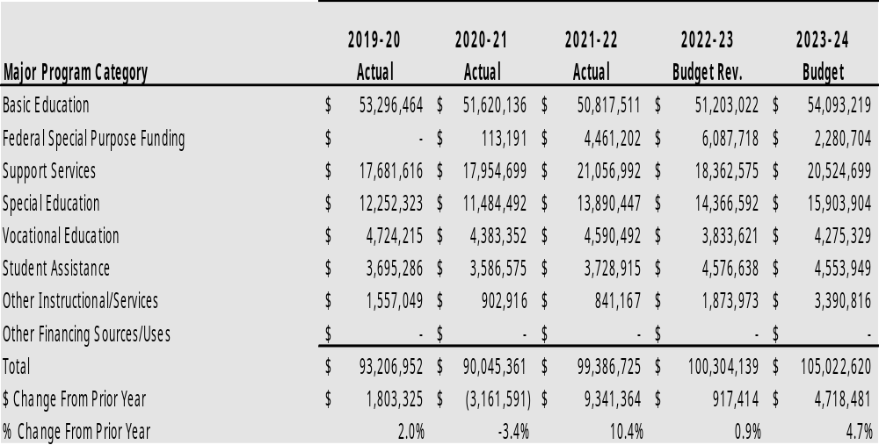
General Fund Expenditures

Slide 14
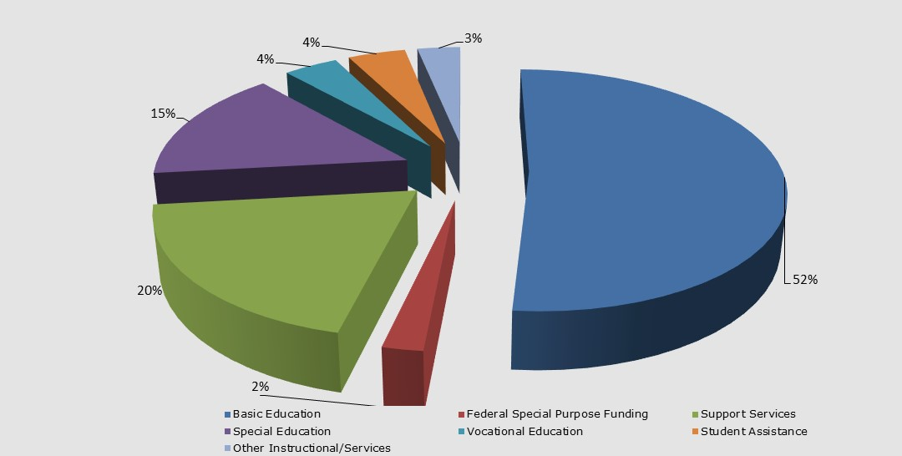
Expenditures by Program Summary
One Time Federal funds continue to lower other category percentages
Basic Education & CTE total 56%
Federal Special purpose, Special Education & Categorical programs total 21%

Slide 15
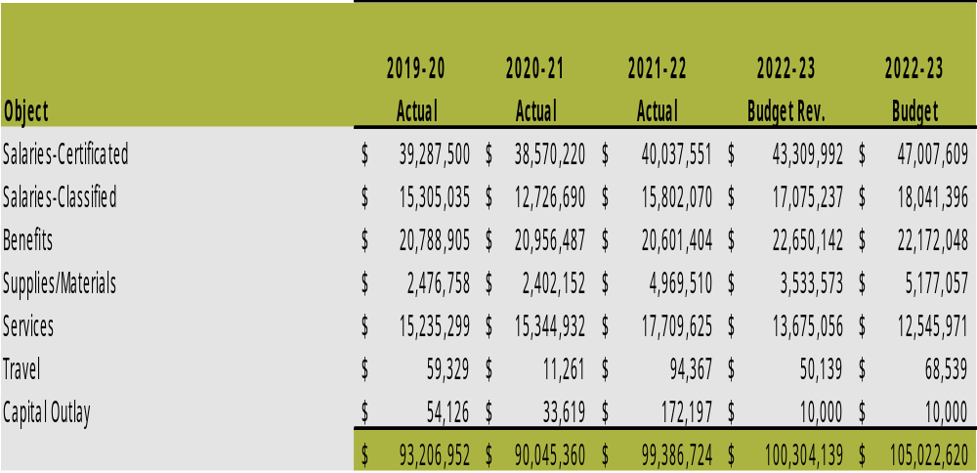
Expenditures by Object Summary
Increased Salaries and Benefits due to 3.7% IPD increase & negotiated collective bargaining agreements
$2.6M of ESSER III funding was set aside from our 22-23 budget & built into the 23-24 budget – last year for this funding

Slide 16
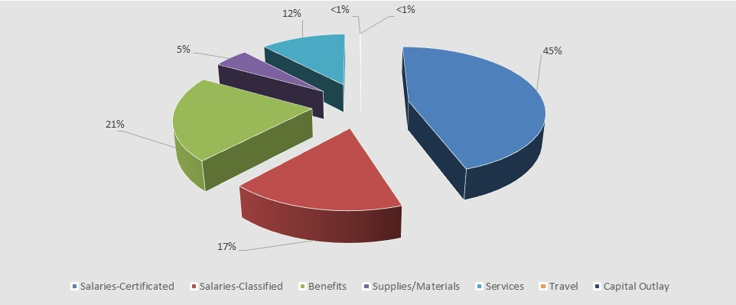
Expenditures by Object Summary
Salaries & Benefits make up 83% of budgeted expenditures
Balance of Expenditures are Materials, Supplies and Operating Costs

Slide 17
Objectives for Today
5
General Fund Summary
6
7
8

Slide 18
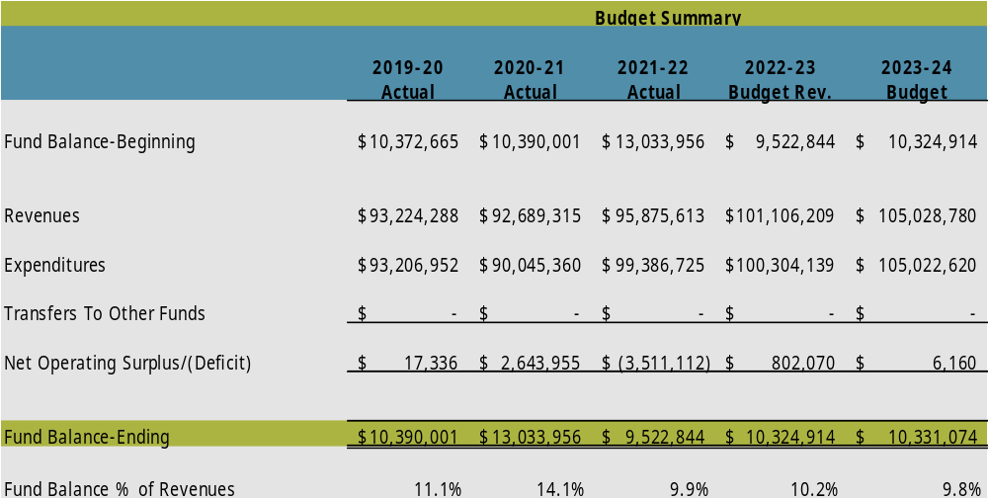
2023-24 General Fund Summary

Slide 19
2023-24 General Fund Summary
Fund Balance Category | 2023-2024 Projected Year End Balance | % of Total Fund Balance | % of Total Budgeted Revenue
GL 821:Resricted for Carryover of Restricted Revenue | $ 450,000 | 4.36% | 0.43%
GL 840: Non Spendable Fund Balance-Inventory & Prepaid Items | $ 300,000 | 2.90% | 0.29%
GL 888: Assigned for Other Purposes | $ 2,520,821 | 24.40% | 2.40%
GL 890: Unassigned Fund Balance | $ 693,813 | 6.72% | 0.66%
GL 891: Unassigned to Minimum Fund Balance Policy | $ 6,366,439 | 61.62% | 6.06%

Slide 20
Moving Forward
  ESSER III
    The last $2.6M of ESSER III is included in this 2023-2024 budget
    Incorporating these funds into our 2023-24 budget allows the district more time to examine effectiveness and efficiencies of existing programs, practices, tools, etc. and make thoughtful 2024-2025 adjustments in alignment with our planned strategic plan development.

Slide 21
Objectives for Today
5
General Fund Summary
6
MSOC Disclosure
7
8

Slide 22
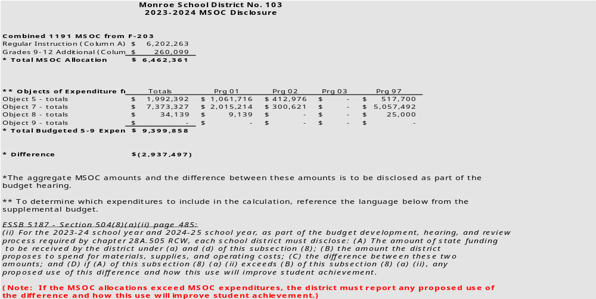
2023-24 MSOC Disclosure
A

Slide 23
Objectives for Today
5
General Fund Summary
6
MSOC Disclosure
7
Capital Projects Fund
8

Slide 24
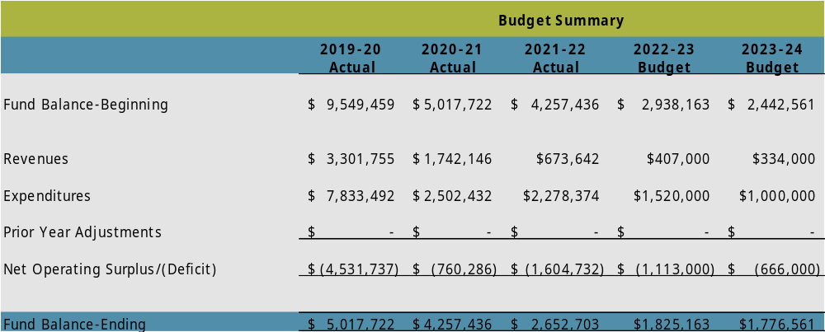
Capital Projects Fund (CPF)
A
CPF revenues sources include Capital Levy and Tech Levy Revenue
Our CPF Levy expired at the end of calendar year 2020

Slide 25
Objectives for Today
5
General Fund Summary
6
MSOC Disclosure
7
Capital Projects Fund
8
Debt Service Fund

Slide 26
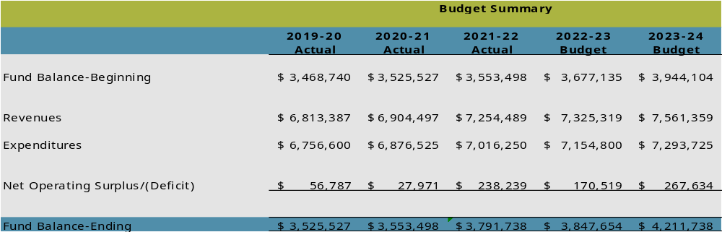
Debt Service Fund (DSF)
A
Revenues received primarily through local taxes
Expenditures consistent with principal & interest payments on bond repayment schedule

Slide 27
Objectives for Today
9
Transportation Vehicle Fund
10
11
12

Slide 28
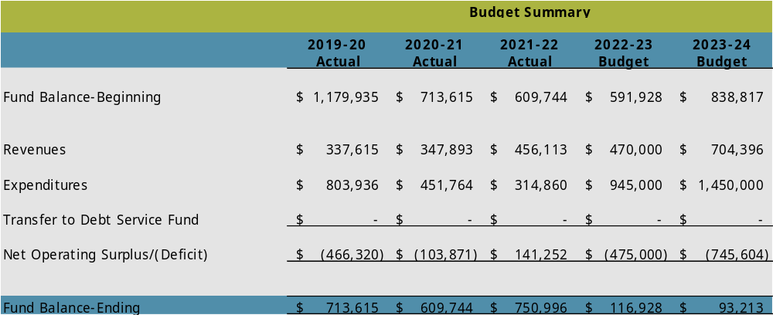
Transportation Vehicle Fund (TVF)
A
State Bus Depreciation Revenue is received in August of each year
Budget Capacity allows for the use of maximum dollars for the purchase of additional buses

Slide 29
Objectives for Today
9
Transportation Vehicle Fund
10
Associated Student Body

Slide 30
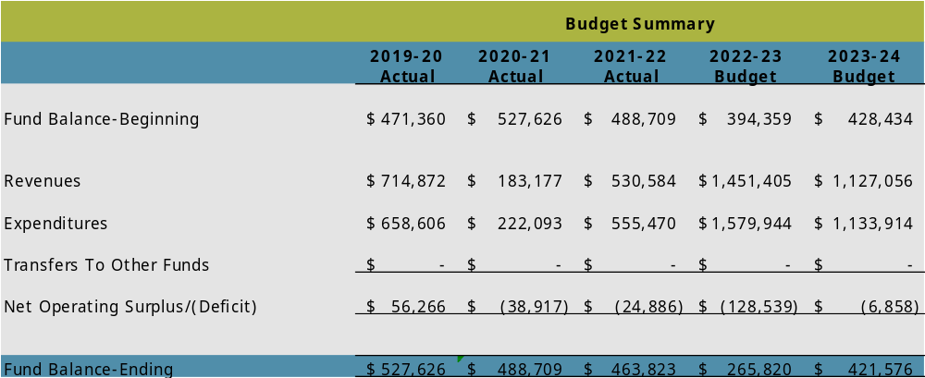
Associated Student Body (ASB)
A
ASB Budgets are developed by the student body at each school

Slide 31
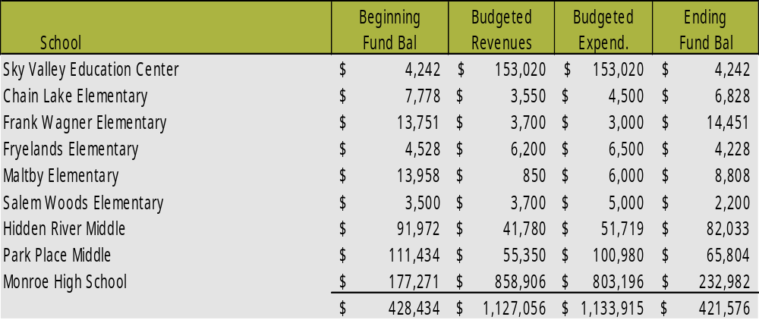
Associated Student Body (ASB)
A

Slide 32

What’s next?
  Budget Adoption – August 28, 2023
  Questions?
    Brenda Hunt
    huntb@monroe.wednet.edu
    360-804-2519

Slide 33
Table Talks
  Discuss the budget hearing information
    What questions do you have regarding the 23-24 budget presented?
  What format do you want to adopt to track and discuss the budget throughout the next fiscal year?
  Report Out

Slide 34
What’s next?
  Budget Adoption – August 28, 2023
  Next Meeting – Thursday, September 21st
  Questions?
    Brenda Hunt
    huntb@monroe.wednet.edu
    360-804-2519

