Slide 1


2023-24 Budget Advisory Committee Update
June 20, 2023

Slide 2
Welcome
Welcome back to our continued Budget Advisory Committee
  What’s different?
    More focus on real data and less on “How district’s are funded and How we spend our money”
      Reports
      Budget Status
    You, as committee members, drive what you would
    like to address
    Continue to reach out if you have any questions

Slide 3
Objectives for Today
1
Enrollment Projections
2
3

Slide 4
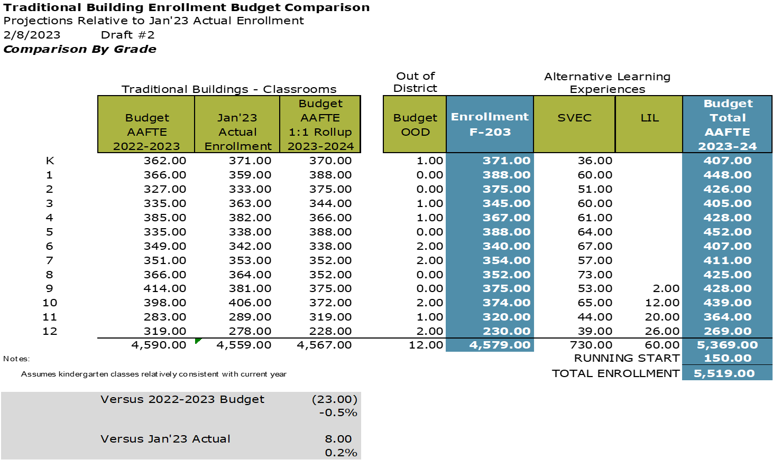
Enrollment Projections

Slide 5
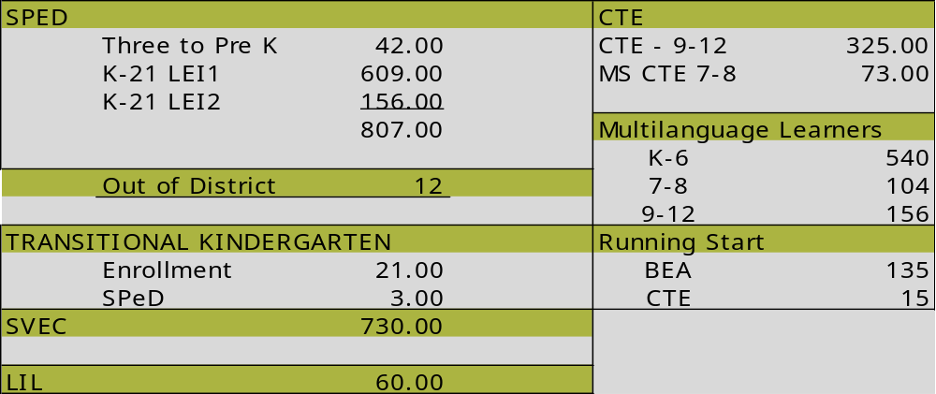
Enrollment Projections
OTHER ENROLLMENT WE MUST CONSIDER:

Slide 6
Objectives for Today
1
Enrollment Projections
2
F203 – State Revenue Calculator
3

Slide 7
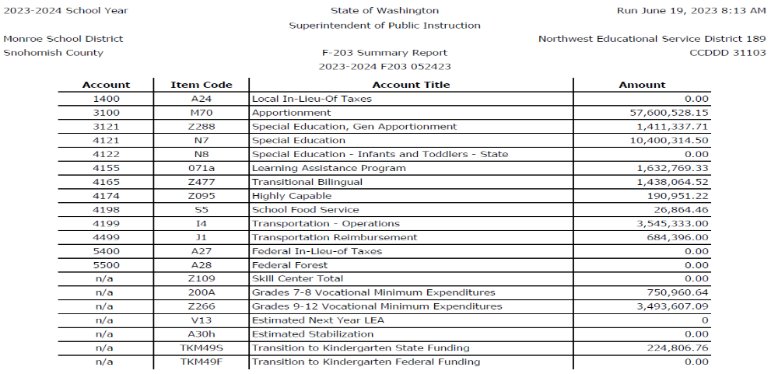
Understanding the F203

Slide 8
Objectives for Today
1
Enrollment Projections
2
F203 – State Revenue Calculator
3
Budget Status Report –
06.19.23 DRAFT

Slide 9
BUDGET STATUS

Slide 10
BUDGET STATUS

Slide 11
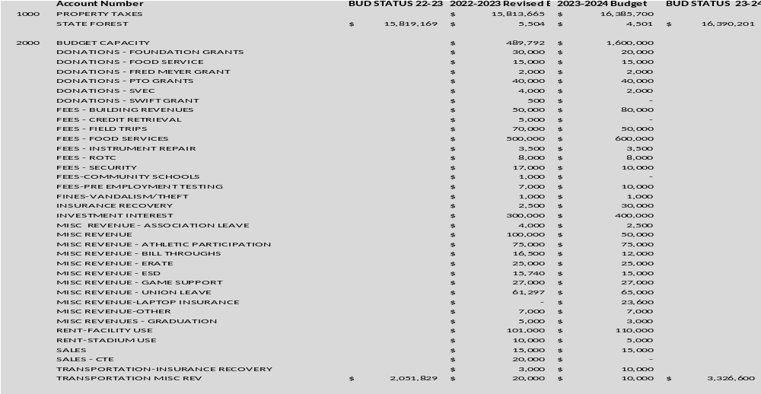
REVENUE BREAKDOWN

Slide 12
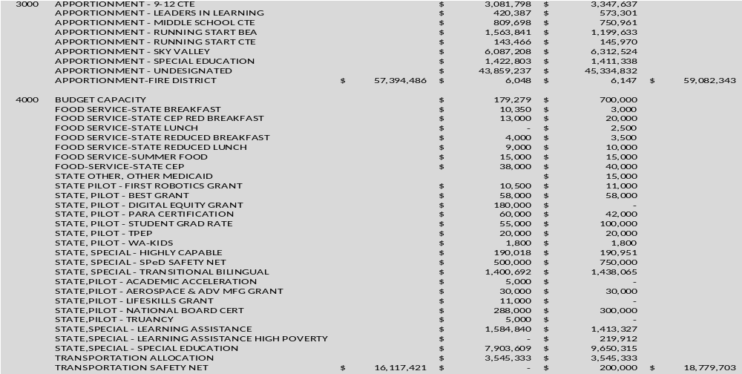
REVENUE BREAKDOWN

Slide 13
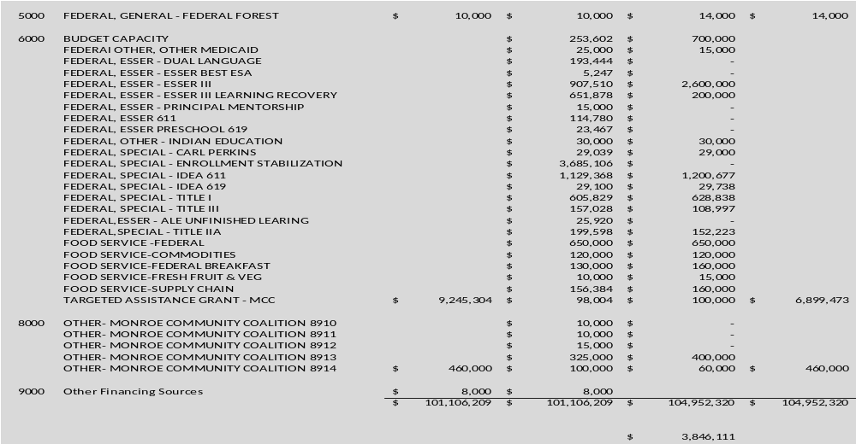
REVENUE BREAKDOWN

Slide 14
Objectives for Today
1
Enrollment Projections
2
F203 – Revenue Calculator
3
Budget Status Report –
06.19.23 DRAFT
4
Meeting Schedule

Slide 15
What’s next?
  No meeting in July – Vacation Month for many
  August Meeting
    Budget Hearing August 14th
    Budget Adoption August 28th
  Would you like to have a meeting the week of August 12th?
  Continue on Tuesdays?

Slide 16

What’s next?
  Next Board Budget Update – June 26, 2023
  Deadline for Draft Budget - July 10, 2023
  Budget Hearing – August 14, 2023
  Budget Adoption – August 28, 2023
  Questions?
    Brenda Hunt
    huntb@monroe.wednet.edu
    360-804-2519

