Slide 1


Budget Advisory Committee
May 23, 2023

Slide 2
Welcome
Welcome back!
  Last scheduled meeting
    Meetings will continue year round for those who sign up for our extended committee
    For those who choose not to continue – THANK YOU for participating and I hope the experience was worth your time!
    Continue to reach out if you have any questions

Slide 3
May 23rd - Agenda
Legislative Session Update – What changes are part of the 23-24 legislative budget? Impacts for Monroe SD?
Enrollment Projections – Preliminary Revenue/Expenditure projections
Table Talks

Slide 4
Future Meetings
August 22nd
Final 2023-24 Budget – What changed?
June 20th
Where are we in the budget development process? What decisions are being considered? Feedback and Ideas….
July 25th
Review of Draft Budget - Feedback and Ideas

Slide 5
Objectives for Today
1
Legislative Update
2
3

Slide 6
Legislative Update
Legislative Update
  Current Session Ended April 23rd
    4 Key focuses:
      K-12 Prototypical Funding Model
      Special Education
      Transitional Kindergarten
      Transportation
    F203 Revenue Projection tool should be released by
    OSPI on May 24th (tomorrow)

Slide 7
Legislative Update
K-12 Prototypical Funding Model
  Prototypical model changes
    Physical, Social, and Emotional Support (PSES)
      Increase of staff allocated in prototypical model over the next two years
      IMPACT: Monroe currently staffs more than the compliance factors so this increase funds more of the existing staff
    Inflationary Increase for Salaries
      3.7% for 2023-2024
      3.9% for 2024-2025 (projected, not final)
      IMPACT: Additional funding for salaries, however, Monroe pays staff per our Collective Bargaining agreements

Slide 8
Legislative Update
K-12 Prototypical Funding Model
  Prototypical model changes (continued)
    Regionalization and Experience Mix
      Legislation required to rebase regionalization every 4 years
      20 Districts Received an increase
      28 District received a decrease
      IMPACT: Monroe’s regionalization remains unchanged-currently at 18%

Slide 9
Legislative Update
Special Education
  Funding Cap raised from 13.5% to 15%
    No impact for Monroe since our rate is currently
      below 13.5% gap
  Funding multipliers increases for 2023-2024
      Greater than 80% in BEA setting – from 1.0075 to 1.12
      Less than or equal to 80% in BEA Setting – from .995 to 1.06
  Remainder of SPeD funding changes Vetoed by
  governor

Slide 10
Legislative Update
Transitional Kindergarten
  Renamed “Transition to Kindergarten”
  Not Basic Education
  Partially state funded/partially federal funded
  Funded through prototypical model components
  Accounted for as a Categorical program is funded –
  revenue received must be spent in program
  OSPI is reviewing whether FTE can be counted in Levy Calculations

Slide 11
Legislative Update
Transportation
  $13,000,000 for FY 2023-2024 and $13,000,000 for FY 2024-2025
  Not considered Basic Education
  No changes to STARS funding formula

Slide 12
Objectives for Today
1
Legislative Update
2
Enrollment Projections
3

Slide 13
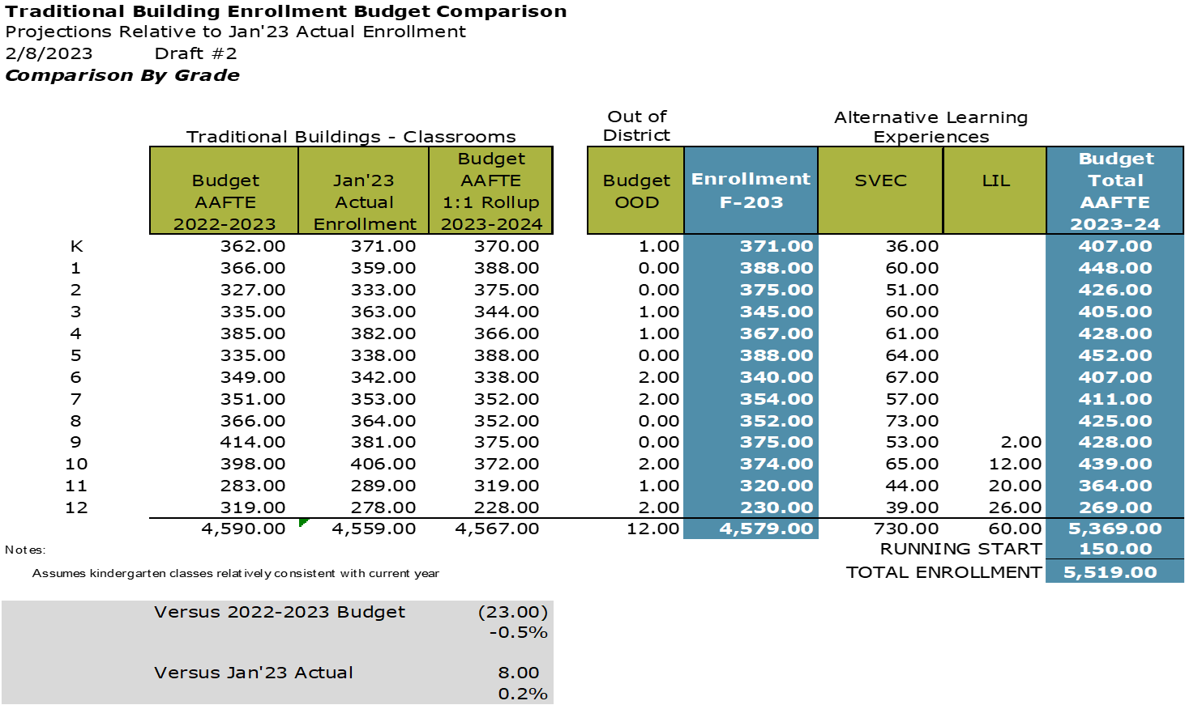
Enrollment Projections

Slide 14
Objectives for Today
1
Legislative Update
2
Enrollment Projections
3
Preliminary Revenue/Expenditure Projections

Slide 15
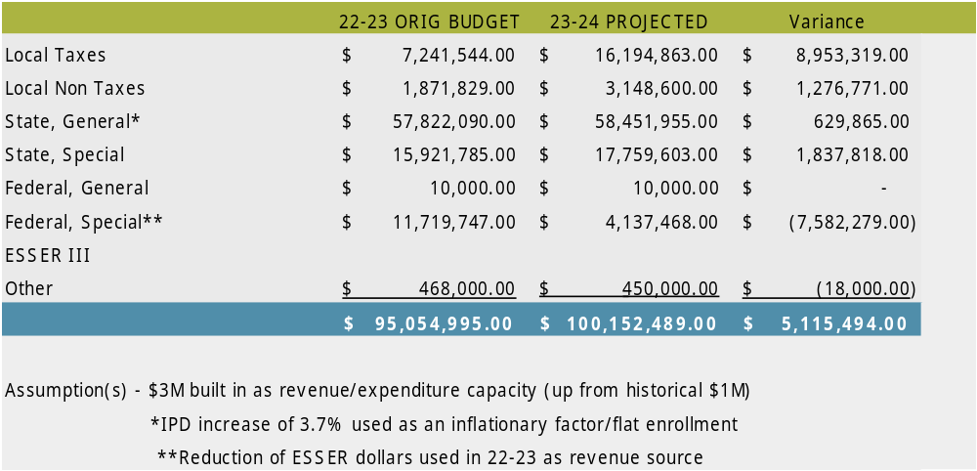
2023-24 Preliminary Revenue Projections
Although estimates are based on conference budget – values may change when official F203 Estimates for State Revenues is available.

Slide 16
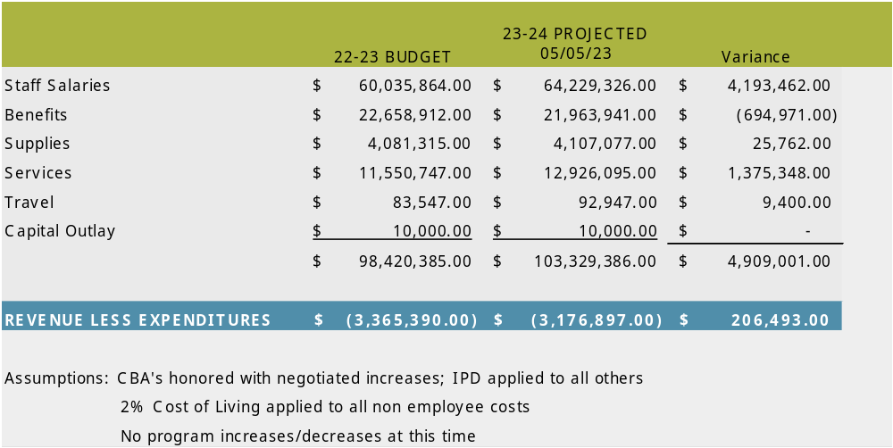
2023-24 Preliminary Expenditure Projections

Slide 17
Objectives for Today
1
Legislative Update
2
Enrollment Projections
3
Preliminary Revenue/Expenditure Projections
4
Table Talks

Slide 18
Table Talks - What’s next?
  Roughly $3.2M total reductions necessary (last of reductions due to
  enrollment loss)
  ESSER III dollars – approximately $2.6M
    Identify areas of reduction over the next 15 months – Move some reductions to the 24-25 fiscal year
  No Reductions in Force
    Will reduce staffing in identified areas through the normal attrition
    process
  Review effectiveness and efficiencies of existing programs, practices,
  tools etc. Make necessary cost saving adjustments to present
  balanced budget board
  Deadline for Draft Budget is July 10th

Slide 19
Table Talks - What’s next?
Charter Reminder
  Level of Authority - Advisory to Superintendent
Table Talks
  What have you heard regarding the state of Washington School District finances?
  After going through this process:
    What would you like to communicate to the superintendent regarding the district budget and future reductions?
    What is (are) your top priority (priorities)for the Monroe
    School District?
  Report Out

Slide 20

Thank you!
Questions/Discussion
  huntb@monroe.wednet.edu
  360-804-2519
Next Meeting: June 20th 6:00pm – 7:30pm
  Optional Sign up for Extended meetings
Exit Ticket

