Slide 1


Budget Advisory Committee
March 14, 2023

Slide 2

Welcome
Welcome back!
  After Today – 86.21% of Total Budget will have
  been presented
  Blue Card Ideas/Questions
  “Parking lot” Document
  Exit ticket
Next Meeting: March 28th 6:00pm – 7:30pm
  Alternative Format for next meeting

Slide 3
March 14th - Agenda
Career & Technical Education -
Shannon Tarrach & Shannon Barksdale
Athletics & Activities –
Ashley Tuiasosopo
Basic Education – Traditional Buildings –
Jeff Presley & Brett Wille

Slide 4
Future Meetings
March 28th
Principals – Alternative Learning Experience Programs; Enrollment Stabilization, ESSER III and remaining programs
April 18
What are out priorities? Enrollment Projections, Current Challenges, Fund Balance, Budget Objectives
May 23rd
Recommendations & Things to think about. Committee Continuation??

Slide 5
Objectives for Today
1
Career & Technical Education
2
3

Slide 6
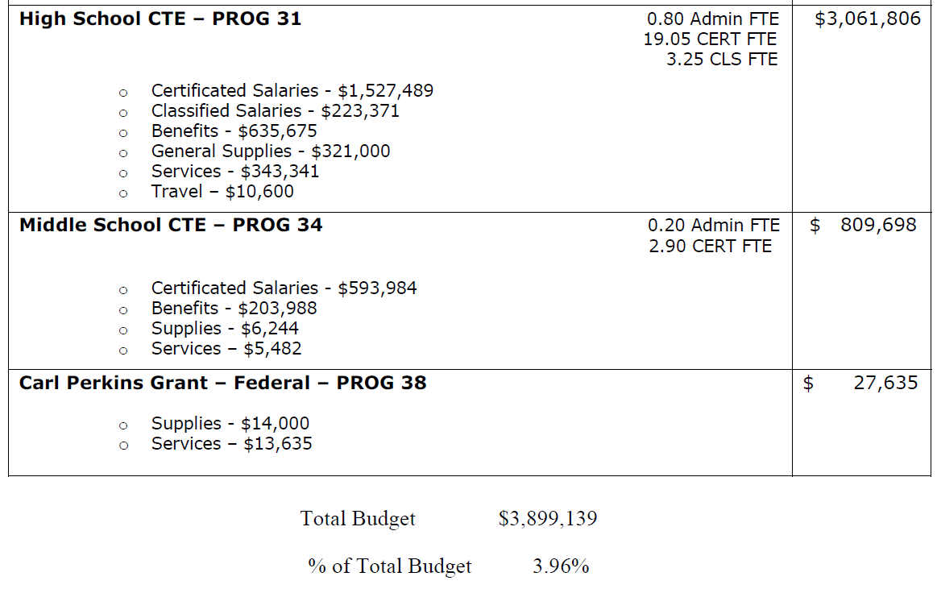
2022-23 Career & Technical Education

Slide 7
Objectives for Today
1
Career & Technical Education
2
Athletics & Activities
3

Slide 8
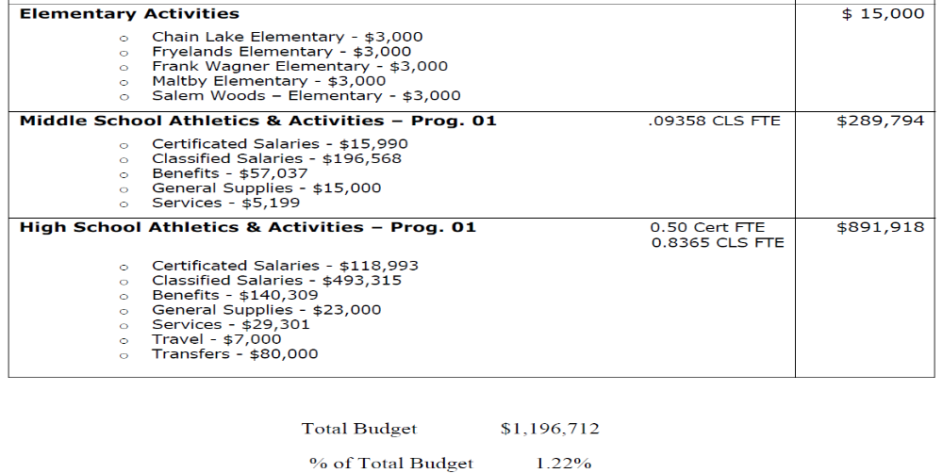
2022-23 Athletics & Activities

Slide 9
Objectives for Today
1
Career & Technical Education
2
Athletics & Activities
3
Traditional Buildings-Basic ED

Slide 10
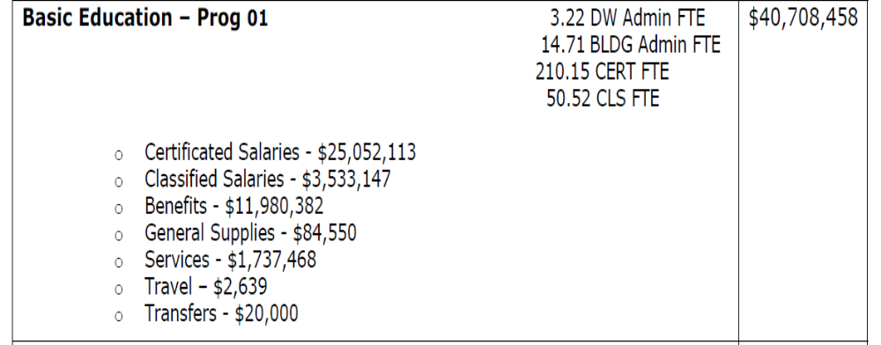
2022-23 Traditional Buildings

Slide 11
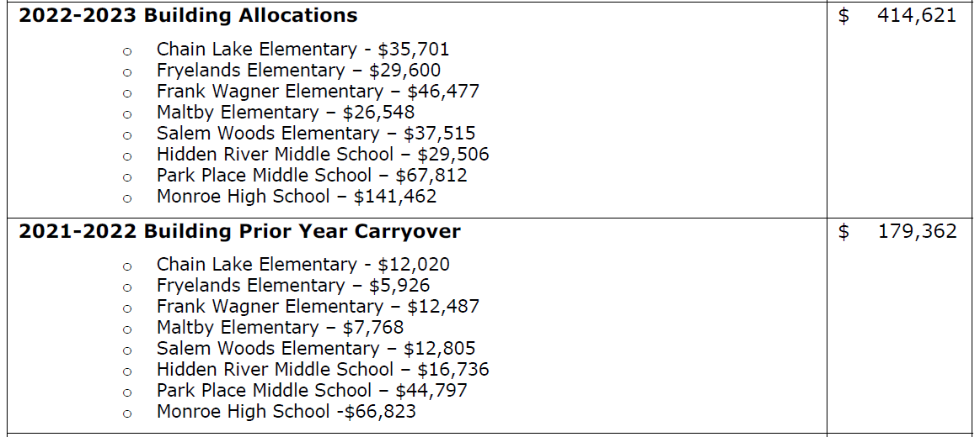
2022-23 Traditional Buildings

Slide 12
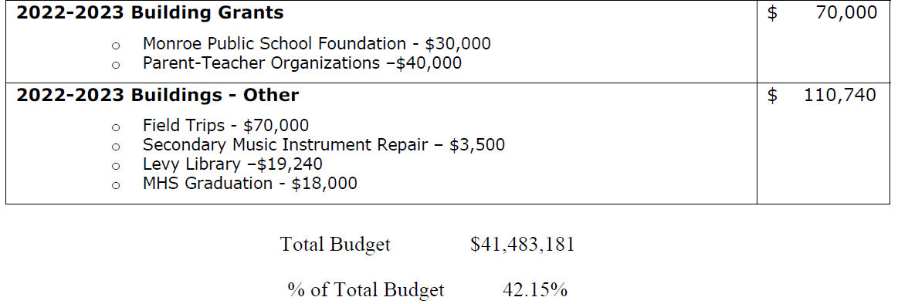
2022-23 Traditional Buildings

Slide 13
First Impressions
First impressions:
  What did you hear today (or the past 3 meetings)
  that made an impression – positive or negative?
  Why?
  What information was new to you?
  What questions do you have?

Slide 14
Thank you!
Questions/Discussion
  huntb@monroe.wednet.edu
  360-804-2519
Next Meeting: March 28th 6:00pm – 7:30pm
Exit Ticket

