Slide 1


Budget Advisory Committee
February 28, 2023

Slide 2

Welcome
Welcome back!
  After Today – 38.95% of Total Budget has been
  presented
  Blue Card Ideas/Questions
  “Parking lot” Document
  Exit ticket
Next Meeting: March 14th 6:00pm – 7:30pm
  Alternative Format for next 2 meetings

Slide 3
February 28th - Agenda
Custodial, Maintenance, & Grounds - Victor Scarpelli & Adam Denney
Food Service – Victor Scarpelli (Kellee Haizlip)
Technology – Victor Scarpelli & Jessie Crowther
Transportation - Victor Scarpelli & Mike Birch
Risk Management – Victor Scarpelli (Kelly Pitts)

Slide 4
Future Meetings
March 28th
Program Admin to discuss Dept. Budgets - Continued
March 14th
Principals – Traditional Buildings; Career & Technical Education (CTE) & Athletics & Activities
April 18th
What are our priorities? Enrollment Projections, Current Challenges, Fund Balance, Budget Objectives
May 23rd
Recommendations & Things to think about. Committee Continuation??

Slide 5
Objectives for Today
1
Custodial, Maintenance &
Grounds
2
3
4

Slide 6
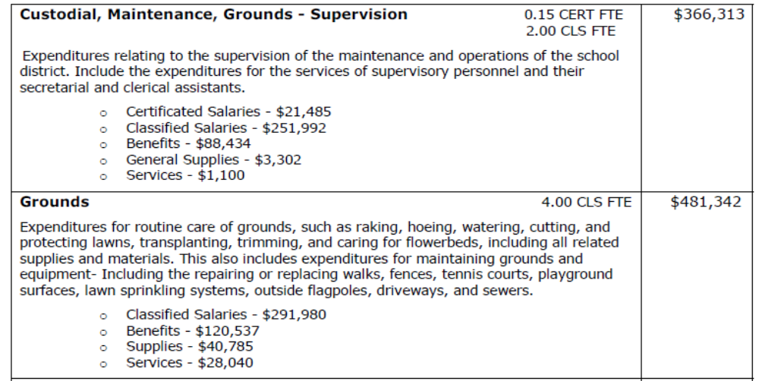
2022-23 Custodial, Maintenance & Grounds

Slide 7
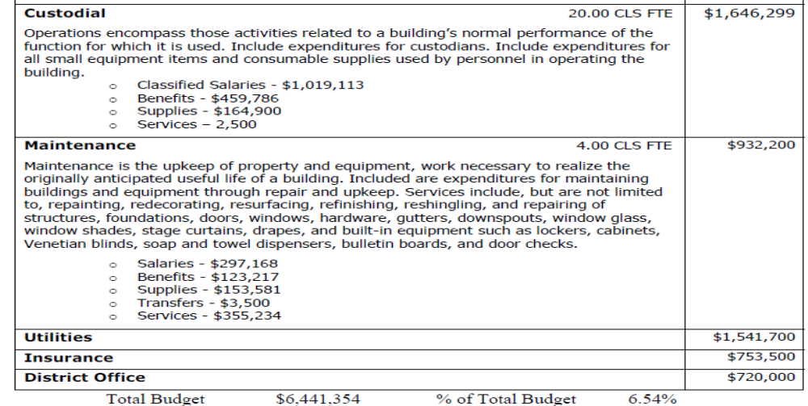
2022-23 Custodial, Maintenance & Grounds

Slide 8
Objectives for Today
1
Custodial, Maintenance &
Grounds
2
Transportation
3
4

Slide 9
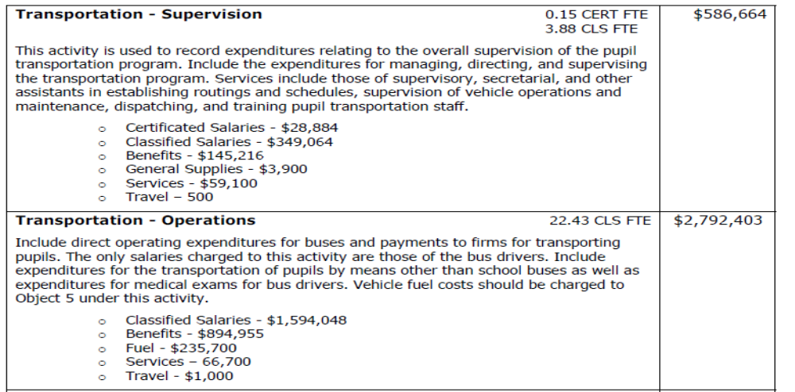
2022-23 Transportation

Slide 10
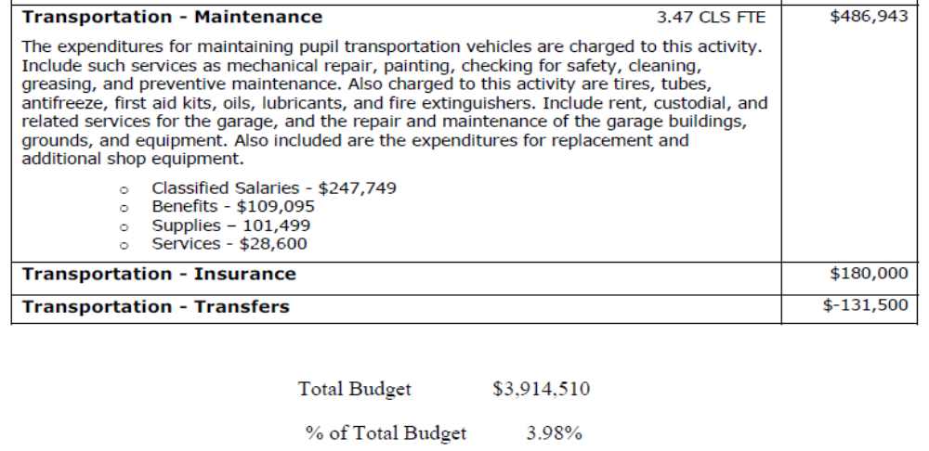
2022-23 Transportation

Slide 11
Objectives for Today
1
Custodial, Maintenance &
Grounds
2
Transportation
3
Technology
4

Slide 12
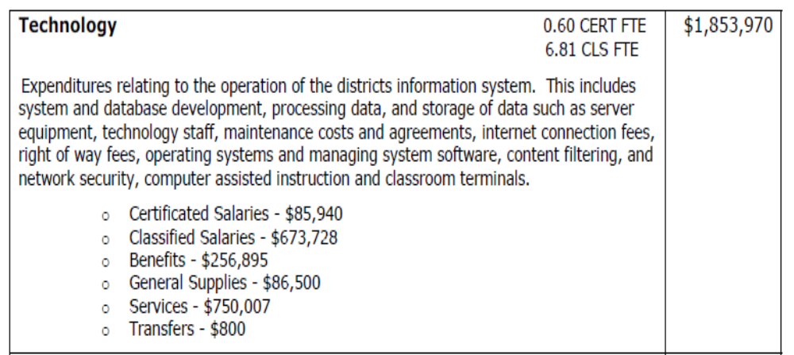
2022-23 Technology

Slide 13
Objectives for Today
1
Custodial, Maintenance &
Grounds
2
Transportation
3
Technology
4
Food Service

Slide 14
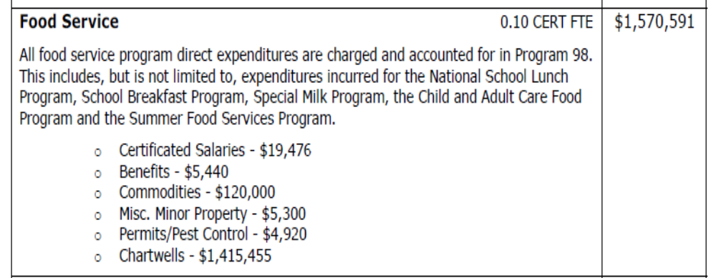
2022-23 Food Service

Slide 15
Objectives for Today
5
Risk Management

Slide 16
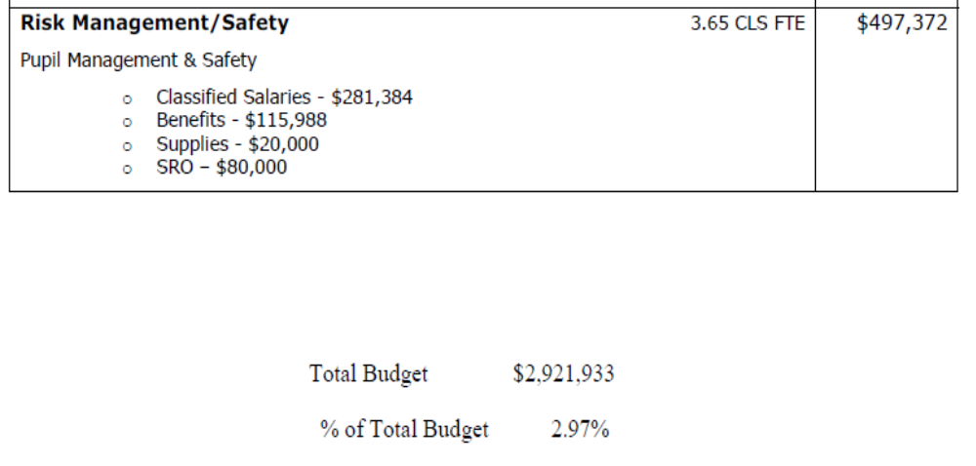
2022-23 Risk Management

Slide 17
First Impressions
First impressions:
  What did you hear today (or on the 14th) that made
  an impression – positive or negative? Why?
  What information was new to you?
  What questions do you have?

Slide 18
Thank you!
Questions/Discussion
  huntb@monroe.wednet.edu
  360-804-2519
Next Meeting: March 14th 6:00pm – 7:30pm
Exit Ticket

