Slide 1

Comprehensive Health Education Advisory Committee
September 16, 2021

Slide 2



Welcome
Elissa Cox; Director of Secondary Programs (Facilitator of Physical & Health Education Grades 7 - 12)
Chad Carper; Director of Student Services (Facilitator of Social Emotional Health & Learning)
Dr. Latoya Dixon; Director of Elementary Programs (Facilitator of Physical & Health Education Grades K – 6)
Latisha Holt; Director of Food Service (Facilitator of Food Service Programs & Healthy Snack Programs)

Slide 3



Today's Focus
5 – 2- 1- 0 + 10 Opportunity and Next Steps
Social-Emotional Learning Update
Keystone Partners

Slide 4
5 – 2 – 1 – 0 + 10 Opportunity
z
5-2-1-0+10 is a national childhood obesity prevention campaign affiliate with Michelle Obama's "Let's Move!" Initiative.
https://atriumhealth.org/community/health/obesity/healthy-together
This program focuses on healthy eating and physical activity for all of our students.
Dr. David Keely is a guest speaker to encourage and inform Elementary and Intermediate Schools to join the program.
There are curriculums and resources available for implementation.
Harold C Johnson has participated in the program previously.

Slide 5
Updates on Food And Nutrition Requirements for Schools
Milk Flexibility
Updated Final Rule for Whole Grains. Reduction of whole grain- rich
Permanently allowing flavored, low-fat milk for ages 6 and older. Allowing the variety of milk provides more menu planning options, promotes students milk consumption, and lead to better health outcomes. YSD1 has now added lowfat strawberry milk within all schools and have seen an increase in milk consumption. We received positive feedback from the students. We offer Fat Free Milk, Lowfat Chocolate Milk, and Lowfat Strawberry Milk.
This final rule will require that half of the weekly grains in the school lunch and breakfast menu be whole grain-rich. Several commenters, including a food industry association, school district personnel, and individual commenters, reasoned that whole grain-rich exemptions should be allowed because some products (e.g., pasta, bread, sushi rice, tortillas, and biscuits) and regional products (e.g., grits in the South), are not acceptable to students in a whole grain-rich form. Currently, we are still providing whole grain-rich biscuits for our breakfast sandwiches but does not count as a grain. We are providing an additional whole grain item to compensate. YSD1 students petitioned in 2018/2019 to keep whole grained enriched biscuits, rice and pasta.

Slide 6
Social-Emotional Learning Update
York One has partnered with Panorama Education in order to provide teachers a tool to screen students and identify their social and emotional needs.
Student screeners completed.
SEL lessons and support will be provided for each student and teacher.

Slide 7
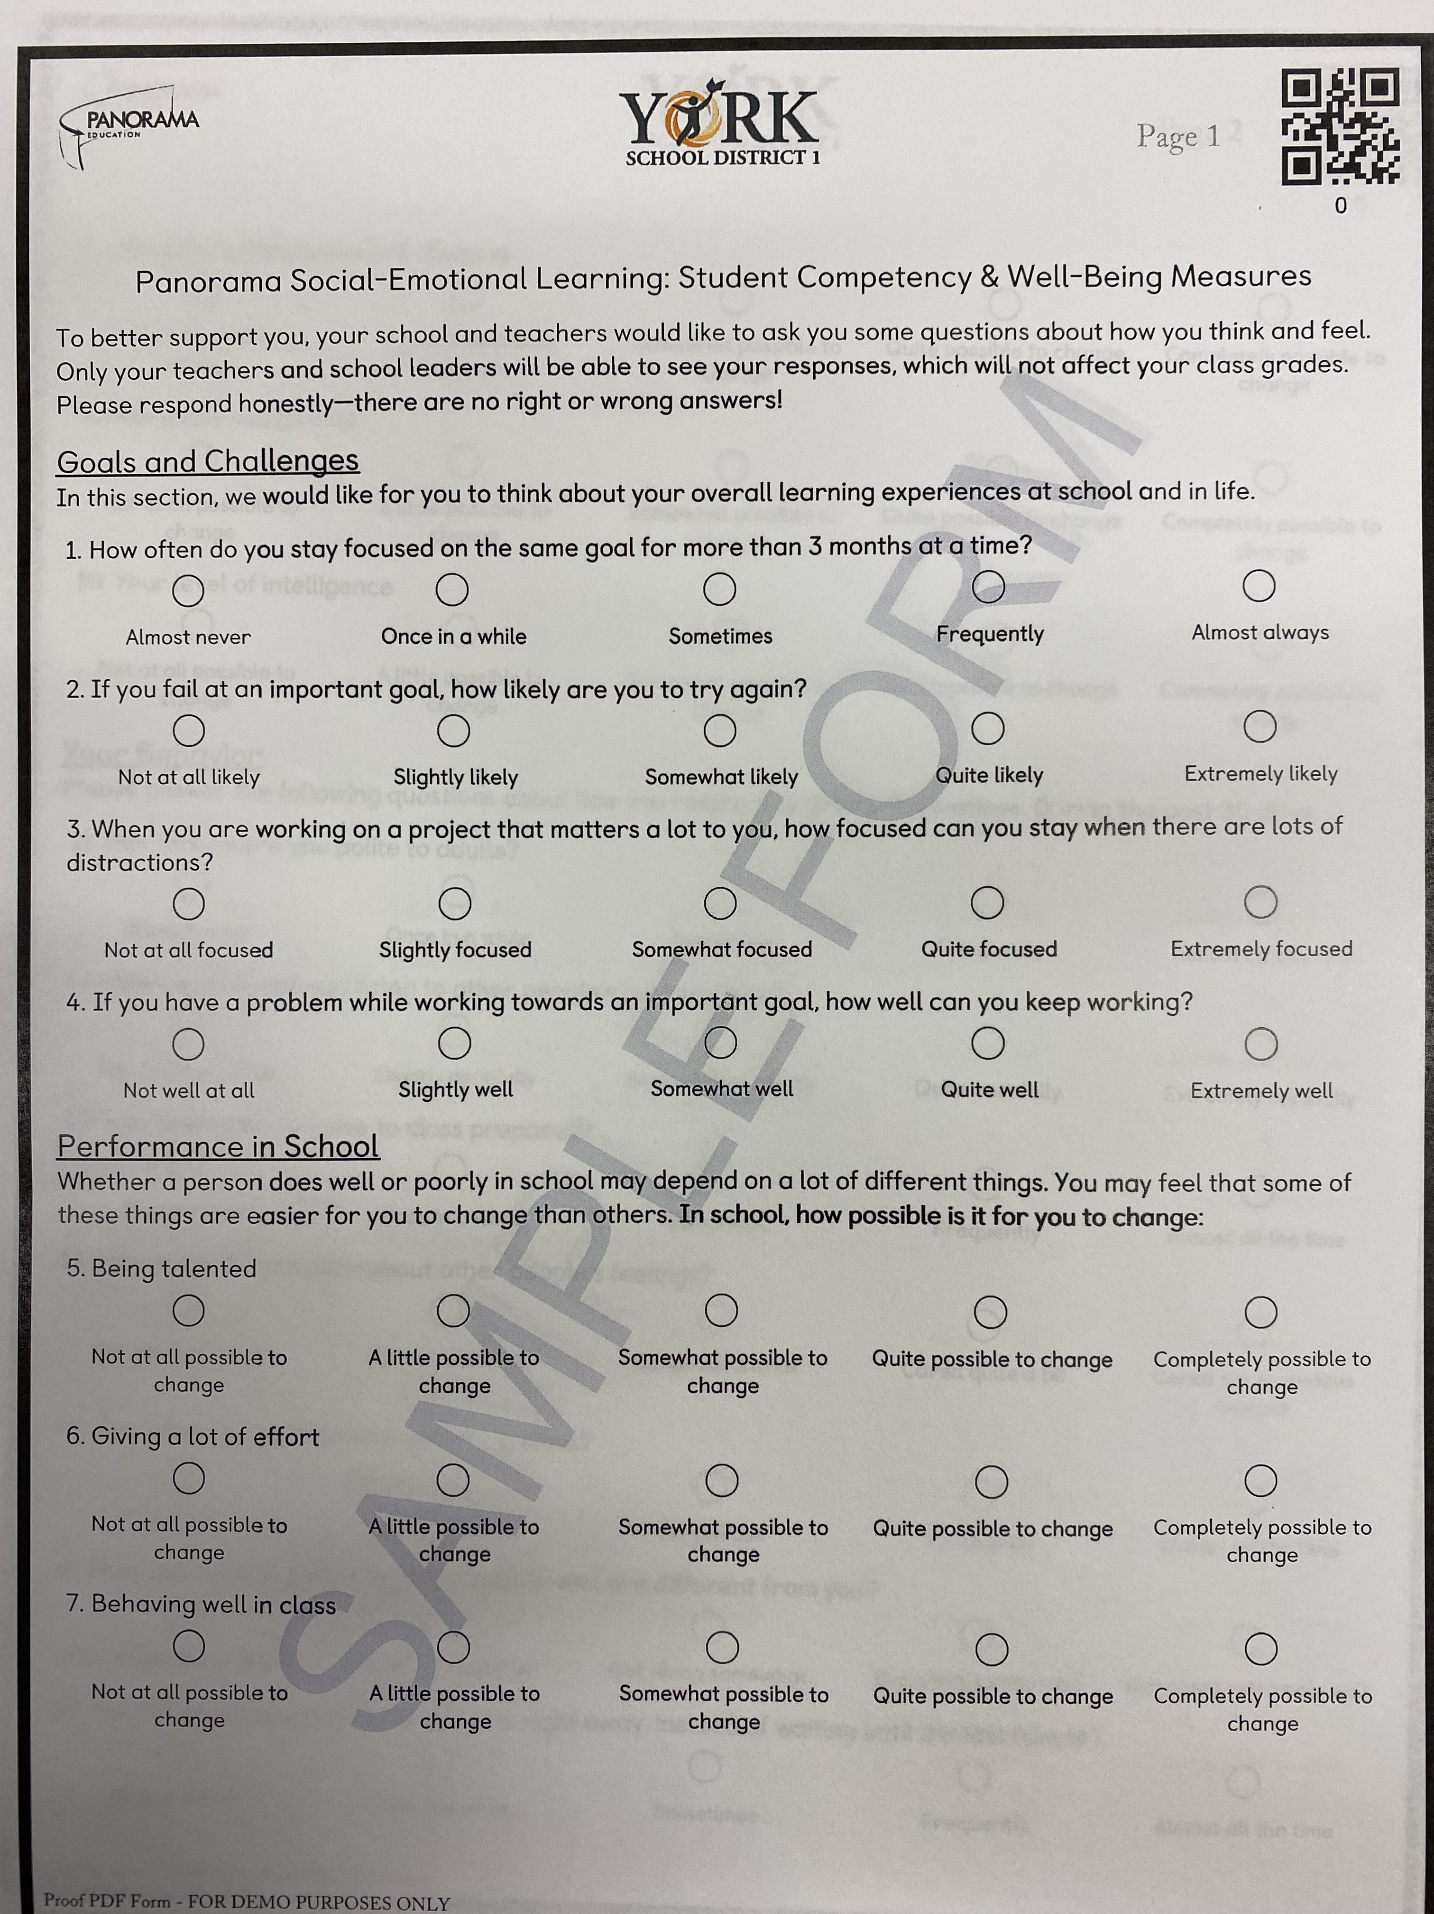
Fall 2021 SEL Surveys
K-2, 3-5 and 6-12
Surveys will be released on Monday September 20th.
K-2 Surveys will be based on teacher perception.
3-5 (33 questions-11 mins)
6-12 (35 questions – 12 min)
The survey link plus a Student ID will get our students into the survey.

Slide 8
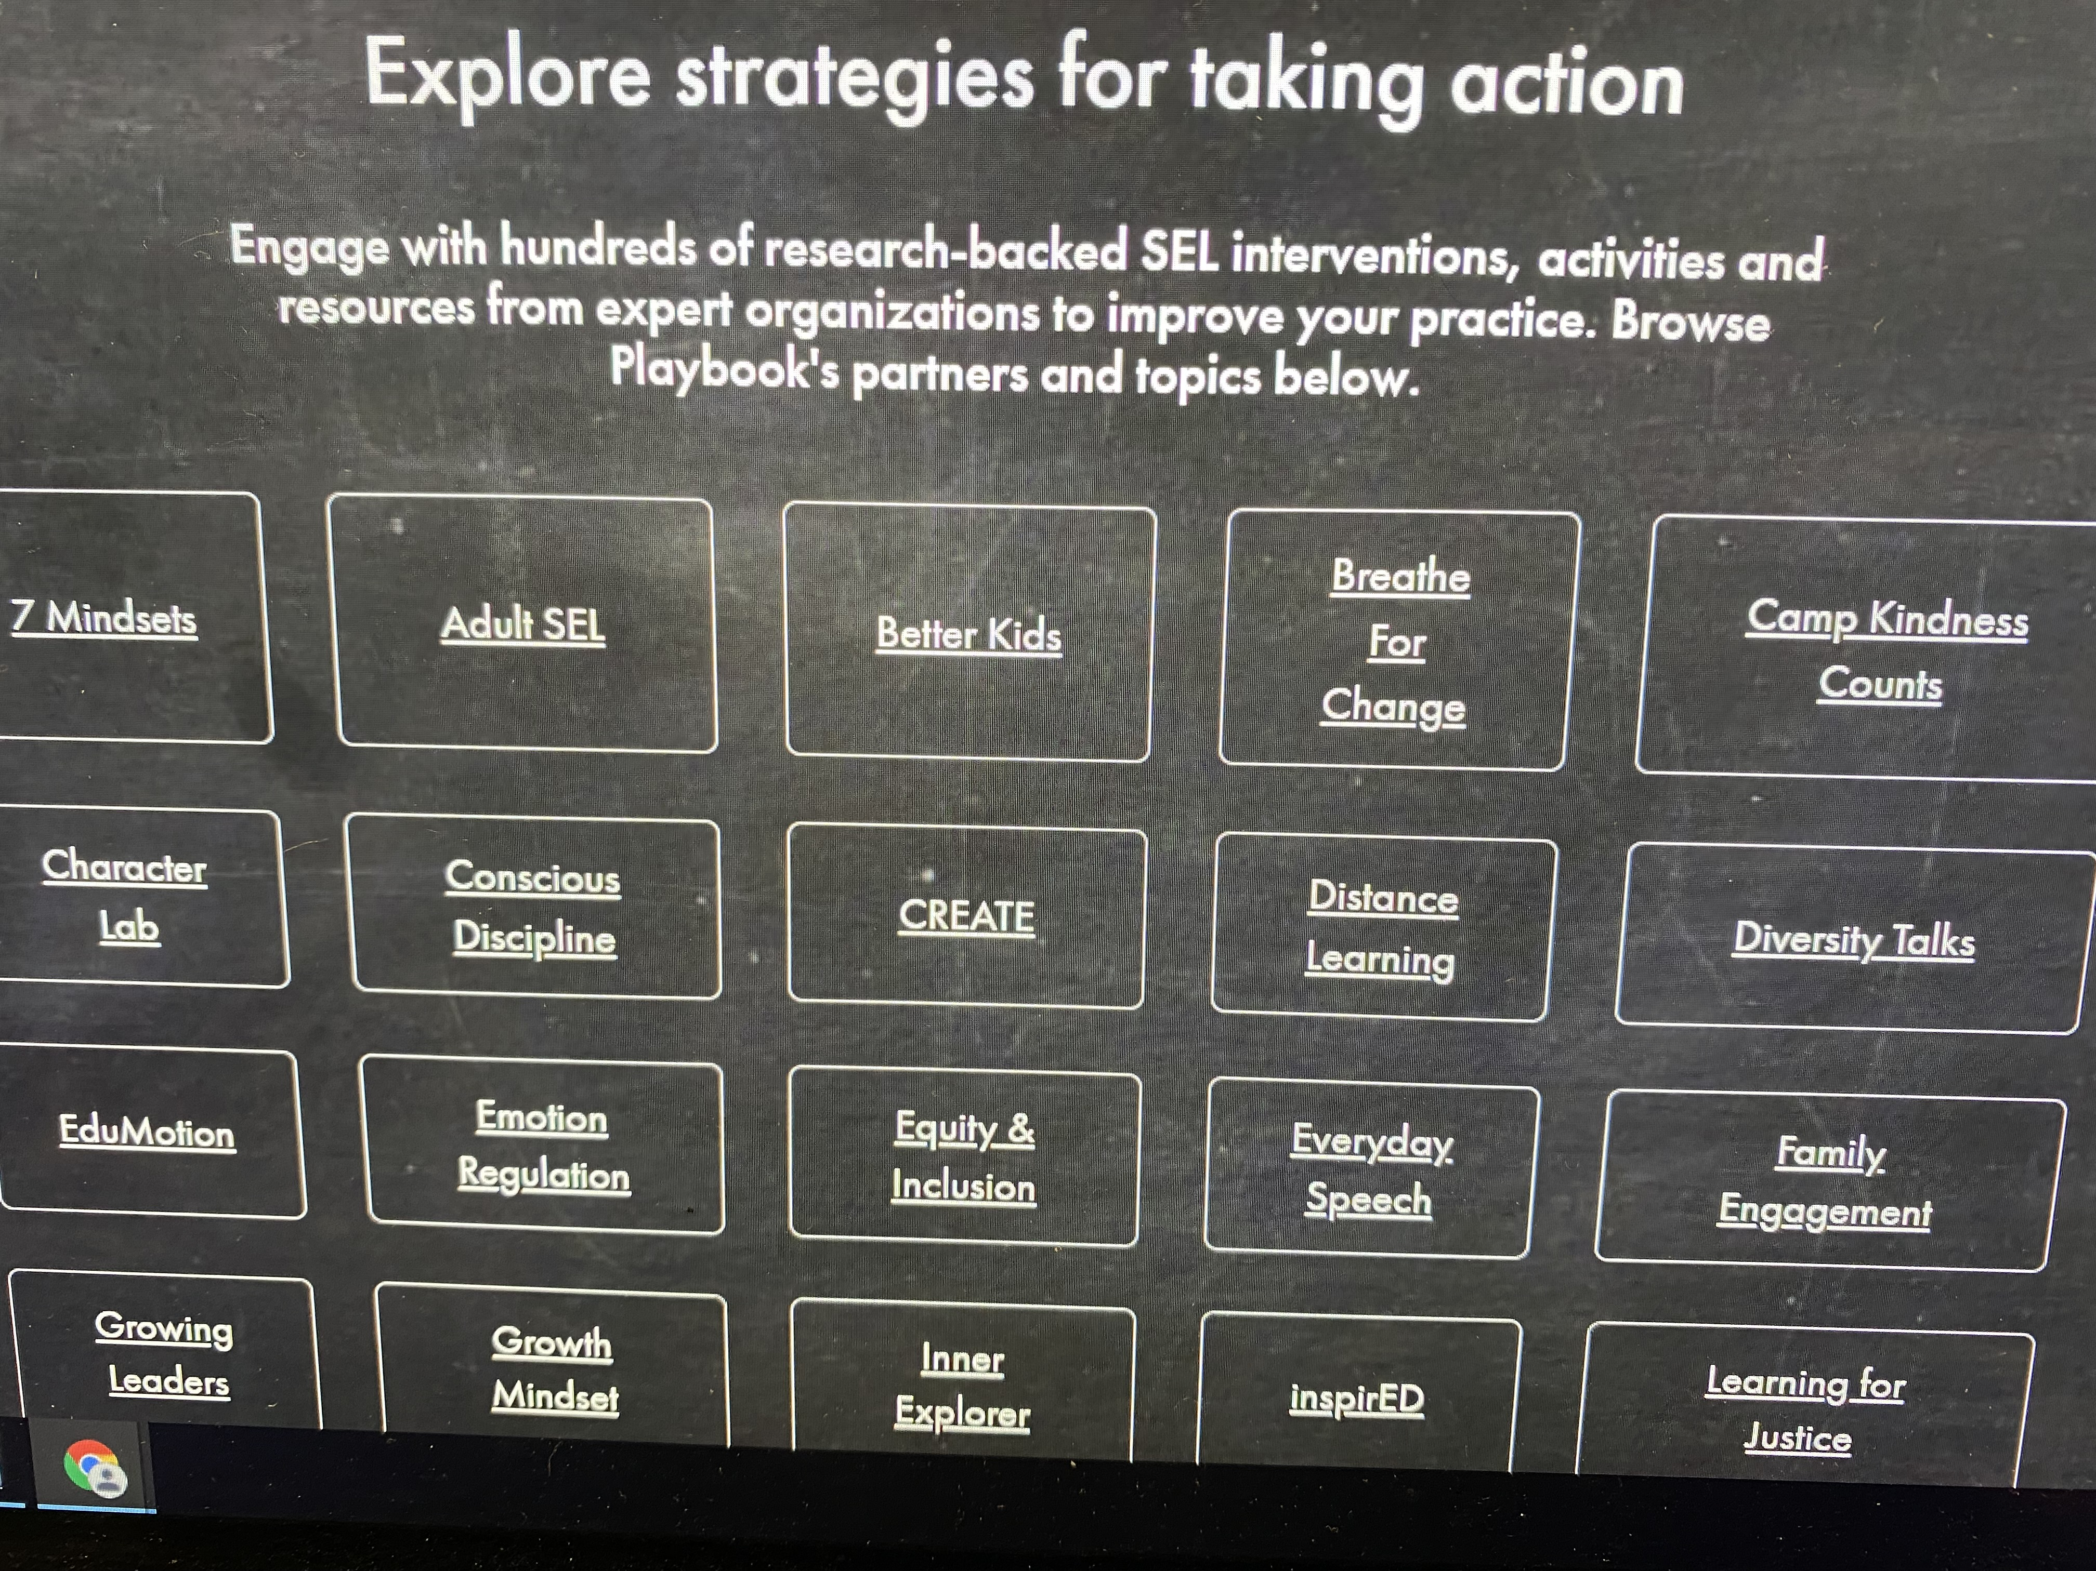
SEL Lessons That Rock!
Teachers can use the Panorama Playbook to find super lessons that meet the needs of their students.
Implementation Calendars
Lessons start October 11th.

Slide 9
Our Keystone Partners
Alison Hurayt, Keystone Representative and Point of Contact
Leslie Mastbaum - counselor assigned to York 1 and housed at YCHS
LifeSkills lessons are taught by Keystone partners in Grade 6
VAPE/Substance intervention available at any level

Slide 10
Committee Meeting Dates
November 18, 2021
February 24, 2022 (Tentative)
April 28, 2022 (Tentative)

