Slide 1

Lancer Academy
Food, Fashion, Art, Music, Entertainment
Providing an interest based pathway for students with a passion for the arts.

Slide 2
Academic Teachers
Math: Mark Travis
Science: Adam Taylor
Language Arts: Marcus Woodworth
Pre Ap English: Marisol Diaz

Slide 3
VAPA Teachers
Art: Michael Hess, Jacqueline Fabritz
Culinary Arts: Chef Tracy Horton
Dance and Drama: Yolanda Rubio –Soto
Fashion: Jacqueline Fabritz
Instrumental Music: Doris Doyon
Vocal Music: Nancy Lanpher

Slide 4
THEMES FOR ACADEMICS:
FRESHMAN: MUSIC 2015-2016
SOPHOMORE: ART 2016-2017
JUNIOR: DRAMA 2017-2018
SENIOR: STUDENT’S SPECIFIC STUDY 2018-2019

Slide 5
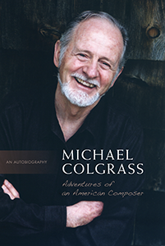
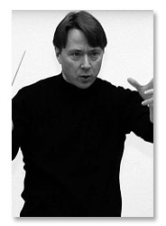
Gen G
Big Event
Glen Adsit

Slide 6
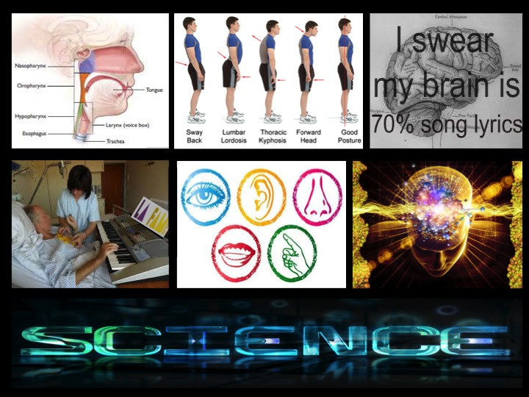

Slide 7
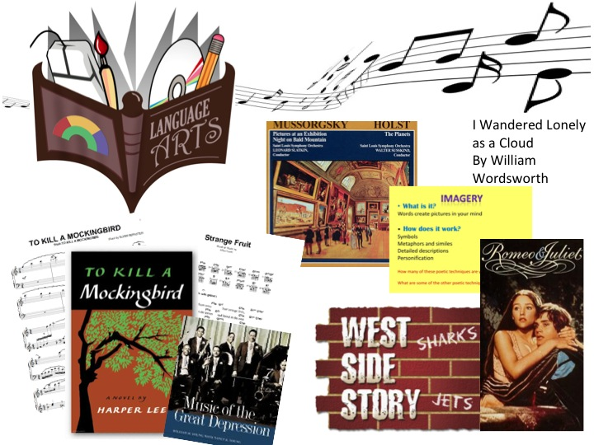

Slide 8
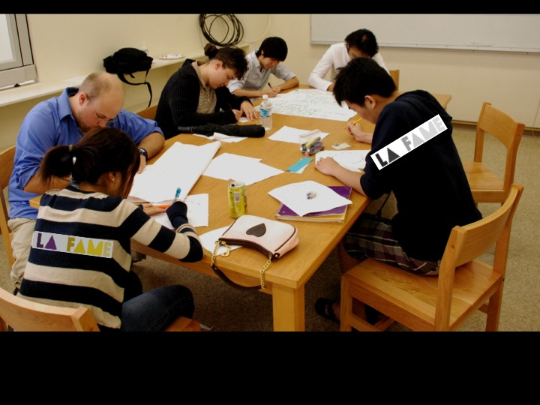
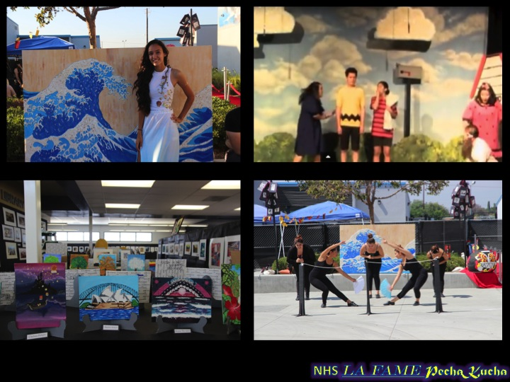
Scheduled Tutoring

Slide 9

Social Media
Join in and follow us on Twitter
@mohmarkbari-everything LA FAME (#nhslafame, #nhsbarbershop, #nhsbbs)
@NhsSingerss- for everything vocal music
@ PrincipalLancer, for exciting news, stories and promotion of every aspect of Norwalk High School.

Slide 10
Jerry Koppe
Counselor for
LA FAME

Slide 11
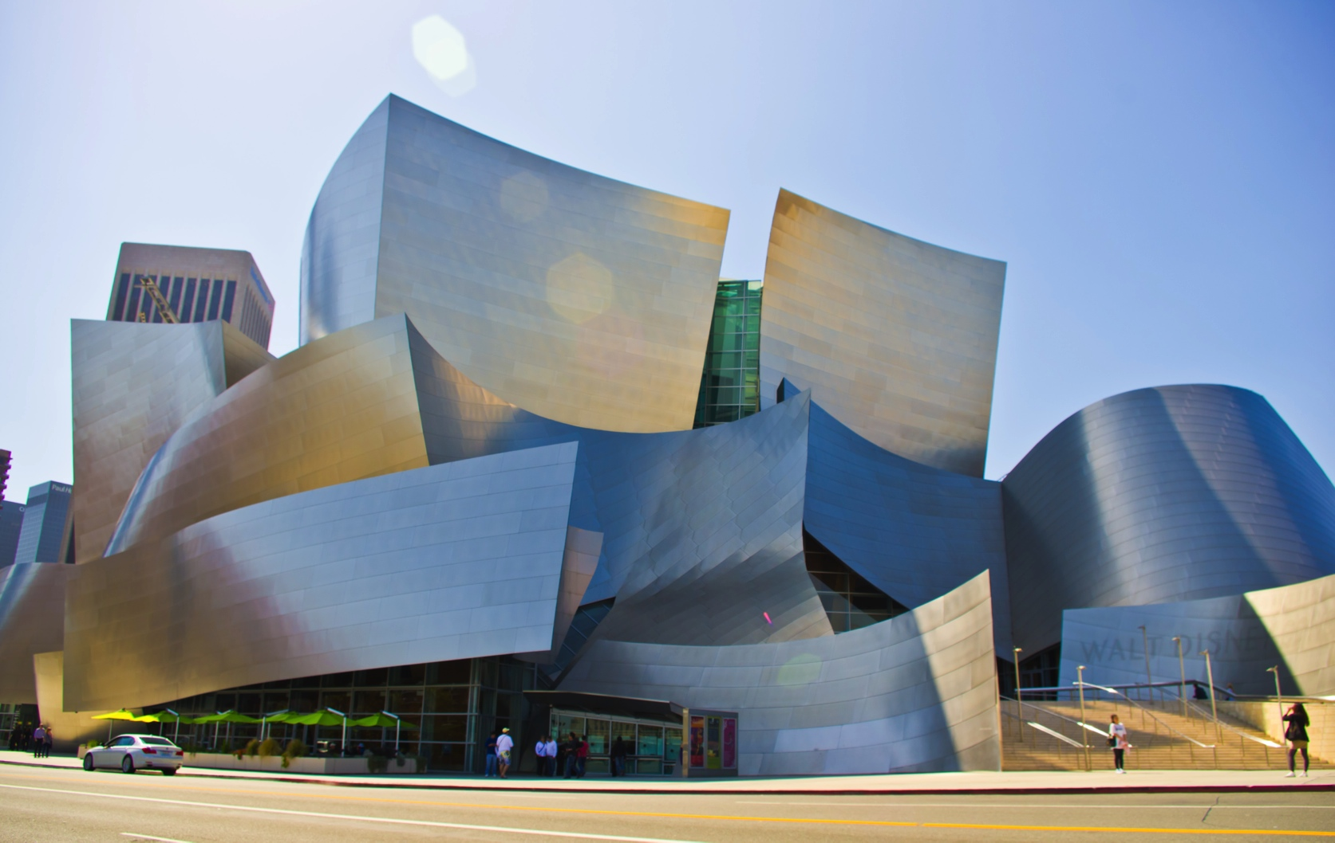
Field Trips

Slide 12
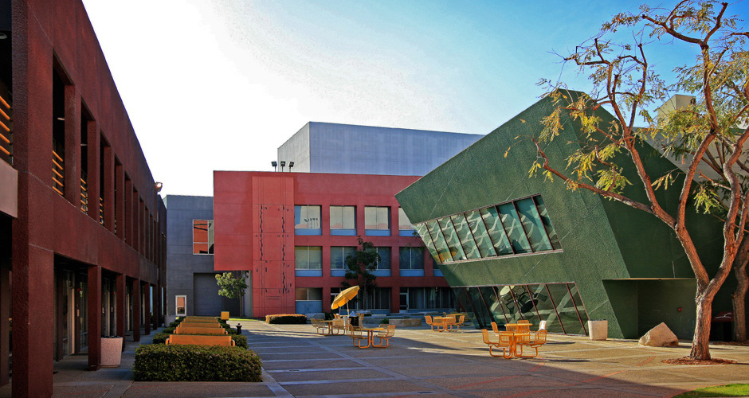
University Visits
California State University
Long Beach

Slide 13
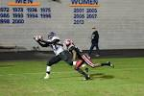
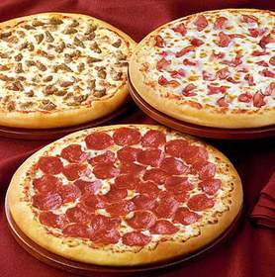
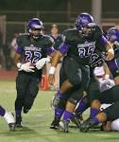
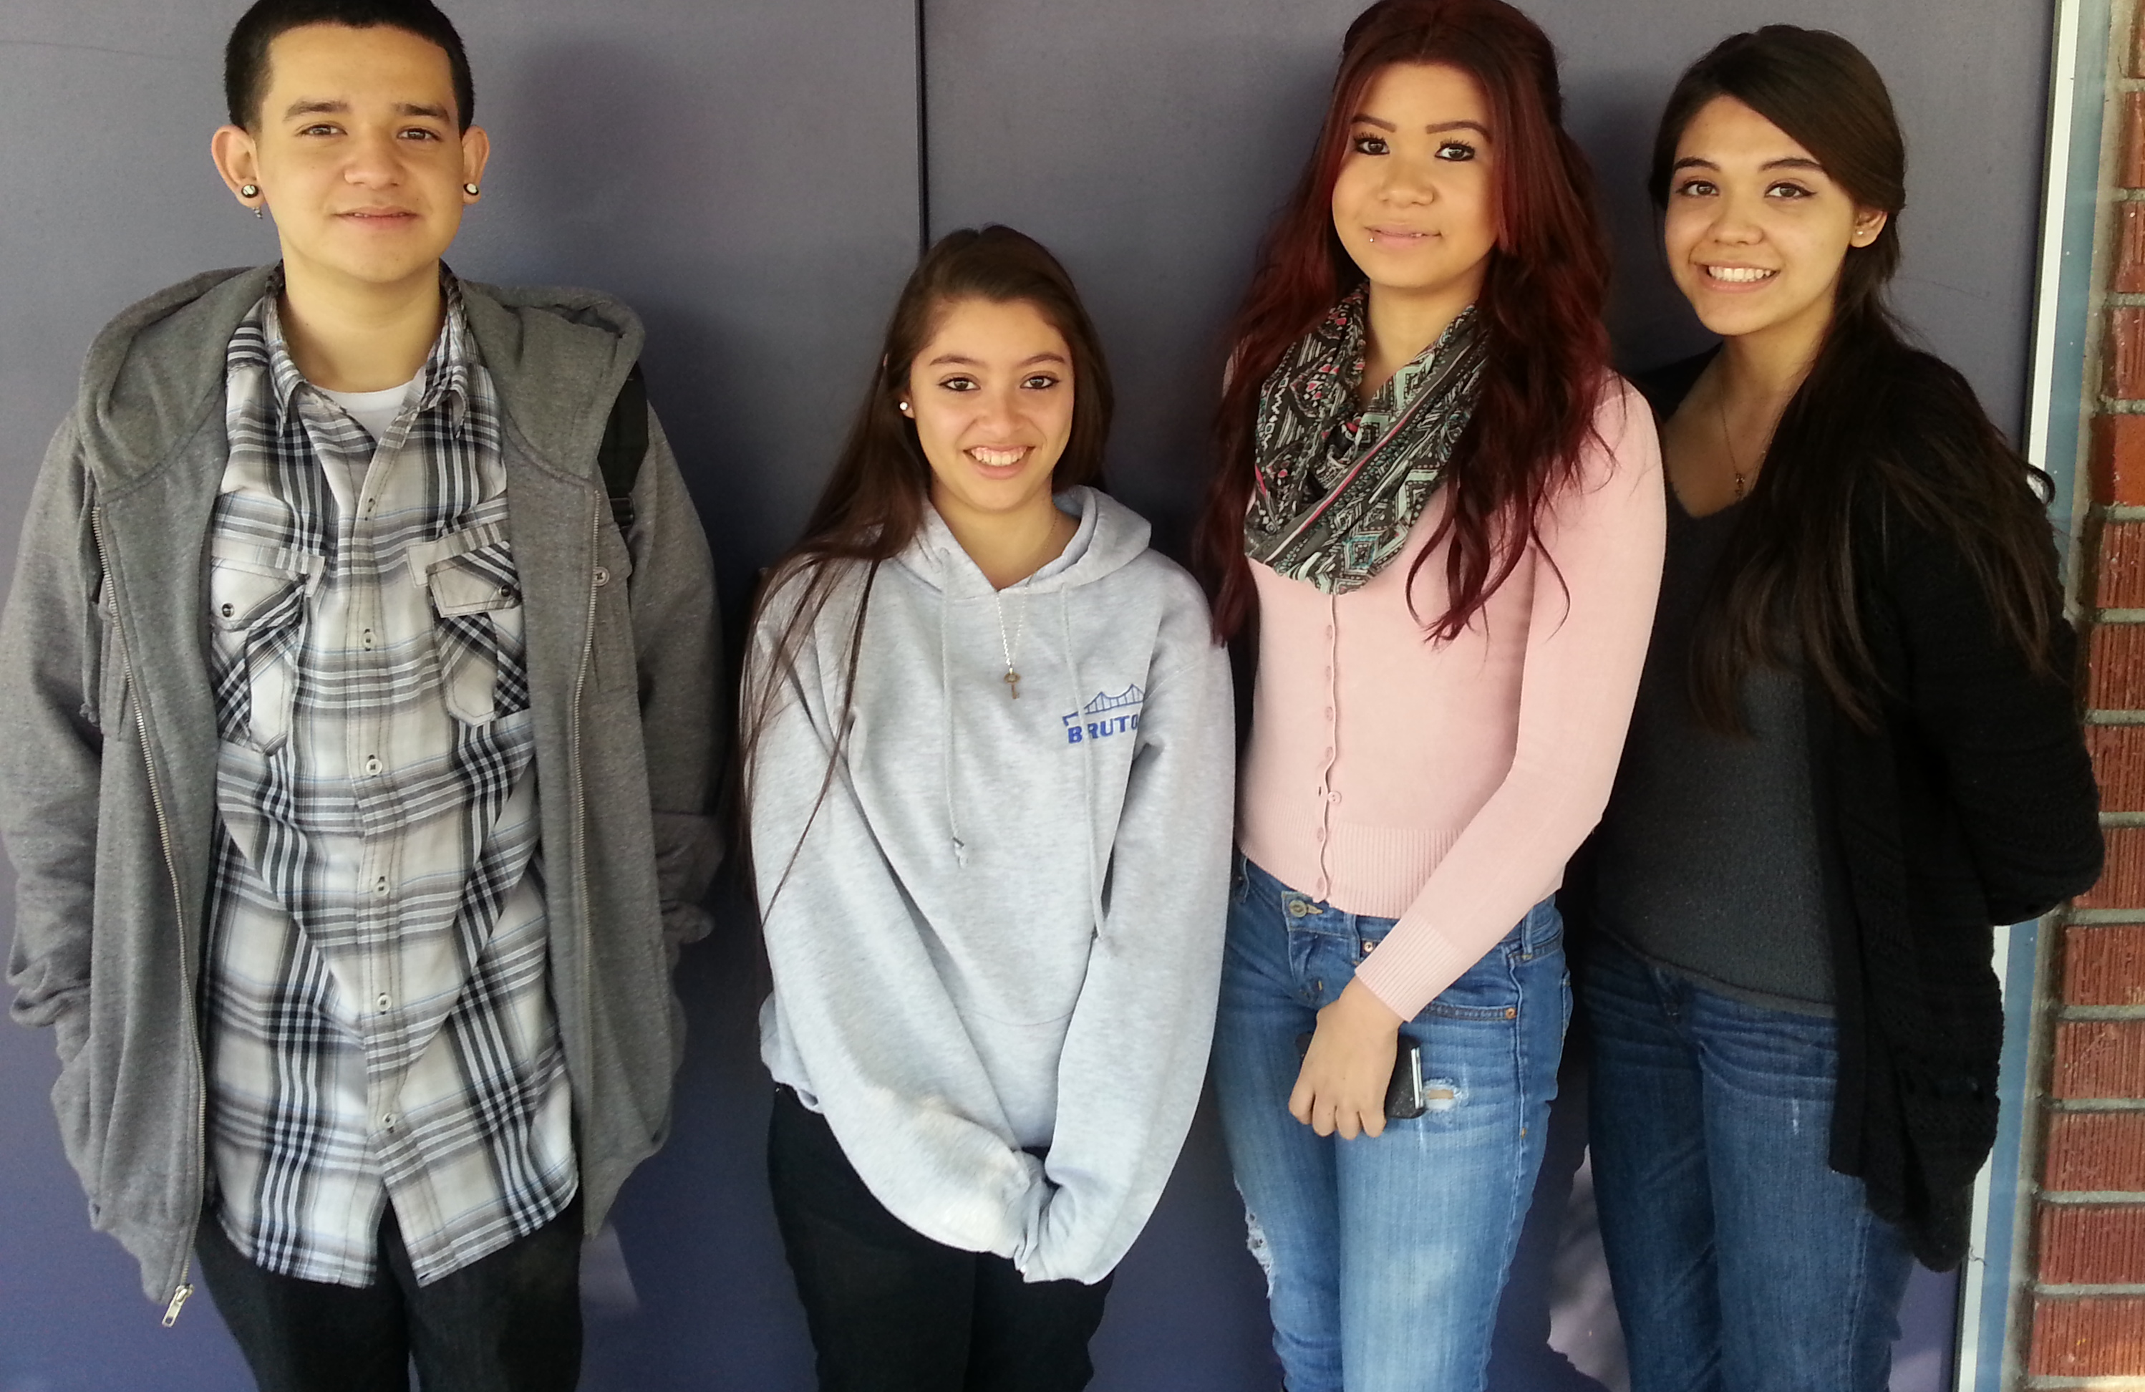
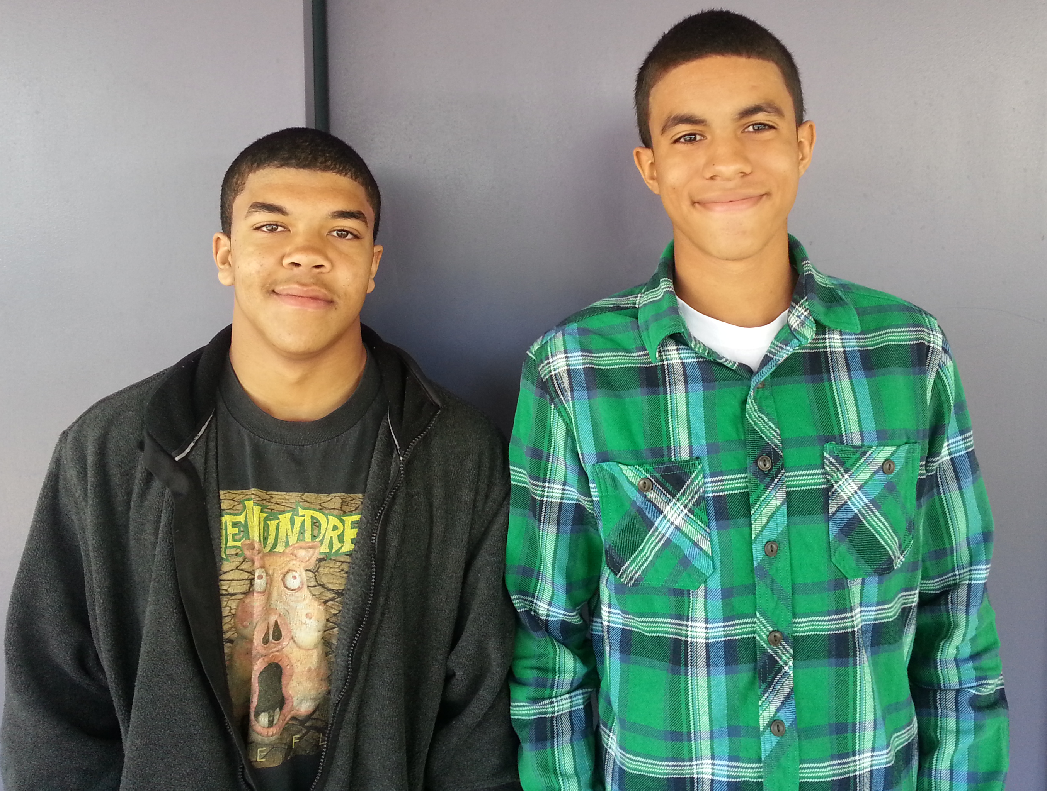
B
Bonding Activities
and Club Meetings!

Slide 14
Artrageous-Capstone Event

