Slide 1

Grade level Meetings
HGSE PTO/SIC
November 16, 2021

Slide 2



Notes:
Parable of Trapeze - Latoya to read
As she reads, think of your own journey – your personal journey – your professional journey – your school’s journey.
Turn & Talk - Take a moment to respond to the reflection questions on page ______ in your guidebook.
Talk at your table. Anyone like to share out?
Try to avoid the race to return to a “sense of normalcy”
Enjoy the learning
“Vision” what the new bar may look like

Slide 3

STRATEGIC CHANGE AGENDA
A LEARNING ORGANIZATION APPROACH
2021-2026

Slide 4

MISSION
Our mission is to cultivate a service-oriented community of learners who strive for personal growth and excellence as communicators, collaborators, creators, and critical thinkers.
VISION
To Learn, Serve, and Give as ONE
BELIEFS
Learning is a life-long, ever-changing process for students and staff.
Each child is unique and should have the opportunity to reach his/her full potential.
A safe, orderly, and nurturing environment is essential for learning.
Education is a collaborative effort between schools and the community.
Technology is a tool that should be leveraged to enhance the teaching and learning process.
Teaching and learning should be relevant, individualized, & intentional to equip students for success.

Slide 5
York School District One
Beliefs and Commitments
Beliefs
Commitments
Learning is a life-long, ever-changing process for students and staff.
Education is a collaborative effort between schools & the community.
A safe, orderly, and nurturing environment is essential for learning.
Each child is unique and should have the opportunity to reach his/her full potential.
Technology is a tool that should be leveraged to enhance the teaching and learning process.
Teaching and learning should be relevant, individualized, and intentional to equip students for success.
We will embrace a commitment to continuous learning for students and staff.
We will partner and collaborate with students, families, and the community to enhance educational experiences.
We will foster and maintain a safe learning environment for students and staff.
We will establish & nurture trusting & caring relationships with students, families, community members, & colleagues.
We will provide quality learning experiences to meet the individual needs of students.
When we commit to what we believe we act accordingly.

Slide 6

York School District One Strategic Goals
Create a challenging and supportive educational environment that ensures readiness for all students.
Create quality opportunities for ongoing learning for students and staff in order to promote innovation and flexibility.
Build capacity and leadership at every level of the organization.

Slide 7

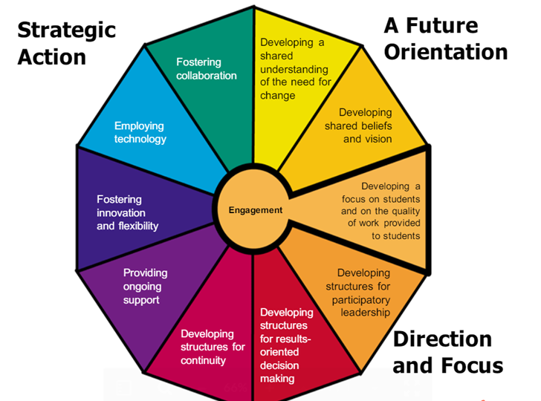
YSD1 Strategic Strengths
Fostering Collaboration
Employing Technology
Developing Shared Beliefs & Vision
Notes:
When we conducted our capacity audit, utilizing the System Capacity Standards, we found our strengths within…
Our ability to foster collaboration
To employ technology
And to develop shared beliefs and vision.
This is not surprising given…
Connected As One
1-to-1 technology initiative
We know what we believe and where we want to go
Now it is time to get clear on how we are going to do it.

Slide 8
YSD1 Strategic Priorities
Developing A Shared Understanding of the Need for Change.
Developing a Focus on Students & on the Quality of Work Provided to Students.
Fostering Innovation & Flexibility.
Notes:
Our priority areas – our focus areas are…
Shared Understanding of Need for Change
Quality of Work
Innovation and Flexibility
I am intrigued by the relationship between our strength with developing beliefs & vision and our focus area of a need for a shared understanding.
2 years ago we began with our “why” – Knowing Your Why
We have firmly grounded connectedness – Connected As One
We are clear on our beliefs about children and their importance of their learning
But simply having this knowledge is not enough.
We have to get serious about the work at hand. And we need to understand why believing isn’t enough. It’s time for action.

Slide 9
If we believe..., then we will...
Learning is a life-long, ever-changing process for students and staff.
We will embrace a commitment to continuous learning for students and staff.
Education is a collaborative effort between schools & the community.
We will partner and collaborate with students, families, and the community
to enhance educational experiences.
A safe, orderly, and nurturing environment is essential for learning.
We will foster and maintain a safe learning environment for students and staff.
We will establish & nurture trusting & caring relationships with students, families, community members, & colleagues.
Each child is unique and should have the opportunity to reach his/her full potential.
Technology is a tool that should be leveraged to enhance the teaching and learning process.
Teaching and learning should be relevant, individualized, and intentional to equip students for success.
We will provide quality learning experiences to meet the individual needs of students.
When we commit to what we believe we act accordingly.
Notes:
To help in this transition we have development commitments.
If we truly believe _________________ then we must ______________________.
This is the linchpin between simply having a belief and acting on that belief.

Slide 10
York School District One Strategic Goals
Create a challenging and supportive educational environment that ensures readiness for all students.
Strategies:
District staff will collaborate to create a comprehensive and seamless K – 12 teaching and learning experience.
Promote a culture that embraces diversity and addresses the needs of the whole child.
Create relevant, meaningful, and applicable learning experiences that support student readiness.
Engage in collaborative reflection with a variety of stakeholders to capitalize on the strengths of the district.
Notes:
Promote a culture that embraces diversity and addresses the needs of the whole child – Remember Yeats – our students are bring us their dreams. How are we handling that responsibility? Do our actions currently support our beliefs?

Slide 11
York School District One Strategic Goals
Create quality opportunities for ongoing learning for students and staff in order to promote innovation and flexibility.
Strategies:
Design opportunities for student-centered learning experiences that are challenging, meaningful, and relevant.
Integrate current and innovative technologies to increase student engagement and performance.
Provide personalized learning experiences to meet the individual needs of students and staff.
Embrace student feedback to aid in the design of quality work and learning experiences.

Slide 12
York School District One Strategic Goals
Build capacity and leadership at every level of the organization.
Strategies:
Develop a shared understanding of quality student work, valuable experiences, and high expectations.
Provide professional learning opportunities to promote a culture of creativity, risk-taking, and innovation.
Establish an onboarding process that orients new members to the learning organization.
Leverage innovative technologies to enhance teacher practice, student engagement, and student learning.
Notes:
Provide professional learning opportunities to promote a culture of creativity, risk-taking, and innovation. – Think of the space between the trapeze bars. Do our teachers and students feel safe in this space?
Establish an onboarding process that orients new members to the learning organization. - Not just our “new to the district” new members – but also our new to thinking and behaving as a learning organization members.

Slide 13
Expectations for HGSE-review and finalize
Personalized Learning for Teachers and Students
PD for teachers in areas of choice
Ongoing support in areas of ELA and technology
Flex Grouping for students in grades 1st-6th = intervention, remediation, and acceleration
Literacy Reflection Tool- Reading Plan- how do these goals align with our strategic change agenda

Slide 14
What is a Learning Organization?
“Organizations where people continually expand their capacity to create the results they truly desire, where new and expansive patterns of thinking are nurtured, where collective aspiration is set free, and where people are continually learning how to learn together,” (Senge, P., 1990).
“Learning organizations are designed to create the type of leadership structures needed to deal with uncertainty in disciplined, productive, and creative ways—to transform problems into possibilities and perplexities into insight,” (Schlechty, P., 2009).
Notes:
Indeed, the third aspect of indelible leadership is to lead and learn in equal measure. Fullan states, “In complex situations, leaders listen and learn so that they can lead better. He then identifies, for leaders, three tensions within the leading and learning dynamic. The first is to both respect and reject the status quo. The second is expertise and apprenticeship, which means that “…the leader has expertise in some domains, but she or he must also be a learner (apprentice to those who know more in other respects). Finally, experimentation and commitment should be balanced such that leaders commit to learning from and building on carefully designed experiments and “…consolidate commitment to the good practices and ideas…” that emerge.

Slide 15
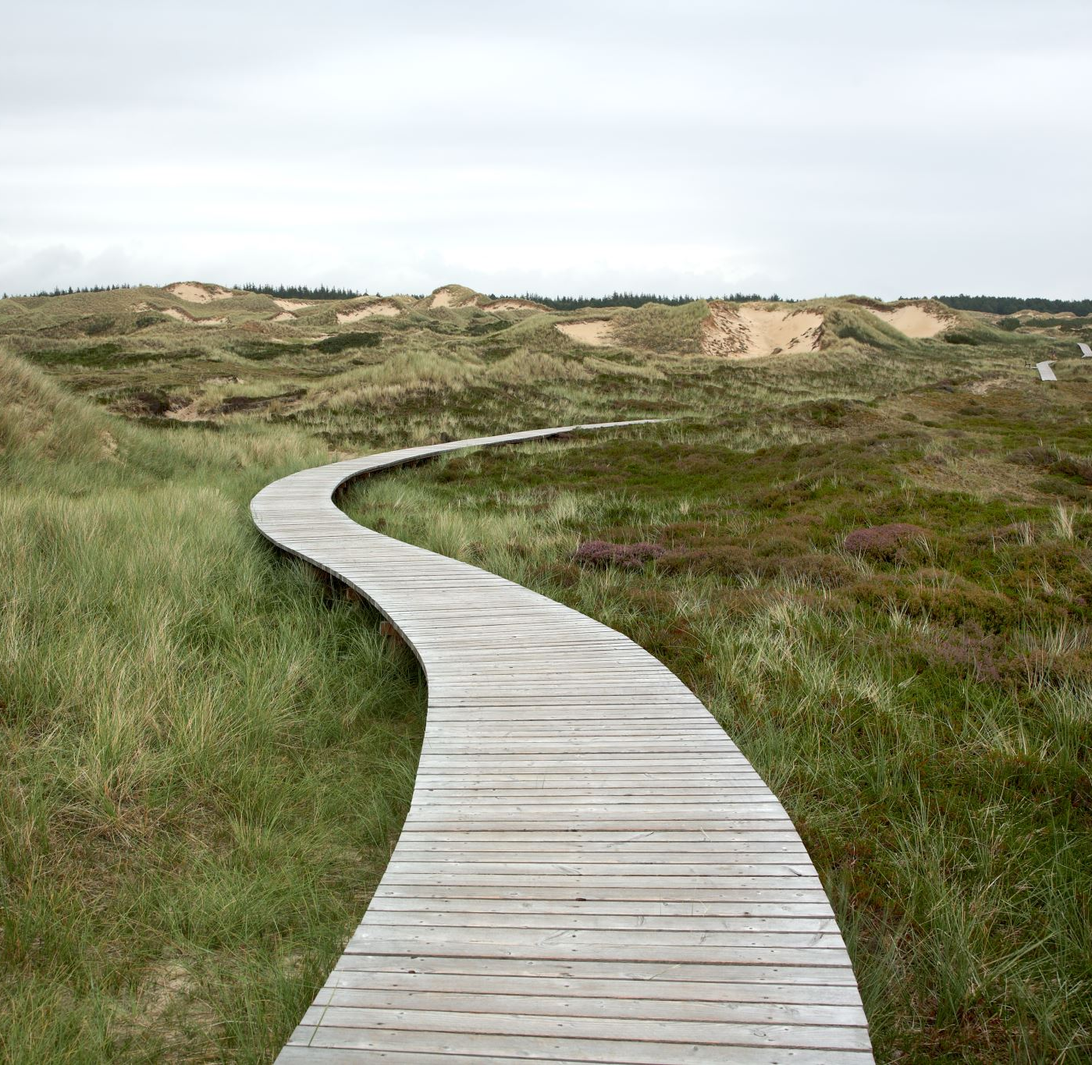
Cognia

Slide 16
The Process:
Domains
capacity
Standards
conditions
Key Concepts
measurement
The Standards are organized under three Domains:
    Leadership Capacity (10 standards)​
    Learning Capacity (12 standards)​
    Resource Capacity (8 standards)
Notes:
The Domains are statements that define the capacity of an organization or institution to provide quality and meet the rigorous demands of continuous improvement.

Slide 17
The Process:
Domains
capacity
Standards
conditions
Key Concepts
measurement
  The Performance Standards are research-based statements that describe conditions.
    There are 30 standards.
Notes:
The Performance Standards are research-based statements that describe conditions. that are necessary for institutions to support organizational effectiveness and improve student performance.

Slide 18
  Key Concepts:
    aligned to the Standards ;
    help provide measurable progress; and
    an overall assessment of practices.
The Process:
Domains
capacity
Standards
conditions
Key Concepts
measurement
School Improvement Continuum
Initiate
Improve
Impact
Notes:
The Key Concepts are organized around the i3 themes of Initiate, Improve and Impact. Let’s take a look at the rubric.

Slide 19
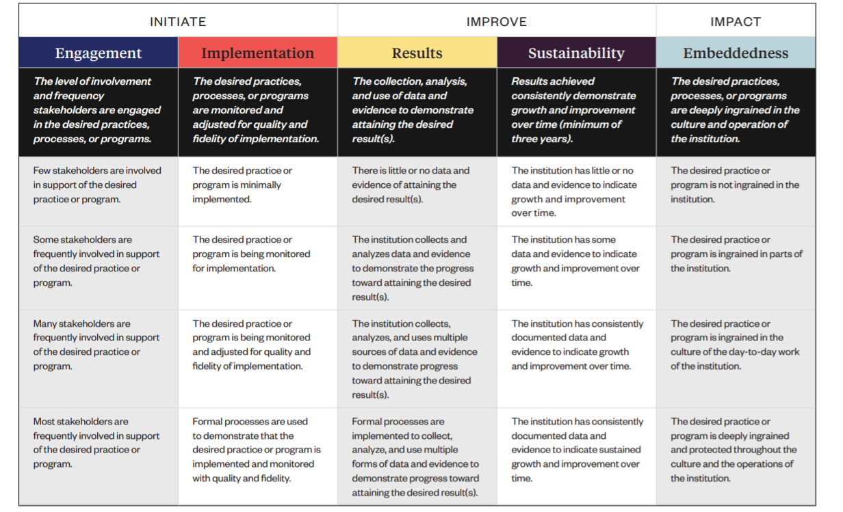
School Improvement Continuum
3 Themes
5 Elements of Impact
Definition of the Elements
}
1
1
1
1
1
Four performance levels for each element of impact
2
2
2
2
2
3
3
3
3
3
4
4
4
4
4
Notes:
Let’s learn about the rubric that will be used to assess our school’s performance as it relates to the standards under each domain. For each standard, we will first take a look a the types of evidence we think we have and can collect that relates to that standard.
Then, we will rate ourselves under each element of impact (Engagement, Implementation, Results, Sustainability, Embeddedness). As you think about supportive evidence think about these questions:
What are our practices and procedures?
How do we know how we are doing?
What documentation do we have?
Who (e.g. students, teachers, parents, etc.) can speak to this statement?
Is it a good idea to think about the evidence first and then determine the rating under each element.

Slide 20
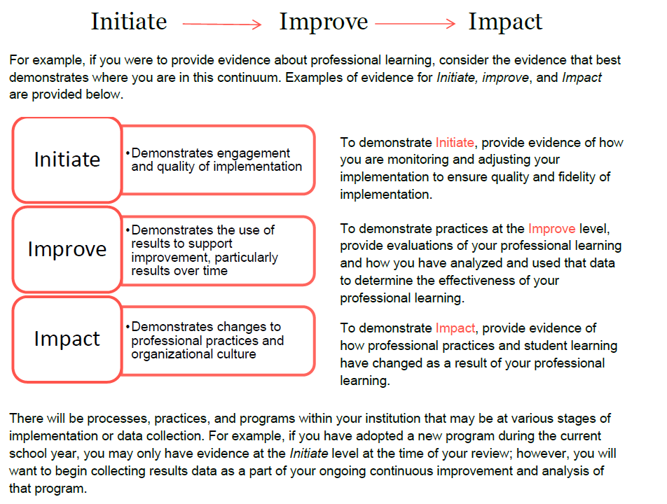
i3 Rubric
INITIATE
Monitoring & Adjusting
Engagement
Implementation
IMPROVE
Analyzing & Evaluating
Results
Sustainability
IMPACT
Evidence of Change/Impact
Embeddedness
Notes:
Here we see there are a few key verbs that align with each of the three themes (initiate, improve, impact) of continuous improvement. Pay attention to the key words in the descriptor beside each of the themes.

Slide 21
Today we will focus on the Leadership Domain
The effectiveness of governance and leadership to enable the institution to realize its stated objectives, the ability to engage and involve stakeholders in meaningful and productive ways, and the capacity to implement strategies that improve learner and educator performance. (10 standards)

Slide 22
Leadership Capacity Domain1
1.1: The institution commits to a purpose statement that defines beliefs about teaching and learning, including the expectations for learners.
1.2: Stakeholders collectively demonstrate actions to ensure the achievement of the institution's purpose and desired outcomes for learning
1.3: The institution engages in a continuous improvement process that produces evidence, including measurable results of improving student learning and professional practice.
1.4: The governing authority establishes and ensures adherence to policies that are designed to support institutional effectiveness.
1.5: The governing authority adheres to a code of ethics and functions within defined roles and responsibilities.
1.6: Leaders implement staff supervision and evaluation processes to improve professional practice and organizational effectiveness.
1.7: Leaders implement operational processes and procedures to ensure organizational effectiveness in support of teaching and learning.
1.8: Leaders engage stakeholders to support the achievement of the institution’s purpose and direction.
1.9: The institution provides experiences that cultivate and improve leadership effectiveness.
1.10: Leaders collect and analyze a range of feedback data from multiple stakeholder groups to inform decision-making that results in improvement.

Slide 23
Today we will focus on the Learning Domain.
The impact of teaching and learning on student achievement and success is the primary expectation of every institution.
An effective learning culture is characterized by:
positive and productive teacher/learner relationships,
high expectations and standards,
a challenging and engaging curriculum,
quality instruction,
comprehensive support that enable all learners to be successful; and
assessment practices (formative and summative) that monitor and measure learner progress and achievement.
Moreover, a quality institution evaluates the impact of its learning culture, including all programs and support services, and adjusts accordingly.
It’s all about the EVIDENCE!

Slide 24
Let’s look at the Learning Domain standards.
2.1 Learners have equitable opportunities to develop skills and achieve the content and learning priorities established by the institution.
2.2 The learning culture promotes creativity, innovation and collaborative problem-solving.
2.3 The learning culture develops learners’ attitudes, beliefs and skills needed for success.
2.4 The institution has a formal structure to ensure learners develop positive relationships with and have adults/peers who support their educational experiences.
2.5 Educators implement a curriculum that is based on high expectations and prepares learners for their next levels.
2.6 The institution implements a process to ensure the curriculum is aligned to standards and best practices.

Slide 25
Let’s look at the Learning Domain standards.
2.7 Instruction is monitored and adjusted to meet individual learners’ needs and the institution’s learning expectations.
2.8 The institution provides programs and services for learners’ educational futures and career planning.
2.9 The institution implements processes to identify and address the specialized needs of learners.
2.10 Learning progress is reliably assessed and consistently and clearly communicated.
2.11 Educators gather, analyze, and use formative and summative data that lead to demonstrable improvement of student learning.
2.12 The institution implements a process to continuously assess its programs and organizational conditions to improve student learning.

Slide 26
Let’s look at the Resource Domain standards.
Resource Capacity Domain: The use and distribution of resources support the stated mission of the institution. Institutions ensure that:
resources are distributed and utilized equitably so that the needs of all learners are adequately and effectively addressed.
The utilization of resources includes support for professional learning for all staff.
The institution examines the allocation and use of resources to ensure appropriate levels of funding, sustainability, organizational effectiveness, and increased student learning
It’s all about the EVIDENCE!

Slide 27
Today we will focus on the Resource Domain.
3.1 The institution plans and delivers professional learning to improve the learning environment, learner achievement, and the institution’s effectiveness.
3.2 The institution’s professional learning structure and expectations promote collaboration and collegiality to improve learner performance and organizational effectiveness.
3.3 The institution provides induction, mentoring, and coaching programs that ensure all staff members have the knowledge and skills to improve student performance and organizational effectiveness.
3.4 The institution attracts and retains qualified personnel who support the institution’s purpose and direction.

Slide 28
Let’s look at the Resource Domain standards.
3.5 The institution integrates digital resources into teaching, learning, and operations to improve professional practice, student performance, and organizational effectiveness.
3.6 The institution provides access to information resources and materials to support the curriculum, programs, and needs of students, staff, and the institution.
3.7 The institution demonstrates strategic resource management that includes long-range planning and use of resources in support of the institution’s purpose and direction.
3.8 The institution allocates human, material, and fiscal resources in alignment with the institution’s identified needs and priorities to improve student performance and organizational effectiveness.

