Slide 1

Test Anxiety and
Test Taking Strategies
Presentation by: Michelle R Gagnon

Slide 2
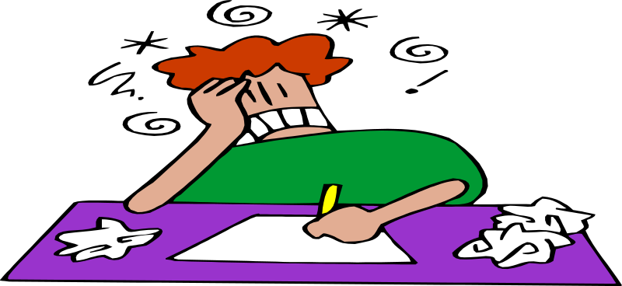
What is Test Anxiety?
Test anxiety is the feeling of nervousness and distress you experience before or during an test. Students who suffer from test anxiety report difficulties with concentration, mental blocks, and distractibility.

Slide 3
What causes Test Anxiety?
Lack of preparation!
Past experiences of blanking out or performing badly on tests.
Focusing too much on the outcome.
Focusing too much on how other classmates and friends are doing.
Issues outside of school distracting you from studying for or concentrating on tests.

Slide 4
How does Test Anxiety affect You?
Test anxiety affects you in three ways:
Physiologically
Behaviorally
Psychologically

Slide 5

Physiological Reactions may Include:
Increased heartbeat
Tensed muscles
Perspiration
Dry mouth

Slide 6

Behavioral Reactions may Include:
Inability to make decisions, act, or express yourself.
Difficulty reading and understanding questions on an test.
Difficulty organizing your thoughts.
Difficulty recalling or retrieving terms and concepts.

Slide 7
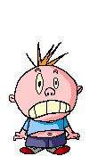
Psychological Reactions may Include:
Feeling apprehensive or uneasy.
Feeling upset.
Having self-doubt or negative self-talk.

Slide 8
What are Some Ways to Deal with Test Anxiety Before the Test?
Prepare well and in advance!
Check your attitude!
Relax!

Slide 9

How can You Prepare Well and In Advance?
Set up a study schedule.
Review material often throughout the nine weeks.
Test yourself.

Slide 10
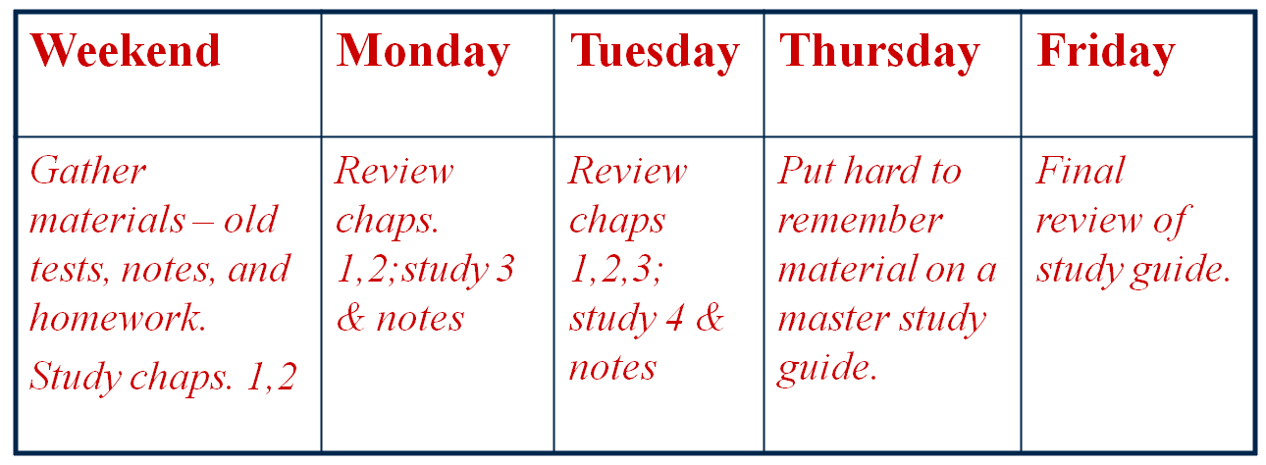
Set up a study schedule
Put specific study times into your schedule and determine study tasks for each review session.
Below is an example of a student’s review schedule one week before a test:

Slide 11

Review Material Effectively and Often Throughout the Nine Weeks
Review 10 minutes a day for each class. Seeing, hearing, or interacting with the class material often will help you remember it.
Study in short spurts (an hour or less) and take breaks, rather that studying straight through for several hours.
Aim for understanding the material, not just memorizing.

Slide 12
Test Yourself
It is important to test yourself on the material.
You can do this by:
Making flash cards.
Using chapter tests in your textbook.
Turning each section heading into a question and then trying to answer it.
Looking away from each section you are studying and reiterating (to yourself or a study partner), verbally or in writing, what that section is about.

Slide 13
Relax
Learn stress releasing strategies that you can use in and out of the test situation. Practice the techniques so they become easy to use.
Exercise
Listen to music that soothes or motivates you
stretch
Practice stress releasing exercises

Slide 14

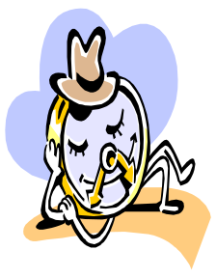
Following are Quick Relaxation Techniques You can use In or Out of the Classroom:
TENSE AND RELAX
If sitting in a chair in class, you can use your chair to help you with this exercise.
Place your feet flat on the floor in front of you.
With both hands, grab the underside of your chair.
Push your feet into the ground and pull on your chair upward. Tense your
muscles, holding for 5 seconds.
Release your pull and relax your feet, letting your body go limp.
Repeat as necessary.
BREATHE
3 Deep Breaths
Inhale through your nose, taking in air as if filling your abdomen.
Hold for 1 second.
Exhale through your mouth or nose, slowly (make sure you exhale completely –push out every last bit of air).
Repeat two more times.

Slide 15
What Strategies can You use to Relieve
Anxiety During the Test?
Here are some suggestions:
Take a break. Stop for a minute, role your shoulders or close your eyes.
Get a drink of water. See if you can leave the room for a drink of water so you can briefly leave the classroom.
Ask a question. Break the uncomfortable silence by asking the teacher a question.
Move on to an easier question. If being stuck on a question is frustrating you, move on and come back to the challenging one later.
Use positive self-talk. Talk to yourself and guide yourself
out of the anxiety.
Use your quick relaxation exercises. Allow yourself a time
out – take a few breaths, tense and relax, or do a quick stretch.

Slide 16

Three Stages Of Test Taking:
Before the test
During the test
After the test

Slide 17

Before the test:
Prepare well through setting a study schedule, reviewing often, and testing yourself.
Get rest and eat well.
Know strategies for different test types – multiple choice, short answer, matching, and essay.

Slide 18
Strategies for Different Types Of Tests
Multiple Choice Tests
Read directions carefully. Most items ask for single answers but some may give you the option of marking several choices.
Read each question thoroughly, then look at the choices.
Underline key words and phrases. If the question is complicated, break it down into small or simple sections that are easier to understand.
Pay attention to qualifiers. Words such as “only” or “except” or negative words such as “not” can confuse your understanding of what is being asked.
Eliminate answers you know are incorrect. Check relevancy and accuracy of each answer.
Look for patterns that may lead you to the answer. Sometimes choices that are more general or are of a middle value in a range may indicate a right answer.
Read every word of each choice. Teachers may include answers that are right except for a single word.
When a test includes a long reading passage, read questions first. This might help you focus on the information you need to answer the questions.

Slide 19
Matching Tests
Read directions carefully. Sometimes an teacher may want you to consider an answer only once; other times an teacher may want you to consider an applicable answer more than once.
Start with the column that has the longest statements and match those with shorter statements or terms.
Do easy matches first to eliminate possible answers and make it easy to spot the more difficult matches.
Short Answers
Look for clues. The sentence structure or number of blanks may give you clues to the answer.
Don’t look hard for hidden meaning. Short answer questions are meant to test your ability to recall information..
Over-answer. If you are stuck with two answers, write down both – you might get partial credit.

Slide 20

True/False
Check for qualifiers.
  Words such as all, always, only and never tend to indicate an absolute. This may indicate a false answer.
  Words such as generally, usually, often, and sometimes may indicate true answers.
Look for two-part statements. If one part of the statement is incorrect, the whole statement is false.
Don’t look hard for hidden meaning.

Slide 21
Essay Questions
Survey test. Read all questions and decide how much time you will spend on each.
Analyze each question carefully. Understand what the question is asking. For example, is the question asking you to compare ideas or describe a situation? Underline key terms and phrases. Look for phrases that limit the topic such as “Between 1815-1830…” or “In the western part of …”
Plan before you begin writing. Write down main ideas and examples and create an outline.
Write your answer using your outline and fill in details.
Review. Do a final check. Did you answers all parts of the question? Check for spelling and punctuation errors.

Slide 22

During the test:
Do an information dump! Before you begin answering, jot down hard to remember formulas and terms on the margins or back of test.
Survey test. Before you begin answering, take a quick look at the whole test. This may help you decide where to begin and how much time to spend on each question.
Read directions carefully and underline key terms and phrases.
Do easy questions first. They may give you clues for the more challenging questions.
Relax! Use your strategies to calm yourself.

Slide 23


After the test:
Reward yourself! Keep practicing positive self-talk.
Analyze your test.
  What went well and what didn’t?
  What type of questions did you find most challenge? Why?
Make and implement a plan to do better next time.

Slide 24
Set Goals For Change:
List test taking or study strategy ideas you think might help you perform better on tests. Then decide how and when you will implement them.
In order to improve my test taking skills I will work on:
________________________________________________________
________________________________________________________
List two test taking or study skills you will incorporate this week:
1)______________________ How?__________________
2)_______________________How?__________________
List two test taking or study skills you will incorporate this nine weeks:
1)______________________How?___________________
2)______________________How?___________________

