Slide 1

Seal of Civic Readiness
White Plains Social Studies Department

Slide 2

What is the Seal?
The Seal of Civic Readiness is a formal recognition that a student has attained a high level of proficiency in terms of civic knowledge, civic skills, civic mindset, and civic experiences. The Seal of Civic Readiness distinction on a high school transcript and diploma:
Counts as a New York State approved 4+1 Pathway to Graduation (see next slide)

Slide 3
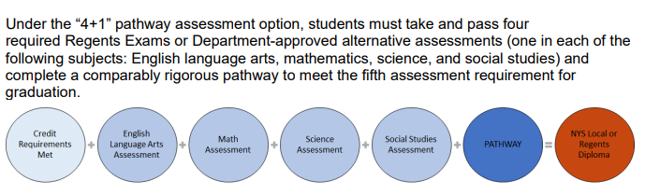

Slide 4
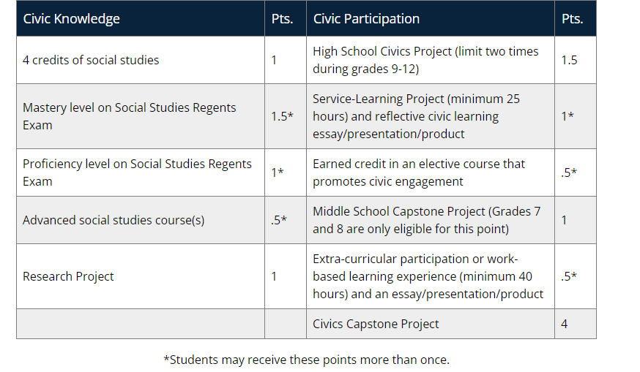
How do I earn the Seal?
-Must complete all requirements for a Regents diploma.
-Must earn a total of six points with at least two points in Civic Knowledge and at least two points in Civic Participation.

Slide 5

Who is on the Civics Seal Committee?
-Ms. Gena Archer, Parent Representative
-Ms. Susan Brumer, High School Social Studies Teacher
-Ms. Lauren Crowley, High School Social Studies Teacher
-Mr. Emory Davis, Social Studies Coordinator Grades 7-12
-Mrs. Kelly Fiscella, Eastview Middle School Social Studies Teacher
-Mr. Kevin Hurley, High School Social Studies Teacher
-Mr. Fred Rickles, High School Social Studies Teacher
-Mrs. Kara Ross, High School Librarian
-Mrs. Samantha Tinampay, High School Social Studies Teacher
-Mrs. Jawanda Weston, Civics Seal Facilitator/High School Social Studies Teacher

Slide 6

How Do We Track Your Progress?
Please join the Schoology pages to submit your work
Class of 2024 (current 12th graders) RZ64-FGMX-GWSNK
Class of 2025 (current 11th graders) F9F9-QVFH-SWQJG
Class of 2026 (current 10th graders) BWDF-4MM3-SWQ5B
Class of 2027 (current 9th graders) 9T7R-BZTG-FDB84
Class of 2028 (current 8th graders) 9ST9-NQJM-334WT

Slide 7
Advanced Social Studies Courses
-Global History 1H -AP Comparative Politics
-AP World History -AP US Government and Politics
-AP United States History -African American History Honors
-SUPA US History -Latinx Studies Honors
-Criminal Law/Justice Honors -Economics: Farm to Table Honors
-SUPA Personal Finance -Economics of Sports Honors
-SUPA Public Policy -Action Civics Honors
-AP Psychology

Slide 8

Research Project
Examine a question (constitutional, historical, political, economic, and/or social) through the lens of civics.
Use a variety of sources (i.e., quantitative, qualitative, primary, secondary) to fully investigate the research question and support the research thesis (argument or perspective on the topic).
Present their research using written, audio/visual, oral, and/or multimodal formats.
-This project will be done in all Global 1 courses

Slide 9
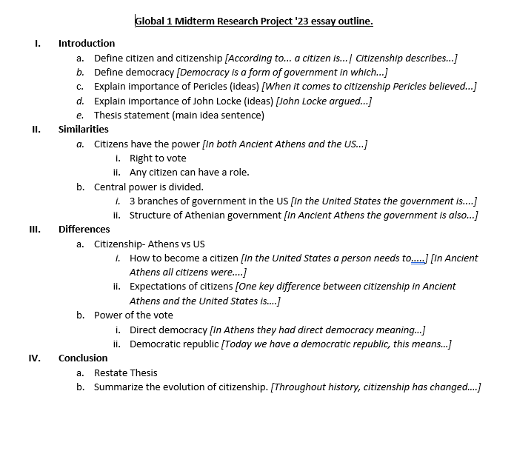

Slide 10

High School Civics Project (limit 2 times)
In a High School Civic Project, students will:
The Civic Project is focused on a civic issue or problem that can be interpreted in a variety of ways by a broad array of citizens holding various viewpoints.
-Students will complete both of these in their 12th grade Social Studies classes. One per half year course.
Exceptions: Full year AP 12th grade classes will complete only one in the Fall not Spring.
AP US History classes will complete one after the AP exam in May.
Civic Seal Action Plan project.docx

Slide 11
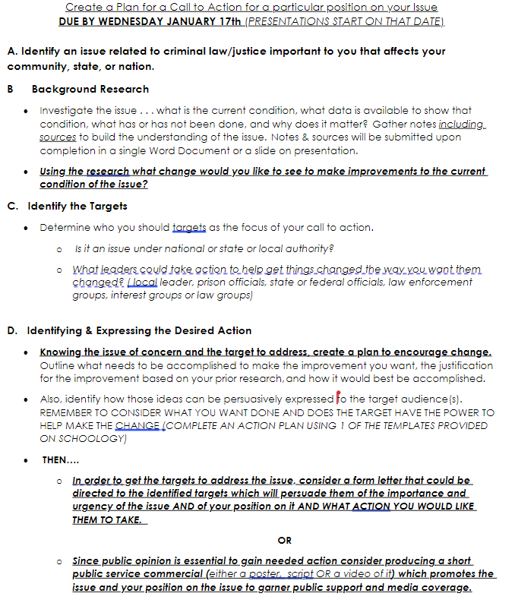
Civics Project

Slide 12
Other examples of Civics Projects
-Celebrating Latinx Cultures
-Climate Change
-Field Day at White Plains HS
-Language: The Power of Connection
-Food Banks
-Human Rights in White Plains
-Upstanders in White Plains
-Creating Green Spaces in the City of White Plains

Slide 13
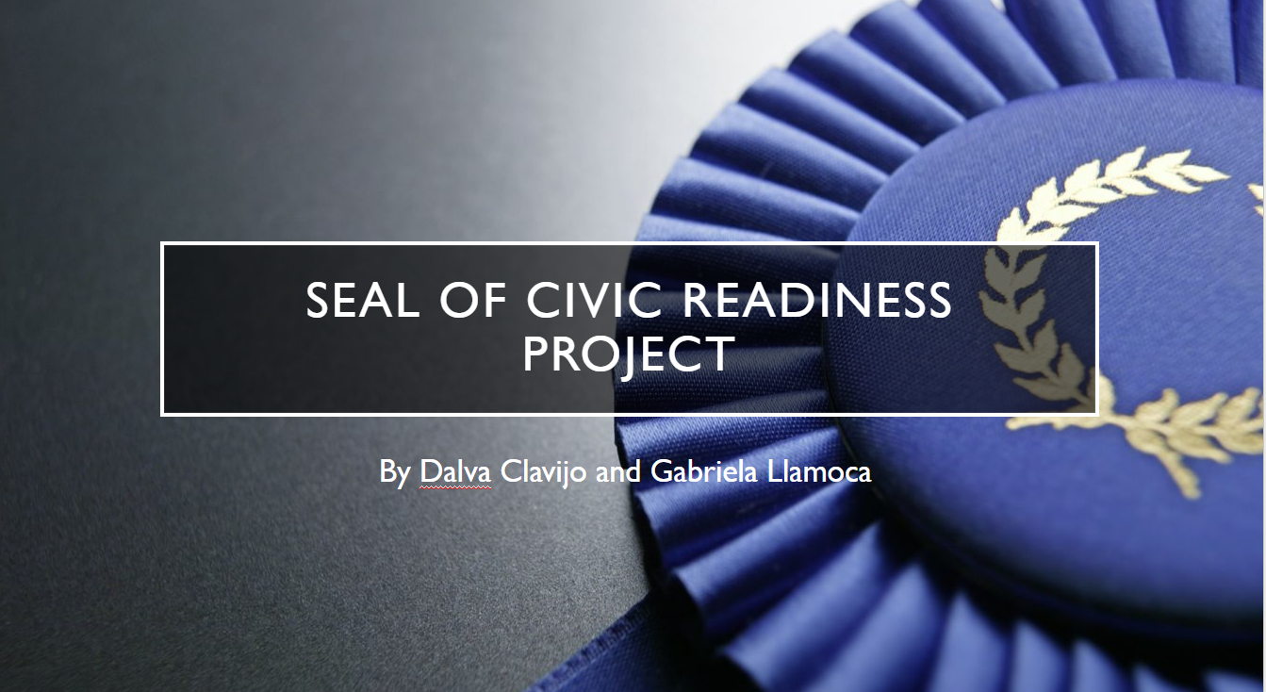
Student Research

Slide 14
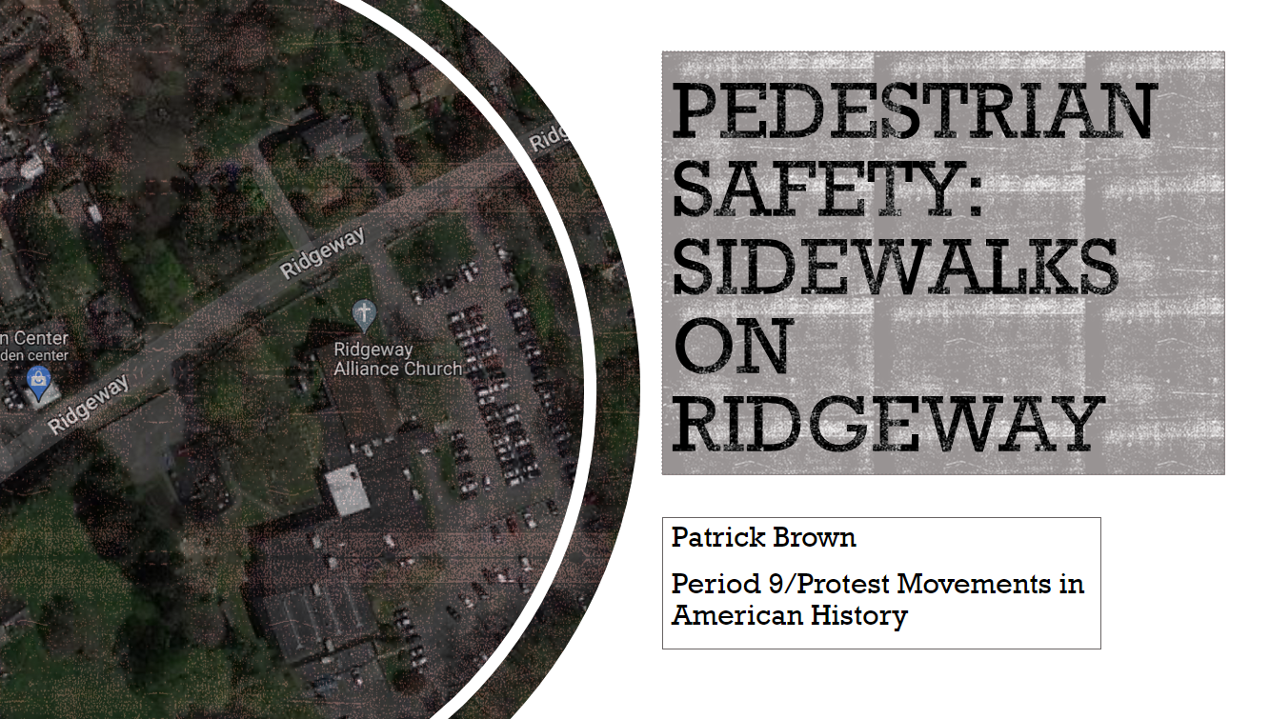
Student Work

Slide 15

Student Research

Slide 16
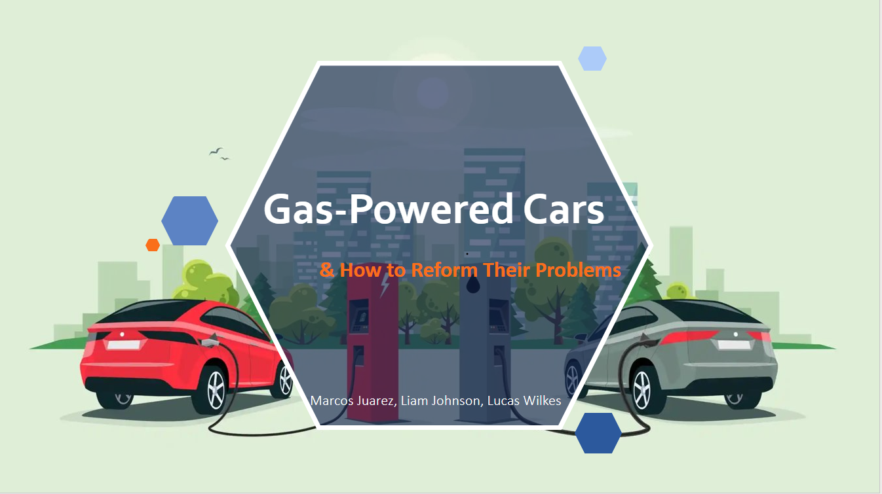
Student Research

Slide 17
Service Learning Project
● Complete a minimum of 25 hours of demonstrated service to the community
● Write and submit a reflective essay
● Present their project to others
-A Service Learning course will be offered every year for Social Studies/English
-We will work with clubs/organizations at the school to identify students who are involved in the community.

Slide 18
Earned Credit in an Elective Course that Promotes Civic Engagement
Service Learning Elective
Action Civics Elective (starting Fall 2024)
Criminal Law
Human Rights

Slide 19
Middle School Capstone Project
● Identify an issue (local, state, national or global)
● Apply civic knowledge, skills, actions, and mindsets to the issue
● Reflect on learning
● Present the project to a wider audience (advisor/teacher and a group of classmates)
All 8th grade students during their unit on the Progressive Era will complete a “modern muckraker” project and present them to their classes.
7th grade students have the option of completing a Capstone project after school. Possibility of integration into the Current Events club or creating an extra after school club for middle school students.

Slide 20
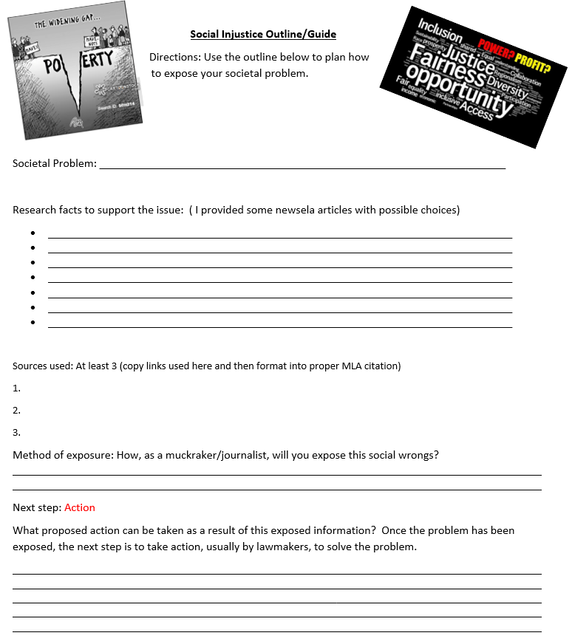

Slide 21
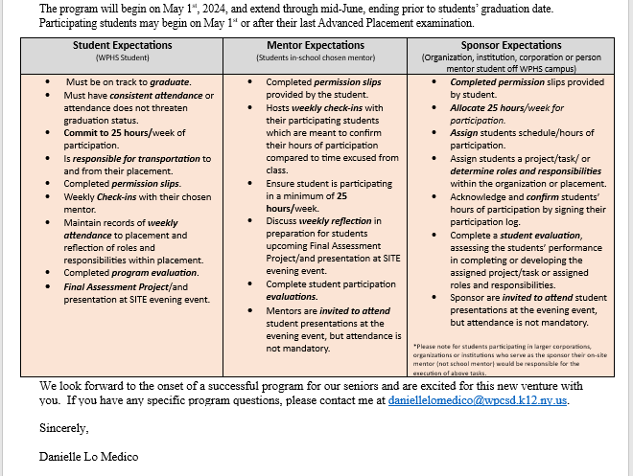
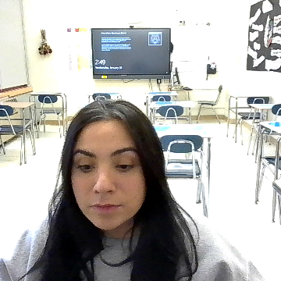
Work Based Learning
● Students must participate a minimum of 40 hours
● Write an Application of Knowledge (AOK) essay/presentation
● This may be accomplished over four years of high school (9-12)
Options: SITE program and Ms. Lo Medico will help identify students who are on track to complete SITE program hours.

Slide 22
High School Capstone
● Take informed action to address the civic issue. (EX: Organizing students to meet with the school principal to present petitions about changing school rules; meeting with local legislators to lobby for a change in local laws; organizing and participating in a debate; writing editorials or creating social media campaigns to raise awareness)
● Reflection what they have learned about their school or community from the Capstone project.
● Make a presentation about their Civic Readiness Capstone project to a panel of stakeholders determined by the Seal of Civic Readiness Committee.
Students will complete this project either independently* or in the Action Civics elective course offered next year.
*Students will also be able to work with a teacher of their choosing and attend the weekly after school meetings for support.

Slide 23

Do you still have questions?
Please contact us
Emory Davis – Social Studies Coordinator
Phone: 914-422-2172 E-mail: EmoryDavis@wpcsd.k12.ny.us
Jawanda Weston – Civics Seal Facilitator
E-mail jawandaweston@wpcsd.k12.ny.us

