Slide 1

Capital Construction Bond Program

Slide 2
2006 School Construction Bond
Last Hillsboro School Construction Bond was approved by District voters in 2006
2006 Bond totaled $169 million
Included five new schools, school capacity increases at three middle schools, modernization and technology improvements throughout District schools
All of these projects were completed on-time and on-budget

Slide 3

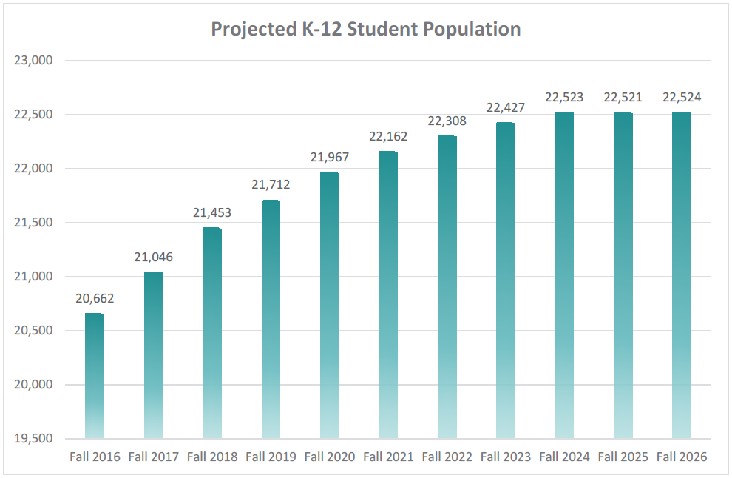
Need for New Construction Bond
District Enrollment Growth
Student enrollment in HSD grew by more than 32% between 1995 and 2015 (+5,085 students)
Next 10 years, an additional 1,862 students are forecasted to enter HSD
This represents a 9% increase in Districtwide student enrollment between 2017 and 2026.

Slide 4
Need for New Construction Bond
District Capital Needs
The District has identified over $700 million in needed improvements to District facilities
Includes the need for:
  New schools to respond to enrollment growth
  Modernization of existing facilities
  Safety & security improvements
  Technology improvements
  Improvement to support student achievement
Notes:
4

Slide 5
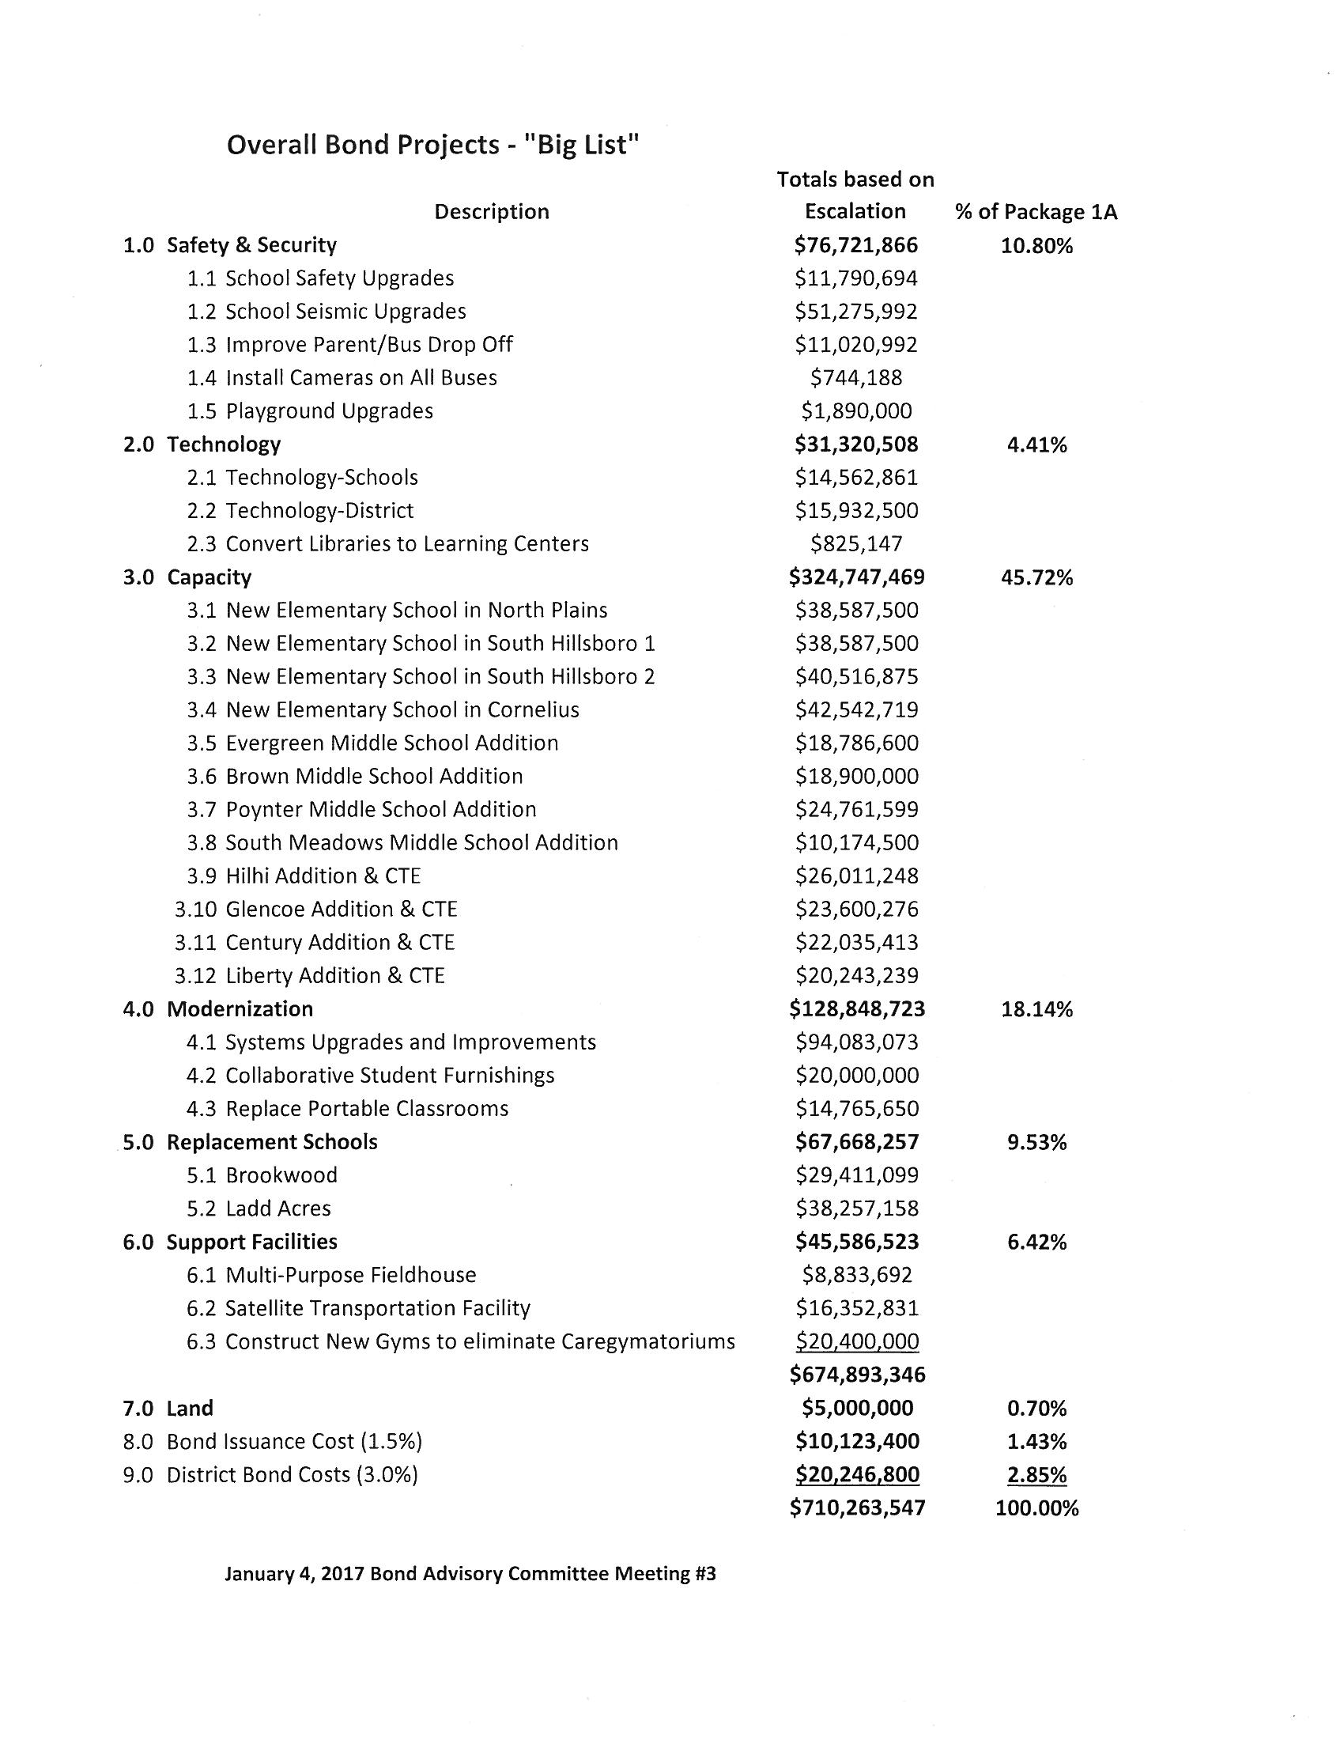
Need for New Construction Bond

Slide 6
Bond Advisory Committee
Bond Advisory Committee
26 members appointed by the School Board – community representatives from neighborhoods, schools, business, local agencies
Develop a Capital Bond Program to present to the Superintendent and School Board
Met beginning in October and will provide their final recommendation by the end of April
Considered a range of project packages & funding levels
Two bond packages to consider this evening
Looking for feedback / input from the Community

Slide 7
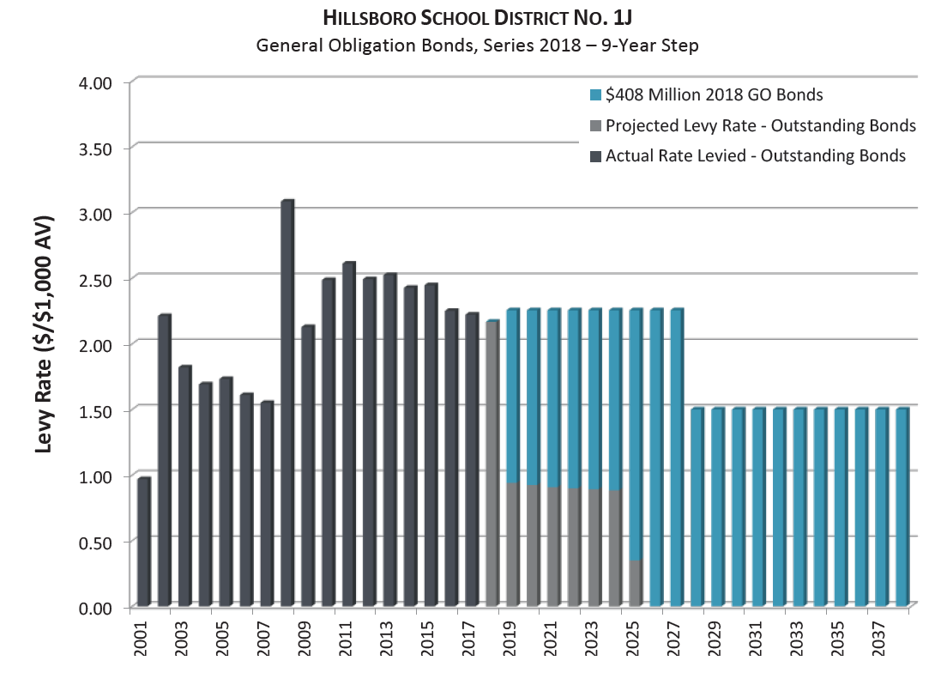
Bond Tax Rates – Bond Package A

Slide 8
Bond Package A – After March 8th BAC Meeting
Bond Package A:
Funding Level = $408.0 million
Maintains current tax rate of $2.24 / $1000
Safety & Security | $69,212,041
Educational Technology | $30,221,198
New Capacity | $181,455,286
Student Achievement | $30,825,147
Current Infrastructure Improvements | $78,643,083
Bond Insurance Costs (Required) | $5,855,351
District Costs (Required) | $11,710,703
Total Package A | $407,922,809

Slide 9
Bond Package A – Key Projects after March 8th
Key Projects Include:
* Two New Elementary Schools * Installing cameras & GPS on all Buses
- North Plains & South Hillsboro * Playground Upgrades
* Rebuild Brookwood ES – New * Classroom Technology and
School Infrastructure
* New Satellite Transportation/ * Convert Secondary Libraries to
Maintenance Facility Learning Centers
* Upgrade Reedville & Hillhi * Mechanical/Electrical/Plumbing
* Additions to Glencoe and Upgrades
Evergreen * Sealing and Painting Building
* Seismic & Safety Upgrades Building Exteriors
* Parent/Bus Drop-Off Safety * Construct New Gyms at Elementary
Improvements Schools w/ Cafegymatoriums – Immediate Occupancy seismic standard

Slide 10
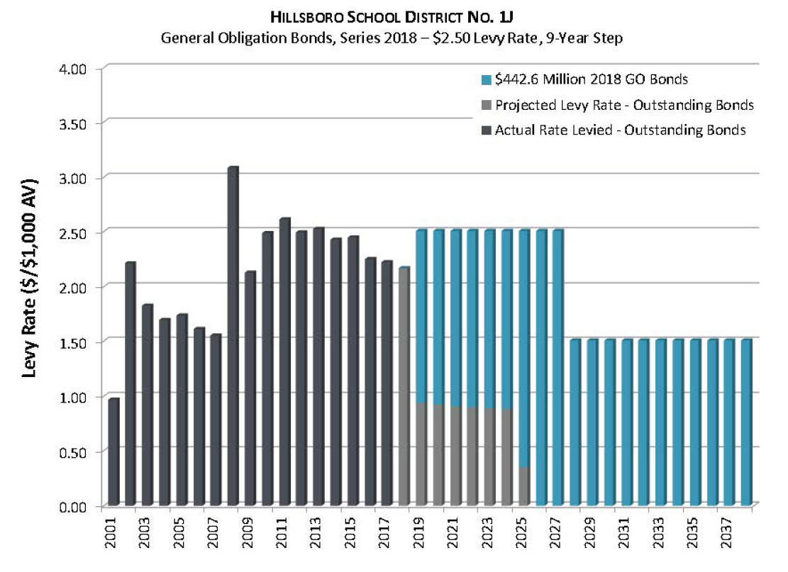
Bond Tax Rates – Bond Package B

Slide 11
Bond Package B – After March 8th BAC Meeting
Bond Package B:
Funding Level = $442.4 million
Increases current tax rate to $2.50 / $1000
Safety & Security | $69,212,041
Educational Technology | $30,221,198
New Capacity | $186,455,286
Student Achievement | $30,825,147
Current Infrastructure Improvements | $106,688,075
Bond Insurance Costs (Required) | $6,351,026
District Costs (Required) | $12,702,052
Total Package A | $442,454,826

Slide 12
Bond Package B – Key Projects after March 8th
Key Projects Include All Improvements in
Bond Package A, with the addition of:
* Pavement/Sidewalk/Hardscape * Replace Portable Classrooms in
(Parking Lot) Repairs and Poor Condition
Replacements * Construct New Track (Hilhi)
* Resurface/Replace Tennis Courts * Construct Lighted Turf Fields at
* Replace Single Pane Windows Hilhi, Century, & Glencoe
* Land Purchases for Future School
Sites

Slide 13
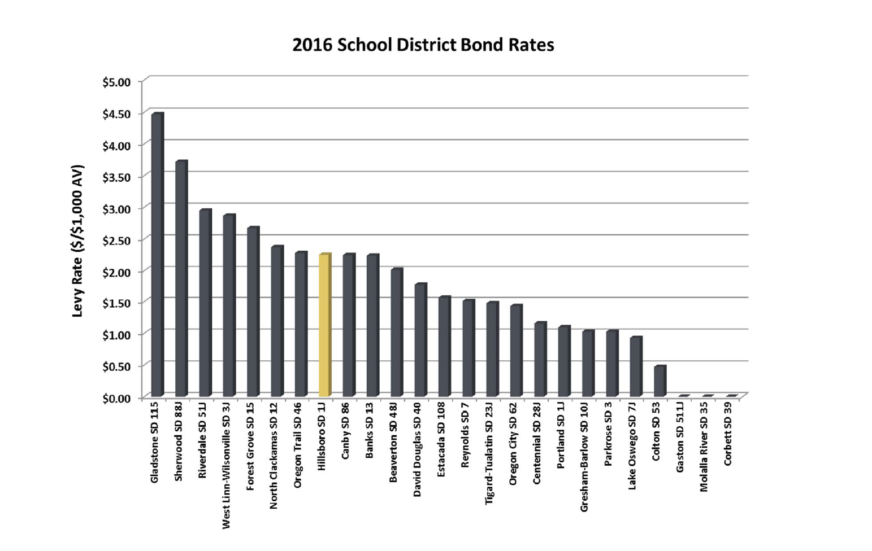
Bond Rates Comparison

Slide 14
Next Steps: Report to Superintendent
Review Results of Open House with Advisory Committee
Conduct additional research / polling
Advisory Committee Drafts Recommendations to Superintendent
Staff prepares Draft Bond Advisory Committee Recommendation Report and sends to members for review and final acceptance by the end of April
Recommendation to address:
  Need for Bond Projects
  Bond Package to put before voters
  Bond Finance Assumptions
  Timing of election (November 2017 / May 2018)
Superintendent reviews Advisory Committee Recommendations
Superintendent Final Report / Recommendation to the Hillsboro School Board in May 2017

Slide 15
Next Steps
Bond information can be found on our website under About HSD/Bond
Please fill out the online comment form if you have additional feedback to share
Engage in discussion with your table groups and respond to the questions provided
Report out
Please complete your exit ticket
THANK YOU so much for coming!
Notes:
Mike
Thank you for coming

