Slide 1

Welcome to Los Alisos Magnet Middle School:
Coffee with the Counselors

Slide 2
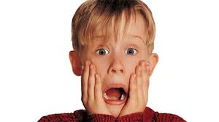
Social Media Use by Youth
*Approximately 92% of teens report going online daily.
*71% of teens report using more than one social networking site
*Approximately 24% report going online “almost constantly”
*Facebook is the most popular social media site among American teens aged 13 to 17 with 71% of all teens using the site.

Slide 3
Positive Aspects of Social Media in Schools
Social Media can be used by schools as a tool to:
*Promote a positive school climate.
*Communicate with students, teachers, staff, and parents/guardians about daily activities.
*Inform the school community during emergencies.

Slide 4

Positive Aspects of Social Media for Prevention
Technology can be an effective reporting tool if it is:
Safe and anonymous
Supported by trusted adults
Maintained collaboratively
Accessible to the whole school community

Slide 5

Popular Social Networking Sites
Facebook
Reddit
Twitter
YouTube
Flickr
Photobucket
Vine.com
Tumblr

Slide 6
Tips to Keep Teens Safe on Social Media
https://www.youtube.com/watch?v=yk9ynrO_GMg

Slide 7




Other Social Media Apps
Discord is a free voice, video and text chat app for teens and adults ages 13 and up. Once there they can join a chat they’ve been invited to or create private chats.
It is a form of anonymous social media, allowing users to post and share photo and video messages anonymously, although this claim has been challenged with privacy concerns over Whisper's handling of user data.
Gaggle app:
Anonymous message board.
Kik is a cross-platform mobile application used for instant messaging. Used by child predators due to ease of use.

Slide 8

Pros and Cons
Pros
  Allow you to express yourself
  Share experiences and pictures
  Keep in contact with family and friends
  Meet new friends with common interests
  Help with school projects
  Information on current events
  Network with professionals

Slide 9
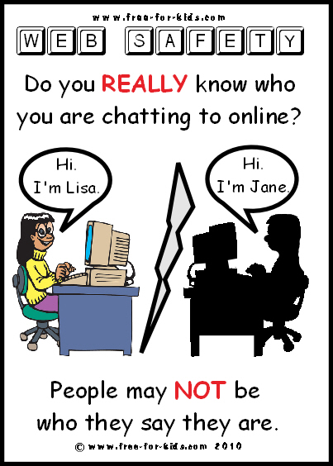
Pros and Cons (cont)
Cons
  Revealing too much information
  Online predators
  Loss of productivity
  Damaged reputation

Slide 10
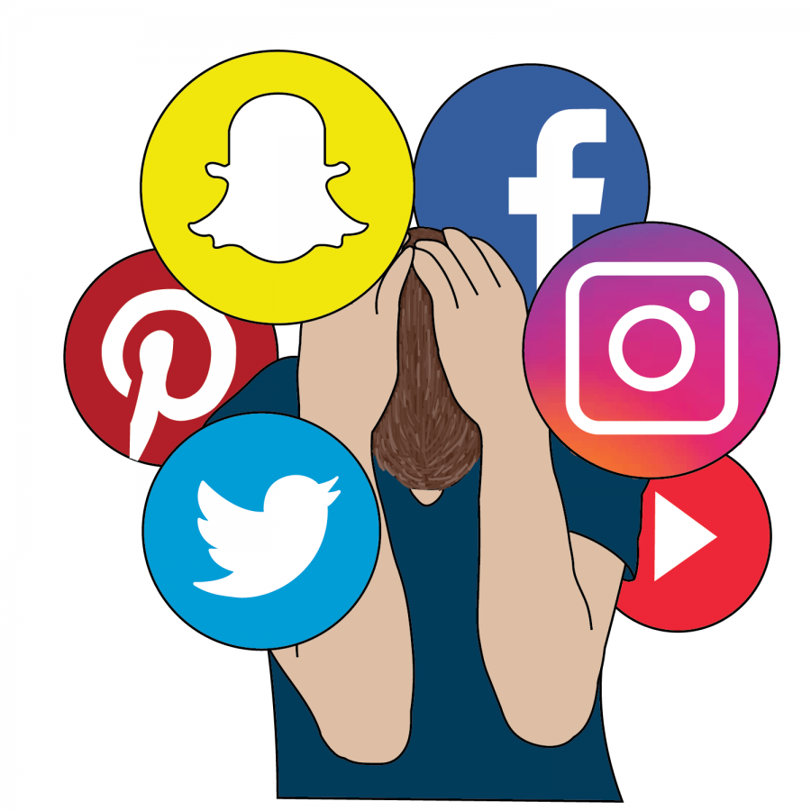
Risks of SNS
Online predators
  Fake accounts/identities
  Malicious software
  Identity theft
Revealing too much information
  Online predators
  Future employers
Cyber Bullying
  Online rumors

Slide 11
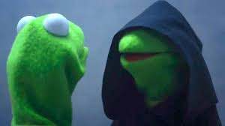
Dos and Don’t
Do…
  Use good judgment to protect your reputation
  Utilize privacy settings
  Monitor content that you (and others) upload
  Use caution when befriending others
Don’t…
  Post any un-safe information
  Post un-tasteful pictures
  Download anything illegal

Slide 12
Informative Websites
Staysafe
  www.staysafe.org
Web Wise Kids
  www.webwisekids.org
WiredSafety
  www.wiredsafety.org
Cyberbully411
  www.cyberbully411.org

Slide 13
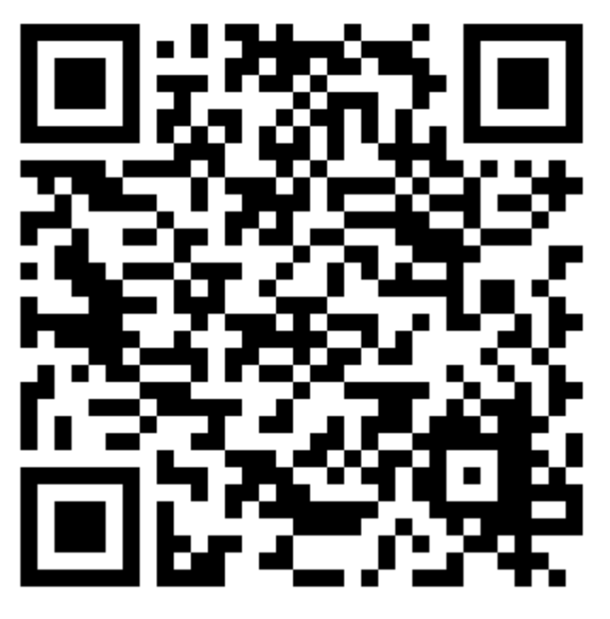
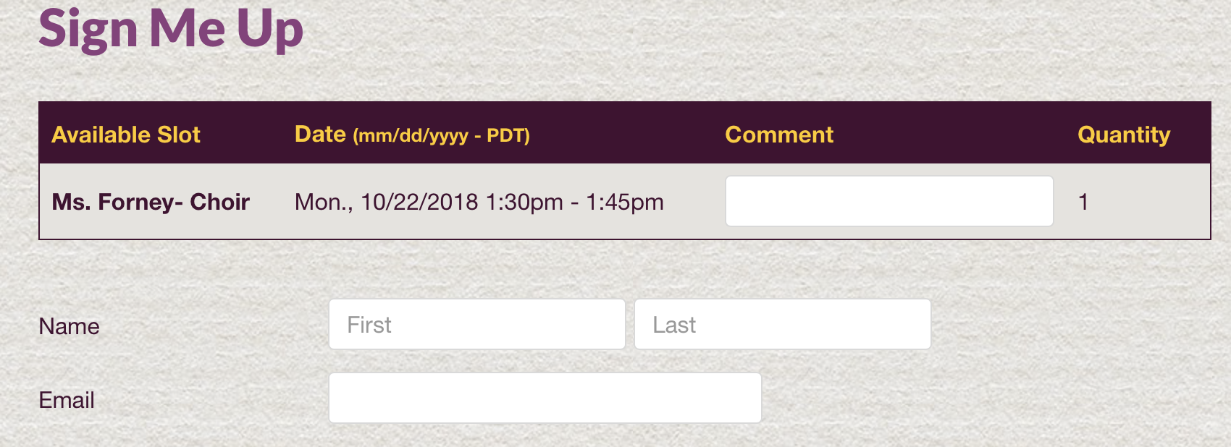
Fall Parent Conferences
Dear Parents,
For Fall conferences we are asking you to schedule a time to meet with specific teachers regarding your child’s performance in that specific class. Each conference should last around 15 minutes and multiple conferences can be scheduled for the same day, if needed.
If your child is receiving a D or an F in a class, you must schedule a conference with that teacher. If your child is passing with a C or higher, then it is your choice whether or not to conference with those teachers.
To sign up:
1) Go to: https://www.signupgenius.com/go/508094cafac2ba0f49-8thgrade
Or
Scan the QR code below using the Camera app on your child’s iPad (a link will appear at the top of your screen upon scanning; tap the link to access the form)
2) Check the boxes for the Times/Teachers with whom you want a conference. You can select multiple Times/Teachers; be careful not to book two teachers for the same time.
3) Complete the “Sign Me Up”
screen as shown:
Fall Parent Conferences
3 ways to sign up
←Link
Scanning QR code on your child’s IPAD
Sign up today
Link for “Other” goes here
QR Code for “Other” goes here
Parent/Guardian Name
Optional
Child First Name
Child Last Name

Slide 14
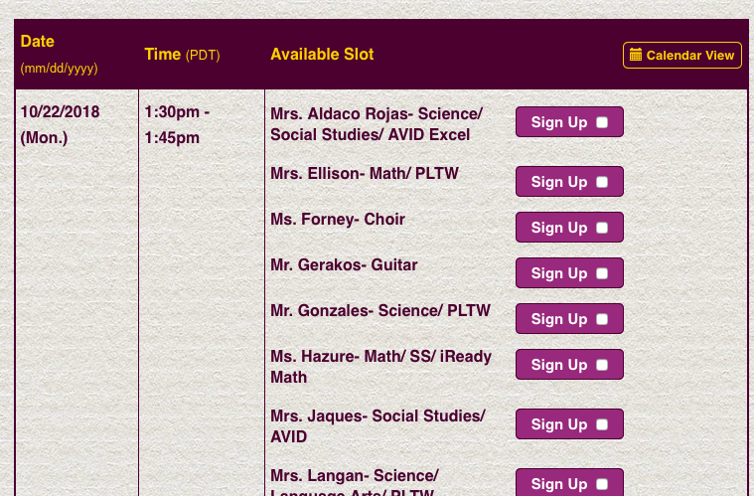
Example
https://www.signupgenius.com/go/508094cafac2ba0f49-8thgrade

Slide 15

Questions?

Slide 16

Thank you!

