Slide 1
Year-long Partnerships
Los Gatos Saratoga Union High School District, the Los Gatos Union School District
Town of Los Gatos
Community Members
Students
Stakeholders

Slide 2
Positive Community Norms Committee:
Heath Rocha, LGSUHSD
Misty Hartung, LGUSD
Laurel Prevetti, Town of Los Gatos
Brad Ward, LGSUHSD
Marico Sayoc, Los Gatos Community Member
Chris Sullivan, Los Gatos Community Member
Selin Acar, Parent
Leanne McAuliffe, Parent
Ryan Idemoto, Student
Sara Thompson, The Montana Institute
Valerie Roche, The Montana Institute
Jason Anderson, The Montana Institute

Slide 3
Vision....New, more accurate stories
Like to create and hear positive stories in the news!
Highlighting and talking about all the amazing, healthy things our students do.
We can all just have fun and be together with out the need for enhancements and substances.
Extreme situations are not seen as the norm or experienced as the norm.
Students looking out for each other and making sensible decisions.

Slide 4

The Science of the Positive Framework
Notes:
BEN

Slide 5

Core Assumption
The POSITIVE exists and is worth growing.

Slide 6
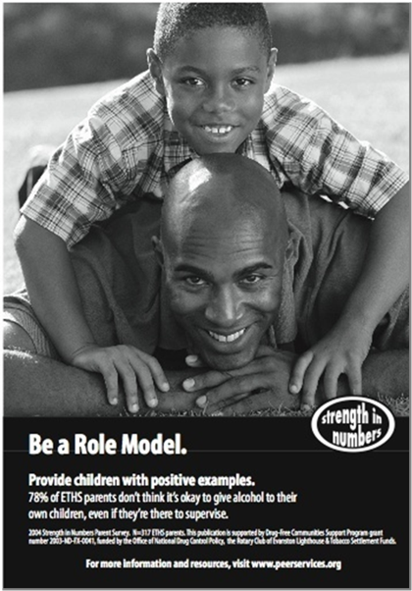

“If we want HEALTH,
we must promote
HEALTH.”
Linkenbach, J. (2001) “Cultural Cataracts: Identifying and Correcting Misperceptions in the Media.” The Report on Social Norms: Working Paper No (1). Paper Clip Communications.

Slide 7


The Positive Community Norms Framework

Slide 8
Positive Community Norms Logic Model
Increase Health
Challenge Misperceptions
Effort
Measure Gaps
Uncover
The Positive
Time
Notes:
HEATHER

Slide 9


Perception is Everything…
Linkenbach, J.W. “The Eye of the Beholder.” The Prevention Connection: A Publication of the Montana Prevention Resource Center and the Addictive and Mental Disorders Division of the Montana Department of Public Health and Human Services. Spring (2008). Vol. XIII (1), 17.
Notes:
Perception is everything because what we perceive to be real becomes real to us in its concequences.

Slide 10
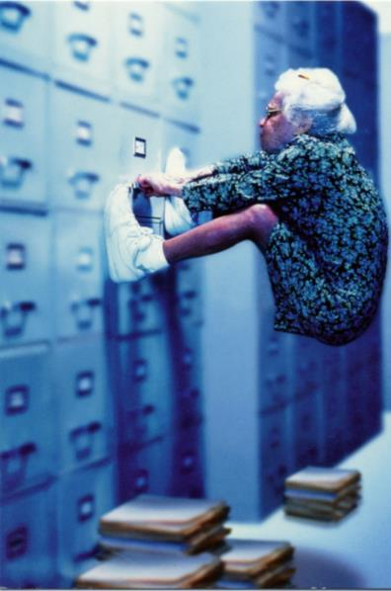

Misperceptions of norms are a
“hidden risk factor.”
Wambeam, R.A, Canen, E. L., Linkenbach, J. & Otto, J. (2014). Youth misperception of peer substance use norms: A hidden risk factor for state and community prevention. Prevention Science (2014) 15:75–84 DOI 10.1007/s11121-013-0384-8
Notes:
10

Slide 11
Los Gatos Positive Community Norms Data Collection
Student Survey (Grades 8-12) May 2023, n=1071
Parent/Guardian Survey (Parent/Guardians of Students in Grades 8-12) October 2023, n=547
School Staff Survey (Fisher Middle School and Los Gatos High School) October 2023, n=116

Slide 12
81% of Los Gatos teens DON’T drink alcohol in a typical month.
49% of students correctly perceive this norm
36% of school staff correctly perceive this norm
42% of parents/guardians correctly perceive this norm

Slide 13
88% of Los Gatos teens say they don’t need alcohol to have fun.
56% of students correctly perceive this norm
72% of school staff correctly perceive this norm
63% of parents/guardians correctly perceive this norm

Slide 14
76% of Los Gatos teens AGREE parents and guardians should clearly communicate with their children about the importance of NOT using alcohol.
53% of students correctly perceive this norm
36% of school staff correctly perceive this norm
52% of parents/guardians correctly perceive this norm

Slide 15
Misperceptions of norms are a RISK FACTOR
Los Gatos teens who misperceive the norm that MOST of their peers do NOT use alcohol monthly or more
are 9.8 times MORE LIKELY to
use alcohol in a typical month.

Slide 16
Communication Planning
Create a new narrative!
Notes:
Ask them to think specifically... Example: Football tailgate parties are about having fun WITHOUT using alcohol...WHAT IF adults intentionally role modeled fun, alcohol-free tailgating in order to influence the youth in the community.
Could use prompts like: What if...

Slide 17
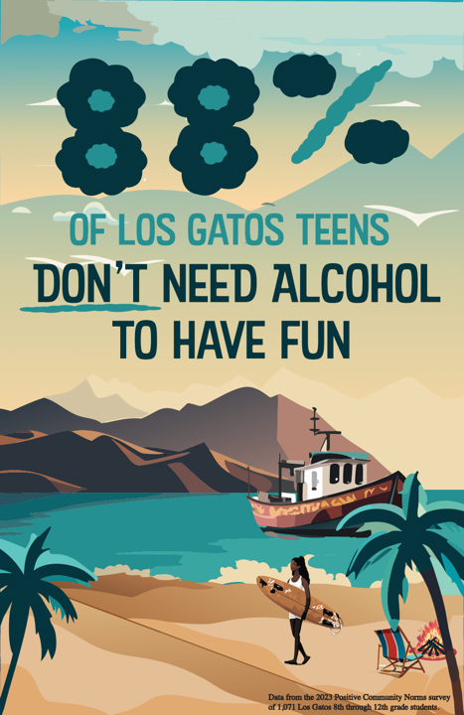
Notes:
Student developed, Pilot tested by 163 students, refined, in print

Slide 18
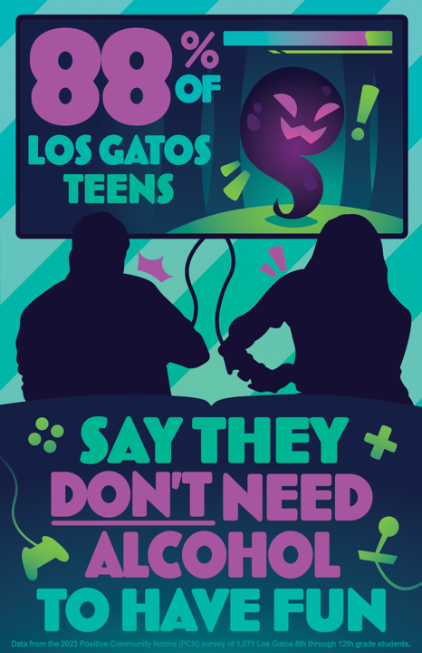

Slide 19
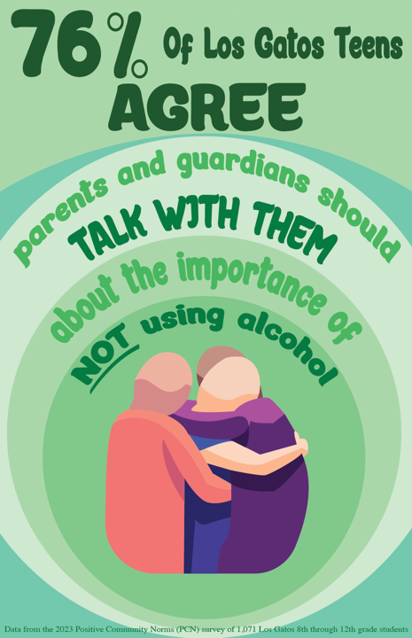

Slide 20
Telling new, more accurate stories about youth alcohol use results in:
Engaging in new conversations with students, staff, parents/guardians, and community members
Correcting misperceptions of norms results in:
more and more students making healthy and safe choices.
More and more youth talking with each other and supporting each other’s healthy safe choices
More and more parents/guardians talking with each other, creating an alliance to keep their kids healthy and safe, and supporting no-use rules and consequences.
Notes:
Intentional practice in wording and asking things from a positive frame.
Instead of why is it important to reduce underage drinking in our community...why is it important to have a growing number of healthy, substance free youth.
Discovering what hopes the community has for our youth
Instead of what things don’t you want to be hearing about...we’re asking: What positive stories do you want to hear in your community regarding students choosing NOT to use alcohol?

