Slide 1

Northshore School District
Highlights from the Healthy Youth Survey
(March 1, 2019)

Slide 2
Student Participation
Northshore School District
  1,525 (86%) of Grade 6 students
  1,406 (83%) of Grade 8 students
  1,269 (72%) of Grade 10 students
  1,015 (62%) of Grade 12 students

Slide 3
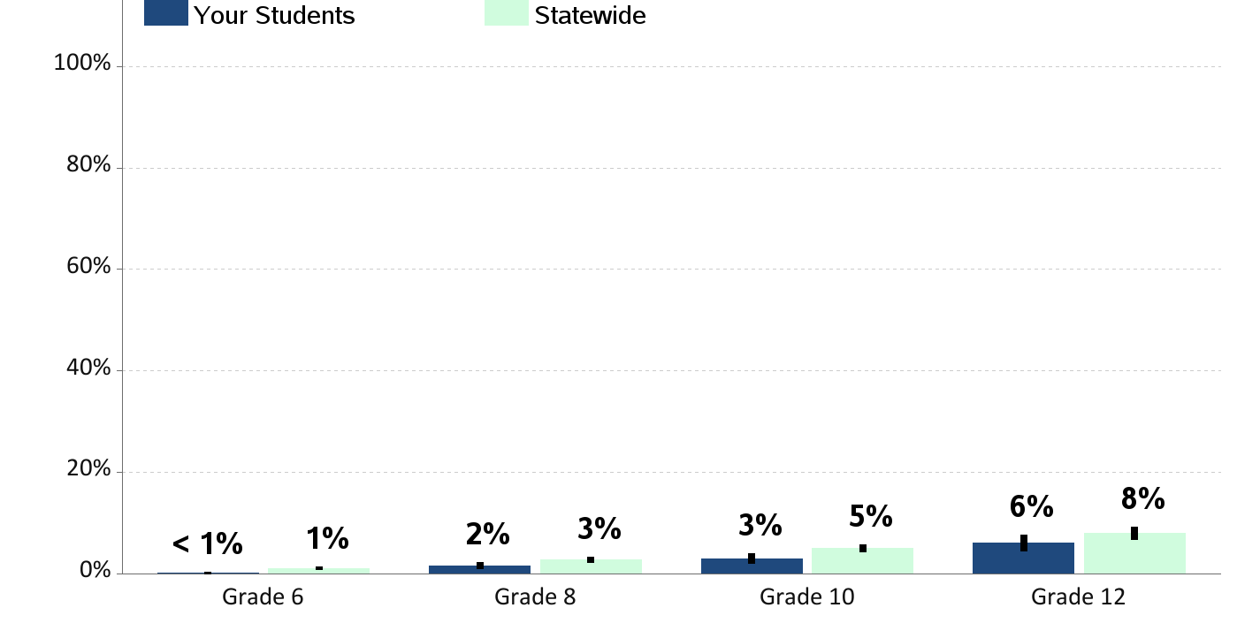
Current Cigarette Smoking
Percent of students who report smoking cigarettes in the past 30 days

Slide 4
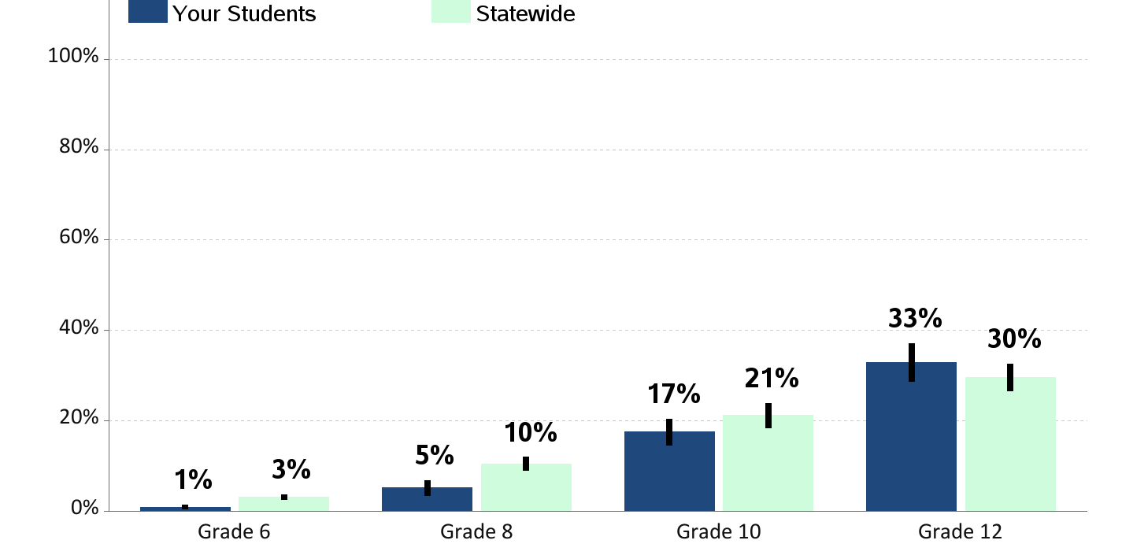
Current E-Cigarette Smoking or Vaping
Percent of students who report using an electronic cigarette, e-cig or vape pen in the past 30 days

Slide 5
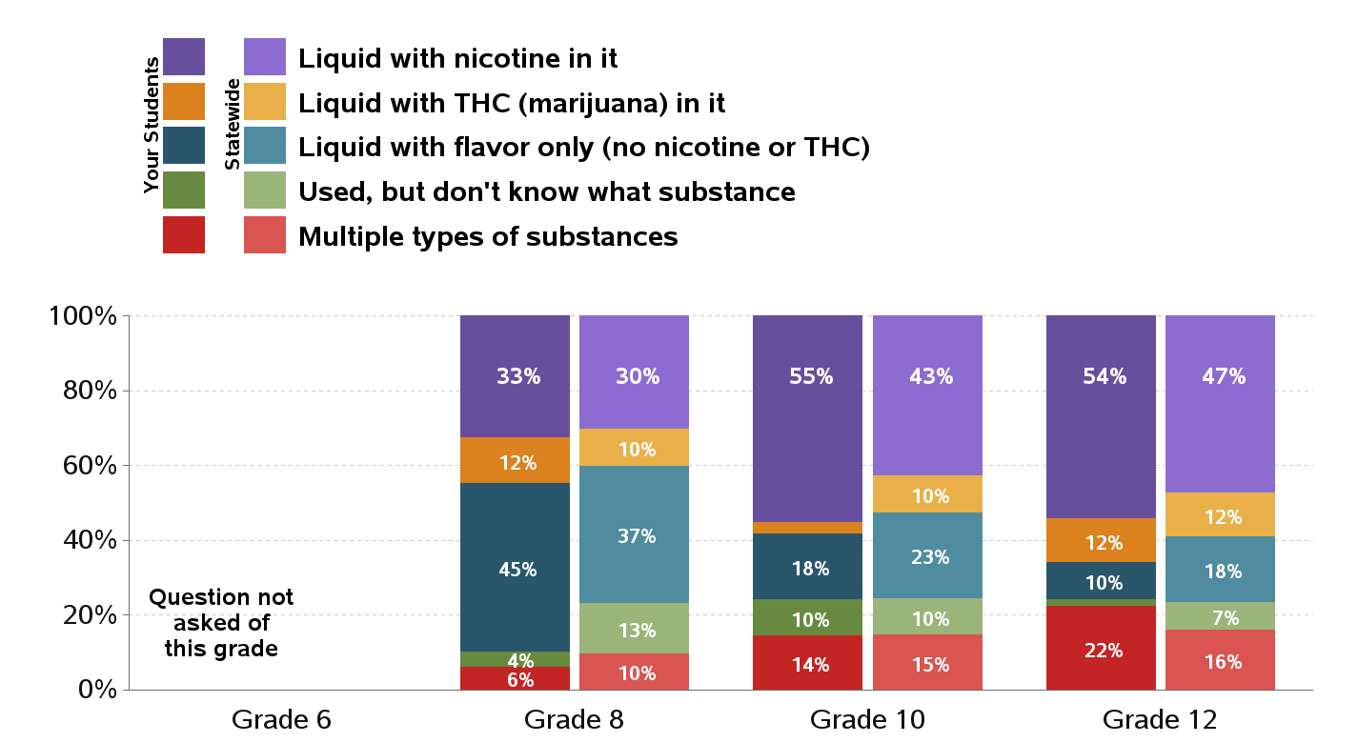
Type of Substance Used in E-Cigarette or Vaped in Past 30 Days
Percentages are of students who used e-cigarettes in the past 30 days

Slide 6
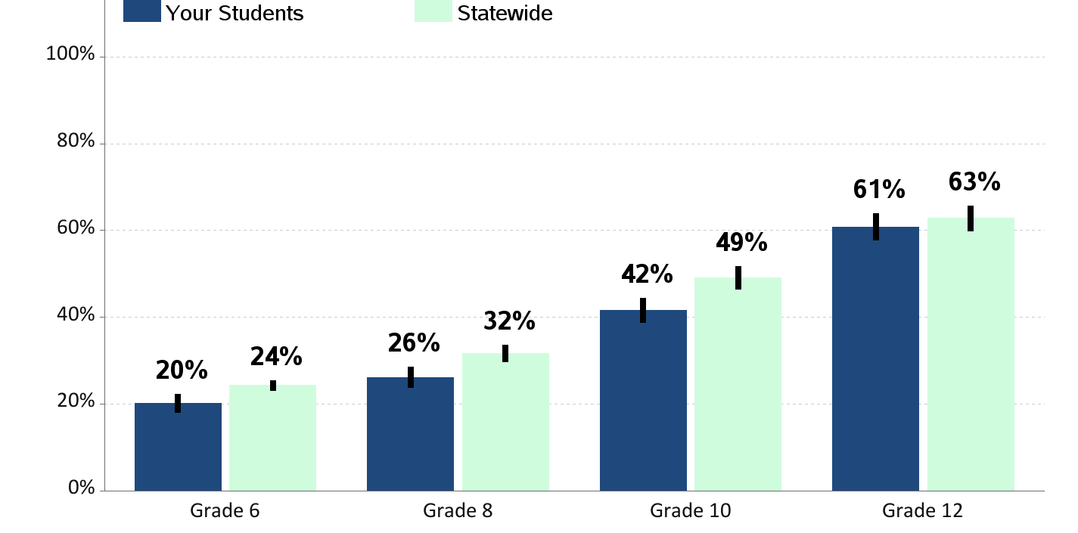
Lifetime Alcohol Use
Percent of students who report having ever drunk more than a sip of alcohol

Slide 7
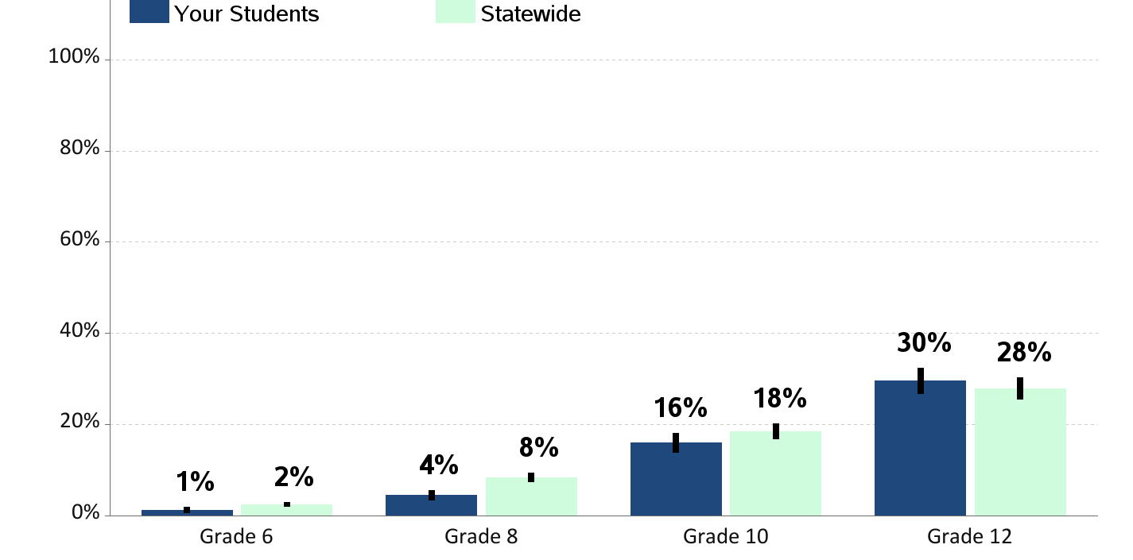
Current Alcohol Use
Percent of students who report having drunk a glass, can or bottle of alcohol (beer, wine, wine coolers, hard liquor) in the past 30 days

Slide 8
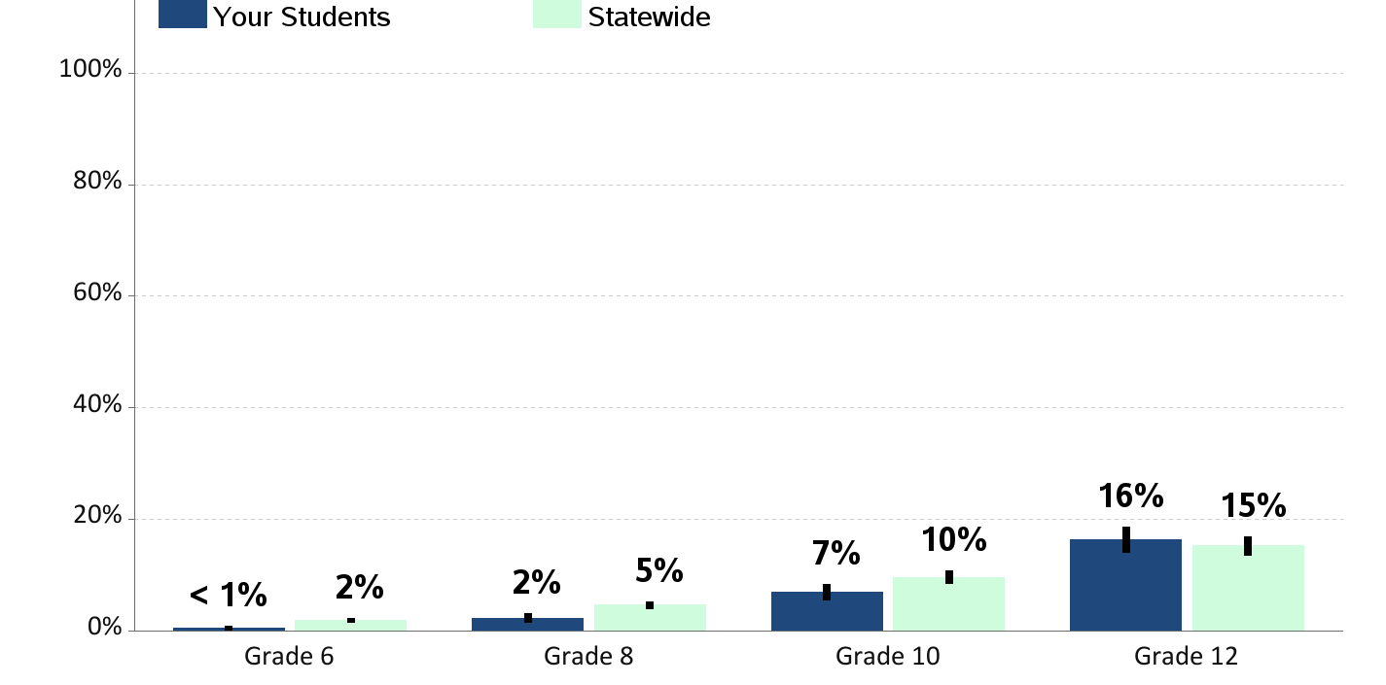
Current Binge Drinking
Percent of students who report having drunk 5 or more drinks in a row in the past 2 weeks

Slide 9
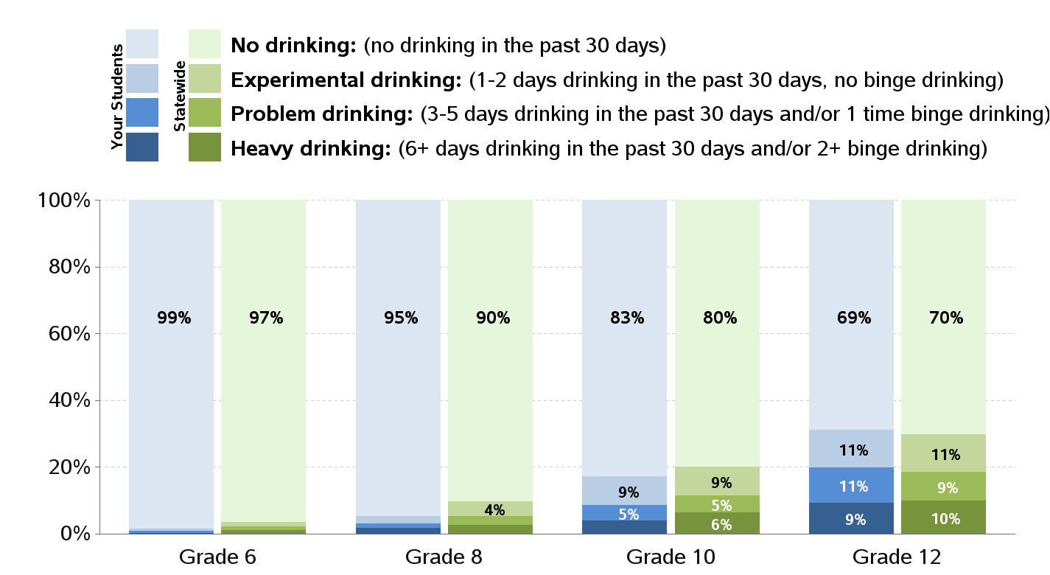
Levels of Alcohol Use

Slide 10
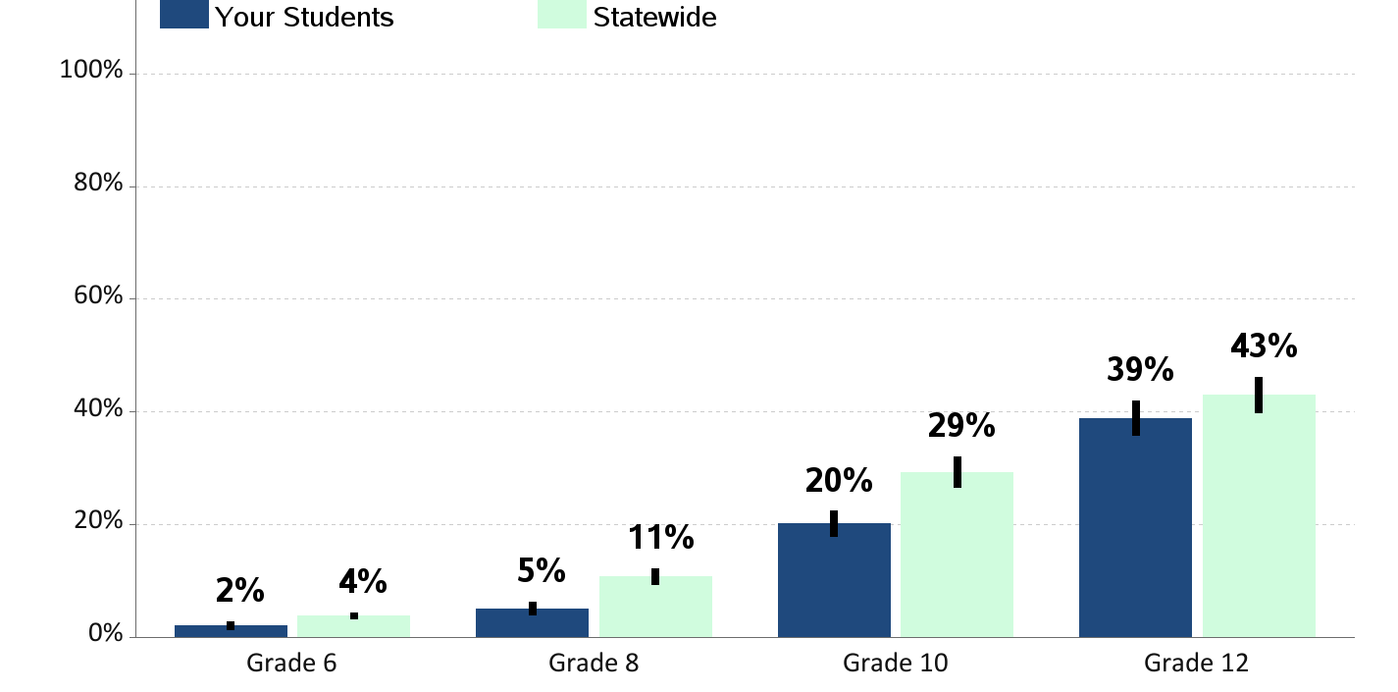
Lifetime Marijuana Use
Percent of students who report having ever used marijuana

Slide 11
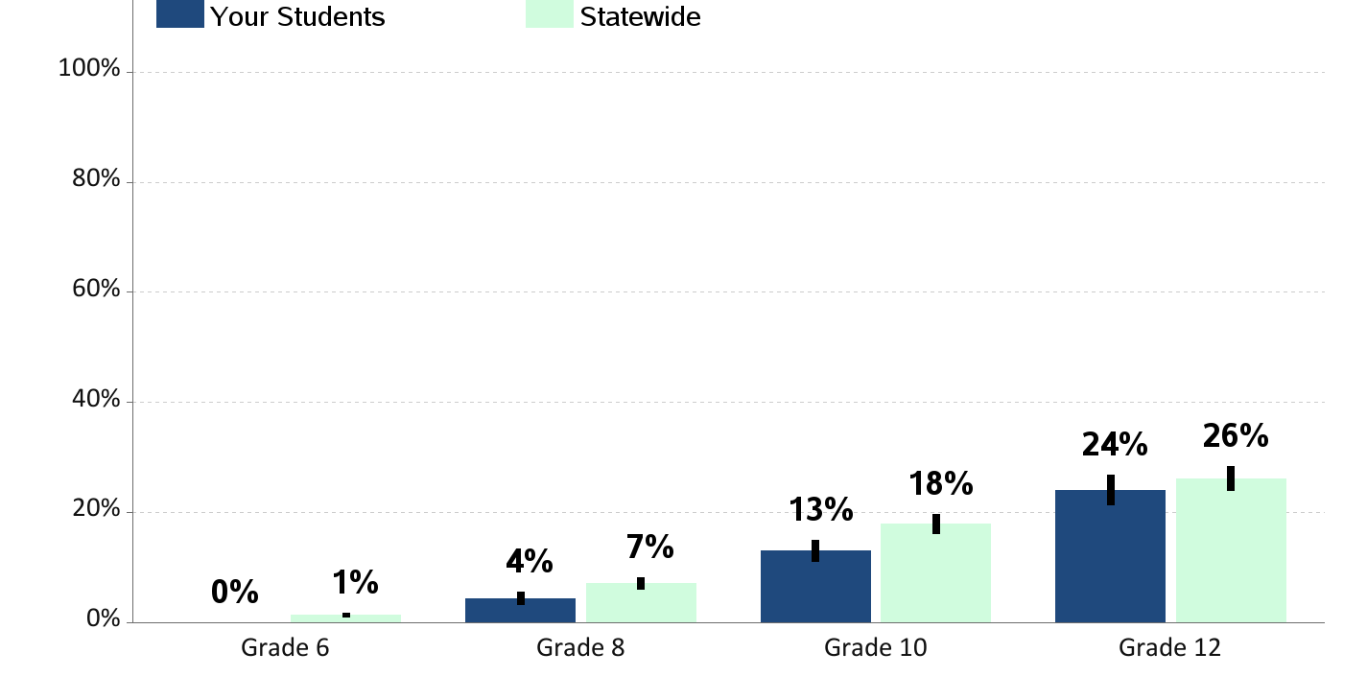
Current Marijuana Use
Percent of students who report using marijuana in the past 30 days

Slide 12
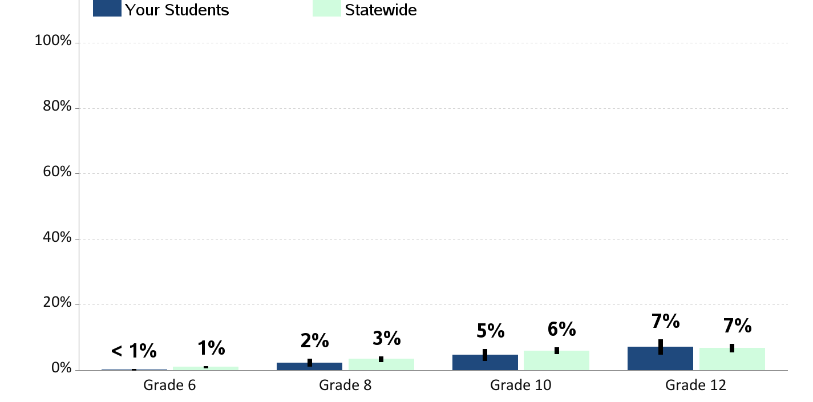
Current Illegal Drug Use
Percent of students who report using illegal drugs in the past 30 days (not including alcohol, tobacco or marijuana)

Slide 13
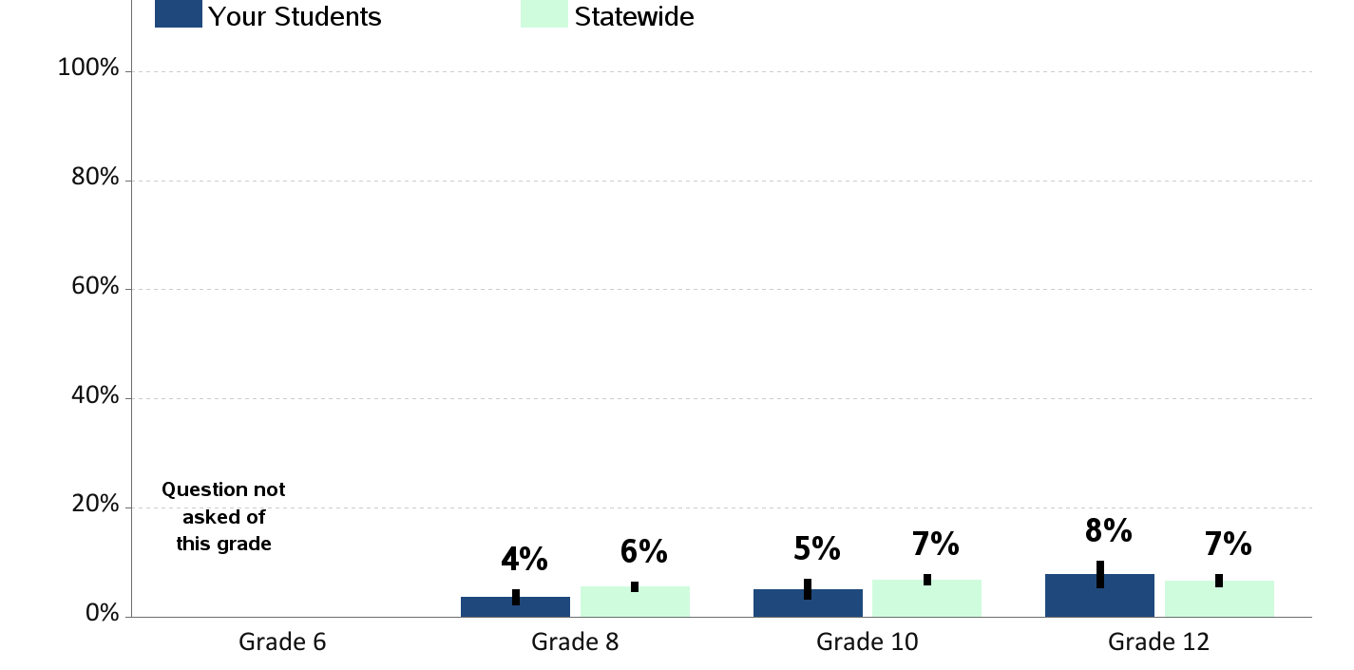
Current Prescription Drug Use
Percent of students who report using prescription drugs not prescribed to them in the past 30 days

Slide 14
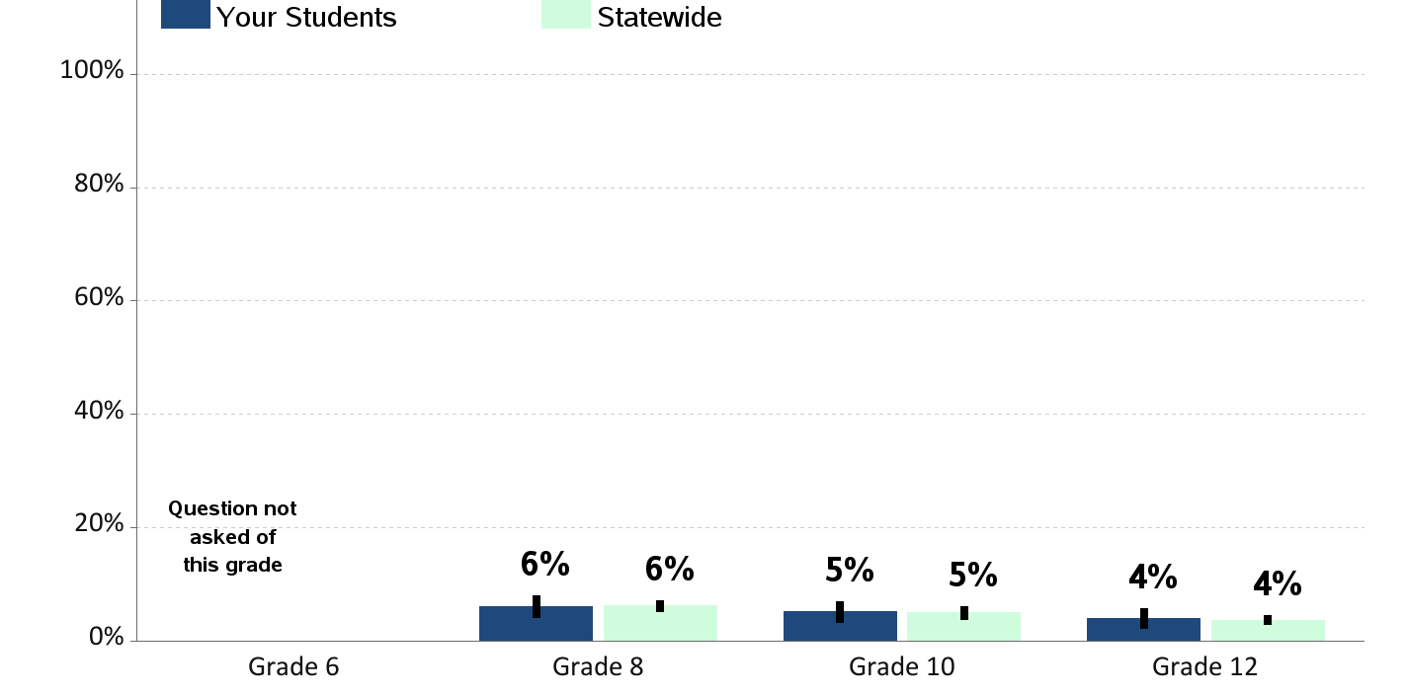
Current Over-the-Counter Drug Use
Percent of students who report using over-the-counter drugs, like cough syrup or cold medicine for non-medical purposes in the past 30 days

Slide 15
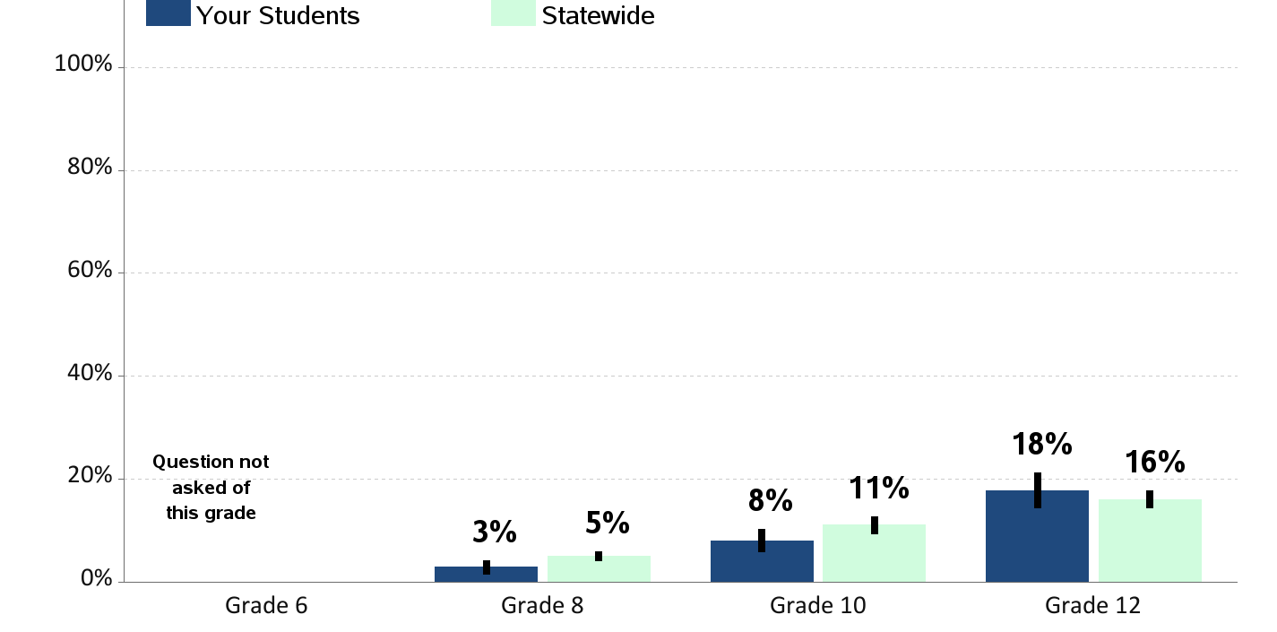
Alcohol Drinking while Using Marijuana
Percent of students who report drinking alcohol at the same time they were using marijuana in the past 30 days

Slide 16
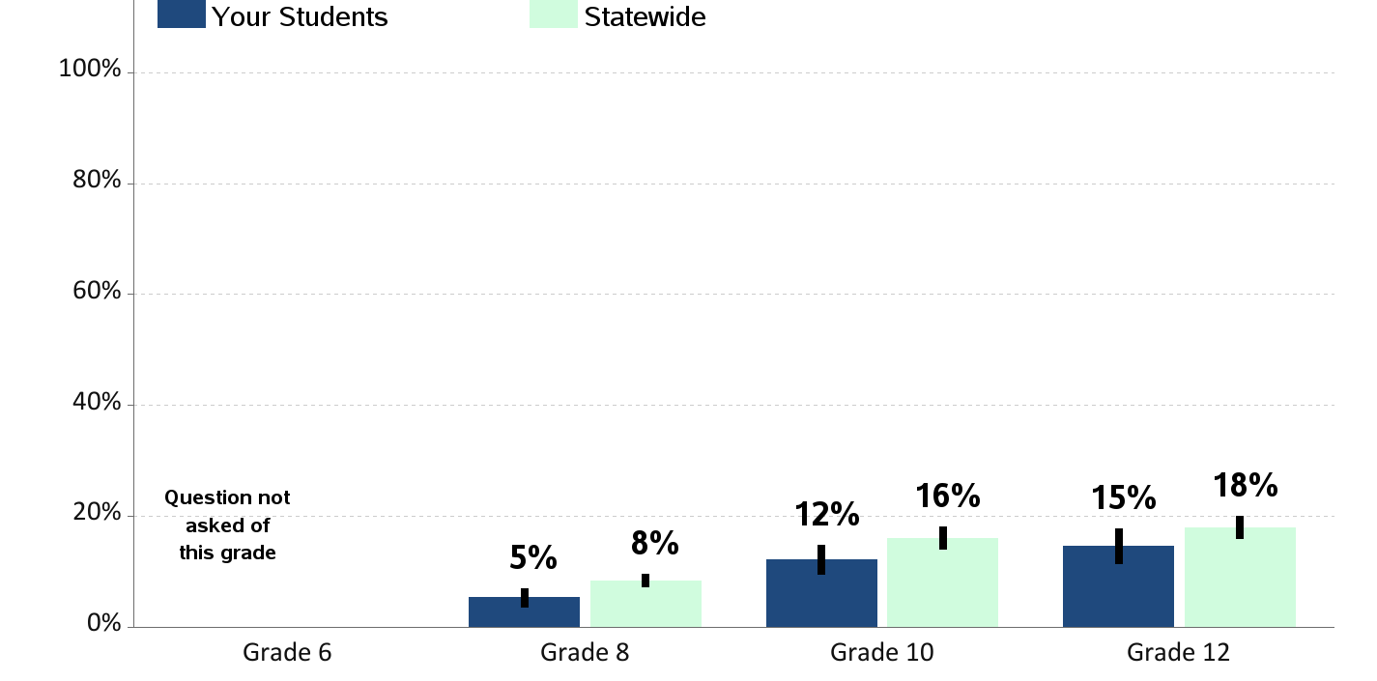
Substance Use at School
Percent of students who report being drunk or high at school in the past year

Slide 17
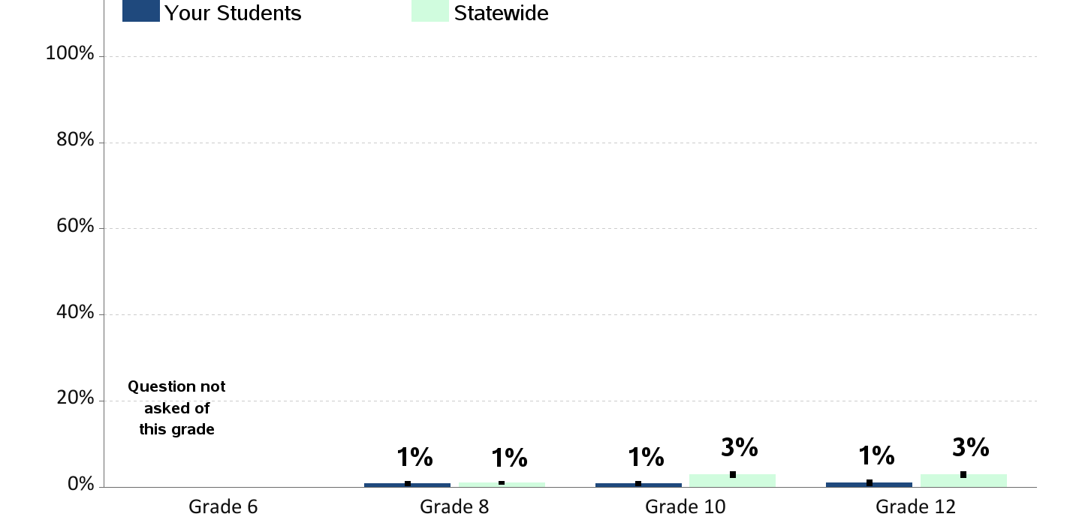
Tobacco Use on School Property
Percent of students who report using cigarettes, cigars, or chew/dip on school property in the past 30 days

Slide 18
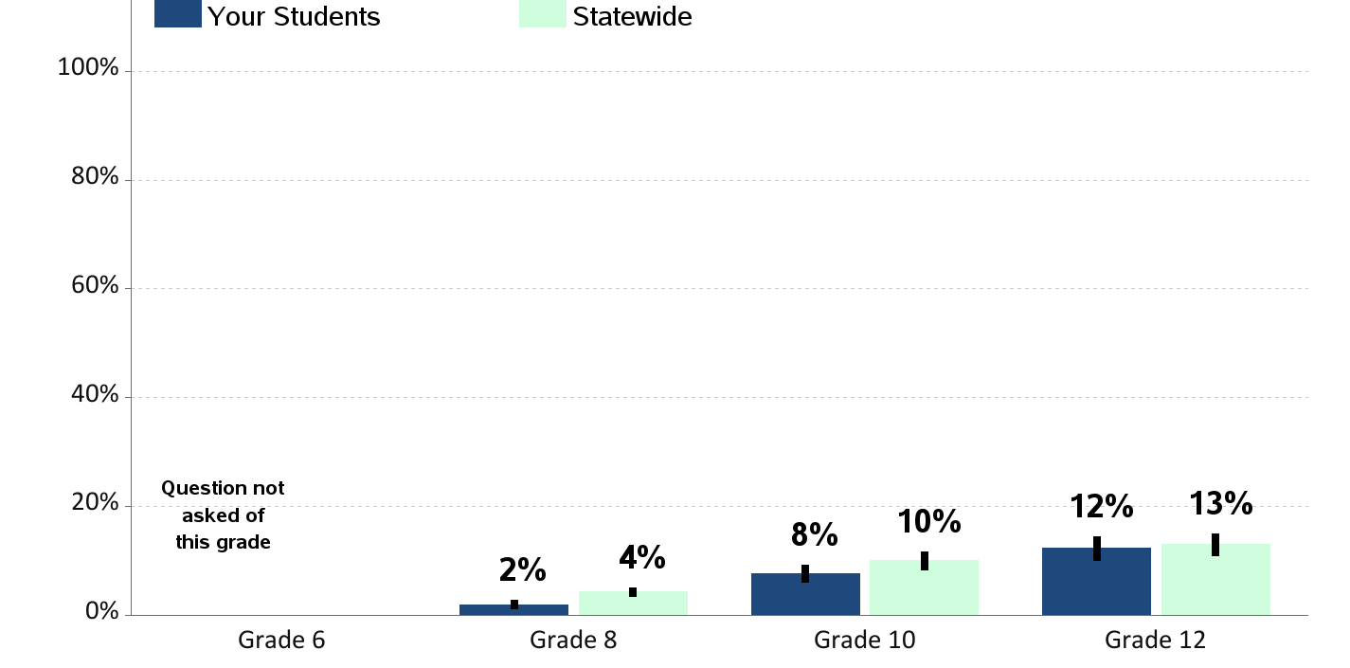
E-Cigarette Use on School Property
Percent of students who report using electronic cigarettes on school property in the past 30 days

Slide 19
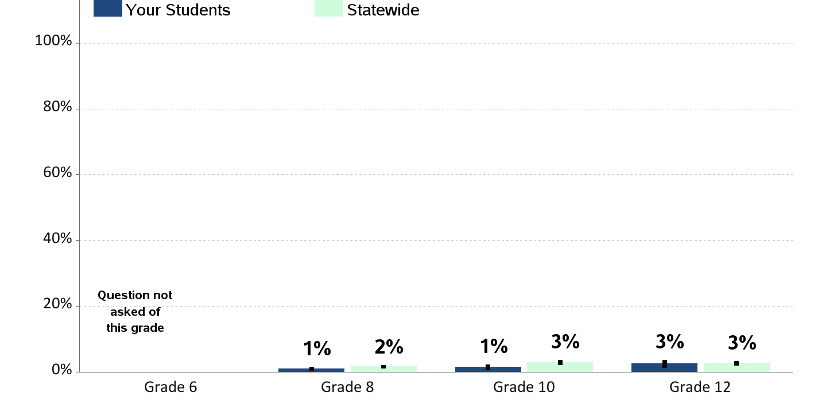
Alcohol Use on School Property
Percent of students who report having at least one drink of alcohol on school property in the past 30 days

Slide 20
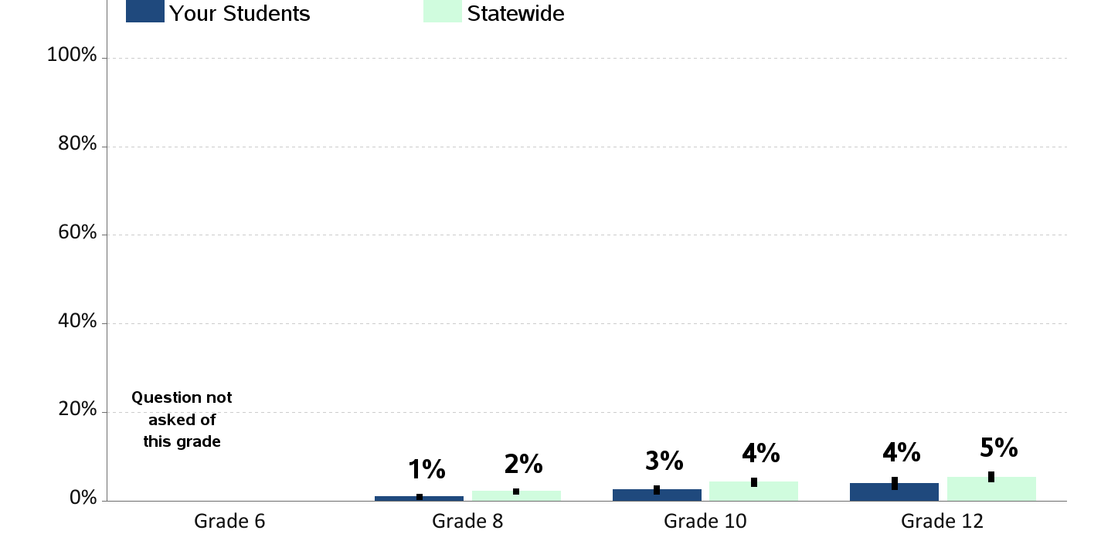
Marijuana Use on School Property
Percent of students who report using marijuana on school property in the past 30 days

Slide 21
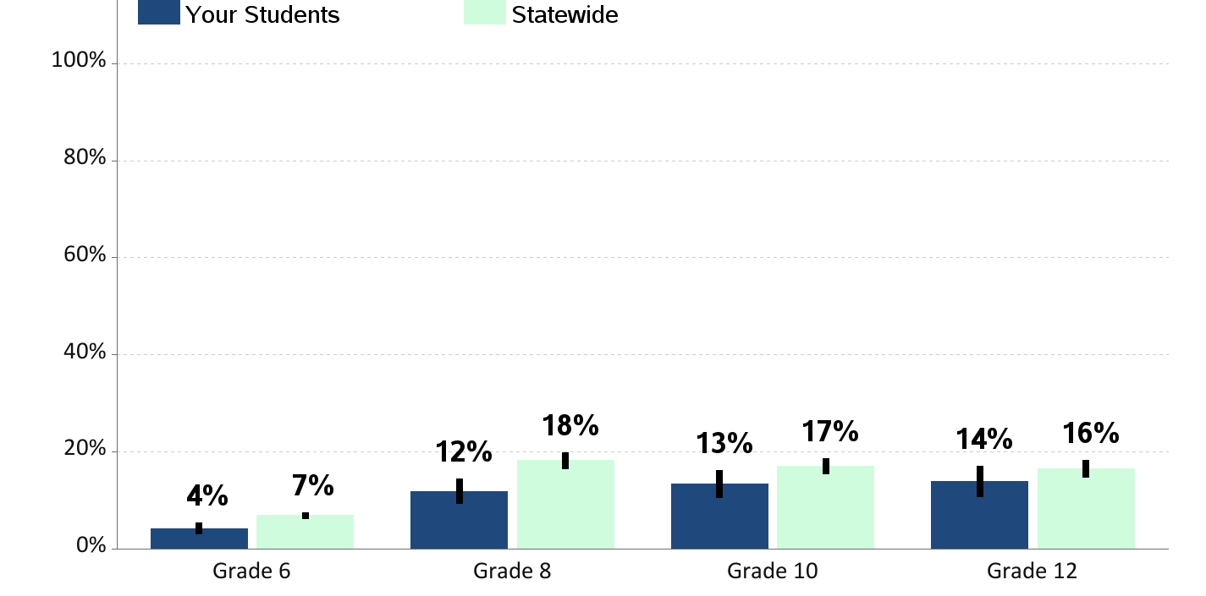
Riding with a Drinking Driver
Percent of students who report having ridden in the past 30 days with a driver who had been drinking alcohol

Slide 22
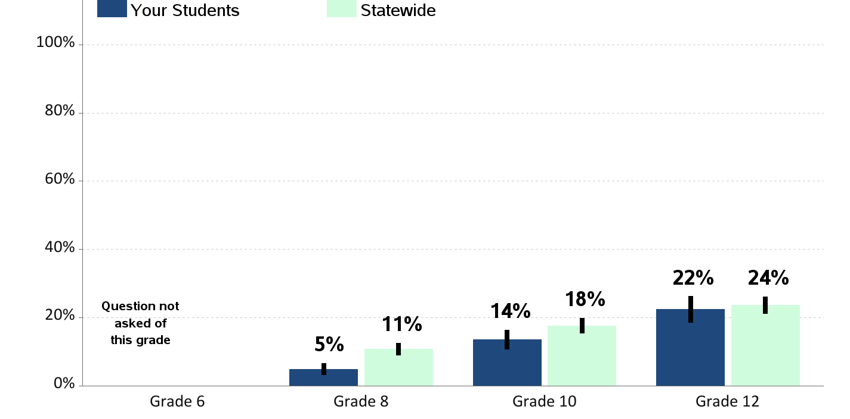
Riding With a Recent Marijuana User
Percent of students who report having ridden in the past 30 days with a driver who had been using marijuana

Slide 23
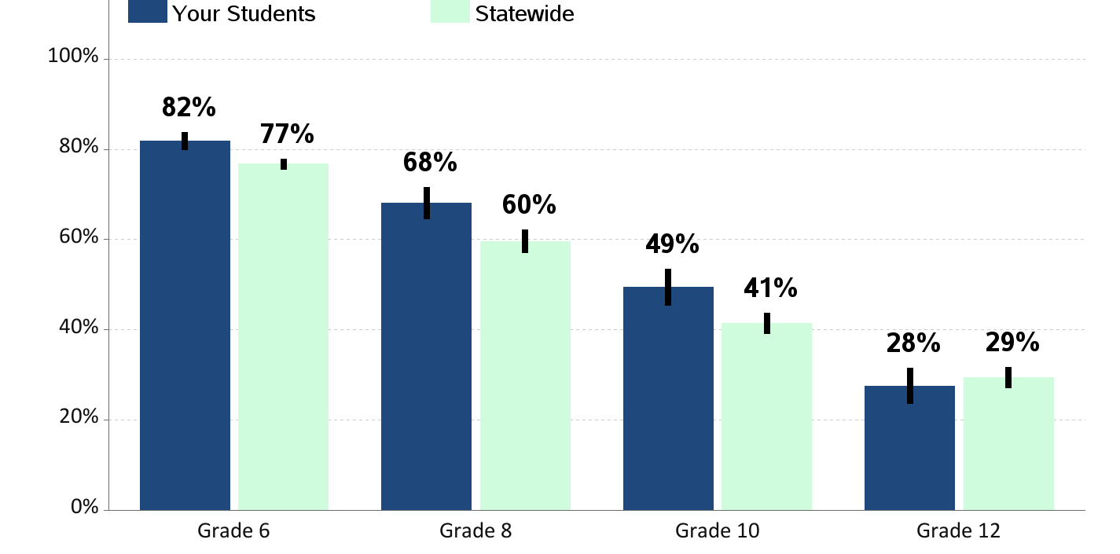
Perception of Neighborhood Norms - Alcohol
Percent of students who report that adults in their neighborhood think youth drinking is "very wrong"

Slide 24
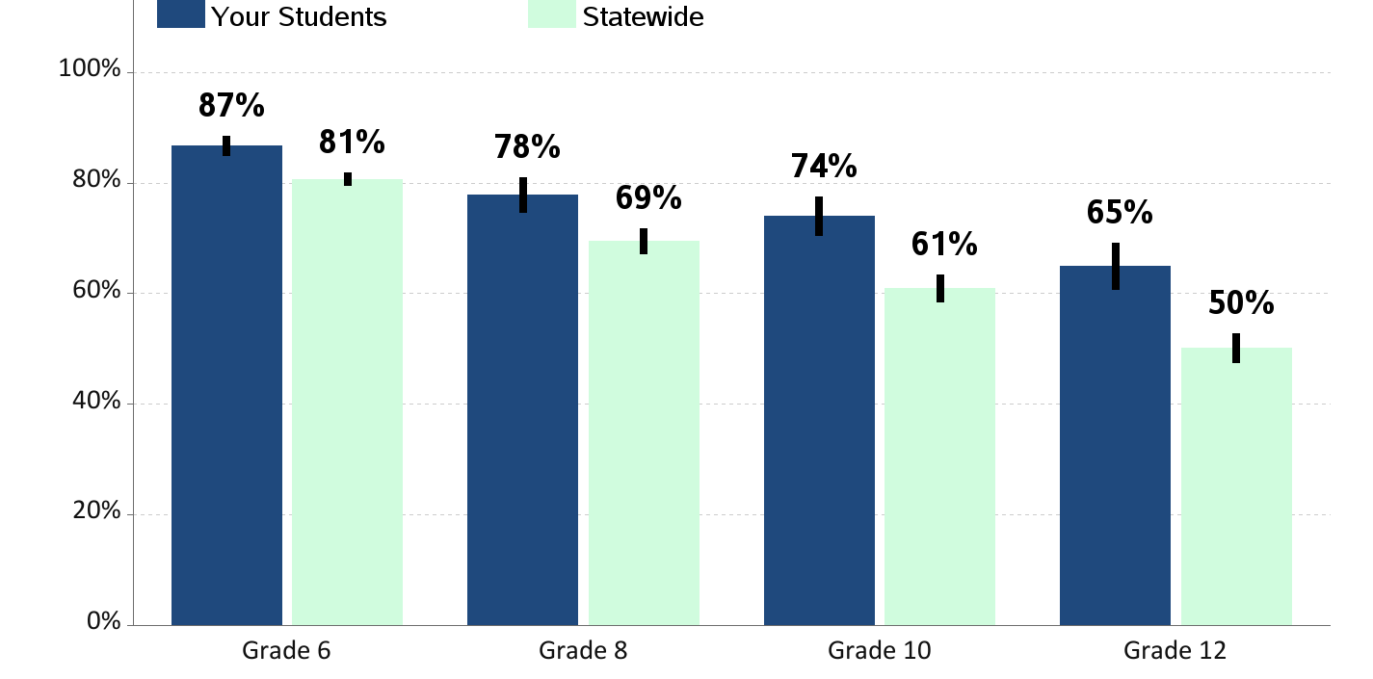
Perception of Neighborhood Norms - Smoking
Percent of students who report that adults in their neighborhood think youth smoking is "very wrong"

Slide 25
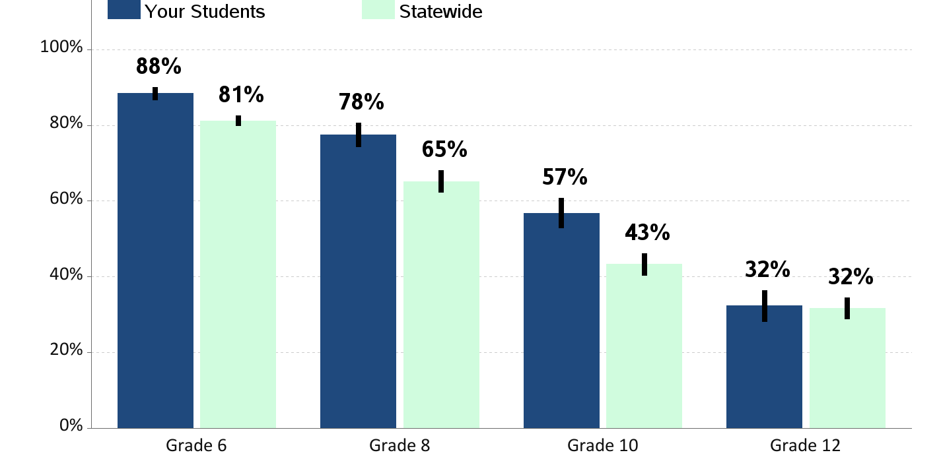
Perception of Neighborhood Norms - Marijuana
Percent of students who report that adults in their neighborhood think youth marijuana use is "very wrong"

Slide 26
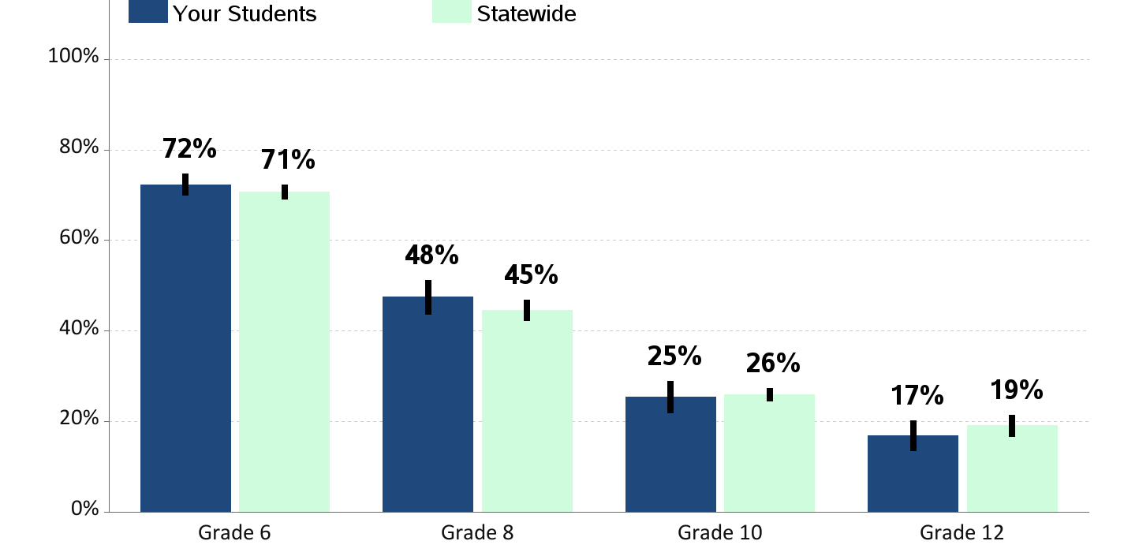
Perceived Availability of Alcohol
Percent of students who report alcohol would be "very hard" to get

Slide 27
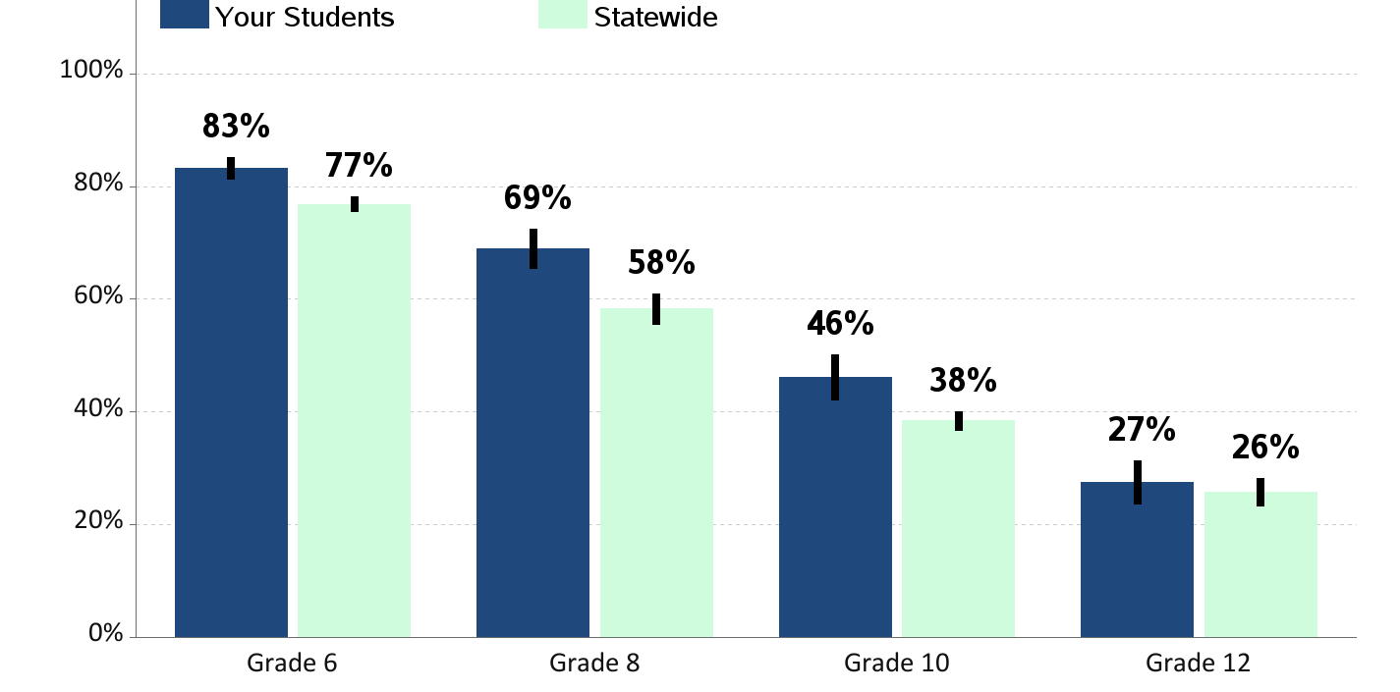
Perceived Availability of Cigarettes
Percent of students who report cigarettes would be "very hard" to get

Slide 28
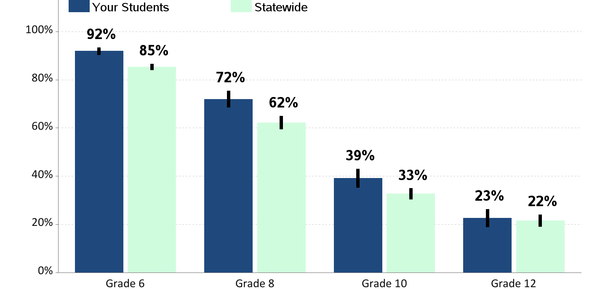
Perceived Availability of Marijuana
Percent of students who report marijuana would be "very hard" to get

Slide 29
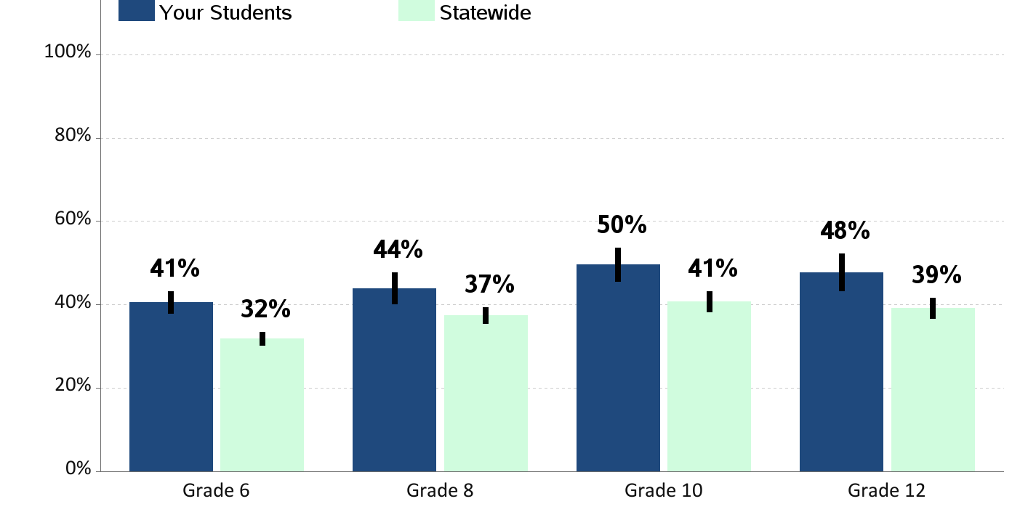
Perceived Risk of Regular Alcohol Use
Percent of students who report "great risk" of harm from drinking alcohol daily

Slide 30
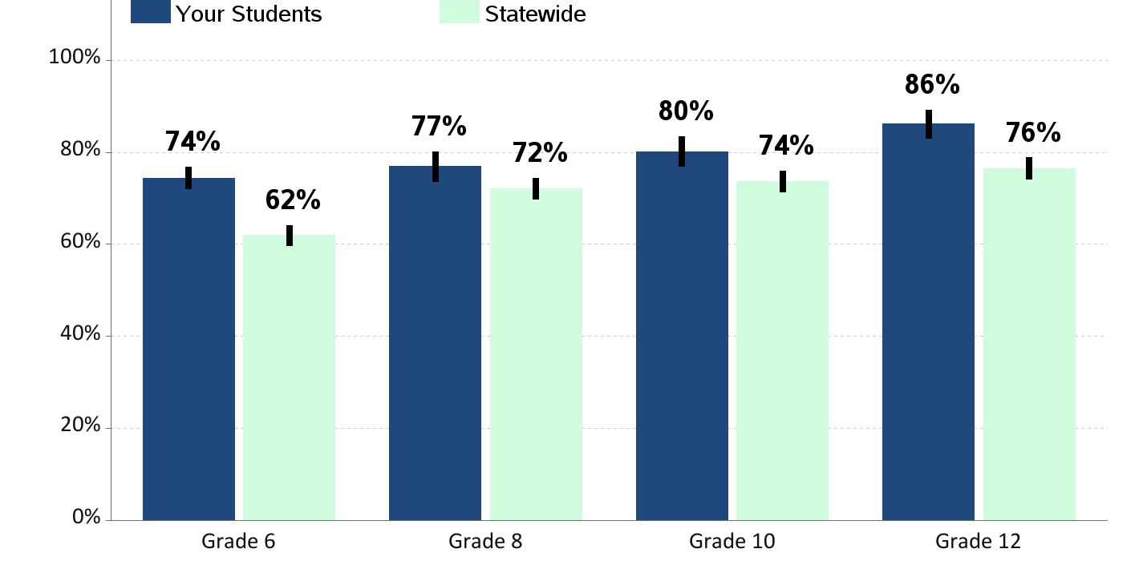
Perceived Risk of Regular Cigarette Smoking
Percent of students who report "great risk" of harm from smoking a pack or more a day

Slide 31
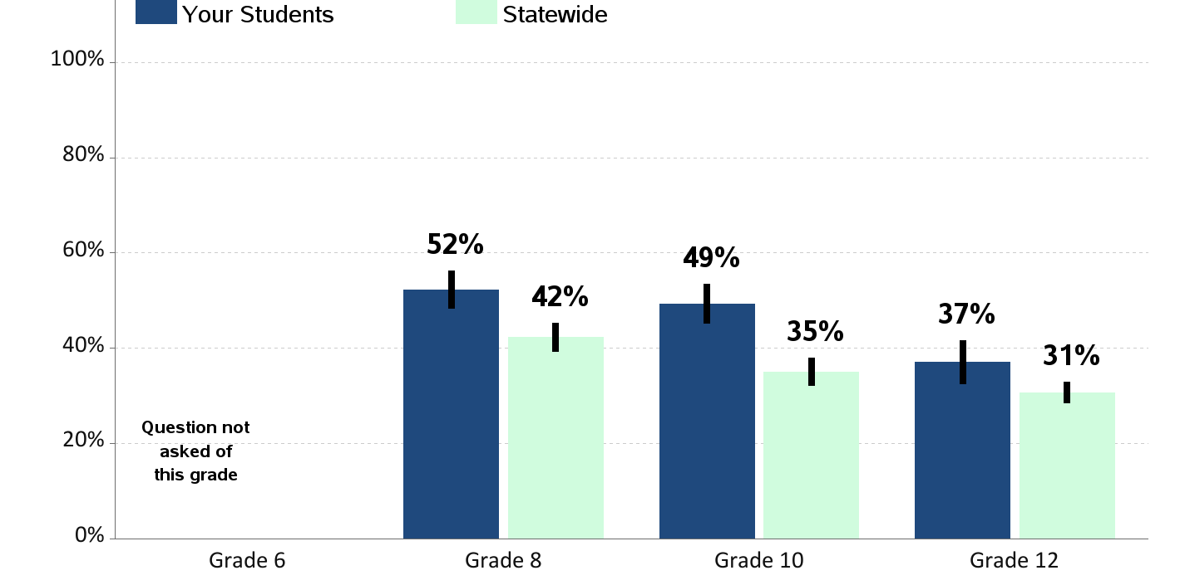
Perceived Risk of E-Cigarette Smoking or Vaping
Percent of students who report "great risk" of harm from using e-cigarette or vape pen regularly (almost daily)

Slide 32
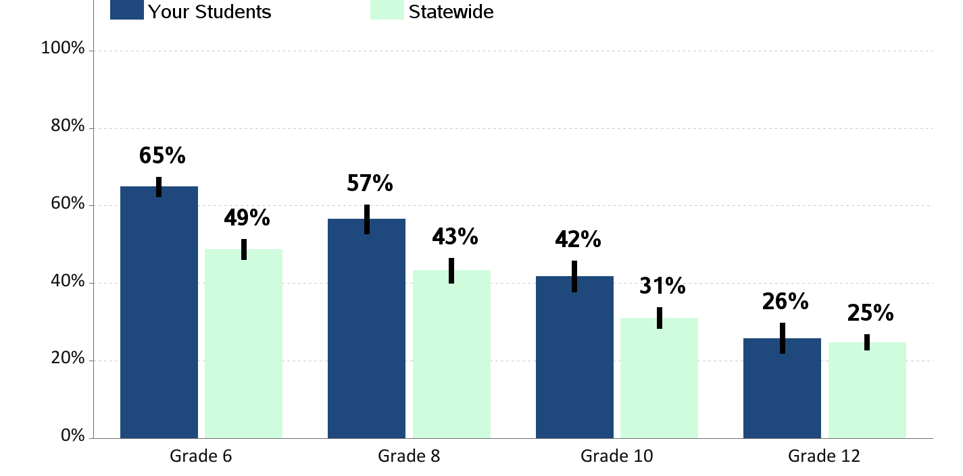
Perceived Risk of Regular Marijuana Use
Percent of students who report "great risk" of harm from using marijuana at least once or twice a week

Slide 33
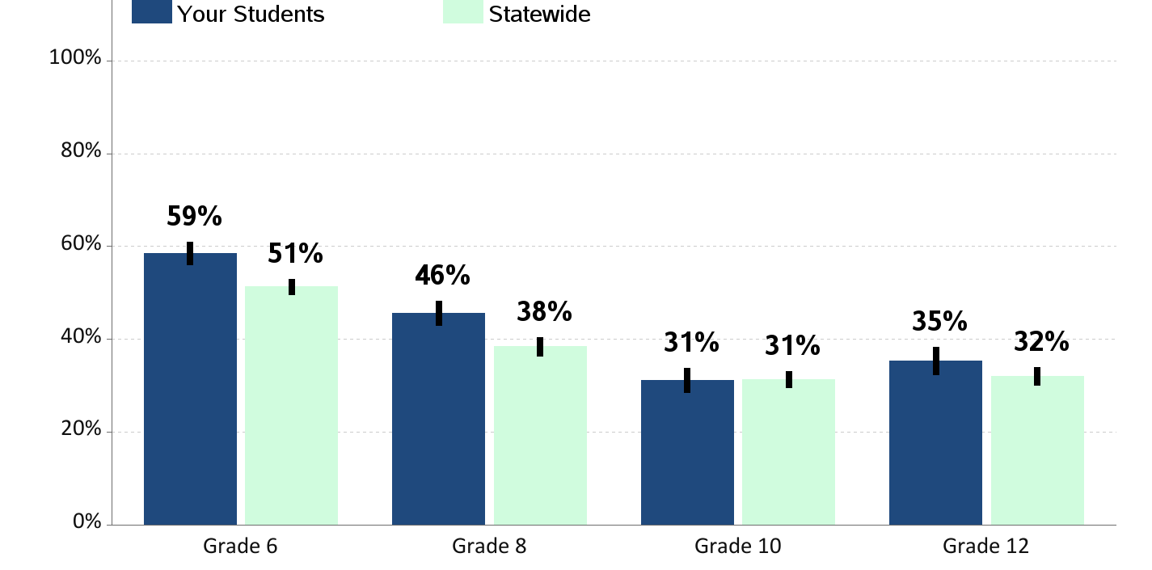
Enjoyment of School
Percent of students who report "often" or "almost always" enjoying being at school in the past year

Slide 34
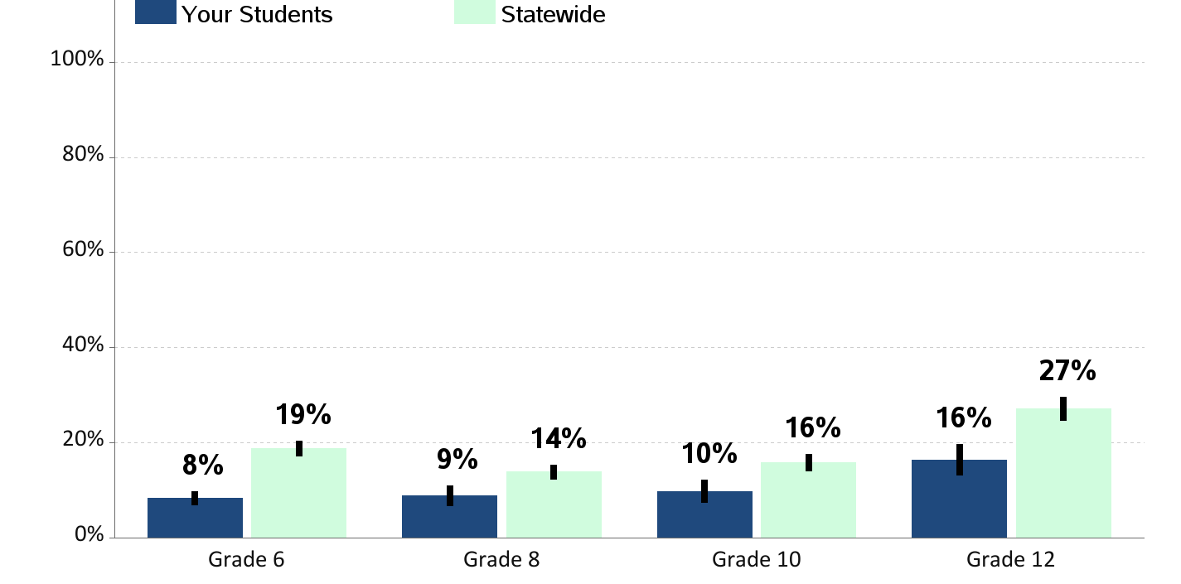
Skipping School
Percent of students who report skipping
1 or more whole days of school in the past 4 weeks

Slide 35
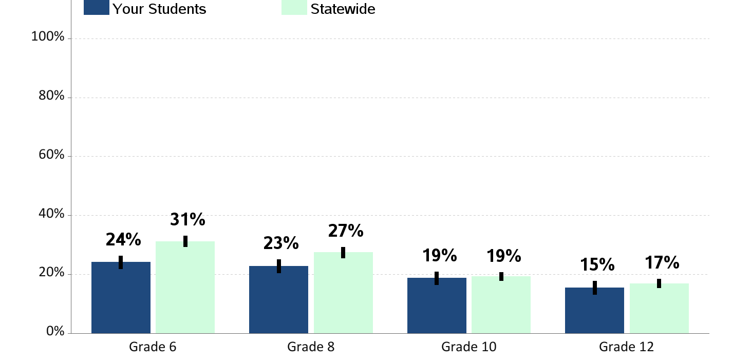
Bullying
Percent of students who report being bullied in the past 30 days
Bullying is when one or more students threaten, spread rumors about, hit, shove, or otherwise hurt another student over and over again.

Slide 36
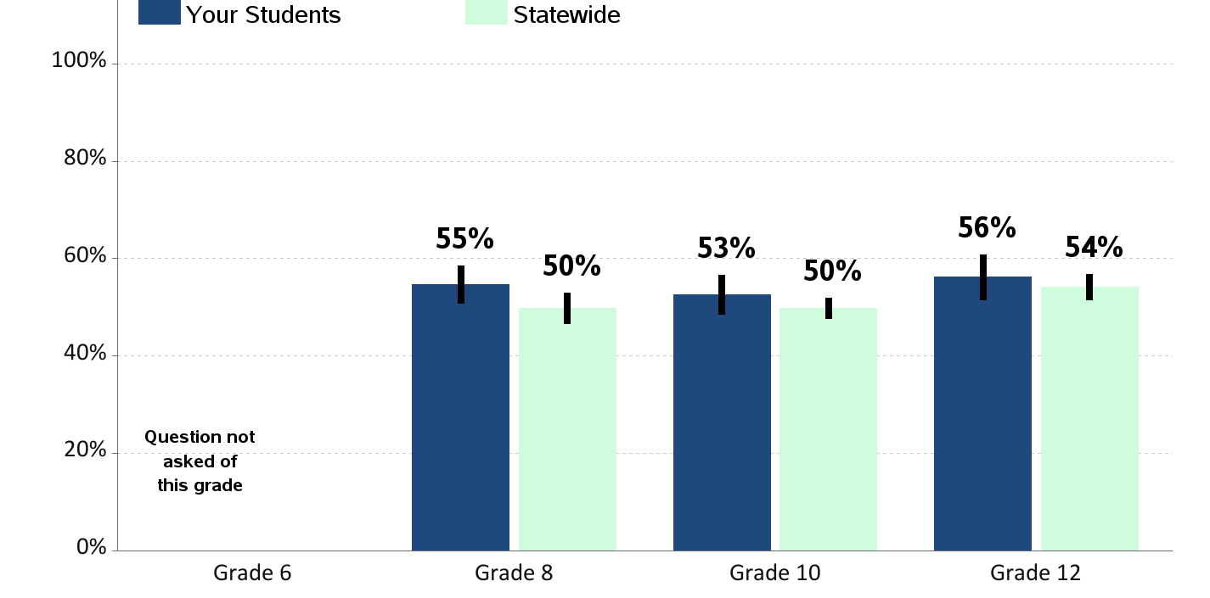
School Tries to Stop Bullying
Percent of students who report teachers or other adults at school
“almost always” or “often” try to stop bullying

Slide 37
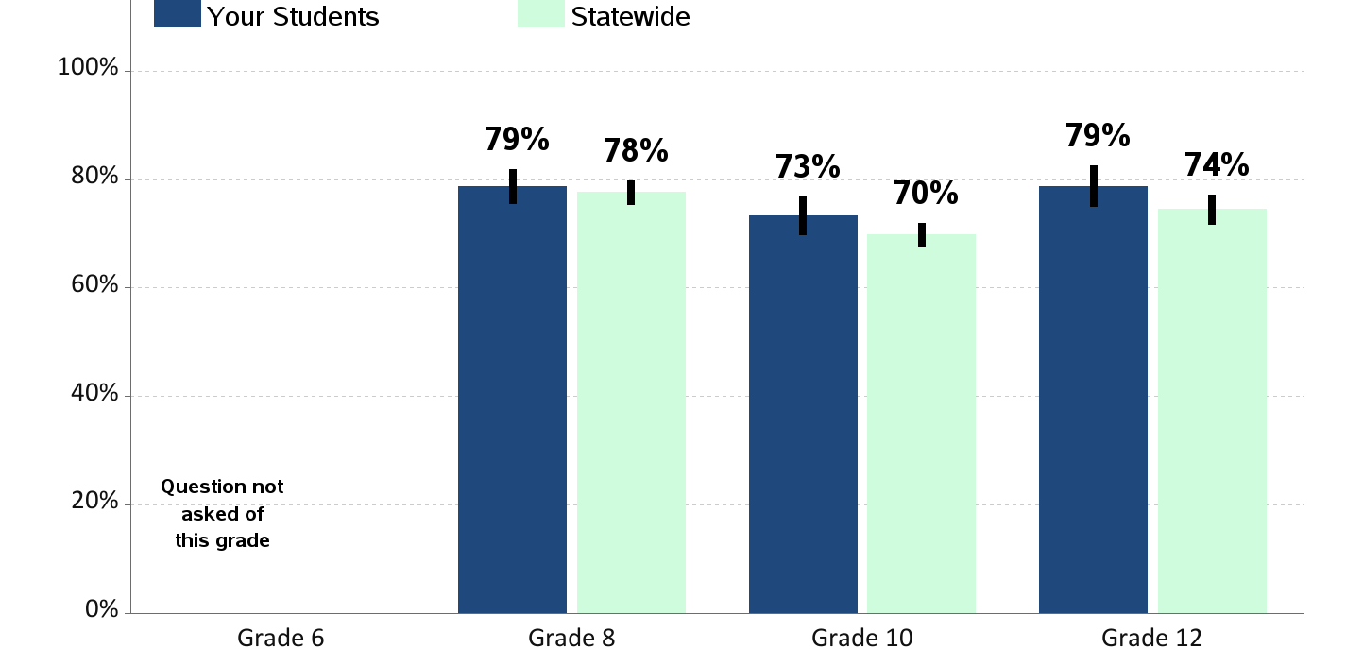
Students Know How to Report Bullying
Percent of students who report they know how to report bullying at school

Slide 38
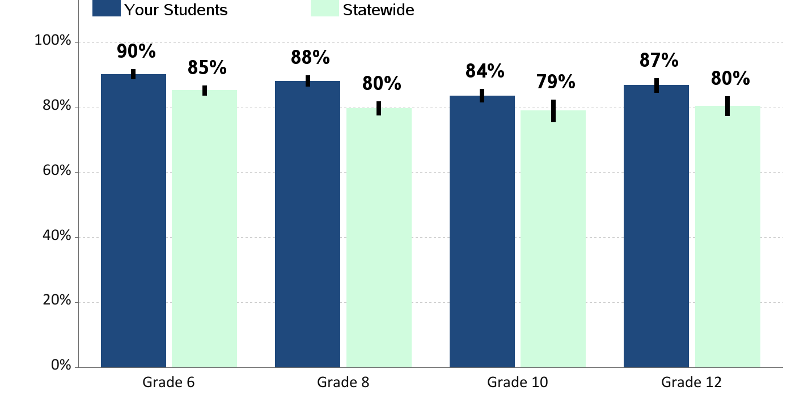
Feeling Safe at School
Percent of students who report that they feel safe at school

Slide 39
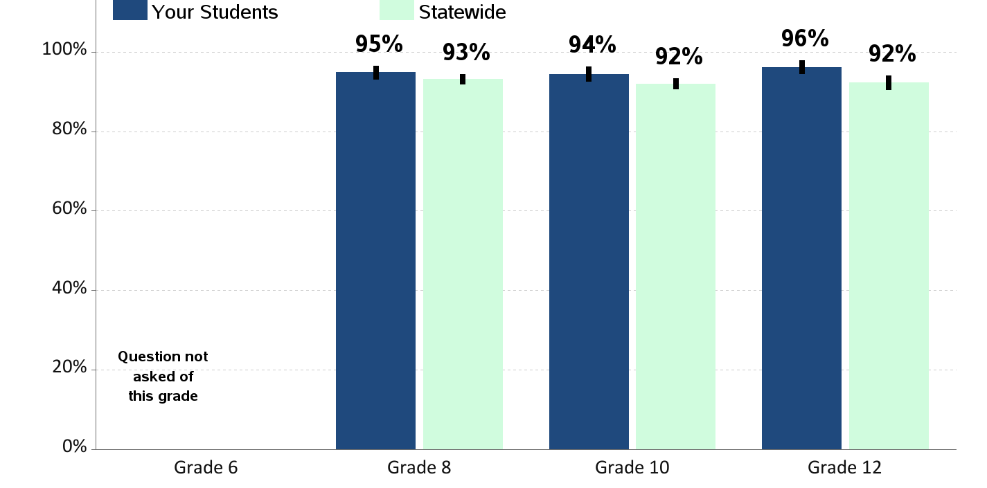
Opportunities for School Involvement
Percent of students who report that they have lots of chances for involvement in school activities

Slide 40
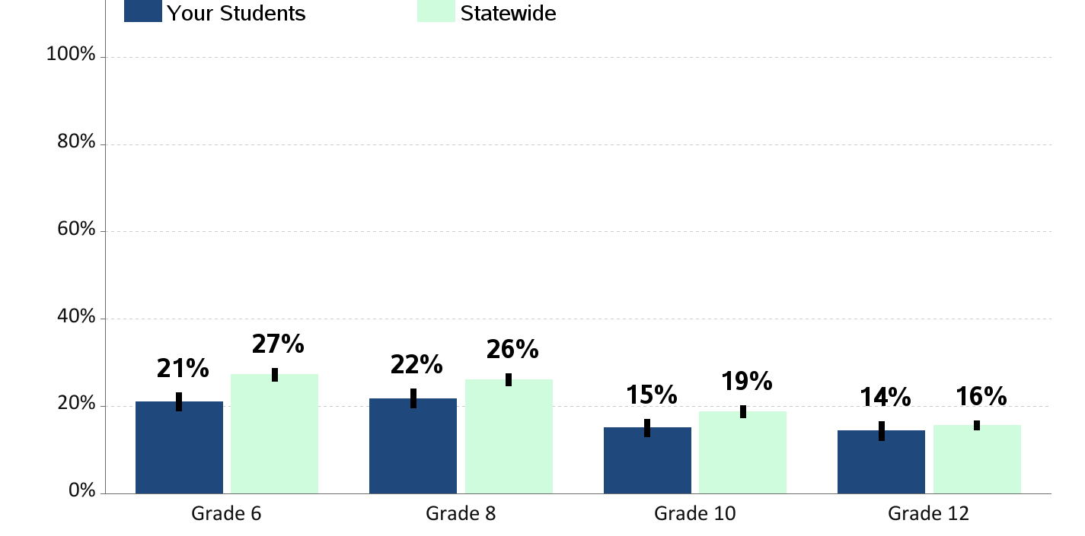
Physical Fighting
Percent of students who report being in a physical fight in the past year

Slide 41
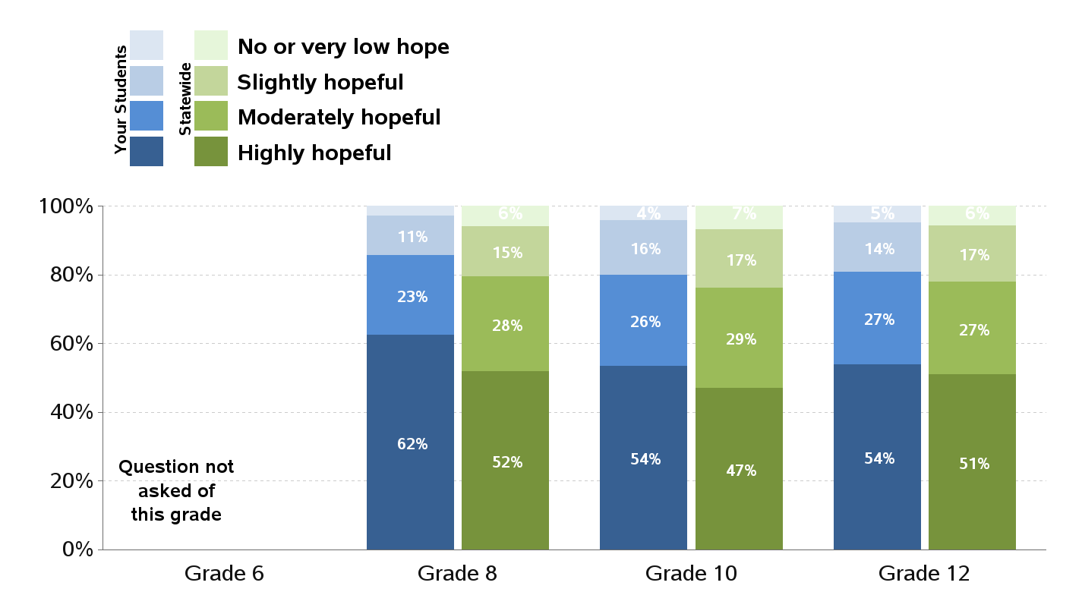
Children's Hope Scale
Hope reflects a future orientated mindset and motivational process toward attaining a desirable goal.
Research has linked hope with overall physical, psychological, and social well-being.

Slide 42
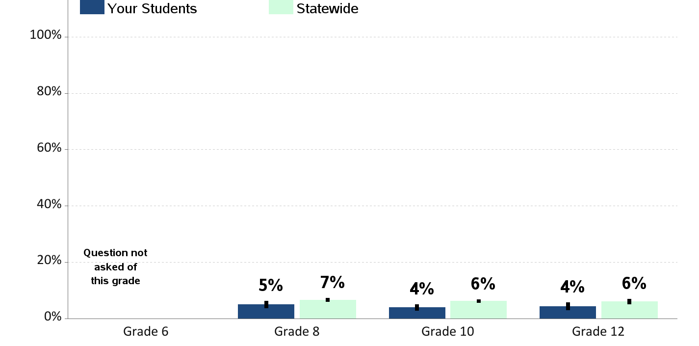
Gang Membership
Percent of students who report being members of a gang in the past year

Slide 43
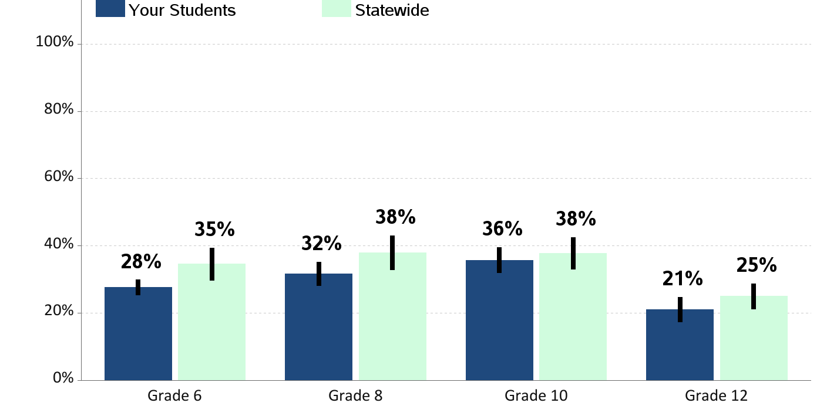
Walking/Biking To or From School
Percent of students who report walking or riding a bicycle to or from school during an average week

Slide 44
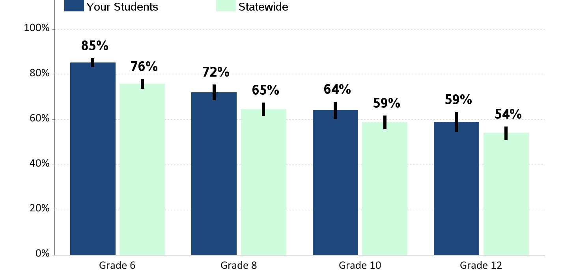
Eating Breakfast
Percent of students who report eating breakfast

Slide 45
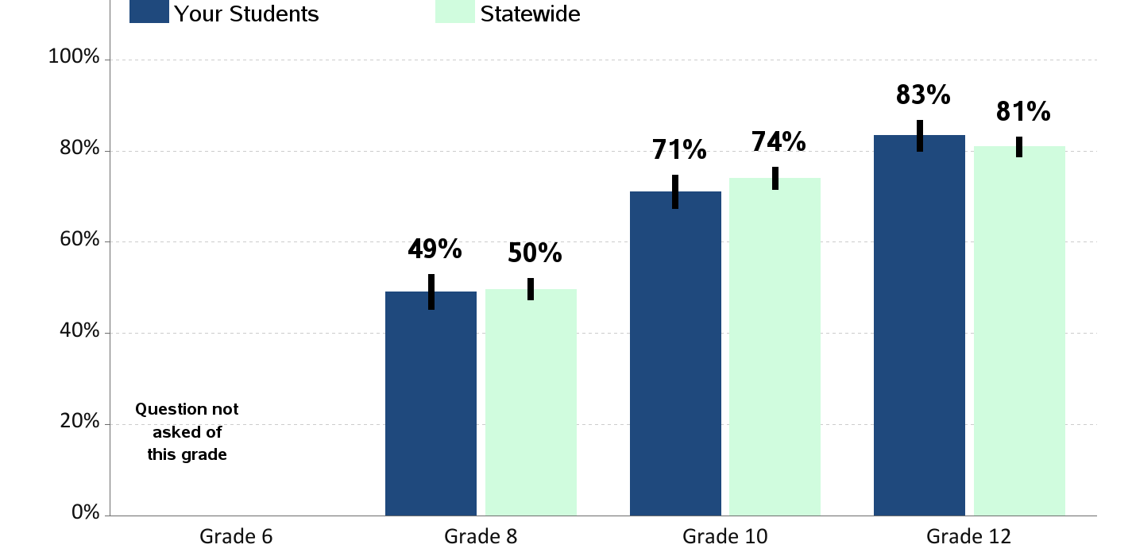
Sleep on a School Night
Percent of students who report sleeping less than 8 hours on an average school night

Slide 46
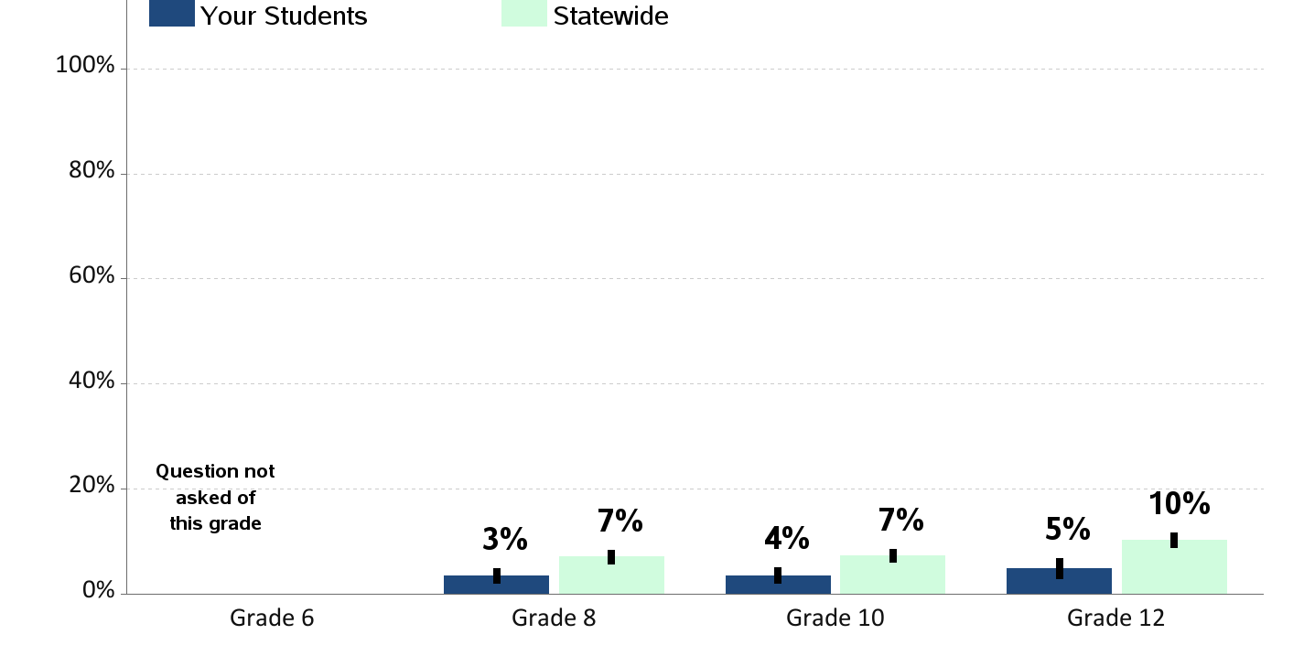
Excessive Sugar Sweetened Beverages Consumption
Percent of students who report drinking sugar sweetened beverages 2 or more times a day

Slide 47
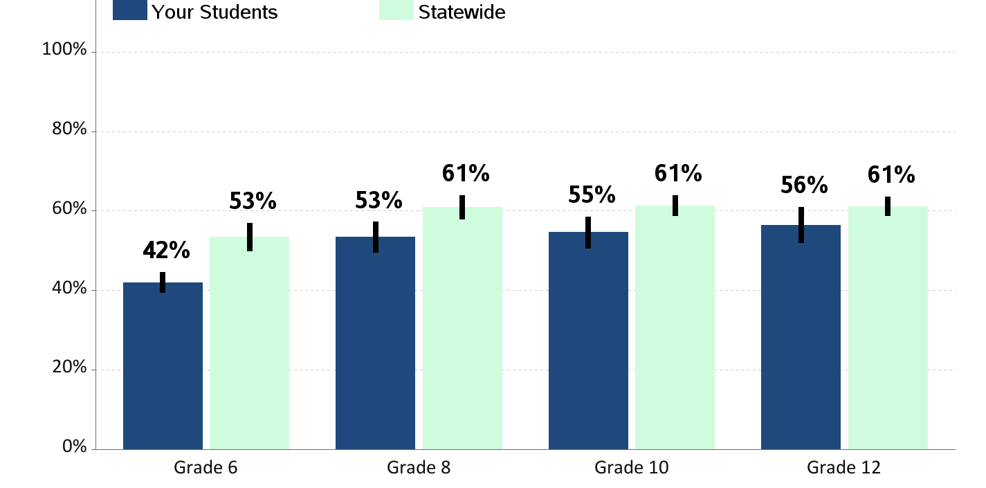
Excessive Television/Video Game Use
Percent of students who report 3 or more hours watching television,playing video games or using the computer for fun on an average school day
(TV includes movies or stream videos on any electronic device. Video games includes tablets, smartphone, social media)

Slide 48
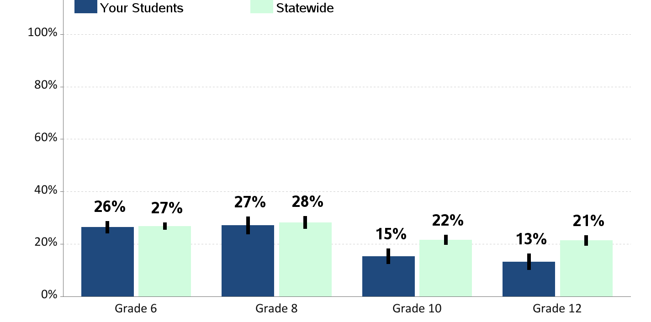
60 Minutes of Physical Activity per Day
Percent of students who report being physically active
60 minutes per day, 7 days a week

Slide 49
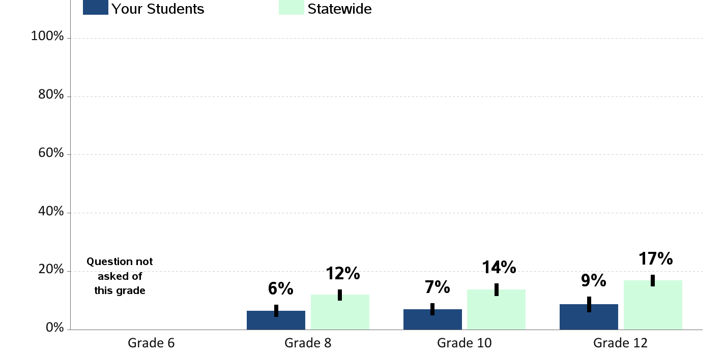
Obesity
Percent of students who are obese
(according to reported height and weight)

Slide 50
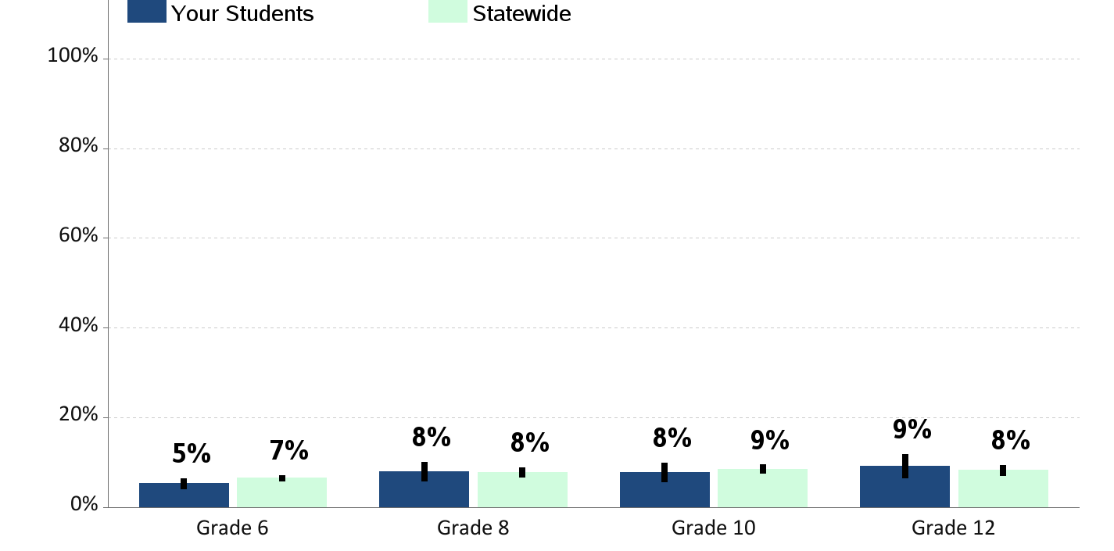
Current Asthma
Percent of students who currently have asthma

Slide 51
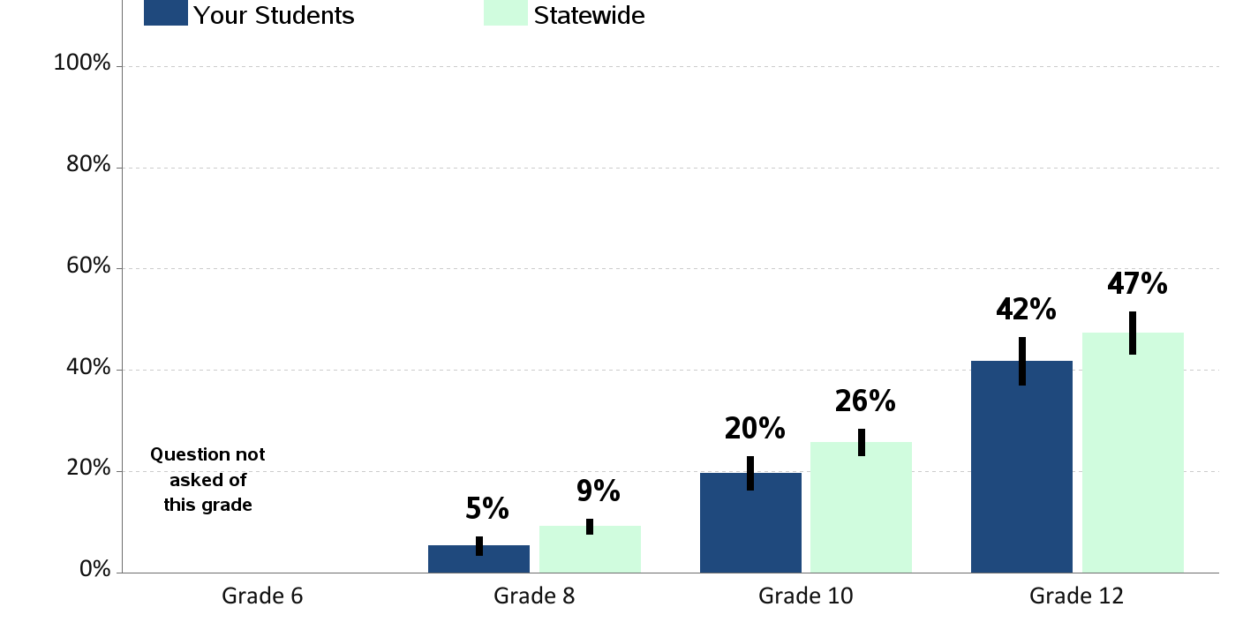
Lifetime Sex
Percent of students who report ever having sex in their lifetime

Slide 52
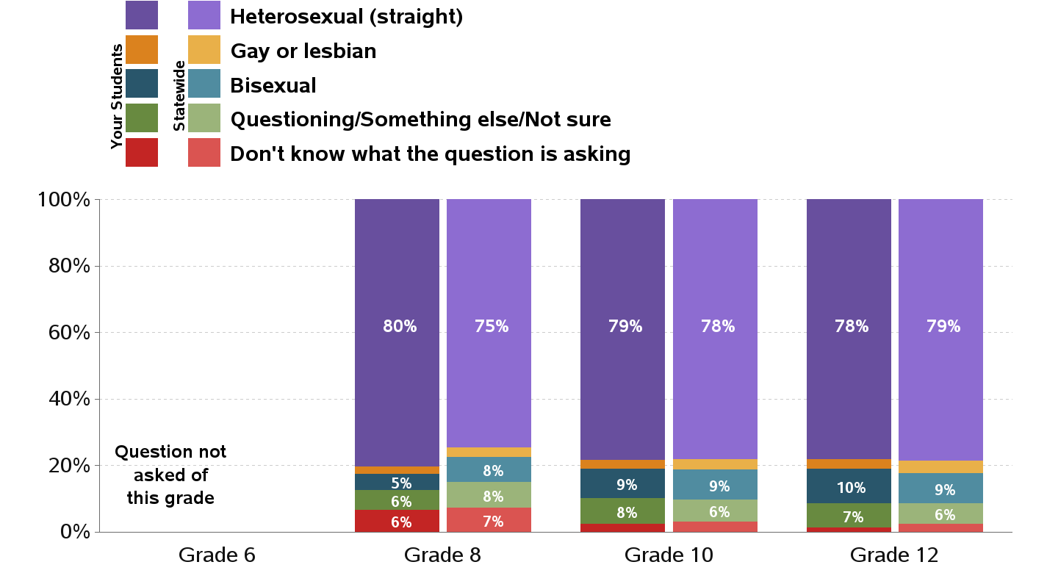
Sexual Orientation

Slide 53

Gender Identity

Slide 54

Lifetime Sexual Abuse
Percent of students who report having ever been in a in a situation where someone made them engage in kissing, sexual touch or sexual intercourse when they did not want to

Slide 55

Access to Dental Care
Percent of students who report visiting a dentist for a routine checkup in the past year

Slide 56

Depression
Percent of students who report feeling so sad or hopeless almost every day for two weeks or more in a row that they stopped doing some usual activities in the past year.

Slide 57

Contemplation of Suicide
Percent of students who report having seriously considered suicide in the past year

Slide 58

Someone in Community to Talk To
Percent of students who report having an adult in their neighborhood or community they can talk to about something important

