Slide 1
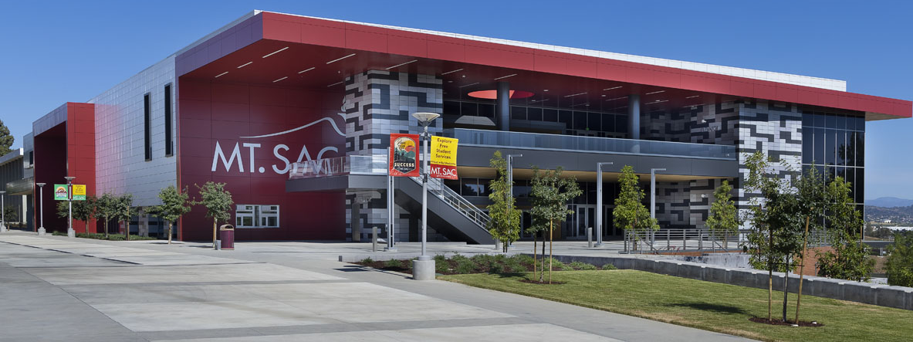


2023-2024
Community College PRESENTATION
Presented by Saydi Tapia Lopez

Slide 2



AGENDA
Benefits of Community College
Cost and Financial Aid
Academic Programs and Options
Athletics and Student Services
Promise Plus and Connect 4

Slide 3






  High School
  Diploma
  B.S. Chicano Latino Studies
  Minor Sociology
  Transfer
I am part of the 18% the undocumented population to obtain Bachelors Degree
First Generation College Student
Oldest daughter
Presenter:
Saydi Tapia Lopez

Slide 4













California Community College (116)

Slide 5


BENEFITS
VALUE!
STUDENT SUPPORT
OUTSTANDING FACILITIES
EXCELLENT ACADEMICS
$46 per unit
80% less than California State University Campuses
California Community Colleges (CCC) offer the California Promise Grant to cover the cost of tuition
Helping a large majority of our students to pay close to nothing for their education
More than 25 support programs including
In addition to childcare, healthcare and FREE tutoring in a variety of subjects
Mt. SAC has invested more than $500 million to provide quality facilities including a technology center, planetarium, agricultural science complex with a veterinary hospital and farm.
We have over 200+ academic programs offerings students 3 pathways to success at Mt. SAC: Transfer, Associate Degrees, and Certificate programs to prepare students for the workforce.

Slide 6

BENEFITS
With the California College Promise Grant (formerly known as the BOG fee waiver) waiving fees for nearly half of students in the California Community Colleges, and with our $46-per-unit fee for community college courses being the lowest in the nation
To students who qualify. The California College Promise program requires students to reapply every academic year, and each school is different in what they offer
Do not know what to do? What Major?- save money and go to a Community College.

Slide 7
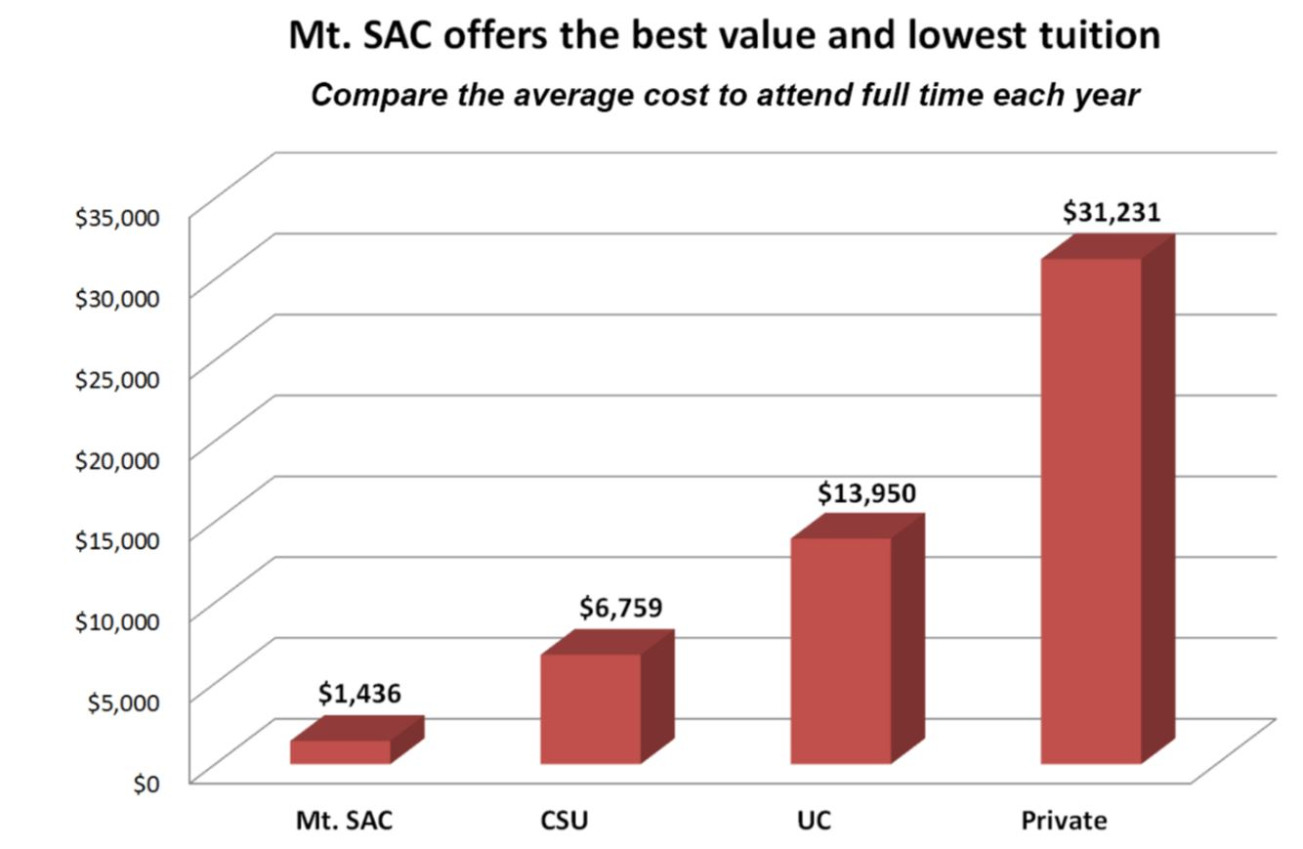

AFFORDABILITY
$53,000
$38,000
$8,000
$1,500

Slide 8





HIGHER EDUCATION
California Community College
California State University
Private/Out of State
University of California
Focus
-Transfer: TAP, TAG,
AA-T, AS-T
Degrees
-Certificate
-Associate Degree
-Associate Transfer
Degree (AA-T, AS-T)
Focus
-Teaching and
research focus
Degrees
-Associates
-Bachelors
-Masters
-Ed. D
Focus
-Teaching focused
Degrees
-Bachelors
-Masters
-Ed. D
Focus
-Research focused
Degrees
-Bachelors
-Masters
-Ed. D
Notes:
CCC-115 colleges
CSU-23
UC-9 and UCSF
Private-100 plus

Slide 9

COMMUNITY COLLEGE MYTHS/FACTS
MYTH | FACT
1. Only students with bad grades go to community colleges. | 1. Mt. SAC students get selected for academic teams and win prestigious national titles.
2. Students never graduate or transfer. | 2. Mt. SAC is ranked among the top-tier community colleges transferring students to UC and CSU campuses.
3. Students must retake the same classes once they transfer to the University. | 3. Students DO NOT have to retake the same classes once they transfer to the University.
4. There are no classes available. | 4. There is CONNECT 4 and other Mt. SAC programs that offer priority registration
5. Community college classes are easy, similar to high school. | 5. Community college classes are Bachelor level classes; however, you get the autonomy to create your own schedule of classes based on your field of interest.

Slide 10

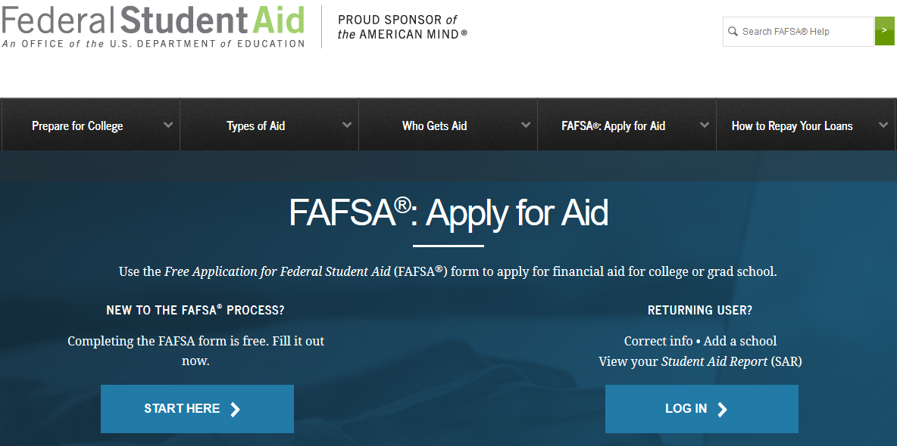
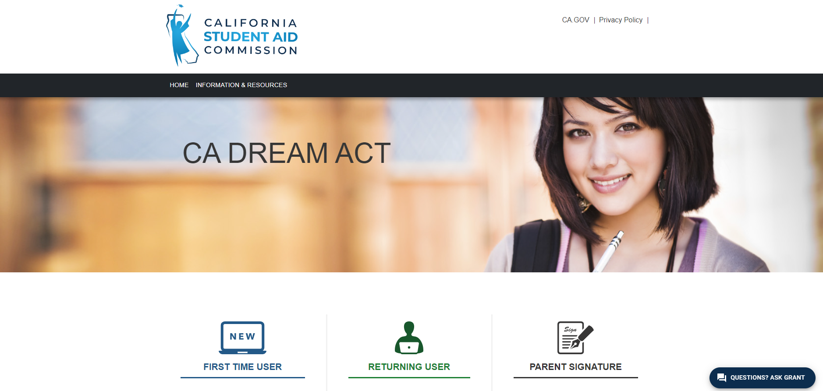
FINANCIAL AID
Mt. SAC’s Financial Aid Department recommends all students to submit a FAFSA or CA Dream Act to be considered for all available funds
FAFSA
Dream Act
U.S Citizen
Permanent Resident
Eligible non-citizen
T Visa Holder
OR
Undocumented
U Visa Holders
TPS (temporary protected status)
Have a valid or expired DACA
https://studentaid.gov/h/apply-for-aid/fafsa
https://dream.csac.ca.gov/landing

Slide 11

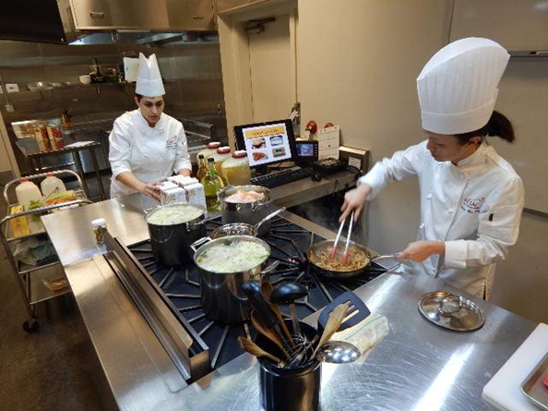
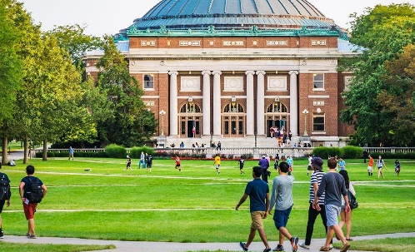
ACADEMIC PROGRAMS & OPTIONS
  Associates in Arts and Science
  Transfer Options
  Certificate Programs
  Accounting
  Landscape Construction
  Air Conditioning
  Radio broadcasting
  Infant/toddler Development
  Horse Ranch Management
  Welding
  Cal State University
  University of California
  Private University
  Out of State Universities
  Elite Universities
  Nursing
  Administration of Justice
  Commercial Flight
  Business Administration
  Veterinary Technician
  Culinary Arts
  Fire Technology
Notes:
https://www.mtsac.edu/guided-pathways/
Update bullet points

Slide 12

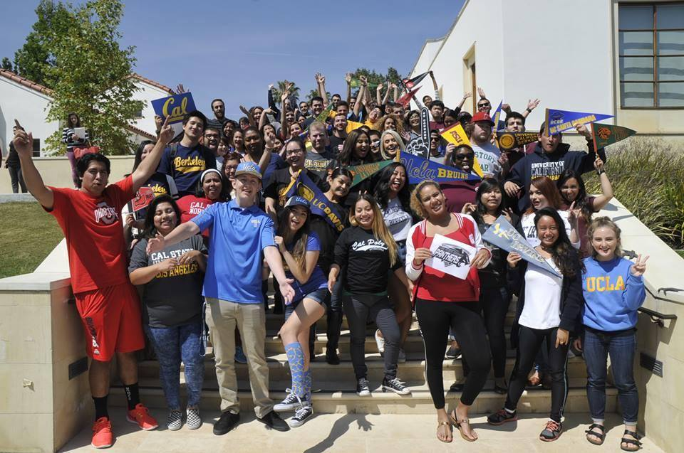








TRANSFER OPTIONS
Transfer Partners
  Honors Program
  TAP w/ UCLA
  TAG w/ UC’s
  AA-T/AS-T Degrees
  Arizona State University Guarantee
  University of La Verne Admission Guarantee
Top CSU and UC
  Cal Poly
  UCLA
  UC Irvine
TOP 10 Transfer College
2nd Private, California
5th Cal State University
5th Out of State
7th University of California
Notes:
TOP 10 Transfer College Fall 2018
UC: https://www.universityofcalifornia.edu/infocenter/california-community-college-enrollments-uc
CSU: http://asd.calstate.edu/dashboard/enrollment-live.html
Out of State and Private: https://datamart.cccco.edu/Outcomes/Student_Transfer_Volume.aspx

Slide 13
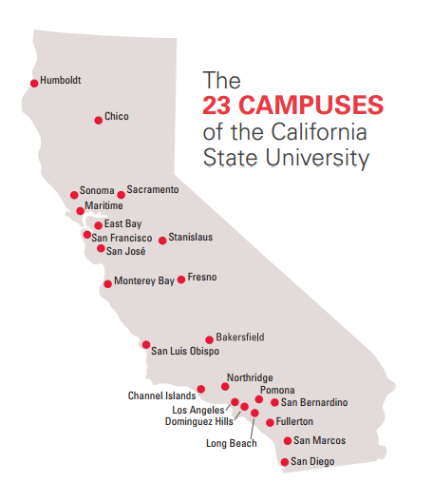

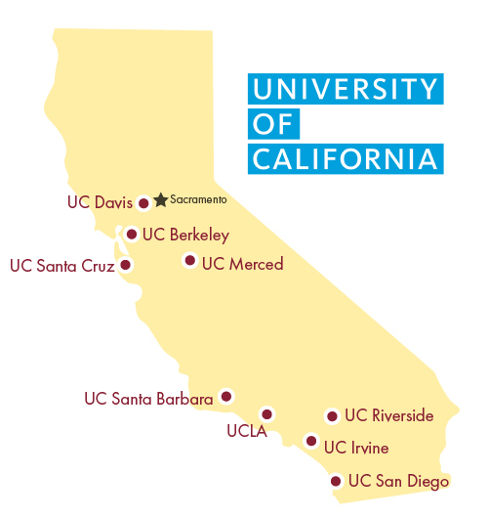
TRANSFER AGREEMENTS
UC Transfer Admission Guarantee (TAG)
Through UC TAG students may receive early review of their academic record, early admission notification and specific academic guidance.
Major Benefit
Offers qualified CCC students GUARANTEED ADMISSION to 1 of the 6 participating UC campuses. Every campus has very specific TAG requirements
Participating Campuses:
UC Davis
UC Irvine
UC Merced
UC Riverside
UC Santa Barbara
UC Santa Cruz
Associate Degrees for Transfer, AA-T & AS-T
Special associate degrees designed to facilitate transfer to the CSU system.
Major Benefit
GUARANTEED ADMISSION to 1 of the 23 Cal State Universities that you apply to, but major can vary at the schools consideration.
Notes:
https://admission.universityofcalifornia.edu/admission-requirements/transfer-requirements/transfer-admission-guarantee-tag.html

Slide 14


ATHLETICS
75
BY THE NUMBERS:
Mt. SAC has captured the National Association of Two-Year College Athletics Administrators Cup Championship for most outstanding athletics program 10 times!
OVER
CHAMPIONSHIPS!
Notes:
https://www.mtsacathletics.com/sportsinformation/state_championships

Slide 15
















STUDENT SERVICES
Career & Transfer
Services
Notes:
https://www.mtsac.edu/studentservices/

Slide 16
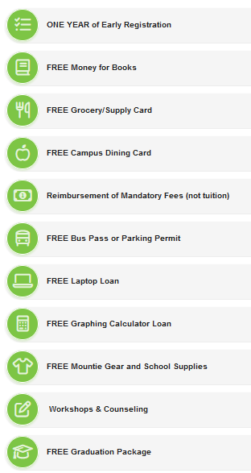
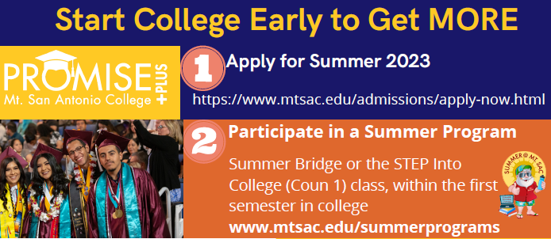
Benefits
The Promise+Plus Program is a combination of financial and support services to help first-time, college students be successful in their first two years of college.
FOR FIRST TIME
COLLEGE STUDENTS
2024
Must apply to Summer 2024 AND do 1 Summer Program to be eligible for Promise + Plus in the FALL.
Summer Intersession
June 20, 2024-August 1, 2024

Slide 17
Follow steps 1 through 4 and receive support services that will lead you to receiving EARLY REGISTRATION your first Fall semester!
Submit a Mt. SAC Application
Complete the Assessment Questionnaire and Claim Your Account
Complete the Online Orientation and MAP Workshop
Register for Fall Classes
Be the FIRST of your class to REGISTER!
Access to Mt. SAC resources through your Outreach Specialist
Attend exclusive CONNECT 4 workshops
Fall Classes Begin August 26, 2024

Slide 18
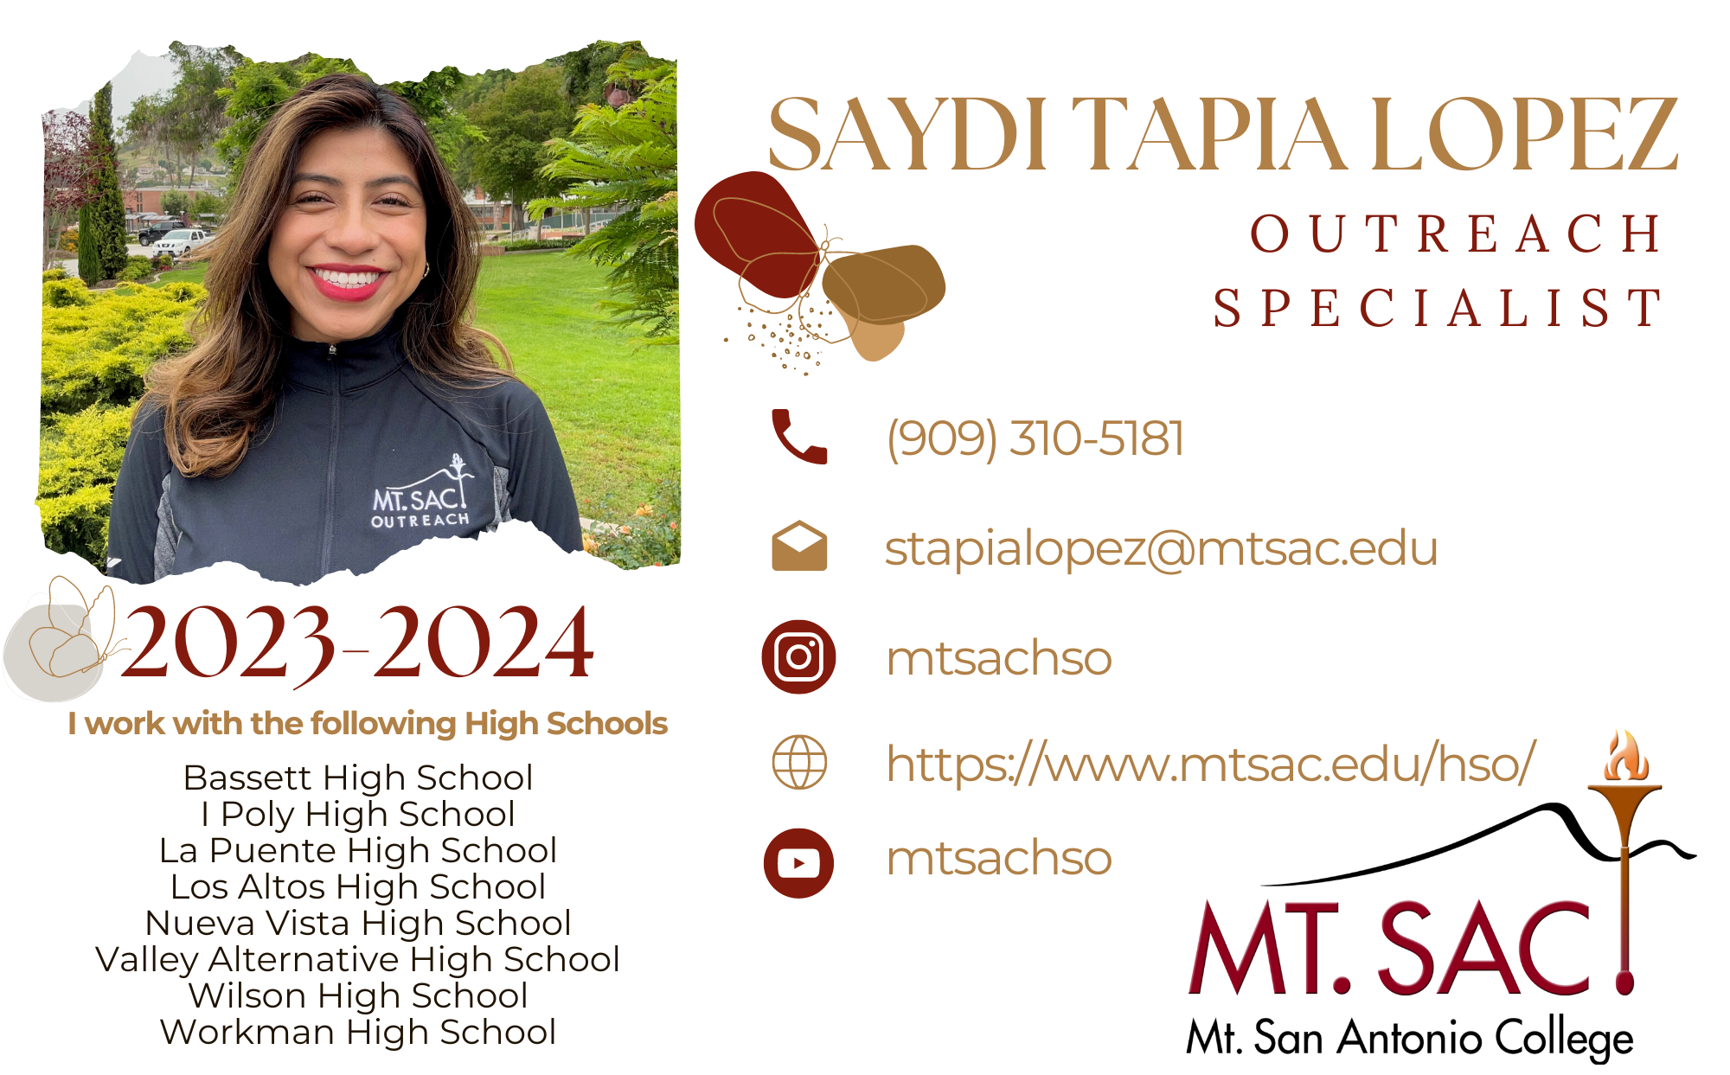
CONTACT ME:
2023-2024

