Slide 1
LCAP
COVID-19 Report
Executive Order – May, 2020
Marin County Office of Education - LCAP Executive Order

Slide 2

LCAP Executive Order
Deadline for adoption of 2020-2021 LCAP from July 1, 2020 to December 15, 2021
Link to Executive Order N56-20: https://www.gov.ca.gov/2020/04/23/governor-newsom-issues-executive-order-empowering-schools-to-focus-on-covid-19-response-and-transparency/
Link to LCAP Executive Order FAQs: https://www.cde.ca.gov/re/lc/lcapfaq.asp
Marin County Office of Education - LCAP Executive Order

Slide 3

Due by:
Districts must still adopt a 2020-2021 budget
Charters submit a budget to chartering authority.
COVID-19 Operations report
Marin County Office of Education - LCAP Executive Order

Slide 4
Due by
2020-2021 LCAP with First Interims*
  Adopted by local governing board
  Also includes Budget Overview for Parents
Template is in process and will be in DTS.
  Anticipated by September 30, 2020
*LCAPs may still require a public hearing prior to board approval on or before December 15, 2020.
2020
Marin County Office of Education - LCAP Executive Order

Slide 5
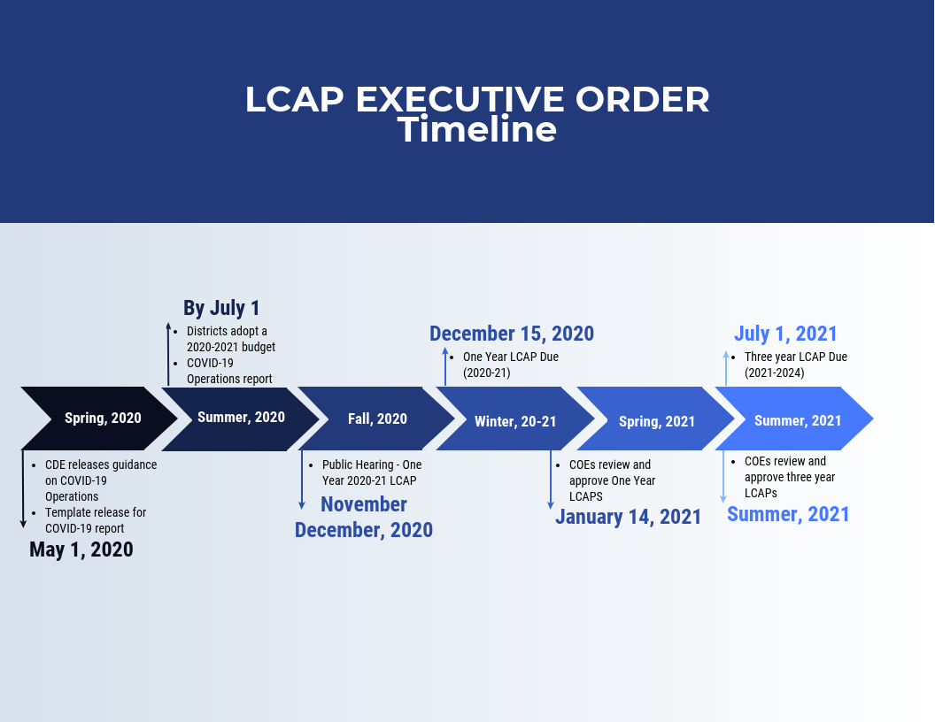
Marin County Office of Education
Marin County Office of Education - ILT-M: May 1, 2020

Slide 6

COVID-19
Operations Written Report
Executive Order:
  LEAs report explaining changes to program offerings mad in response to school closure
    Impact of school closures on students/families
    How is LEA meeting needs of unduplicated students
    Steps taken during closure to address:
      Delivering high quality distance learning
      Providing school meals – non-congregate settings
      Arranging for supervision of students during ordinary school hours
Marin County Office of Education - LCAP Executive Order

Slide 7

FAQs
Who approves the COVID 19 Operations Written Report?
  LEA Governing Board – along with submission to MCOE.
  Operations Written Report does NOT require a separate hearing prior to the approval by the local board.
Local Indicators?
  The requirement to bring Local Indicators to Governing Board is waived.
  More detail/guidance Fall, 2020.
Can districts use the 3 year LCAP template for the 2020-21 LCAP due December 15?
  CDE guidance = no.
Annual Update for 2020-21 LCAP?
  Part of the 2020-21 LCAP
  Not expected to use Annual Update template approved in 2020.
Marin County Office of Education - LCAP Executive Order

