Slide 1

2024-25 Transition to Sweetwater Union High School District
CAC Meeting
January 11, 2024

Slide 2





WELCOME!!
Notes:
Today we want to give you some information about what to expect for your students in the coming transition to a secondary district.

Slide 3
Sweetwater Special Services Mission
Sweetwater Union High School District Special Services Department provides special education services for students with disabilities in inclusive learning environments where
students access a meaningful educational experience,
families and community are equal partners
staff work collaboratively to support student success in their chosen pathway and life goals.

Slide 4
Key Contacts at school site:
Who should you call?
School Principal
School Psychologist
Assistant Principal
Service Provider
Case Manager
Classroom Teacher
School Counselor

Slide 5
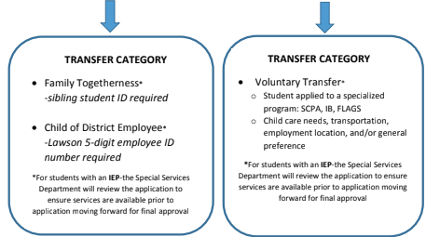
Intradistrict Transfer Process
Parent fills out online application within the open enrollment window.
Transfer information is found on the Student Support Services website.
Notes:
Home school preferred - peer relationships that can develop into healthy friendships through adulthood
Sense of Community for Transition Purposes - consider bus routes, recreation, familiarity with surroundings & employment

Slide 6
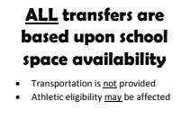
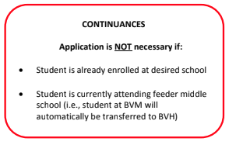
Intradistrict Transfer Process
Only ONE application per student may be submitted.

Slide 7
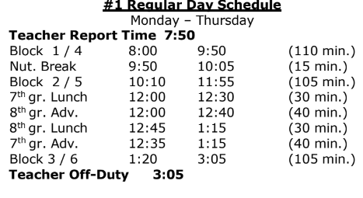
Daily Schedules
May have multiple teachers and classrooms throughout the day.
Different rules and expectations for each class
Nutrition Break 10 minutes
Lunch 30 minutes.
No recess.
Variety of bell schedules:
  Block Schedule = 1 hr 45 min periods (3 classes per day)
  Full Day = 50 min per period (all classes every day)
  Minimum Days with early dismissal

Slide 8

Must We Hold an IEP Prior to Fall 2024?
A new IEP does not need to be held until the next scheduled annual IEP.
Middle school staff have met already with elementary districts to review students’ IEPs, evaluations, etc

Slide 9

Must We Hold an IEP Prior to Fall 2024?
However, in some cases, Sweetwater staff may determine a Transition IEP meeting is needed.
If a Transition IEP meeting is needed, it will be scheduled after July 1st, 2024 and before the beginning of the school year

Slide 10
Special Education Programs offered at SUHSD
Resource Specialist Program (RSP) - Diploma Bound
Special Day Class (SDC)
- Diploma Bound
Moderate Program (M)
- Non Diploma Bound
Moderate/Severe Program (M/S) - Non Diploma Bound

Slide 11
 | Certificate of Completion | Diploma
What it means | completed high school (moderate or moderate/severe program) did not meet all graduation requirements Still participates in graduation ceremony with peers | A student has met all requirements for graduation.
Requirements | IEP Team determines courses necessary to meet IEP Goals and progress | Must pass ALL grade-level English, Math, Science, Social Science, etc.
Curriculum Modification Allowed | Yes | May NOT alter the standard nor change what is learned (i.e. Braille does not change what is learned)
Transition Service Delivery | Individual Transition Plan begins age 16. After completion may receive transition services through Transition Program up until age 22. | Individual Transition Plan begins age 16. After diploma no longer eligible for IEP services.
Notes:
Accommodations do not fundamentally alter course content and are afforded to all students thereby fulfilling graduation requirements.
Modifications fundamentally alter the course content, therefore do not fulfill graduation requirements.

Slide 12

Why have this conversation now?
You may already be having this conversation when discussing Promotion Criteria in the Offer of FAPE: Educational Setting page of your student’s IEP (check)
DIPLOMA
CERTIFICATE OF COMPLETION
Notes:
Promotion Criteria must be consistent with what the graduation plan is beginning in 8th grade -
when student is pursuing a diploma goals must be aligned with grade level standards;
typically a student pursuing graduation will have promotion criteria as district to maintain rigor with peers to meet graduation with the 4-year cohort

Slide 13

Graduation Plan: Must be completed for student in grade 8 and higher.
Indicate date when the student is expected to graduate or receive a certificate of completion (4-year cohort)
Indicate if the student is/or will be taking classes toward a certification of completion.
DIPLOMA
CERTIFICATE OF COMPLETION

Slide 14

Related Services - Delivery Models
Services are comparable, but may look different based on the needs of student in a new learning environment:
Specialized Academic Instruction
Related Services
  Speech
  Individual Counseling
Intensive Individual Services (SCIA)
Student-centered Discussions
Notes:
SAI - Language used differs district to district
Pull-out, co-teach or collaborate, learning center, RSP, SDC
Related Services - student requires support towards maximum independence
Speech - prepare for student in community (real world) services start looking more like what would occur naturally - tend to see less 1-to-1 and more classroom embedded
Individual Counseling - service delivery may be different provider based on need
Intensive Individual Services (SCIA)
not a person, but a service provided to a student for specific needs throughout the day
Aligned to a goal, measurable
Must be faded towards maximum independence - consider adult whether college or in an adult care facility - 1-to-1 limits access and is typically not provided by regional, unless nursing or medical care is involved
Student-centered discussions
More involvement of student in the IEP meeting, creation of goals, ownership of accommodations
Consider advocacy needs of an adult under ADA
Difference between ADA and IDEA

Slide 15
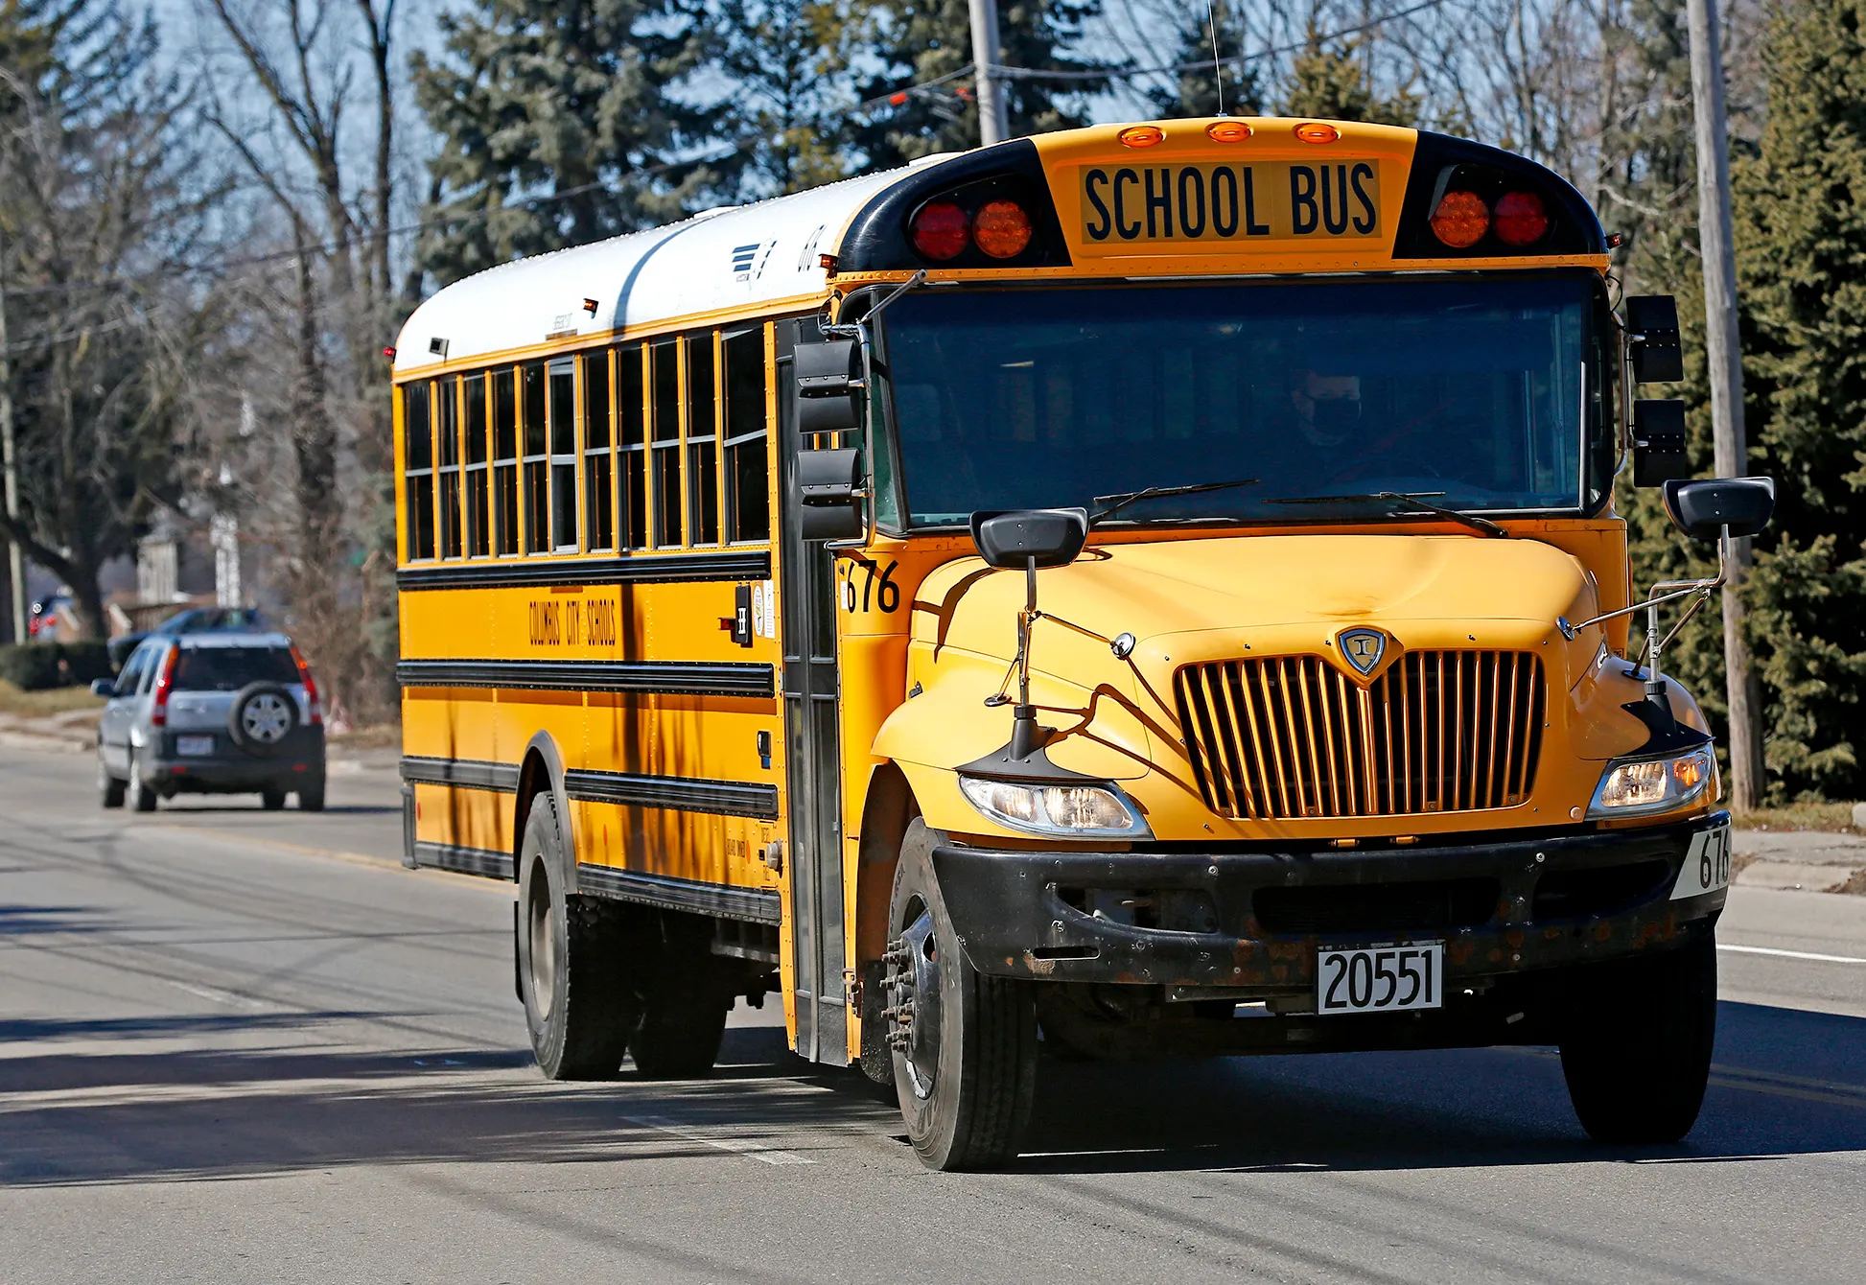
Transportation
IEP Team Considers Student’s Unique Needs:
Medical Diagnosis and Health Needs
Physical Needs (Wheelchair, VI , DHH)
Safety Needs
Program Location (IEP team decision)
Students may no longer need transportation services if the IEP services/program is available in their “new” home school
Notes:
Medical
Does the student have significant limitations in strength, vitality or alertness that prevents him/her from riding the regular bus?
Does the student have a medically fragile condition that prevents riding the regular school bus?
Does the student have special medical equipment that must be transported on a specialized school bus?
Physical
Safety
Is there a substantial risk to the student's safety and well-being as a result of significant delays in social, emotional, or cognitive development?
Program Location

Slide 16

24-25 School Calendar
Wednesday July 24, 2024
First Day of School for Students!
Monday & Tuesday /July 22 - 23
Staff Report Preparation

Slide 17

Questions?

Slide 18
SUHSD Contact Information
Special Services Main Number: 619-796-7500
Program Managers
Ed Canett, eduardo.canett@sweetwaterschools.org, 619-796-7568
Middle Schools: Eastlake, Rancho del Rey
High Schools: Eastlake, Olympian, Otay Ranch, San Ysidro
Palomar, Alta Vista, Life School, Options Sec, Alternative Ed.
Nancy Walter, nancy.walter@sweetwaterschools.org, 619-796-7557
Middle Schools: Bonita Vista, Chula Vista, Granger, Mar Vista, National City
High Schools: Bonita Vista, Chula Vista, Mar Vista, Sweetwater
Daniel Smirniotis, daniel.smirniotis@sweetwaterschools.org, 619-796-7553
Middle Schools: Castle Park, Hilltop, Montgomery, Southwest
High Schools: Castle Park, Hilltop, Montgomery, Southwest
East Hills Academy

Slide 19


