Slide 1
Curriculum Council DEI/CR-SE Resources:
Overview of the NYSED Creating a Safe, Supportive, and Affirming School Environment for Transgender and Gender Expansive (TGE) Students (2023) Pt. 2
Presented by:
April Francis-Taylor,
ESBOCES
Director of DEI
Notes:
Share: “As we move to the end of the session, we will share resources and explain how you can continue your learning.”
Note: Allow 10 minutes for closing and next steps.

Slide 2

Braving Conversations...
Notes:
response afte break-out rooms: Highlight for participants that each of them have likely have shifted their understanding of LGBTQ
people and identities over the course of their lifetimes and that this workshop may or may not also
shift their understanding of LGBTQ people and identities.
Often there is a mention of language or vocabulary that has shifted over the course of someone’s
exposure to the LGBTQ community and you can call back to this mention in order to create a
seamless transition into vocabulary

Slide 3

When you hear the term “Title IX” What comes to mind?
https://www.cnn.com/videos/us/2022/06/03/title-ix-amendment-examples-law-history-suffrage-orig.cnn

Slide 4

Deeper Dive into Policy

Slide 5
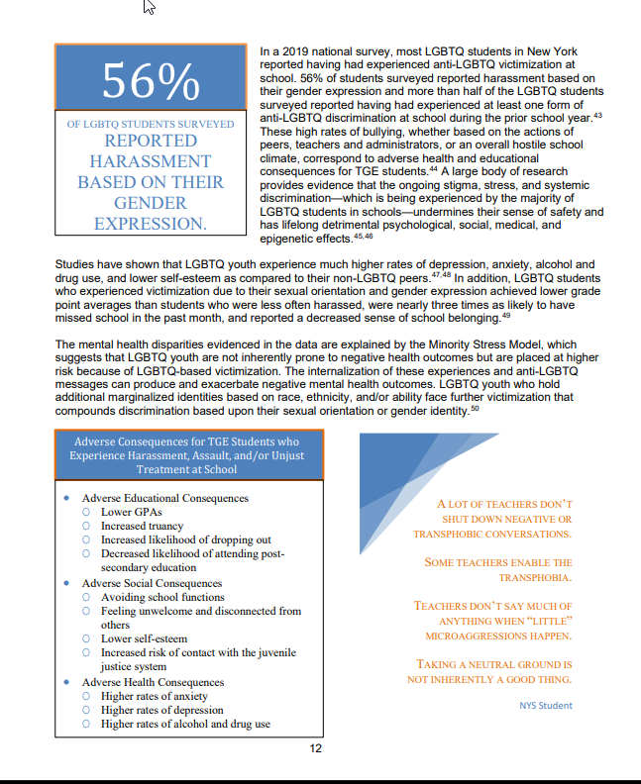
Last time together, we reviewed the introduction of the document and terms.
Notes:
Ryan

Slide 6
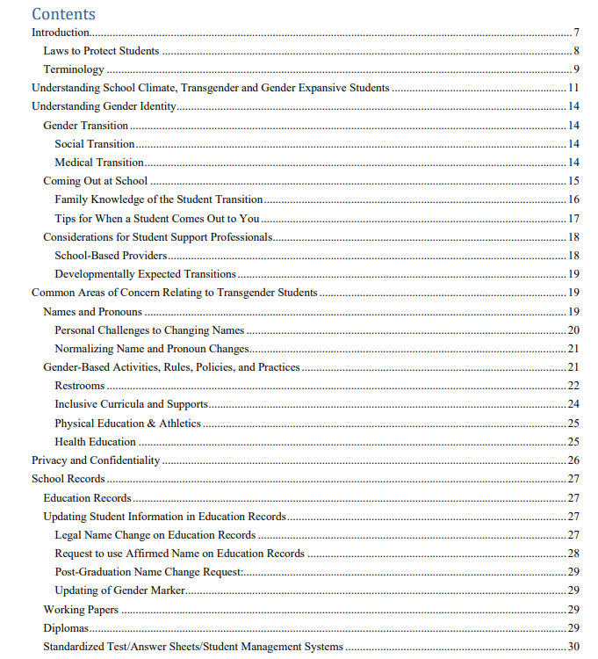
NYSED Creating a Safe, Supportive, and Affirming School Environment for Transgender and Gender Expansive Students
A: pg. 14- mid. 16 (stop at sub-heading)
B: pg. 16 (middle)- pg. 18 (bottom)
C: pg. 18 (bottom) of pg. 21 (bottom)
D: pg. 21 (bottom)- pg. 24 (middle)
E: pg. 24 (middle)- pg. 26 (middle)
F: pg. 26 (middle)- pg. 29 (top)
G: pg. 29 (top)- pg. 31
Notes:
http://www.p12.nysed.gov/dignityact/documents/Transg_GNCGuidanceFINAL.pdf

Slide 7
Professional Discussion
Take notice of your table group. Reference the section you are assigned. Individually, take 6-8 mins. To review your section.
Next, with your colleagues at your table discuss the following:
  What resonated with you?
  What is your school/district already doing in this area?
  What is a potential barrier you may foresee?
  What is one action step you can take in your district to implement this guidance?
Select a spokesperson for your group to report out 2 main highlights from your discussion to share with the whole group.

Slide 8
Let’s Share!

Slide 9
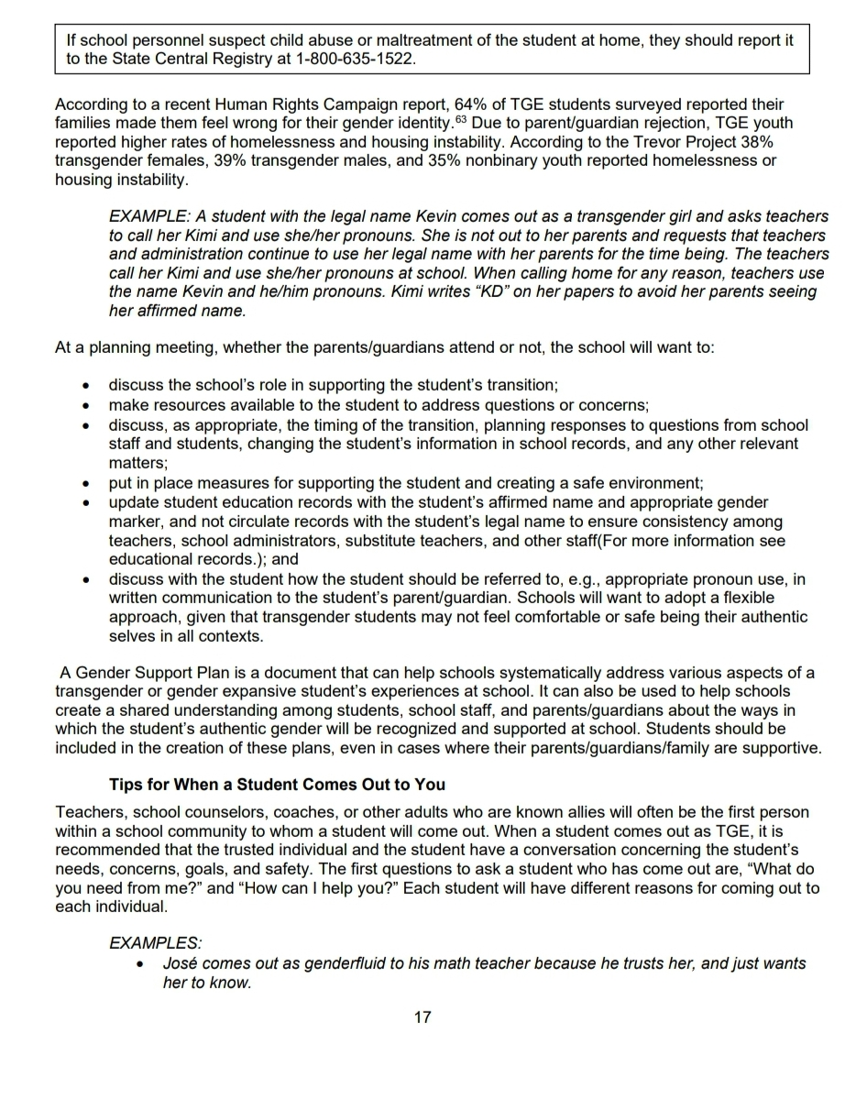
GENDER SUPPORT PLANS

Slide 10
NYSED Creating a Safe, Supportive, and Affirming School Environment for Transgender and Gender Expansive (TGE) Students (2023)
Impacts to districts can include:
As you update policies and practices review use of language (i.e. pronouns, etc.)
Development of student gender identity policies if there are none
Development of “Gender Support Plans” w/counseling service personnel
DASA Coordinator Training updated
DASA Training for all staff to be updated

Slide 11
How can we support developing policy around this?
Discussion for our next time together

Slide 12
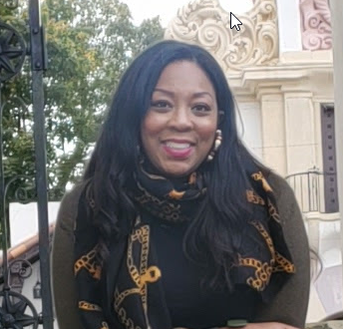
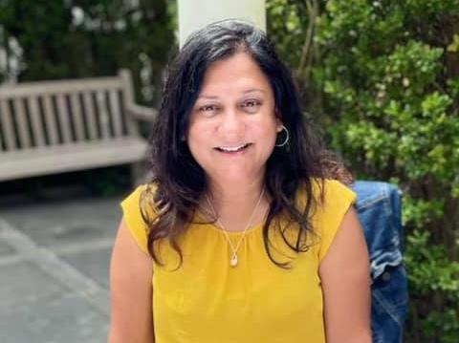
ESBOCES OFFICE OF DEI
EST. 2020
April Francis-Taylor (she/her)
Director of DEI
ESBOCES Office of DEI
Amanda Chansingh (she/her)
Admin. Coordinator of DEI Services
ESBOCES Office of DEI
CONTACT
ESBOCESDEI@ESBOCES.ORG
Notes:
Please introduce yourself!
Share: “After we review the agenda and objectives, we will do more introductions.”

