Slide 1


Phonics in the Early Years
Information to support every child in Owls Class to develop their reading and writing skills.

Slide 2

What helps your child to be ready for phonics?
The ability to hear and identify sounds that they can hear around them e.g. bird and animal noises, vehicle noises, instrumental noises etc.
The ability to change the sound of their voice or instrument e.g. playing with loud and quiet sounds, fast and slow sounds, bouncy and stretchy sounds etc.
The ability to identify rhyming words in the stories that are read to them eg. The mouse took a stroll through the deep dark wood. A fox saw the mouse and the mouse looked good. The Gruffalo by Julia Donaldson and Axel Scheffler
The ability to orally segment and blend words they hear e.g. d – o – g … dog
The ability to tune in to what we are hearing around us is so important … a sound or a spoken word!

Slide 3
What is phonics?
Phonics is a method for teaching the reading and writing of an alphabetic language. It is done by demonstrating the relationship between the sounds of the spoken language (phonemes), and the letters or groups of letters or syllables of the written language (graphemes).
When your child receives instruction in phonics they are provided with the opportunity to develop the skills they require to decode letters into their respective sounds, a skill that is essential for them to read unfamiliar words by themselves.
Your child’s ability to identify the relationship between the sound (phoneme) each letter or group of letters (grapheme) makes will support them to be able to ‘break down’ or segment a word to read or spell it and then to ‘put it back together’ or blend the sounds into a word that can be read.

Slide 4

How is phonics taught?
Phonics is taught daily in Owls Class and is the foundation of our English programme for all children in Reception, Year One and Year Two.
We follow the Ruth Miskin’s Read Write Inc. Phonics programme.
’Phonics teaches children to read accurately and fluently with good comprehension. They learn to form each letter, spell correctly, and compose their ideas step-by-step.’ www.ruthmiskin.com/en/programmes/phonics/
Your child will be introduced to 40+ sounds across three sets of sounds in a timely fashion.
Each lesson provides your child with opportunities to read, write and spell.
Read Write Inc. Phonics Parent video: What is Read Write Inc. Phonics? www.youtube.com/watch?v=sjlPILhk7bQ

Slide 5
Phonics – Sounds
In the early stages of reading and writing, your child should use there knowledge of phonics as the ‘go to’ strategy to support them. Your child should be encouraged to ‘sound out’ when they read and write.
As your child’s skills develop so will their ability to spot complex and unusual sound patterns e.g.
Digraph – 2 letters making one sound cow
Trigraph – 3 letters making one sound night
Split digraphs – 2 vowels with a consonant in between them cake.
It is incredibly important that your child uses and hears pure sounds.
It is best to focus on sounds and not letter names. Letter names are introduced formally later in the process.
Read Write Inc. Phonics Parent video: How to say the sounds www.youtube.com/watch?v=TkXcabDUg7Q

Slide 6
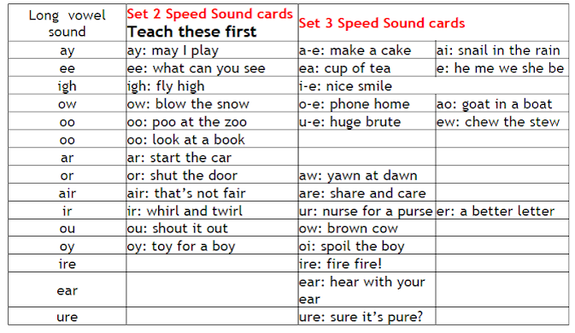
Phonics – Reading
Your child will learn the English alphabetic code: first they learn one way to read the 40+ sounds and blend these sounds into words, then they learn to read the same sounds with alternative graphemes (written forms).
They experience success from the very beginning. Phonic books are closely matched to their increasing knowledge of phonics and ‘tricky’ words and, as your child re-reads the stories, their fluency will increase.
Along with a thought-provoking introduction, prompts for thinking out loud and discussion, your child will be helped to read with a storyteller’s voice.
Set 2 and Set 3 Sound Comparison Grid

Slide 7
Phonics – Writing
Your child will write every day, rehearsing out loud what they want to say, before forming the letters of spelling the words using the correct graphemes (written forms) and ‘tricky’ words they know.
They will practise handwriting every day: learning correct letter formation and how to write legibly.
Your child’s composition (ideas, vocabulary and grammar) is developed by drawing on their own experiences and talking about the stories they read.

Slide 8

Read Write Inc. Phonics Set 1 Sounds
There are 31 sounds split into 6 teaching groups across the Set 1 sounds group.
Initially your child will be exposed to the single sounds and their corresponding letters.
Latterly they will be introduced to the first of the digraphs, sounds that are represented by two letters when in written form e.g. sh
Set 1.1. m a s d t
Set 1.2. i n p g o
Set 1.3. c k u b
Set 1.4. f e l h
Set 1.5. r j v y w
Set 1.6. z x sh th ch qu ng nk
Down the tower and across the tower

Slide 9
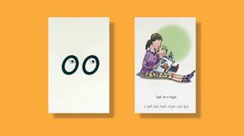
Read Write Inc. Phonics Set 2 Sounds
ay ee igh ow oo oo
ar or air ir ou oy
oo – look at a book
There are 12 sounds in the Set 2 sounds group.
This groups sounds are predominantly represented as digraphs, two letters together, in their written form e.g sh
This is the group introduces us to the concept of a trigraph, three letters that represent one sound e.g. igh

Slide 10
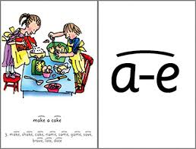
Read Write Inc. Phonics Set 3 Sounds
ea oi a-e i-e o-e u-e aw are ur er ow ai oa ew ire ear ure tion tious cious
a-e – Make a cake
There are 20 sounds in the Set 3 sounds group.
This groups sounds are predominantly represented as digraphs, two letters together, in their written form e.g ea and trigraphs, three letters that represent one sound e.g. are.
It is within this group that the split digraphs are introduced. A split digraph is where two vowels are separated by a consonant.
Additional sounds (to be introduced after Set 1, 2 & 3) : ue ie au e-e kn ck wh ph

Slide 11
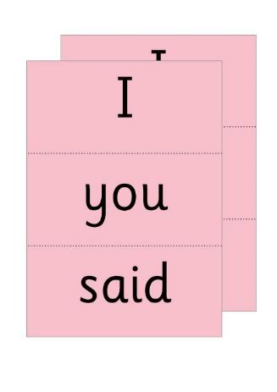
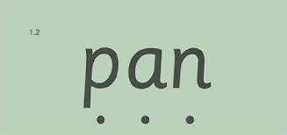
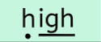
Phonics – Green Words & Red Words (Tricky Words)
Green Words
Red Words
Green words can be broken down into their component sounds (segmented) and then blended back together for reading and spelling.
Not all words can be blended or segmented meaning that your child will need to learn such words by sight.
Your child will be introduced to a number of these tricky words and will benefit from practising these at home.
Remember: some words are only red until such a time they become green as a new sound is learnt e.g. look then l – oo – k – look during Set 2.
Green words are initially presented to your child with ‘speed buttons’ on … dots for single sounds and dashes to indicate digraphs or trigraphs.

Slide 12

Phonics – Segmenting & Blending
Segmenting
Blending
The process of splitting words into their individual phonemes (sounds).
This allows your child to hear each sound in a word e.g. cat … c – a - t
Putting all the sounds together to read the word before you.
The phonemes (sounds) in this word are p – i – n.
Your child would read each sound and then blend them together into the word pin.
The process of segmenting and blending is done orally initially before we move onto showing your child green words in their written form.

Slide 13
End of Year Reading Expectations
ELG 01 & 02 – Listening, Attention, Understanding & Speaking
ELG 09 – Word Reading
Children listen attentively and respond to what they hear with relevant questions, comments and actions when being read to and during whole class discussions and small group interactions. Make comments about what they have heard and ask questions to clarify their understanding. Hold conversation when engaged in back-and-forth exchanges with their teacher and peers.
Children participate in small group, class and one-to-one discussions, offering their own ideas, using recently introduced vocabulary. Offer explanations for why things might happen, making use of recently introduced vocabulary from stories, non-fiction, rhymes and poems when appropriate. Express their ideas and feelings about their experiences using full sentences, including use of past, present and future tenses and making use of conjunctions, with modelling and support from their teacher.
Children say a sound for each letter in the alphabet and at least 10 digraphs. Read words consistent with their phonic knowledge by sound-blending. Read aloud simple sentences and books that are consistent with their phonic knowledge, including some common exception words.

Slide 14
A word on reading …
Our aim is to create a love of reading and sharing books and stories in your child and every child in Owls Class.
How can you help?
Be a reading role model!
Find a time that suits you and your family to share your child’s reading book and/or other reading material.
Read your child’s reading book to them and/or other reading material … children need to be read to as well as listened to … no matter how old they are!!
Please let us know when you have read to your child by noting in their diary. Thank you.

Slide 15
End of Year Writing Expectations
ELG 6 & 7 – Gross Motor Skills & Fine Motor Skills
ELG 10 - Writing
Children negotiate space and obstacles safely, with consideration for themselves and others. Demonstrate strength, balance and coordination when playing. Move energetically, such as running, jumping, dancing, hopping, skipping and climbing.
Children hold a pencil effectively in preparation for fluent writing – using the tripod grip in almost all cases. Use a range of small tools, including scissors, paint brushes and cutlery. Begin to show accuracy and care when drawing
Children write recognisable letters, most of which are correctly formed. Spell words by identifying sounds in them and representing the sounds with a letter or letters. Write simple phrases and sentences that can be read by others.

Slide 16
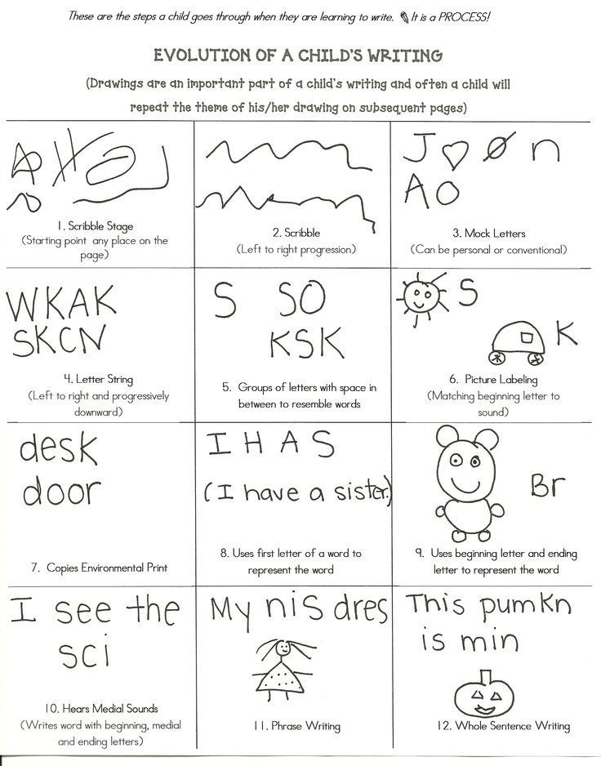
A word on writing …
Note: Writing has two parts the physical formation of marks and the content of a written piece e.g. words, spelling, ideas etc.
Before formal hand writing comes mark making. Children make purposeful marks using clockwise and anticlockwise movements, straight lines and curves. This is an important part of the physical writing process.
Before they can form letters your child needs sound gross and fine motor skills to meet the physical demands of writing.
It is a process and one not to be rushed.
All children are individual.

Slide 17
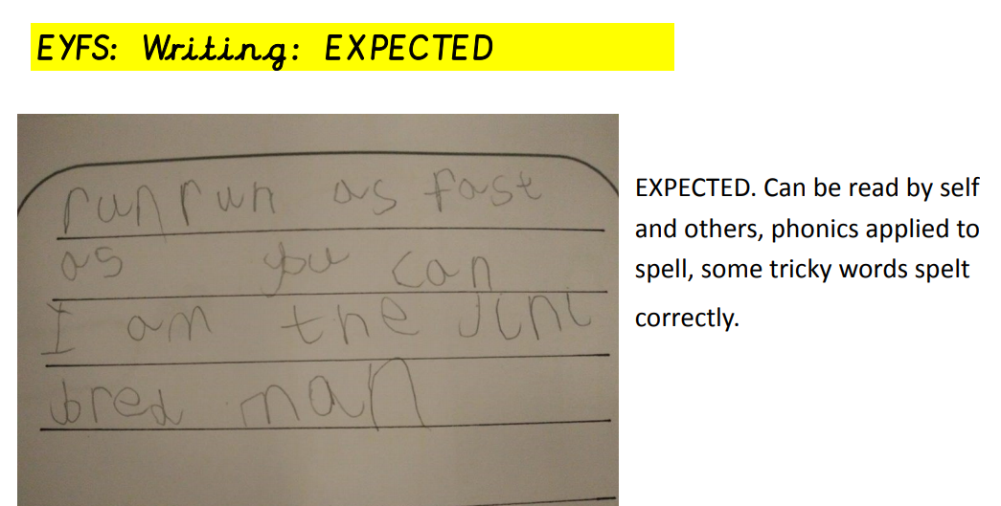
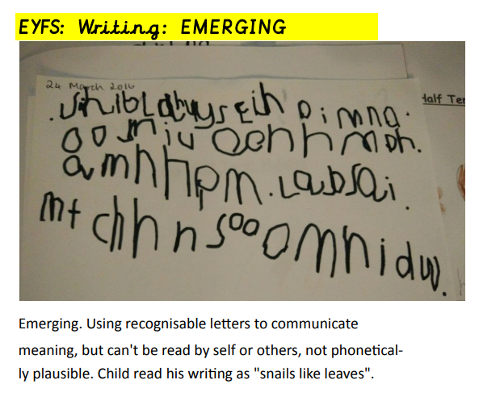
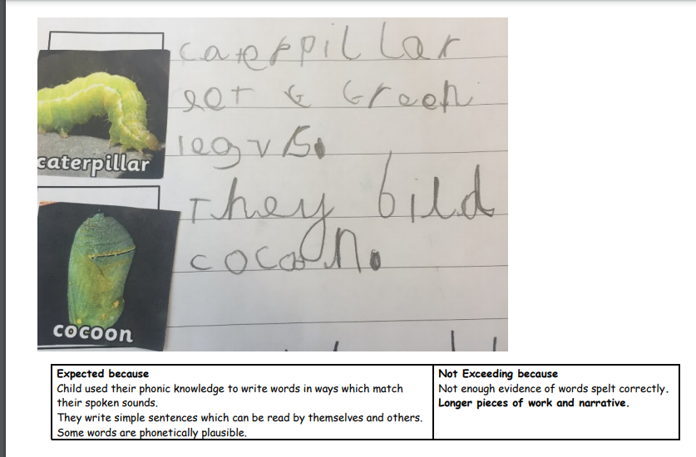
Writing Exemplars
Take a look at the sort of writing we would be expecting to see at the end of the year ☺

Slide 18


