Slide 1


Positive Behavior Interventions and Supports (PBIS)
Foundational Training
Notes:
Thank you for joining us today learning all about Positive Behavior Interventions and Supports or PBIS.

Slide 2


Outcomes:
Participants will gain a foundational understanding of PBIS and its purpose in the Kyrene School District.
Participants will learn the essential components of PBIS:
  school-wide expectations
  positive reinforcement
  positive relationships
Notes:
Participants will gain a foundational understanding of PBIS and its purpose in the Kyrene school District.
Participants will learn the essential components of PBIS:
Creating & teaching school-wide expectations
The use & purpose of positive reinforcement
Building & sustaining positive relationships

Slide 3

Proficiency Scale
4 I understand and have implemented PBIS. I can help others understand PBIS.
3 I understand PBIS but have limited experience with implementation.
2 I have a basic understanding of PBIS but have no experience with implementation.
1 I have limited to no understanding of PBIS.
Notes:
Please take a moment to rate your personal proficiency score regarding PBIS.
Some of you may not be familiar with PBIS at all, while others have heard of it, or implemented it directly in your prior classrooms.

Slide 4

Multi-Tiered Systems of Support (MTSS) Defined
Whole-school, data-driven, prevention-based framework for improving academic, behavioral, and social emotional outcomes for EVERY student through a tiered continuum of evidence-based practices & systems
https://www.cde.state.co.us/mtss/overviewtrainingmaterials-fall2014
Notes:
PBIS is part of the Multi Tiered Systems of Support (MTSS) framework. MTSS is a whole school, data-driven, prevention-based framework for improving academic, behavioral, and social emotional outcomes for EVERY student through a tiered continuum of evidence-based practices and systems.
(Click) During the duration of this presentation today, we will focus our attention primarily on supporting students with behavioral supports.

Slide 5
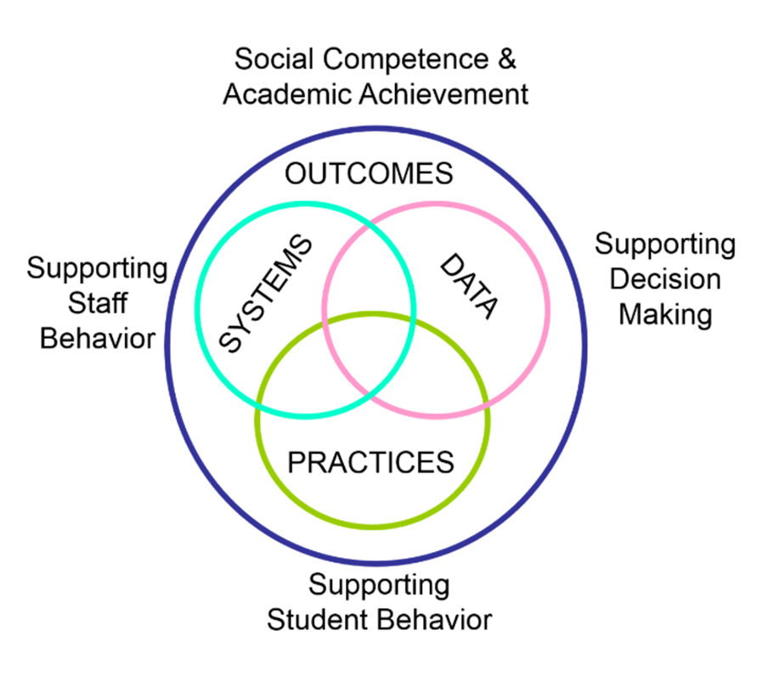
What is PBIS?
Positive Behavior Interventions and Supports
  Evidence and Research-Based Framework
  School-wide, Team-based Approach
  ALL Staff, Students, and Settings
  Data Driven
  Focuses on Prevention
Notes:
What is PBIS? PBIS stands for positive behavior interventions and supports. PBIS is an evidence-based and researched-based framework which originates from the public health prevention model. PBIS provides supports for all students and staff, in all settings. The essential components of the PBIS framework are: (click) using data to support team-based decision making, (click) incorporating evidence-based practices to support student behavior, (click) and implementing consistent school-wide systems and expectations that support staff behavior.

Slide 6
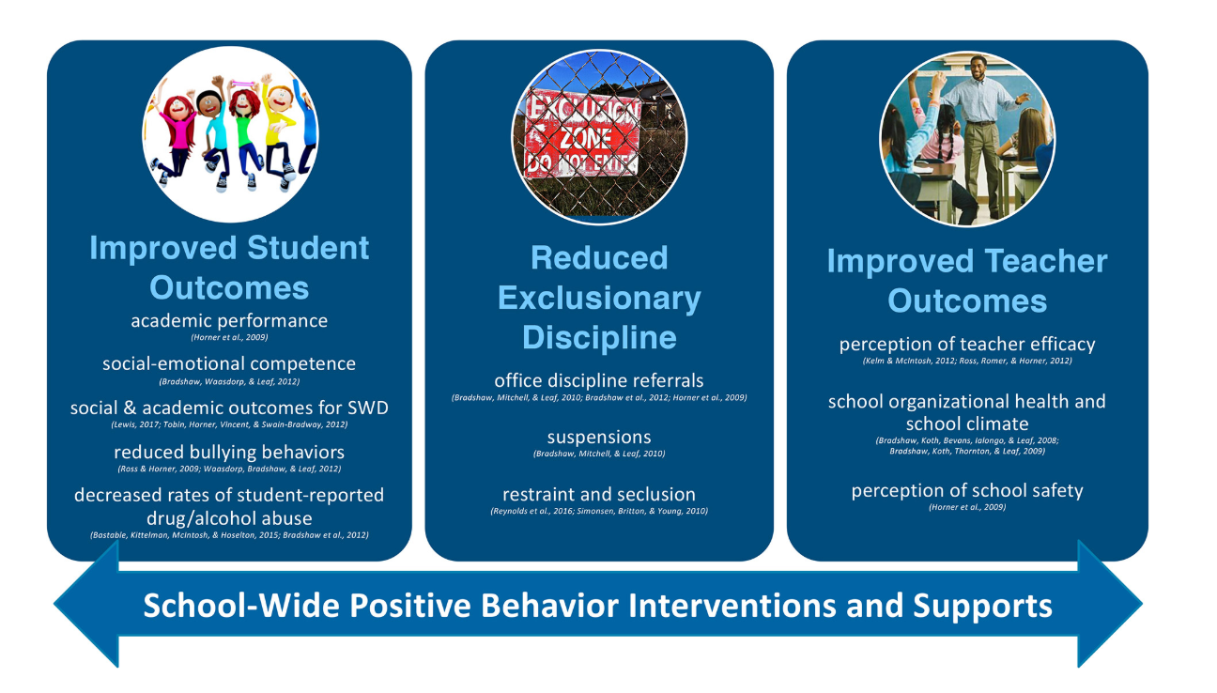
Notes:
PBIS has over 3 decades of research that has demonstrated many positive outcomes. Click. PBIS has shown to improve student outcomes. This includes: increasing academic performance and social emotional competence as well as decreases bullying behavior. Click. PBIS reduces exclusionary discipline. PBIS focuses on keeping students in the learning environment and reduces office discipline referrals and suspensions. Click. Teachers also report a greater sense of efficacy and increased feelings of school safety while implementing PBIS.

Slide 7
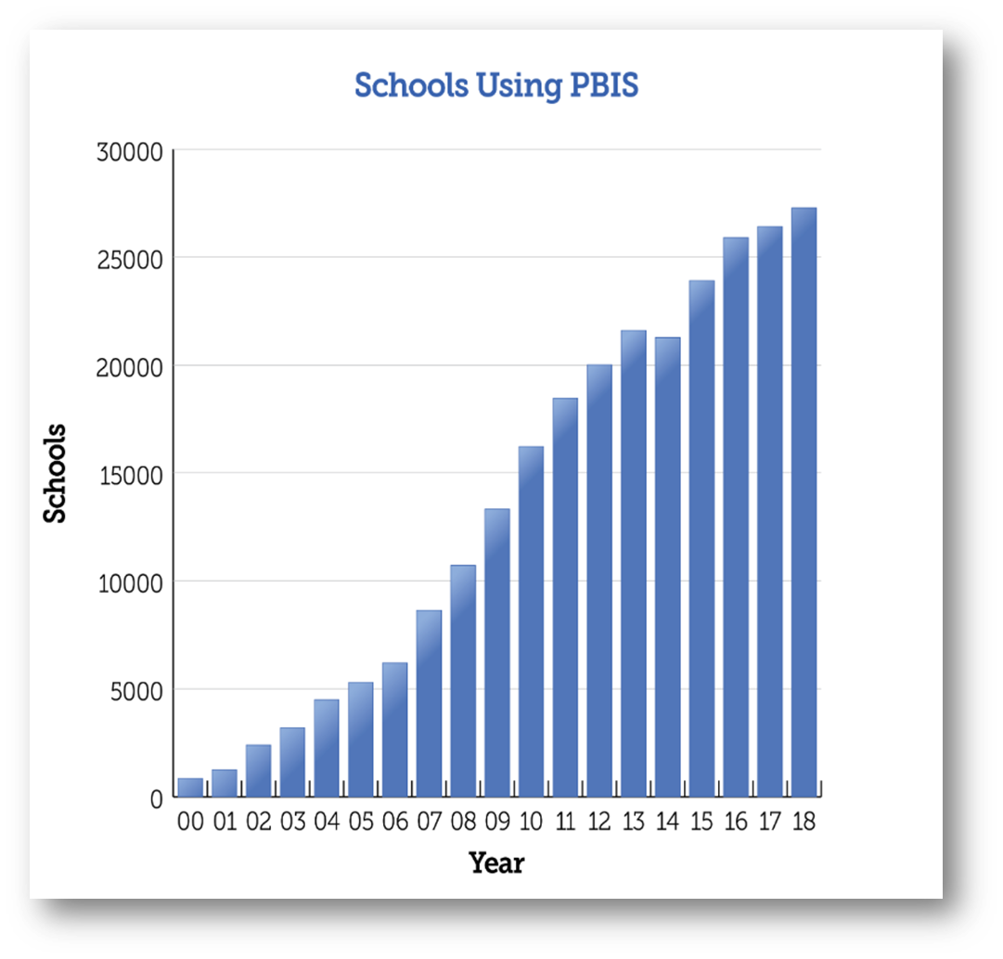
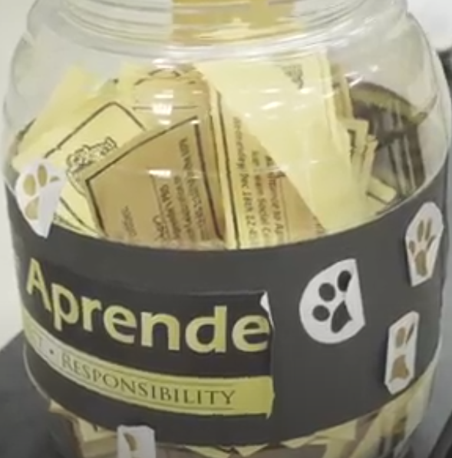
PBIS in the Kyrene School District
Implemented at all 26 schools and our buses
Notes:
Because of its strong evidence-based outcomes, PBIS school implementation has rapidly grown around our Nation and worldwide.
Here at the Kyrene School District, PBIS is implemented and essential in all of our 26 schools as well as our transportation department.

Slide 8
Tier 3 Intensive Individual Interventions:
Specialized
Individualized
Systems for Students with High-Risk Behavior
Multi-Tiered Systems of Behavior Support
~5%
~15%
Tier 2 Targeted Group Interventions:
Specialized Group
Systems for Students with At-Risk Behavior
Tier 1 Universal Interventions:
School-/Classroom-
Wide Systems for
All Students,
Staff, & Settings
~80% of Students
Notes:
Within a Multi Tiered System of Support, All students and staff receive and participate in PBIS which is Tier 1 or Universal interventions (click). Within a strong Tier 1 PBIS framework, typically 80% of students will be responsive to these systems and supports. Tier 2 is for a smaller percentage of students (click) , typically 10-15% that need more support, in addition to Tier 1 interventions. (click) Tier 3 is intensive individualized behavior support that is for 1-5% of the student population.
Tier 1 is the foundation and the most critical component of PBIS. When this tier is sufficient and consistent, the MTSS triangle will look more like this, a balanced, prevention-based framework where the majority of students are responsive with Universal interventions.

Slide 9
Check for Understanding
What does PBIS stand for?
Which example below is not a part of PBIS?
Data based decision making
Setting school wide behavior expectations
Punitive and exclusionary discipline measures
Positive reinforcement and acknowledgements
Notes:
Now, it’s time for a quick check for understanding.
What does PBIS stand for? – Positive Behavior Interventions and Supports
Which example below is not a part of PBIS?
Data based decision making
Setting school wide behavior expectations
Punitive and exclusionary discipline measures
Positive reinforcement and acknowledgements

Slide 10
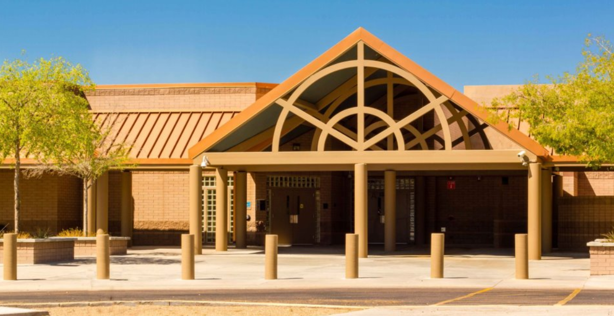
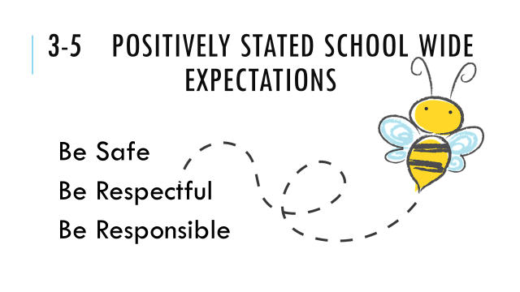
School Wide Behavior Expectations
Notes:
One major component of PBIS is setting school wide behavior expectations. These can be seen and heard at each Kyrene school around our District.

Slide 11
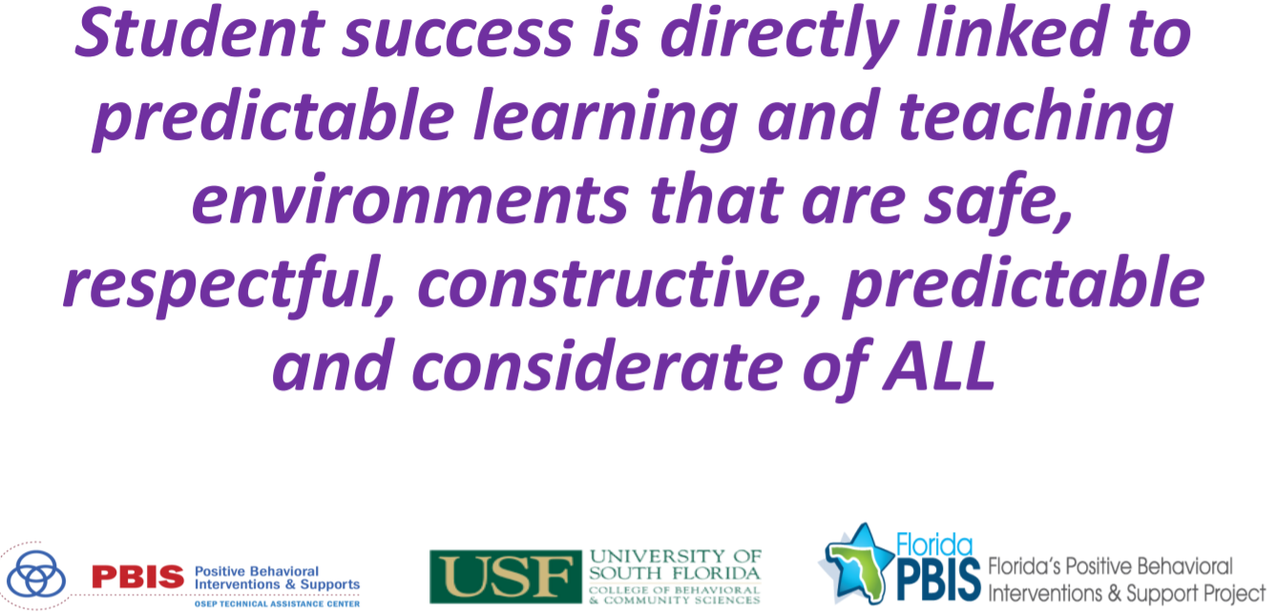
-Dr. Heather George, Research Professor and Co-Director, University of South Florida
Notes:
Read Slide- this is an essential part of PBIS

Slide 12
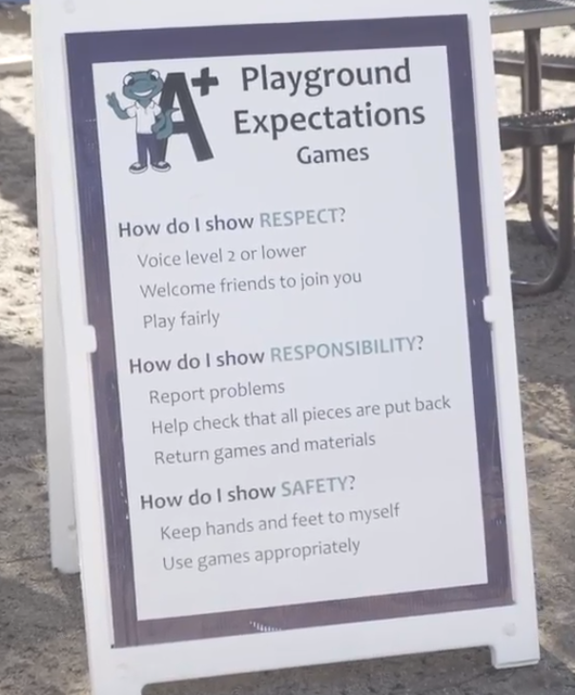
School Wide Expectations
Schools have created and continue to revise their school wide PBIS expectations in Kyrene
ALL staff, ALL students, ALL settings
Expectations are a vital part of the school culture
Notes:
Schools have created and continue to revise their school wide PBIS Expectations in Kyrene. Setting and reinforcing positive behavior expectations is a way to use a common language that provides a predictable and safe environment. All staff and students are aware of and engage in these expectations around the school campus. These expectations are a vital part of the school culture.

Slide 13
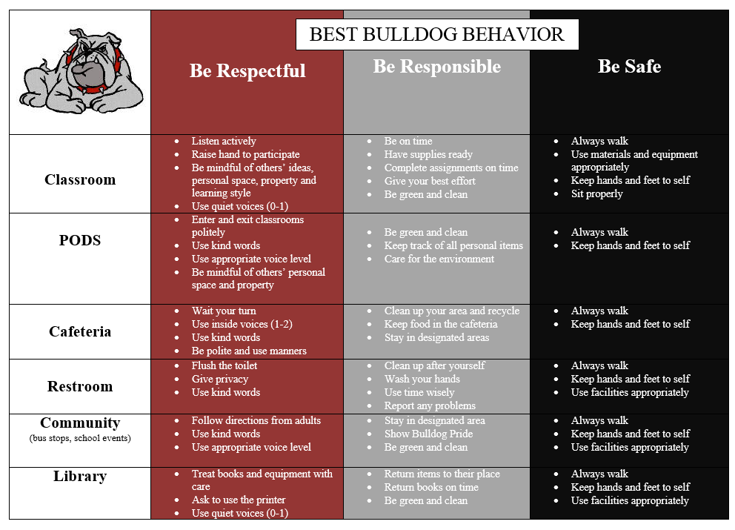
Notes:
Each school site has a PBIS matrix which contains their school wide expectations for each common area. Behavior Expectations are written and stated to be comprehensible for all students. Each expectation is positive, specific, observable, and age appropriate. This ensures that students can learn and demonstrate the expected behaviors. Let’s take a look at this example from one of our Kyrene Middle schools. Click.
In the cafeteria, being responsible means: cleaning up your area and recycling, keeping food in the cafeteria, and staying in the designated area. Notice the expectations are written to state what we want the students to do, for example “keeping food in the cafeteria” rather than what we don’t want them to do, “don’t take food into the classroom”. It is also imperative that each expectation is taught through modeling and repetition to ensure that students understand how to demonstrate the expectation.

Slide 14
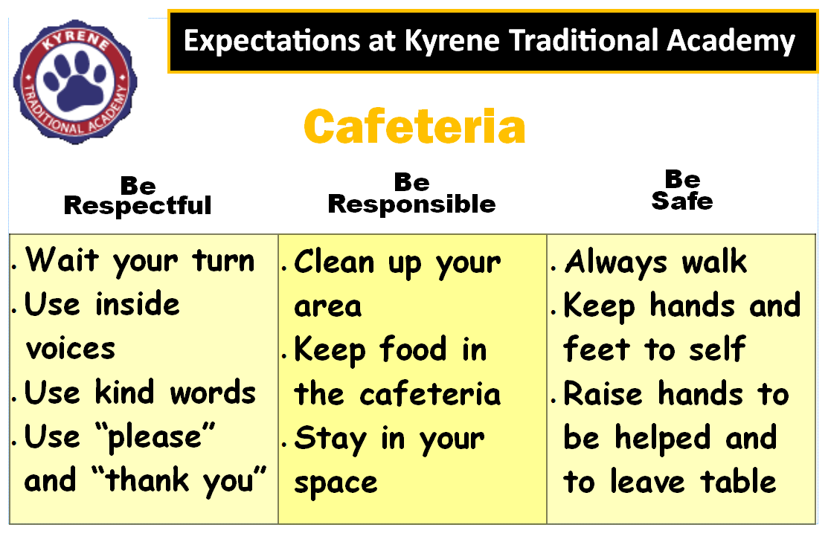
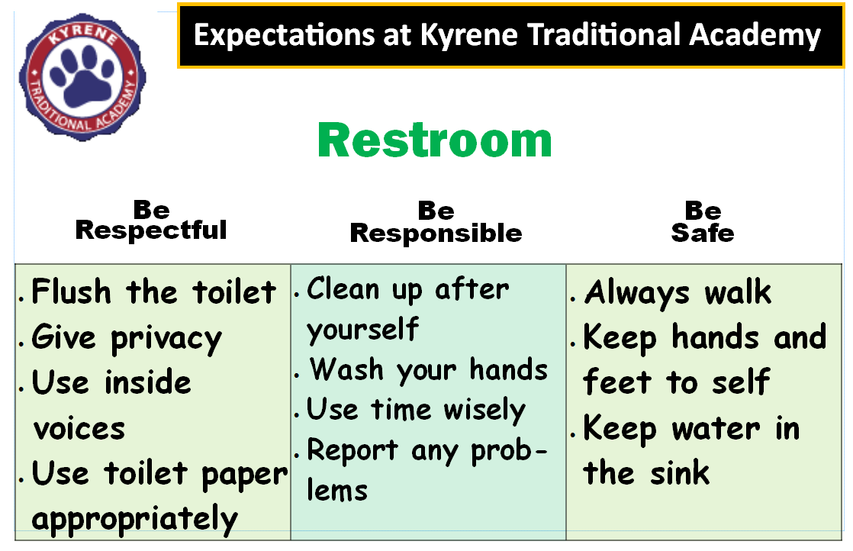
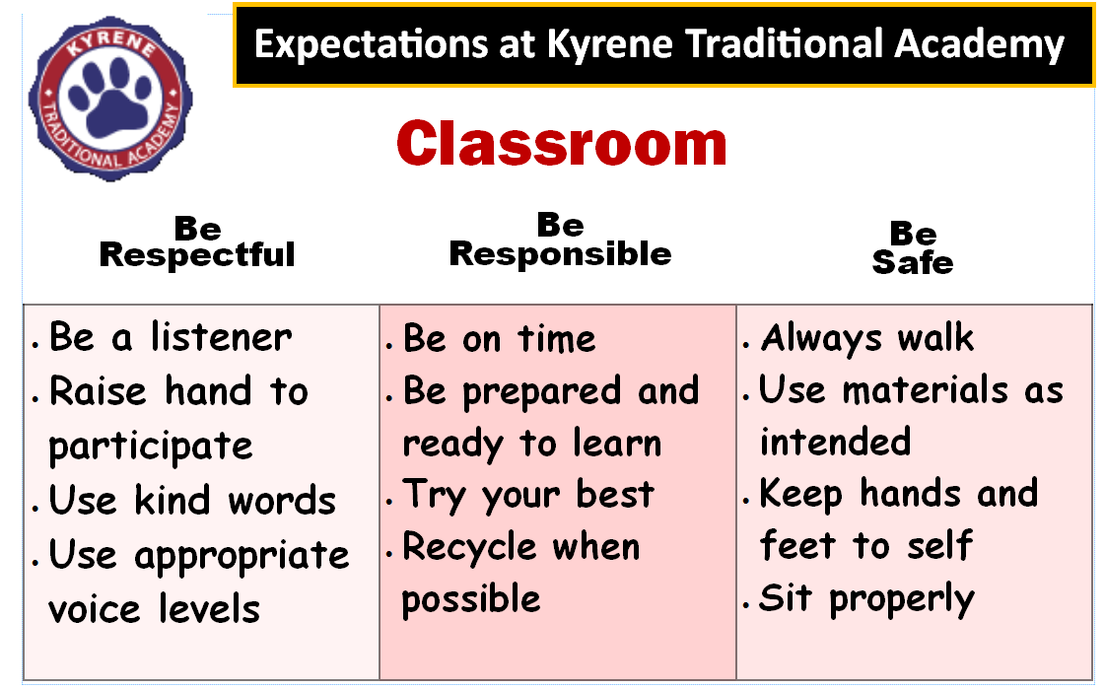
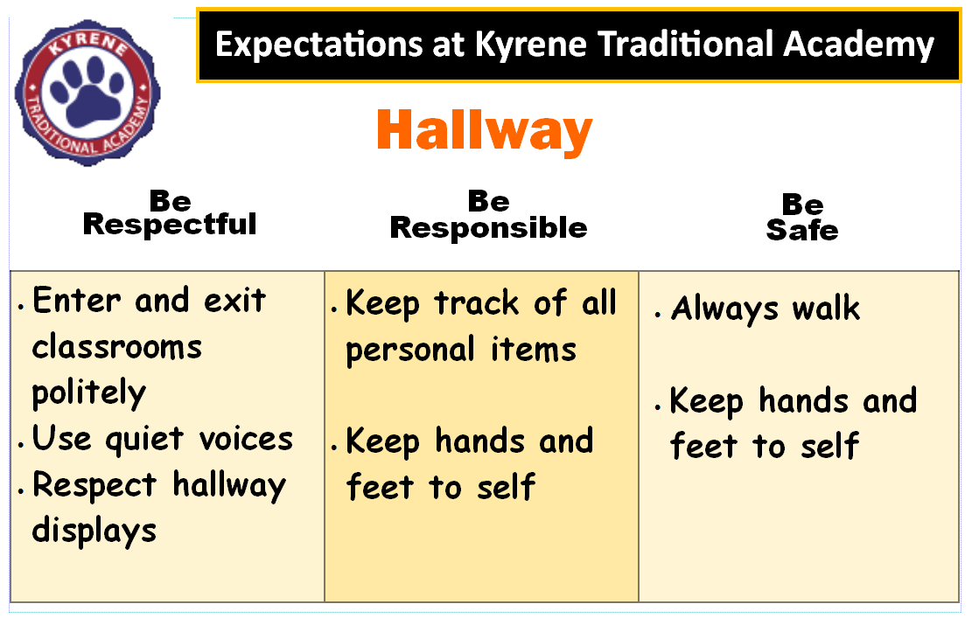
Notes:
At your school site, you will observe PBIS expectations posted in all areas around the building, as you can see in the examples.
Please take a moment to look over these PBIS expectations. Remember, each statement should be written to be: positive, specific, observable, and age appropriate (easier to understand for younger students)
New Teacher Ambassadors- spend a few minutes on this slide looking over examples. If new to PBIS, ask them how these expectations could help improve school-wide behavior?

Slide 15
Check for Understanding
PBIS School-Wide expectations are written to be Positive, Specific, Observable, and Age Appropriate.
Pick two expectations below that follow these guidelines…
We show respect in the hallway by walking silently facing forward, keeping hands and feet to selves.
We demonstrate responsibility in the classroom by not shouting out during instruction time.
We show safety on the playground by going down the slide facing forward.
Notes:
New Teacher Ambassadors: Answers are highlighted below
We show respect in the hallway by walking silently facing forward, keeping hands and feet to selves.
We demonstrate responsibility in the classroom by not shouting out during instruction time.
We show safety on the playground by going down the slide facing forward.

Slide 16
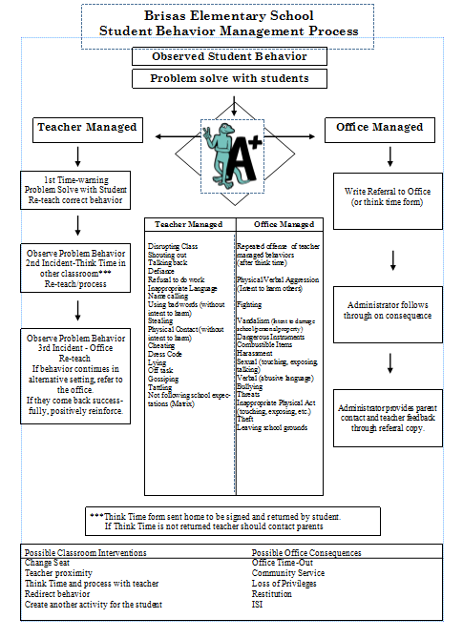
Behavior Expectations
Major – office handled (office discipline referral)
Minor – teacher handled
Notes:
For Discipline, each school in Kyrene has a well defined minor and major discipline flow chart. This document defines what constitutes a “major” behavior (assault, theft, property damage) from a “minor” behavior (shouting out in class, getting out of seat) and steps for how to handle challenging behavior in and outside of the classroom setting.
New Teacher Ambassador- Please have your school’s discipline flow chart and spend a few minutes looking it over with new teachers.

Slide 17

PBIS School Teams
Meets monthly
Administration, teachers, counselors, psychologists, and Behavior Intervention Teacher Specialist (BIT)
Data based decision making
Regular communication with staff
Action Planning
Notes:
Data based decision making is a vital component of PBIS.
Each school has a PBIS team on campus typically made up of: at least one administrator, teachers, counselors, psychologist, and the behavior intervention teacher specialist (BIT). The PBIS team is responsible for reviewing school-based behavior data monthly (office discipline referrals), communicating PBIS information to staff, and action planning.

Slide 18
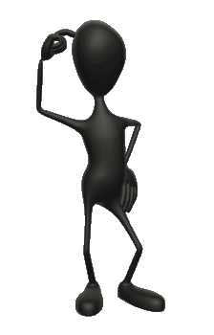
If a student doesn’t know how to read, we --
If a student doesn’t know how to swim, we --.
If a student doesn’t know how to multiply, we --
If a student doesn’t know how to drive, we --
If a student doesn’t know how to behave, we --
Why is the last sentence not as easy to answer as the others?
Behavior needs to be taught, just like any other skill!
Notes:
Take a moment and finish these statements to yourself as I read them out loud.
New Teacher Ambassador: Discuss why the last statement is harder to answer. ****As a reminder, behavior should be taught, just like any other skill.

Slide 19
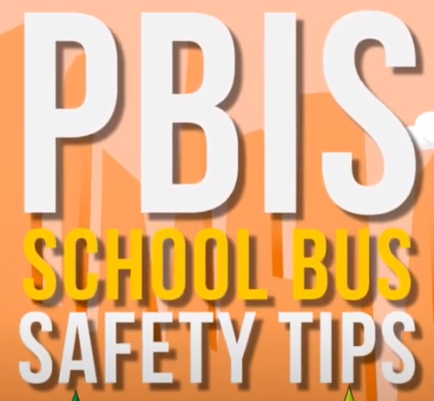
We Teach the Expectations
School wide lesson plans
School wide overview
School expectation videos
  Staff lead
  Student lead
  Examples and non-examples
Notes:
Behavior is a learned skill and needs to be taught, just like academics. There are many ways all schools and staff teach school wide expectations. These can include but are not limited to: detailed lesson plans for teaching behavior in each school location, making school wide expectation videos, and holding assemblies. Behavior expectations should be taught at the beginning of the year, after a school break, and throughout the year anytime a re-teach is necessary.
When it comes to teaching expectations in your classroom, be the example! Practice, practice, practice! When teaching expectations show tell and describe what is expected. Provide many opportunities to practice the skills. Monitor students and give them feedback on their behavior. Acknowledge students who are meeting the expectations.
New Teacher Ambassadors- if there is time, please watch the Kyrene bus expectation video
https://www.youtube.com/watch?time_continue=1&v=QvYCO6-eZjA&feature=emb_logo

Slide 20
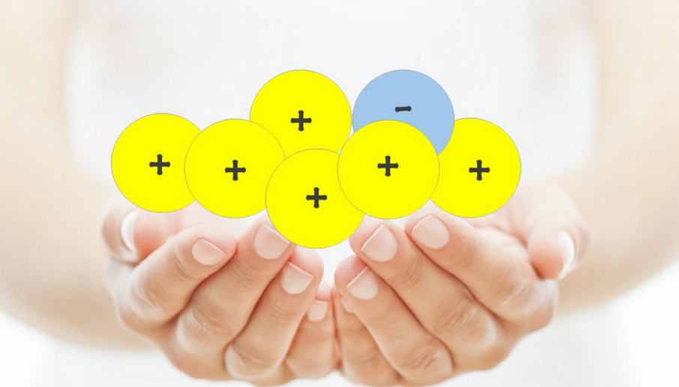
The Power of Positive Reinforcement
Types of Reinforcement:
verbal
tangible
attention (your time)
Behavior to Reinforce:
effort
positive choices
any behavior you would like to see continue
Notes:
Research indicates that you can improve behavior by 80% just by pointing out what someone is doing correctly. An effective practice that is embedded in all of our school systems through PBIS is to focus on what students are doing well. This is called positive reinforcement. When we spend more time to acknowledge the positive behavior, we are encouraging more positive behavior to continue. Your positive interactions with students should outweigh the corrections, or negative reinforcement. Research shows that positive reinforcement should be provided on a 5 to 1 ratio, meaning 5 positive interactions to 1 negative interaction.

Slide 21

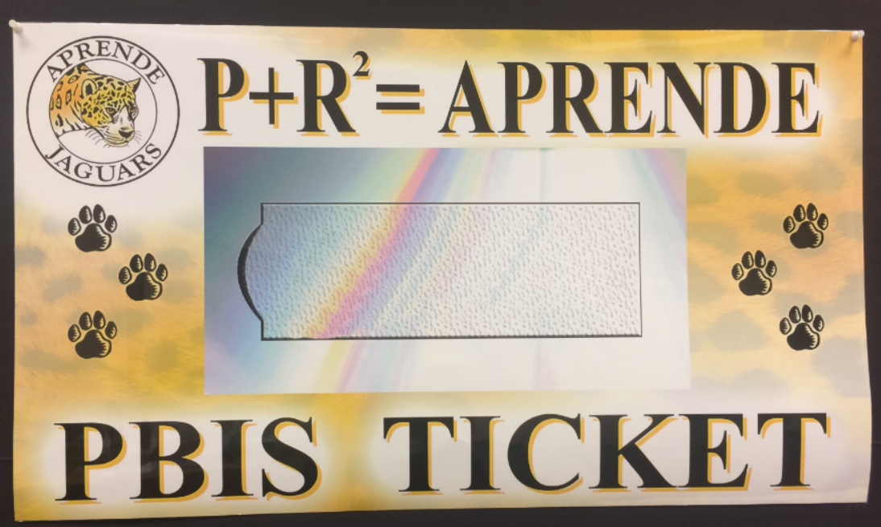
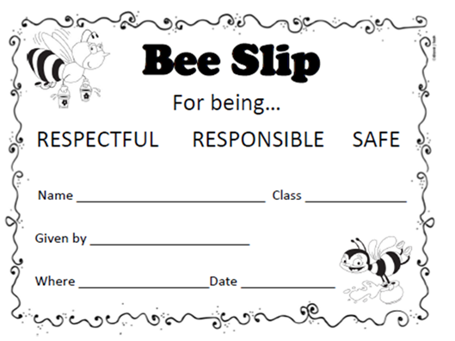
We Reinforce Expectations
Every school in Kyrene has a way to recognize ALL students on their campus for demonstrating positive behavior.
Notes:
Each school in Kyrene has a way to recognize ALL students on campus for demonstrating positive behavior.
When we provide positive reinforcement, we give Regular and frequent feedback, increase the likelihood that desired behaviors will be repeated, foster a positive school climate, and increase instructional time. Every staff member gives out tickets to any student at any time in any location for observing behavior that is encouraged campus wide!
New Teacher Ambassadors- if time, show your school’s PBIS ticket and briefly state how it is used throughout your school.

Slide 22

3 Steps for Positive Reinforcement
1. Verbal praise
2. Name and expectation
3. Observed behavior
Great job, (Student name), for walking forward in the hallway and showing safety.
THEN, give out ticket!
Notes:
When recognizing positive behavior with your school’s PBIS ticket, it is important to follow these three steps first. Remember, without these steps, the ticket is just a piece of paper and isn’t nearly as meaningful or effective. With these three steps, we state: a verbal praise or positive language, the student’s name and the expectation followed, and the observed behavior. Sounds like a lot, but can be combined seamlessly into one sentence. Here is an example (read example). The goal of using a ticket for reinforcement is for students to learn what expected behavior they demonstrated and how it is connected to your PBIS school matrix. In the example above, the student learns through reinforcement that when he or she walks in the hallway facing forward (the observed behavior) that this is showing school safety (the expectation).

Slide 23
Examples and Non-Examples:
I appreciate you keeping your hands to yourself, (name). That’s showing respect.
I see you, (name) putting your materials away. I appreciate your safe choices!
Here’s a ticket for being respectful.
Good job putting your materials away.
Notes:
Here are a few examples and non-examples of providing positive reinforcement with a ticket. Non-examples are: Here’s a ticket for being respectful. What’s missing? With this learning opportunity, students have been told that they were just respectful but may not be clear what they actually did that was respectful. Another non-example, Good Job putting your materials away. The teacher states the observed behavior (putting materials away) but does not connect the observed behavior with a PBIS expectation (showing responsibility).
Here are a few examples with all 3 steps: read examples. The goal is to hit all three steps, but there is freedom and flexibility to individualize for what you are comfortable doing. Above all, like any skill, it takes practice but will be beneficial for you and your students in the long run.

Slide 24
Take time to practice!
Fill in the blank exercise:
Great job, (name) , you showed (expectation), by (observed behavior, what the child did).
Awesome job (name), I heard you say (observed behavior), that’s showing (expectation).
Notes:
Let’s take time to practice! Please take a moment to complete these fill in the blank statements using a sample student name, expectation, and observed behavior.

Slide 25
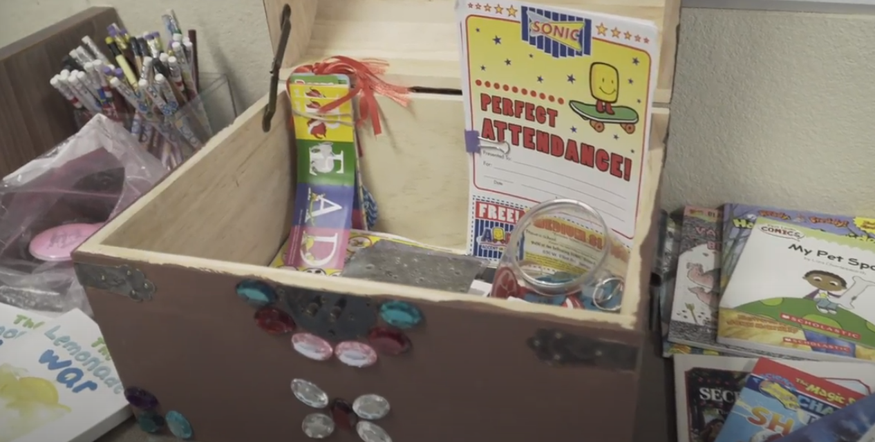
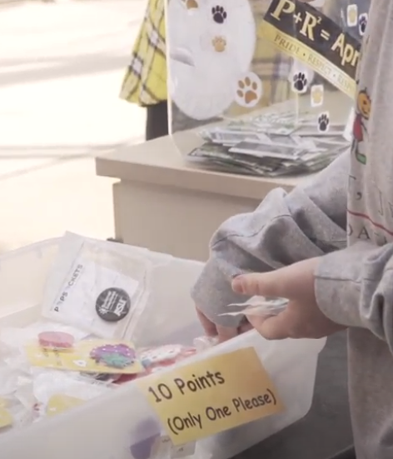
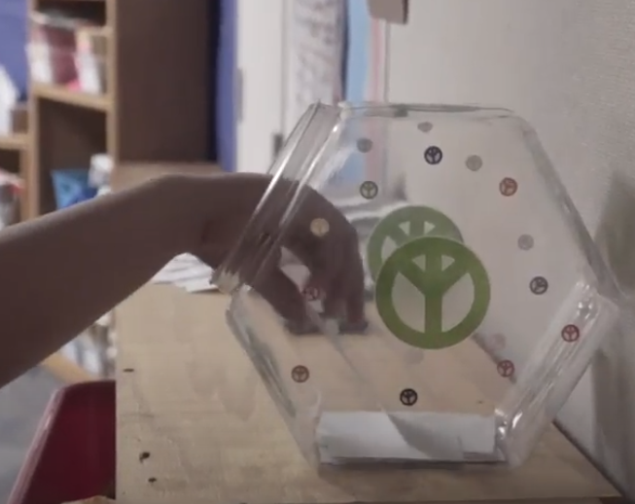
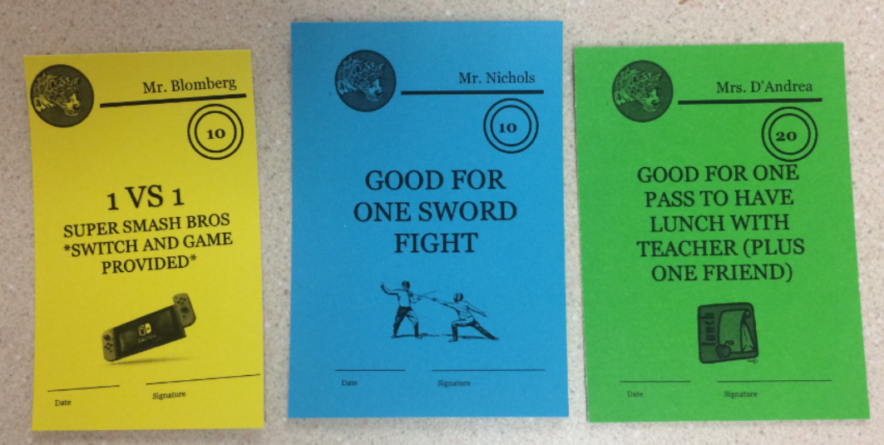
Monetary/Non-Monetary Incentives
School Store Raffles Quarterly Drawings | Lunch bunch with friends and a teacher Principal recognition Certificate Reading tickets on the announcements Game time Certificate
Notes:
Tickets are typically tied to larger classroom and school-based incentives. Remember, incentives do not need to cost money to be effective!
New Teacher Ambassadors- take a moment to share a few school-based and classroom based incentive systems you use at your school.

Slide 26

Building Positive Relationships
“There is no more effective neurobiological intervention than a safe relationship.”
-Dr. Bruce Perry, researcher, child psychiatrist, and author
Notes:
Positive relationships make a difference in our students’ lives. Research has shown that one positive relationship with a trusted adult can help change the trajectory of student’s lives in a positive way, even with students that have experienced wide ranges of trauma and setbacks. Building and sustaining relationships with students is not a “one and done” concept. It takes time, continuous effort, and consistency. To help understand this notion, we can picture each of our students as having invisible banks. Throughout the day, take time to make small deposits into these banks with positive reinforcement (could be a simple as a smile). Remember some students may require more deposits than others.

Slide 27
Building Positive Relationships
I notice statements…
  I noticed that you’re wearing a ____________ (external).
  I noticed that you helped a student with his backpack this morning (internal).
Curiosity questions/statements…
  “I’m curious, what did you have for dinner last night?”
  “favorite” questions
  “I’m curious about what just happened in the hallway. Please tell me about it.”
Share something!
Notes:
Here are a few quick and simple techniques with making daily deposits into your students’ well-being banks.
Read slide

Slide 28
Outcomes:
Participants will gain a foundational understanding of PBIS and its purpose in the Kyrene School District.
Participants will learn the essential components of PBIS:
  school-wide expectations
  positive reinforcement
  positive relationships
Notes:
Let’s take time to review our outcomes for today:
Participants gained a foundational understanding of PBIS and its purpose in the Kyrene school District.
Participants learned the essential components of PBIS:
school-wide expectations
The use & purpose of positive reinforcement
Building & sustaining positive relationships

Slide 29
PBIS Support
School | District | State and More
Administrator PBIS School team School Behavior Intervention Teacher | Sharyn Weinheimer - sweinheimer@kyrene.org 480-541-1261 | www.pbisaz.org www.pbis.org
Thank you!
Notes:
For more information and support regarding PBIS at your school, in Kyrene School District, and our state, please refer to the resources and names above for more help. Thank you for joining us today for our Kyrene School District PBIS Foundational Training.

