Slide 1


Strategic Planning
Data Retreat

Slide 2
Once you get settled, please take a moment to get to know each other at your tables….
Your name & role
What is/was your high school experience like? What is/was most impactful in a positive way? What is/was most challenging?
If you are no longer in high school, how have those experiences shaped you as an adult?

Slide 3

Welcome
Superintendent Brian Waterman

Slide 4
Group Norms/Agreements
Listening (with intent),
Openness (Take risks. Embrace perspectives and information from others.)
Empathy (Seek to understand. Keep personal stories and disclosures confidential)
Patience (Be kind to yourself; give yourself the gift of time to learn, grow, and connect with colleagues)
What is learned here leaves here!

Slide 5

Equity Lens in Action: Apply These 3 Questions in the Decision-Making Process
What is the action/policy/decision in question?
Who is centered in the discussion? Who is missing?
How do we maximize opportunities and eliminate barriers?

Slide 6

FOUNDATION OF CONTINUOUS IMPROVEMENT
Pillars | Guiding Question
MISSION | What is our fundamental purpose; why do we exist?
VISION | What must we become in order to accomplish our fundamental purpose?
VALUES | How must we behave to achieve our mission, vision and goals?
GOALS | How will we know if we are making a difference?

Slide 7
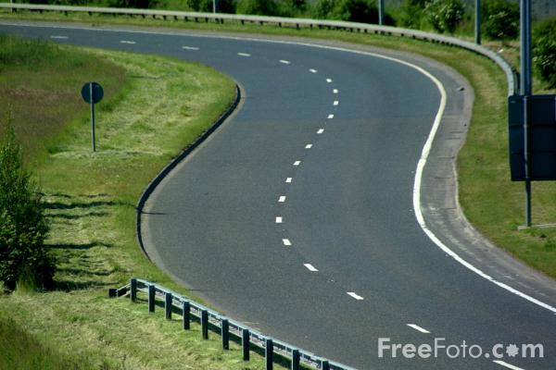
It is good to have an end to journey toward;
but it is the journey that matters in the end.
Ursula K. LeGuin 1999
WHERE DO WE WANT
TO BE?
HOW DO WE GET FROM
WHERE WE ARE TO
WHERE WE WANT TO BE?
WHERE ARE WE NOW?
CONTINUOUS IMPROVEMENT

Slide 8
PART ONE: Determine the current state of the district – Where are we now?
STRENGTHS
WEAKNESSES
OPPORTUNITIES
THREATS
State of
District
Environmental
Scan
Perceptions
Performance
Data
School/
Community
Feedback

Slide 9
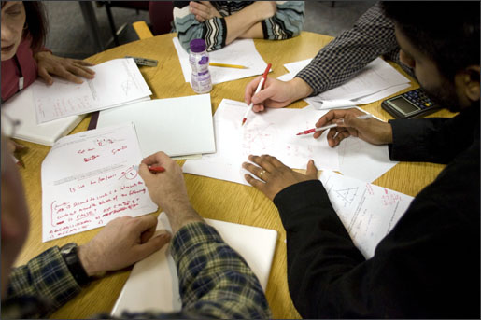
Data Retreat Outcomes
Review and discuss perceptions
Paint a data picture of the district to develop a shared understanding of our performance results. Identify information that is trending in the right direction and information that may need attention and improvement
Develop a SWOT analysis to identify our strengths, weaknesses, opportunities and threats.
Preview NEXT STEPS and the Vision Retreat

Slide 10
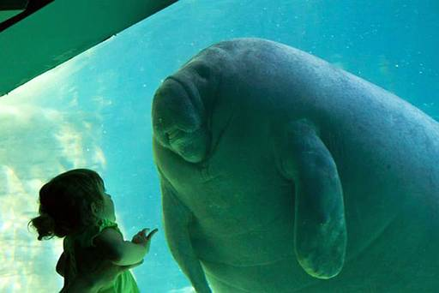
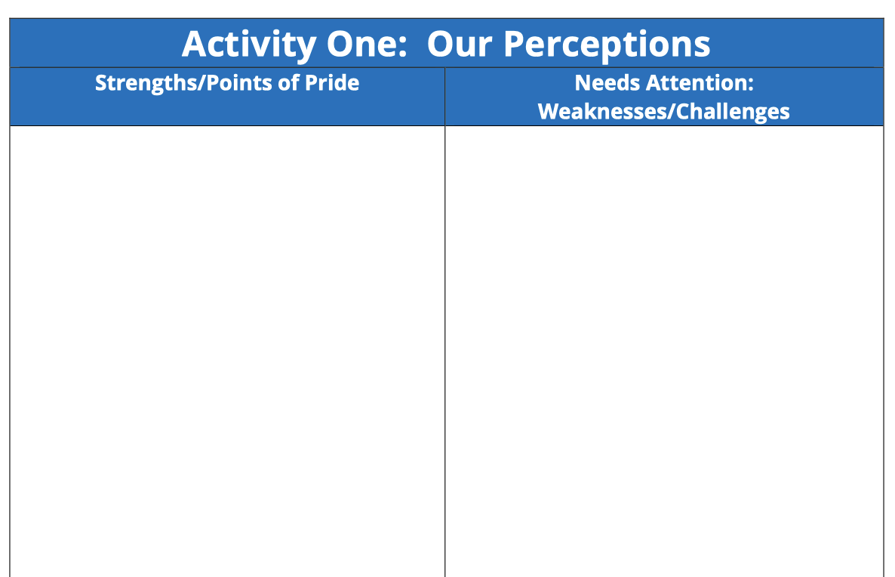
Activity 1: YOUR OPINION STUDENTS
Points of Pride | Opportunities for Improvement
Activity One
Student learning,
Culture & Climate, Resources

Slide 11
Roles
Facilitator
Timekeeper

Slide 12
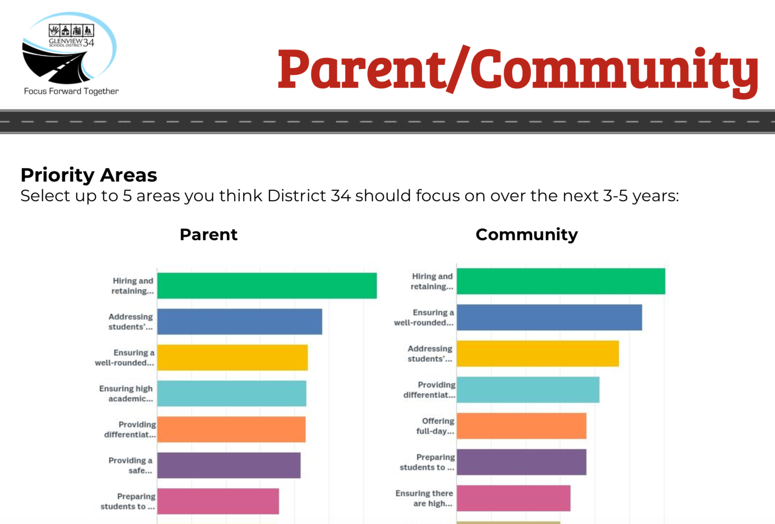
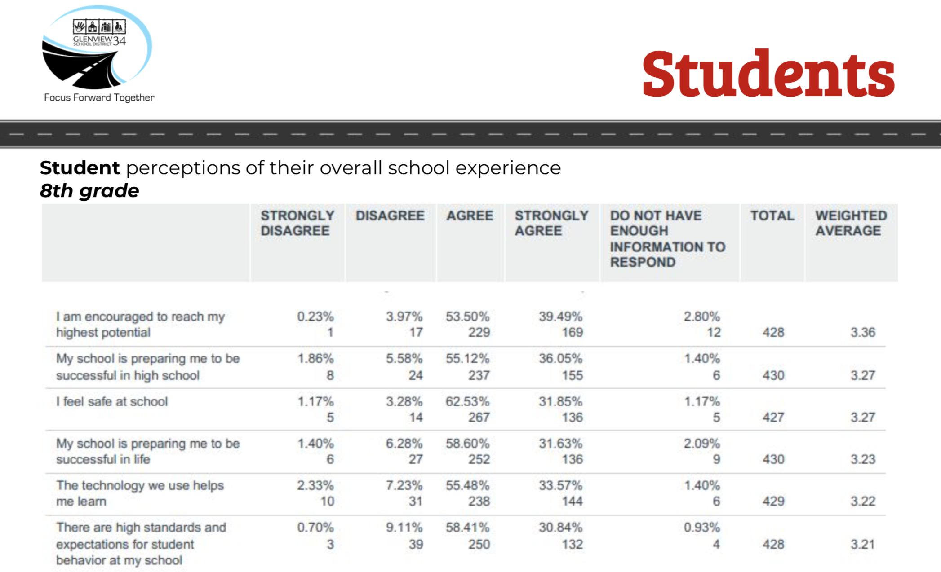
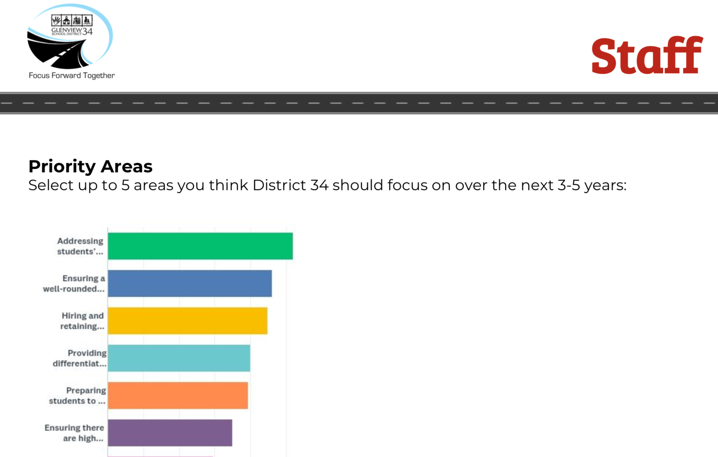
Activity Two
Environmental Scan-
Advice from stakeholders

Slide 13
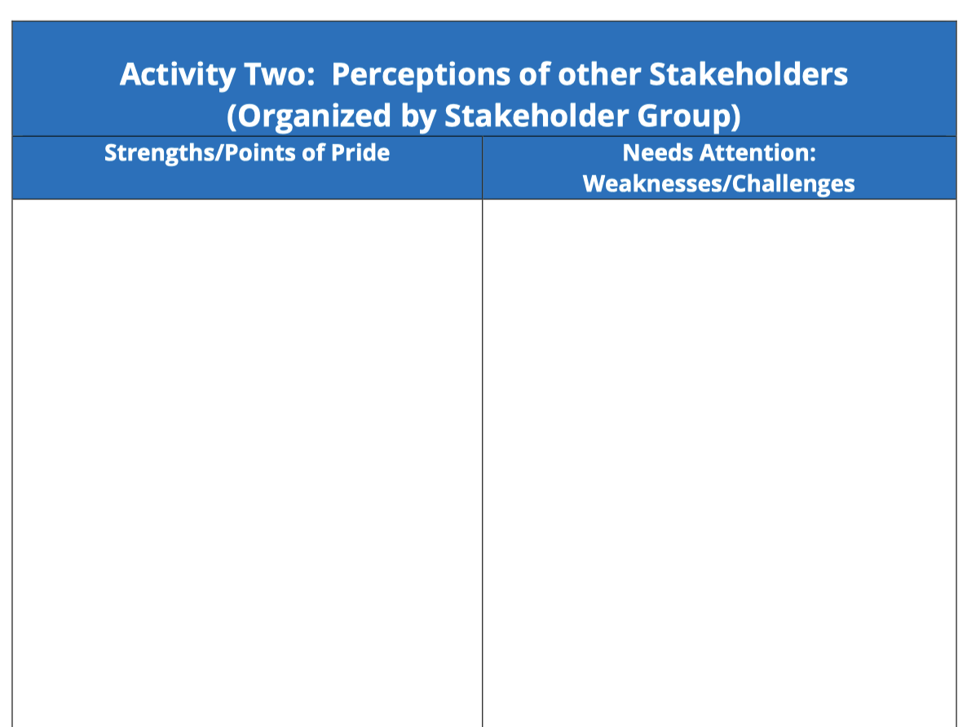
Activity 2: OTHERS’ OPINIONS COMPREHENSIVE SCHOOL CLIMATE INVENTORY (CSCI)
Points of Pride | Opportunities for Improvement
Activity Two—Part I

Slide 14
Roles
Facilitator
Timekeeper

Slide 15
Activity 2: OTHERS’ OPINIONS COMPREHENSIVE SCHOOL CLIMATE INVENTORY (CSCI)
Points of Pride | Opportunities for Improvement
Activity Two—Part 2

Slide 16
Roles
Facilitator
Timekeeper
Scribe

Slide 17
Presentations to the Plan Team
Student Learning
Culture and Climate
Resources
Trend, Cohort, Comparative, Demographic, Growth . . Is it a strength? Is it an opportunity?

Slide 18
Activity Three:
Three 45-minute sessions
Paint a data picture that describes current District Performance as to what is going well and what are the challenges ahead.
Student Learning
Culture and Climate
Resources

Slide 19
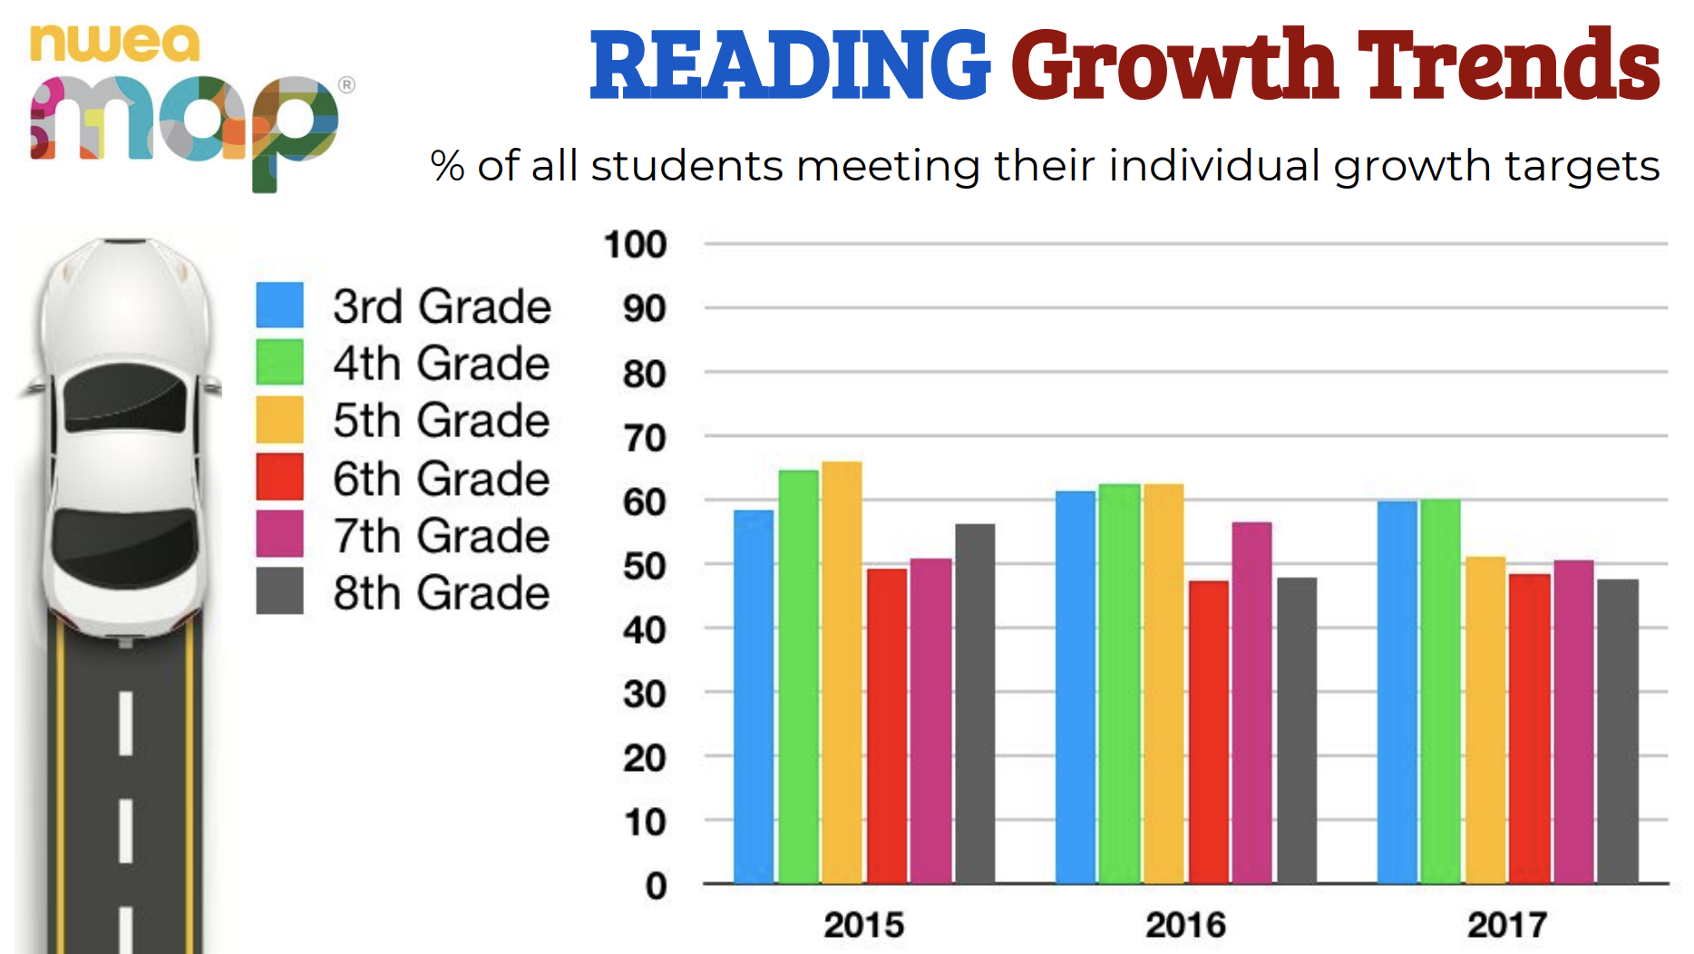
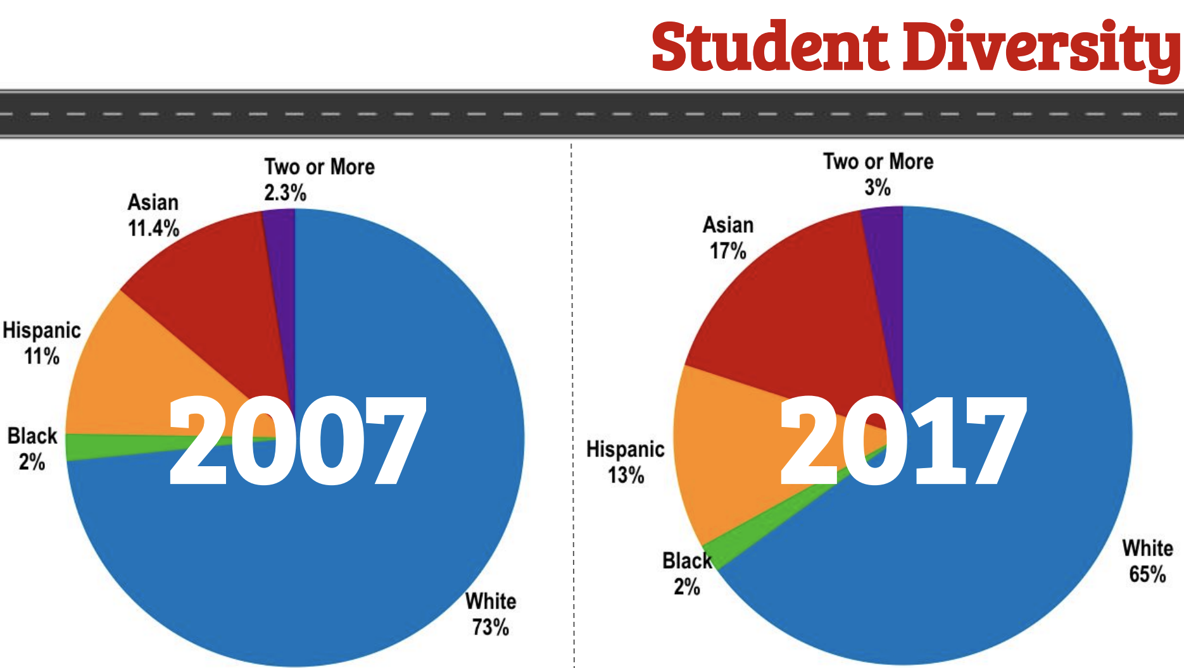
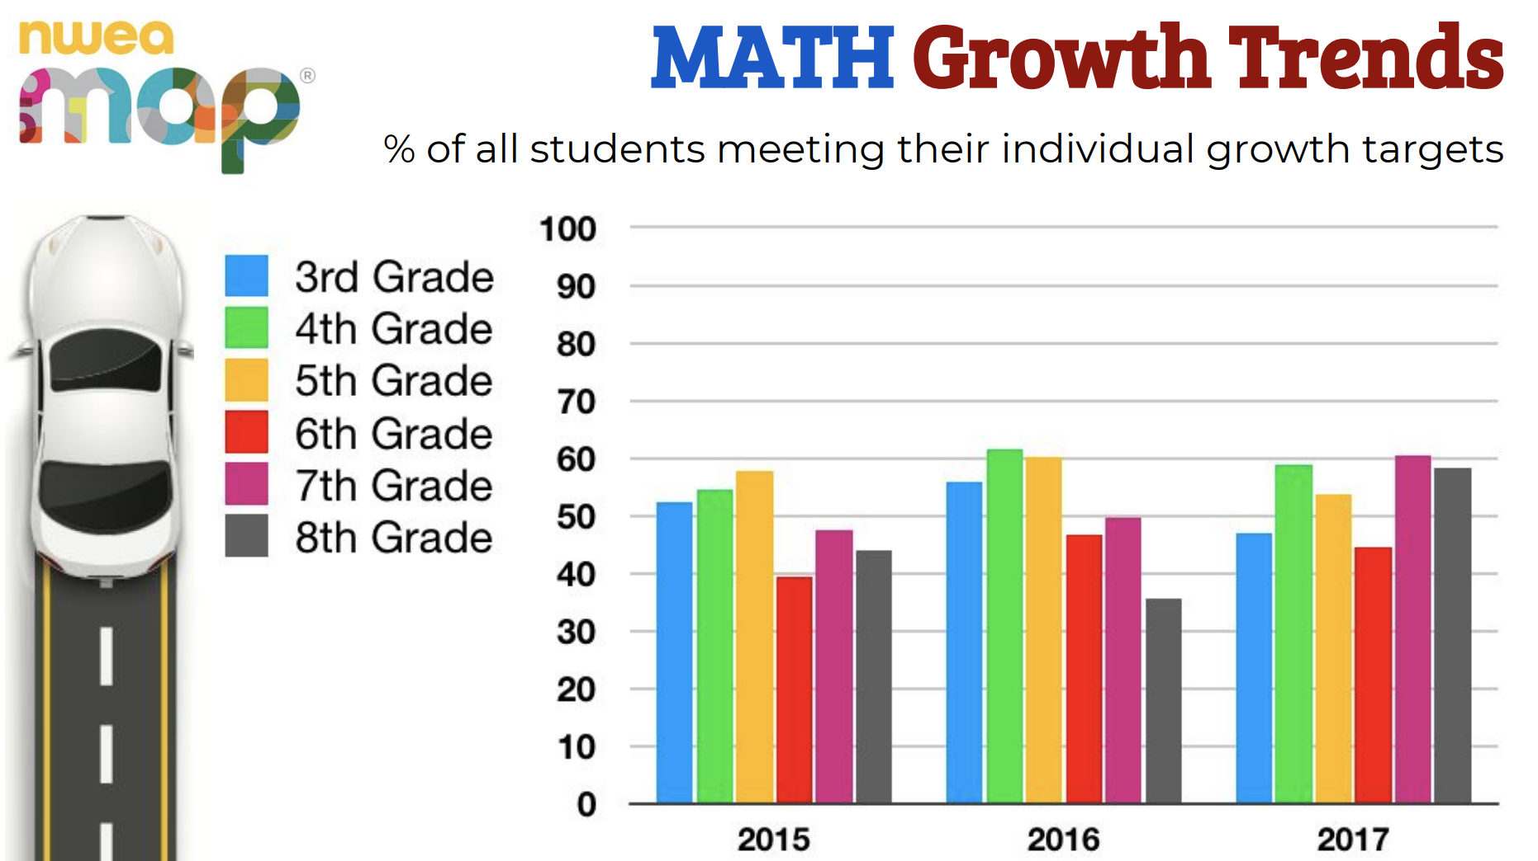
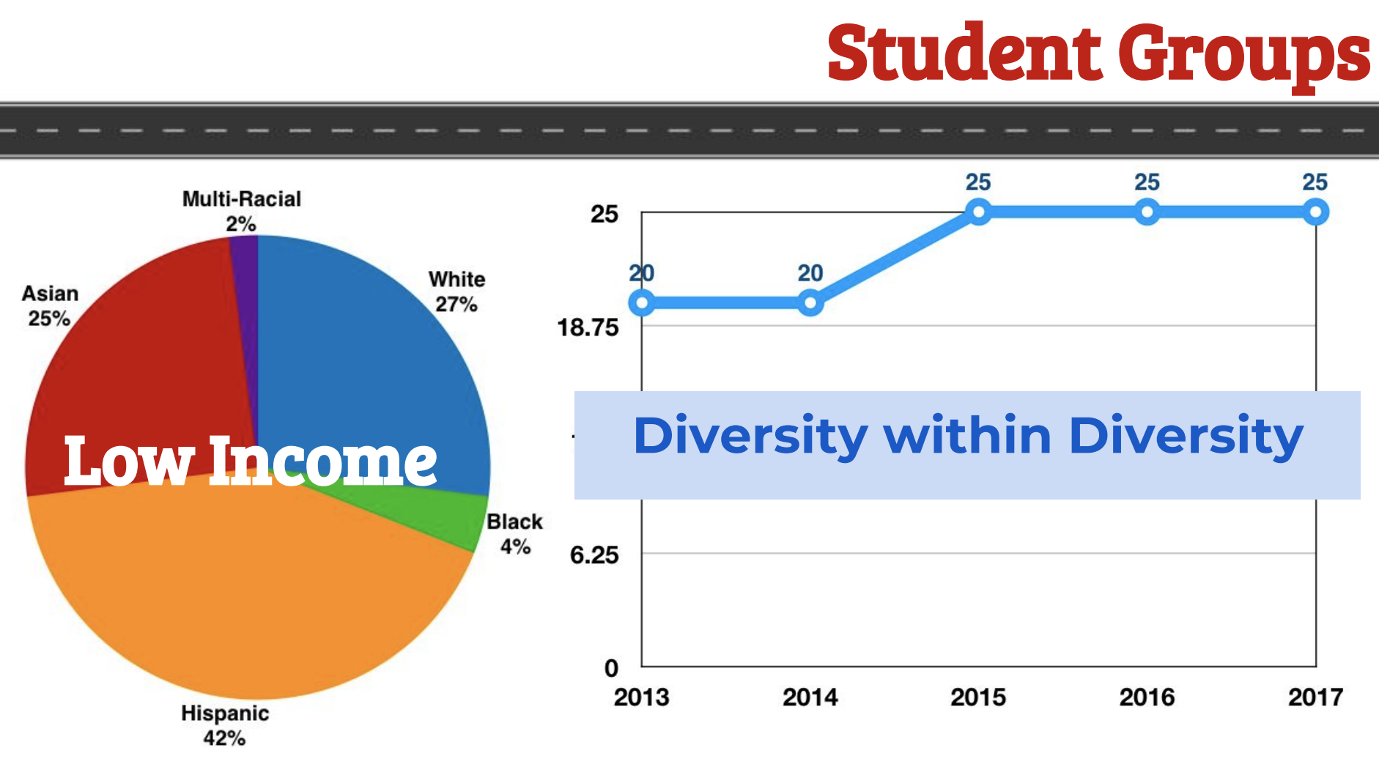

Slide 20
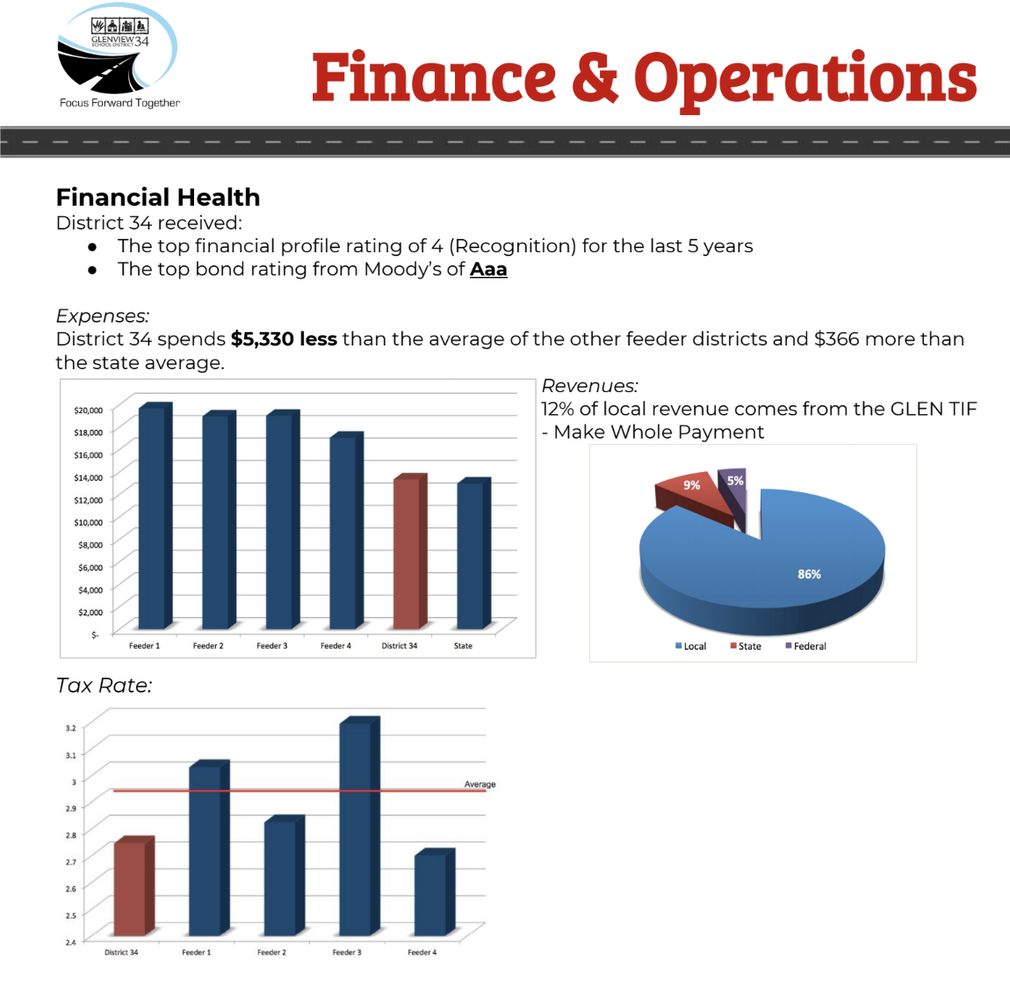
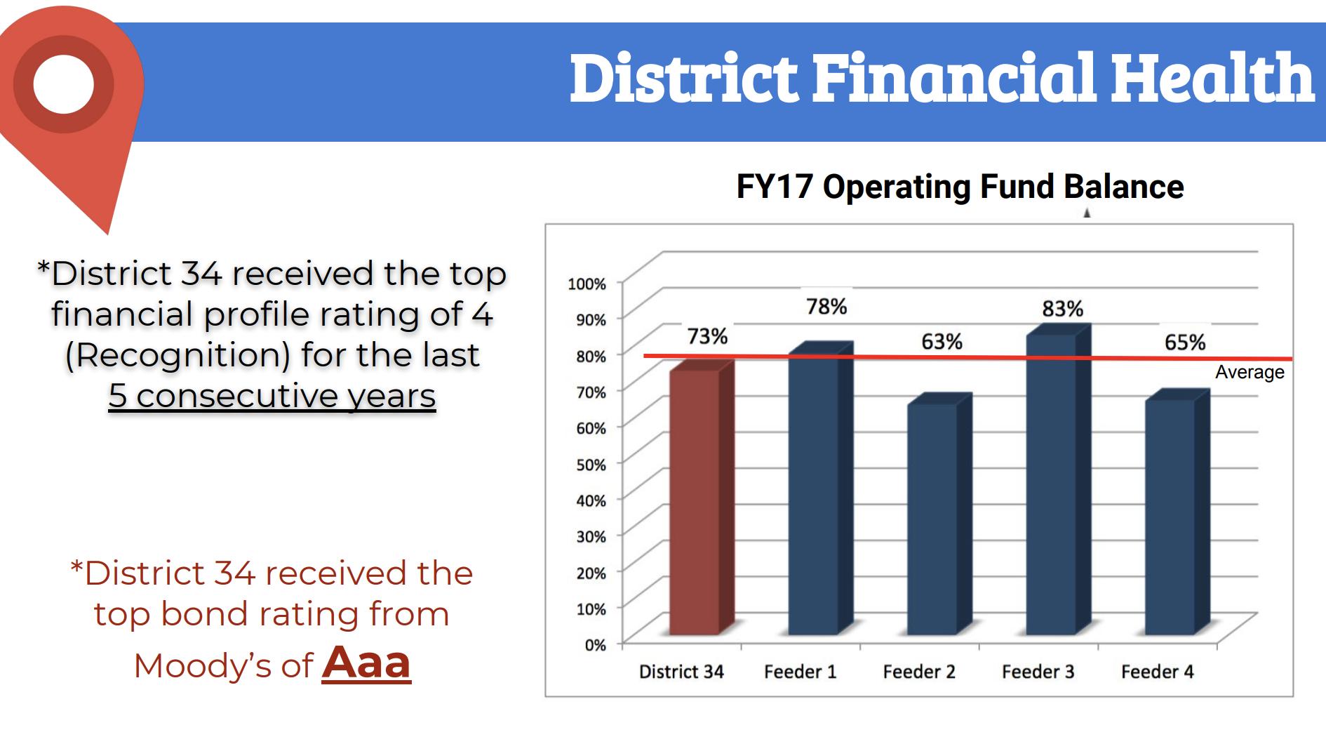
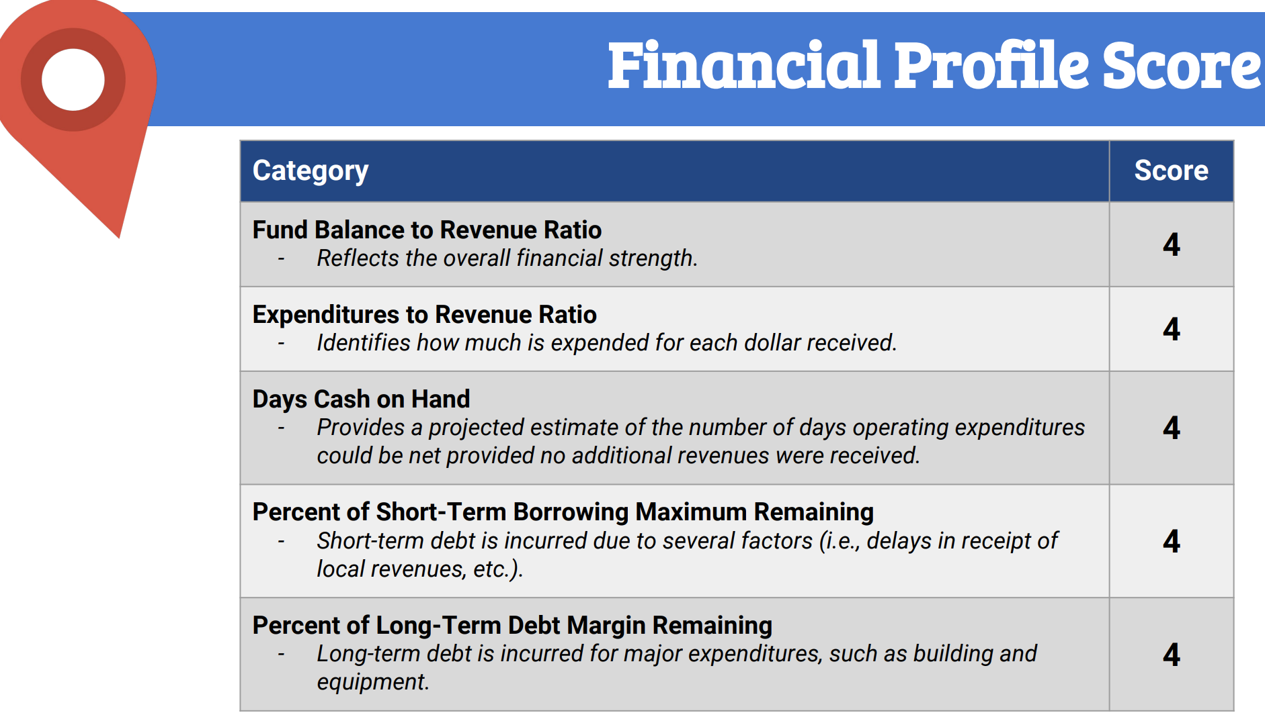
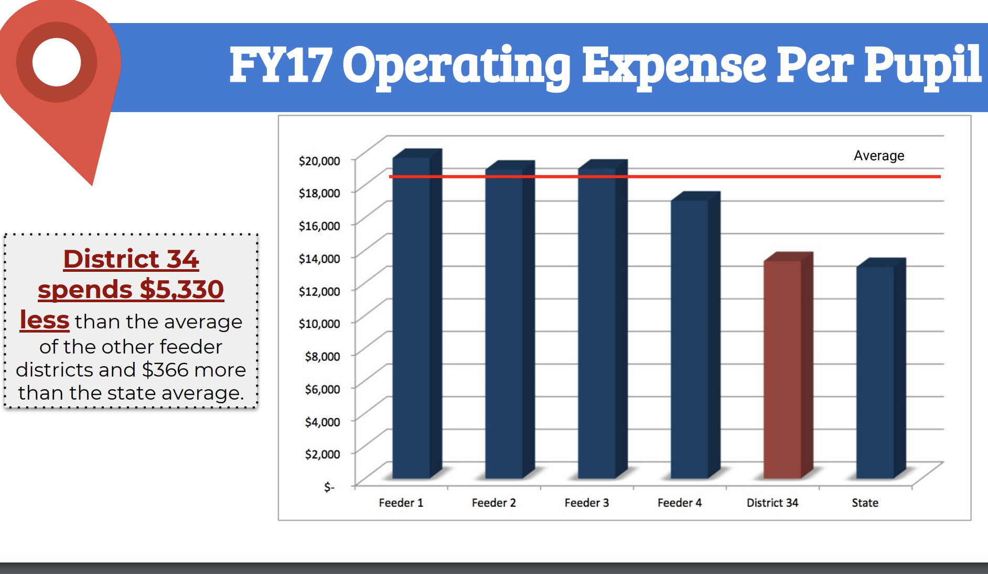

Slide 21

Activity Directions
Each presentation is to be approximately 30 minutes with an additional 10 minutes for questions.
Take notes on the participant handout.
Thanks to the Presenters.

Slide 22
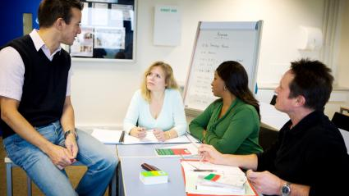
Reflection
      What did you learn from each report that lets you know how the DISTRICT is performing?
      Performing compared to others?
      Performing compared to the past?
      Which are STRENGTHS?
      Which are CHALLENGES?

Slide 23

LUNCH

Slide 24
Activity Directions
Each presentation is to be approximately 30 minutes with an additional 10 minutes for questions.
Take notes on the participant handout.
Thanks to the Presenters.

Slide 25

PROCESSING THE DATA PRESENTATIONS: 45 min
  Each group will process the last of the three reports they hear.
  The presenter will support the groups.
  Each group will present a poster highlighting no more than the top key information trending well and the top key information needing attention of improvement.
  Teams will post their findings for all to view.

Slide 26
Roles
Facilitator
Timekeeper
Scribe

Slide 27
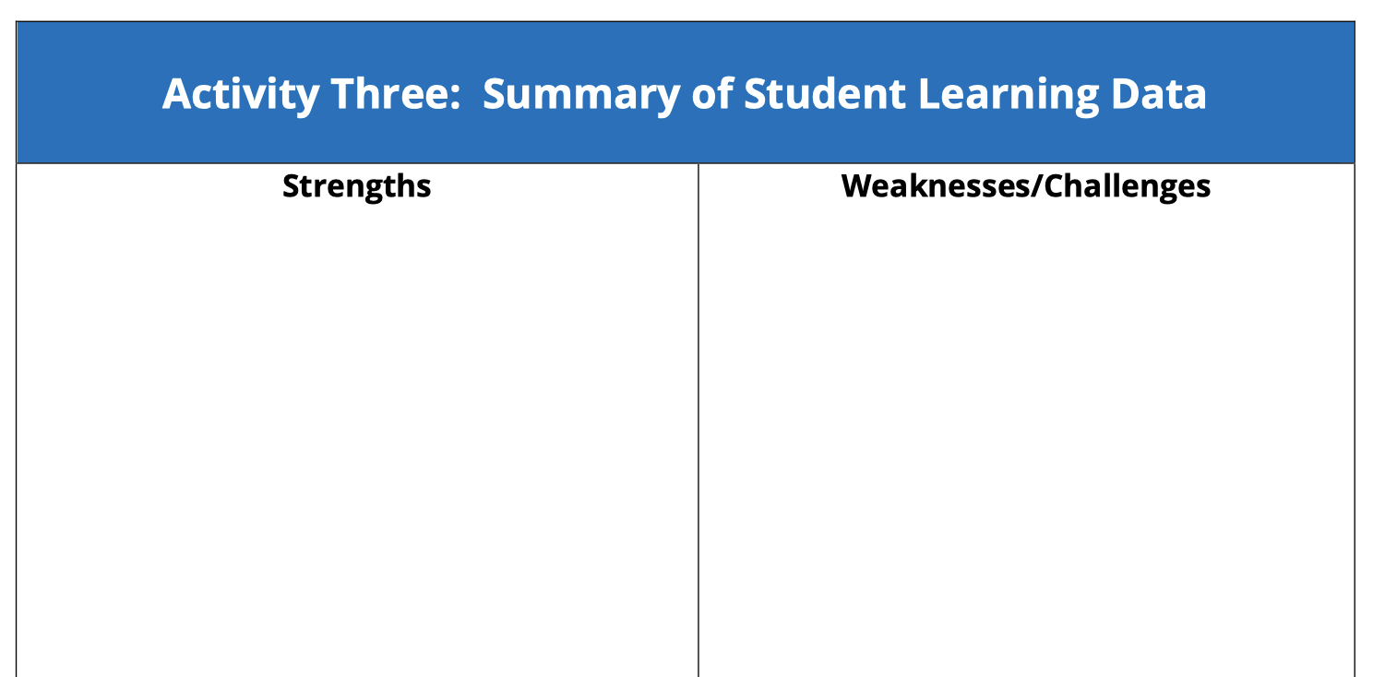

Slide 28
Please share what you believe to be the district’s greatest point of pride based on today’s presentations

Slide 29

What We Learned Thus Far
  Our perceptions of Strengths and Opportunities for improvement
  Others’ perceptions of Strengths and Opportunities for improvement
  Data and information from the reports:
  Student learning
  Culture and Climate
  Resources

Slide 30
Activity Four:
45 minutes
10 minutes Gallery Walk
Conduct a SWOT analysis
  Strengths
  Weaknesses
  Opportunities
  Threats

Slide 31

SWOT ANALYSIS
Strengths
Weaknesses
Opportunities
Threats

Slide 32
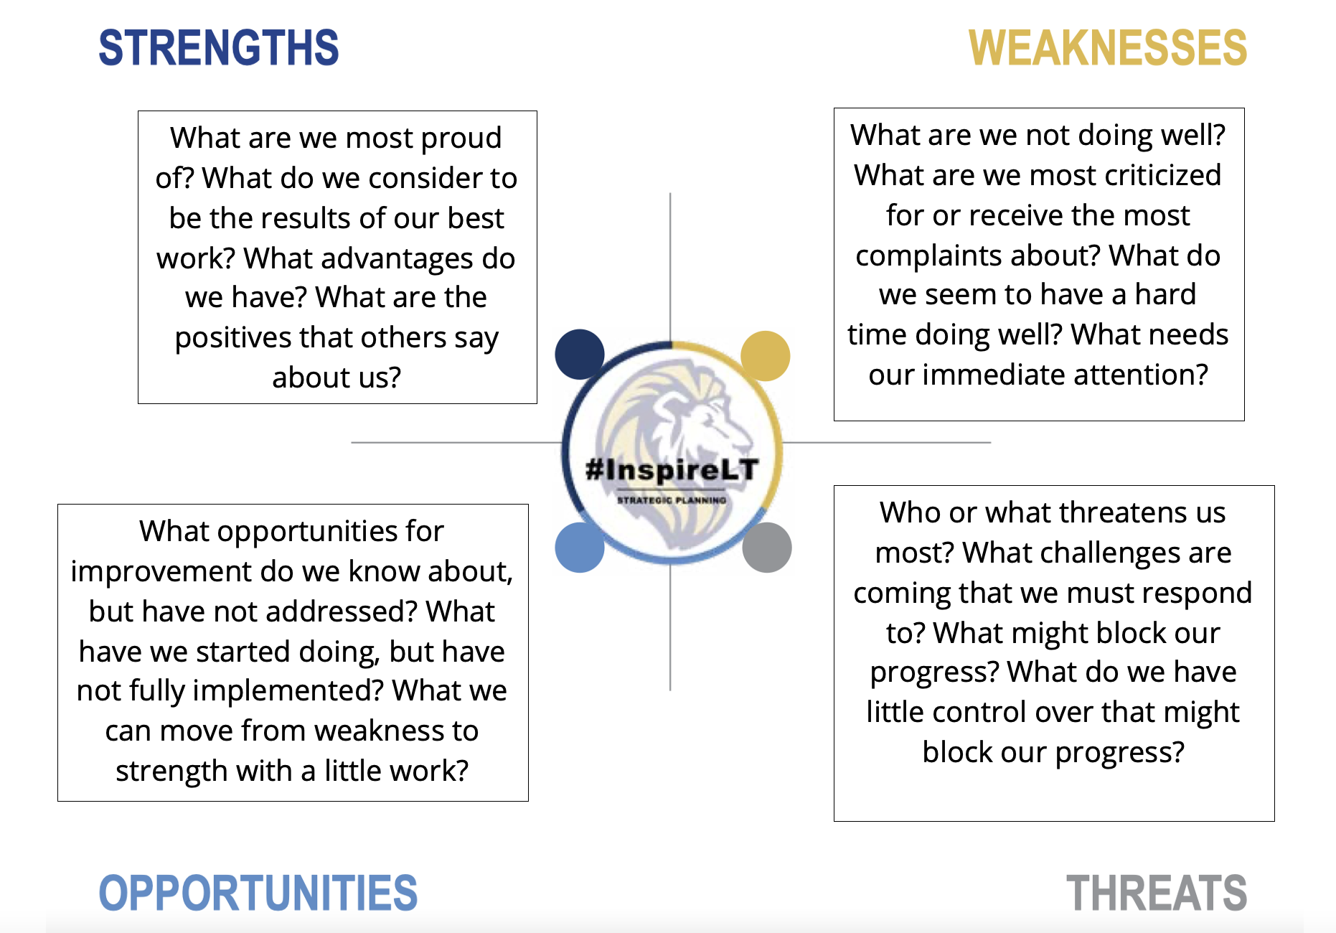
  What do we consider to be our strengths?
  What advantages to do have?
  What do others say our strengths are?
  What do we consider to be our weaknesses?
  What are we most criticized for or receive the most complaints about?
  What do we seem to have a hard time doing well?
STRENGTHS
WEAKNESSES
OPPORTUNITIES
THREATS
  What opportunities for improvement do we know about but have not addressed?
  Where with a little work could we change a weakness into a strengths?
  Who or what threatens us the most?
  What challenges are coming that we must respond to?
  What might block our progress?

Slide 33
SWOT ANALYSIS EXAMPLE
STRENGTHS: What are we most proud of? What do we consider to be our results of our best work? What advantages do we have? What do others say about us in positive ways? Dedicated, caring, and invested staff and administration High quality academic program Strong financial management; balanced budgets Bond rating, and state financial profile rating Community and family involvement Perceptions of the district Technology devices, access, and infrastructure Whole child philosophy Value and appreciation for diversity Safe schools with nurturing learning environments Fine Arts and Physical Education programs | WEAKNESSES: What do we consider to be our weaknesses? What are we most criticized for or receive the most complaints about? What do we seem to have a hard time doing well? Student performance above state average, but below community expectations Achievement gaps Differentiated instruction with impactful interventions and enrichments and supports to meet academic and social and emotional needs of all students Consistencies in practices school-to-school, classroom-to-classroom Homework and grading practices with a positive impact on student learning Competitive salaries and benefits to attract and retain high quality staff Variability in class sizes, admin to student and admin to staff ratios Aging facilities with deferred maintenance Meaningful technology integration with teaching and learning Limited and inconsistent opportunities for student voice, choice, collaboration, and empowerment Managing & responding to student stress & anxiety
OPPORTUNITIES: What opportunities for improvement do we know about, but have not addressed? Where with a little work could we change a weakness into a strength? What are we not doing currently that might be the opportunity for us to improve. Collaborate with high school district to develop a pathway to new college, career & life readiness expectations Reimagine definition of student success System for data collection, use, analysis & management Additional social and emotional supports and implementation Early learning & full-day kindergarten options to ensure improved readiness for school Instructional tools and strategies to provide clarity and consistency expectations for family engagement New opportunities to energize & support initiatives and change management through professional learning Exploring options to make better use of time & space Offer global language in younger grades Higher quality bilingual programs and services | THREATS: Who or what threatens us the most? What challenges are coming that we must respond to? What might block our progress? What do we have little control over that might impact our resources? State and federal funding Resistance to change; fixed mindset New state assessment Balance of ability to pay taxes with critical support to maintain a high quality educational program Economic disparity and equity throughout the district Health, wellness, stress, anxieties for students and their families Social media Safety and security

Slide 34
Activity Directions
Identify your Top Ten strengths, weaknesses, opportunities and threats.
Develop and post the chart to share with the whole strategic plan team.

Slide 35
Roles
Facilitator
Timekeeper
Scribe

Slide 36

Consensus
  We have arrived at consensus when all points of view have been heard, and the will of the group is evident.
  DuFour, DuFour, Eaker.

Slide 37






Fist to Five

Slide 38

NEXT STEPS
SWOT Analysis
Stakeholder Engagement
Encourage feedback participation
Data Retreat resources on website

Slide 39

Stakeholder Engagement Opportunities
Did we get it right?
What did we miss?
What did we get wrong?
Other advice to the plan team?

Slide 40
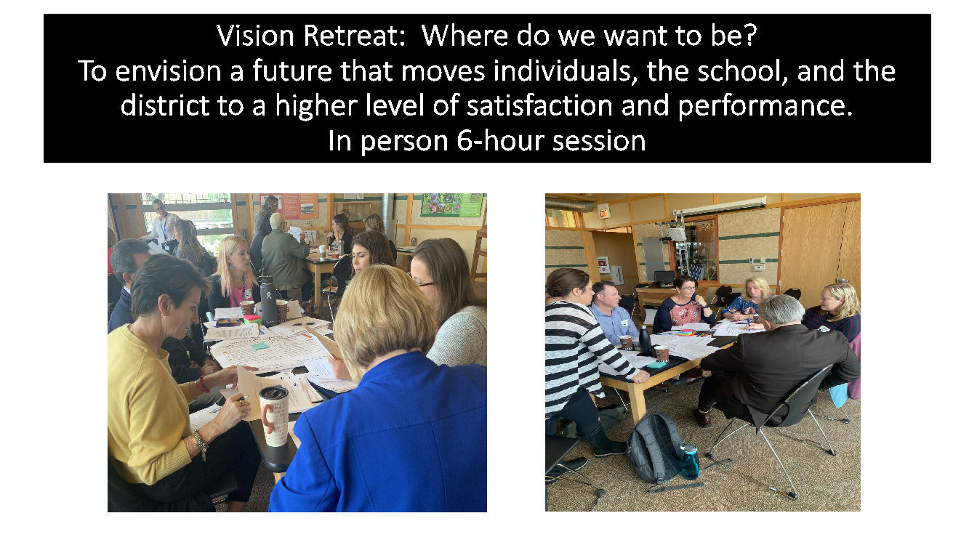
Looking Ahead: Vision Retreat
Instruction
Collaboration
Assessment
Structure
Schedule
Time
Curriculum
Technology
Where are we today?
Where do we want to be in the future?
How will we be different?

Slide 41

Vision Retreat
\To envision a future that moves individuals, school and system to a higher level of satisfaction and performance.

Slide 42

"If schools are not imagining a different future, they will amplify their efforts to do what they have always done."
Grant Lichtman, #EdJourney: A Roadmap to the Future of Education

Slide 43
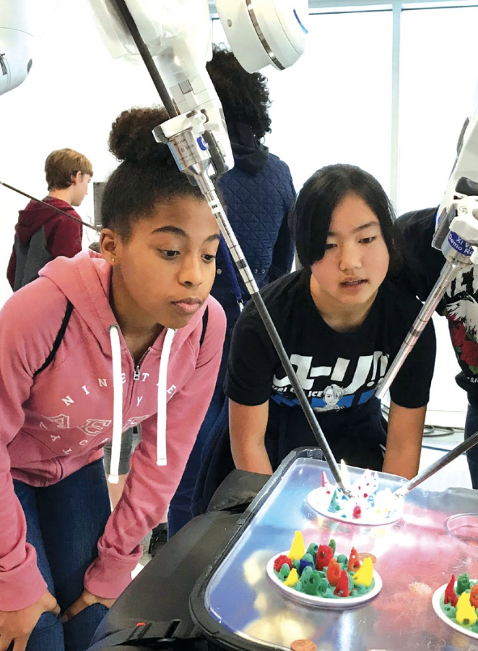
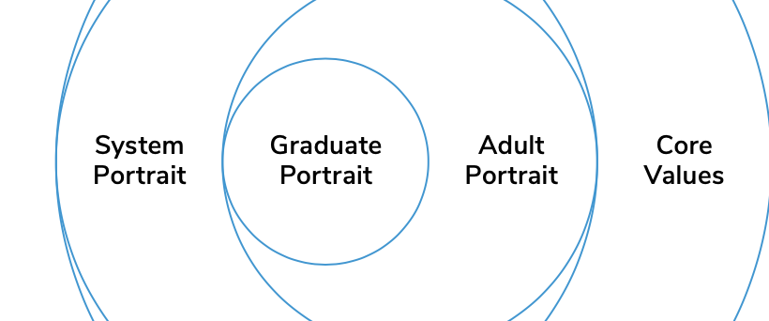
Vision 2030
Thanks to the Santa Clara Unified School District and their Vision 2035 process

Slide 44
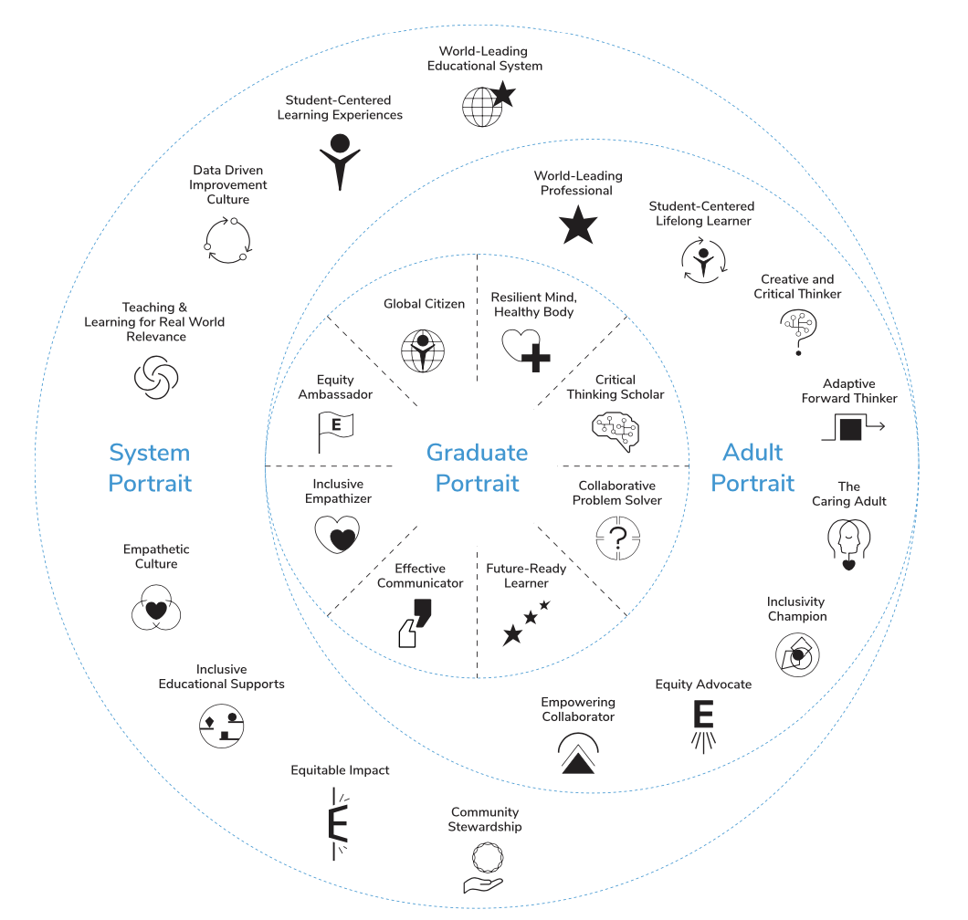

Slide 45

Thanks to the Strategic Plan Team

