Slide 1


Slide 2

TONIGHT’S AGENDA
Project Status Updates
- Middle School
- High School

Slide 3
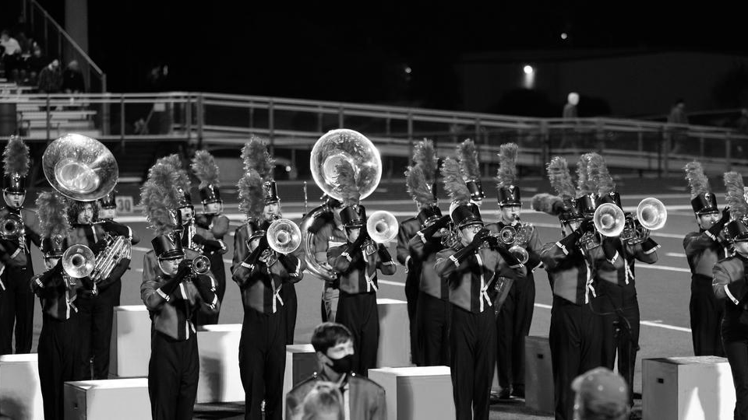
Krum Middle School

Slide 4

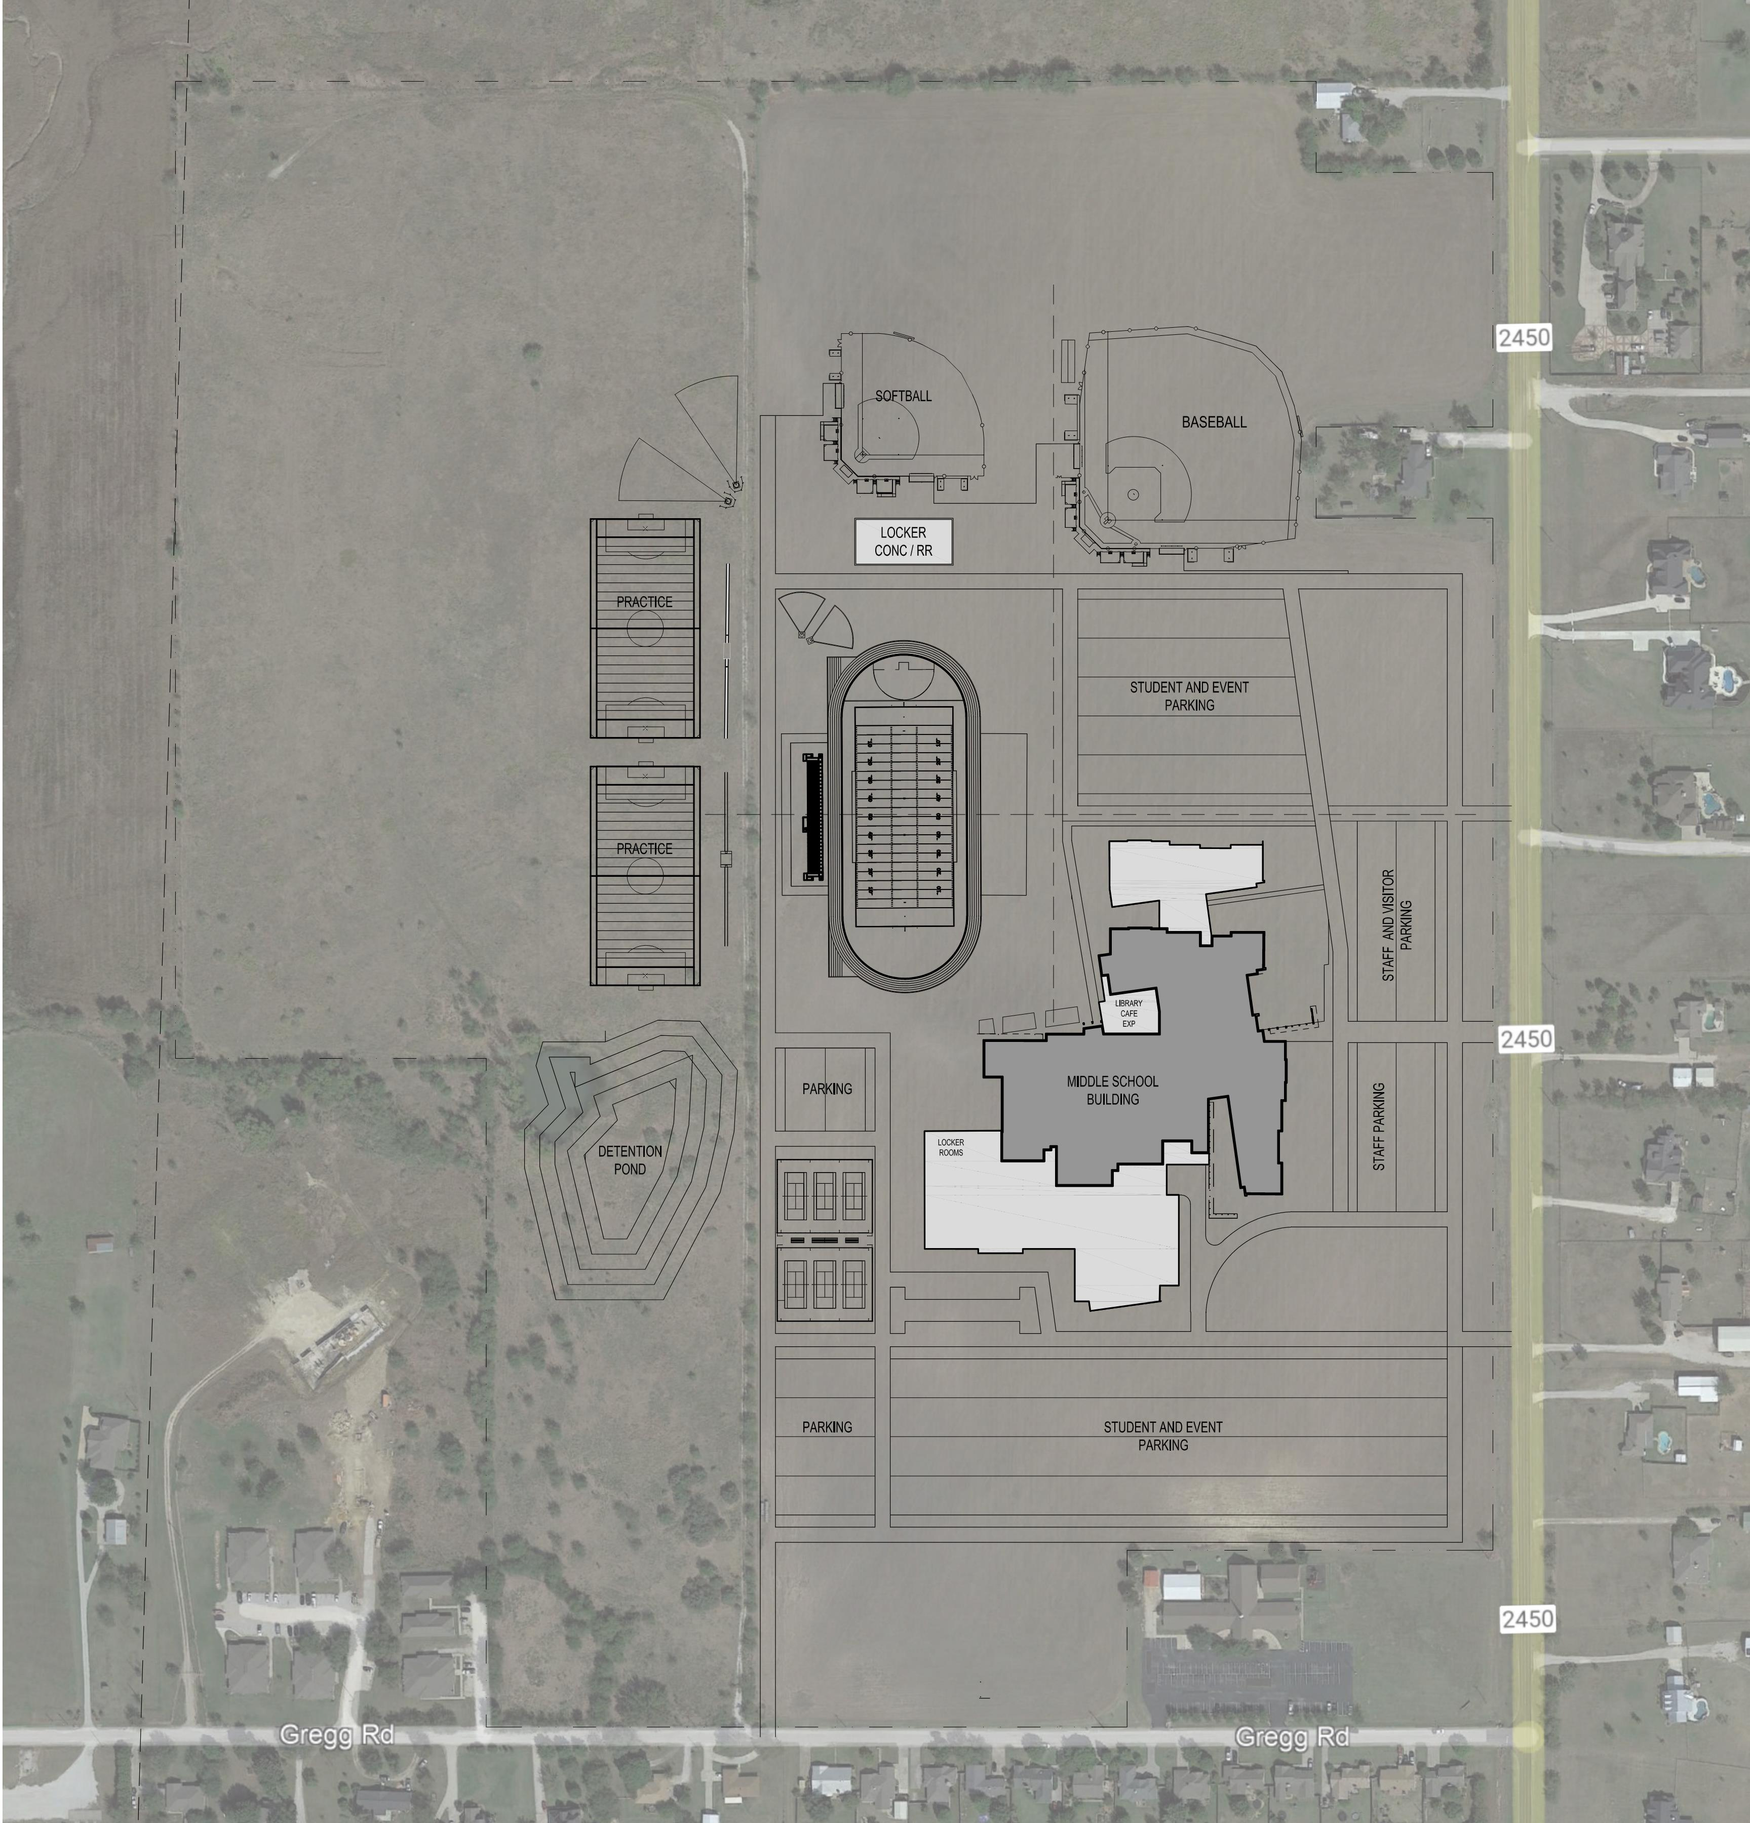
KRUM MIDDLE SCHOOL
New site layout
(note: this shows options for potential later expansion to operate as a high school)

Slide 5
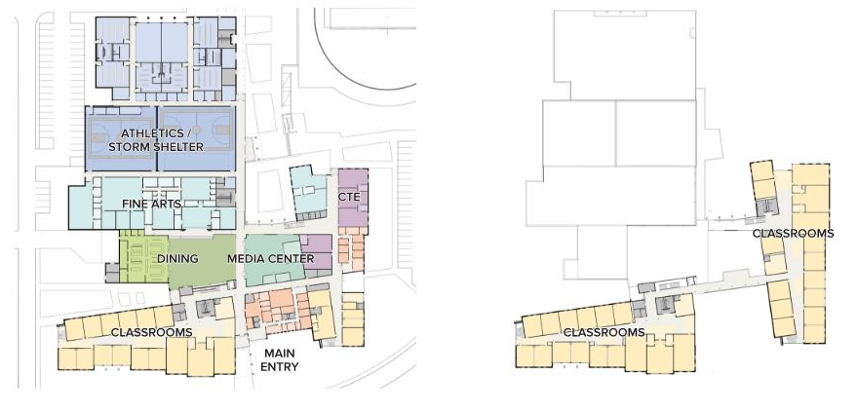
KRUM MIDDLE SCHOOL
First Floor
Second Floor

Slide 6
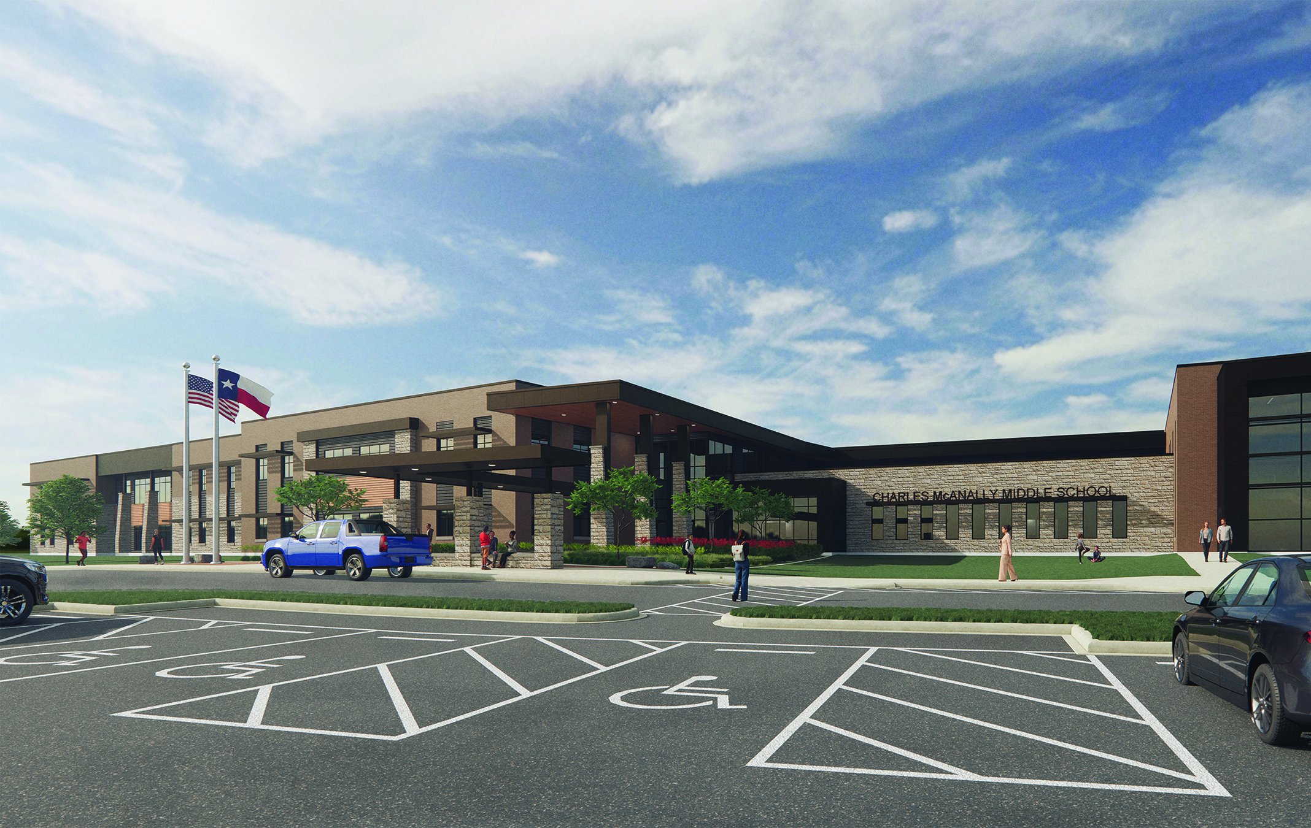
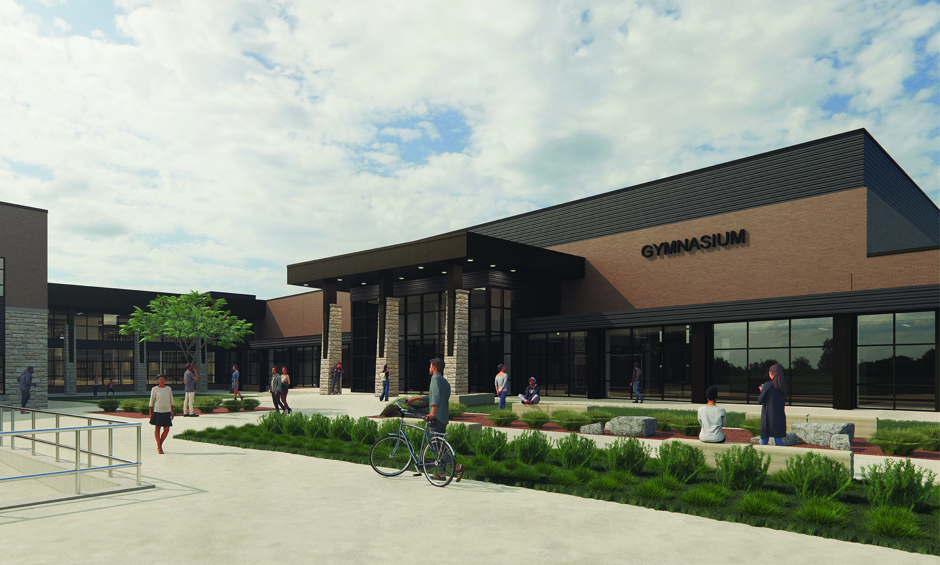
KRUM MIDDLE SCHOOL
Potential main entry
Potential gym entry

Slide 7
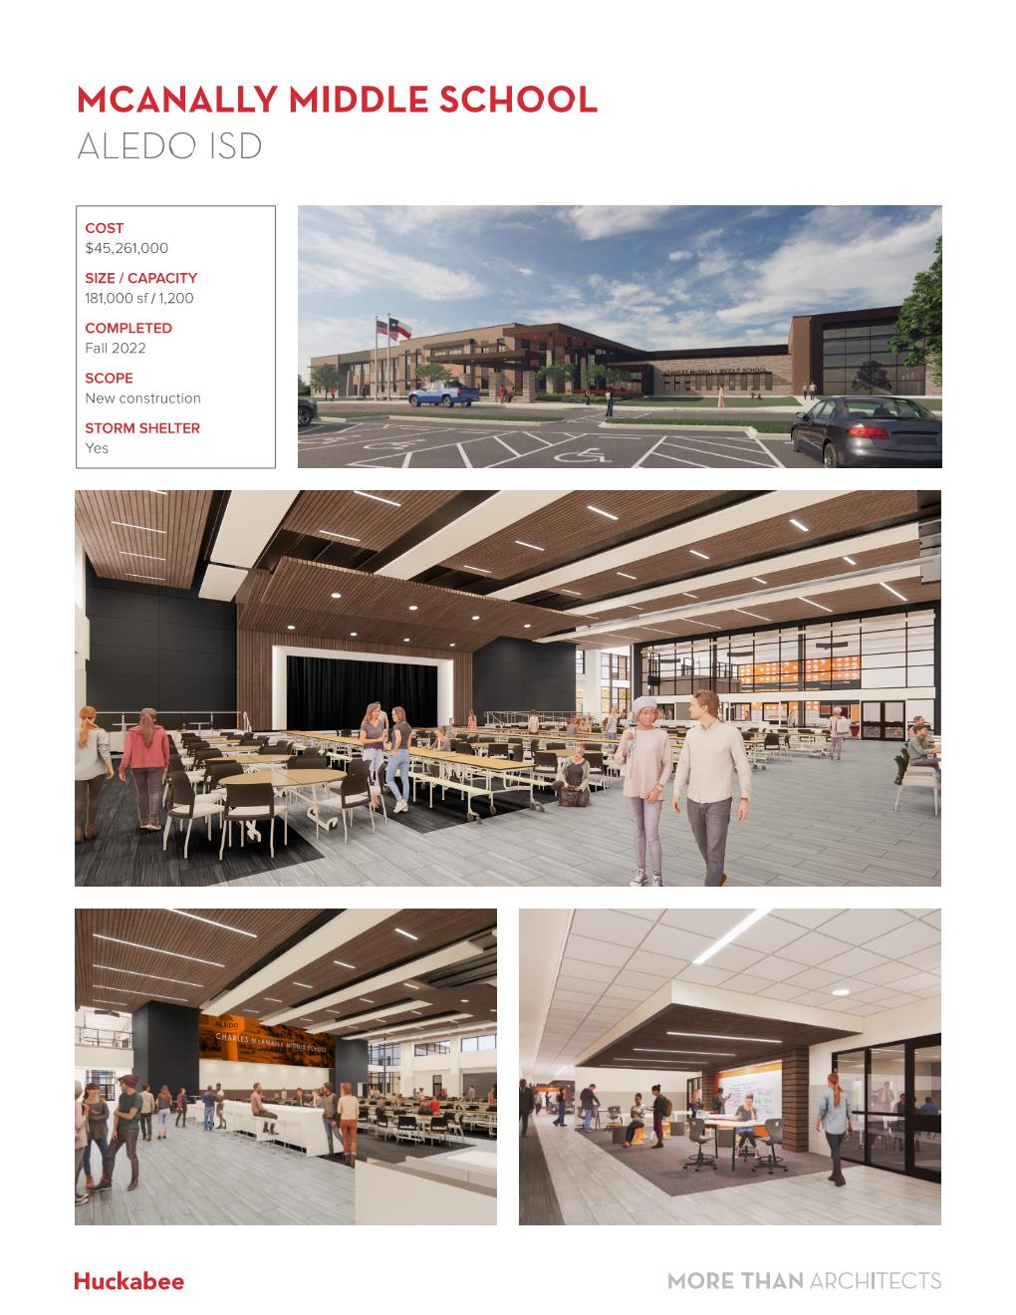
KRUM MIDDLE SCHOOL
Potential Cafeteria
Potential Classroom Wing

Slide 8
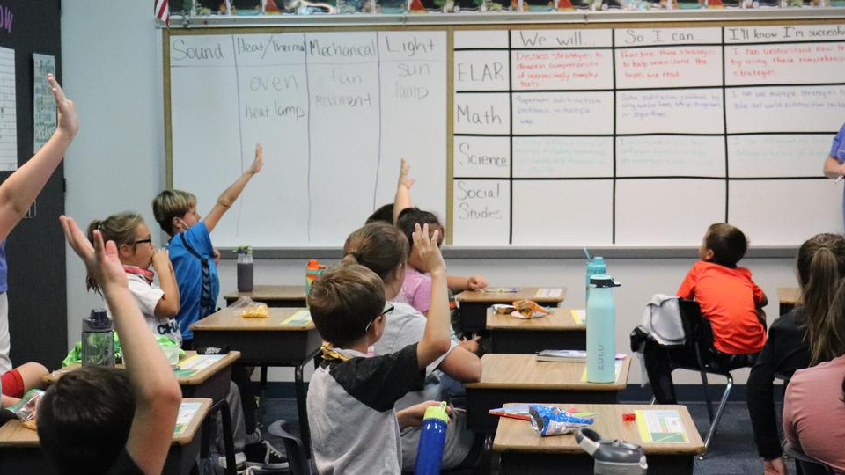
KRUM HIGH SCHOOL

Slide 9
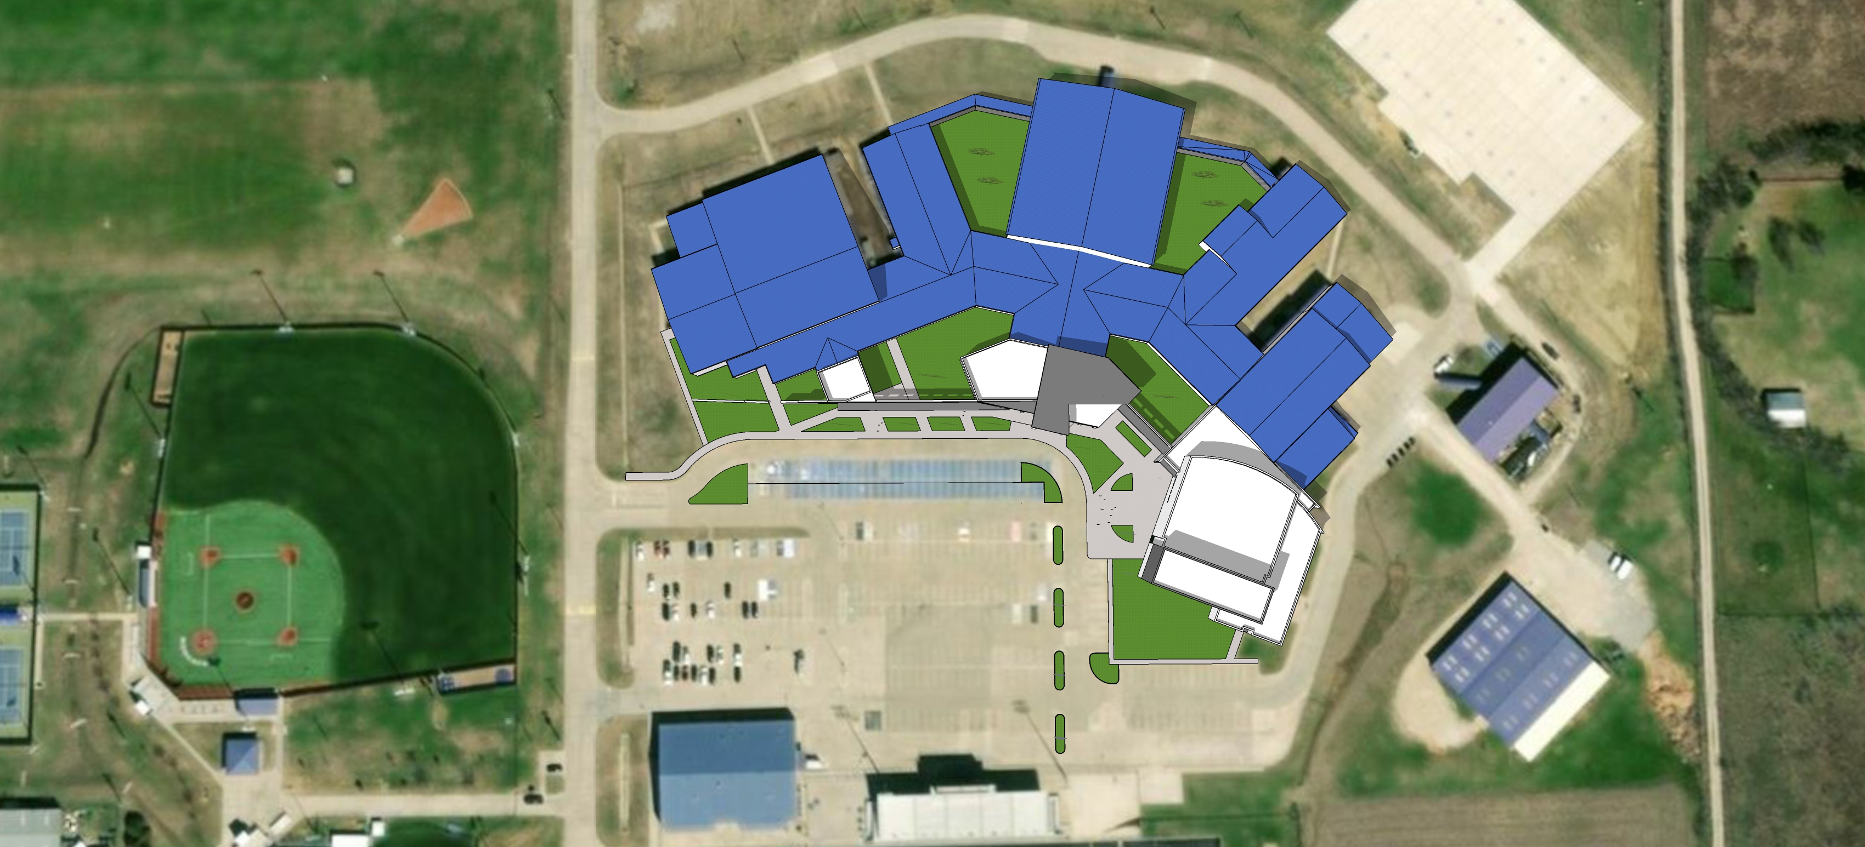
KRUM HIGH SCHOOL
Layout additions

Slide 10
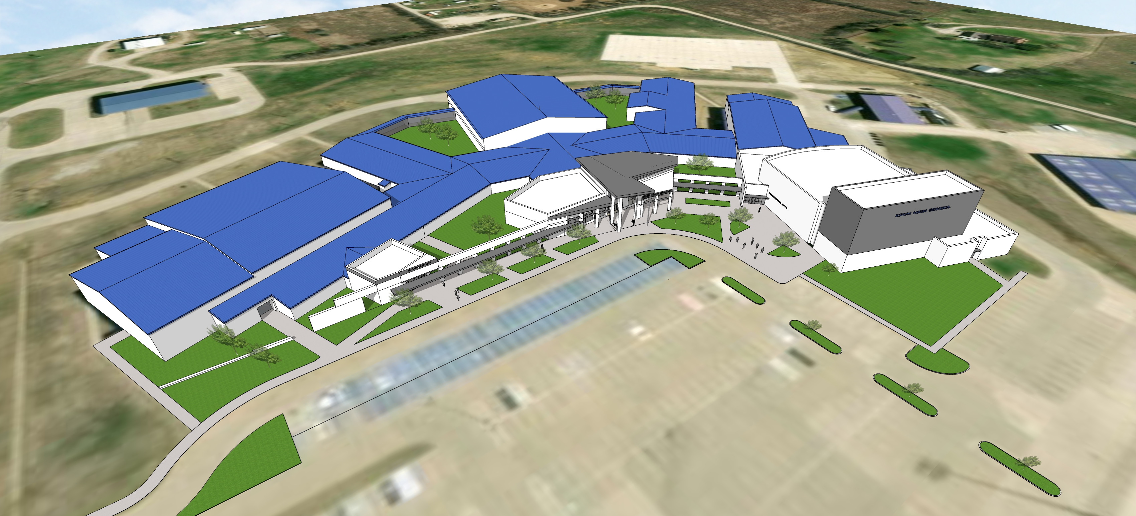
KRUM HIGH SCHOOL
Overall building perspective

Slide 11
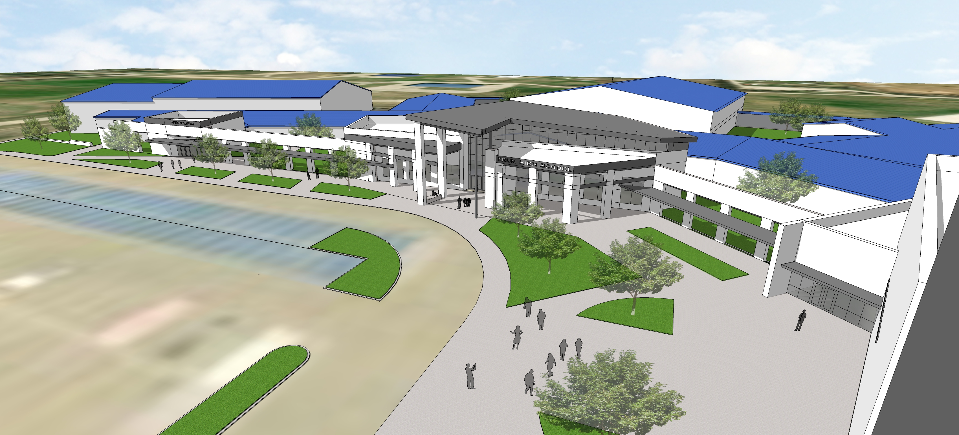
KRUM HIGH SCHOOL
New Main Entry

Slide 12
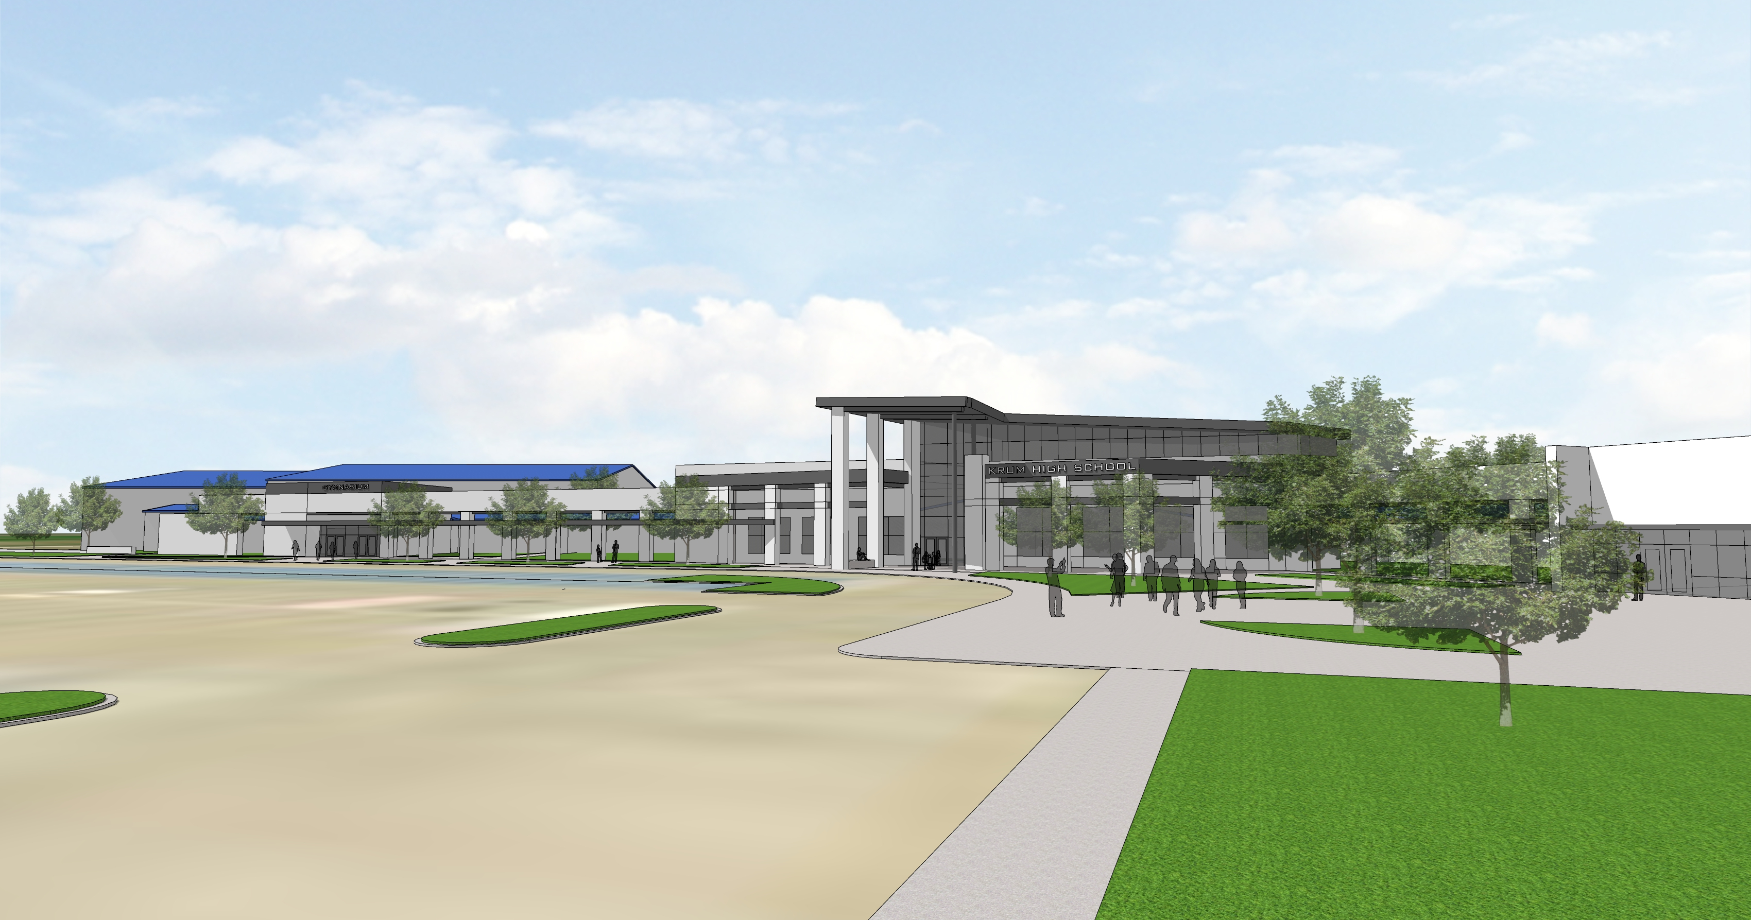
KRUM HIGH SCHOOL
New Main Entry

Slide 13
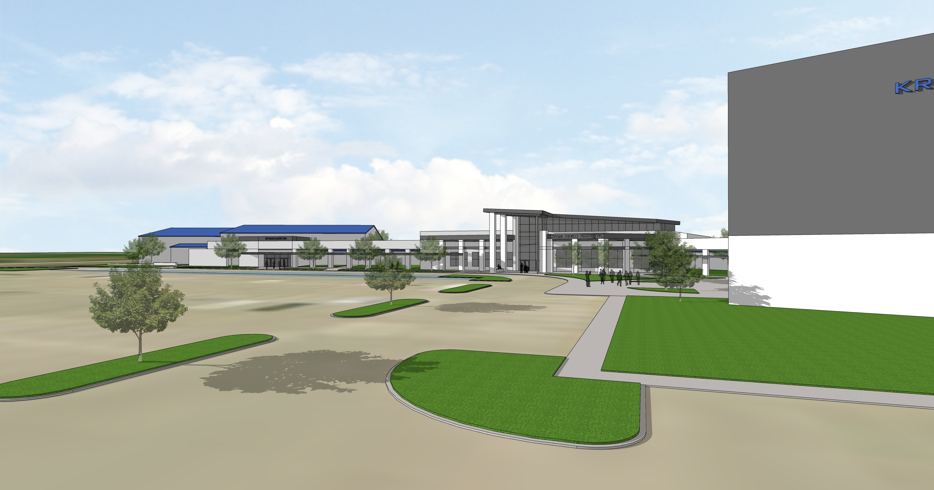
KRUM HIGH SCHOOL
New Main Entry

Slide 14
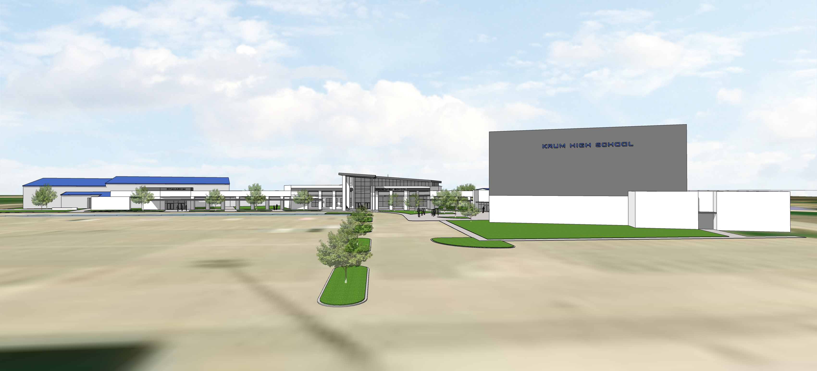
KRUM HIGH SCHOOL
New Main Entry

Slide 15
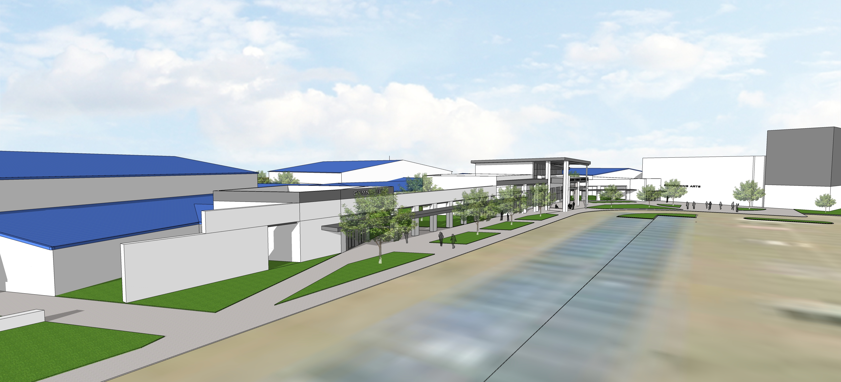
KRUM HIGH SCHOOL
New Front Drive

Slide 16
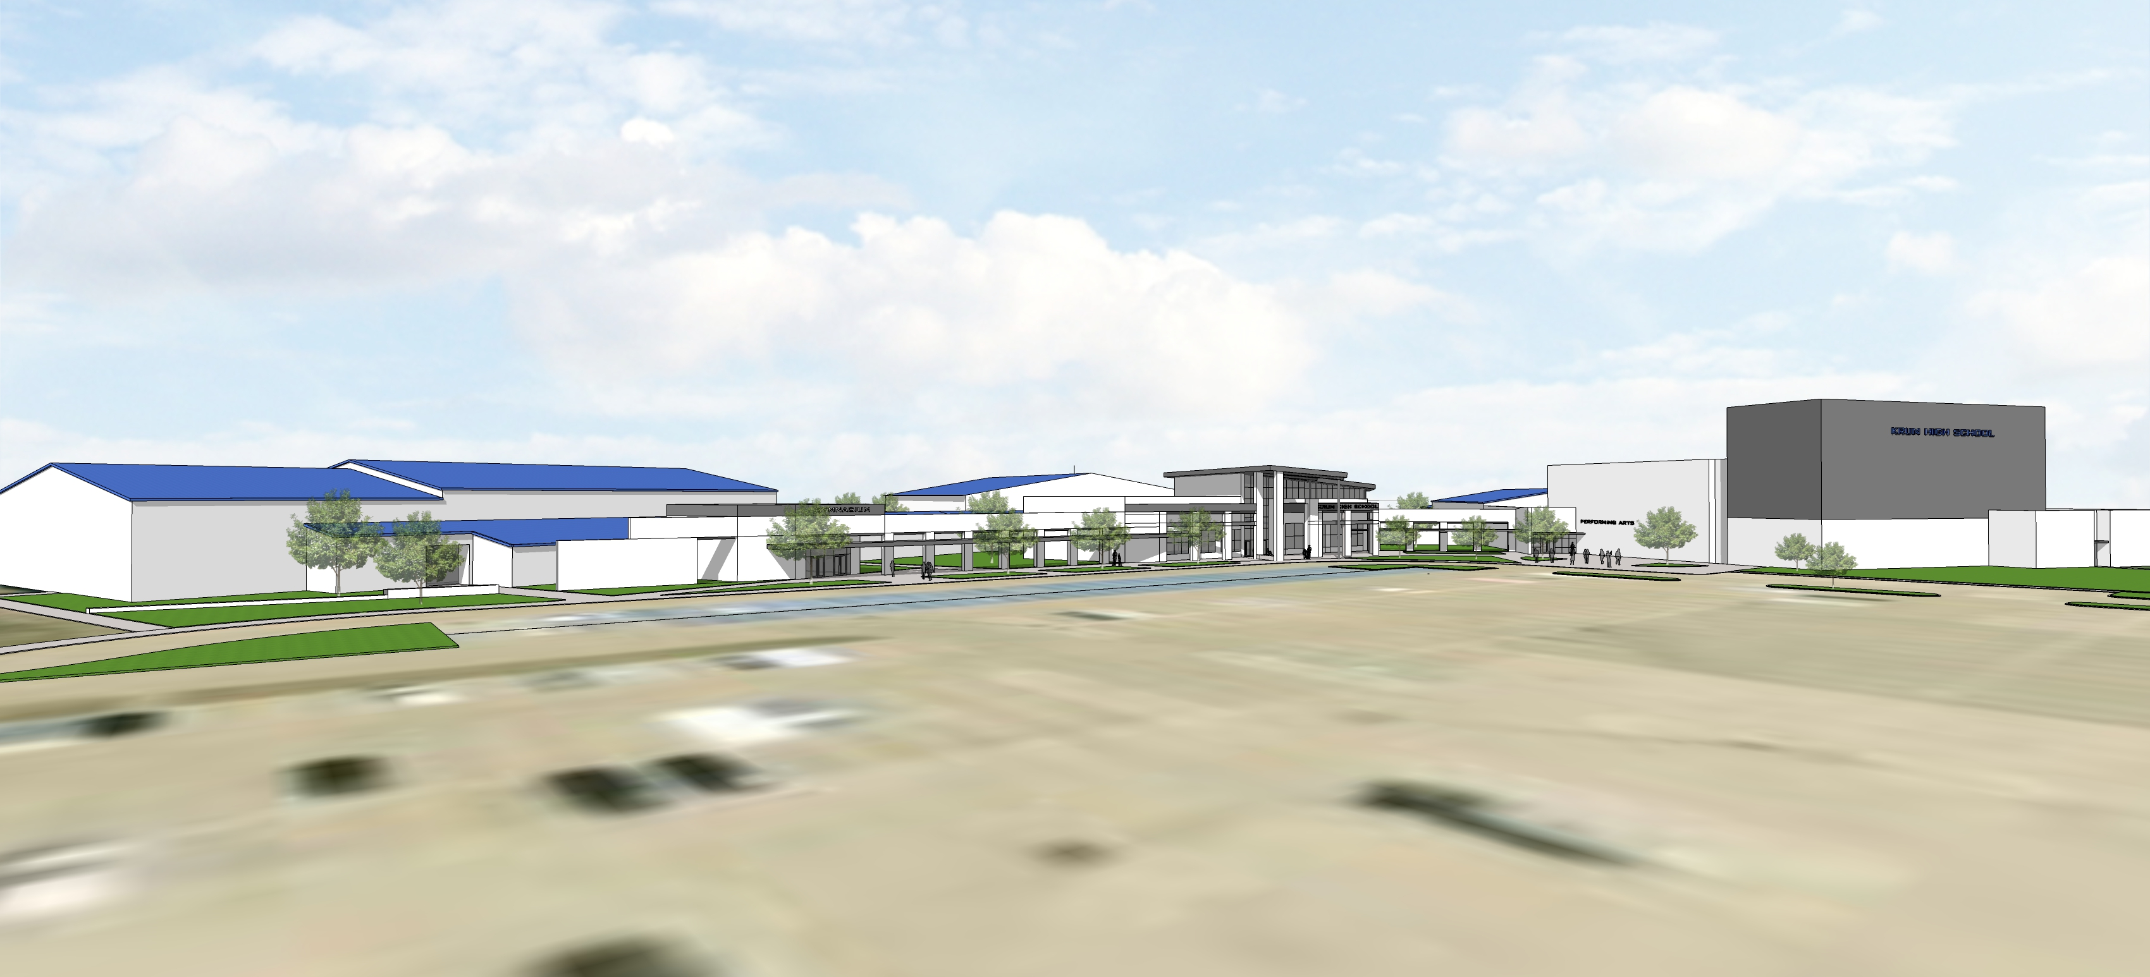
KRUM HIGH SCHOOL
New front approach

Slide 17
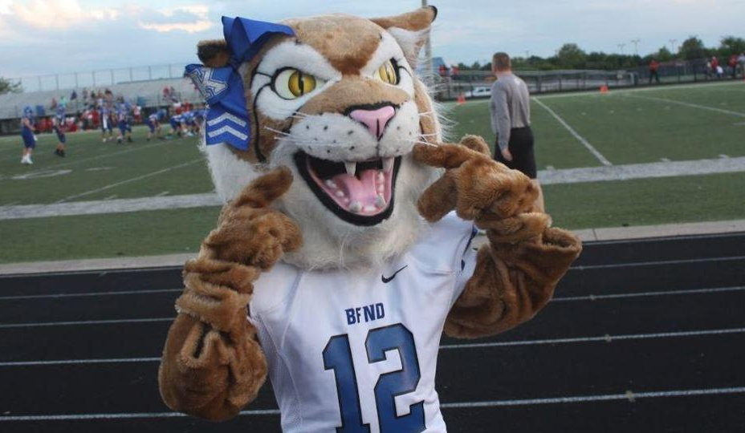
NEXT STEPS
Design
Budget
December Approval

